Slide 1
From Many, One
(or creating one great precipitation data set
from many good ones)
Dave Bolvin (SSAI and NASA/GSFC)
George Huffman (NASA/GSFC)
Earth Science Data Analytics
January 7, 2015

Slide 2
Methodology
Disclaimer - precipitation is unlike most meteorological parameters in that it is intermittent and not Gaussian
We create global precipitation data sets (regional data sets “easier”)
Use satellite data + global precipitation gauge analysis
Individual input satellite data sets
Low-Earth passive and active microwave (infrequent overpasses but good quality)
Geostationary Infrared (frequent images but low quality)
Solution – produce a combined product using the strengths and mitigating the weaknesses of individual data sets
Integrated Multi-satellitE Retrievals for GPM (IMERG) is a prime example (0.5 hour, 0.1° lat/lon, currently 60°N – 60°S)

Slide 3
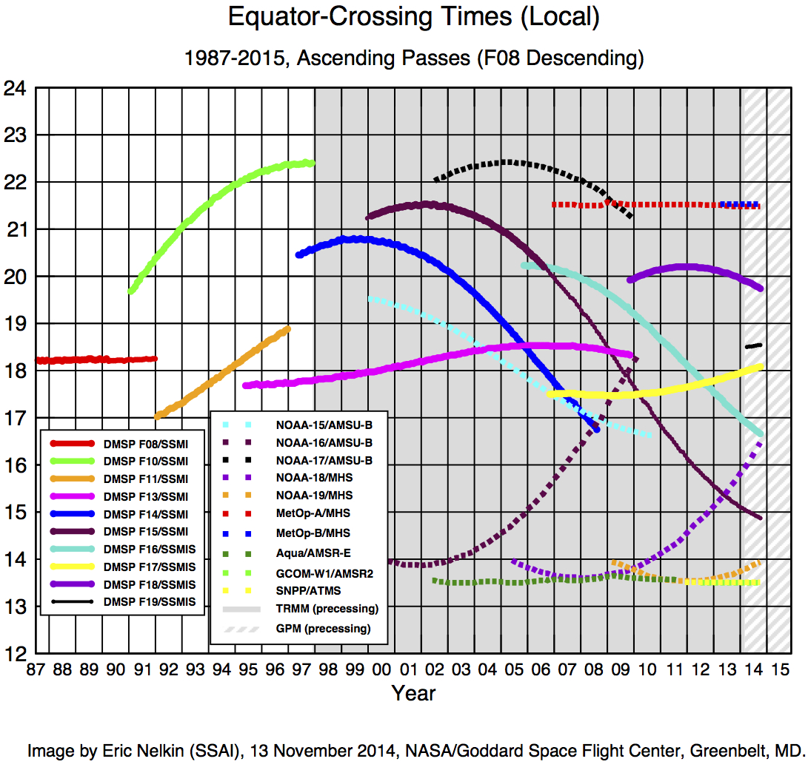
Available Low-Earth Orbit Input Satellite Data
Local Overpass Time

Slide 4
Satellite Intercalibration
Different sensors provide different precipitation estimates so we must intercalibrate all estimates to the best standard (GPM combined GMI/DPR)
Three step intercalibration process:
Intercalibrate radiometric data (not done by us)
2. Calibrate all other satellite estimates to GMI
Coincident overpasses over a long time span
Static seasonal climatological large-area matched histograms for each satellite sensor type
Calibrate GMI to combined GMI/DPR estimates
Continuous coincident estimates (narrow combined GMI/DPR swath encompassed by wider GMI swath)
Dynamic regional matched histograms of precipitation covering a 45-day accumulation

Slide 5
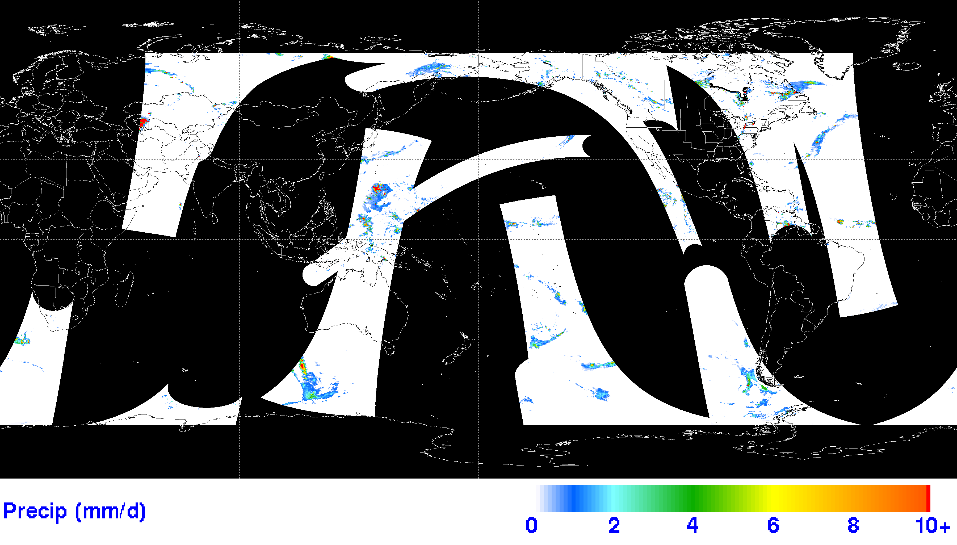
0.5-Hour Snapshot of Instantaneous Precipitation
00:00Z-00:30Z 20140630 Precipitation (mm/hour)
All estimates have been calibrated to the Combined GMI/DPR estimate
If estimates overlap, select higher-quality estimate; if equal quality estimates overlap select observation closest to center of half hour
Despite many satellites, fairly sparse coverage
Need a method to fill in the gaps

Slide 6
Fill the Gaps by “Morphing” Precipitation
Use 4-km geostationary infrared data to compute large-scale cloud motion vectors
Propagate/average observed precipitation forward and backward in time to obtain estimates in between overpasses
Propagation is a simple Lagrangian movement of precipitation
Does not take into account actual development or decay
Analysis has shown that propagated precipitation is better than no precipitation estimate
(Joyce et al, 2004)

Slide 7
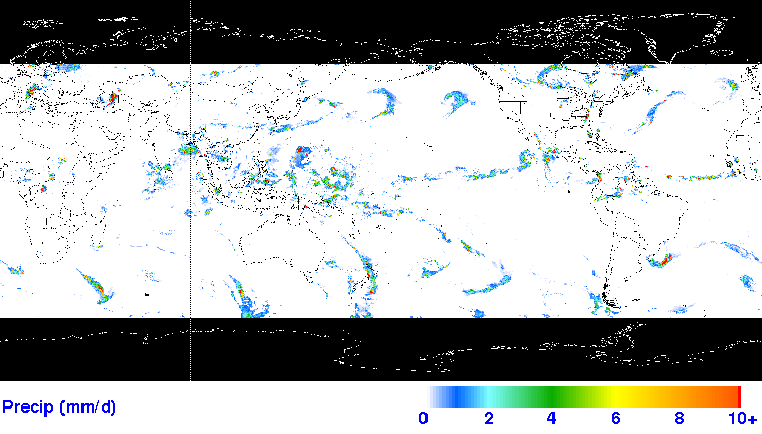
0.5-Hour Observed + Morphed Precipitation
00:00Z-00:30Z 20140630 Precipitation (mm/hour)
Drawback to propagation is persisting a snapshot of precipitation over many time steps away from current time
Use Kalman filter-based technique to weight forward and backward propagated estimates, and geostationary infrared-based precipitation estimates

Slide 8
Inclusion of Rain Gauge Analyses
Surface gauges can provide high-quality observations over land
Use GPCC gauge analyses, but are only available at the monthly time scale
Compute a monthly multi-satellite – gauge combination and force 0.5-hour estimates to sum to the month

Slide 9
Summary
Intercalibrate all satellite estimates to the best standard (trust but verify)
Combine intercalibrated satellite estimates based on relative quality (have to be smart)
Precipitation requires a Lagrangian framework for the best result (morphing)

