Slide 1
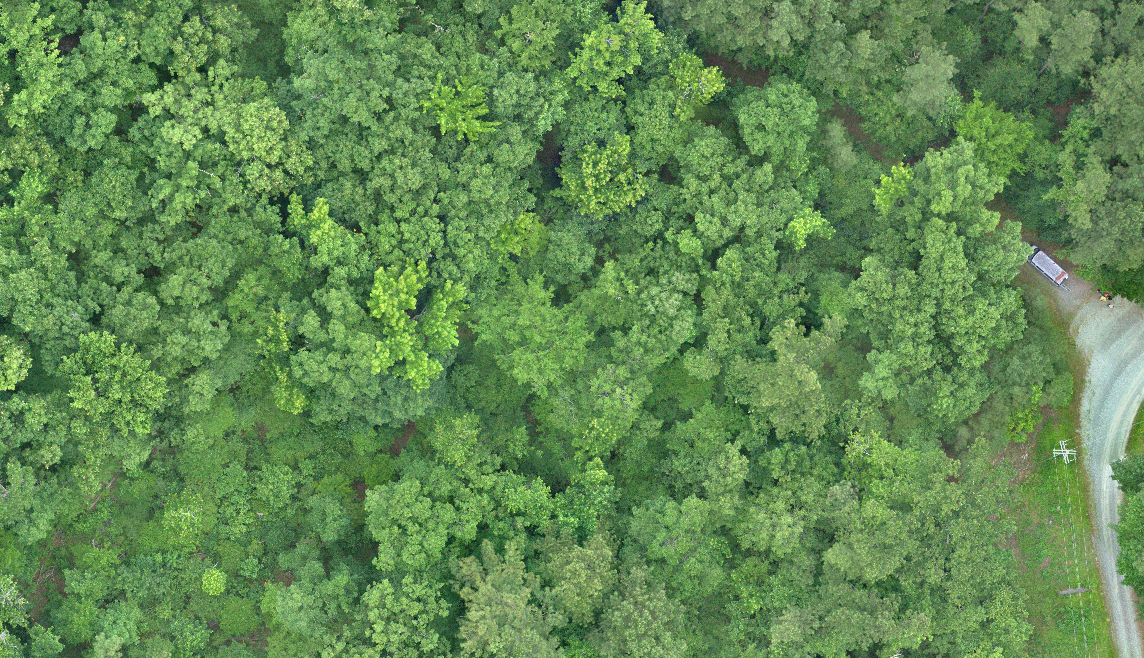
Max Messinger
Wake Forest University
Linn Aerospace

Slide 2
Background
Wake Forest University SUAS Lab
Aircraft Development (Rotary and Fixed-Wing)
Aircraft Deployment
Image Analysis Methods Development
Tactical Carbon and Deforestation Monitoring
Linn Aerospace
Remote Sensing UAS Development and Sales
Aircraft Operation and Imagery Processing/Analysis Training
Contract Imagery Collection and Processing

Slide 3
Notable Projects

Slide 4
Notable Projects

Slide 5
Notable Projects

Slide 6
Notable Projects

