Slide 1
Compliance Checker
Presented by Luke Campbell (RPS)
in collaboration with
Derrick Snowden (IOOS), Jennifer Bosch (IOOS), Ajay Krishnan (NOAA)

Slide 2
Background
Funded and Supported by IOOS
Wanted a tool to improve metadata
Community Driven
Worked closely with NOAA NetCDF group to interpret standards for CF
Recently implemented NCEI 2.0 checkers

Slide 3
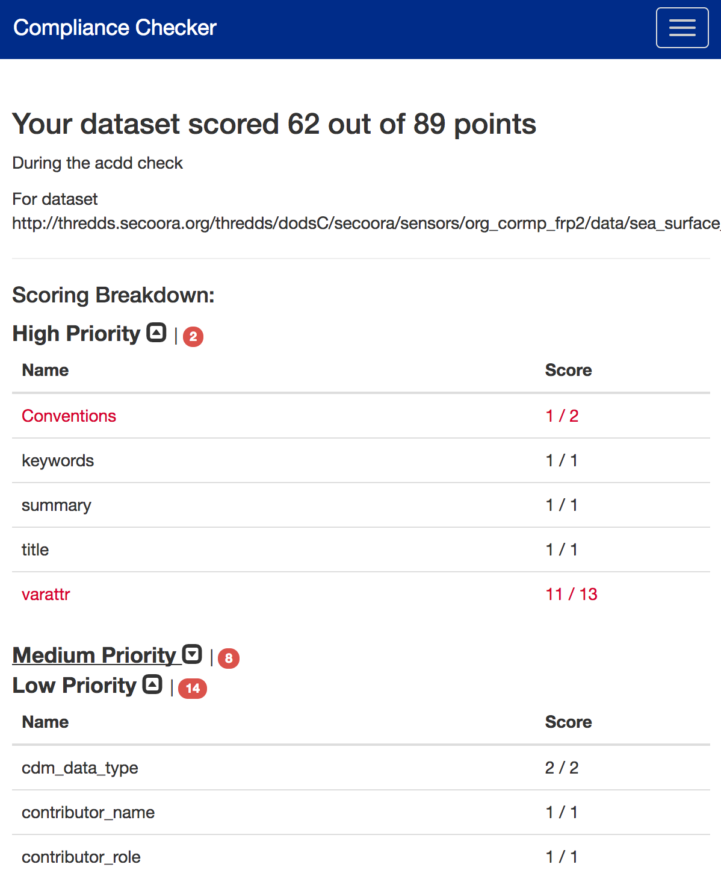
Capabilities
Implemented Standards
ACDD 1.1, 1.3
CF 1.6
NCEI 1.1, 2.0
GliderDAC (Plugin)

Slide 4
Capabilities
Attribute Checking
Checks attributes exist and are valid

Slide 5
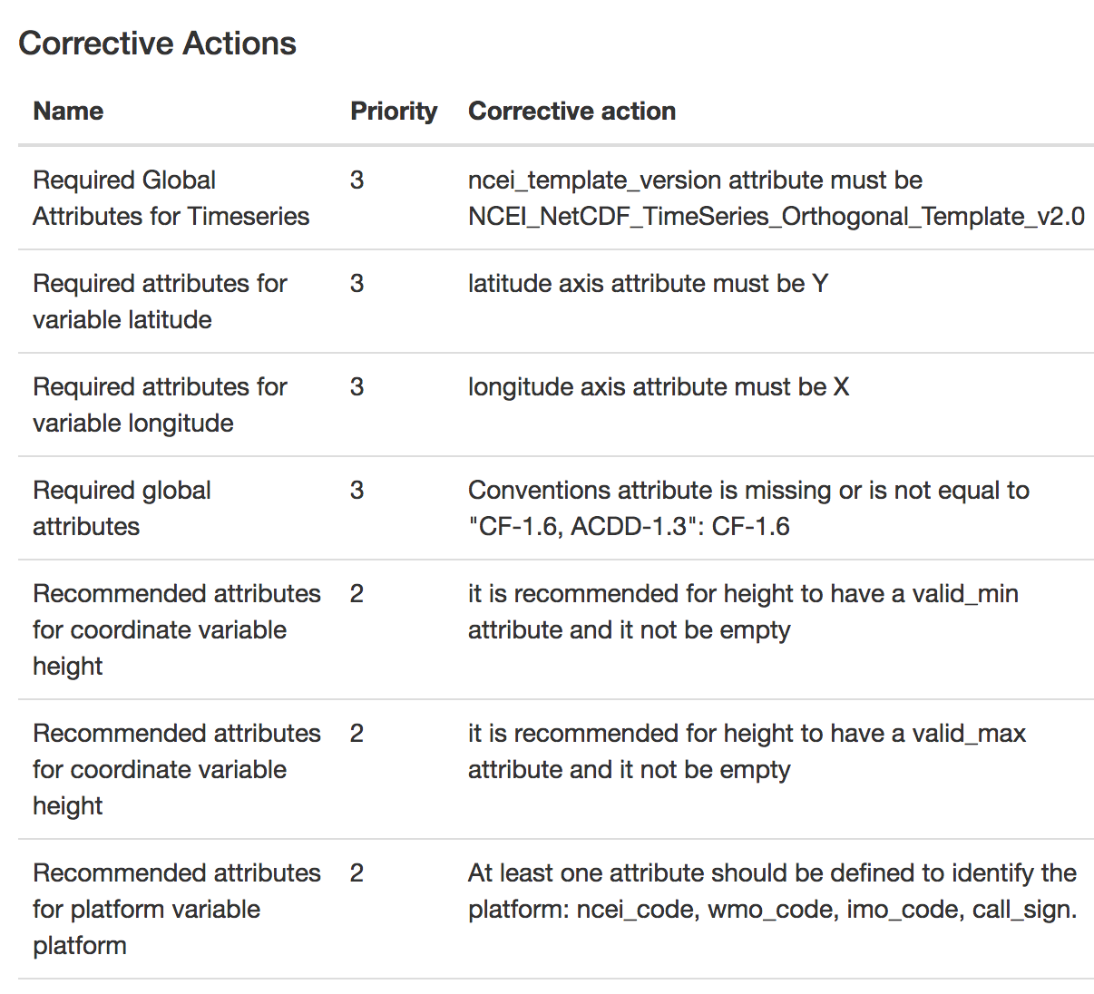
Capabilities
Corrective Actions
Maximize the quality of metadata

Slide 6
Capabilities
Comprehends CF Data Model
Understands the differences between discrete geometries
Makes the right tests for the right geometry

Slide 7
Using the web interface
An online version is available
https://data.ioos.us/compliance/
Hosted on AWS Cloud Infrastructure using a docker instance

Slide 8
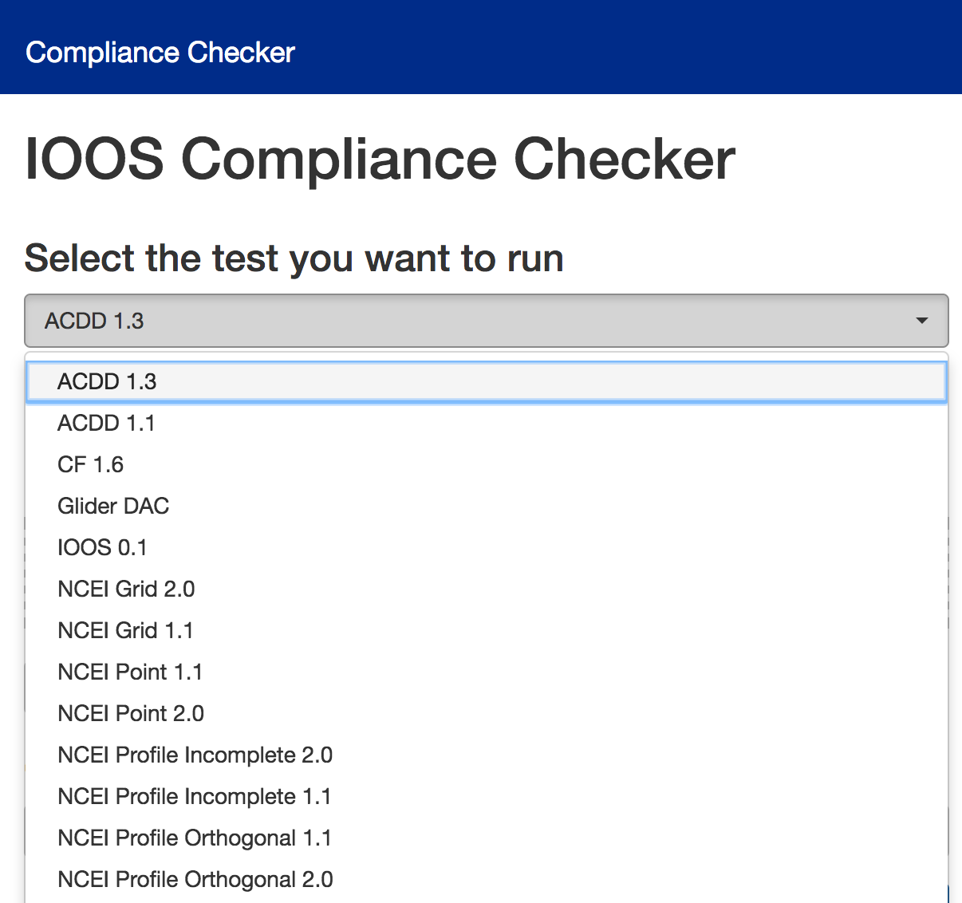
Using the web interface
Select the checker

Slide 9
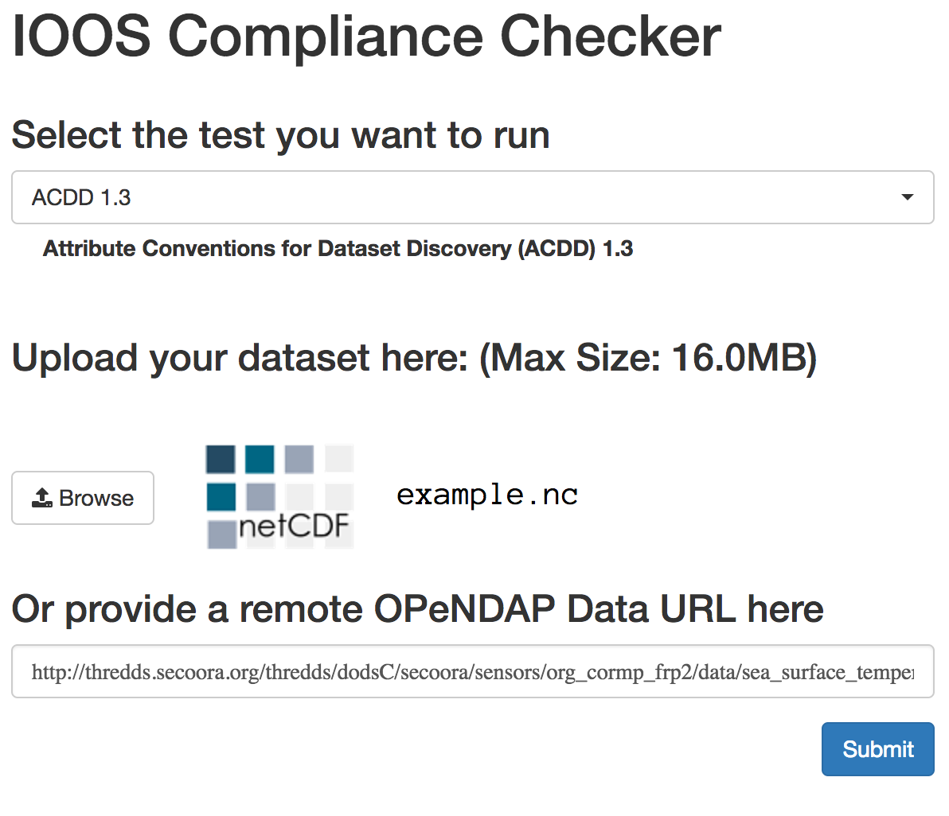
Using the web interface
Drag and Drop File
or
Paste OPeNDAP URL

Slide 10
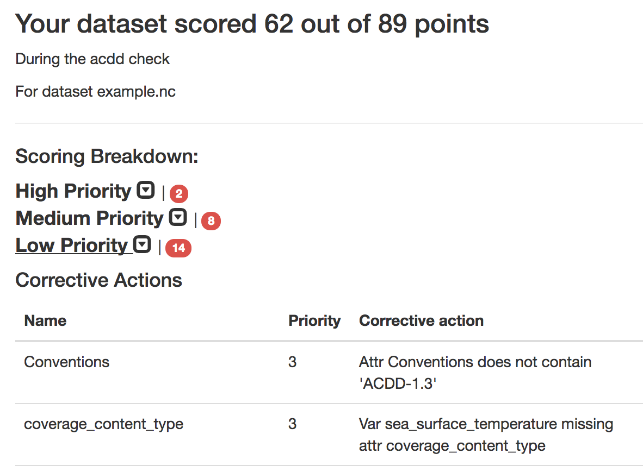
Using the web interface
Run the test and read the results

Slide 11
Future Capabilities

Slide 12
Future Capabilities
Support for unstructured gridded datasets
UGrid and SGrid Conventions Plugins
Better public API
Machine to Machine interface
Build a composite report of all checks

Slide 13
Related Projects
IOOS Catalog
Glider Data Assembly Center
OceansMap (oceansmap.com)
Environmental Data Server (EDS)
NcSOS
Implementation of IOOS Standards for USACE

Slide 14
Questions?

