Slide 1
OneStop: Architecture Review
David Fischman OneStop Architecture Team Lead
NOAA’s National Centers for Environmental Information
January 4 and 7, 2016
NOAA Satellite and Information Service | National Centers for Environmental Information

Slide 2
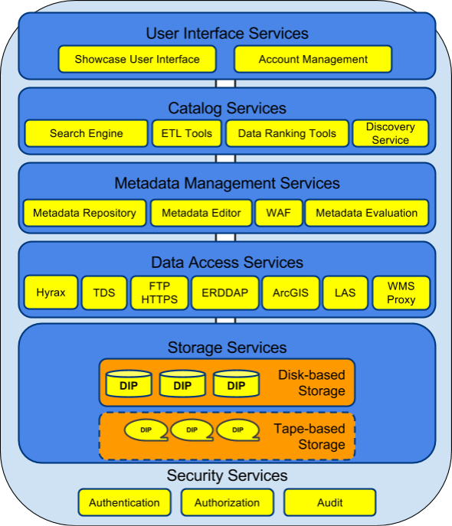
Service-oriented Architecture
The OneStop architecture is based around services to support discovery, access, and visualization.
OneStop’s components will be compartmental and modular so it can evolve along with other NOAA initiatives.

Slide 3
OneStop: An Agile Approach
OneStop is an Agile project, based on a user-centered design approach.
User stories lead to discrete functional requirements, which are met and tested iteratively and refined through additional stories.
The overall design and architecture of the system evolve through these iterations as the modular building blocks are aggregated into services and “promoted” up.

Slide 4
OneStop: Data Discovery and Access
OneStop supports NOAA's efforts by leveraging existing catalog and access technologies to develop an improved data access framework.
The framework will be based on improved discovery, access, and visualization services for the data.
In order to support the framework, one important goal of the project is to improve documentation, access, and machine-readability of the data.

Slide 5
Search Engine

Slide 6
Search Engine
Each Center will locally host Elasticsearch to index both the collection level and granule level data under their jurisdiction.
Dataset specific applications can use the local Elasticsearch to host specific search capabilities
OneStop will harvest the local Elasticsearch to populate OneStop’s Elasticsearch
ESRI’s Geoportal, NASA’s Earthdata and Australia’s National Computational Infrastructure are also using Elasticsearch for their OneStop like applications

Slide 7
Data Access
OneStop could package the requested data for delivery via an email notification containing a link to the bundle (possibly in a bagit format) on FTP
This will link datasets that are stored in multiple locations thus reducing user interaction with different applications

Slide 8
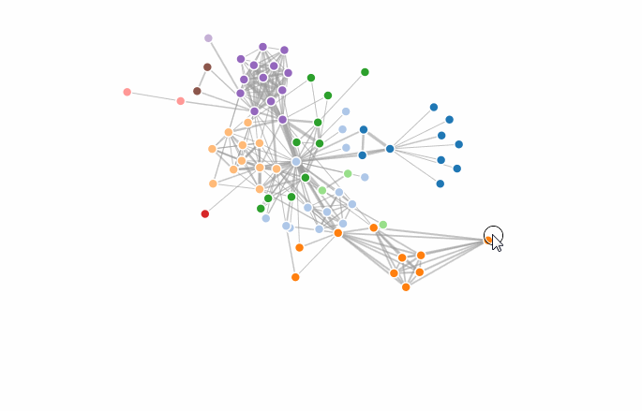
Data Information
OneStop is advancing a metadata graph database where each node represents an entity, and each relationship represents how two nodes are associated.

Slide 9
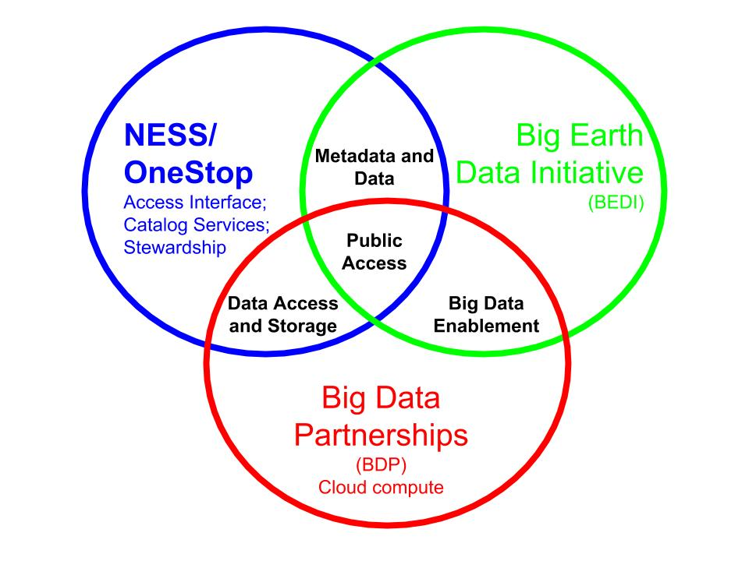
Other NOAA Initiatives

Slide 10
Feedback Form
http://goo.gl/forms/6c54aH7S1e
Three thumbs up/thumbs down questions, add a user story, become a beta tester, and a free text comment field (email address optional)
Questions?

Slide 11
www.ncei.noaa.gov
NCEI Climate Facebook: http://www.facebook.com/NOAANCEIclimate NCEI Ocean & Geophysics Facebook: http://www.facebook.com/NOAANCEIoceangeo NCEI Climate Twitter (@NOAANCEIclimate): http://www.twitter.com/NOAANCEIclimate
NCEI Ocean & Geophysics Twitter (@NOAANCEIocngeo): http://www.twitter.com/NOAANCEIocngeo

Slide 12
Backup Slides
For more information...

Slide 13
A major focus of NOAA OneStop is moving hard-to-access data from deep storage to easily accessible spinning disk storage. Having these data available on spinning disk will enable machine- and human-readable access via interoperable services such as HTTP, FTP, WCS, OpenSearch, and WMS served by THREDDS, OPeNDAP Hyrax, and other servers. OneStop intends to procure, install and operate this disk storage with the help of OSGS, building on their experience in deploying a similar solution for NOMADS and Ocean NOMADS. This approach represents a step in the direction of NESDIS providing enterprise “storage as a service” capabilities for its many large-volume data programs. In this session we will provide an overview and solicit feedback from the community on the system’s concept of operations.

