Slide 1
OneStop: Progress Toward Implementation of Enterprise Storage Services
John Relph OneStop IT Team Lead
NOAA’s National Centers for Environmental Information
January 4 and 7, 2016
NOAA Satellite and Information Service | National Centers for Environmental Information

Slide 2
OneStop: Data Discovery and Access
OneStop supports NOAA's efforts by leveraging existing catalog and access technologies to develop an improved data access framework.
The framework will be based on improved discovery, access, and visualization services for the data.
In order to support the framework, one important goal of the project is to improve documentation of, access to, and machine-readability of the data.

Slide 3
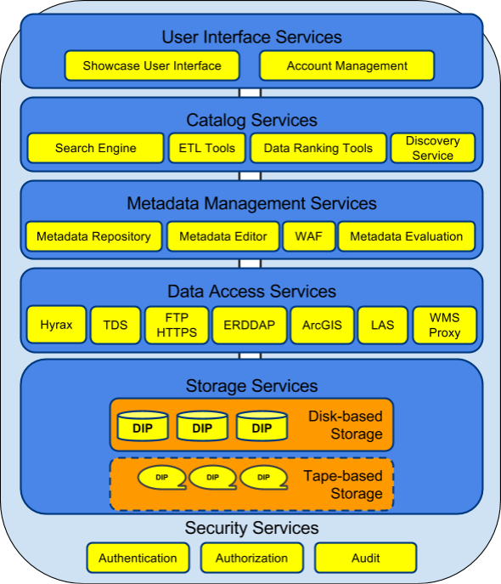
Service-oriented Architecture
The OneStop architecture is based around services to support discovery, access, and visualization.

Slide 4
Data Access and Storage Services
Having data available on spinning disk will enable machine- and human-readable access via interoperable services such as HTTP, FTP, WCS, OpenSearch, and WMS served by THREDDS, OPeNDAP Hyrax, and other servers.

Slide 5
Modernization of Data
Thus, we need to move some data from hard-to-access deep storage to easily accessible spinning disk storage.
In some cases, we may also need to modernize the data file format, to support the data access services.

Slide 6
OneStop Storage ConOps
OneStop intends to procure, install and operate a large disk storage solution with the help of OSGS, building on their experience in deploying a similar solution for NOMADS and Ocean NOMADS. The storage will be based on commodity hardware, chosen for simplicity, price, and supported access protocols.
This approach represents a step in the direction of NESDIS providing enterprise “Storage as a Service” capabilities for its many large-volume data programs, and conforms to the GEARS ConOps.
Notes:
OSGS: Office of Satellite Ground Systems, GEARS: Ground Enterprise Architecture System

Slide 7
System Requirements
Scalable (to multiple PBs)
Aiming for >1PB initial capability
Low cost to own (TCO)
Energy efficient
Space efficient
Open standards
Low overhead
Simple installation
Reliable (RAID, redundancy, etc.)
Compatible with existing IT infrastructure
Configurable
Compatible protocol support
Reasonable performance
Support interoperable services
Acceptable speeds

Slide 8
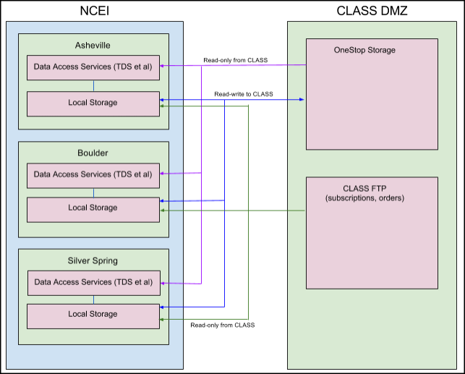
ConOps Continued
OneStop storage will be connected to NCEI systems via standard protocols (e.g., iSCSI, NFS).
NCEI will have full control over the data that resides on OneStop storage.
Notes:
CLASS will operate

Slide 9
Storage Data Flows
Data will be copied from deep storage (e.g., CLASS tape), modernized if necessary, then copied to OneStop Storage.
Data access services running on NCEI systems will serve the data residing on the OneStop storage to the public.
Notes:
CLASS will operate

Slide 10
Feedback Form
http://goo.gl/forms/6c54aH7S1e
Three thumbs up/thumbs down questions, add a user story, become a beta tester, and a free text comment field (email address optional)
Questions?

Slide 11
www.ncei.noaa.gov
NCEI Climate Facebook: http://www.facebook.com/NOAANCEIclimate NCEI Ocean & Geophysics Facebook: http://www.facebook.com/NOAANCEIoceangeo NCEI Climate Twitter (@NOAANCEIclimate): http://www.twitter.com/NOAANCEIclimate
NCEI Ocean & Geophysics Twitter (@NOAANCEIocngeo): http://www.twitter.com/NOAANCEIocngeo

Slide 12
Backup Slides
For more information...

Slide 13
A major focus of NOAA OneStop is moving hard-to-access data from deep storage to easily accessible spinning disk storage. Having these data available on spinning disk will enable machine- and human-readable access via interoperable services such as HTTP, FTP, WCS, OpenSearch, and WMS served by THREDDS, OPeNDAP Hyrax, and other servers. OneStop intends to procure, install and operate this disk storage with the help of OSGS, building on their experience in deploying a similar solution for NOMADS and Ocean NOMADS. This approach represents a step in the direction of NESDIS providing enterprise “storage as a service” capabilities for its many large-volume data programs. In this session we will provide an overview and solicit feedback from the community on the system’s concept of operations.

Slide 14
OneStop IT Team
John Relph (Lead, NCEI), Jay Morris (OSGS), Thomas Carey (NCEI), Jefferson Ogata (NCEI), Ken Schmidt (NCEI), James Goudouros (OSGS), Joseph Mani (OSGS), Joseph Mangin (OSGS), Paul Yun (OSGS)

