Slide 1
The Need for Earth Science Data Analytics to Facilitate Community Resilience
(and other applications)
Earth Science Data Analytics Cluster
Steve Kempler, Moderator
July 16, 2015
ESIP Federation Meeting
Monterey
Presentation for Lawrence
Chris: Do you know how to paste Gilberto’s sample presentation format into this Google Presentation?
Steve: See if this works. (GV)

Slide 2
The Need for Earth Science Data Analytics to Facilitate Community Resilience (and other applications)
Session Focus:
Review our current work (for new participants)
Discuss and finalize Earth Science Data Analytics definition (published definitions targeting the Business world do not exactly fit)
Discuss and finalize Earth science Data Analytics types (published types targeting the Business world do not exactly fit)
Discuss/Collect Use Cases pertaining to the utilization of Earth science data (analytics) in addressing social, economic, and environmental issues

Slide 3
Commercial Break (already?): Going to AGU?
IN004. Advanced Information Systems to Support Climate Projection Data Analysis - Gerald L Potter, Tsengdar J Lee, Dean Norman Williams, and Chris A Mattmann
IN009. Big Data Analytics for Scientific Data - Emily Law, Michael M Little, Daniel J Crichton, and Padma A Yanamandra-Fisher
IN010. Big Data in Earth Science – From Hype to Reality - Kwo-Sen Kuo, Rahul Ramachandran, Ben James Kingston Evans. and Mike M Little
IN011. Big Data in the Geosciences: New Analytics Methods and Parallel Algorithms - Jitendra Kumar and Forrest M Hoffman
IN012. Computing Big Earth Data - Michael M Little, Darren L. Smith, Piyush Mehrotra, and Daniel Duffy
IN023. Geophysical Science Data Analytics Use Case Scenarios - Steven J Kempler, Robert R Downs, Tiffany Joi Mathews, and John S Hughes
IN031. Man vs. Machine - Machine Learning and Cognitive Computing in the Earth Sciences - Jens F Klump, Xiaogang Ma, Jess Robertson and Peter A Fox
IN034. New approaches for designing Big Data databases - David W Gallaher and Glenn Grant
IN039. Partnerships and Big Data Facilities in a Big Data World - Kenneth S Casey and Danie Kinkade
IN049. Towards a Career in Data Science: Pathways and Perspectives - Karen I Stocks, Lesley A Wyborn, Ruth Duerr, and Lynn Yarmey

Slide 4
The Need for Earth Science Data Analytics to Facilitate Community Resilience (and other applications)
Earth Science Data Analytics (ESDA) Cluster Goal:
To understand where, when, and how ESDA is used in science and applications research through speakers and use cases, and determine what Federation Partners can do to further advance technical solutions that address ESDA needs. Then do it.
Ultimate Goal:
To Glean Knowledge about Earth from All Available Data and Information

Slide 5
Motivation
Increasing Amounts of Heterogeneous Datasets
aka Big Data
… and a lot of people/directives are addressing it
But don’t worry… I won’t discuss any words that begin with ‘v’ *.
(If you were at AGU, you’ve seen them enough)
* I have backup slides for later, if you need a ‘v’ refesher

Slide 6
So… What’s the Big Deal about Big Data
If you just look at the ‘Big Data’ problem, it can indeed be overwhelming.
But, what’s new?... what’s different?... what’s the problem?
We have been managing large volumes of heterogeneous datasets for a long time
Researchers have been analyzing this data for a long time
Technology is accommodating our needs
What is new is the need to grow and implement the ability to efficiently analyze data and information in order to extract knowledge

Slide 7
The Punchline
Thus, it is not necessarily about Big Data, itself.
It is about the ability to examine large amounts of data of a variety of types to uncover hidden patterns, unknown correlations and other useful information.
That is:
To glean knowledge from data and information

Slide 8
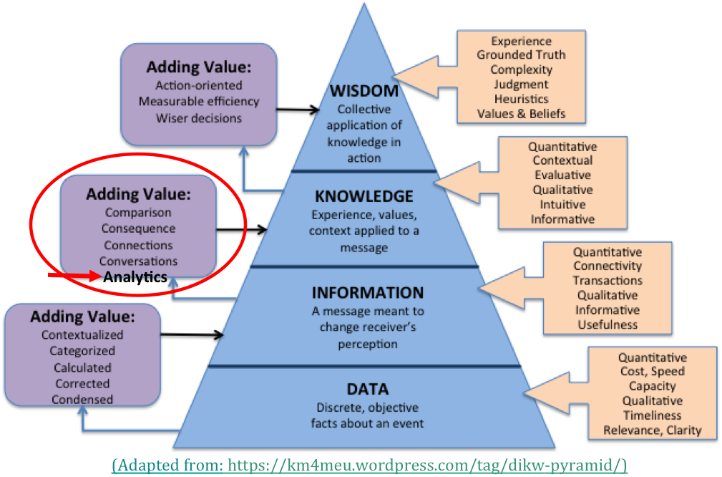
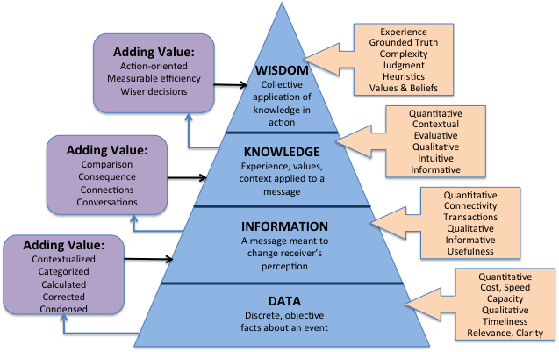
(Adapted from: https://km4meu.wordpress.com/tag/dikw-pyramid/)
(Adapted from: https://km4meu.wordpress.com/tag/dikw-pyramid/)

Slide 9
ESDA Cluster Goal
To understand where, when, and how ESDA is used in science and applications research through speakers and use cases, and determine what Federation Partners can do to further advance technical solutions that address ESDA needs. Then do it.
Ultimate Goal:
To Glean Knowledge about Earth from All Available Data and Information

Slide 10
ESDA Cluster – What we have done
14 Telecons
6 face-to-face sessions
16 ‘guest’ presentations
Created an ESDA specific use case template
Gathered 18 use Cases
Settled/Focused on Data Analytics definition
Refocused on Earth science data analytics definition *
Settled/Focused on 5 Data Analytics types
Refocused on 11 Earth science data analytics types *
Acquiring Use Case *
Describe/Demonstrate UV CDAT and ClimatePipes visualization analytics tools
* - Subjects of today’s discussion

Slide 11
Data Analytics Definition
Data Analytics Definition:
Is the science of examining raw data with the purpose of drawing conclusions about that information

Slide 12
Another Take http://www.gartner.com/it-glossary/analytics
Analytics has emerged as a catch-all term for a variety of different business intelligence (BI)
Process of analyzing information from a particular domain, such as website analytics
Applying the breadth of BI capabilities to a specific content area (for example, sales, service, supply chain and so on)
Used to describe statistical and mathematical data analysis that clusters, segments, scores and predicts what scenarios are most likely to happen.

Slide 13
Definitions
Data analytics definitions tend to accommodate the needs and data analysis trends in the business world

Slide 14
Earth Science Data Analytics Definition
Earth Science Data Analytics Definition:
The process of examining large amounts of data of a variety of types to uncover hidden patterns, unknown correlations and other useful information, involving one or more of the following:
Data Preparation – Preparing heterogeneous data so that they can ‘play’ together
Data Reduction – Smartly removing data that do not fit research criteria
Data Analysis – Applying techniques/methods to derive results
Is this the definition we want to stamp ‘ESIP’ on?

Slide 15
Data Analytics Types
Why is it important to identify Data Analytics Types
To better identify key needs that tools/techniques can be developed to address.
Basically, once we can categorize different types of Data Analytics, we can better associate existing and future Data Analytics tools and techniques that will help solve particular problems.

Slide 16
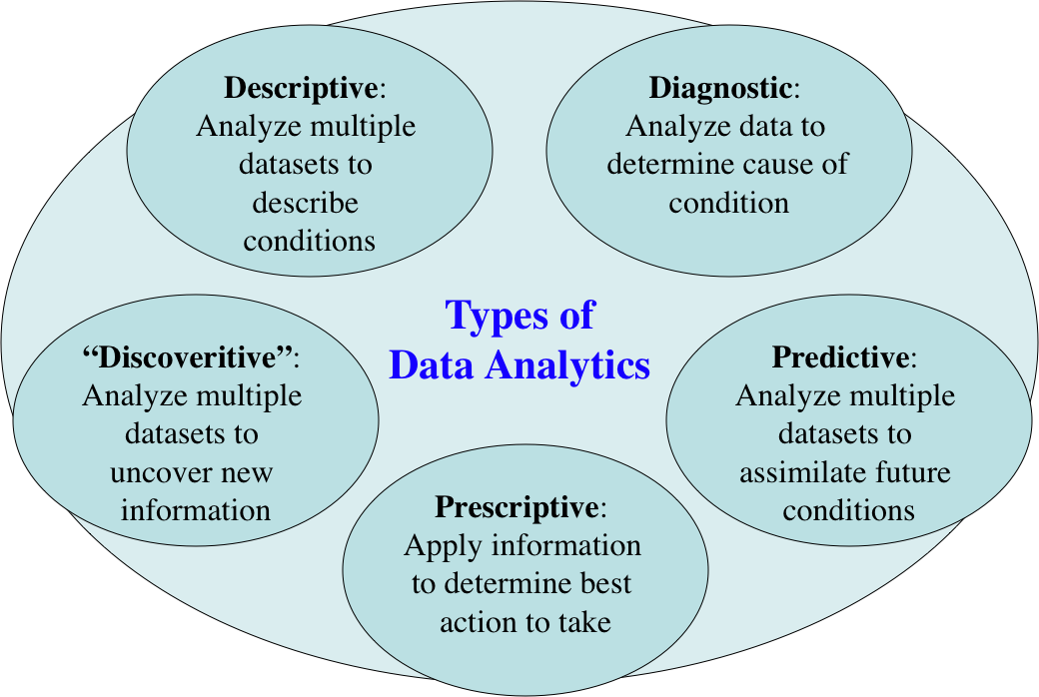
The 5 Types of Data Analytics

Slide 17
Another Take http://searchdatamanagement.techtarget.com/definition/data-analytics
The science is generally divided into:
Exploratory data analysis (EDA), where new features in the data are discovered
Confirmatory data analysis (CDA), where existing hypotheses are proven true or false
Qualitative data analysis (QDA) is used in the social sciences to draw conclusions from non-numerical data like words, photographs or video.

Slide 18
ESDA Use Case Template
Use Case Title
Author/Company/Email
Actors/Stakeholders/Project URL and their roles and responsibilities
Use Case Goal
Use Case Description
Current technical considerations to take into account that may impact needed data analytics.
Data Analytics tools applied
Data Analytics Challenges (Gaps)
Type of User
Research Areas
Societal Benefit Areas
Potential for and/or issues for generalizing this use case (e.g. for ref. architecture)
More Information and relevant URLs (e.g. who to contact or where to go for more information)

Slide 19
Use Cases Gathered (so far)
1 MERRA Analytics Services: Climate Analytics-as-a-Service
2 MUSTANG QA: Ability to detect seismic instrumentation problems
3 Inter-calibrations among datasets
4 Inter-comparisons between multiple model or data products
5 Sampling Total Precipitable Water Vapor using AIRS and MERRA
6 Using Earth Observations to Understand and Predict Infectious Diseases
7 CREATE-IP - Collaborative Reanalysis Technical Environment - Intercomparison Project
8 The GSSTF Project (MEaSUREs-2006)
9 Science- and Event-based Advanced Data Service Framework at GES DISC
10 Risk analysis for environmental issues
11 Aerosol Characterization
12 Creating One Great Precipitation Data Set From Many Good Ones
13 Reconstructing Sea Ice Extent from Early Nimbus Satellites
14 DOE-BER AmeriFlux and FLUXNET Networks *
15 DOE-BER Subsurface Biogeochemistry Scientific Focus Area *
16 Climate Studies using the Community Earth System Model at DOE’s NERSC center *
17 Radar Data Analysis for CReSIS *
18 UAVSAR Data Processing, Data Product Delivery, and Data Service *
* - Borrowed, with permission, from NIST Big Data Use Case Submissions [http://bigdatawg.nist.gov/usecases.php]

Slide 20
ESDA Use Case Template
Use Case Title
Author/Company/Email
Actors/Stakeholders/Project URL and their roles and responsibilities
Use Case Goal
Use Case Description
Current technical considerations to take into account that may impact needed data analytics.
Data Analytics tools applied
Data Analytics Challenges (Gaps)
Type of User
Research Areas
Societal Benefit Areas
Potential for and/or issues for generalizing this use case (e.g. for ref. architecture)
More Information and relevant URLs (e.g. who to contact or where to go for more information)

Slide 21
ESDA Use Case Template
Use Case Title
Author/Company/Email
Actors/Stakeholders/Project URL and their roles and responsibilities
Use Case Goal → Earth Science Data Analytics Types
Use Case Description
Current technical considerations to take into account that may impact needed data analytics.
Data Analytics tools applied
Data Analytics Challenges (Gaps)
Type of User
Research Areas
Societal Benefit Areas
Potential for and/or issues for generalizing this use case (e.g. for ref. architecture)
More Information and relevant URLs (e.g. who to contact or where to go for more information)

Slide 22
Types of Earth Science Data Analytics
1. To calibrate data
2. To validate data (quality) (note it does not have to be via data intercomparison)
3. To perform course data reduction (e.g., subsetting, data mining)
4. To intercompare data (i.e., any data intercomparison; Could be used to better define validation/quality)
5. To derive new data product
6. To tease out information from data
7. To glean knowledge from data and information
8. To forecast/predict phenomena (i.e., Special kind of conclusion)
9. To derive conclusions (i.e., that do not easily fall into another type)
10. To derive analytics tools
11. To recover/rescue data

Slide 23
Types of Earth Science Data Analytics
These Data Analytics types work better for Earth science:
Can better identify Earth science analysis needs that tools/techniques can be developed to address.
Types are result focused.
Earth science use cases easily fit into these types
1. To calibrate data
2. To validate data (quality) (note it does not have to be via data intercomparison)
3. To perform course data reduction (e.g., subsetting, data mining)
4. To intercompare data (i.e., any data intercomparison; Could be used to better define validation/quality)
5. To derive new data product
6. To tease out information from data
7. To glean knowledge from data and information
8. To forecast/predict phenomena (i.e., Special kind of conclusion)
9. o derive conclusions (i.e., that do not easily fall into another type)
10. To derive analytics tools
11. To recover/rescue data

Slide 24
Use Cases Gathered (so far)
 | Types of Earth Science Data analytics
Use Cases | 1 | 2 | 3 | 4 | 5 | 6 | 7 | 8 | 9 | 10 | 11
1 MERRA Analytics Services: Climate Analytics-as- |  |  |  |  |  |  |  |  |  | √
2 MUSTANG QA: Ability to detect seismic |  | √ | √ |  |  |  |  | √
3 Inter-calibrations among datasets | √ | √ |  | √
4 Inter-comparisons between multiple model or |  |  |  | √
5 Sampling Total Precipitable Water Vapor using |  | √ |  | √
6 Using Earth Observations to Understand and |  |  |  |  |  |  |  | √ | √
7 CREATE-IP - Collaborative Reanalysis Technical |  |  |  | √
8 The GSSTF Project (MEaSUREs-2006) |  |  |  |  | √
9 Science- and Event-based Advanced Data |  |  |  |  | √ |  |  |  |  | √
10 Risk analysis for environmental issues |  |  |  |  |  |  |  | √
11 Aerosol Characterization |  |  |  | √ |  |  |  |  | √
12 Creating One Great Precipitation Data Set From |  |  |  |  | √
13 Reconstructing Sea Ice Extent from Early Ni | √ |  |  |  |  |  |  |  |  |  | √
14 DOE-BER AmeriFlux and FLUXNET Networks |  |  |  |  |  | √ |  |  | √
15 DOE-BER Subsurface Biogeochemistry |  |  |  |  |  |  |  | √
16 Climate Studies using the Community Earth |  |  |  |  |  |  |  | √ | √ | √
17 Radar Data Analysis for CReSIS |  |  |  |  |  | √
18 UAVSAR Data Processing, Data Product * |  |  |  |  | √ | √

Slide 25
Use Case Conclusions, so far
• Most Earth science data analytics use cases tend to focus on data intercomparison, deriving new products, forecasting/predicting, and deriving conclusions
• No use cases were identified to glean knowledge from data/ information. Perhaps some use cases were not recognized as such
• Distributed data sources, and data heterogeneity are persistent characteristics…
• … Velocity issues are not
• Earth science data analytics challenges provide interesting problems for data analytics tool/technique developers to ponder
• If any, use case 5.16 provides the true Big Data problem

Slide 26
Types of Earth Science Data Analytics
1. To calibrate data
2. To validate data (quality) (note it does not have to be via data intercomparison)
3. To perform course data reduction (e.g., subsetting, data mining)
4. To intercompare data (i.e., any data intercomparison; Could be used to better define validation/quality)
5. To derive new data product
6. To tease out information from data
7. To glean knowledge from data and information
8. To forecast/predict phenomena (i.e., Special kind of conclusion)
9. To derive conclusions (i.e., that do not easily fall into another type)
10. To derive analytics tools
11. To recover/rescue data
Are these the Data Analytics types we want to stamp ‘ESIP’ on?

Slide 27
More Use Cases
Looking for more use cases…..

Slide 28
Next …
Finalize the ESIP Data Analytics definition and Types
More Use Cases!
Add ‘Skills Needed’ to use cases
Serious Tools/techniques Analysis
Associate with Data Analytics Types
To mention a few… Dryad, MapReduce, Hadoop, OpenCyc, Powerset, True Knowledge, WolframAlpha, myGrid, UV-CDAT, ClimatePipes, MIIC II, CtrazyEgg/Heat Maps
What else?

Slide 29
Thank you

Slide 30
BACKUP

Slide 31
NIST Big Data Definitions and Taxonomies, V 0.9
National Institute of Standards and Technology (NIST) Big Data Working Group (NBD-WG)
February, 2014, http://bigdatawg.nist.gov/show_InputDoc.php, M0142
Big Data consists of extensive datasets, primarily in the characteristics of volume, velocity and/or variety, that require a scalable architecture for efficient storage, manipulation, and analysis.

Slide 32
Open Geospatial Consortium (OGC)
Big Data Working Group
http://external.opengeospatial.org/twiki_public/BigDataDwg/WebHome
“Big Data” is an umbrella term coined by Doug McLaney and IBM several years ago to denote data posing problems, summarized as the four Vs:
Volume – the sheer size of “data at rest”
Velocity – the speed of new data arriving (“data at move”)
Variety – the manifold different
Veracity – trustworthiness and issues of provenance

Slide 33
IEEE BigData 2014
http://cci.drexel.edu/bigdata/bigdata2014/callforpaper.htm
… in any aspect of Big Data with emphasis on 5Vs (Volume, Velocity, Variety, Value and Veracity) relevant to variety of data (scientific and engineering, social, …) that contribute to the Big Data challenges
Ruth adds:
Visibility

Slide 34
From: Demystifying Data Science
(Natasha Balac , accessible via: http://bigdatawg.nist.gov/show_InputDoc.php, M0169)

Slide 35
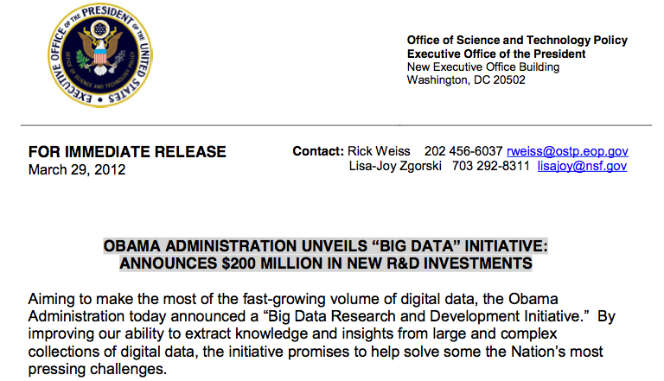
So, Why does Big Data Have Everybody’s Attention?
This is an encourager:
(http://www.whitehouse.gov/sites/default/files/microsites/ostp/big_data_press_release_final_2.pdf)

Slide 36
Data Scientist in the context of analytics
Data Scientist
A data scientist possesses a combination of analytic, machine learning, data mining and statistical skills as well as experience with algorithms and statistical skills as well as experience with algorithms and coding. Perhaps the most important skill a data scientist possesses, however, is the ability to explain the significance of data in a way that can be easily understood by others. (Source: http://searchbusinessanalytics.techtarget.com/definition/Data-scientist)
Rising alongside the relatively new technology of big data is the new job title data scientist. While not tied exclusively to big data projects, the data scientist role does complement them because of the increased breadth and depth of data being examined, as compared to traditional roles. (Source: http://www-01.ibm.com/software/data/infosphere/data-scientist/)

Slide 37
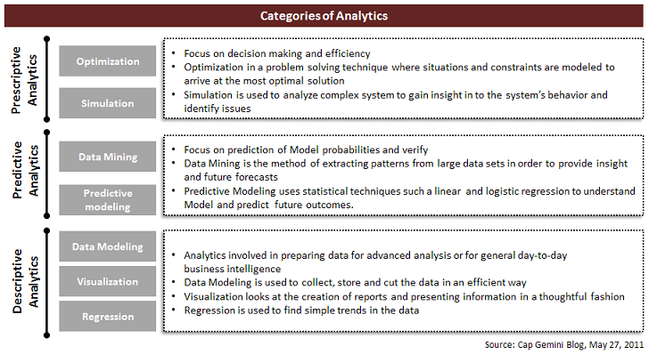
Analytics
(http://steinvox.com/blog/big-data-and-analytics-the-analytics-value-chain/)

Slide 38
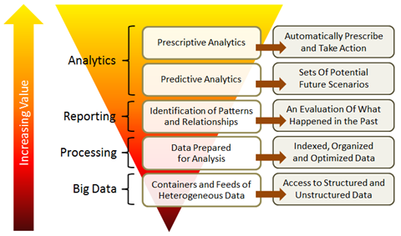
Another look at Analytics
(http://steinvox.com/blog/big-data-and-analytics-the-analytics-value-chain/)

Slide 39
2014 IEEE International Conference on Big Data (IEEE BigData 2014) | What V's do the call for papers
Call for papers in the following (consolidated) areas: | address:
 | Volume | Velocity | Variety | Veracity
1. Big Data Science and Foundations
a. Novel Theoretical Models for Big Data | √ | √ | √ | √
b. New Computational Models for Big Data | √ | √
c. Data and Information Quality for Big Data | √ |  |  | √
d. New Data Standards |  |  | √ | √
2. Big Data Infrastructure
a. High Performance/Parallel/Cloud/Grid/Stream Computing for Big Data | √ | √
b. Autonomic Computing and Cyber-infrastructure, System Architectures, Design and Deployment | √ | √
c. Programming Models, Techniques, and Environments for Cluster, Cloud, and Grid Computing to Support Big Data | √
d. Big Data Open Platforms | √ | √
e. New Programming Models and Software Systems for Big Data beyond Hadoop/MapReduce, STORM | √ |  | √

Slide 40
2014 IEEE International Conference on Big Data (IEEE BigData 2014) | What V's do the call for papers
Call for papers in the following (consolidated) areas: | address:
 | Volume | Velocity | Variety | Veracity
3. Big Data Management
a. Algorithms, Architectures, and Systems for Big Data Web Search and Mining of variety of data. |  | √ | √ | √
b. Algorithms, Architectures, and Systems for Big Data Distributed Search | √ | √ | √
c. Data Acquisition, Integration, Cleaning, and Best Practices |  |  | √ | √
d. Visualization Analytics for Big Data |  |  | √ | √
e. Computational Modeling and Data Integration | √ |  | √
f. Large-scale Recommendation Systems and Social Media Systems |  |  | √ | √
g. Cloud/Grid/Stream (Semantic-based) Data Mining and Pre-processing- Big Velocity Data |  | √ | √ | √
h. Multimedia and Multi-structured Data- Big Variety Data |  |  | √

Slide 41
A 2011 McKinsey report suggests suitable technologies include...
(http://www.mckinsey.com/insights/business_technology/big_data_the_next_frontier_for_innovation)
…A/B testing, association rule learning, classification, cluster analysis, crowdsourcing, data fusion and integration, ensemble learning, genetic algorithms, machine learning, natural language processing, neural networks, pattern recognition, anomaly detection, predictive modelling, regression, sentiment analysis, signal processing, supervised and unsupervised learning, simulation, time series analysis and visualisation.

Slide 42
Analytics Master's Degrees Programs

