Slide 1
AGU’s Data Management Maturity (DMM) Workshop
ESIP Summer Meeting, Durham
July 19, 2016
Shelley Stall
AGU Assistant Director,
Enterprise Data Management
sstall@agu.org
Notes:
A path to identifying data management best practices and implementing them within your organization.

Slide 2
AGU’s position statement on data affirms that
“Earth and space sciences data are a world heritage. Properly documented, credited, and preserved, they will help future scientists understand the Earth, planetary, and heliophysics systems.”
https://sciencepolicy.agu.org/files/2013/07/AGU-Data-Position-Statement-Final-2015.pdf
Notes:
US Dept of Interior ‏‪@Interior‬ 5 Dec 2015
‪#Sunsets‪ @OlympicNP are incredible. Photo by John Donofrio #Washington ‬
https://twitter.com/Interior/status/673178801598255104
Statement adopted by the American Geophysical Union 29 May 1997; Reaffirmed May 2001, May 2005, May 2006; Revised and Reaffirmed May 2009, February 2012 and September 2015.

Slide 3
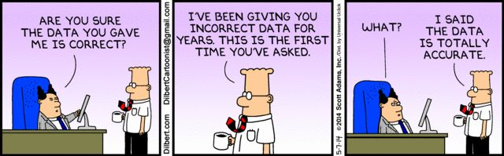
Data Management Challenges

Slide 4
Best Practices for Data Management
3.5 Years of Development
70 Peer Reviewers
-------
25 Process Areas
350+ Practice Statements
Notes:
AGU has partnered with the CMMI® Institute to adapt their Data Management Maturity (DMM)SM framework to the specific needs of the Earth and space sciences to improve data management practices in repositories and institutions.
developed for more than 3.5 years by 4 sponsoring organizations, 50+ contributing authors, 70 peer reviewers, 80+ organizations. It contains 25 process areas that span all key aspects of data management.

Slide 5

Data Management Maturity (DMM)
The DMM is a process improvement and capability maturity model for the management of an organization’s data assets and corresponding activities. It contains best practices for establishing, building, sustaining, and optimizing effective data management across the data lifecycle, from creation through curation, delivery, maintenance, and preservation.
Notes:
Process Improvement Model
Management of data assets
Best practices (recommended)
Optimizing Effective data management across the data lifecycle

Slide 6
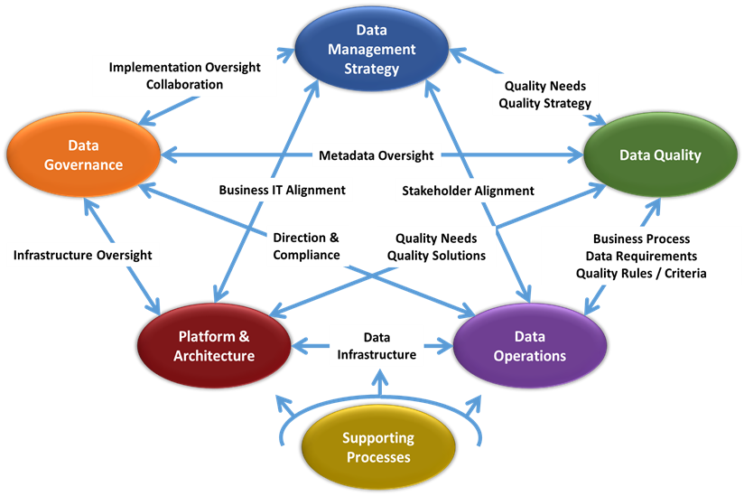
DMMSM Structure
Notes:
The DMM SM model is a framework that fosters organizational alignment around data and process improvement for data management. The framework defines “what” processes need to be in place, not “how” they are to be accomplished. The model includes best practices for establishing, building, sustaining, and optimizing effective data management across the data lifecycle, from creation through delivery, curation, maintenance, and archiving.
Example – use of standards. We don’t tell you the correct standard to use, but instead how well you’re using it.

Slide 7
DMM – Capability and Maturity
Capability – “We can do this”
  Specific Practices – “We’re doing it well”
  Work Products – “We’ve documented the processes we are following” (work products, templates, guidelines, standards, etc.)
Maturity – “….and we can prove it”
  Process Stability – “Solid as a rock”
  Ensures Repeatability – “Sustainable Process”
    Policy
    Training
    Resources and Responsibility, etc.
Notes:
The assessment measures to aspects: Capability and Maturity.
Capability – What data management processes you are actually performing and to what level.
Maturity – The mechanisms in place to perform data processes consistently and with high quality.

Slide 8
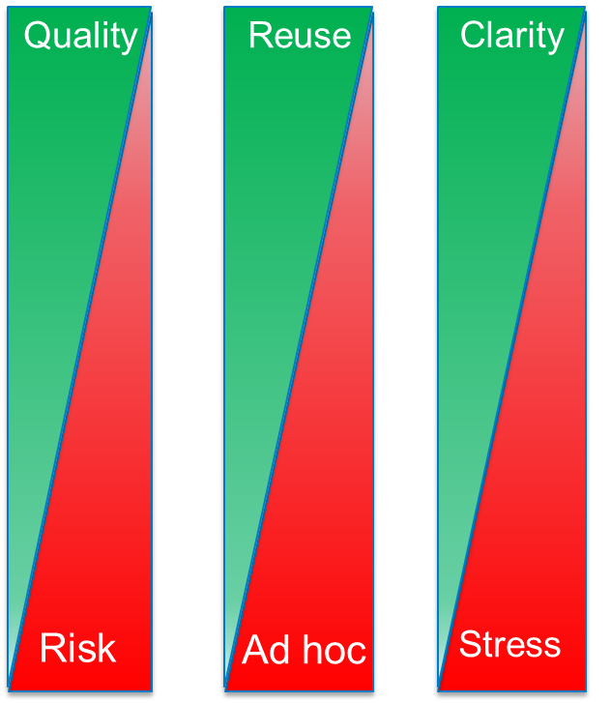
DMM Capability Levels
Level
5
Optimized
Level
4
Measured
Level
3
Defined
Level
2
Level
1
Managed
Performed
Notes:
Performed: Processes are performed ad hoc, primarily at the project level.
Managed: Processes are planned and executed in accordance with policy for at least one line of business, program, or cross-cutting project.
Defined: Set of standard processes is employed and consistently followed across the organization.
Measured: Process metrics have been defined and are used for data management.
Optimized: Process performance is optimized through applying Level 4 analysis for target identification of improvement opportunities. Best practices are shared with peers and industry.

Slide 9
DMM Capability Levels
DM processes are regularly improved and optimized based on changing organizational goals – we are seen as leaders in the DM space
(5)
Optimized
DM practices are managed and governed through quantitative measures of process performance
(4)
Measured
DM practices are aligned with strategic organizational goals and standardized across all areas
(3)
Defined
Target
(2)
Managed
DM practices are deliberate, documented and performed consistently at the program level
(1)
Performed
Data management practices informal and ad hoc
Dependent on heroic efforts
Notes:
It is important to note that the capabilities within the model are organized along increasing levels of capability and organizational maturity. The practices espoused in each level build one atop the other. For example, you cannot perform at level 4, managing your processes quantifiably, unless you are performing all the correct practices expected of level 2 and 3, and doing so consistently across the organization.

Slide 10
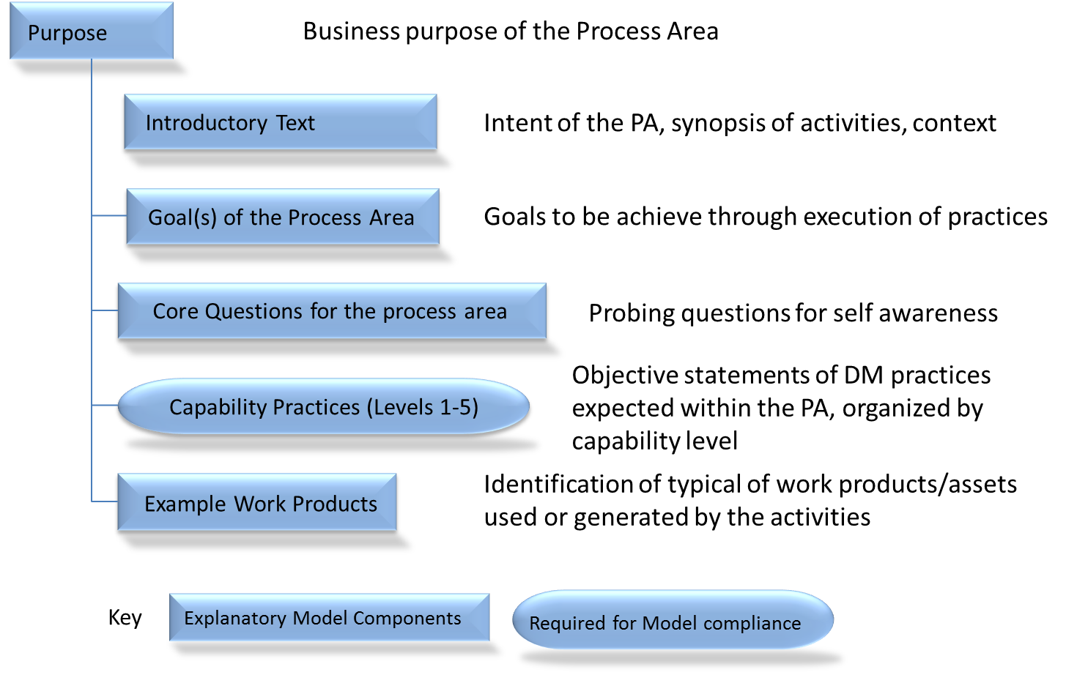
DMM Process Area Construct
Notes:
This slide presents the basic format of each Process Area, showing how the content is organized and presenting an explanation of each piece of the Process Area component. There are typically several practice statements for each capability level 1-5, with levels 2 and 3 containing a majority of the practice statements.

Slide 11
DMM Best Practices
Data Management Strategy
Grant Strategy/Business Case
Funding
Data Lifecycle Management
Communications
Data Management Function
Data Requirements
Data Quality Strategy
Metadata Management
Vocabulary/Glossary
Data Profiling & Assessment
Data Cleansing
Curation
Contribution Management
Governance Management
Architectural Approach
Metadata Standards
Open Linked Data
Data Integration
Interoperability
Data Citation
Measurement & Analysis
Process Management
Process Quality Assurance
Risk Management
Configuration Management
Data Management Platform
Data Archive & Preservation
Disaster Recovery

Slide 12
Data Management Strategy Process Areas:
Encompasses process areas designed to focus on development, strengthening, and enhancement of the overall data management program.
Data Management Strategy
  Defines the vision, goals, and objectives for the data management program and ensures that relevant stakeholders are aligned on program priorities, implementation and management.
Communications
  Ensures that policies, progress announcements, and other data management communications are published, enacted, understood, and adjusted based on feedback.
Data Management Function
  Provides guidance for data management leadership and staff to ensure that data is managed as an asset.
Grant Strategy/Business Case
  Provides a rational for determining which data management initiatives should be funded, and ensures that sustainability of data management by making decisions based on resource considerations and benefits to the organization.
Funding
  Ensures the availability of adequate and sustainable financing to support the data management program.

Slide 13
Data Governance Process Areas:
Identifies important data assets, defines and implements processes to manage the assets, and formally manages them throughout the organization.
Governance Management
  Develops the ownership, stewardship, and operational structure needed to ensure that data is managed as a critical asset and implemented to an effective and sustainable manner.
Vocabulary/Glossary
  Supports a common understanding of terms and definitions about structured and unstructured data supporting the community for all stakeholders.
Metadata Management
  Establishes the processes and infrastructure for specifying and extending clear and organized information about the structured and unstructured data assets under management, fostering and supporting data sharing [to include data discoverability, data understandability, data interoperability], ensuring compliant use of data, improving responsiveness to community changes, and reducing data-related risks.

Slide 14
Data Quality Process Areas:
Defines a collaborative approach for receiving, assessing, cleansing, and curating data to ensure fitness for intended use in the scientific community. This includes ensuring metadata content and standards are met, data submissions are complete, and data is accessible at the right time.
Data Quality Strategy
  Defines an integrated, organization-wide strategy to achieve and maintain the level of data quality required to support the organization’s goals and objectives. Where data quality guidelines are defined at a domain or community level, the strategy incorporates that compliance.
Data Profiling
  Develops an understanding of the content, quality, and rules of a specified set of data under management.
  This is the first step taken when a new data set is being reviewed. It provides a basic quantitative understanding. For example, profiling can provide the following information: establishing types or number of distinct values in a column, number or percent of zero, blank or null values, string length, date ranges, and data patterns.
Data Quality Assessment
  Provides a systematic approach to measure and evaluate data quality according to processes, techniques, and against data quality rules.
Data Cleansing and Curation
  Defines the mechanisms, rules, processes, and methods to validate and correct data (and metadata) as appropriate.

Slide 15
Data Operations Process Areas:
Ensures data requirements are fully specified and data is traceable with documented provenance, manages data changes, and manages data contributions.
Data Requirements Definition
  Ensures the data submitted and accessed by the scientific community will satisfy organizational objectives, is understood by all relevant stakeholders, and is consistent with the processes that receive, curate and make data discoverable and accessible.
Data Lifecycle Management
  Ensures that the organization understands, maps, inventories, and controls its data flows through processes throughout the data lifecycle from creation or acquisition to curation, archive, preservation and access.
Contribution / Provider Management
  Optimizes internal and external contribution of data to satisfy organizational requirements and to manage data access agreements consistently.

Slide 16
Platform & Architecture
Ensures the implemented data management platform successfully integrates, archives, preserves data assets to support the organization and/or scientific community objectives.
Architectural Approach
  Designs and implements an optimal data layer that enables the acquisition, curation, storage, archive, preservation, and access of data to meet organizational and technical objectives.
Architectural Standards
  Provides an approved set of expectations for governing architectural elements supporting approved data representations, data access, and data distribution, fundamental to data asset control and the efficient use and exchange of information.
Data Management Platform
  Ensures that an effective platform is implemented and managed to meet organizational needs.
Data Integration
  Reduce the need for the organization to obtain data from multiple sources, and to improve data availability for organizational processes that require date consideration and aggregation, such as analytics.
Data Archiving and Preservation
  Ensures that data maintenance will satisfy organizational and federal requirements for scientific research data availability, and that legal and regulatory requirements for data archiving, preservation and disaster recovery of data are met.

Slide 17
Supporting Processes
Foundational processes that support adoption, execution, sustainment, and improvement of data management processes.
Measurement and Analysis
  Develop and sustain a measurement capability and analytical techniques to support managing and improving data management activities.
Process Management
  Establish and maintain a usable set of organizational process assets, and plan, implement, and deploy organizational process improvements informed by the business goals and objectives and the current gaps in the organization’s processes.
Process Quality Assurance
  Provide staff and management with objective insight into process execution and the associated work products.
Risk Management
  Identify and analyze potential problems in order to to take appropriate action to ensure objectives can be achieved.
Configuration Management
  Establish and maintain the integrity of the operational environment using configuration identification, control, status accounting, and audits.

Slide 18
Key Notes on DMM Model Construct
The categories presented are not intended to be sequential. They were developed for to organize the Process Area’s into related groups.
The sequence of Process Area’s (PAs) within a Category is not intended to be sequential. The collection of PAs within a Category are for Maturity rating of the Category
Capabilities are guided/assessed based on the collection of Practice Statements listed for each level within the PA (i.e. all Statements listed for levels 1,2, and 3 to achieve a Level 3 capability within anyone PA).
Statements within any one level of a PA are not intended to be sequential. For example statements 3.1 and 3.2 are numbered for reference only (identifies 1st and 2 statements of level 3)
The specific PAs of focus and sequence of implementation are unique for each organization based on their individual state of activities and organizational objectives.

Slide 19

Characterization of Practices
Not Yet
Implemented
Improvements
in Progress
Partially
Implemented
Largely Implemented
Fully Implemented

Slide 20
DMM Maturity – Consistent and Sustainable
Establish an Organizational Policy
Plan the Process
Provide Resources
Assign Responsibility
Train People
Manage Configuration
Identify and Involve Relevant Stakeholders
Monitor and Control the Process
Objectively Evaluate Adherence
Review Status with Senior Management
Establish Standards
Provide Assets that Support the Use of the Standard Process
Plan and Monitor the Process Using a Defined Process
Collect Process-Related Experiences to Support Future Use (re: Use Cases)
Applies Across the Organization and
to all the Process Areas
Notes:
Goals and practices for infrastructure support – model components that constitute a support framework to aid process execution in an organization adopting the DMM.
Level 1 – Perform the Functional Practices
Level 2 – Implement a Managed Process
Level 3 – Institutionalize Organizational Standards
For Level 1, they ensure that adopting organizational components (i.e., project, business unit, etc.) perform the Level 1 practices.
For Level 2, the ISPs will help to ensure that adopting organizational components will do
the following: operate under an organizational policy, plan the process, provide resources, assign responsibility, train people in the process, manage configurations, identify and involve relevant stakeholders, monitor and control the process, objectively evaluate adherence, and review status with higher level management.
For Level 3, they ensure the following: a set of standard processes is in place; organizational assets support the use of the standard process; elements can be tailored from the standard process to fit unique circumstances; process-related experiences are collected to support future use and improvements.

Slide 21
Assessment - Objective Measurement
A Data Management Assessment…
Establishes a baseline of capability and maturity.
Is conducted by a trained and certified Enterprise Data Management Expert (EDME) to ensure consistency of the method across assessments.
Uses an evaluation process for capability and maturity proven over 20 years by over 10,000 organizations.

Slide 22
AGU Data Management Assessment
Tools
Data Management Maturity (DMM) process model
Assessment and Scoring Methodology
Scope
Organizational processes in place that manage data assets.
Determine level of awareness of best practices and to what extent they are performed.
Objective
Characterize the level into capability and maturity.

Slide 23
DMM Assessments
The DMM is applied through an assessment.
Assessments include facilitated workshops at the customer facility.
Data management process areas are assessed using granular practice statements as criteria.
Objectives of the organization are used to customize the assessment focus.
Workshops provide education to the organization.
Interviews with key decision makers and influencers are conducted.
Notes:
We focus on processes not a direct look at the data

Slide 24
DMM Assessment Method
Preparation, 2+ weeks
Scope Determination
Assessment, 3-5 days
Onsite
Conclusions, 2+ weeks
Review Findings and Observations
Interviews (5-10)
Review of DMM Process Areas
Recruit Participants
Logistics
Workshops
Wrap-Up Briefing
Formulate Recommendations
Develop Final Report (Confidential)
Executive Briefing
Kickoff
Document Review

Slide 25
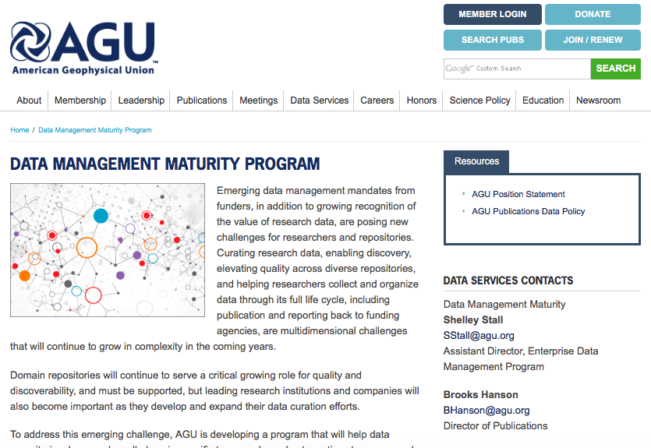
AGU Data Management Program:
http://dataservices.agu.org/dmm/

Slide 26
Contact Information:
Shelley Stall sstall@agu.org
AGU Data Management Program:
http://dataservices.agu.org/dmm/

