Slide 1
ESIP Summer Meeting – Frisco, CO – 07/08/14
Data Quality Session
Gilberto A. Vicente
NASA GES-DISC Science Data Manager – Code 610.2
Gilberto.A.Vicente@nasa.gov

Slide 2
Main Issue
We often hear that Data Quality Management is too complicated to deal with. Therefore we have been talking about it for years and did not come up with any simple and practical approach to address the problem on a scalable fashion. What the ESIP and its member organizations (NASA, NOAA, USGS, NSF, Universities, etc) can do to advance this cause?
Session Purpose
Describe the main problems related to Data Quality from the individual user to the data producer in the organizational level.
Discuss with the audience an efficient Data Quality Matrix Concept focused in the very essential and basic data quality features.

Slide 3
What the scope is:
To define a top down approach
To set the ground rules
To focus on how to present the information
To transfer data quality knowledge from the more expert to the less expert user
To ask what I can do to help the user community to understand my data
What the scope is not:
To discuss the merits of the ISO 19115 and ISO 19157
To talk about what is important to my own data set of interest
To focus on my personal interest on data quality issues

Slide 4
Agenda
11:00 - 11:10AM:
Introduction: The "Consumer Report" version of a the Data Quality Container,
Dr. Gilberto A. Vicente, NASA GES-DISC
11:10 - 11:25AM:
Product Quality and Documentation – Recent Developments
Dr. H. K. “Rama” Ramapriyan, NASA ESDIS
11:25 - 11:40AM:
NASA Perspective on Earth Science Data Quality
Steve Berrick, NASA ESDIS
11:40 - 11:55AM:
Assessing the Maturity of Climate Data Records
Dr. John J. Bates, NOAA/NESDIS – NCDC
11:55 - 12:30PM:
Discussion with the audience.

Slide 5
The "Consumer Report" version of a the Data Quality Container
Gilberto A. Vicente
NASA GES-DISC Science Data Manager – Code 610.2
Gilberto.A.Vicente@nasa.gov
ESIP Summer Meeting – Frisco, CO – 07/08/14

Slide 6
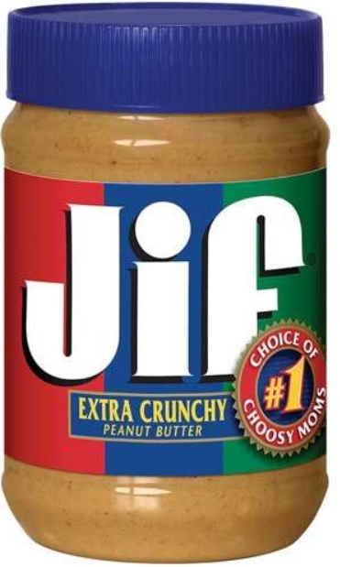
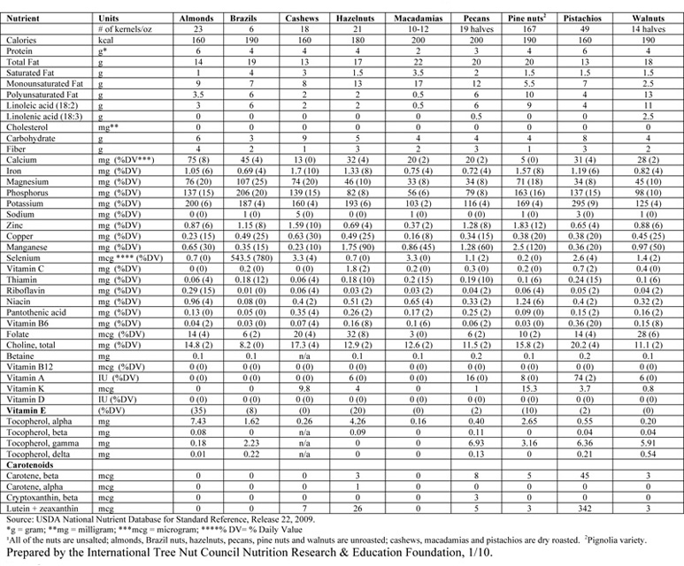
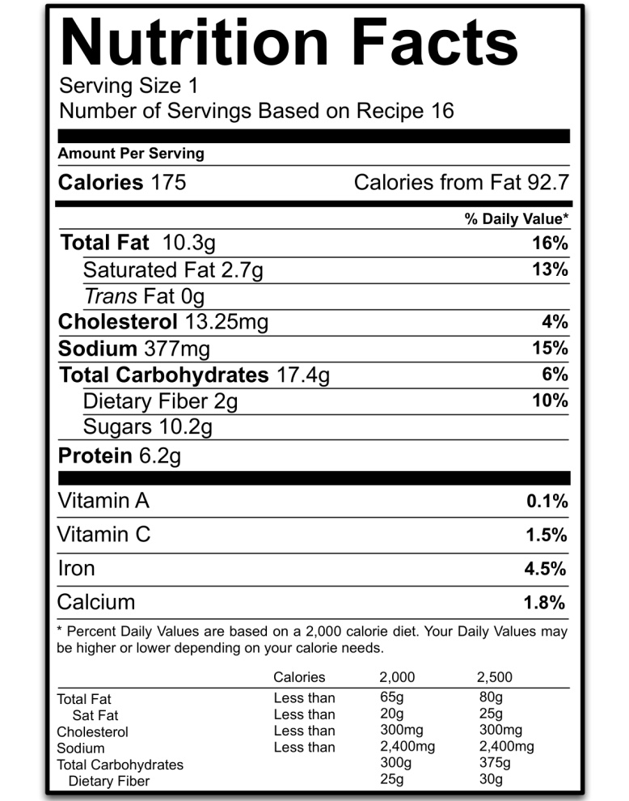
Data Quality – how to label (present) it?

Slide 7
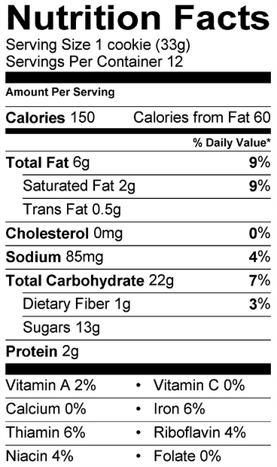
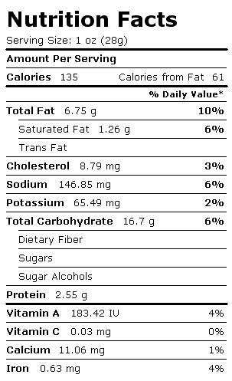
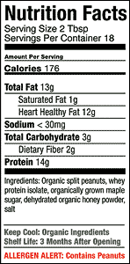
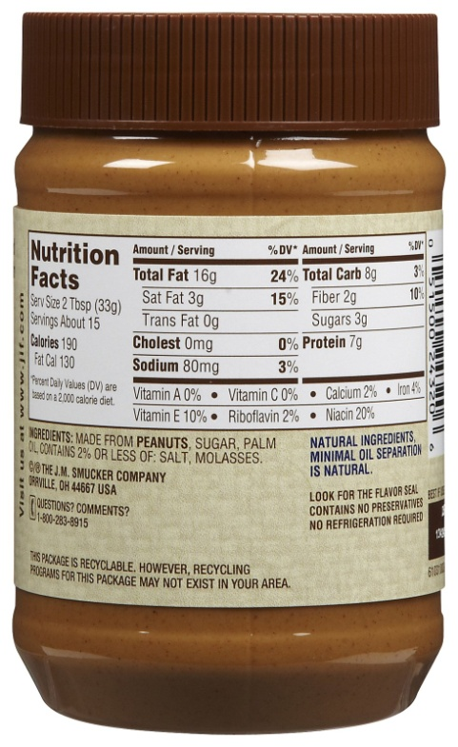
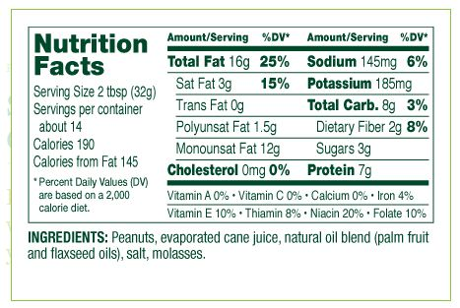
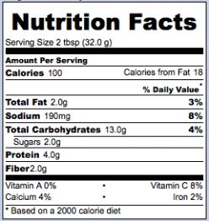
Uniformity, simplicity, to the point

Slide 8
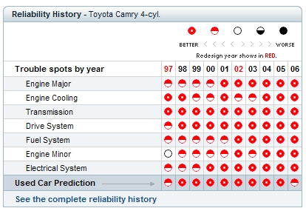
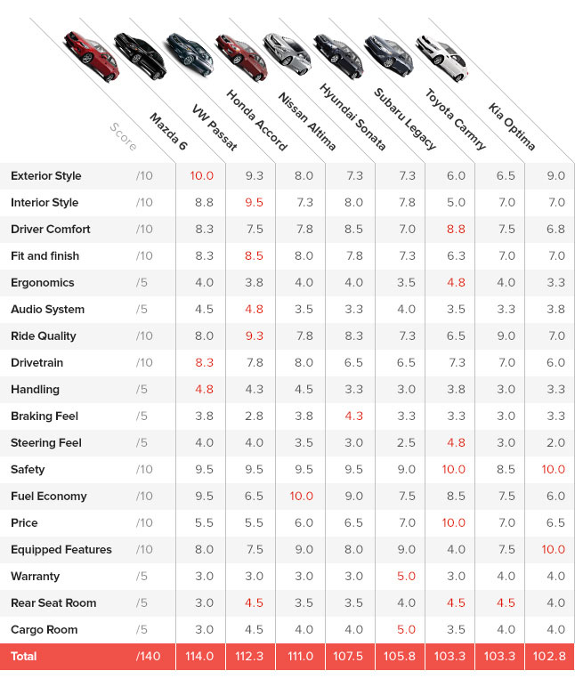
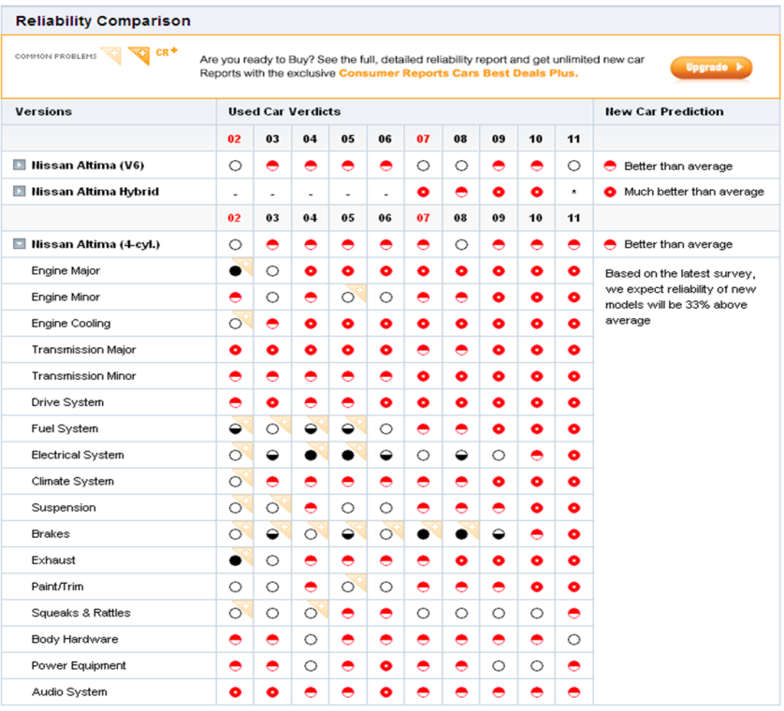
Comparison capability, friendly design

Slide 9
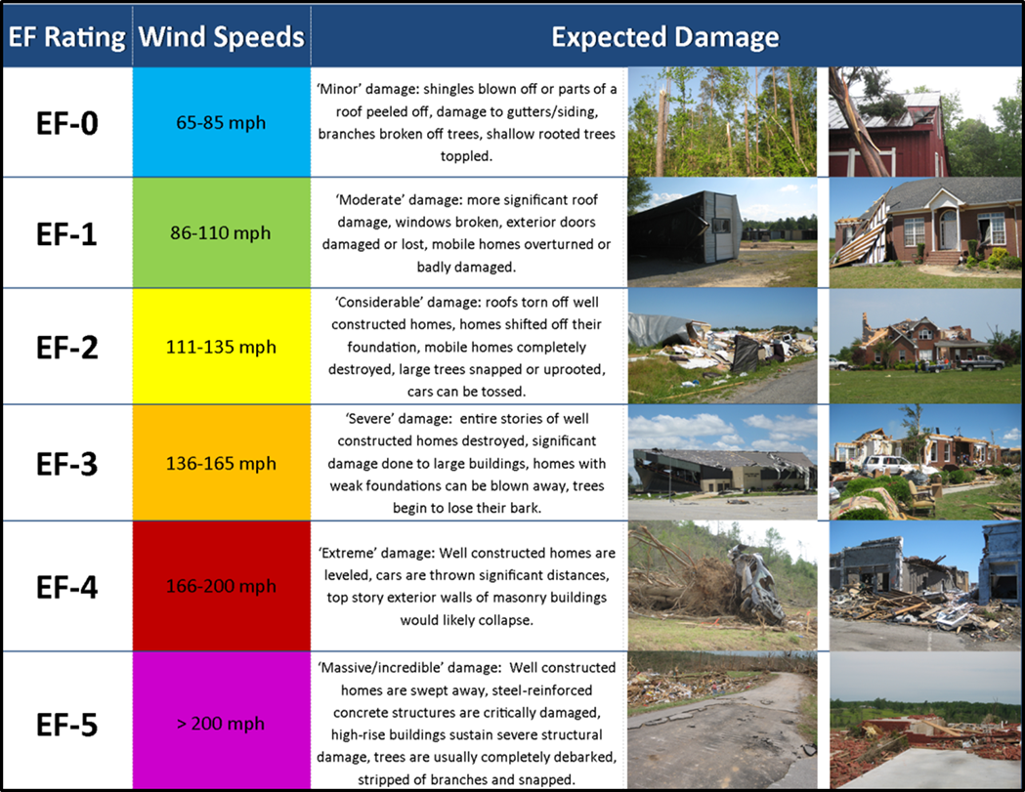
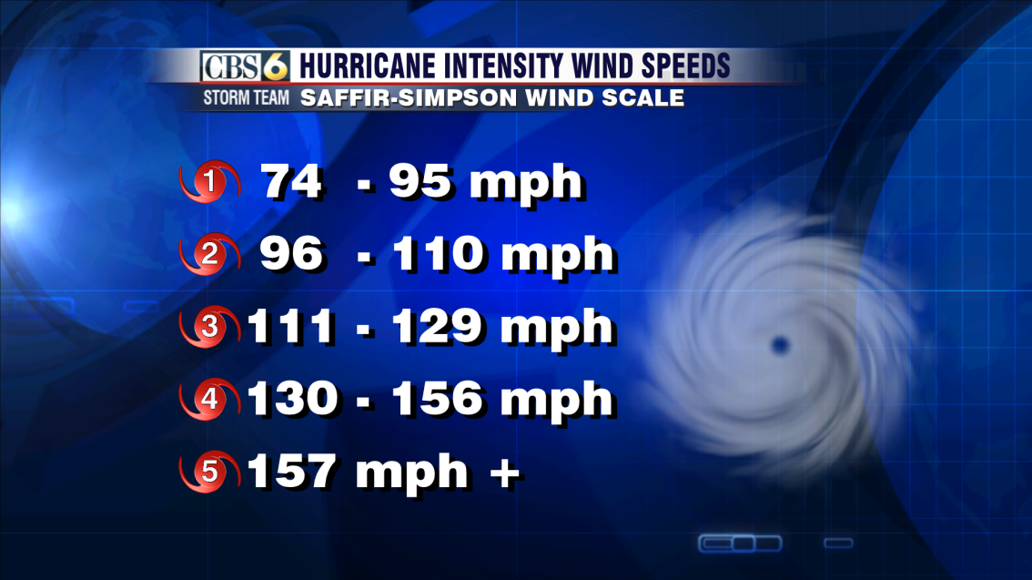
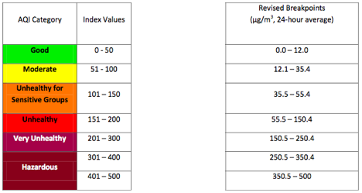
Focus in the most essential information
Tornado intensity: Fujita Scale
Hurricane intensity: Saffir-Simpson Scale
EPA PM2.5 Air Quality Index
Water Quality Bioindicator Index

Slide 10
User classification into interest groups
General public
K-12 Teachers
Undergraduates
Graduate students
Professors
Education / Public Outreach specialists
Production Centers
Internal Data Providers
External Data Providers
Science Team
Cal/Va
QA and Testing
Data Analyst
Data Tech
Computer Scientist
Domain Scientist
Interdisciplinary Scientist
Operational User
Discipline-specific Modeler
Assimilation modelers
Climate Modelers
Web Services
Decision Support Systems
Data Analysis and Visualization Systems
From Chris Lynnes presentation: 2014 ESIP Winter meeting

Slide 11
User groups common interest
From Chris Lynnes presentation: 2014 ESIP Winter meeting

Slide 12
Current system
proposed system
Quality
Properties
Different
Organization
Formats
Quality
Properties
One Standard
Organization
Format
Classified
User
Groups
Quality 1
Quality 1
USERS 1
Quality 2
Quality 2
Quality 3
Quality 3
USERS 2
Quality 4
TO ALL USERS
Quality 4
Quality 5
Quality 5
USERS 3
Quality 6
Quality 6
Quality 7
Quality 7
USERS 4
Quality 8
Quality 8
Quality 9
Quality 9

Slide 13
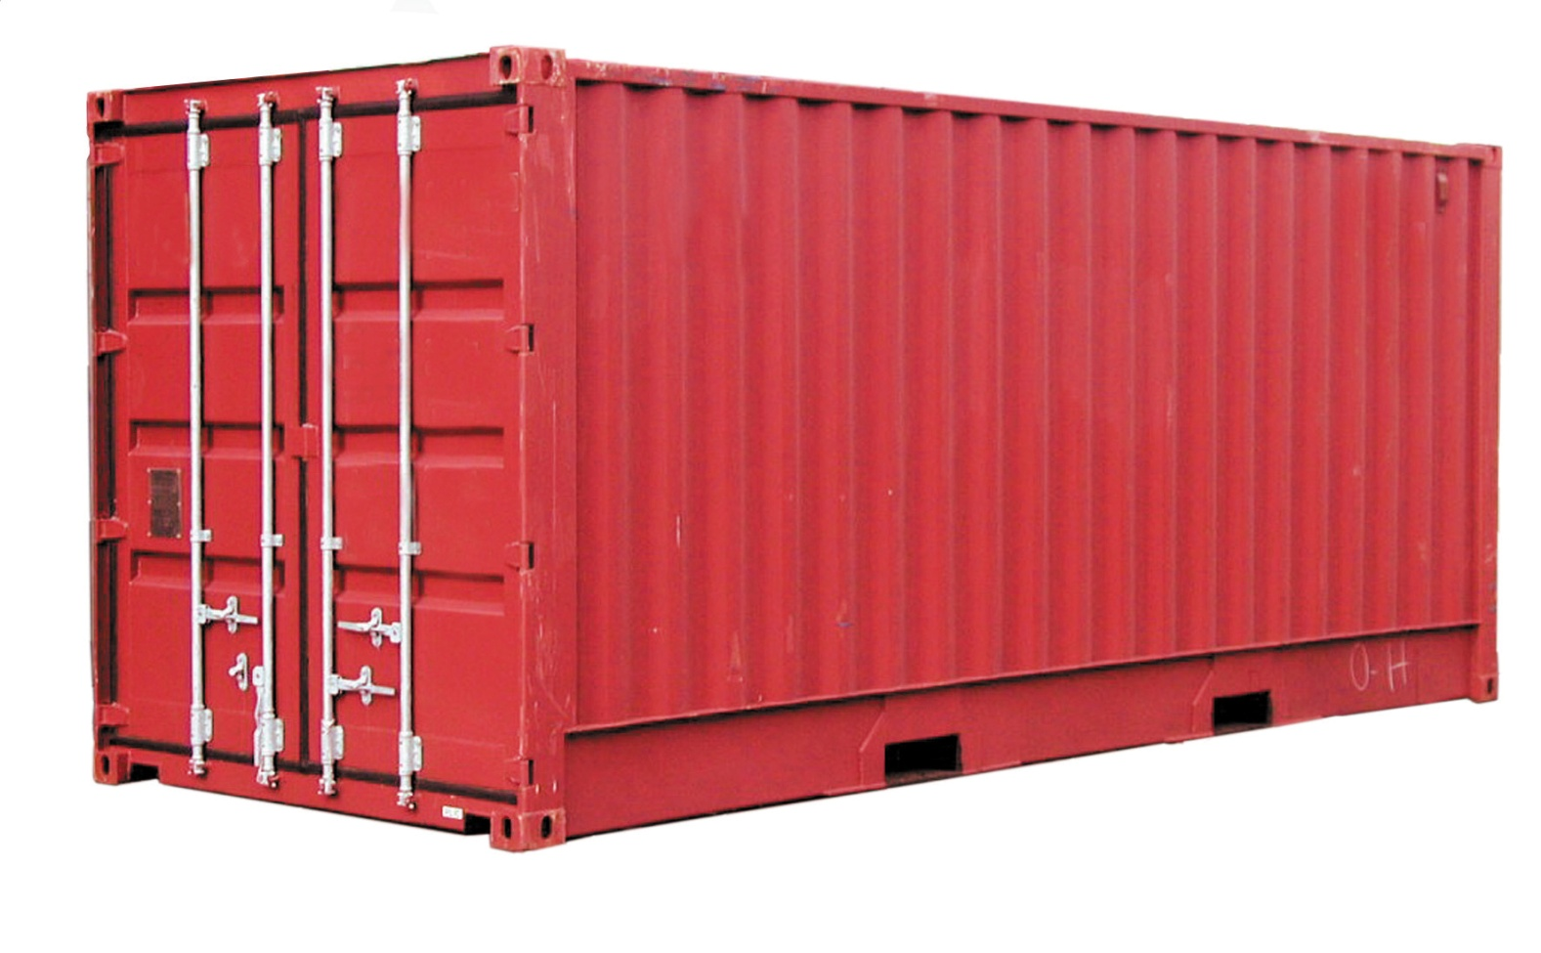
The containerization concept
TRANSPORTED PRODUCT
DIMENTIONS | OUTSIDE | INSIDE
Length | 20’ 0” | 19’ 4”
Width | 8’ 0” | 7’ 6”
Height | 8’ 0” | 7’ 1”
CARGO CAPACITY |  | 41,300 lb
EMPTY WEIGHT |  | 3,500 lb
EARTH SCIENCE DATA/PRODUCT
REQUIREMENTS | USERS | PRODUCERS
Coverage | Teacher | NASA
Resolution | Student | NOAA
Format | Public | USGS
… | … | …
The Data Quality Matrix

Slide 14
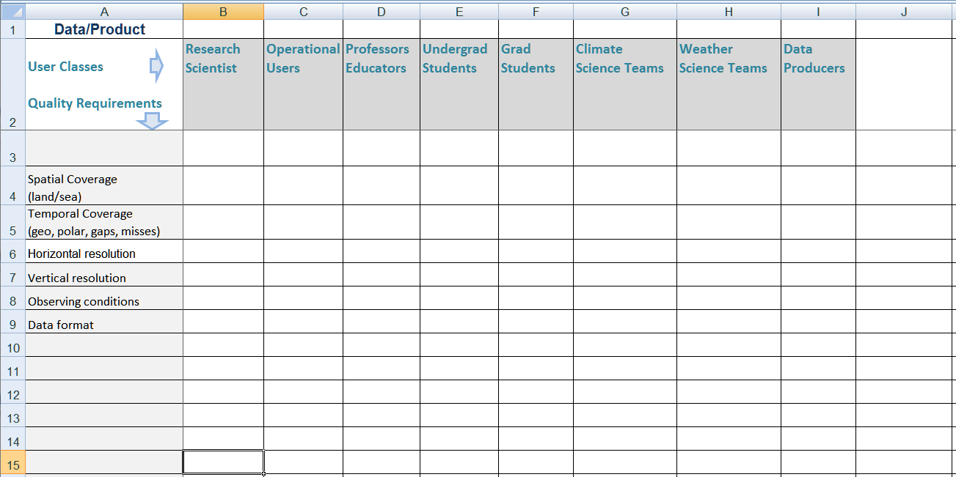
general data quality requirements
The consumer report approach
List of requirements
List of user classes
Rate the requirements for each user category

Slide 15
Backup slides

Slide 16
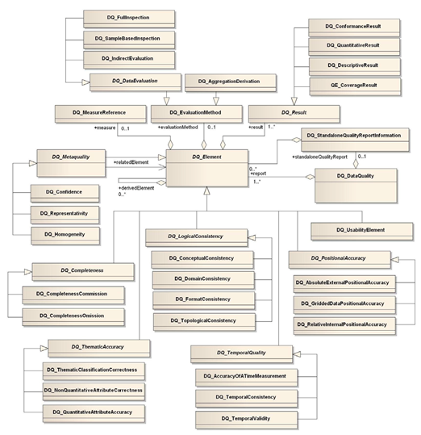
International Organization of Standards - ISO 19157
A unified conceptual model for the description of relevant data quality assessment parameters approved as an international standard.
Legacy of the ISO 19115
From Ted Habermann ESDSWG presentation

Slide 17
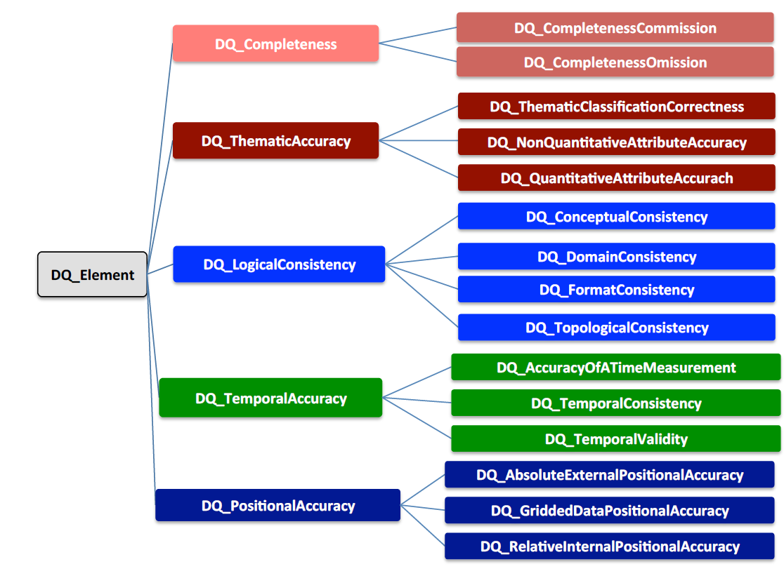
ISO 19157

Slide 18
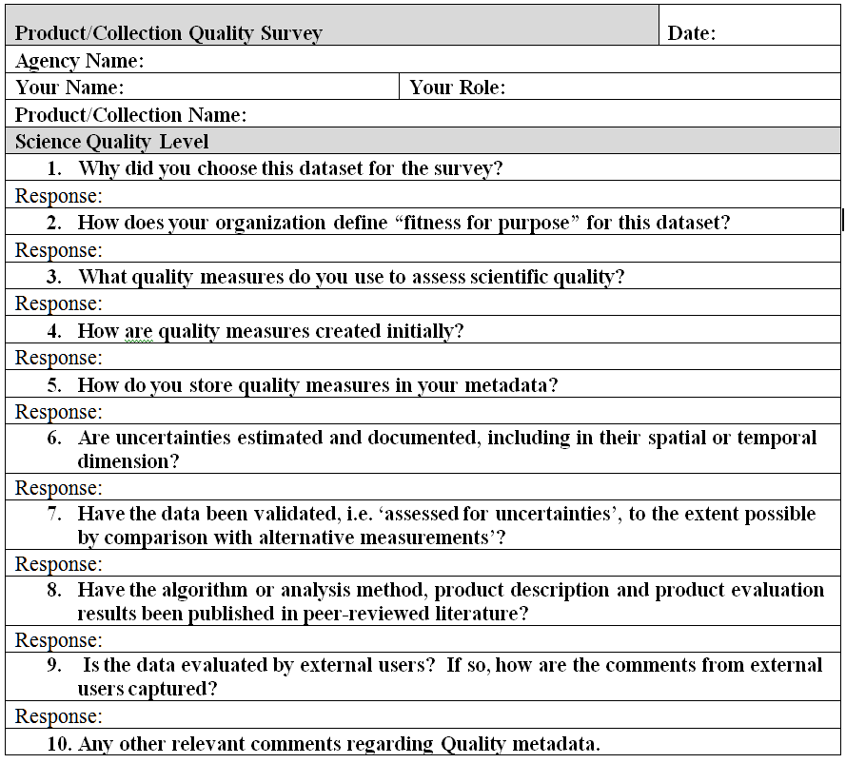
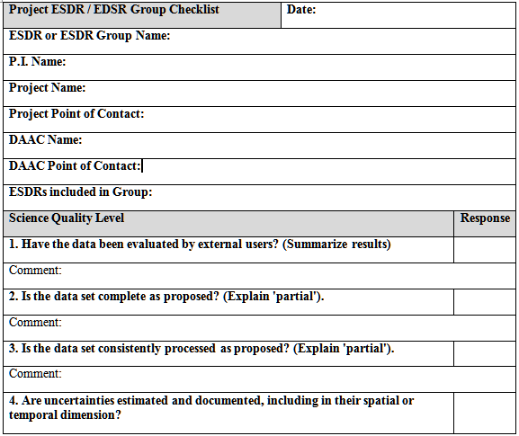
Data Quality Surveillance
CEOSS WGISS Metadata Quality Survey
MEaSUREs Product Quality Checklists

