Slide 1
Discovery Best Practices
ESIP Winter Meeting, 10:30am January 8, 2015
Doug Newman (NASA Earthdata – Raytheon)
This work was supported by NASA/GSFC under Raytheon Co. contract number NNG10HP02C.

Slide 2
Agenda
Presentation on where we are
Open discussion
Tell us what your discovery pain points are
Discuss how we can resolve them

Slide 3
Best practice goals
Application driven/friendly
Simple
Standards-based
Interoperable
Relevant
Community buy-in

Slide 4
Candidates
Earth Data Open Search
OGC Catalog Service for the Web (CSW)
(Schema.org)

Slide 5
Open search

Slide 6
Outline
HTTP + REST
Simple
Single query API
Keyword Value pair querying
ATOM results
Reduced metadata in results
HATEOS navigation
Baked in two-step searching

Slide 7
Best practice strengths
API covers > 93% of query needs according to ECHO metrics
Two-step searching is the burden of the API
ESIP/CWIC/CEOS best practices are dynamic
Adoption rate is very promising

Slide 8
Best practice weaknesses
No facility for controlled vocabulary constraints
Limited query palette has raised concerns about precision

Slide 9
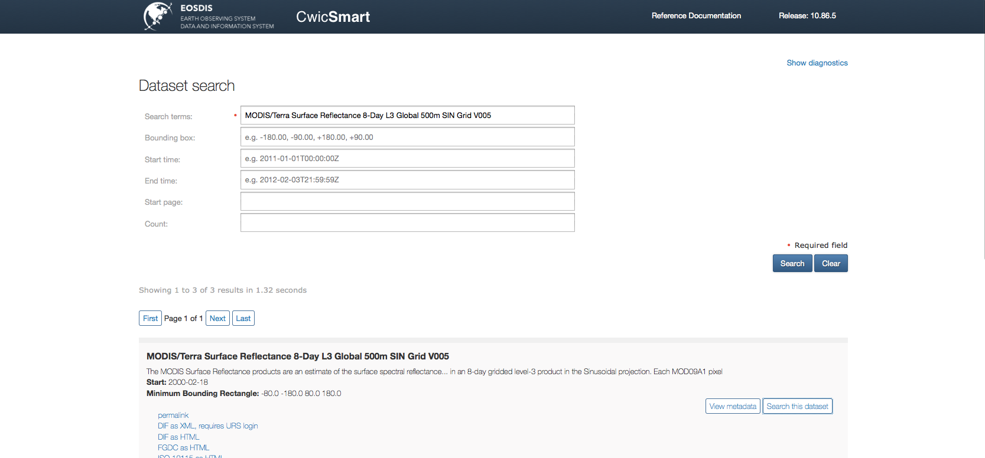
CWICSmart

Slide 10
Catalog service for the web (CSW)

Slide 11
Outline
HTTP + SOAP
GET, POST+form and POST+XML querying
XML results
Multiple query API
GetRecords
GetRecordsById

Slide 12
Best practice strengths
Relative maturity
High precision through complex queries
Controlled vocabulary support

Slide 13
Best practice weaknesses
Two-step is the burden of the client
OGC augmentation process is extremely slow and cumbersome
Complex
Client developers HATE SOAP

Slide 14
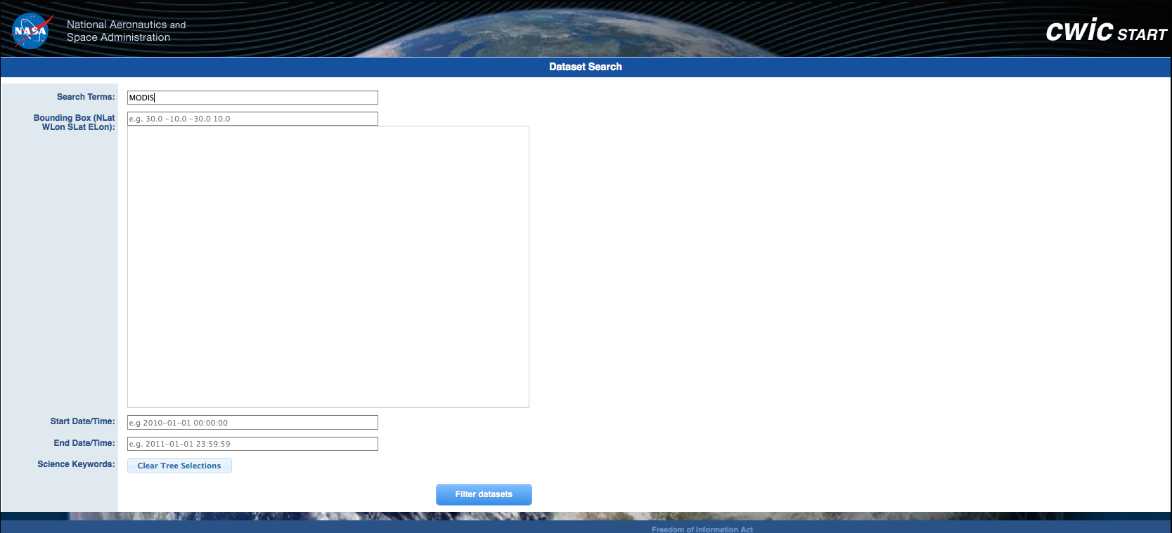
CWICStart

Slide 15
Schema.org

Slide 16
Google!
HTML views of your OpenSearch/CSW output can be marked up with schema.org tags to give you searchable pages.

Slide 17
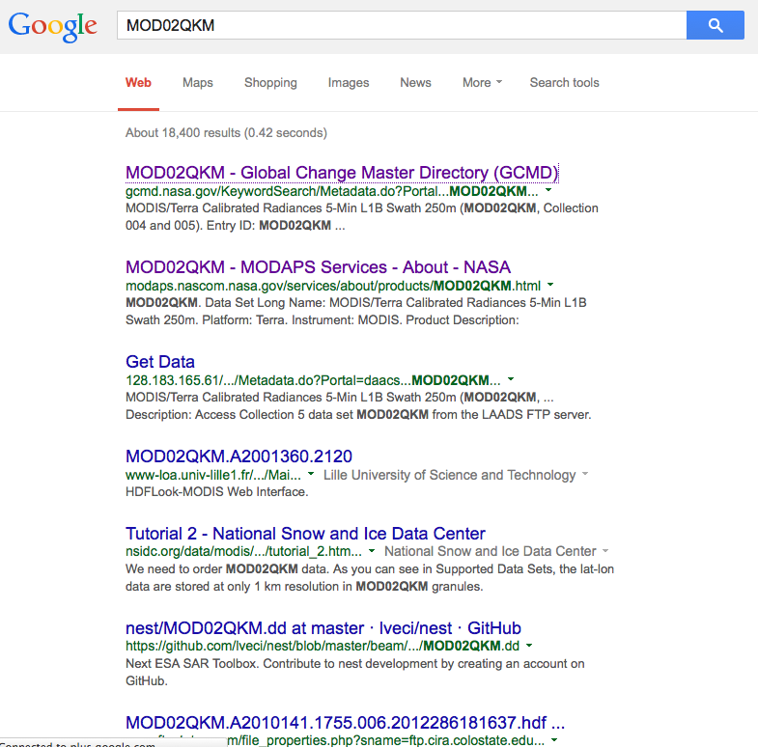
Example

Slide 18
Under the hood
<div itemscope="itemscope" itemtype="http://schema.org/Dataset" itemid="http://gcmd.nasa.gov/learn/datasets.html">
<span itemprop="Dataset">MODIS/Terra Calibrated Radiances 5-Min L1B Swath 250m (MOD02QKM, Collection 004 and 005)</span>
<span itemprop="name”>MOD02QKM</span>
</div>

Slide 19
Current issues
Are the main players indexing based on this markup?
Are they presenting this structured information to the user?

Slide 20
Where does it hurt?
Notes:
Facetted search
Relevancy heuristics

