Slide 1
Connecting Data to Information for Decision-makers
Dr. Ann Bartuska
USDA Research, Education and Economics
January 8, 2013
ESIP Federation Winter Meeting

Slide 2
What I’ll be covering
The Context – global challenges
Forest Service’s RPA Assessment – information managers can use
Creating practical research networks - LTAR
Data to information – Digital Data Commons
Going global for information - Global Agricultural R&D Strategic Platforms
Notes:
The Context – challenges we are facing where quality information is needed to make effective policy decisions – “evidence based”
The RPA Assessment – you heard about the NCA process. The FS’s RPA process has been institutionalized. It is built on on-going research and analysis, and looks out 50 years. It provides information scaled to be locally relevant
Another approach is creating integrated networks of research that builds fundamental understanding of key processes, leading to better decision-making…LTAR and EF&R’s
The Digital Data commons – better utilizing existing data bases to address issues related to sustainability. [The dairy example and carbon footprint]
Finally – going global. The G20 and the Global Agric R&D Strategic Platforms --Stay Tuned

Slide 3
The challenge: meeting the food, water, and energy needs of the future

Slide 4
Situational Analysis
9 billion people by 2050
25% of all land “highly degraded”
60-75% of disease outbreaks from animals to humans
By 2025, 1.8 billion potentially living with absolute water scarcity
Uncertainty brought by climate change

Slide 5
The RPA Assessment
The Forest and Rangeland Renewable Resources Planning Act of 1974 mandates a national report (RPA Assessment) on the conditions and trends of renewable resources every ten years on all forest and rangelands.
The RPA Assessment provides a snapshot of current U.S. forest and rangeland conditions and trends; identifies drivers of change; and projects 50 years into the future (2010-2060).
The Assessment includes analyses of outdoor recreation, fish and wildlife, wilderness, forests, water, range, urban forests, and the potential effects of climate change on these resources.
Notes:
What is RPA – legislative direction for long term – FS decided on 50 years
We also focus on the resources found on forest and rangeland.

Slide 6
2010 RPA Scenarios
Characteristic | Scenario RPA A1B | Scenario RPA A2 | Scenario RPA B2 | Scenario RPA HFW
Linked to International Context through IPCC scenarios
Global Real GDP Growth (2010-2060) | High (6.2X) | Low (3.2X) | Medium (3.5X) | High (6.2X)
Global Population Growth (2010-2060) | Medium (1.3X) | High (1.7X) | Medium (1.4X) | Medium (1.3X)
Global Expansion of Primary Biomass Energy Production | High | Medium | Medium | Fuelwood demand follows historical trends in all countries
U.S. national projections scaled to county
U.S. GDP Growth (2006-2060) | Medium (3.3X) | Low (2.6X) | Low (2.2X) | High (3.3X)
U.S. Population Growth (2006-2060) | Medium (1.5X) | High (1.7X) | Low (1.3X) | Medium (1.5X)
Expansion of U.S. Wood Fuel Feedstock (2006-2060) | High (15.7X) | Medium (9.4X) | Low (3.7X) | Historical (1.6X)
Notes:
National projections - linked to IPCC, but updated for GDP and population based on more recent US data.
National projections were scaled to the county level for population, income, and climate.
On the driving forces,
US economic growth, like all developed countries, is slower than global average
US population continues to grow, difference from most other developed countries
Numbers in parentheses are factors of change over the projection period.
RPA HFW scenario was developed in response to peer review comments – generally has the characteristics of A1B, only analyzed for forest resources and forest product sector.

Slide 7
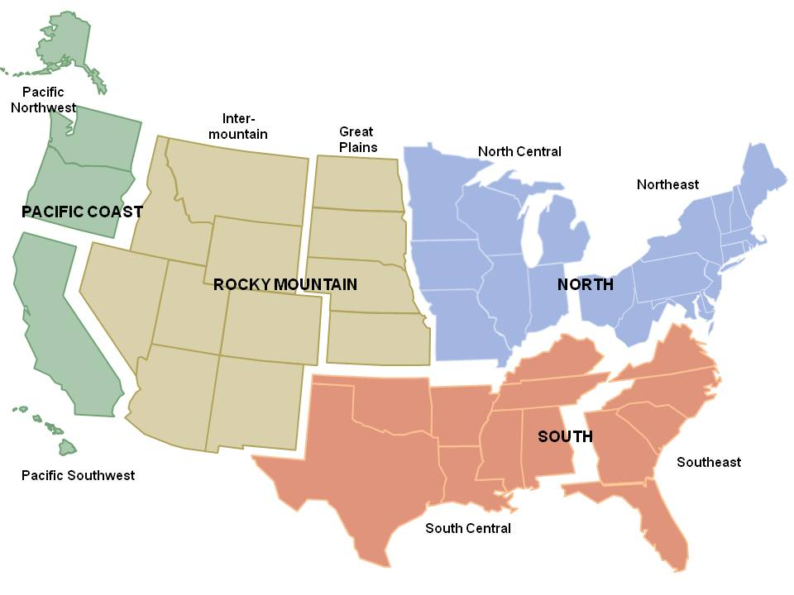
RPA Assessment Regions
Notes:
While the RPA focus is national, we typically report results at RPA region or sub-region.
For some resources, other regional designations are used – most notably for water, which uses ASRs, a subset of WRRs.
Use EPA regions for some water quality reporting.

Slide 8
2010 RPA Assessment: Key Themes
Land development will continue to threaten the integrity of natural ecosystems.
Climate change will alter natural ecosystems and affect their ability to provide goods and services.
Competition for goods and services from natural ecosystems will increase.
Geographic variation in resource responses to drivers of change will require regional and local strategies to address resource management issues.
Notes:
While other briefings this week focus on particular resource areas, we also tried to synthesize the findings by common themes across resources areas. I’ll be using the themes to describe the findings.
The four main themes…. ANALYSES ASSUME NO POLICY CHANGE

Slide 9
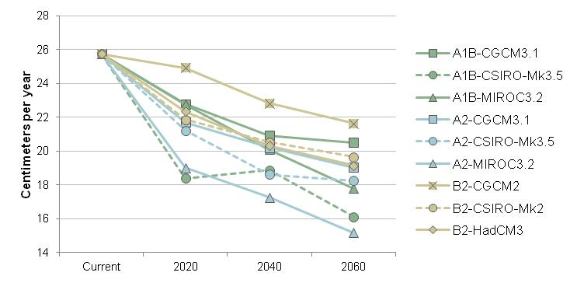
Key Theme: Climate Change
Water yield declines across all RPA scenario-climate combinations.
Current and projected yield for the conterminous United States for nine RPA scenario-climate combinations
Notes:
Future water availability will depend most importantly on water use trends in the agricultural sector.
Water yield is the sum of surface and sub-surface runoff, estimated as precipitation minus evapotranspiration.

Slide 10
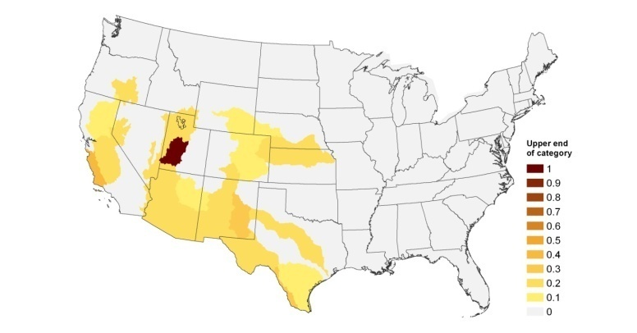
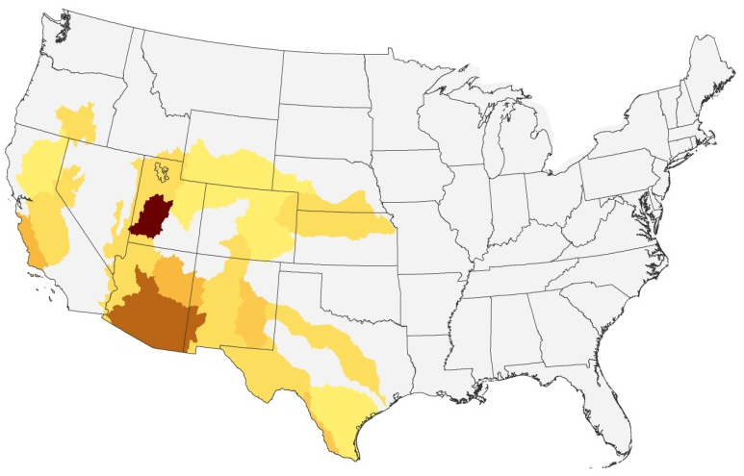
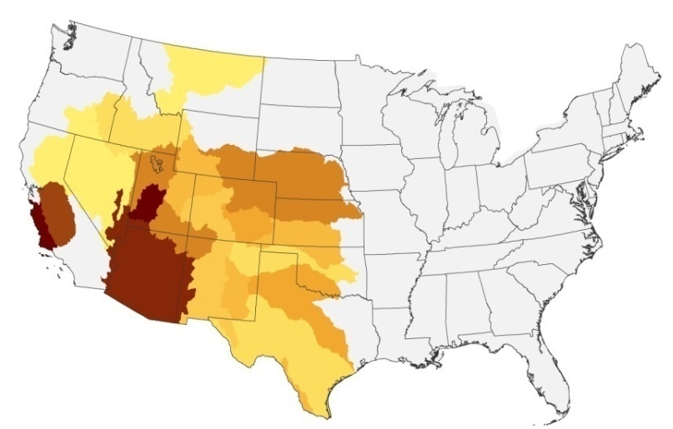
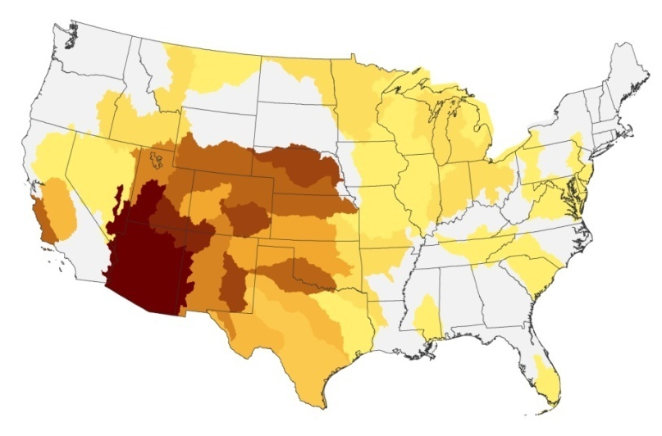
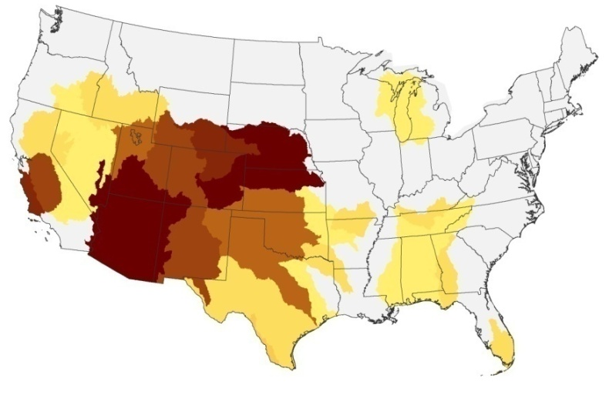
Key Theme: Climate Change
Current
2060, RPA A2-CGCM3.1
2060, RPA A2-CSIRO-Mk3.5
2060, RPA A2-MIROC3.2
Probability of annual water shortage
The vulnerability of the U.S. water supply will increase, especially in the Southwest and Great Plains.
Notes:
Vulnerability of water supply –defined as the probability of annual water shortage- for the A2 scenario using three different GCMs. A2 has the highest population growth, which tends to have the greatest increases in water demand. Show similar patterns, but the climate models vary in the degree of change in temp and precip. MIROC tends to be the driest, but not for all parts of the US.
General conclusion – there are going to be problems if we don’t adapt, and we have to adapt in the face of considerable uncertainty about when and where the changes will occur.

Slide 11
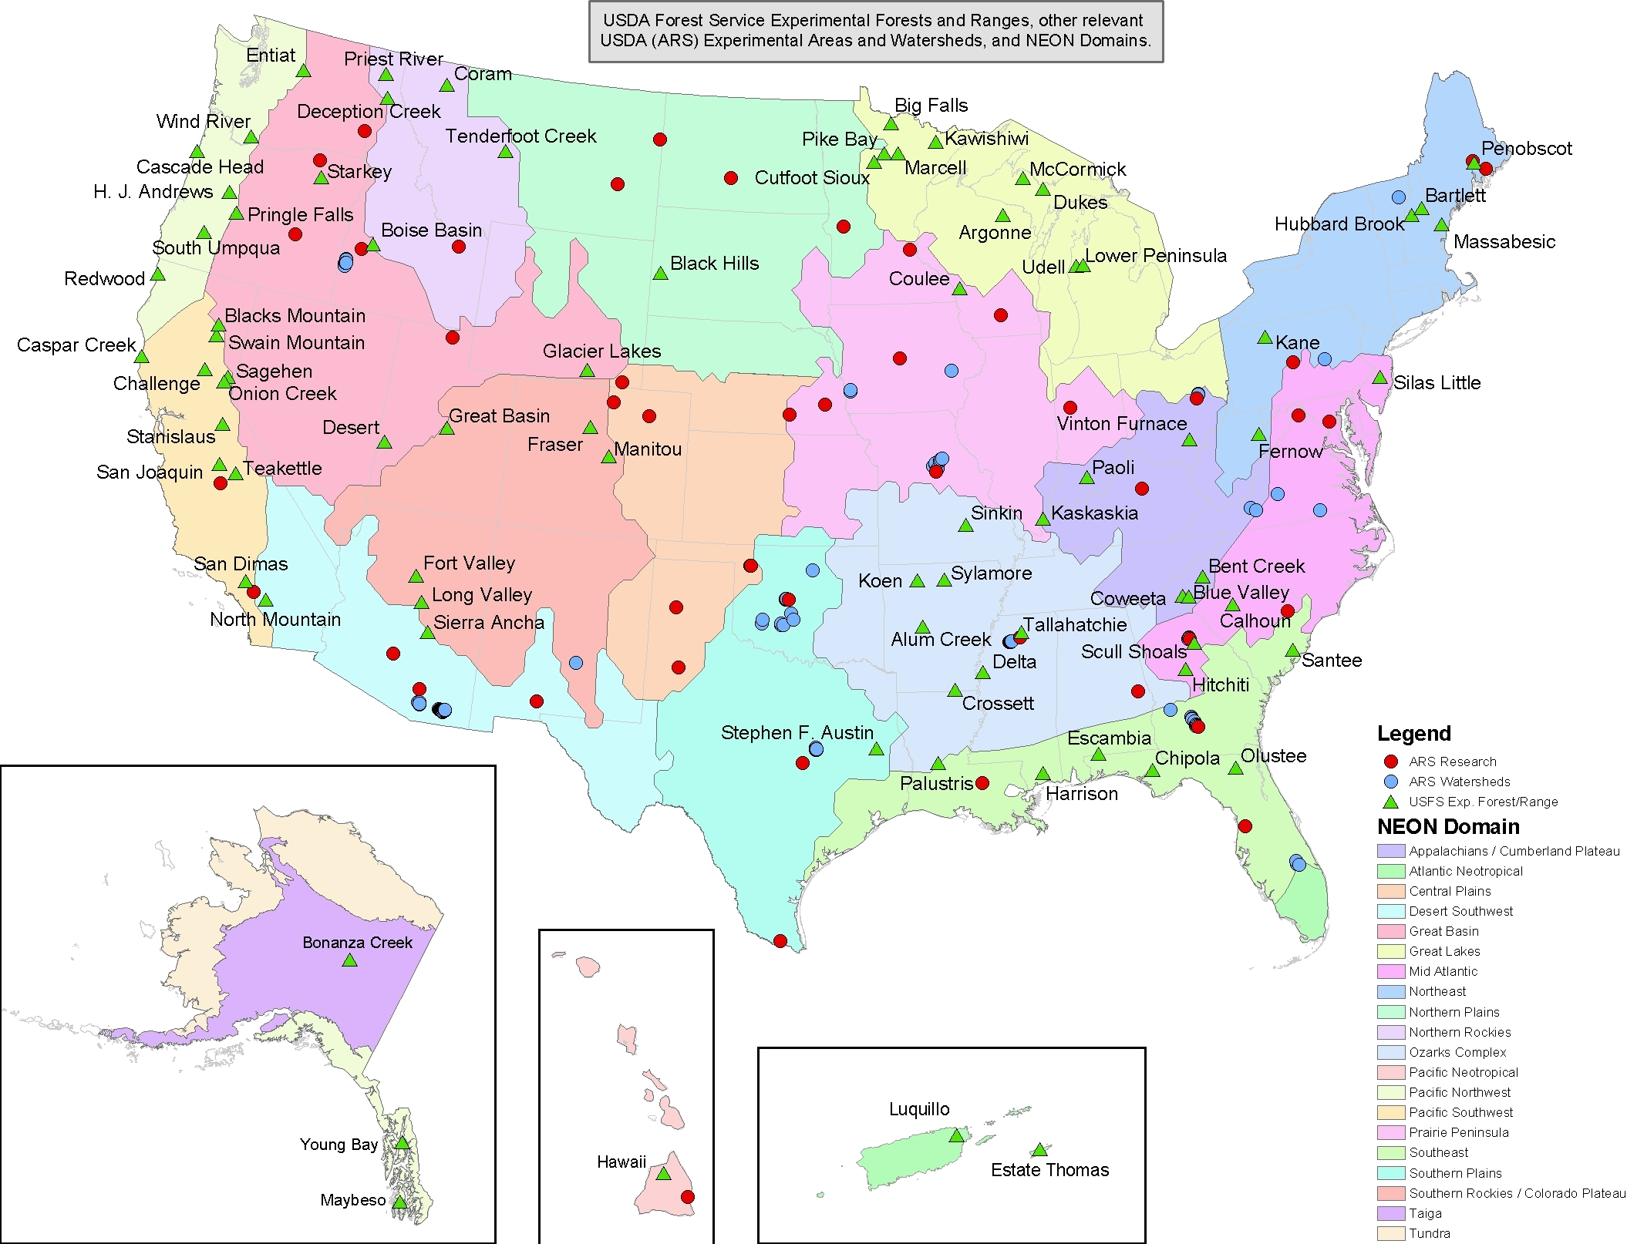

Slide 12
Vision and Goals for an LTAR Network
Goal
To sustain a land-based infrastructure for research, environmental management testing, and education that enables understanding and forecasting of the Nation’s capacity to provide agricultural commodities and other ecosystem goods and services under changing environmental and resource-use conditions.
Vision
Trans-disciplinary science conducted over decades on the land in different regions, geographically scalable, enhancing the sustainability of agro-ecosystems goods and services.

Slide 13
Criteria for LTAR Network Sites
Productivity – track record; level of existing understanding.
Infrastructure Capacity – an instrumented watershed or other long-term research facility large enough to capture landscape-scale processes, heterogeneity, and to integrate across small plot, watershed, and landscape scales.
Data Richness – The length, breadth, depth, and overall quality of the existing data record.
Data Availability/Accessibility -- the state of organization and accessibility of existing data sets.
Geographic Coverage at Various Scales – How a site fits within the overall network, and/or complements other potential network sites in terms of major US agro-ecosystems, the 21 HUC-2 watersheds in the lower 48 states, the 20 NEON Domains, etc.
Partnerships – The strength of existing external partnerships with producers, other stakeholders, universities, etc., including the potential for education and outreach.
Institutional Commitment – to support the continued operation of the site for the next 30-50 years

Slide 14
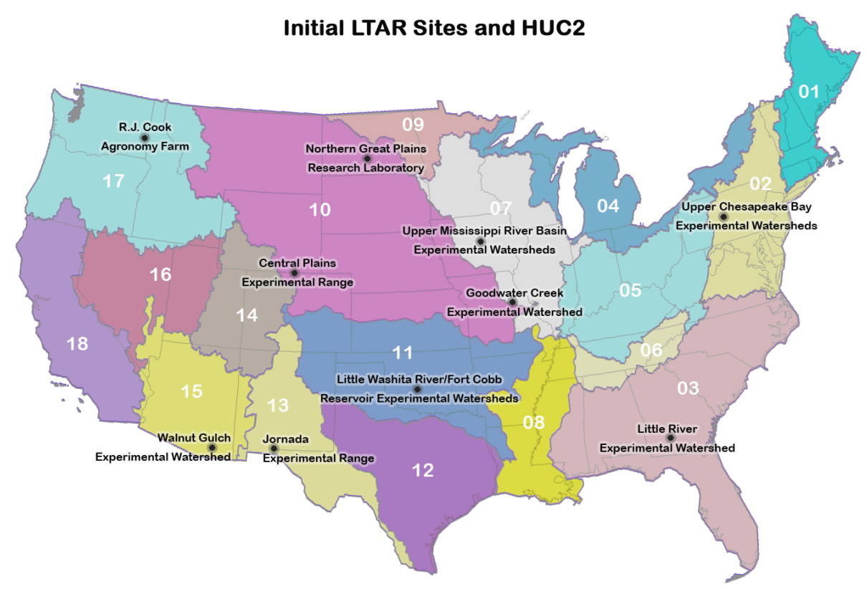

Slide 15
USDA’s LCA Digital Commons
Provide transparent & high quality information
Promote open access to LCA data
Maximize return on sustainability research investments
Reuse sustainability datasets
Preserve sustainability datasets
Avoid duplication efforts
Speed up sustainability research
Integrated view
Intelligent tools
Notes:
Read from slide
Objectives of the LCA Digital Commons:
Provide transparent & high quality information
Promote open access to LCA data
Maximize return on sustainability research investments
Reuse sustainability datasets
Preserve sustainability datasets
Avoid duplication efforts
Speed up sustainability research
Integrated view
Intelligent tools

Slide 16
LCA Provides Information For Making Smarter Choices
U. of Arkansas study estimates that in 2007/8:
The average gallon of U.S. fluid milk contributed 17.6 lbs of GHG emissions
Production was the largest source
Packaging the smallest
Notes:
As a first step toward it’s commitment of reducing GHG emissions of fluid milk by 25% by 2020, the Innovation Center for US Dairy, representing 80% of the US industry, commissioned a life cycle assessment of GHG for fluid milk. The study, conducted by Thoma et al at the University of Arkansas found that the average gallon of U.S. fluid milk contributed 17.6 lbs of CO2 equivalent emissions in 2007-8. This chart shows the breakdown of where those emissions occurred along the supply chain. You can see that milk production was the largest source and packaging the smallest.
Value of the exercise:
It was an important step because it provides a baseline for which the industry can measure future progress.
Provides evidence showing that management practices matter: and that it really comes down to how a given farm manages its natural resources, the cow’s diet and its manure.
This study also helps in accurately describing the dairy industry’s carbon footprint. These results suggest that U.S. dairy is only responsible for 2% of total emissions in the U.S. -- less than that on a global scale (as contrasted with the 2006 FAO estimate that global livestock are responsible for 18% of global GHG emissions).
Image caption: Greenhouse Gas Emissions for U.S. Fluid Milk: Contributions by Supply Chain
Total CO2 equivalent emissions of fluid milk = 17.6 lbs. per gallon of milk.
Thoma et. al. (2010) “Greenhouse Gas Emissions of Fluid Milk in the U.S.”, University of Arkansas

Slide 17
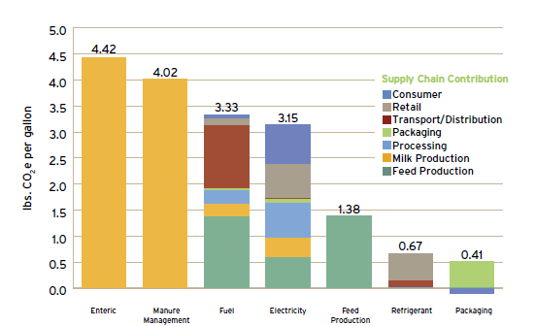
Manure Management Is A Key
Notes:
This slide is taken verbatim from the Innovation Center’s slide presentation on US Dairy Sustainability Commitment and represents a report on their lessons learned. Full talking points for this chart are available with the original presentation. I would like to focus attention on Manure Management – it is a significant contributor to GHG emissions and represents a target to work from.

Slide 18
USDA’s Digital Commons for LCA data
The USDA LCA Digital Commons is
An open-access, inventory of peer-reviewed, formatted, US LCA data
USDA’s contribution to the collection, organization, management, dissemination, and preservation of LCA data for current and future public and private decision-making and research
Notes:
Read from slide
The USDA LCA Digital Commons is
An open-access, inventory of peer-reviewed, formatted, US LCA data
USDA’s contribution to the collection, organization, management, dissemination, and preservation of LCA data for current and future public and private decision-making and research
Data in the LCA Digital Commons has practical management application. For example, the Dairy GHG Emissions study identified manure management as a significant source of GHG emissions. The staff of the Innovation Center can go to the Commons and find data on manure management practices by state over several years. Trend information will inform the Innovation Center staff as to possible outreach, education, and training needs to promote best management practices – AND where this information is most needed.
Our data can help to make a difference.

Slide 19
Digital Commons Built on Extensive Data
Key data sources
USDA data sources
ARS Integrated Farm System Model (IFSM)
ERS Agricultural Resource Management Survey (ARMS)
ERS Fertilizer Imports/Exports
ERS Fertilizer Use and Price Summaries
NASS Agricultural Chemical Use Database
NASS Farm and Ranch Irrigation Survey (FRIS)
NASS Quick Stats
NASS Usual Planting and Harvesting Dates for U.S. Field Crops
NRCS Crop Nutrient Database
OCE Agriculture and Forestry Greenhouse Gas Inventory
Other US government data sources
USDOE EERE Biomass Feedstock Composition and Property Data
USDOE-Argonne Greenhouse Gases, Regulated Emissions, and Energy Use in Transportation Model (GREET)
USEPA Emissions & Generation Resource Integrated Database
USEPA NONROAD Model (nonroad engines, equip, and vehicles)
USEPA Tool for the Reduction and Assessment of Chemical and Other Environmental Impacts (TRACI)
USEPA US Greenhouse Gas Inventory
USGS Minerals Yearbooks
NOAA Satellite and Information Services
NRC Tables of Feed Composition
Other data sources
ASABE (American Society of Agricultural and Biological Engineers)
CDPR (California Department of Pesticide Regulation) Inerts Dataset
FAO CROPWAT and CLIMWAT
IPCC (Intergovernmental Panel on Climate Change) Emission Factor
UNEP-SETAC UseTox
and a wealth of project reports and archival journal articles
NAL Digital Commons Data
Products and co-products
Crop production
Co-production of corn silage, cotton seed, crop residues
Flows from nature and related impacts
Land use
Water withdrawal
Nutrient uptake (C, N, P, K, and water in crops and co-products)
Flows from other unit processes
Field residue burning and management
Soil preparation
Planting or sowing
Seed use
Irrigation
Fertilizer application
Secondary applications (limestone, dolomite, gypsum, sulfur, zinc, sewage sludge)
Manure application
Pesticide application
Harvest of crops and co-products
Industrial drying, cleaning, and sorting
Flows to nature and related impacts
Residue burning emissions
Residue left on the field
Releases from fertilizers, manures, secondary applications, and pesticides
Notes:
Above all, the LCA digital commons is a huge data management project. I don’t expect you to be able to read this slide, just wanted to impress upon you the extensive amount of data—much of it data collected by the US government -- that goes into an LCA – and that will be housed and organized at the digital commons.

Slide 20
LCA Digital Commons Network
Software Development Partners
Commercial tools (SimaPro, GaBi, ..)
CIRAIG
System Interoperability
U. of Washington
U. of Arkansas
U. Wisconsin
Duke U.
LCA Digital Commons
Innovation Center for US Dairy
United Soybean Board
Cotton Inc.
American Center for LCA
Academic Partners
Industry Partners
US Federal Partners
Notes:
To make this effort possible, the Digital Commons has had input and consultation from a number of sectors:
From Software sector:
Earthster - collaborated in the development of data visualization tools
OpenLCA – GreenDeltaTC created OpenLCA Framework as an open source LCA database and analysis tool. The LCA Digital Commons is built on the database backbone of OpenLCA Framework, we are also using the tool to compile life cycle inventories for selected processes. (We are further collaborating with the GreenDeltaTC team in upgrading the capacity of OpenLCA Framework.)
System interoperability
EC and others – set standards; created databases and other tools with which the LCA Digital Commons seeks to be compatible and interoperable with.
Ecoinvent is the gold standard having the most complete and robust data at this time. They are also the authors of a major data format standard EcoSpold, used in the LCA Digital Commons.
Academic:
Dr. Joyce Cooper and her team at the University of Washington are transforming the USDA data into LCA compatible formats.
Industry:
Innovation Center for US Dairy – will be the first industry partner to submit full data used in the development of their greenhouse gas emissions study for fluid milk.
A number of other industry groups, including the United Soybean Board and Cotton Inc, have expressed interest in working with the Digital Commons to publish their data.
US Federal
A number of US government departments are contributing data and expertise to the project, most notably, EPA and DOE.

Slide 21
USDA LCA Digital Commons contains
Tier 1 data on U.S. commodity crop production
Over 500 assessments of nine major crops:
Corn (138 datasets)
Cotton (93 datasets)
Oats (13 datasets)
Peanuts (11 datasets)
Rice (7 datasets)
Soybeans (144 datasets)
3 Kinds of Wheat (169 datasets)
Datasets are growing …
Notes:
Digital commons currently contains environmental data/physical input/output data on first tier of commodity production for nine major crops
As you can see, for most of these crops numerous assessments for different locations for different years -- for example, soybeans has 144 assessments for different locations at different times.
We expect the LCA Digital Commons will be able to accept data submissions by the end of 2012 (calendar year) or early in 2013.

Slide 22
Six Strategic Platforms
Open Access to Scholarly Publications
Open Access to Germplasm Collections
Open Access to Genetic and Genomic Data
Accelerated Technology Transfer
Improved Statistics
Assembling Chief Scientists of R&D

