Slide 1
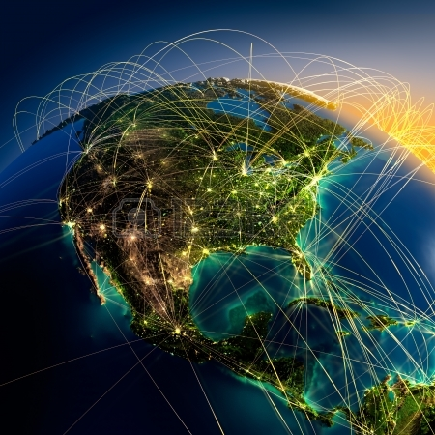

Drone Cluster:
Lindsay Barbieri
Jane Wyngaard

Slide 2
Presentations (40 minutes): Drone Use Case Studies and Resource Catalog Overview:
Sean: Project Overview & Background
Bar & Jane: Project Overview → Campaign One & SSEDD
Max: (Re)introduction & Project Overview
ESIP Drone Cluster Updates (20 minutes) : Intro to ESIP Drone Cluster & OSF
Updates - Jane and Bar
Resource Catalog - Kush: Resource Catalog Overview
Informal Drone Data Panel Discussion (30 minutes):
Data/Metadata Framing: Jane summarizes
Discussion:
  Data Data/Metadata Standards
  Community Resources Discussion
  Projects / Next Steps
Overview

Slide 4
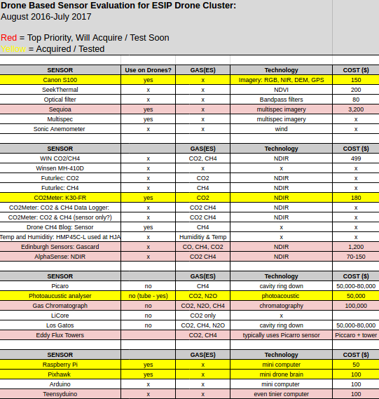
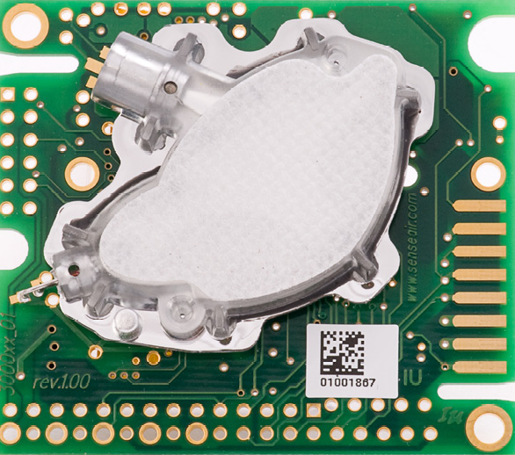
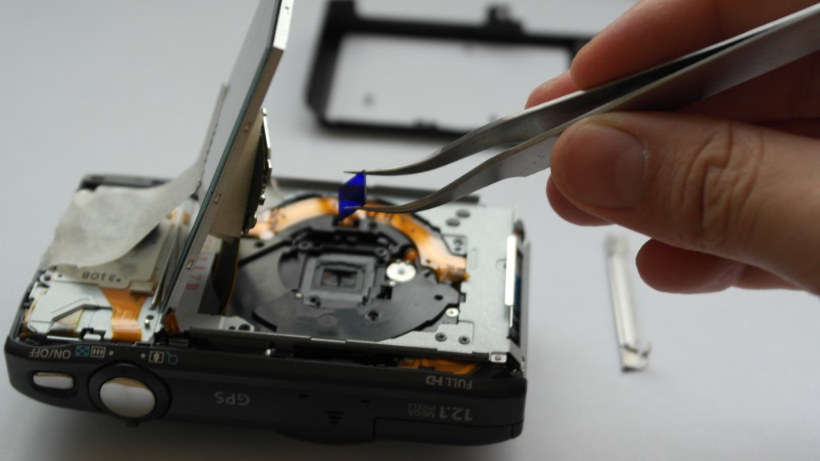
Campaign1: https://osf.io/nuvem/
K-30 CO2Meter
Canon S100 + Optical Filter for NIR

Slide 5
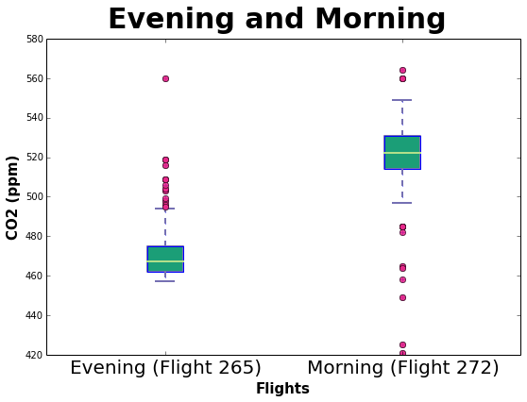
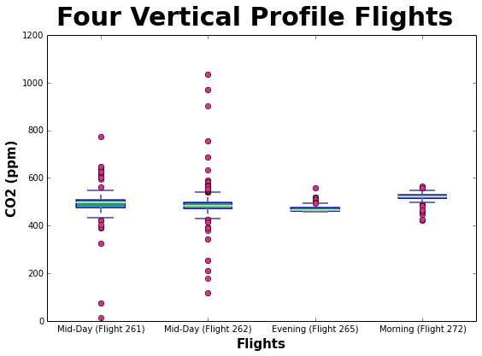
Campaign1: https://osf.io/nuvem/

Slide 6
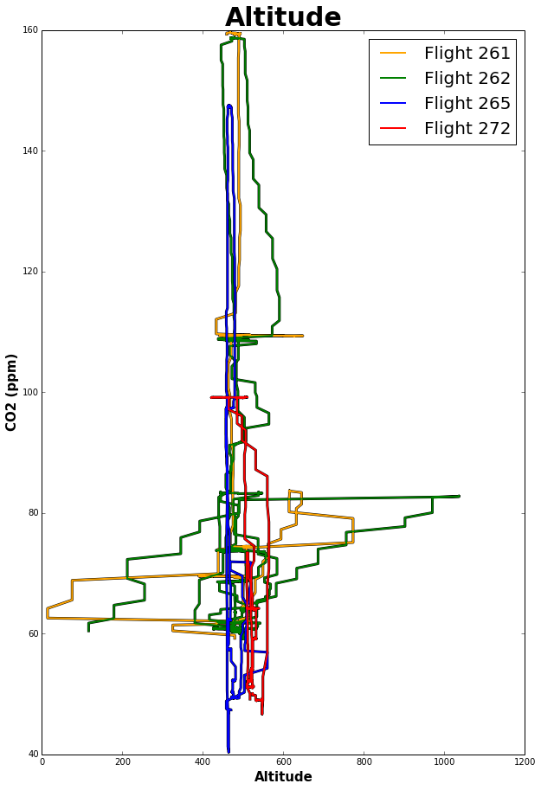
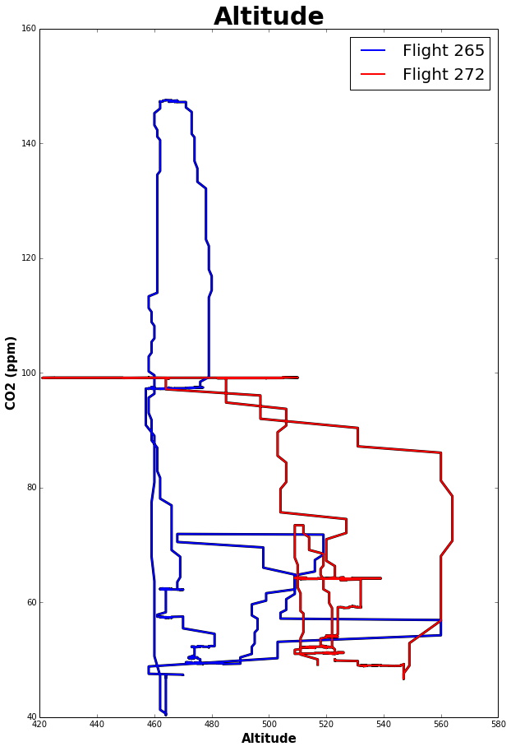
Campaign1: https://osf.io/nuvem/

Slide 7
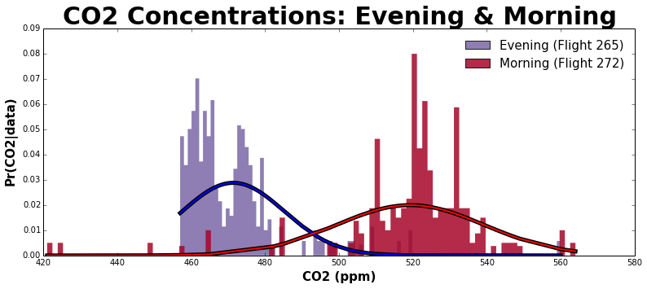
Campaign1: https://osf.io/nuvem/

Slide 8
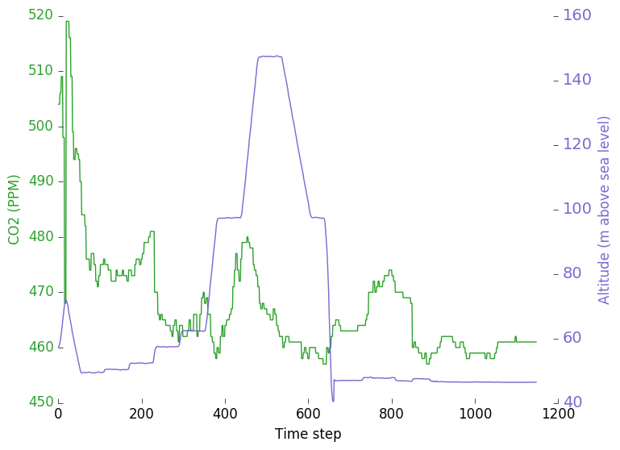
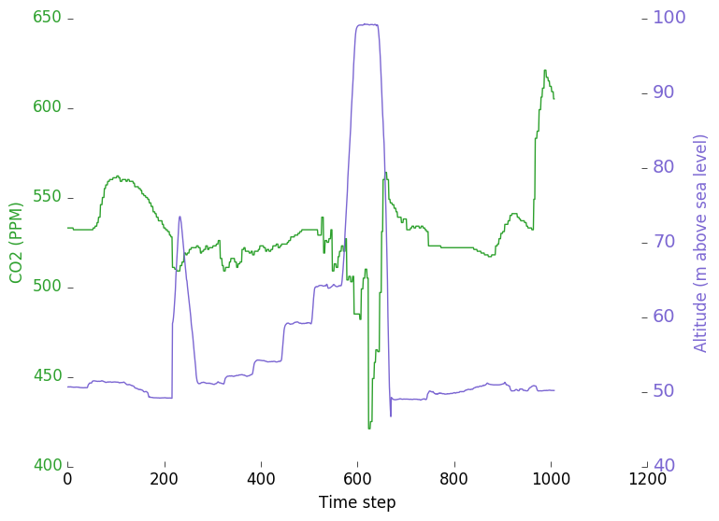
Campaign1: https://osf.io/nuvem/

Slide 9
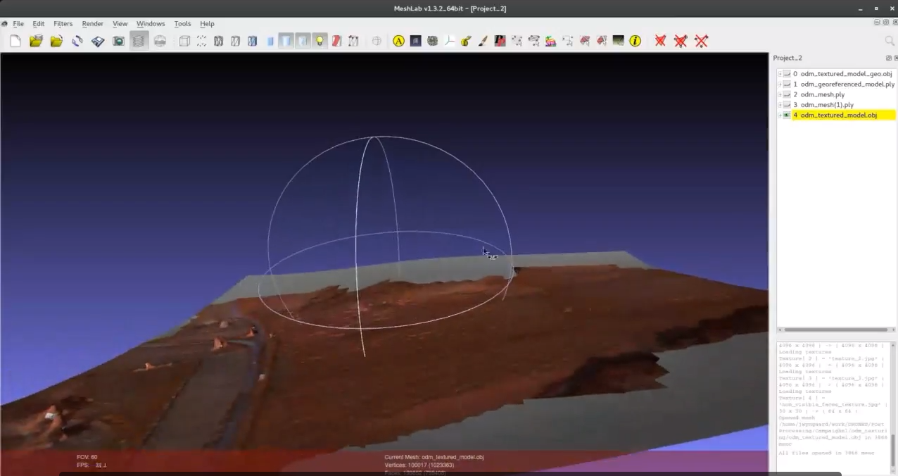
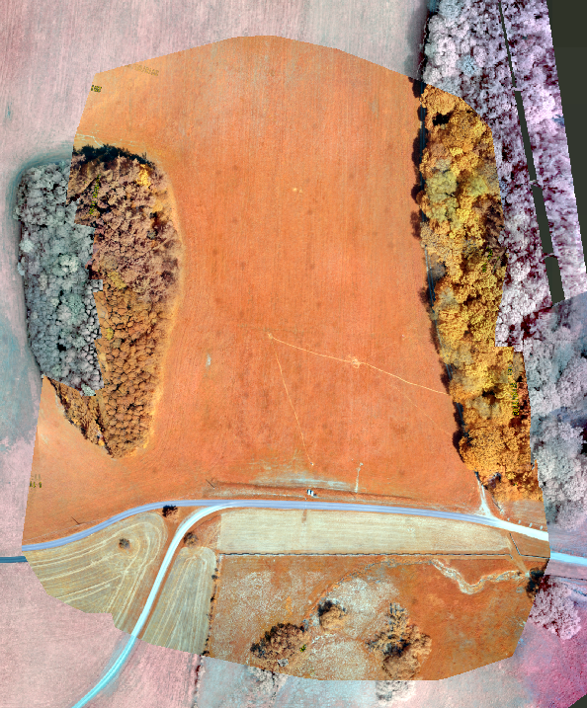
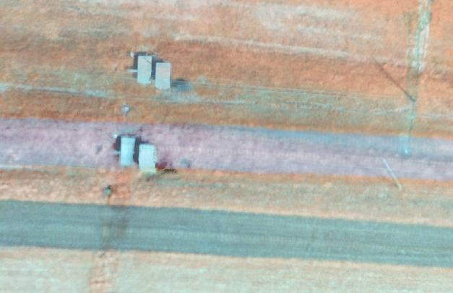
Campaign1: https://osf.io/nuvem/
Near Infrared Camera Imagery
(Open source drone)
Create mesh and Mosaic
(Open Drone Map)
TimeStamps
Visualise textured mesh/point cloud
(Meshlab)
3D DEM
Offset:
1.3m
7.3m
Imagery Analysis!
Digital Elevation Model / NIR
(QGIS)

Slide 10
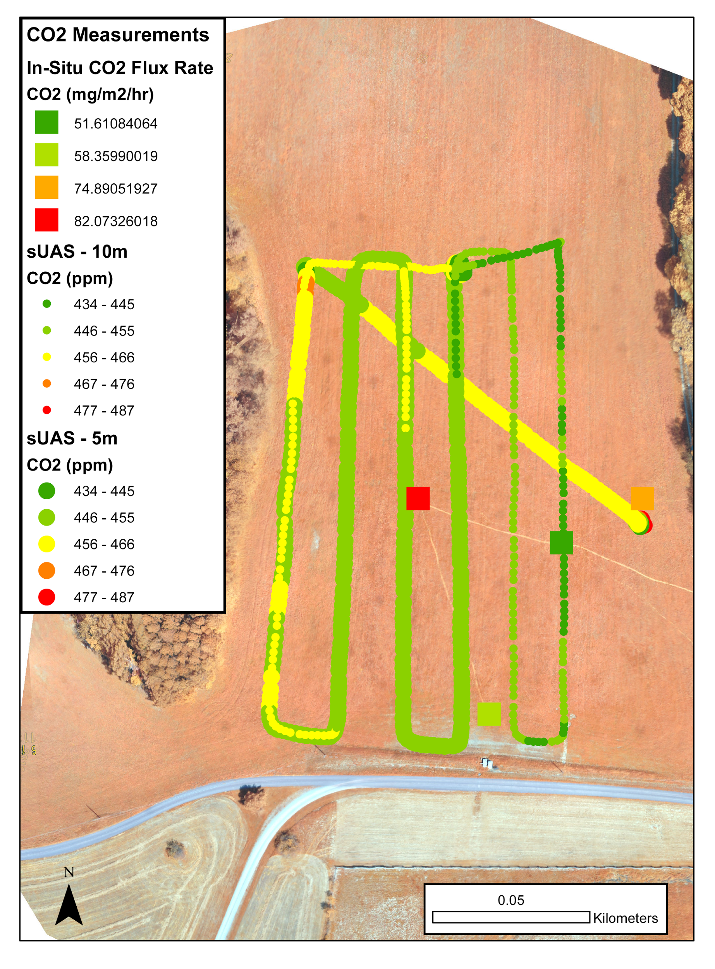
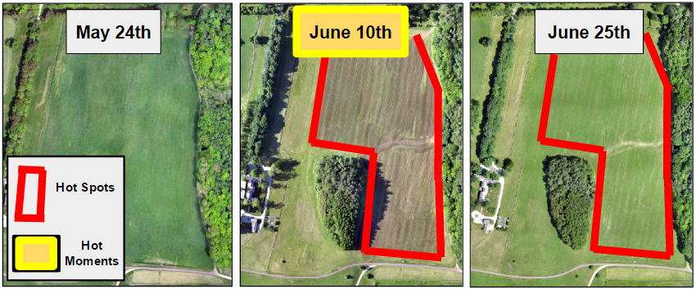
Campaign1: https://osf.io/nuvem/

Slide 11
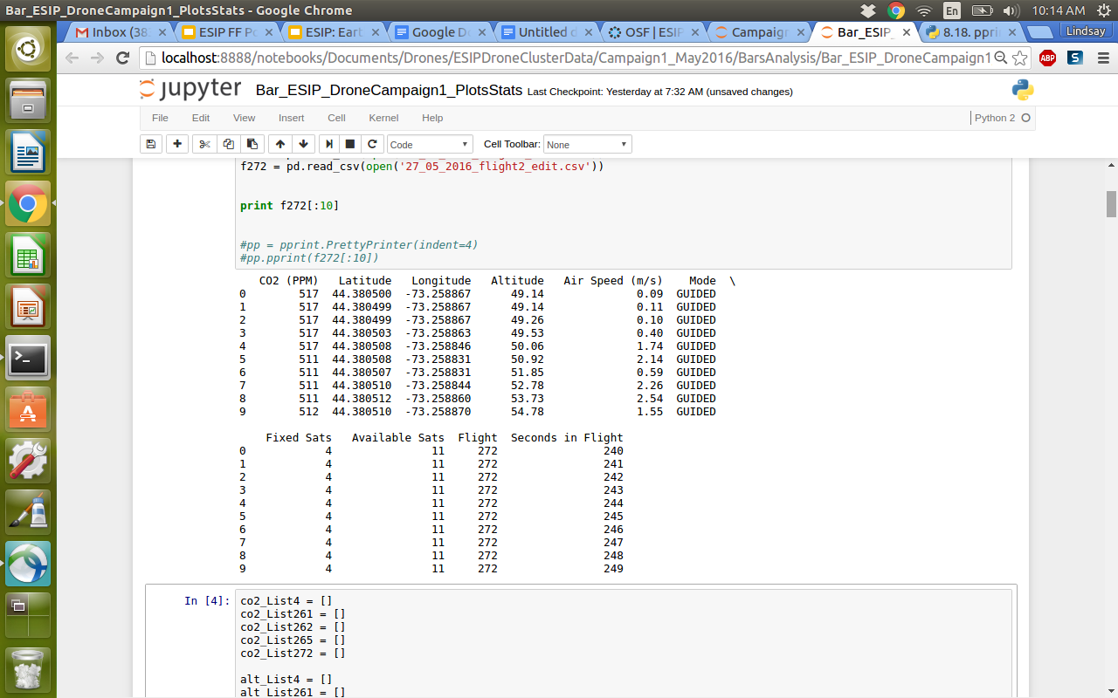
Campaign1: https://osf.io/nuvem/
CSV file for every flight

Slide 12
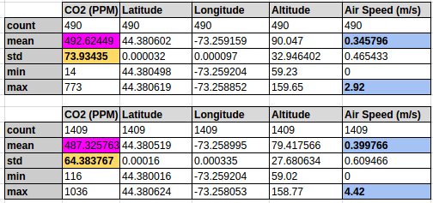
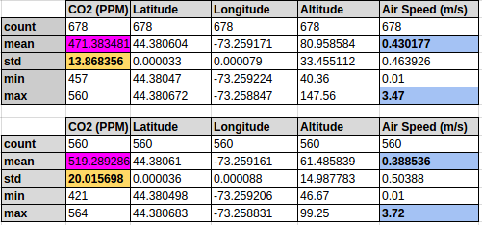
Campaign1: https://osf.io/nuvem/

Slide 13
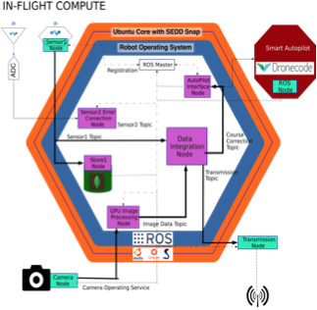
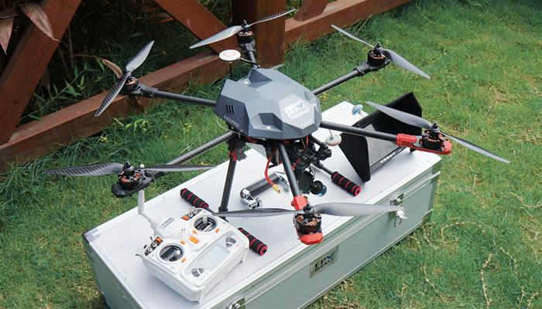
Testbed: SSEDD
Science Standardised Embedded Data infrastructure for Drones
Make sUAS more readily accessible to Earth Scientists:
  Lower the learning curve required to use sUAS
  Automate much of the required “engineering”
Provide a degree of automated data qualification

Slide 14
Enabling Drone Data - Challenges
Standards
  ….???....
Software
  Hobbyist/maker community has us 80% there
Data Sharing:
  Highly heterogeneous
  Disparate
  Citizen captured?
  Real value in drone data is its reuse

Slide 15
Discussion:
SAL Structure:
UAS Data
  Locations of Flights
    Date
      Flight # (Unique?)
        RAW
        DEM
        ORTHO
2. EXCEL → Mission Overview (Metadata)
USGS Structure:
PROJECT
  Project.meta
  MISSION1
    Mission.meta
    COLLECT1
      Collect1.meta
      SENSOR
        RAW
        DEM
        ORTHO
        SUPPORT FILES

Slide 16
Discussion
Strawman:
Data:
  Geojson (from SSEDD)
    Lat, Long, Alt
    CO2
    No. Satellites
    Barometer
    UTC
  NetCDF
Metadata:
  XML (from ODK)
  CF/ISO19115
What formats?
  Point data
  Imagery
  Video
  Other?
What directory structure?
What structure within a file?
  Coalesce by?
    By location?
    By date?
    By frequency?
Others things? Technologies? Follow us! Join group!

