Slide 1

ESIP 101
An Introduction to All Things ESIP
http://esipfed.org
July 9, 2013

Slide 2

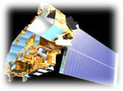
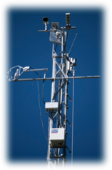





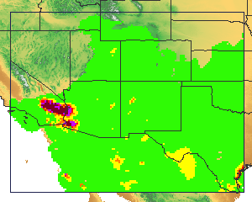
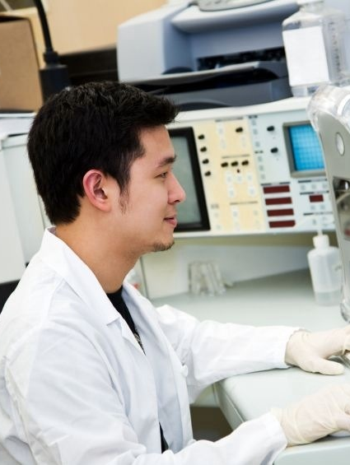

ESIP Vision
To be a leader in promoting the collection, stewardship and use of Earth science data, information and knowledge that is responsive to societal needs.

Slide 3
ESIP Community
Multiple Science Domains
Data Providers
Cross-Agency
Users
Data Archives
Application
Developers
Tool & System
Developers
Academia
Corporate
Notes:
Benefits of Engaging with Community:
Enhance staff knowledge through peer knowledge exchange
Take away new technologies
Identify new collaborations
Leverage scarce resources through reuse, repurpose
Help define community best practices

Slide 4
ESIP Core Values
Agility
Collaborative
Collegial
Community-driven
Innovative
Neutral
Open
Participatory
Voluntary

Slide 5


Two Organizations: ESIP Federation & Foundation for Earth Science
ESIP Federation is the community.
Foundation for Earth Science provides management, operational and logistical services to the ESIP Federation.
ESIP
Federation
Foundation for
Earth Science

Slide 6
Foundation Coordination for ESIP
Data
Systems
Organizational
Human
In Person Meetings
Website, Wiki, Commons
Telecons/Web Meetings
Clusters, Working Groups, Committees
Facilitating Connections
Notes:
ESIP supports connections at the data and systems levels by providing a neutral venue to build relationships at the human and organization level. Fdn staff has birds eye view to link communities and organizations to each other…

Slide 7
Governance
Assembly
  1 partner, 1 vote
  Annual meeting in Jan.
  Leadership elected from Assembly representatives
Committee
  Chair elected by Assembly
  Chair serves on
  Executive Committee
Working group
  Created by
  Assembly or Committee
  Task-oriented
Cluster
  Self-forming
  For any reason
  Ends when the last person hangs up

Slide 8
ESIP Groups
Standing Committees
  Data Stewardship
  Education
  Information Technology and Interoperability
  Products and Services
Administrative Committees
  Constitution and Bylaws
  Finance and Appropriations
  Partnership
Working groups
  Air Quality
  Climate Education
  Energy & Climate
  Visioneers
Clusters
  Cloud Computing
  Decisions
  Discovery
  Documentation
  Drupal
  Earth Science Collaboratory
  Geospatial
  Open Source
  Semantic Web
  Visualization
  Student Fellows
  And Yours?

Slide 9
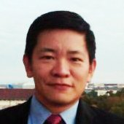
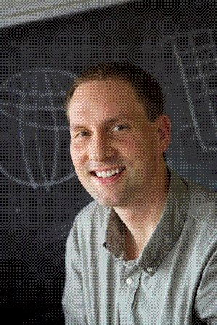
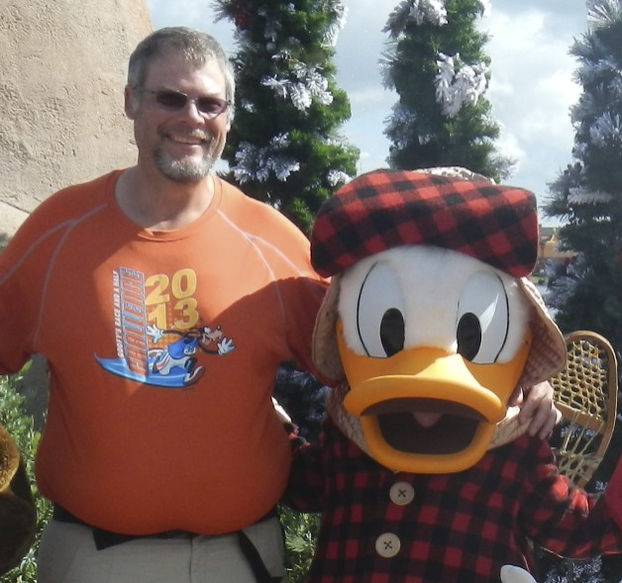
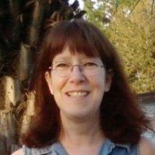
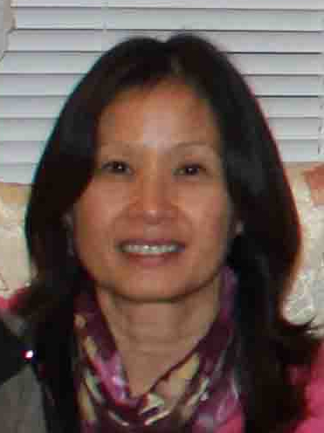
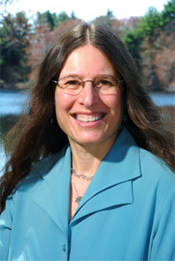
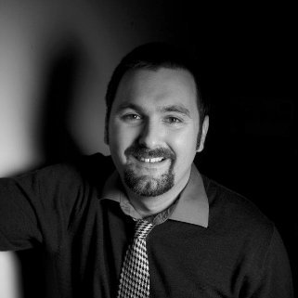
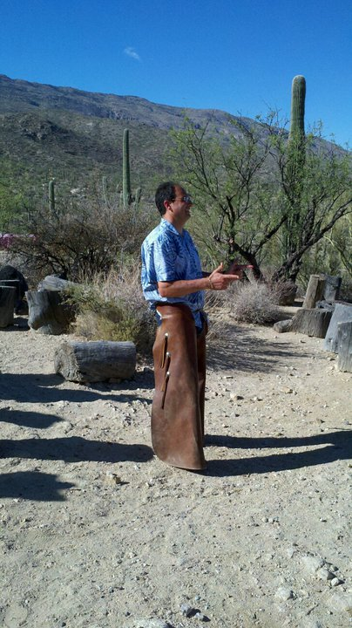
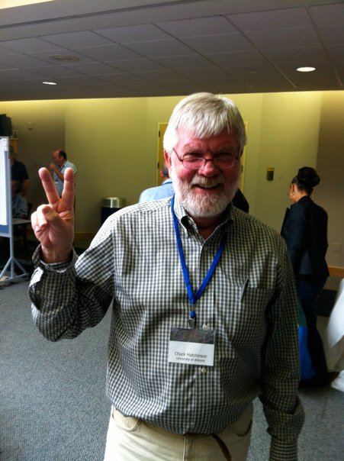

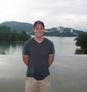
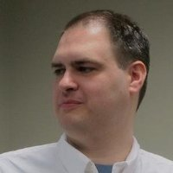
ESIP Leadership
Brian Wee
Annette Schloss
Karl Benedict &
Donald
Tamara Ledley
Emily Law
Stefan Falke
President & Vice President
ESIP Type Reps
Administrative Committee Chairs
Chris Mattmann
Standing Committee Chairs
Chuck Hutchinson
John Scialdone
Roberta Johnson
Matt Austin
Curt Tilmes
Notes:
ESIP works cross agencies, cross sectors, and cross science domains.

Slide 10
ESIP-Speak – Alphabet Soup

Slide 11
Things ESIP Does
Community-generated Best Practices (e.g. Citation)
Testbed (e.g. Identifiers, Ontology)
Community Conventions (e.g. Discovery)
Professional Development
  Technical Workshops
  Non-technical Workshops (e.g. Evaluation, Communication)
  Data Management Short Course/Workshops
Outreach
  Education (e.g. annual teacher workshop on climate change)
  Professional Societies (e.g. AGU, GSA)
  International Efforts (e.g. GEO, ISRSE)
Provide Venue for Collaboration and Connections
  Both virtual and in-person
  Support with suite of collaboration tools
Provide mini-grants to make stuff happen
Notes:
Testbed activities:
Digital Identifiers Evaluation
Deploy a Testbed Portal
Esri Geoportal Server: Discovery Services and Clients: Interoperability Testing, Advertisement, and Assessment of Data to Service Broker
A Classification and Annotation Scheme for Data and Service Quality
Drupal Metadata Editing Tool Suite
Data Stewardship: Metadata and Identifier Mapping
ESIP Ontologies in the Cloud: Semantic Web Focus
ESIP DOES not build infrastructure – it enables other to leverage the work across the community to build better infrastructure

Slide 12
Get ESIP’ed
Ongoing activities
  Clusters
    start a new one!
  Working groups
  Committees
Twice-yearly meetings
  Attend
  Next: January 7-9, 2014 in Washington, DC
  Present a talk or poster
  Chair a session
Partnership
  Join
  Invite your colleagues
Host a summer meeting
Consider ‘running’ for office
Jump in and get involved – that’s what makes it work!

Slide 13
ESIP Online
Home page
  http://esipfed.org
Wiki
  http://wiki.esipfed.org
Commons
  http://commons.esipfed.org
Facebook
  http://tinyurl.com/esip-facebook
Twitter
  #esipfed

Slide 14

Questions
Karl Benedict, kbene@edac.unm.edu
Carol Meyer, carolbmeyer@esipfed.org

