Slide 1
Approaches to Machine-Actionable Links: a hypermedia format for data
Breakout session
ESIP Summer Meeting, 2013-07-12
Chapel Hill, North Carolina
Stephen M Richard, organizer

Slide 2
Objectives
Develop a content model for information associated with links
Enable hypermedia applications
Focus on functionality related to data discovery, evaluation, access, and processing
Review usage of links in web architecture
Look at example use scenarios
Proposal for content

Slide 3
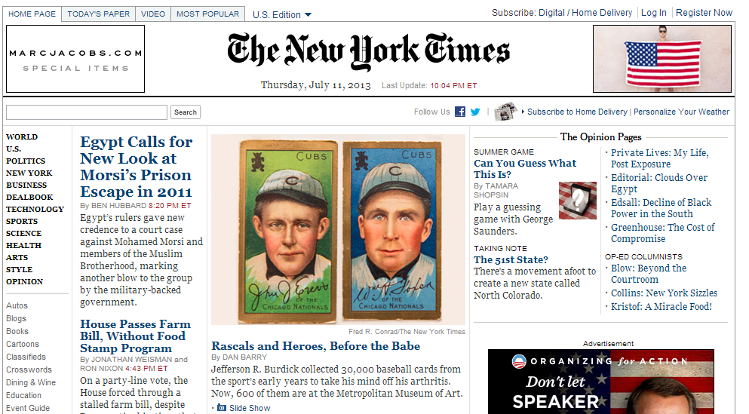
‘Traditional’ Web application
HTML is the hypermedia format
Application state is directed by a Human
<ul class="secondary">
<li><a href="http://www.nytimes.com/pages/automobiles/index.html">Autos</a></li>
<li><a href="http://www.nytimes.com/ref/topnews/blog-index.html">Blogs</a></li>
<li><a href="http://www.nytimes.com/pages/books/index.html">Books</a></li>
<li><a href="http://wordplay.blogs.nytimes.com/cartoons/">Cartoons</a></li>
<li><a href="http://www.nytimes.com/ref/classifieds/?incamp=hpclassifiedsnav">Classifieds</a></li>
<li><a href="http://www.nytimes.com/crosswords/index.html">Crosswords</a></li><li id="navWorld"><a href="http://www.nytimes.com/pages/world/index.html">World</a></li>
<li id="navUS"><a href="http://www.nytimes.com/pages/national/index.html">U.S.</a></li>
<li id="navPolitics"><a href="http://www.nytimes.com/pages/politics/index.html">Politics</a></li>
<li id="navNYRegion"><a href="http://www.nytimes.com/pages/nyregion/index.html">New York</a></li>
<li id="navBusiness"><a href="http://www.nytimes.com/pages/business/index.html">Business</a></li>
<li id="navDealbook"><a href="http://dealbook.nytimes.com">Dealbook</a></li>
<li id="navTechnology"><a href="http://www.nytimes.com/pages/technology/index.html">Technology</a></li>
<li id="navSports"><a href="http://www.nytimes.com/pages/sports/index.html">Sports</a></li>
…..
<a href="http://www.nytimes.com/ref/ topnews/blog-index.html">Blogs</a>

Slide 4
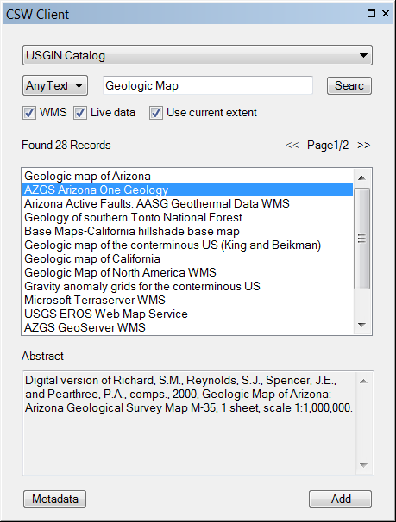
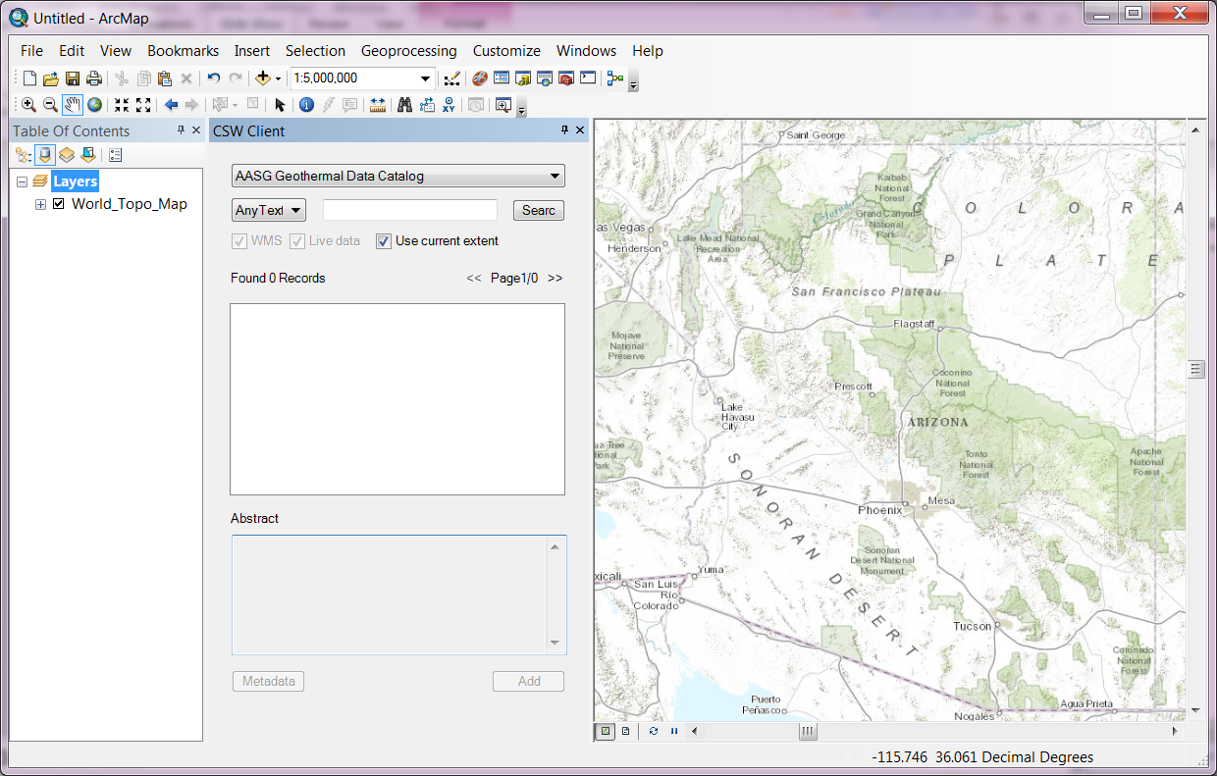
Hypermedia driven

Slide 5
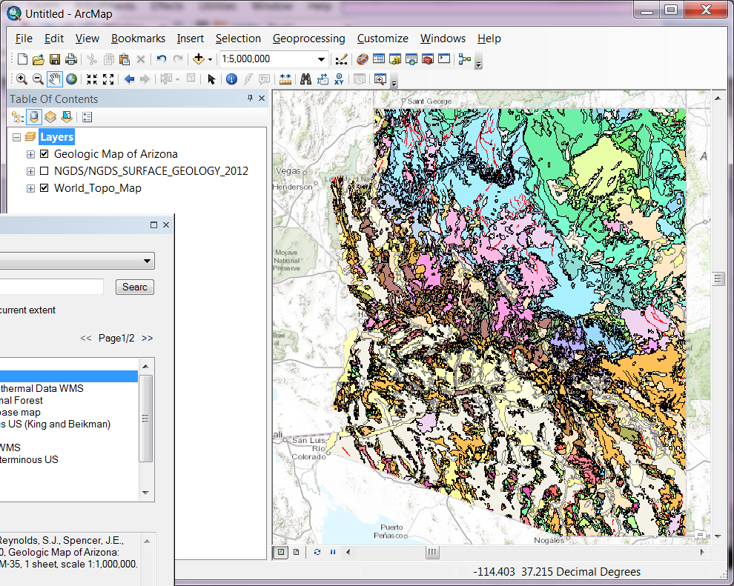
Add data to Map Application

Slide 6
Distributed applications on the Web
HTTP as the transport for application messaging
Operations: GET, PUT, POST, DELETE
Agnostic about message format and content
Headers provide metadata for messages
Language, MIME type

Slide 7
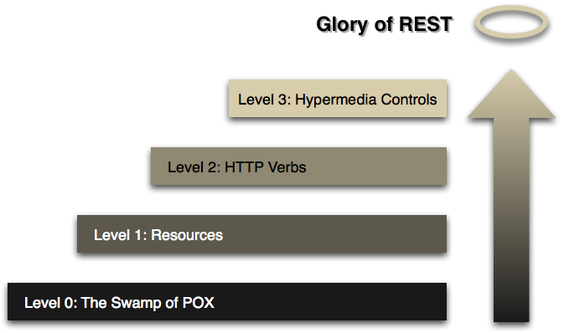
Richardson Maturity Model
HATEOAS (Hypertext As The Engine Of Application State)
Use HTTP operations as intended
Operate on domain objects
Tunneling, RPC (Plain Old XML)
http://martinfowler.com/articles/richardsonMaturityModel.html
NOTE: Roy Fielding has made is clear that level 3 RMM is a pre-condition of REST.
Useful comparison table: http://nordsc.com/ext/classification_of_http_based_apis.html

Slide 8
Approaches to application messaging
Tunneling
HTTP GET or POST
URL or message content contains method request
SOAP, ‘remote procedure call’
encode methods and parameters in URLS
HTTP messages always directed to a single web location

Slide 9
Tunneling RPC call
http://api.flickr.com/services/rest/? method=flickr.test.echo&name=value
http method is GET
https://sdb.amazonaws.com/? Action=PutAttributes&other parameters…
http method is POST
URI contains action
Message semantics depend on action .

Slide 10
Approaches to application messaging
Object based
Define resource scheme for application objects
Use HTTP request to create, read, update, delete
Various representations may be available for the objects

Slide 11
Resource object-based
https://api.twitter.com/1.1/ statuses/mentions_timeline.json
http://resources.usgin.org/uri-gin/ nmbgmr/bhintercept/API:30-035-2024
specific schema used is only known to client and server

Slide 12
URI template
A sequence of characters for describing a range of URIs through variable expansion (IETF RFC-6570)
Example: Get scientific metadata for a dataOne data package
https://datadryad.org/mn/object/{identifier}
identifier:= "http://dx.doi.org/10.5061/dryad.8790"
https://datadryad.org/mn/object/http://dx.doi.org/10.5061/dryad.8790

Slide 13
Approaches to application messaging
Hypermedia
messages specify resources and possible actions (read, write, create, delete, filter, report, etc.)
controls provided to invoke next action
media format must be understood a priori by client applications
server can change any URI except the initial entry point

Slide 14
Machine Actionable Links
Essential to hypermedia applications
HTML
<a> anchor element for HTTP GET
<form> form element for HTTP POST
<img>

Slide 15
Can we produce a content model for hypermedia controls for data applications?

Slide 16
Scenarios
Examine several scenarios commonly encounter with data access and processing
Search and data access
Linked data
Web processing services
Vocabulary usage in content

Slide 17
Hypermedia search
Search catalog
Get list of distributions
Select WMS distribution
Add to arc map project

Slide 18
CI_OnlineResource affordance
Distribution options offered by an ISO19139 XML metadata response
<URL> http://services.kgs...service=WMS
<protocol> OGC:WMS
<name> Service Description
<description> WMS Capabilities
<function> webService
<URL> http://services.kgs.ku.....;service=WFS</URL>
<protocol> OGC:WFS
<name> Service Description
<description> WFS Capabilities
<function> webService
<URL> http://services.kgs.ku..../MapServer
<protocol> ESRI
<name> Service Description
<description> ESRI Service End Point
<function> webService
<URL> http://repository.stategeothermaldata.org/..._20121212.zip
<name> Zipped 2007 Excel file containing Borehole Temperature data for the State of Kansas
<function> download

Slide 19
Hypermedia and linked data
Offer an ‘affordances’ representation for any URI
Dereference URI to see list of things can do with it
Picture, text explanation, searches, discussion, usage, plot, publications, people, brokers…
Over to Doug…

Slide 20
Web processing service
Landing page: start process
Select existing and execute
Start new—identify inputs and parameters and execute
Successful completion
Modify parameter and rerun
Save results
Visualize result
If process is largely user driven, HTML forms provide necessary hypermedia

Slide 21
Semantics: Vocabulary
URI identifies a concept
Hypermedia helps user understand concept
Hypermedia to help machine agent navigate semantic web
Related, broader, narrower
RDF graph, SPARQL endpoints
ISO codelists, GML codeType

Slide 22
Vocabulary examples
<gsmlem:lithology
xlink:href="http://resource.geosciml.org/classifier/ cgi/lithology/wacke"
xlink:title="Wacke" />
gmd:CI_RoleCode
codeList="http://www.isotc211.org/2005/resources/Codelist/gmxCodelists.xml#CI_RoleCode"
codeListValue="pointOfContact">
pointOfContact</gmd:CI_RoleCode>

Slide 23
Survey
Specification | Link
ATOM | http://tools.ietf.org/html/rfc4287
CoRE | http://tools.ietf.org/html/rfc6690
ESIP discovery | http://wiki.esipfed.org/index.php/Discovery_Change_Proposal-8
GML codeType
HAL | http://tools.ietf.org/html/draft-kelly-json-hal
Home document | http://tools.ietf.org/html/draft-nottingham-json-home
Hydra | http://www.markus-lanthaler.com/hydra/spec/latest/core/
IANA link type registry
IETF Web Linking | http://tools.ietf.org/html/rfc5988
ISO19115/19139 | see USGIN profile document
RDFa | http://rdfa.info/about/
xlink | http://www.w3.org/TR/xlink11/
OWC offering | OCG 12-080 Table 3

Slide 24
Content model for link
link (syn: href, targetURI)
title
type
rel
overlayAPI
template
profile

Slide 25
Link property
Essential– must be a URI that will dereference using web architecture (DNS, TCP/IP), with result according to other link properties
Typically using http
URI syntax (IETF RFC-3986) specifies that "each URI begins with a scheme name" [RFC3986, section 1.1.1]

Slide 26
Title
Text string that identifies the link function for a human user.
Only necessary if link is being used for human user interaction

Slide 27
type
Registered string that identifies the media type
MIME type (http://www.iana.org/assignments/media-types).
Allow comma-delimited list
Intention is that if a type is listed here, it is known to be available from the host

Slide 28
rel property
Semantics of link
Attribute value is list;
Use global vocabulary for interoperability (IETF RFC-5988)
include one of the 5 original Atom link@rel values
Domain specific rel values should be URI that will dereference as a vocabulary term

Slide 29
overlayAPI: Legacy approaches
identifies the API for messages tunneled to a component on the target server
should be defined by the service specification for the protocol or service type
Include version information if applicable

Slide 30
template: guidance for URI patterns
identifies template scheme
if a value is provided for this attribute, the targetURI MUST be interpreted as a template
service specification should define the URI that identifies the scheme and version.

Slide 31
profile property
application specific conventions
Specific vocabularies for message content
Restrictions on alternate usages of interchange format schema
May apply to template scheme or overlayAPI

Slide 32
parameters
Additional parameters encoded as key-value pairs
Account for information like layer name in WMS, feature Name in WFS or ESRI service, coverage name in WCS
Can this be done more simply?

Slide 33
Other possible properties
Property | Scope
altTitle | Title value in a different character set, or language
behavior | list of properties specifying behavior expected in client when link is actuated
descriptionURL | URL that locates a detailed text description of what the online resource is/does
hints | profile-specific information about link operation; granular to protocol or overlayAPI method level
hreflang | language of resource content; multiple "hreflang" parameters indicate options
length | advisory size linked content in octets

Slide 34
Where to from here
Collect examples of example links intended for machine to machine operation
(examples from white paper)
What vocabularies are necessary?
https://github.com/usgin/usginspecs/blob/master/MetadataAsHypermediaApp.docx
ESIP Google Doc or Discovery Cluster
Presentation to ESIP Semantic Cluster

