Slide 1
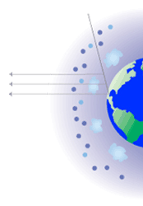
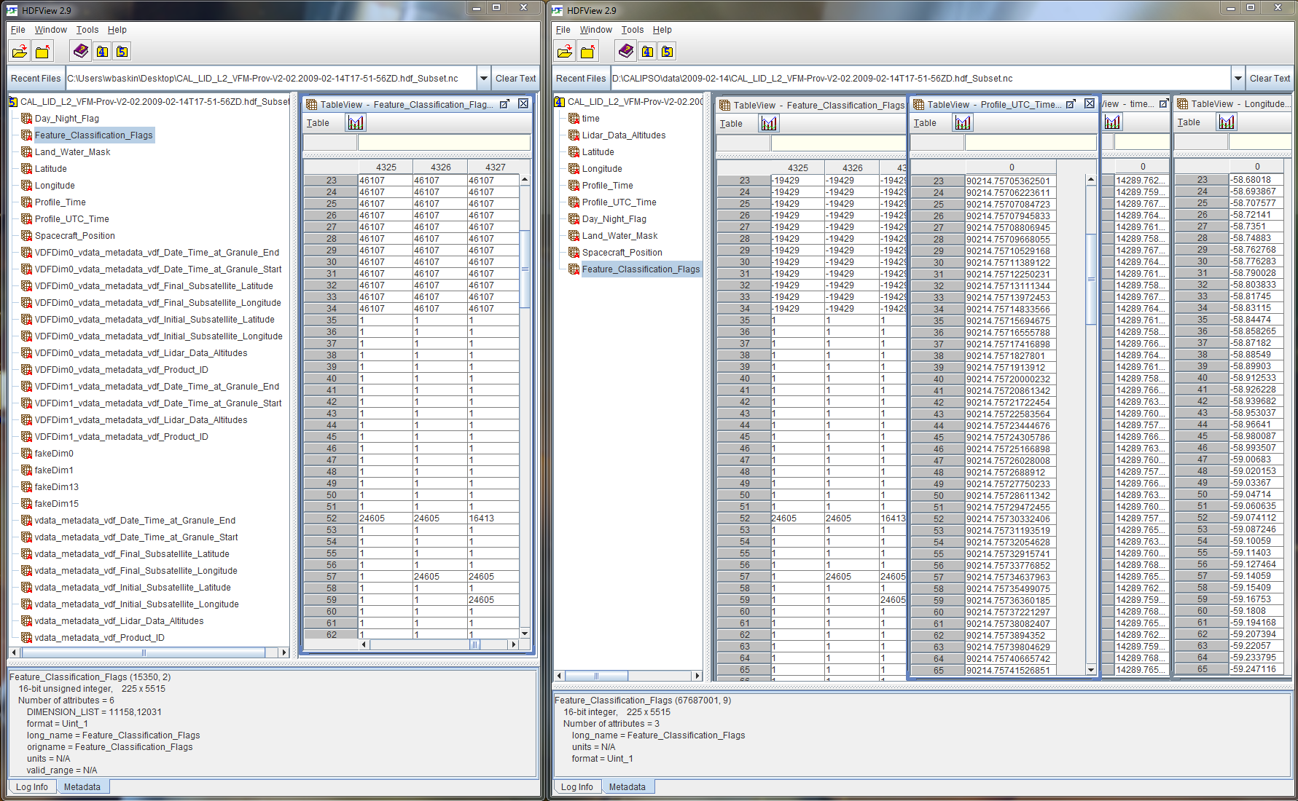
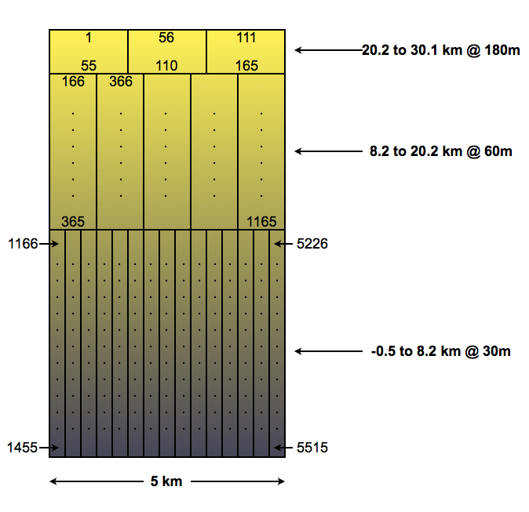
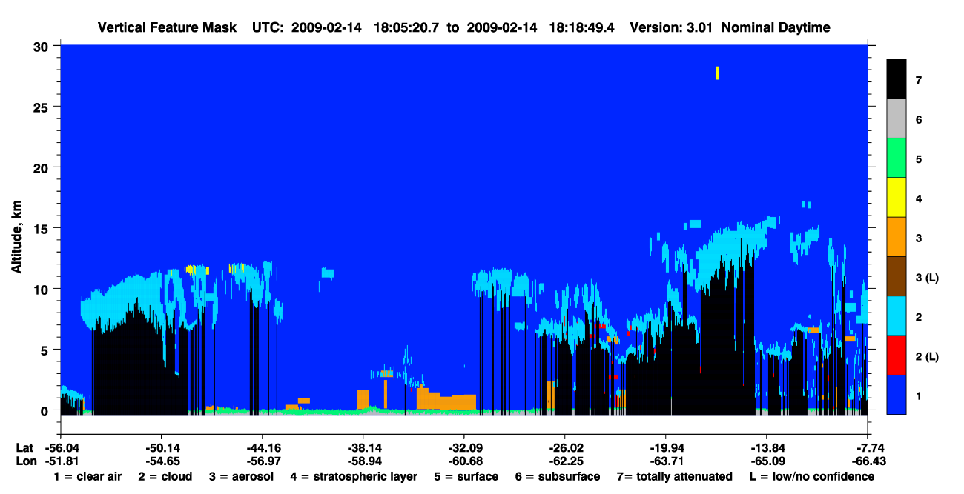
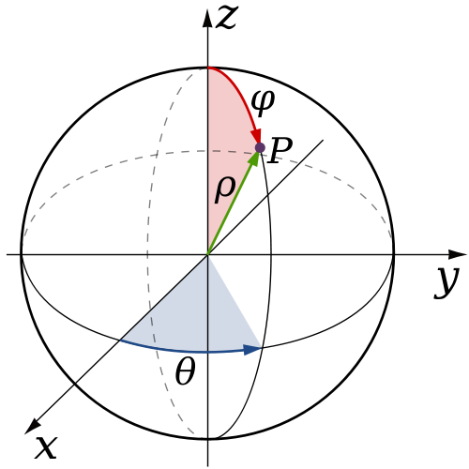
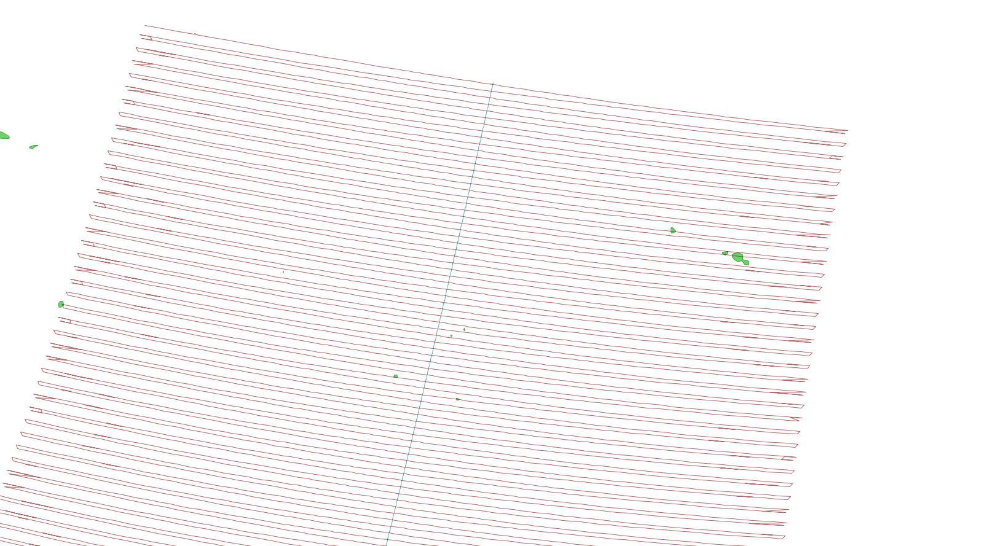
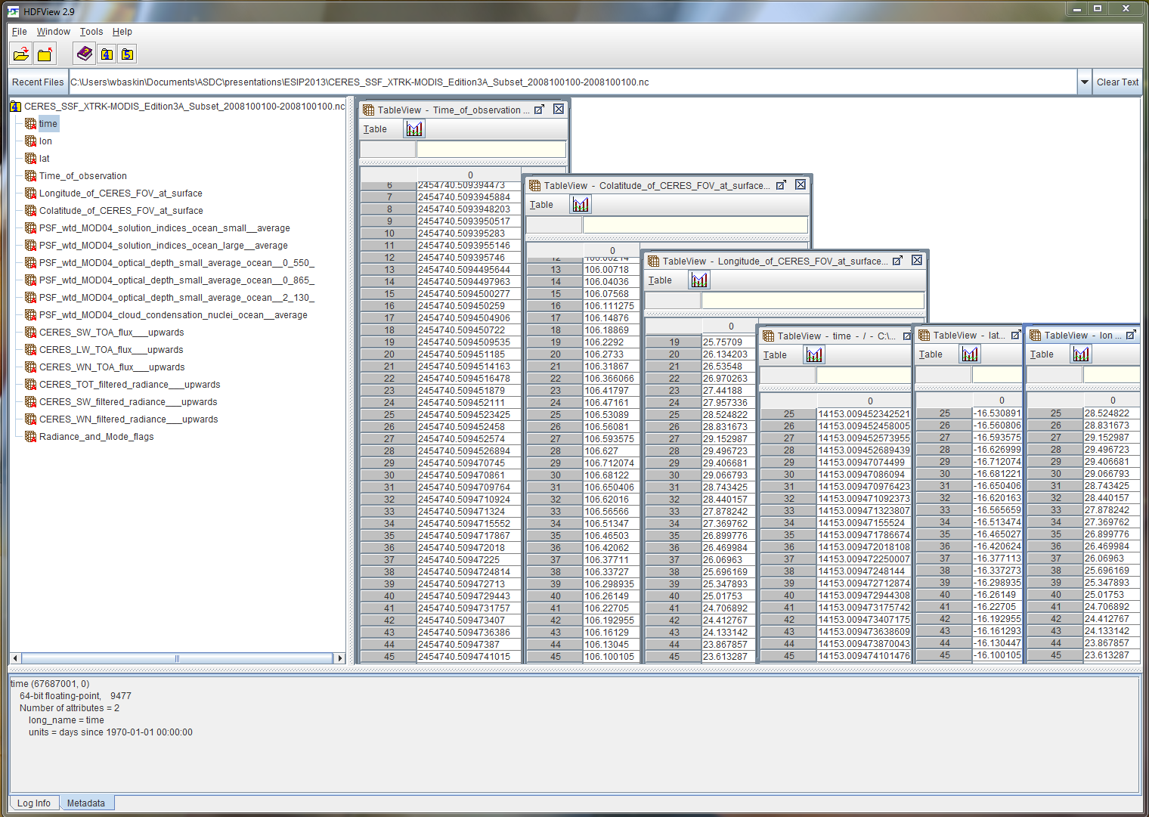
National Aeronautics and Space Administration
Conversion of Archived HDF Satellite Level 2 Swath Data Products to NetCDF
Walter E. Baskin¹, Jennefer Perez²
(1) Science Systems and Applications, Inc., Hampton, VA, USA. (2) NASA Langley Research Center, Hampton, VA,USA.
ATMOSPHERIC
SCIENCE
DATA
CENTER
Introduction
The NASA Atmospheric Sciences Data Center (ASDC) has developed and deployed provider-specific HDF-to-NetCDF conversion options in search and subset web applications for the CALIPSO, CERES, TES, and MOPITT missions with tailored subsetting for level 2 satellite datasets.
This presentation illustrates specific challenges in HDF to NetCDF conversion encountered by the ASDC's development team.
HDF4 to CF Compliant NetCDF Conversion Challenges
The HDF Group released the HDF4 CF Conversion Toolkit on June 15, 2013. This comparison of NetCDF conversion results from a subsetted CALIPSO Level2 data granule between the HDF Group’s h410nccf_nc4 utility and the ASDC CALIPSO subsetter utility illustrates several challenges faced by both generic netcdf converters and converters tailored to specific datasets.
NetCDF file generated from HDF4 CF Conversion Toolkit (h4tonccf_nc4)
NetCDF file generated from ASDC CALIPSO Subsetter
Packed data arrays with varying spatial context
Visualization and Analysis Clients would not be able to plot the data shown in the Feature Mask Browse image since Feature_Classification_Flags for each vertical profile are packed in a 5515 element array (shown below) and require a non-trivial algorithm to extract the information.
Universal Compliance Paradox
3-way ‘chicken or egg’ problem
Data configuration standards are derived from the best practices of data providers and client applications used by science data users, but science data providers need data standards to create data products that can be utilized by a broad user community, and application developers need standardized input data sources to create useable analysis and visualization tools.
CALIPSO Level 2 Vertical Feature Mask Browse Image
Standards and Compliance Groups
ESIP[documentation]
CF – ISO -OGC
Data Centers and Science Data Providers
Analysis Visualization Application Developers
Source URL:
http://www-calipso.larc.nasa.gov/products/lidar/browse_images/show_detail.php?s=production&v=V3-01&browse_date=2009-02-14&orbit_time=17-51-56&granule_name=CAL_LID_L1-ValStage1-V3-01.2009-02-14T17-51-56ZD.hdf&page=2
Invalid or non-compliant valid_range attribute values
CF compliant value ranges consist of two Attribute value Array elements that are the same datatype as the attribute’s variable.
NetCDF JAVA API does not allow for unsigned integer data types
The ASDC’s CALIPSO Subsetter NetCDF conversion utility uses Unidata’s JAVA NetCDF library (Version 4.0.49.20090825.2329) bundled with HDFView 2.9. This NetCDF library does not support unsigned integers.
No dimension labels in original hdf data granule
If dimensions are not labeled in the source hdf file a generic name must be provided to be CF compliant. These names are usually used by client applications to label axes of plots.
The ‘time’ variable was added to address non-standard temporal parameter in the original data
Original variable: ‘Profile_UTC_Time’ units = UTC - yymmdd.ffffffff
Added NetCDF CF-Compliant variable: ‘time’ units = days since 1970-01-01 00:00:00
Colatitude (φ) and Longitude (ϴ)
Plot of CER_SSF_Aqua-FM3-MODIS Field of view at surface connected as a single line.
NetCDF file generated from ASDC CERES SSF Subsetter
Conclusion
New generic conversion utilities such as the HDF4 CF Conversion Toolkit are very useful and can be applied to almost any HDF4 dataset, but many archived datasets are missing information from the archived HDF files that are critical to visualization and analysis software that use the resulting NetCDF output.
Dataset-specific NetCDF conversion utilities such as the ASDC Subsetter NetCDF conversion utilities can reformat original archived data and include critically needed information not in the archived HDF granules, but long term maintenance of this code is not desirable.
Lessons learned from the work at ASDC to create NetCDF output options for specific archived HDF data products could benefit a broad science user community if they can be adopted as configurable APIs to generic conversion utilities
Image Source: http://commons.wikimedia.org/wiki/File:Spherical_Coordinates_(Colatitude,_Longitude).svg
Time dimension not in temporal order
The primary dimension in all swath-based level 2 satellite data is time. The frayed edges of the cross-track scan path illustrates that CERES SSF data is not always in temporal order. In order to be CF compliant all the data must be sorted temporally.
Non-standard geospatial parameters
The geospatial parameters in CERES SSF data granules are Colatitude_of_CERES_FOV_at_surface and Longitude_of_CERES_FOV at surface. ‘lon’ and ‘lat’ parameters were added as primary CF Compliant variables and to simplify plotting in standard GIS utilities.
www.nasa.gov
ESIP 2013

