Slide 1
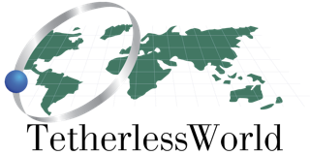
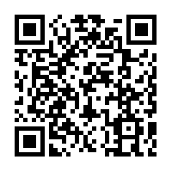
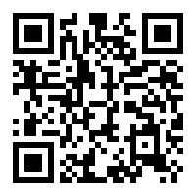
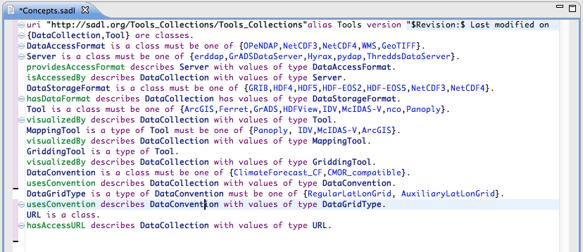
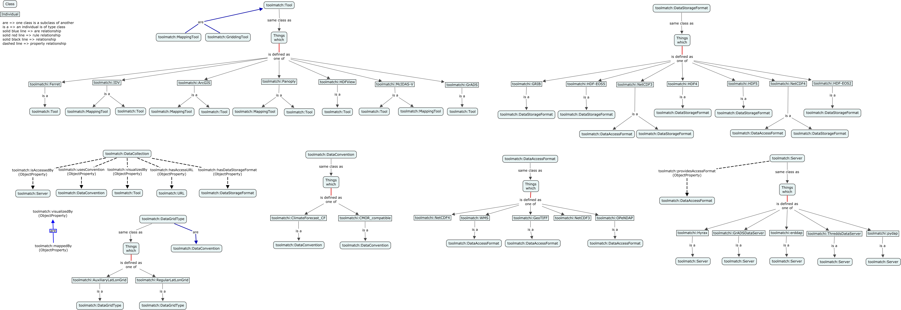
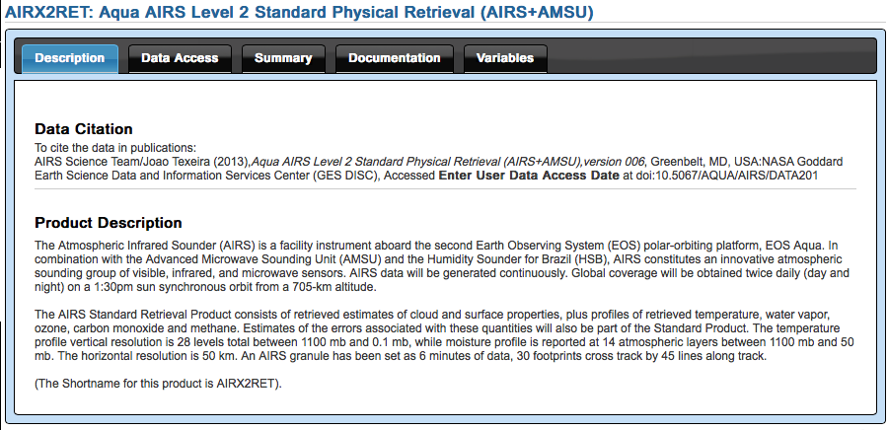
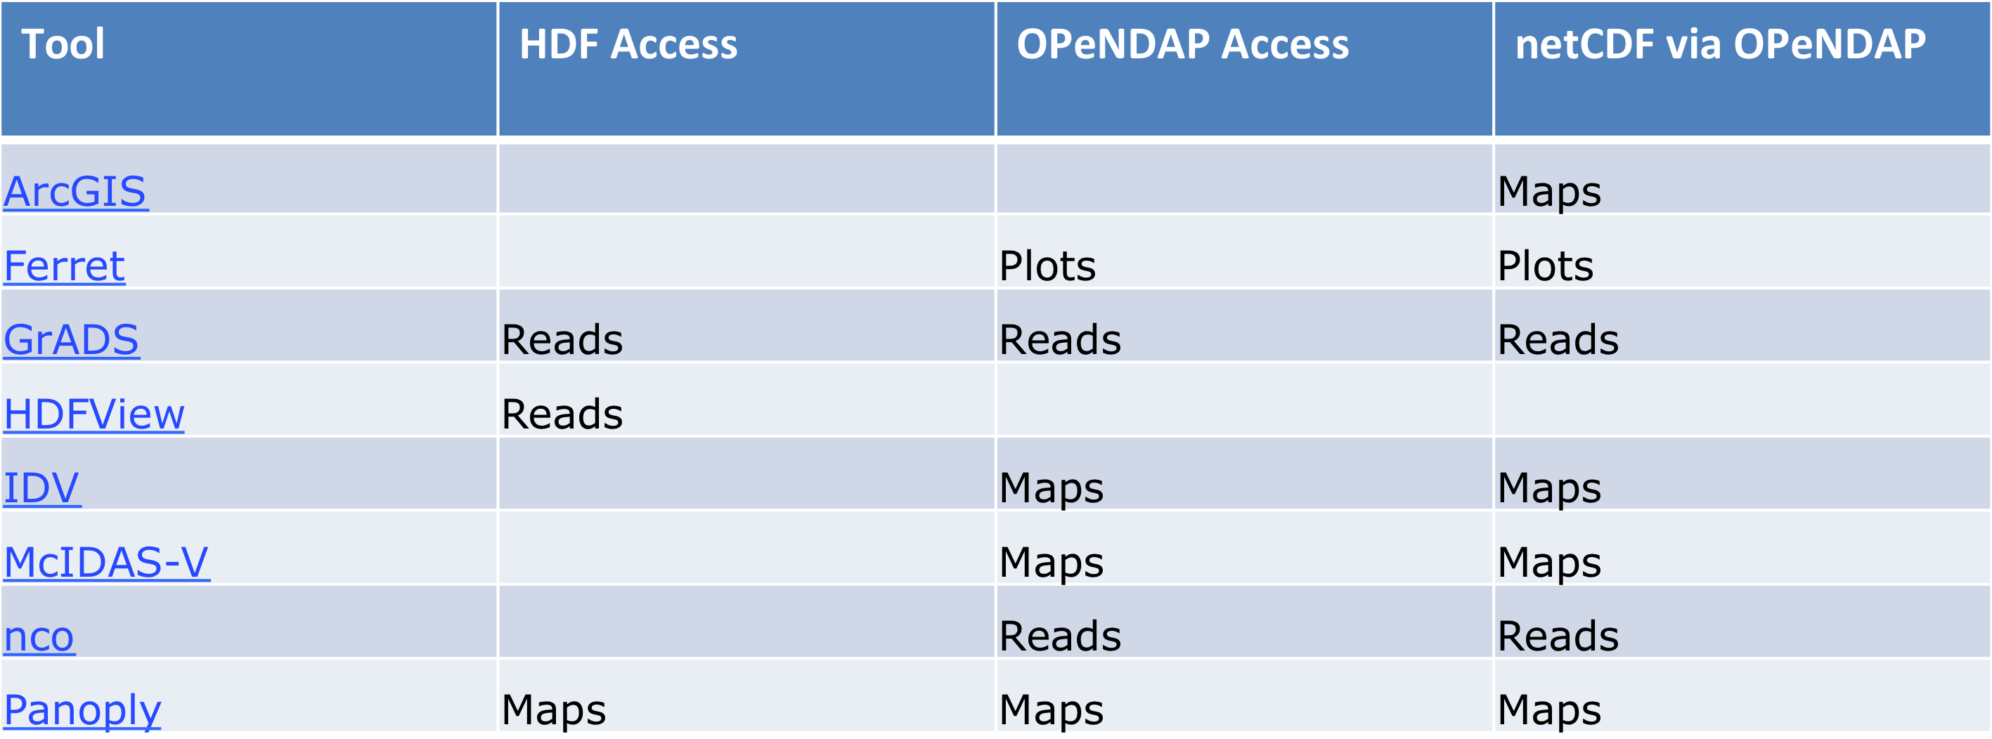
Relationship Diagram
Poster
ToolMatch
ToolMatch: Discovering What Tools can be used to Access, Manipulate, Transform, and Visualize Data
Patrick West^{1 (westp@rpi.edu)}, Nancy Hoebelheinrich^{2(nhoebel@kmotifs.com)}, Peter Fox^{1(pfox@cs.rpi.edu)}, Christopher Lynnes3 (christopher.s.lynnes@nasa.gov)
(²Tetherless World Constellation, Rensselaer Polytechnic Institute 110 8th St., Troy, NY, 12180 United States)
(¹Knowledge Motifs, San Mateo, CA, United States)
(³Goddard Space Flight Center, NASA, Greenbelt, MD, United States)
SADL is an open source language designed for domain experts who are not ontologists, but are still interested in building formal models of an OWL ontology, testing the validity of the models, expressing rules using ontological concepts, and retrieving information via ontologically based queries. SADL is designed to be English-like, and was used in an Eclipse-Indigo IDE for this project. From the SADL file we can:
generate an rdf/xml file
import the rdf/xml file into CMAP/COE to generate a relationship diagram
import the rdf/xml file into our triple store and run the inferences over the information.
Abstract
The accessibility of science data products is becoming increasingly easier, with more and more data and scientific community portals coming online all the time. But what can one do with the data product once it has been found? Can I visualize the data product as a map, plot, or graph? Can I import the data into a particular data manipulation tool like MatLab or IDL or iPython Notebook? How is the dataset accessible, and what kind of data products can be generated from it? ToolMatch is a crowd source approach (ontological model, information model, RDF Schema) that allows data and tool providers, and portal developers to enable user discovery of what can be done with a science data product, or conversely, which science data products are usable within a given tool.
Example queries may include "I need data for Carbon dioxide (CO2) concentrations, a climate change indicator, for the summer of 2012, that can be accessed via OPeNDAP Hyrax and plotted as a timeseries.", or "I need data with measurements of atmospheric aerosol optical depth sliced along latitude and longitude, returned as netcdf data, and accessible in MatLab."
This contribution outlines the progress of the ToolMatch development, plans for utilizing its capabilities, and efforts to leverage and enhance the use of ToolMatch in various portals.
Resulting query
The resulting query to find the set of tools available to visualize a data collection becomes very simple
SELECT ?tool
WHERE {
<data_collection> toolmatch:visualizedBy ?tool .
?tool rdf:type toolmatch:Tool .
}
Inference
Proposed Solution
* Equivalent Class
DataCollection <Aqua_AIRS_Level2_Plus_AMSU>
and (isAccessedBy value OPeNDAP)
or (hasDataStorageFormat value NetCDF)
and (usesGridType value AuxiliaryLatLonGrid)
or (usesGridType value RegularLatLonGrid)
and usesConvention value ClimateForecast_CF
* Subclass Of
mappedBy value IDV
and mappedBy value McIDAS-V
and mappedBy value Panoply
To facilitate a crowd source approach for domain experts who are not ontologists, we develop an ontological model using one of the open source, English-like languages available that can help us. We develop an ontology that can help us:
Determine what storage format a data collection is in, i.e. NetCDF4, HDF4
Determine what conventions the metadata follow
Determine the types of information stored in the file
Determine the type of server the data collection can be accessed from
From this information we can then:
Infer the various tools available that can visualize the given data collection
Description
Tools
* Equivalent Class
DataCollection
and (isAccessedBy value OPeNDAP)
or (hasDataFormat value NetCDF)
and usesConvention value CF1Convention
and usesConvention value RegularLatLonGrid
* Subclass Of
mappedBy value Ferret
and mappedBy value GrADS
Next Steps
Complete the Tools Concept Modeling
Integrate the Model and Knowledge Information into an existing Virtual Observatory
Feedback from the ESIP Community on the Information Model
Crowdsourcing, getting people and groups to contribute to the knowledge store
* Equivalent Class
DataCollection
and (isAccessedBy value GrADSDataServer)
or (isAccessedBy value Hyrax)
or (isAccessedBy value ThreddsDataServer)
or (isAccessedBy value erddap)
* Subclass Of
isAccessedBy value OPeNDAP
Glossary:
CMAP/COE – Concept Mapping Application Ontology Editor, built on top of the IHMC CmapTools concept mapping software
ESIP – Earth Science Information Partners (http://www.esipfed.org/)
FOAF - Friend of a Friend (http://xmlns.com/foaf/0.1/)
O&M – Observations and Measurements (http://www.opengeospatial.org/standards/om)
OWL – Web Ontology Language
RDFs – Resource Description Framework Schema
RPI/TWC – Rensselaer Polytechnic Institute / Tetherless World Constellation (http://tw.rpi.edu)
SADL – Semantic Application Design Language (http://sadl.sourceforge.net/)
SPARQL – Simple Protocol and RDF Query Language
The resulting information displayed to the user allows them to decide how best to visualize this information
Acknowledgments:
Eric Rozell, Master’s Graduate of Rensselaer Polytechnic institute

