Slide 1

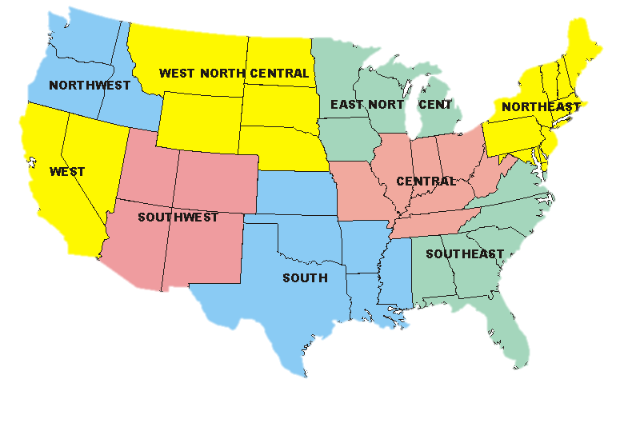
HIPGEO (Harvesting Information Partnerships for Geospatial Data Education and Outreach)
Wade Bishop, PhD,
Assistant Professor
wade.bishop@utk.edu
Jeni Trimmer
Graduate Assistant jtrimmer@vols.utk.edu
Lara Marler
Graduate Assistant lmarler1@vols.utk.edu
Purpose
The purpose of this project is to create a potential partner directory to grow the ESIP Federation membership.
Process
Following a review of the current ESIP membership directory, a test strategy for finding potential partners was created. ESIP Partner Types I and II were targeted by developing an entity list to guide the search process. The search was conducted using a search engine. After testing the strategy on Maryland, the entity list was refined. Research was done within regions based on the NOAA U.S. Climate Regions with additional divisions for Alaska/Hawaii and US Territories/District of Columbia.
This entity list was used on a first round of states after which non-productive entity types were eliminated. The final search strategy involved looking for four types of entities 1) land-grant universities, 2) research institutes or organizations affiliated with land-grant university research, 3) state associations and agencies, 4) specific regional or state divisions of U.S. Departments.
Potential members were cross-checked against the current member directory to avoid duplication. Information collected included name and contact information, affiliation and funding, and notes on type of research or data collected. Potential members were listed in the directory at the most specific level for which contact information was available (e.g. labs, research groups, divisions). Partner type was assigned based on ESIP guidelines. Data was merged for simple analysis.
Preliminary Findings
Potential partners are involved in rich and diverse research and data collection. A directory of 1,344 potential members was created. Breakdown by region and ESIP Partnership Type is presented in the Table.
Table. Summary of Potential Partnership by Type and Region
Discussion
This study shows there is great potential to expand ESIP membership. The directory created is just a sampling of earth science related information and work being done. It could be expanded by 1) increasing the type and number of universities screened; 2) further exploring US government departments, particularly the USDA and USGS; 3) following up on leads outside the scope of the study for related professional organizations; and 4) social networking.
While the major contribution of this work is as a tool to expand ESIP Federation membership, it may also serve as a reference resource for the type of research being done and data being collected. Creating a controlled set of keywords to categorize the research generally may expand the usefulness of this directory allowing for retrieval of specific types of earth science data.
Next Steps
ESIP may use this directory in a number of ways to increase membership:
Targeted short but informative direct email
Physical mailing
Regional invitations to ESIP meetings with incentive discount for attending
Planning future meetings in areas where large numbers of potential members have been identified or in areas where few members currently reside
Start an “Every Member Recruit a Member” campaign—Current members scan directory to identify potential partners they know or with whom they have a shared research interest
Allow potential members outside the continental U.S. to participate remotely in ESIP meetings or sessions
Create a Type V partnership type to invite related professional organizations to develop a working relationship with ESIP
Visit related professional organization meetings to increase awareness of ESIP and the Federation’s visibility through booths or poster presentations
Area | Total | I | % | II | % | III | %
United States | 1344 | 520 | 39 | 709 | 53 | 115 | 9
Northwest | 61 | 40 | 66 | 19 | 31 | 2 | 3
West | 95 | 42 | 44 | 47 | 49 | 6 | 6
West North Central | 72 | 32 | 44 | 40 | 56 | 0 | 0
Southwest | 78 | 38 | 49 | 38 | 49 | 2 | 3
East North Central | 84 | 33 | 39 | 42 | 50 | 9 | 11
South | 191 | 75 | 39 | 102 | 53 | 14 | 7
Central | 178 | 67 | 38 | 89 | 50 | 22 | 12
Northeast | 298 | 83 | 28 | 184 | 62 | 31 | 10
Southeast | 177 | 55 | 31 | 97 | 55 | 25 | 14
Alaska/Hawaii | 73 | 37 | 51 | 33 | 45 | 3 | 4
Territories/DC | 36 | 17 | 47 | 18 | 50 | 1 | 3
http://www.cpc.ncep.noaa.gov/
Figure. NOAA Climate Regions Map
Several websites for associations and programs outside the scope of the current project were identified during the search.

