Slide 1
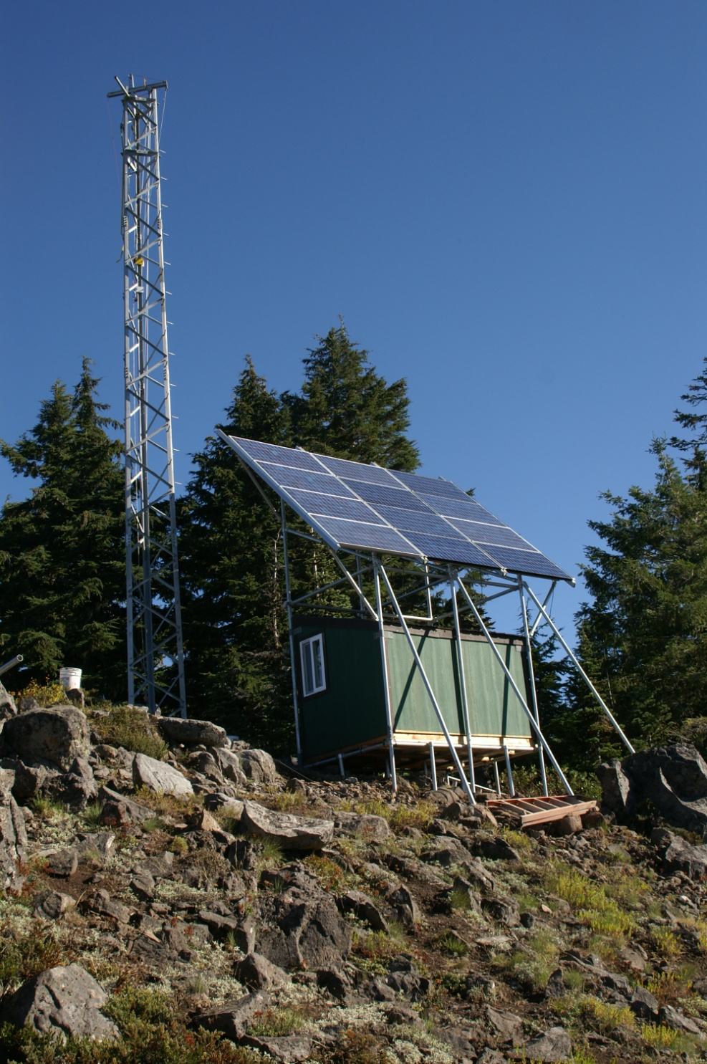
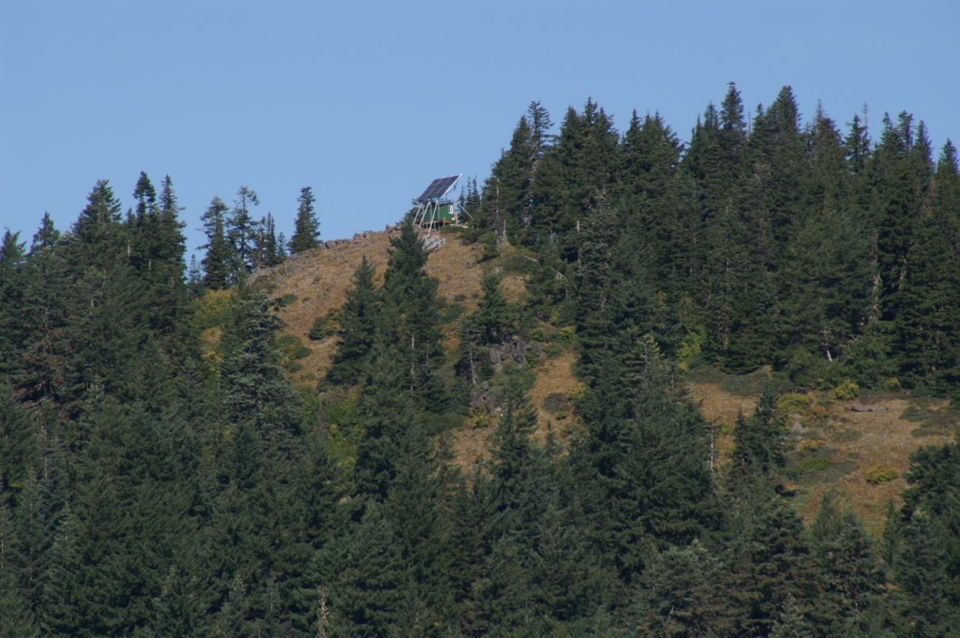
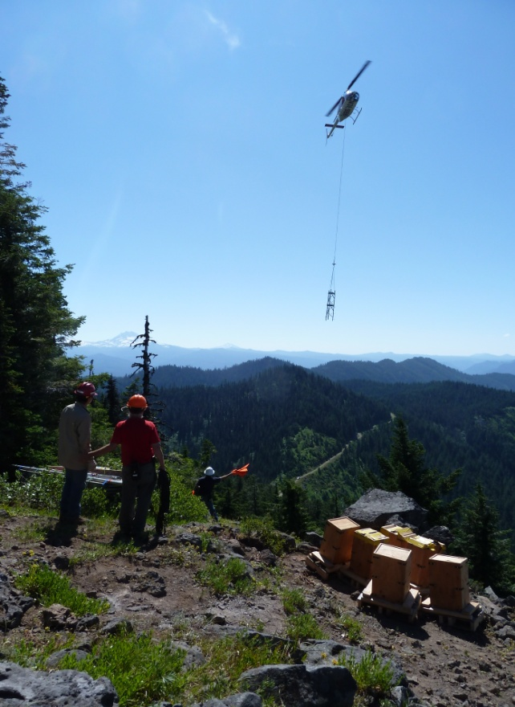
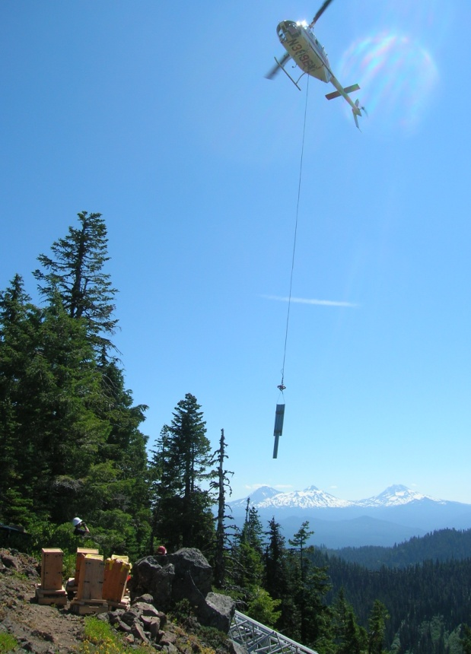
Don Henshaw – USFS PNW Research Station
H.J. Andrews Forest LTER
Janet Fredericks – Woods Hole Oceanographic Institute
X-DOMES Project
ESIP Summer Meeting 2016, 21 July 2016

Slide 2
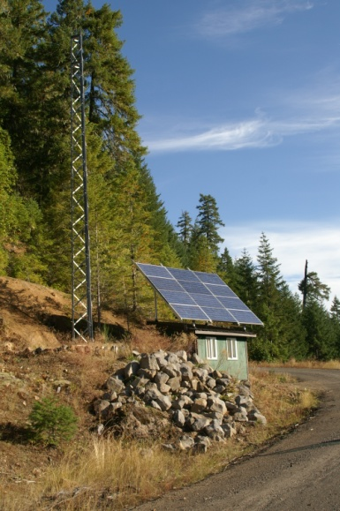
EnviroSensing Cluster History
Origin in Environmental Sensor Workshop Hubbard Brook EF, Oct 25-27, 2011 (NSF LTER, NERC)
Recommendations for sensor network data and tools
Training workshops
Online resource guide or best practices
Training sessions at LTER Network Office, Albuquerque, NM
2012 (LTER, NCEAS, DataONE)
2013 (LTER, UCSD)
Best practices development
2013 LTER workshops (LTER)
2014 EnviroSensing Cluster establishment
Monthly teleconferences
ESIP Summer Meeting 2016, 21 July 2016

Slide 3
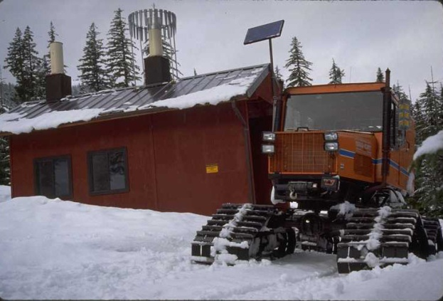
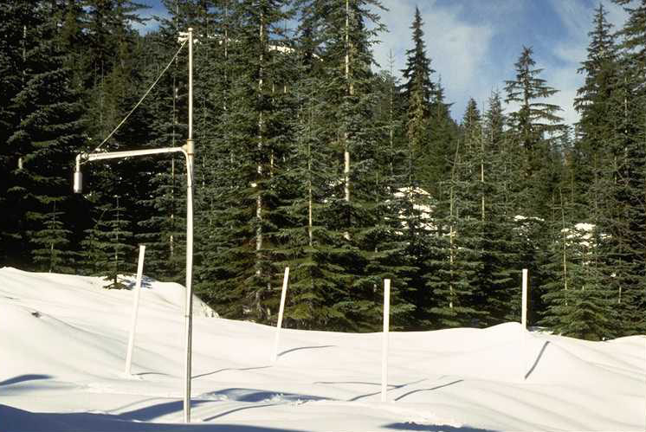
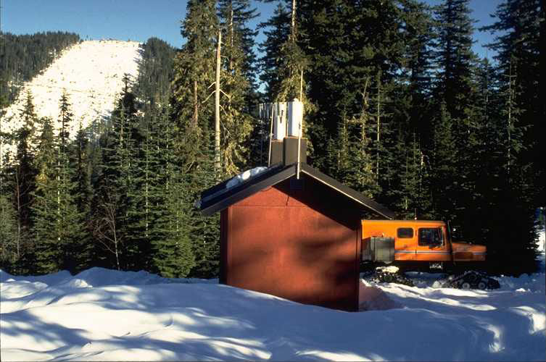
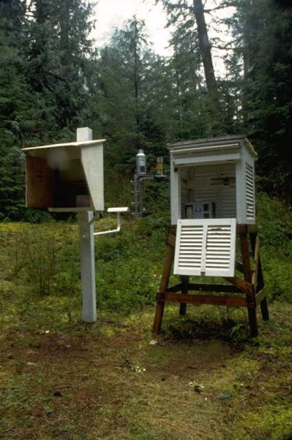
ESIP EnviroSensing Cluster:
Building a sensor network resource guide through community participation
http://wiki.esipfed.org/index.php/EnviroSensing_Cluster
Resource guide chapters
Sensor, site, and platform selection
Data acquisition and transmission
Sensor management, tracking, documentation
Streaming data management middleware
Sensor data quality assurance/quality control (QA/QC)
Sensor data archiving
Software Tools for Sensor Networks, April 23-26, 2013

Slide 4
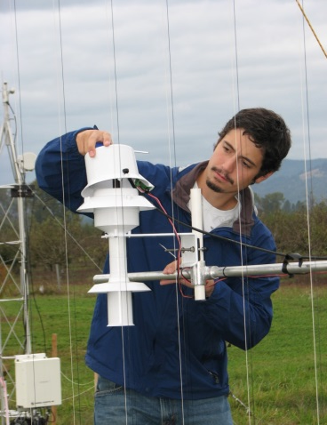
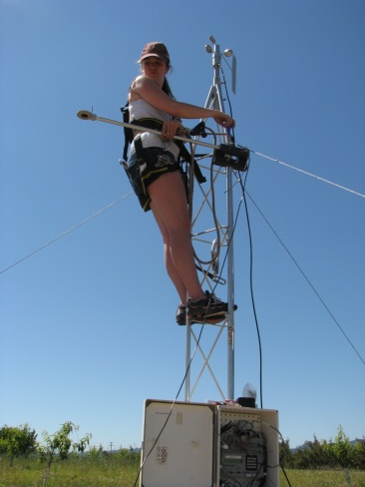
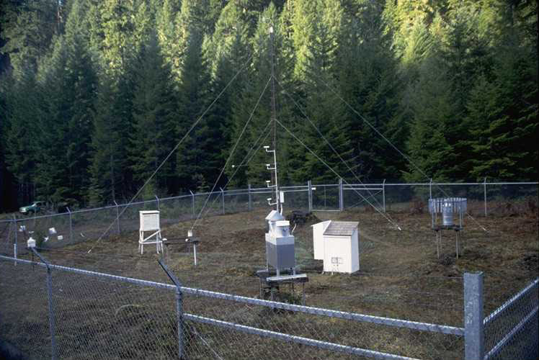
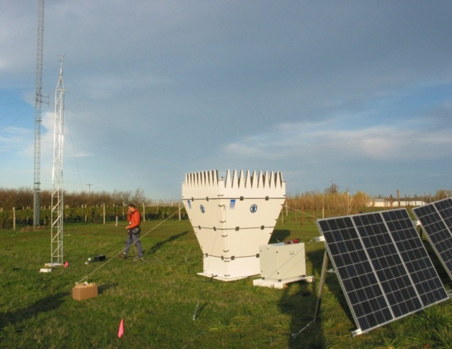
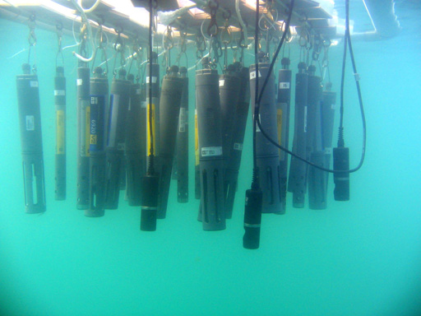
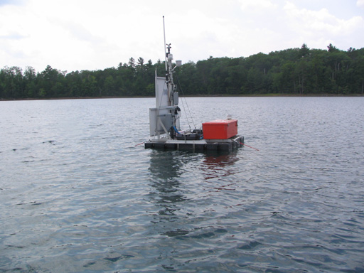
EnviroSensing Collaboration Area:
Sensors and Sensibility
X-DOMES Project
– Janet Fredericks (WHOI)
OpenSensorHub
– Mike Botts (Botts Inc.)
New sensor technologies
– Vasu Kilaru (EPA)
ESIP Summer Meeting 2016, 21 July 2016

