Slide 1
The Federation of Earth Science Information Partners: On the Frontiers of Big Data
Annie Burgess | Community Director | @ESIPFed
http://esipfed.org
Presentation at: http://commons.esipfed.org/node/xxx

Slide 2
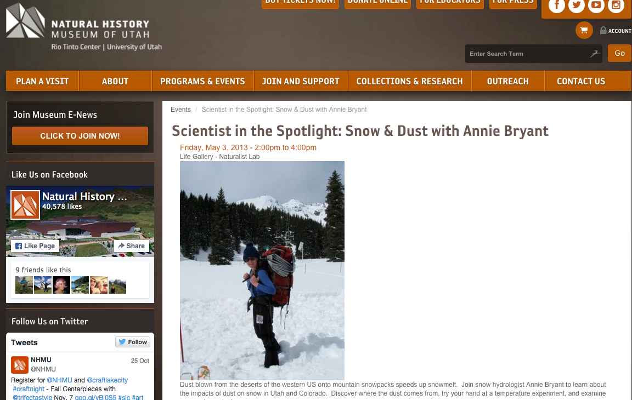
About me
Pivotal Career Moment:
Lets scale it up!

Slide 3
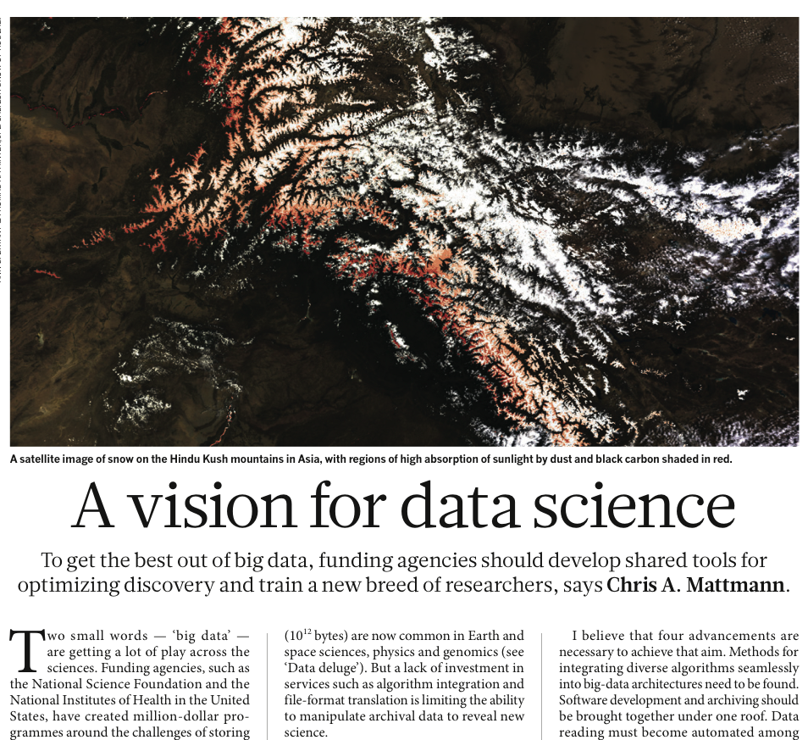
About me
From my laptop to Near Real Time Operations at JPL:
Lots of Lessons learned!

Slide 4
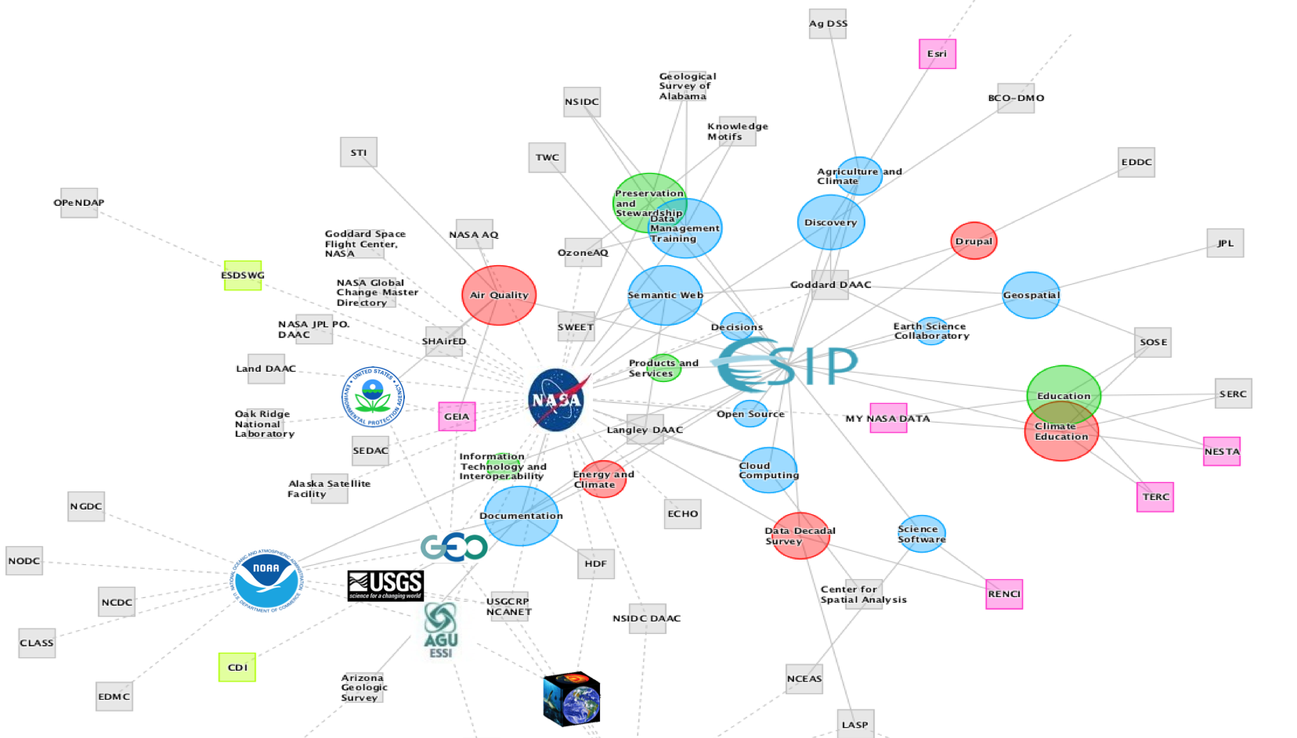
Moving into the Social Era
“We need to use business models that will allow connected humans with shared interests and goals to work
together [across organizations]
and to produce returns.”
Nilofer Merchant,
11 Rules for Creating Value in the Social Era
Notes:
The challenges associated with big data are not solved by individuals or even by organizations. More the challenges we are facing are more social than technical. Nilofer goes on to write that connected people with shared interests and goals can create “virtual circles to produce returns for any company that serves their needs.

Slide 5
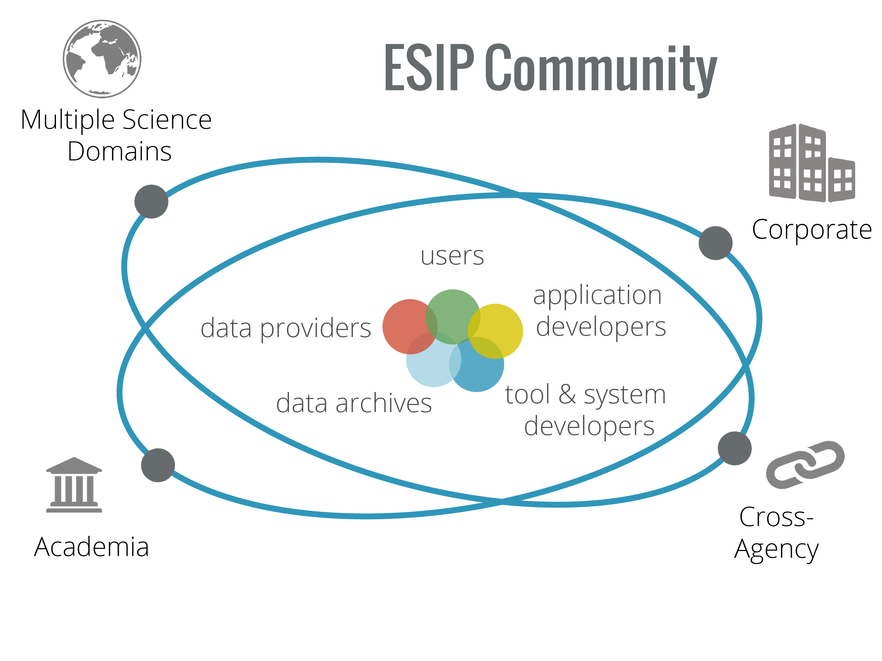
Notes:
We are seeing a shift into the social era, and ESIP embodies collaboration across sector. is a community of technical practitioners that come together across domains, sectors, the data lifecycle .
Benefits of Engaging with Community:
Enhance staff knowledge through peer knowledge exchange
Take away new technologies
Identify new collaborations
Leverage scarce resources through reuse, repurpose
Help define community best practices

Slide 6
ESIP Transforms Earth Science
ESIP provides community coordination to support interoperability at the data, systems, human and organizational levels.
ESIP Meetings Optimize Collaboration
Open Forum for Community-Driven Collaborations
Professional Development for Earth Science Data Management
Innovation Hub for Experimental Development
Notes:
We don’t build software or hardware. We connect people and organizations that can spread what they have learned through ESIP and implemented what they have learned.
Building on this meeting, we’re continuing on to Frontiers in Earth ScienceExample: The discovery cluster has come together.
All this to say – Together, ESIP enables interoperability by aligning distributed groups and connecting at the humanware/humans/organization level to exchange best practices and lessons learned.
*

Slide 7
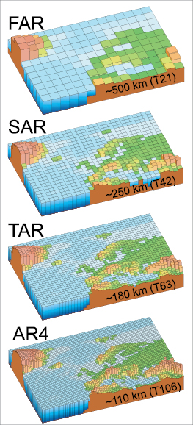
2016 Theme: Frontiers in Earth Sciences Big Data
ESIP Winter Meeting: January 6-8 Washington, DC
ESIP Summer Meeting: July 19-22 Location, TBD
And many in-person opportunities to connect in 2016!
IPCC AR4 Report

Slide 8
Get ESIP’ed
Ongoing activities
Clusters
Start a new one! (Big Data?)
Working groups
Committees
Twice-yearly meetings*
Attend
Present a talk or poster
Chair a session
Partnership
Join
Invite your colleagues
Jump in and get involved – that’s what makes it work!
* Accepting sessions and posters for the Winter Meeting.
Notes:
Let’s continue the conversation on Big Data at ESIP. ESIP is a formum for coming together around technic

Slide 9
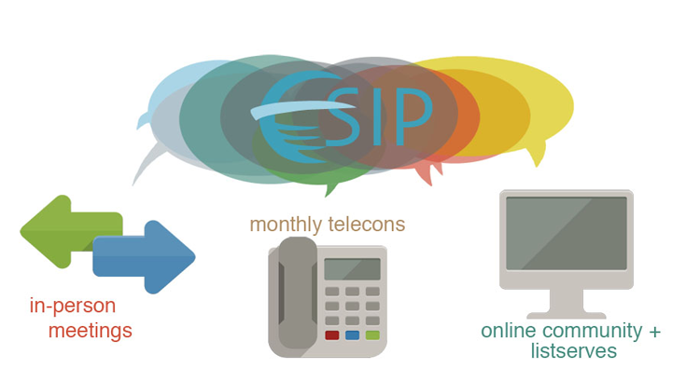
Questions?
Peter Fox, ESIP President, president@esipfed.org
Erin Robinson, Executive Director, erinrobinson@esipfed.org
Annie Burgess, Community Director, annieburgess@esipfed.org

