Slide 1
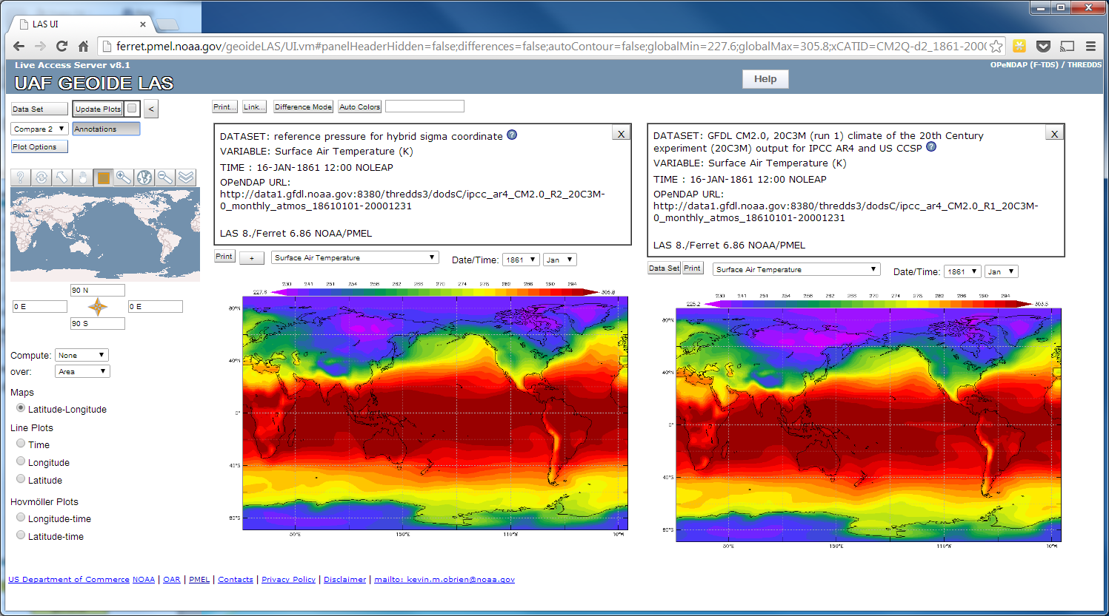
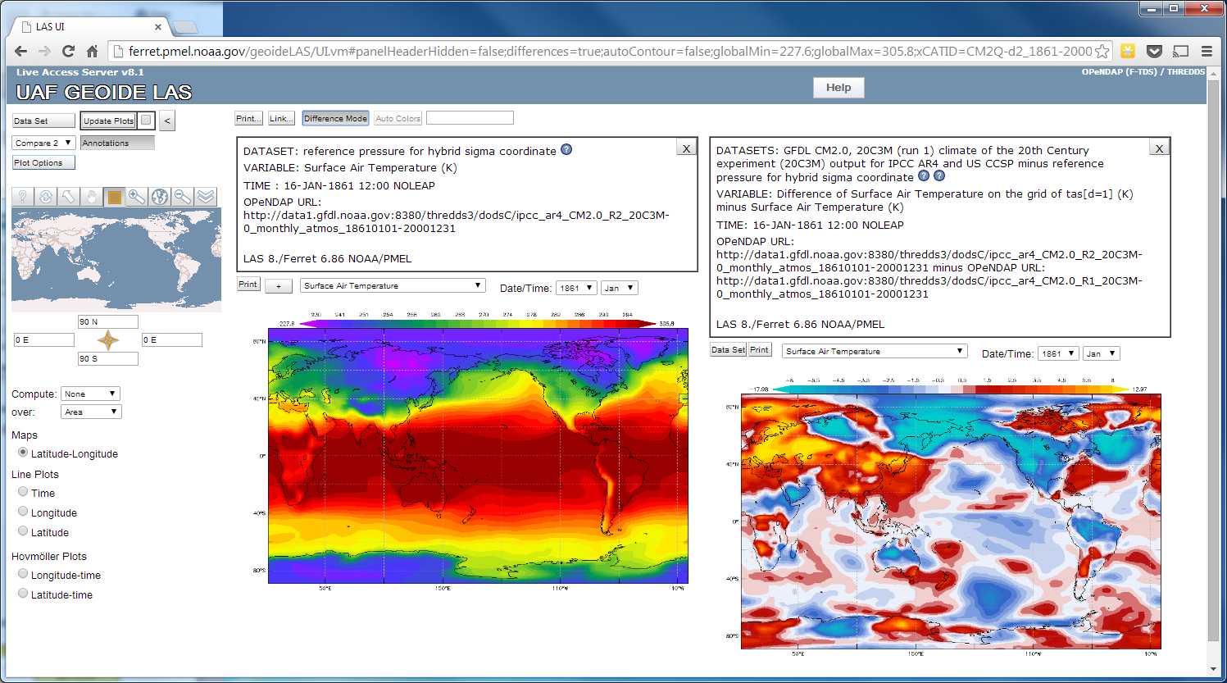
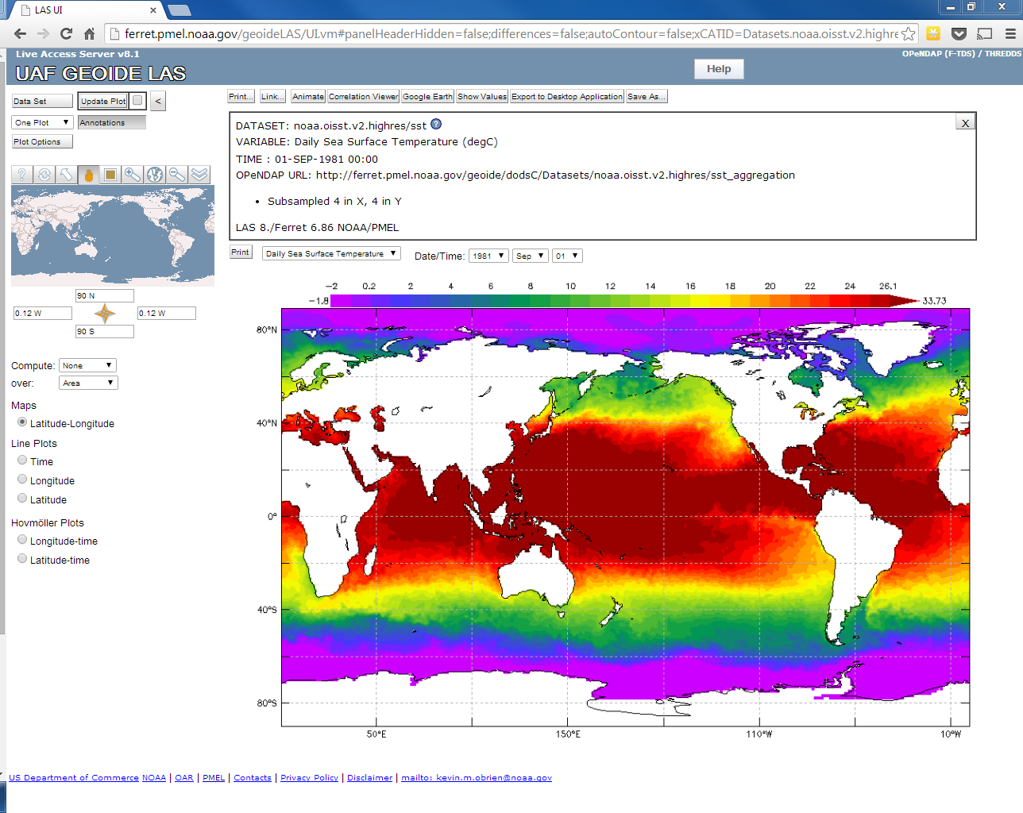
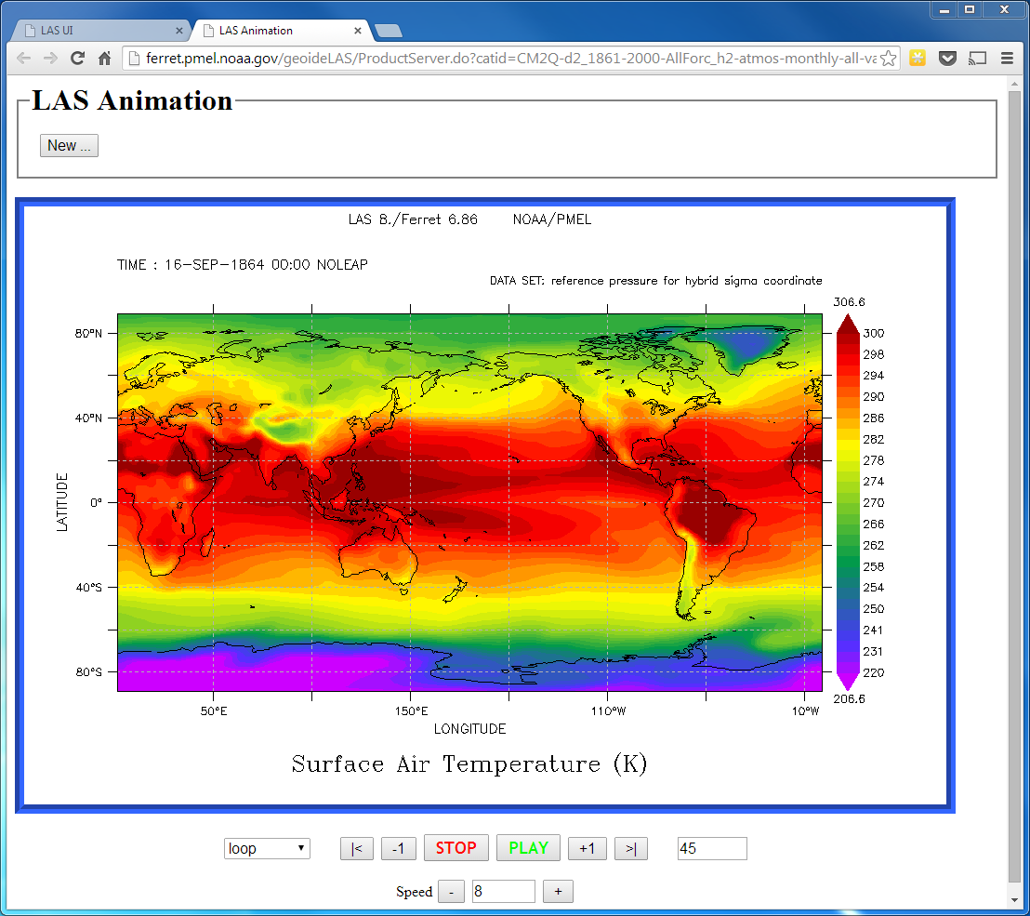
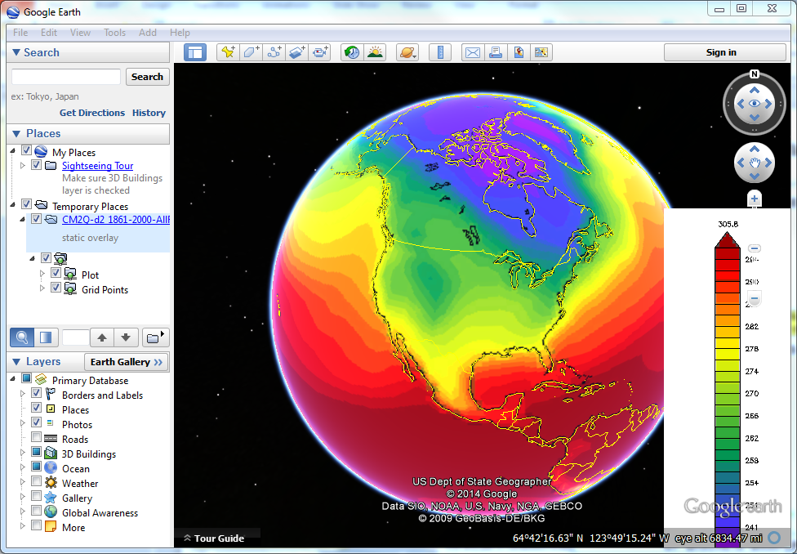
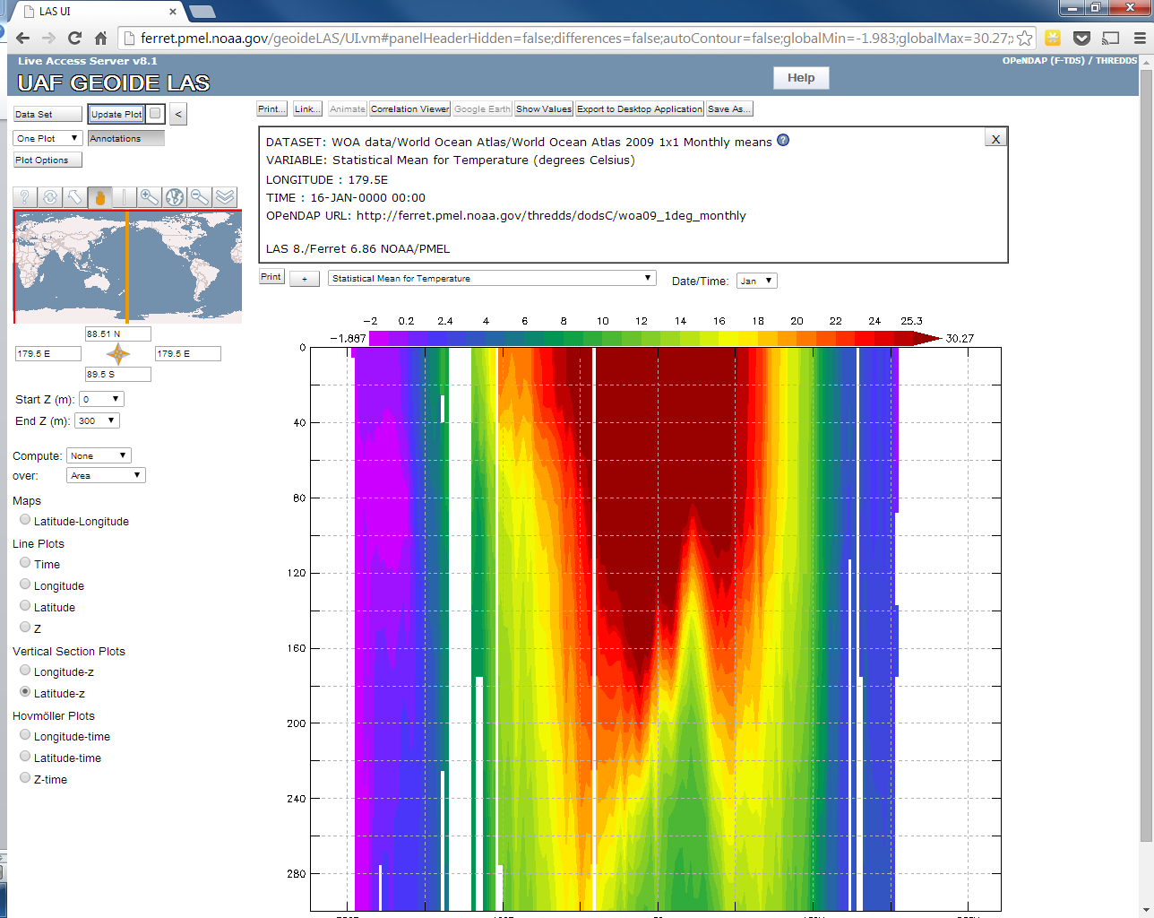
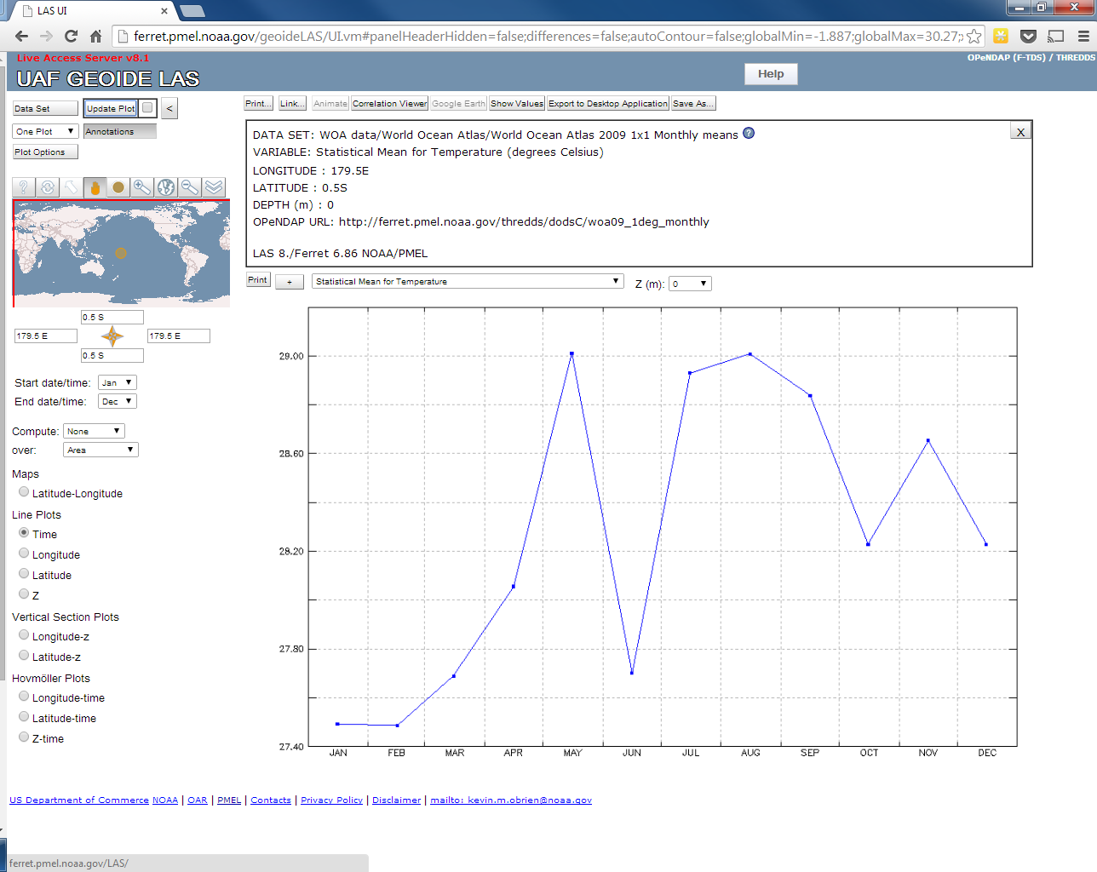
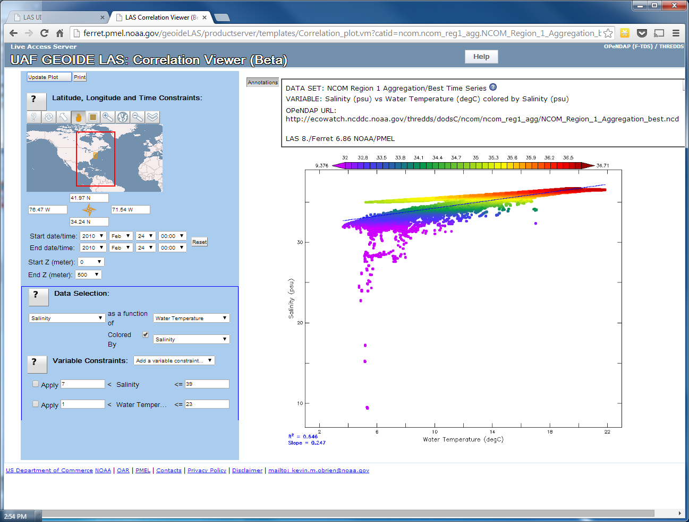
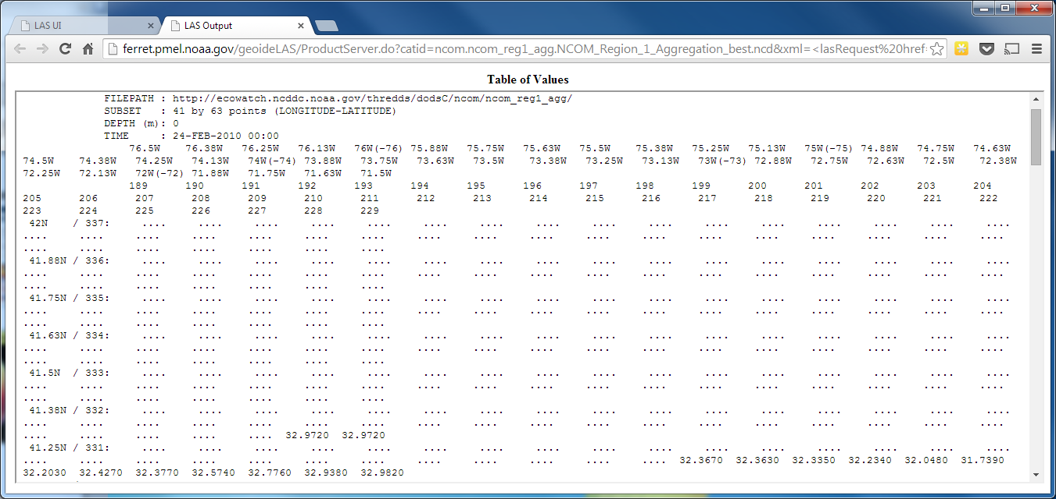
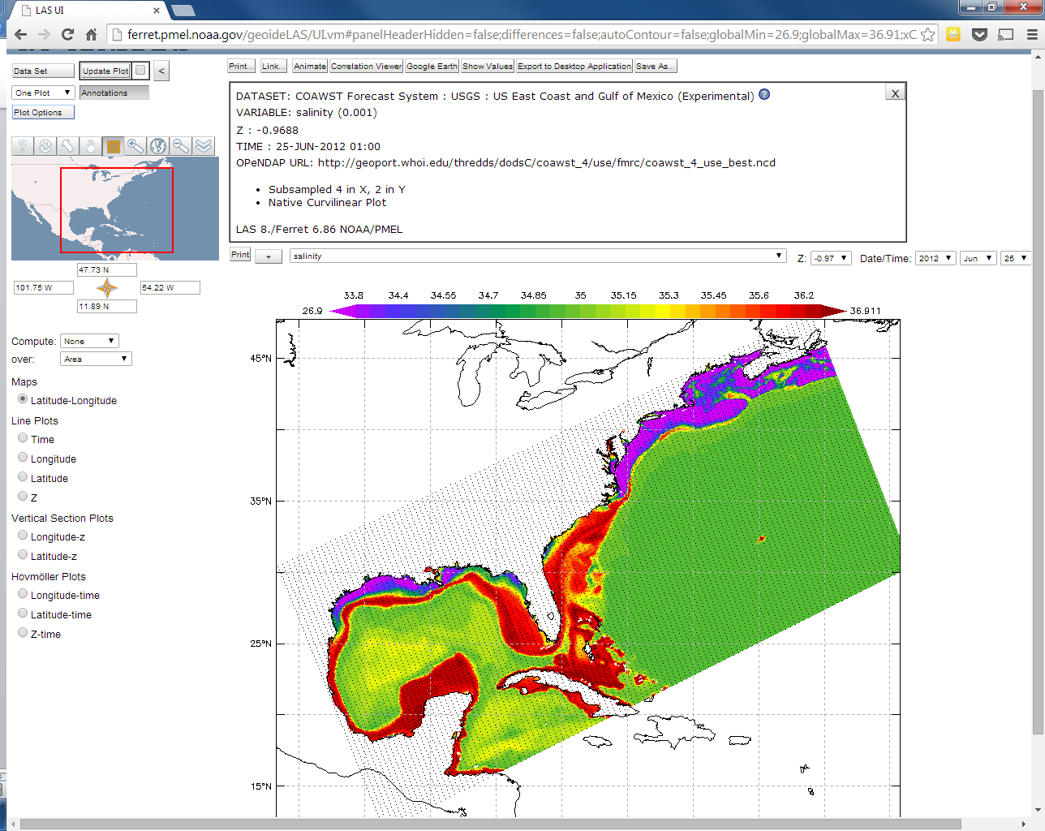
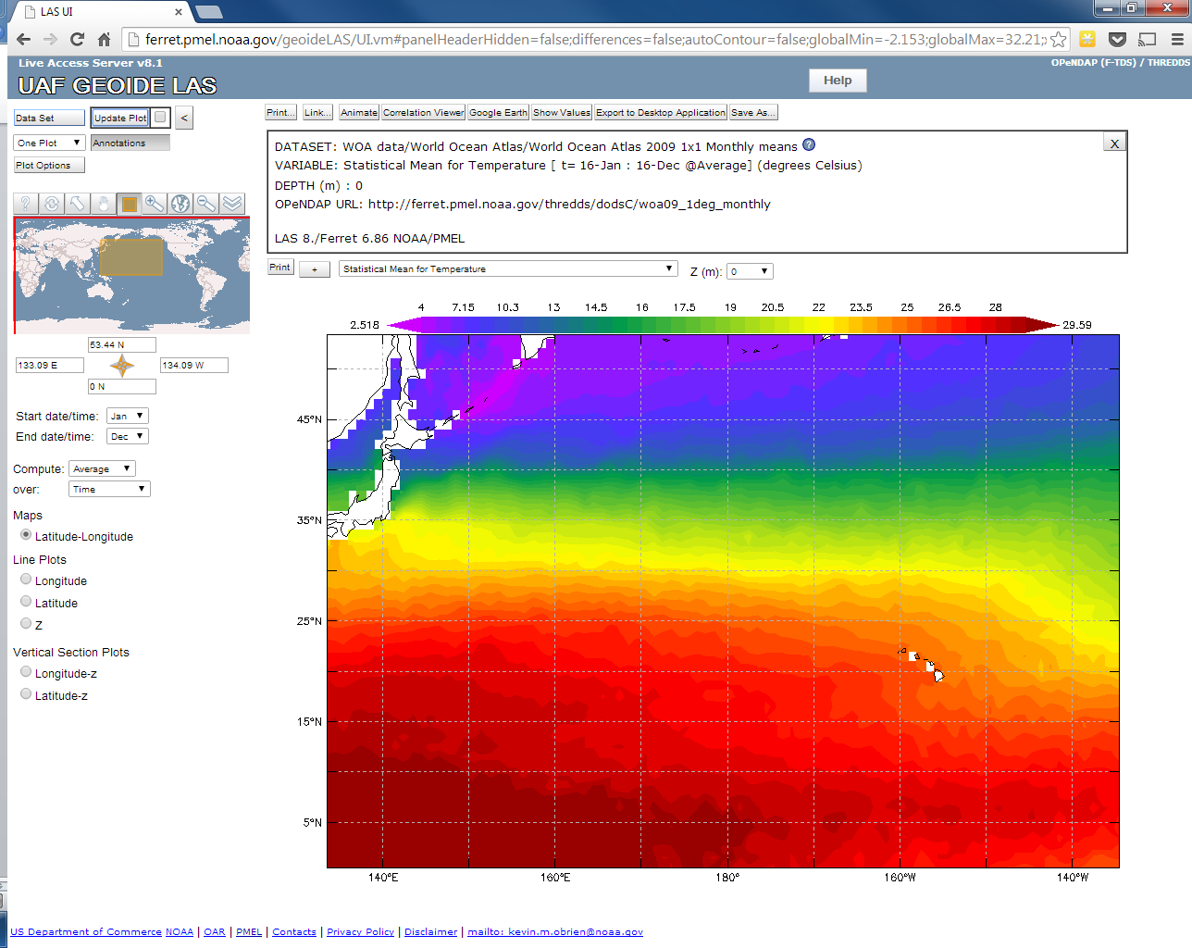
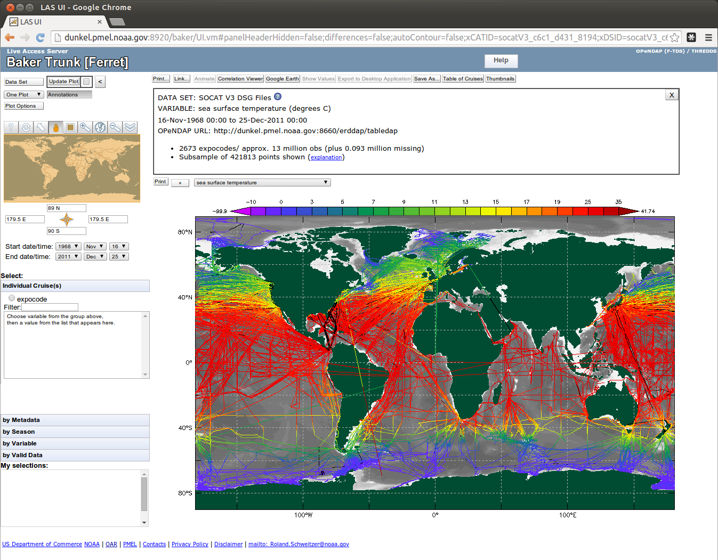
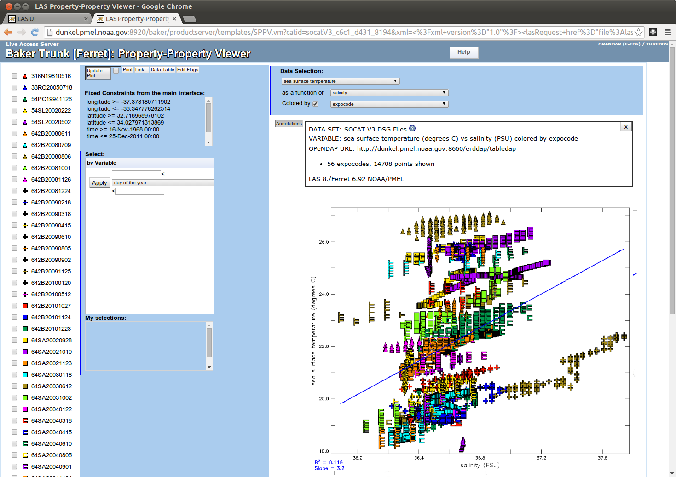
The Live Access Server:
Display, Analysis, and Distribution of Environmental Data
Roland Schweitzer* Kevin O'Brien¹, Steve Hankin², Ansley Manke², Karl Smith¹,
* Weathertop Consulting, LLC, ¹ University of Washington/JISAO, NOAA/PMEL, Seattle, WA, ⁵ OAR/PMEL, NOAA, Seattle, WA
Display and Analysis
Comparison, Differences and Other Views
Local data and remote data served via OPeNDAP that is accessible via the netCDF API and follows the CF metadata conventions can be configured into LAS with a simple command. Trajectory data served via ERDDAP can also be served by LAS.
LAS displays data with a well thought-out set of plot options including a dynamic variance-based color scale.
Every plot type can be further customized by the LAS installer to match special aspects of the data collection.
Users have ultimate control over every option in the system to override LAS and installer defaults to meet their needs.
Users can apply analysis operations to any LAS gridded data set to see sum, average, minimum, maximum and variance in any dimension.
Users can create normalized side-by-side plots from different data sets.
Users can plot differences between variables even if the data are in different data sets and defined on different grids.
LAS includes custom user interfaces for creating property-property plots with any pair of variables in a data set.
Users can download data in many formats for custom sub-sets and tabular views in the browser are available for all data.
LAS now has features for display of CF Discrete Sampling Geometry trajectory files and more DSG feature types are on the way.
LAS main UI
Compare and difference data from different data sets and different grids
Animate in Time
View in Google Earth
OSMC data and products may be viewed on Google Earth
Trackline of Drifter SLP August, 2011
View data along any dimension
Plot property vs property
See aTable of Values
Plot data on its native grid.
Compute avg, min, max, or sum in time, lat, lon, or area
CF Discrete Sampling Geometry Data
Make Ribbon Plots
Plot property vs property
Live Access Server
Unified Access Framework
THREDDS
ERDDAP
http://ferret.pmel.noaa.gov/LAS
http://geo-ide.noaa.gov/
http://www.unidata.ucar.edu/projects/THREDDS/
http://coastwatch.pfeg.noaa.gov/erddap/

