Slide 1
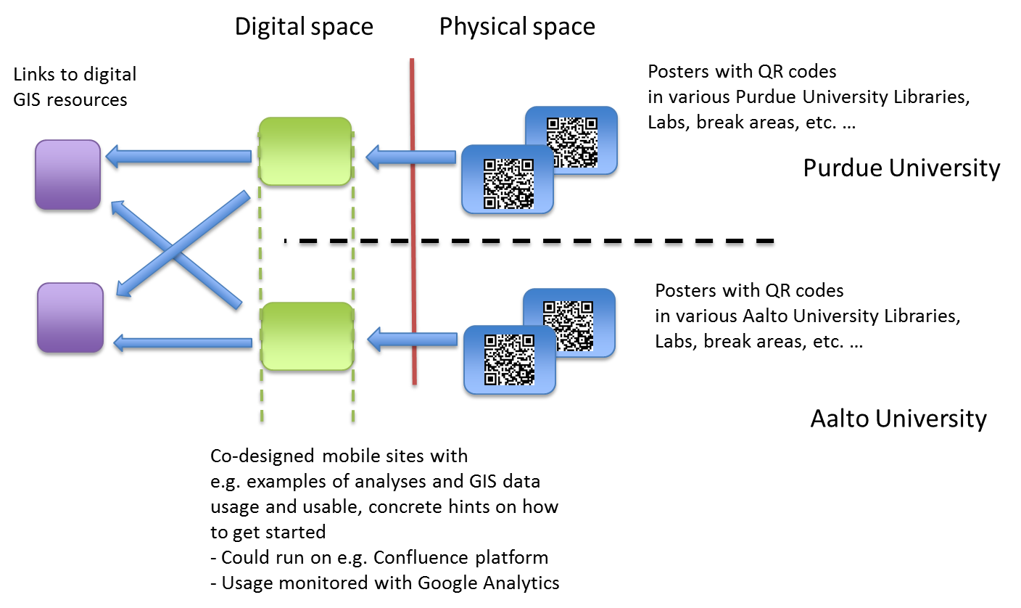
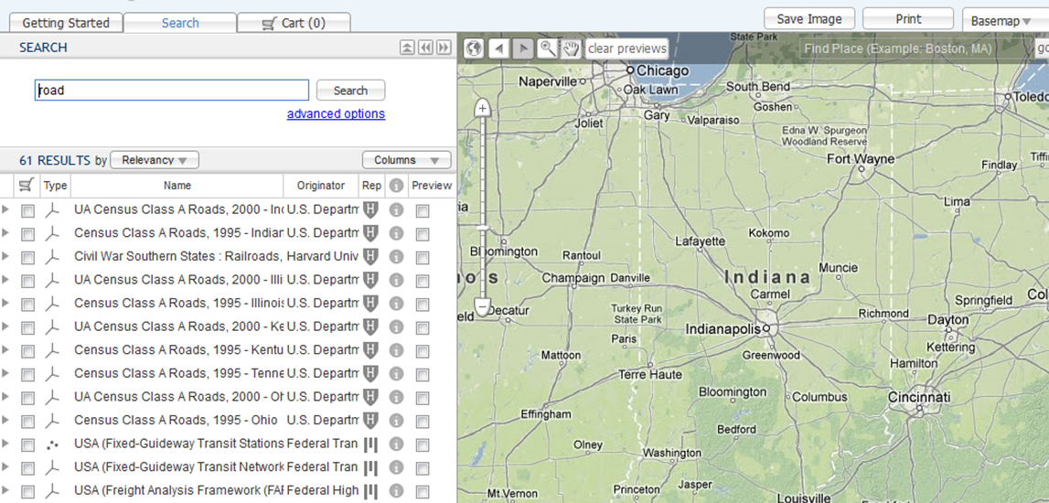
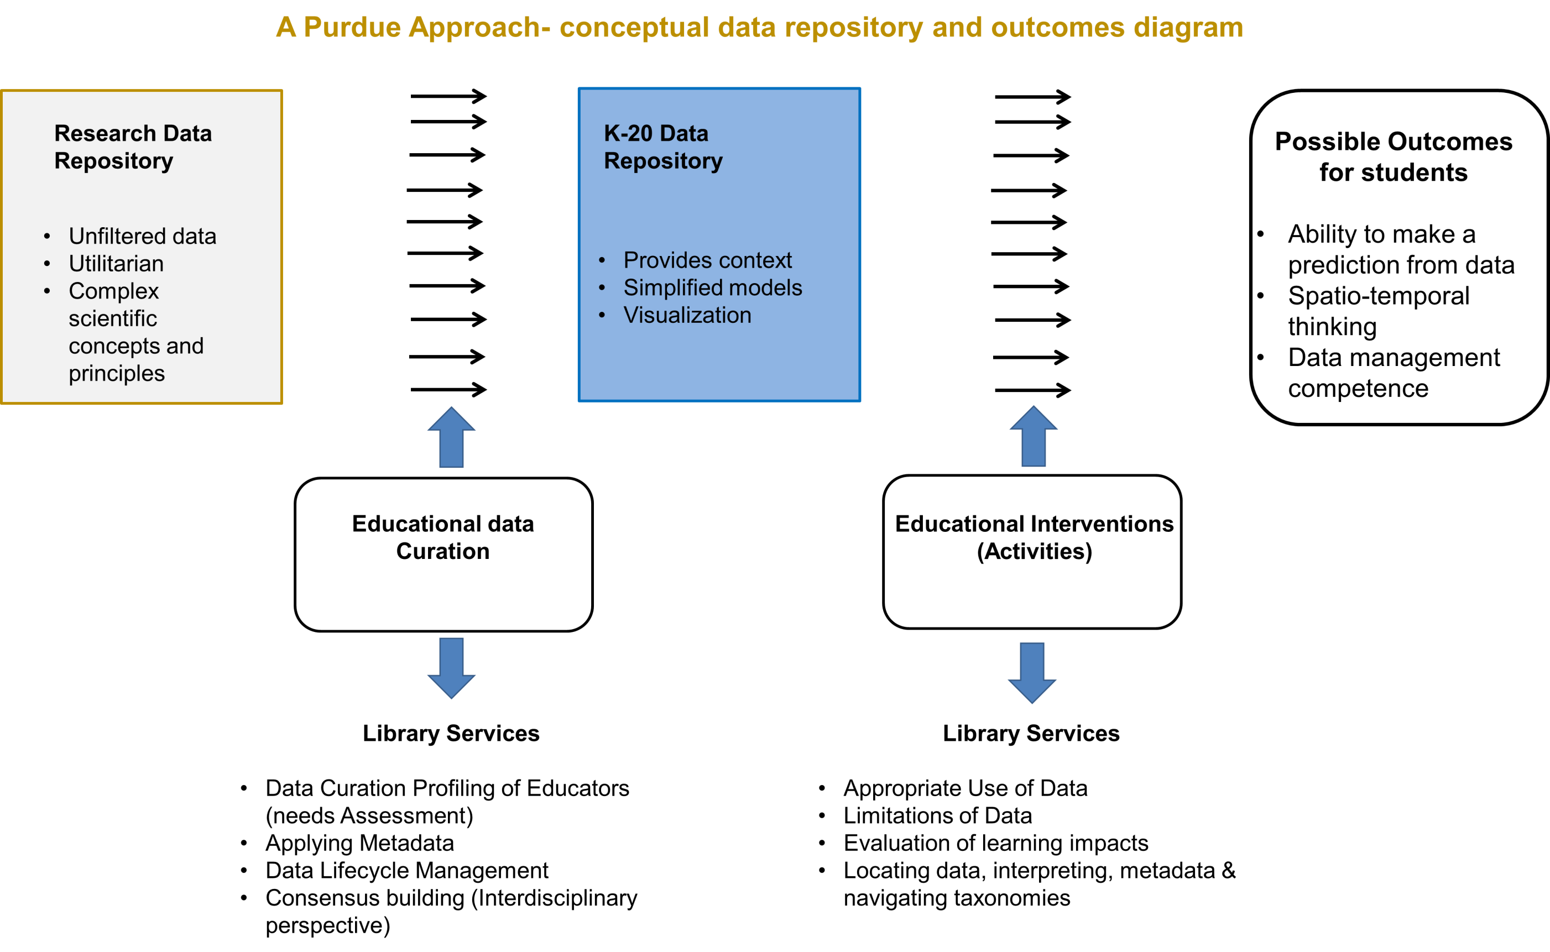
An International GIS and Data Curation dissemination framework
using mobile devices: a Purdue-Aalto University example
Authors: Benjamin Branch and Antti M. Rousi
Purdue University Libraries
Federation of Earth Science Information Partners July 9-12, 2013 Summer Meeting, Chapel Hill, NC
Abstract- The Purdue University Libraries in collaboration Aalto University Library presents a framework for an international method of bridging geospatial resources from one university campus to another. It should be noted that this is a small-scale framework based on open policy, open access and the Group of Earth Observation Systems of Systems (GEOSS) values of sharing data, resources and cyber-infrastructure capacity. This framework advocates that library services could pioneer knowledge dissemination efforts in a low cost manner utilizing mobile devices that can link international users with resources and advance international collaborative inter-librarian data support services that may incite cost reduction of operations while still broadening an international research mission of collaborating universities. Lastly, various forms of data curation may benefit from international collaboration, including such as educational data curation.
Benefits for both libraries include: being in the forefront of designing new real-time collaboration methods that transcend continent boundaries; mobile technology allows these services designed in collaboration to be embedded into different physical learning environments; this framework in development could to applied to various services to be embedded in learning environments across the globe; would generate skills and knowledge transfer between libraries and results in scientific publications.
Geographical Information System (GIS) and geospatial library services represent major opportunities for data curation and services to universities, communities and society. As an emerging issue, geospatial literacy can be seen as a data science of the global citizen. This framework may aid the data dissemination and advance geospatial literacy by making aspects of its use within the reach of a mobile devices and by embedding it into surroundings such as university learning environments.
Rationale for international mobile device data dissemination framework for geospatial expansion or consideration
Mobile device framework to support International knowledge dissemination and Geospatial data curation awareness.
Data Management Profiles Research
The international collaboration of geospatial resources is congruent with international laws concerning GEOSS and its 87 participating countries that work to advance the issues of climate change. Hence, as libraries collaborate on international data services, research capacity and student learning may benefit and gain a new level of global and scholar exposure. This framework recognizes the power of mobile devices that could not only aid the dissemination the metadata framework or ontology design, but also promote the and discussion towards open policy and open access. In addition, this framework promotes collaborative and comparative analysis in geospatial data research and collaboration building between participating universities.
Conceptual framework of 1-1 user use of collaborative mobile device enabled system
As a continuation of research lead by Jake Carson on Data Profiles research used to provide empirical data for library data services our 2013 task of geospatial data collection does such to generate profiles addressing the geospatial community and its needs warranted via such IRB approved research. Here, the best practices and effective data services could be subcontracted from a Purdue GIS team to support a Aalto University GIS team in a mutually beneficial manner. Moreover, mobile device dissemination use may spurn international best data services and data curation activity from data management profiles research based on empirical data.
Project Status-An IRB ground theory approach with 32 interviews.
Project started 1/5/2013
Data Collection Completed 4/15/2013
Data Preparation for Analysis-Ongoing
Data Management Profile Generation-TBD
Data Analysis-TBD
Finding and Presentation-TBD
The problem: Developing library GIS and data curation using GIS is challenged because a lack of expertise in even academic or research libraries and standard library science training. Moreover, mobile device technology is an emerging consideration for library pathfinder integration or next generation data curation frameworks. Learning environments are changing such that new consideration of engagement and data dissemination may shape future data science and library science patron behaviors and data services. Moreover, international compliance with spatial data laws may need to be joint collaborative between such partnerships as a recognition of spatial data skills for the global citizen.
Highlights of such an international GIS collaboration.
Sharing knowledge about GIS methodologies and concrete skills between institutions.
The use of ArcGIS software
Sharing proper ways of the GIS data usage in research
Sharing knowledge about different GIS data repositories
Also Sharing knowledge on GIS instruction
Sharing improvements on instruction methods
Sharing improvements on mediating instruction methods, e.g. multimedia, mobile technology
Sharing emerging trends and needs of different international user communities
Positions faculty for international GIS grants across disciplines on a
Positions universities to offer international learning using geospatial tools
Sets up mobile device research for library science and data science on a global level
Why mobile technology
Via QR codes mobile technology allows applications that are constantly present in the users environment
Different services or mixtures of services can be designed on need-basis to be incorporated into a spatial space with its own individual user groups and their needs.
In their simplest forms, these kinds of services that are integrated into spatial design with much ease, very little investment and with much ease of iteration
Practical Application- Here is a formal geospatial web interface that may be aligned or justified with the mobile dissemination pathfinder effort.
Educational Data Curation –Is defined here as Higher Education (HE) to K-12 knowledge transfer framework based upon the effective and interdisciplinary data science skills of future librarians working with all disciplines to data curation properly at the HE level and have an ontological method to share the data in any possible placed based or evidenced based K-12 or primary education learning environment.
Research Purpose
To promote Geospatial literacy and advance its proper data curation as a library and data science paradigm for the benefit of society and the world.
Research Challenges and barriers
Geospatial Literacy may involve learning by doing and an open mindedness to solve problems with new tools.
“We cannot solve our problems with the same thinking we used when we created them.”-Albert Einstein
Therefore a sustainable pace of change , training and exposure may be the essence of proper geospatial literacy development.
Library Expertise gained to Benefit such Research and Learning:
Temporal analysis
Spatial analysis
May generate interdisciplinary perspectives across disciplines.
Scientific data literacy
Geospatial literacy
Mobile device data delivery
Global citizen literacy
Benjamin Branch CLIR/DLF GIS and Data Curation Fellow bbranch@purdue.edu
Antti M. Rousi, Visiting Scholar @ Purdue, Information Specialist, Aalto University Library,
Otaniemi Campus Library, Finland, antti.m.rousi@aalto.fi
acknowledgements
Jake Carlson, Associate Professor of Library Sciences, jakecarlson@purdue.edu

