Slide 1
Metadata Principles
Matthew Mayernik
Project Scientist & Research Data Services Specialist
NCAR Library / UCAR Integrated Information Services
National Center for Atmospheric Research (NCAR)
University Corporation for Atmospheric Research (UCAR)
ESIP Winter Meeting
Jan. 6, 2016
UCAR
NCAR
UCP
air • planet • people

Slide 2
Principles & Professional Practice
Principles are an established part of library and information science education & practice
Principles of library cataloging, e.g. authorship as main consideration for access points, focus on “works” vs. individual books
Principles of archival arrangement and description, e.g. respect des fonds and provenance
Debates about principles have been central to the intellectual development of the fields

Slide 3
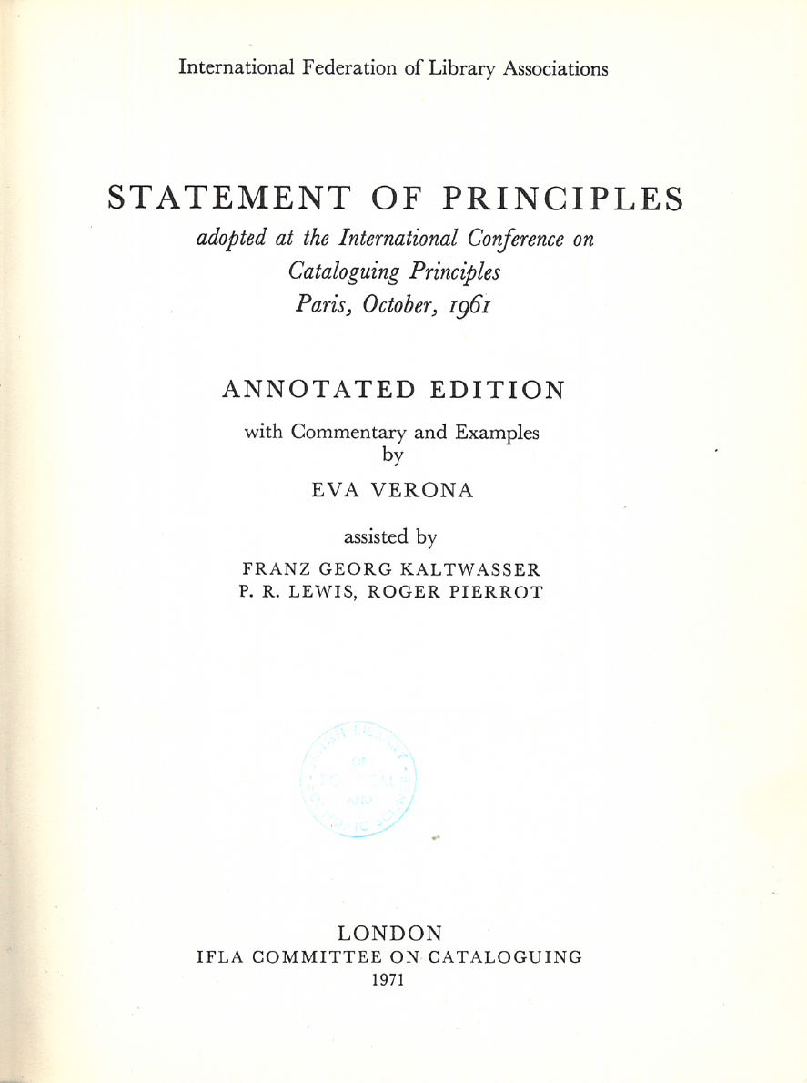
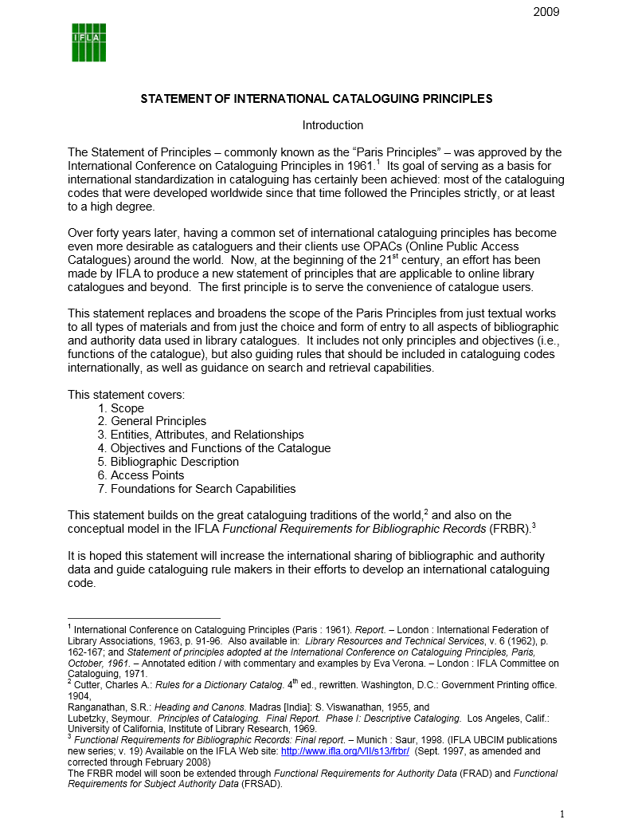
[image on right] Tillett, B.B. & Cristan, A.L. (Eds.). (2009). IFLA Cataloguing Principles: Statement of International Cataloging Principles (ICP) and its Glossary. Munchen: K. G. Saur. http://www.ifla.org/files/assets/cataloguing/icp/icp_2009-en.pdf

Slide 4
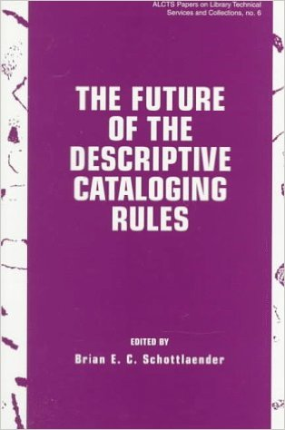
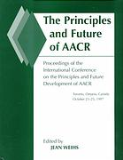
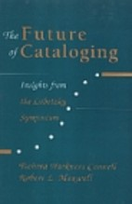
Conf. 1995
Proc. 1998
Conf. 1997
Proc. 1998
Conf. 1998
Proc. 2000
Schottlaender, B.E.C. (Ed.). (1998). The Future of the Descriptive Cataloging Rules: Papers from the ALCTS Preconference, AACR2000, American Library Association Annual Conference, Chicago, June 22, 1995. Chicago, IL: American Library Association.
Weihs, J. (Ed.). (1998). The Principles and Future of AACR: Proceedings of the International Conference on the Principles and Future Development of AACR. Chicago, IL: American Library Association.
Harkness Connell, T. & Maxwell, R.L. (Eds.). (2000). The Future of Cataloging: Insights from the Lubetzky Symposium. Chicago, IL: American Library Association.

Slide 5
Why Principles?
Principles offer directives for how information systems and languages should be designed
Help bring more consistency within and between standards:
The ways that they are constructed
The practices they promote
Help to formalize data management & metadata education

Slide 6
LIS Metadata Principles
Svenonius (2000) – Principles specific to the design of a bibliographic language | Weibel (1995) – Principles that guided the development of the Dublin Core metadata element set
User convenience: descriptions should be made with the user in mind, including using vocabulary according with common usage. | Extensibility. Extension mechanisms allow the inclusion of intrinsic data for objects that cannot be adequately described by a small set of elements. Modifiability. It is necessary that the definitions of the elements satisfy the needs of different communities.
Accuracy of representation: descriptions should be based on the way an information entity describes itself, and should faithfully portray the entity described. | Intrinsicality. The Dublin Core concentrates on describing intrinsic properties of the object, e.g. that could be discovered by having the work in hand, such as its intellectual content and physical form.
Sufficiency and necessity: descriptions should be sufficient to achieve stated objectives and should not include elements not required for this purpose. | Repeatability. All elements in the Dublin Core are repeatable. Optionality. All elements in the Dublin Core are optional.
Standardization: descriptions should be standardized to the extent possible. | Syntax Independence. Syntactic bindings are avoided because the Dublin Core is intended to be used in a range of disciplines and application programs. [Note: this is counter to the standardization principle.]
Integration: descriptions for all types of materials should be based on a common set of rules, to the extent possible.
Svenonius, E. (2000). The Intellectual Foundation of Information Organization. Cambridge, MA: MIT Press. Pg. 68.
Weibel, S. (1995). Metadata: the foundations of resource description. D-Lib Magazine, 1(1). http://www.dlib.org/dlib/July95/07weibel.html

Slide 7
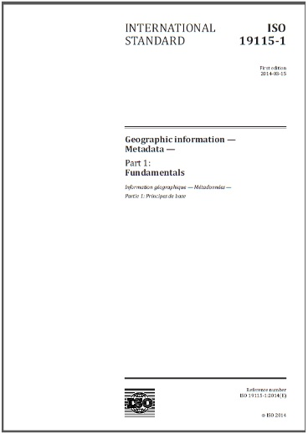
ISO 19115-1:2014
“This part of ISO 19115 is intended to be used by information system analysts, program planners, and developers of information systems, as well as others in order to define basic principles and requirements for standardized description of information resources.” (pg. v)

Slide 8
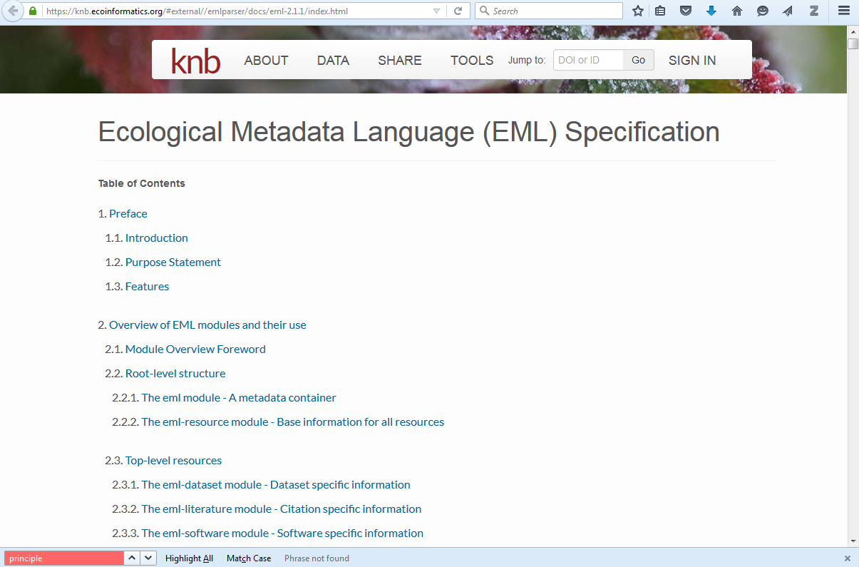
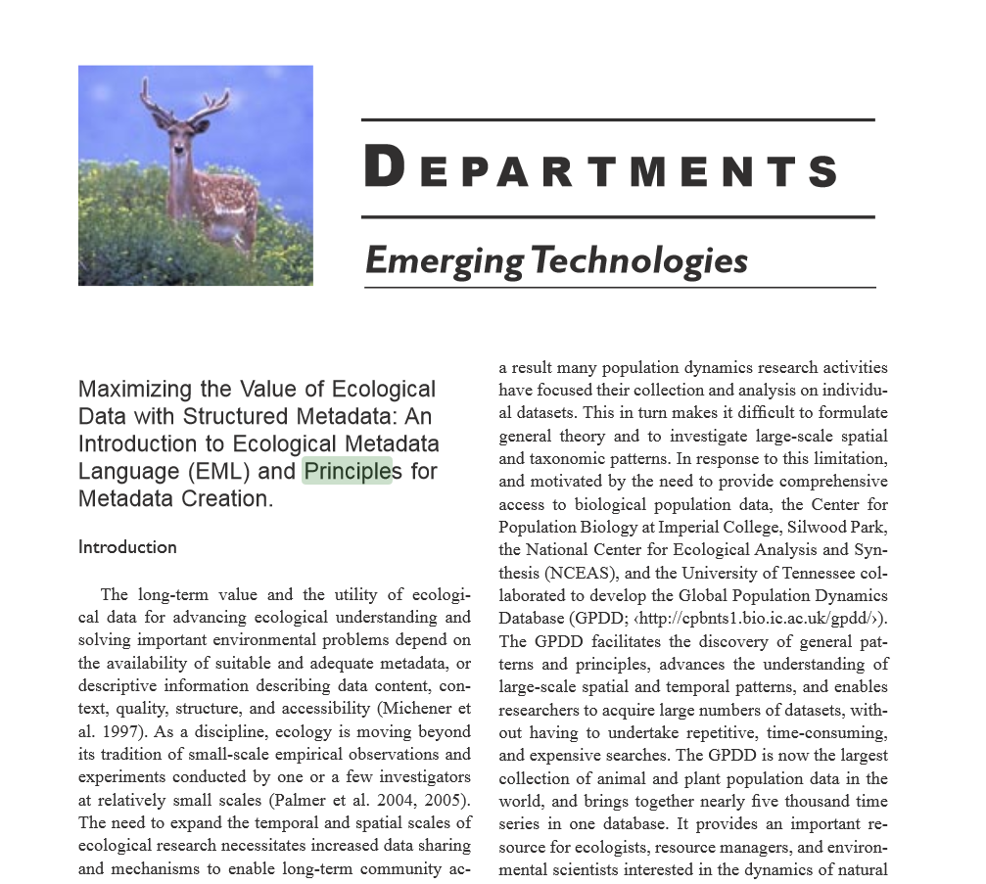
EML
Fegraus, E. H., Andelman, S., Jones, M. B., & Schildhauer, M. (2005).
Bulletin of the Ecological Society of America, 86(3): 158–168. http://doi.org/10.1890/0012-9623(2005)86[158:MTVOED]2.0.CO;2

Slide 9
Metadata Functions
Michener (2006) - (1) support data discovery; (2) facilitate acquisition, comprehension and utilization of data by humans; and (3) enable automated data discovery
Danko (2011) - Locate, evaluate, access, and employ data
Michener, W.K. (2006). Meta-information concepts for ecological data management. Ecological Informatics, 1(1): 3-7.
Danko, D. M. (2011). Geospatial Metadata. In W. Kresse & D. M. Danko (Eds.), Springer Handbook of Geographic Information (pp. 191–244). Berlin: Springer. http://link.springer.com/10.1007/978-3-540-72680-7_12

Slide 10
How?
Principles
What?
Functions
Goals
Why?

Slide 11
LIS Metadata Principles
Svenonius (2000) – Principles specific to the design of a bibliographic language | Weibel (1995) – Principles that guided the development of the Dublin Core metadata element set
User convenience: descriptions should be made with the user in mind, including using vocabulary according with common usage. | Extensibility. Extension mechanisms allow the inclusion of intrinsic data for objects that cannot be adequately described by a small set of elements. Modifiability. It is necessary that the definitions of the elements satisfy the needs of different communities.
Accuracy of representation: descriptions should be based on the way an information entity describes itself, and should faithfully portray the entity described. | Intrinsicality. The Dublin Core concentrates on describing intrinsic properties of the object, e.g. that could be discovered by having the work in hand, such as its intellectual content and physical form.
Sufficiency and necessity: descriptions should be sufficient to achieve stated objectives and should not include elements not required for this purpose. | Repeatability. All elements in the Dublin Core are repeatable. Optionality. All elements in the Dublin Core are optional.
Standardization: descriptions should be standardized to the extent possible. | Syntax Independence. Syntactic bindings are avoided because the Dublin Core is intended to be used in a range of disciplines and application programs. [Note: this is counter to the standardization principle.]
Integration: descriptions for all types of materials should be based on a common set of rules, to the extent possible.
Svenonius, E. (2000). The Intellectual Foundation of Information Organization. Cambridge, MA: MIT Press. Pg. 68.
Weibel, S. (1995). Metadata: the foundations of resource description. D-Lib Magazine, 1(1). http://www.dlib.org/dlib/July95/07weibel.html

Slide 12
Questions
What are the principles of metadata creation for scientific data?
Would the scientific data communities benefit from developing an agreed-upon set of metadata principles?
What would be the appropriate venue(s) for such discussions? ESIP? Research Data Alliance?

