Slide 1




EarthCube conceptual design
A Scalable Community Driven Architecture
http://earthcube.org/group/scalable-community-driven-architecture
Overview
PI: G. Djorgovski (Caltech)
CO-I: D. Pilone, T. Pilone (Element 84), D. Crichton, E. Law (JPL)
Other key personnel: S. Caltagirone (E84), S. Hughes (JPL),
T. Huang (JPL), A. Mahabal (Caltech)
2016 ESIP Winter Meeting

Slide 2
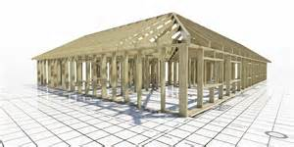
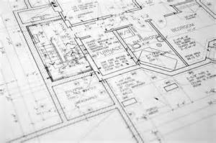
A high level system blueprint for the definition, construction, and deployment of both existing and new components to ensure that they can be unified and integrated into an evolutionary national infrastructure for EarthCube
Notes:
Our objective to provide a comprehensive framework

Slide 3
Methodology
Identification of stakeholders, concerns and requirements
Identification of architectural use cases and drivers
Selection of an architectural framework
Development of the architectural principles
Development of the architectural models
Capture of the architecture artifacts in a consolidated report
Generation of recommendations for adopting the architecture for the EarthCube program

Slide 4
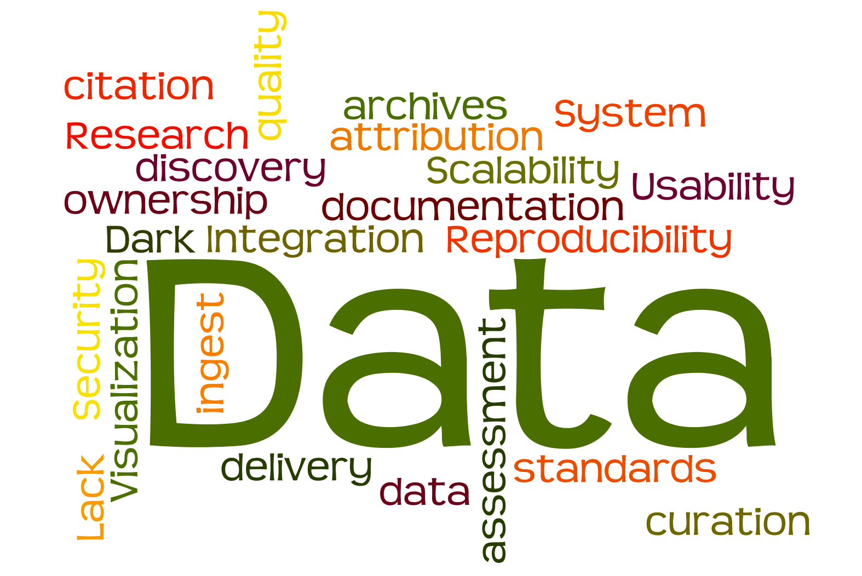

Slide 5
Stakeholders
Stakeholder/Actor | Concerns
NSF Program Managers | Make decision and provide guidance at the EarthCube program level.
 | Provide sufficient funding to support the EarthCube mission.
EarthCube Scientists | Use EarthCube resources and services to conduct scientific research.
 | Publish scientific results & curate data as needed.
EarthCube Developers | Develop technologies and services that can be integrated into EarthCube.
EarthCube Architects | Establish EarthCube requirements, framework and operational concept.
 | Develop information model (vocabulary, ontology).
 | Establish standards guidelines.
 | Ensure interoperability between EarthCube Building Blocks.
External Data Users | Use EarthCube resources and services for research, education, and decision-making.
Curator | Ensure data is properly captured in EarthCube compliant data repositories.
Data Owner | Responsible for producing the data.
 | Concerned about its distribution and use.
External Data Facility | Responsible for archiving data at other agencies (NASA, NOAA, USGS, etc); interoperability with the EarthCube Cyberinfrastructure.
EarthCube Governance Committees | Responsible for generating and monitoring the governance for the system including data curation, access, use case priority, interoperability standards, etc.
EarthCube Office Staff | Responsible for maintaining the community involvement within EarthCube and communicating changes and how to use the system.

Slide 6
Use Cases
Big Science – Discovery, Comparison, Provenance, Model & visualization
Collaborative Science
Dark Data Contribution
Tools Contribution
Data Documentation
Models Sharing
High Performance Computing and Storage Resources
Real Time Data
Physical Sample Curation

Slide 7
Drivers
Transform and accelerate research and discovery by turning data into knowledge and enabling interdisciplinary data integration.
Provide critically needed data, tools, and computational resources and frameworks for cross-domain scientific collaboration, analysis and with long-term geoscience software and data preservation, discovery and use.
Provide a geosicences cyberinfrastructure and architecture that is scalable, extensible and sustainable.

Slide 8
Frameworks
Zachman Framework - For organizing stakeholder concerns and perspectives.
ISO/IEC/IEEE 42010:2011- For architectural description guidelines.
Reference Model for Open Distributed Processing (RM-ODP) – For architectural patterns for distributed systems.
Open Group Architecture Framework (TOGAF) – For managing the architecture.
Federal Enterprise Architecture Framework (FEAF) – For classifying the architecture into architectural elements and viewpoints.
ISO 14721:2003 - Open Archival Information System (OAIS) Reference Model - Provides a standard for information objects.
ISO/IEC 11179:3 Registry Metamodel and Basic Attributes specification - Provides a schema for a metadata registry.

Slide 9

Scalability
Community Driven
Open Science
Interoperability
Sustainability
Distributed
Data Model Driven

Slide 10

Science
Data
Manage
Satellite
Instrument
Data
Systems
Science
Data
Manage
EarthCube CI
Airborne
Data
EarthCube Discovery
Science
Data
Manage
Agency
Earth Data
Archives
Data Provider
Notes:
Leverage existing data facilities

Slide 11
EarthCube CI
Science
Data
Manage
Satellite
Instrument
Data
Systems
Science
Data
Manage
Airborne
Data
EarthCube Repository
EarthCube Discovery
Science
Data
Manage
Agency
Earth Data
Archives
Other Data Systems (e.g. NOAA)
Other
Data Systems
(In-Situ, University)
Other Data Systems (e.g. NOAA)
Data Provider
Notes:
Handle dark data

Slide 12


Science Teams
EarthCube CI
Science
Data
Manage
Data Science Infrastructure (Data, Algorithms, Machines)
Satellite
Instrument
Data
Systems
Science
Data
Manage
Airborne
Data
EarthCube Repository
EarthCube Discovery
Science
Data
Manage
Agency
Earth Data
Archives
Other Data Systems (e.g. NOAA)
Other
Data Systems
(In-Situ, University)
Other Data Systems (e.g. NOAA)
Data Provider
Notes:
Provide data science infrastructure

Slide 13


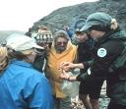


Science Teams
EarthCube CI
Science
Data
Manage
Data Science Infrastructure (Data, Algorithms, Machines)
Earthcube Data Analytics Centers
Satellite
Instrument
Data
Systems
Research
Science
Data
Manage
Airborne
Data
Applications
EarthCube Repository
EarthCube Discovery
Science
Data
Manage
Decision
Support
Agency
Earth Data
Archives
Other Data Systems (e.g. NOAA)
Other
Data Systems
(In-Situ, University)
Other Data Systems (e.g. NOAA)
Data Provider
Data Analysis
Notes:
Integrate both new and existing, a unified set of data records and platforms for analytics
Allow other to provide data and build applications

Slide 14
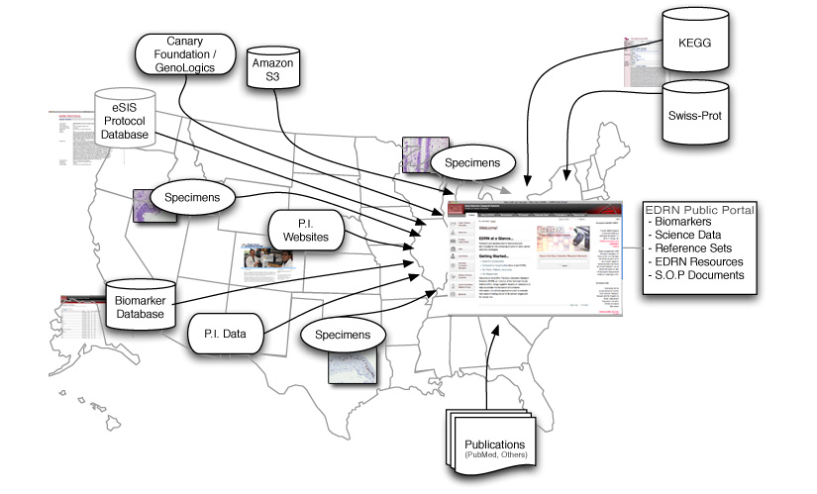
Benchmark
Earth System Grid Federation (ESGF)
Early Detection Research Network (EDRN)
NASA’s Earth Observing System Data and Information System (EOSDIS)

Slide 15
Architecture Elements

Slide 16
Data Lifecycle

Slide 17
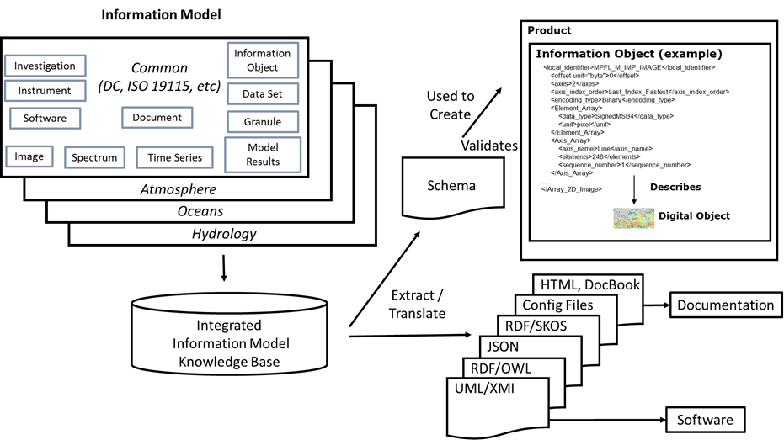
Information Model Context
Notes:
An information model is a representation of concepts, relationships, constraints, rules, and operations to specify data semantics for a chosen domain
It provides a sharable, stable, and organized structure of information requirements

Slide 18
Framework

Slide 19
Example Instantiation

Slide 20
Thank You
Questions?

Slide 21
EarthCube Conceptual Architecture Discussion
The controversial bits…

Slide 22
THIS IS A DISCUSSION.
Please Talk.

Slide 23
EarthCube Architect
EarthCube Developer
EarthCube Scientist
Curator
NSF Program Manager
External Data Users
External Data Facility
Earthcube Staff
Governance Committee

Slide 24
Stakeholders
Do we have the right stakeholders?
Do they overlap at all? Too much?
Are they useful to provide use cases and personas that help drive the system?
Are we missing key stakeholders?

Slide 25
Stakeholders
NSF Program Managers | EarthCube Scientists
EarthCube Developers | EarthCube Architects
External Data Users | Curators
Data Owner | External Data Facility
EarthCube Governance Committees | EarthCube Office Staff
Notes:
Do we have the right Stakeholders?

Slide 26
Architectural Principles
Federation | Sustainability
Standards | (Data) Model-Driven
Extensibility | Scalability
Provenance | Security

Slide 27
Standards…
We do not advocate a particular standard…
Our Conceptual Architecture emphasizes fully defined and self contained data rather than prescribing standard(s).
EarthCube’s heterogenous data, applications, and systems appear to justify possible increase in complexity.
Common models and representations should be used.

Slide 28
EarthCube Software Lifecycle Processes
Technology Planning
Software Development
Release

Slide 29
Research Software Lifecycle Processes
Technology Planning
Software Development
Software Versioning
Software Search and Distribution
Algorithm Search and Distribution

Slide 30
Software Lifecycle Processes
We place an emphasis on software versioning, discovery, etc. for Research Software. Should we treat “EarthCube proper” processes the same way?
What about discovery and distribution?

Slide 31
Metrics
Use Examples:
  Product Searches
  Products Downloaded
  Services Accessed
  Publications Cited
Quality Examples:
  Ingestion speed
  Search Response Time
  User “conversions”

Slide 32
Metrics & Conceptual Architectures
Is this the right place to advise / mandate metrics? (e.g. we’re not doing this for standards)
Should we be specific or just provide categories?
Do we go so far as to ”mandate” it for EarthCube components / building blocks / etc?

Slide 33
Science Teams
EarthCube CI
Science
Data
Manage
Data Science Infrastructure (Data, Algorithms, Machines)
Earthcube Data Analytics Centers
Satellite
Instrument
Data
Systems
Research
Science
Data
Manage
Airborne
Data
Applications
EarthCube Repository
EarthCube Discovery
Science
Data
Manage
Decision
Support
Agency
Earth Data
Archives
Other Data Systems (e.g. NOAA)
Other
Data Systems
(In-Situ, University)
Other Data Systems (e.g. NOAA)
Data Provider
Data Analysis
Notes:
Integrate both new and existing, a unified set of data records and platforms for analytics
Allow other to provide data and build applications

Slide 34
Places we haven’t expressed an opinion
Cloud vs. on-premises hosting
Data location (hosted vs. distributed)
Compute location
Should we?

Slide 35
Best Practices
Common Software Stack | Common Data Model
Standard Interfaces | Service-Oriented Architecture
Decoupled Storage, Compute, and Data Management | Federated Search
Analytic Services | Visualization

Slide 36
Misc Questions
How do we make this real?
What’s the next thing you need to make EarthCube more valuable to you?
How can the Conceptual Architecture effort help you get there?

Slide 37
Our Next Steps
Solicit Reviewers for Conceptual Architecture Document (NOW!)
Incorporate feedback and review comments
Write actionable recommendations and incorporate into final Conceptual Architecture
Prioritize and Deploy Key Architectural Components

Slide 38
We need reviewers!
Please contact Emily Law if you’re interested.
Thank you!

