Slide 1
Presentation for Lawrence
Chris: Do you know how to paste Gilberto’s sample presentation format into this Google Presentation?
Steve: See if this works. (GV)
Analytics and Data Scientists
Steve Kempler and You
January 9, 2014
ESIP Federation Meeting
Washington, DC

Slide 2
Format
Interactive:
Slides are to stimulate thinking
Think: (Managing Data): What is important, that needs to be done, but currently can not be done? (And how WE can get it done?)
We are here to explore the possibilities, not just hear the possibilities
Information defining/gathering/listing mode to lay the groundwork for the work to be addressed
Presentation for Lawrence
Chris: Do you know how to paste Gilberto’s sample presentation format into this Google Presentation?
Steve: See if this works. (GV)

Slide 3
This Session’s Goal
“Large Heterogeneous Datasets” (LHDs) aka “Big Data”, “Analytics”, “Data Scientist” are overused and often abused terms that mean different things to different people.
This session aims to explore the possibilities, interest, involvement, experience, and understanding that Partners are willing to bring to the table to enhance and foster the next evolutionary phase of enabling science research.

Slide 4
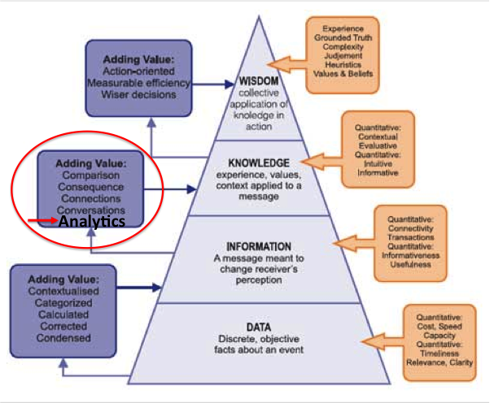
The Ultimate Long Term Goal

Slide 5
Session Concept
Federation Partners are forward thinking, by nature, and are industry leaders positioned to apply smart innovative ideas to conceptualizing, developing (implementing?) analytics tools and techniques that facilitate the use of large heterogeneous data sets, unique to serving large heterogeneous datasets.
It truly appears that analytics, and data scientists to usher in analytics, is the logical next step in our quest up the pyramid to 'knowledge'.
This session is not necessarily interested in repurposing existing tools and techniques, but understanding innovative tools and techniques that can be uniquely applied to large heterogeneous datasets.

Slide 6
Agenda
- Some words on Session Concept
Session Goal 1 (~ 25 Minutes):
Discuss the definition of LHD
Discuss the definition of analytics in the context of LHD
Discuss the definition of a Data Scientist in the context of analytics

Slide 7
Agenda
Session Goal 2 (~ 45 Minutes):
Define Activities to advance the utilization of analytics techniques and methodologies
List potential activities to facilitate “cost-effective, innovative forms of information processing” techniques and methodologies, in particular, unique to LHD
List potential actions
Draft a timeline with activities and actions
Define Activities that facilitate the definition/qualifications of a Data Scientist as we, in Earth Science, see it
List potential activities that would enable us to better understand, analyze and refine Data Scientist qualifications
List potential actions
Draft a timeline with activities and actions

Slide 8
Starting Point
On the continuum of ever evolving data management systems, we need to understand and develop ways that allow for data relationships to be examined, and information to be manipulated, such that knowledge can be enhanced, to facilitate science.
In short, we have a lot of data that we really have not provided opportunity for users to holistically ‘mine’.

Slide 9
Session Goal #1: Define Terms
Large Heterogeneous Datasets…
OK…Big Data:
An Adjective: Big Data methodology
A Phenomenon: Rapid acceleration of increasing data volume….
An Architecture: ‘Solved by Big Data’
A Paradigm: The shift to Big Data analytics
A Movement: Glean intelligence from data
A Term: To describe the voluminous amount of unstructured and semi-structured data that would take too much time and cost too much money to load into a relational database for analysis.
(Source: http://searchcloudcomputing.techtarget.com/definition/big-data-Big-Data)

Slide 10
Gartner’s big data definition –
“Big data” is high-volume, -velocity and -variety information assets that demand cost-effective, innovative forms of information processing for enhanced insight and decision making.
(source: http://www.gartner.com/it-glossary/big-data/)

Slide 11
The V’s
Consider the “3 V’s”:
Data Management: Controlling Data Volume, Velocity and Variety. Current business conditions and mediums are pushing traditional data management principles to their limits, giving rise to novel and more formalized approaches
Big data spans four dimensions: Volume, Velocity, Variety, Veracity
Volume: Enterprises are awash with ever-growing data of all types
Velocity: Big data must be made available and used in a reasonable time period
Variety: Big data is any type of data - structured and non-structured
Veracity: Trusting the information to make decisions.
(Source: http://www-01.ibm.com/software/data/bigdata/)

Slide 12
Thus…
Big data requires exceptional technologies to efficiently process large quantities of data within tolerable elapsed times
The next frontier is learning how to manage Big Data throughout its entire lifecycle.
(Source: http://www.forbes.com/sites/ciocentral/2012/07/05/best-practices-for-managing-big-data/)
Big data is only as good as your analytics
(Source: http://www.theserverside.com/news/2240178385/Big-data-trends-Big-things-in-store-for-2013)

Slide 13
Analytics in the context of LHD
Analytics vs Analysis
Analytics is a two-sided coin. On one side, it uses descriptive and predictive models to gain valuable knowledge from data - data analysis. On the other, analytics uses this insight to recommend action or to guide decision making - communication. Thus, analytics is not so much concerned with individual analyses or analysis steps, but with the entire methodology (Source: http://en.wikipedia.org/wiki/Analytics)

Slide 14
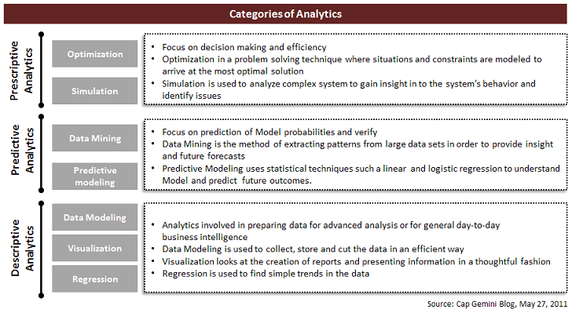
Analytics
(http://steinvox.com/blog/big-data-and-analytics-the-analytics-value-chain/)

Slide 15
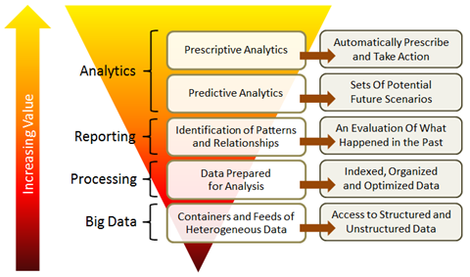
Another look at Analytics
(http://steinvox.com/blog/big-data-and-analytics-the-analytics-value-chain/)

Slide 16
A 2011 McKinsey report suggests suitable technologies include...
(http://www.mckinsey.com/insights/business_technology/big_data_the_next_frontier_for_innovation)
…A/B testing, association rule learning, classification, cluster analysis, crowdsourcing, data fusion and integration, ensemble learning, genetic algorithms, machine learning, natural language processing, neural networks, pattern recognition, anomaly detection, predictive modelling, regression, sentiment analysis, signal processing, supervised and unsupervised learning, simulation, time series analysis and visualisation.

Slide 17
Data Scientist in the context of analytics
Data Scientist
A data scientist possesses a combination of analytic, machine learning, data mining and statistical skills as well as experience with algorithms and statistical skills as well as experience with algorithms and coding. Perhaps the most important skill a data scientist possesses, however, is the ability to explain the significance of data in a way that can be easily understood by others. (Source: http://searchbusinessanalytics.techtarget.com/definition/Data-scientist)
Rising alongside the relatively new technology of big data is the new job title data scientist. While not tied exclusively to big data projects, the data scientist role does complement them because of the increased breadth and depth of data being examined, as compared to traditional roles. (Source: http://www-01.ibm.com/software/data/infosphere/data-scientist/)

Slide 18
Analytics Master's Degrees Programs

Slide 19
What Defines a Data Scientist?
Organizational Leadership, Statistics, Data analysis, Probability, Algorithms for Data Science, Data Engineering, Machine Learning, Exploratory Data Analysis, HealthCare Analytics, Business Analytics
Woodstock, AGU IN43A-1638: The role of the Data Scientist is a hybrid one, of not quite belonging and yet highly valued. With the skills to support domain scientists with data and computational needs and communicate across domains, yet not quite able to do the domain science itself. Role of the data scientist: Provides access to unified technology (open standards); know seamless access, training scientists in IT, build community (with scientists)
Evans, AGU IN43A-1641: Data Scientist, who has a greater capacity in mathematical, numerical modelling, statistics, computational skills, software engineering and spatial skills and the ability to integrate data across multiple domains.

Slide 20
Session Goal 2: Define Activities to advance the utilization of analytics techniques and methodologies
Goal: List potential activities to facilitate “cost-effective, innovative forms of information processing” techniques and methodologies, in particular, unique to LHD
Goal: List potential actions
Goal: Draft a timeline with activities and actions
Possibilities:
<1 year:
Specify/Analyze user scenarios that involve the need for analytics required to further analyze large heterogeneous Earth science datasets.
1-2 years:
Document a wish list of clearly specified analytics that can satisfy user scenarios, lending themselves to gleaning knowledge from information.
Have them peer reviewed
2-3 years:
From collaborations to implement analytics tools and techniques

Slide 21
Session Goal 2: Define Activities to advance the utilization of analytics techniques and methodologies
Dozens of excellent user scenarios have already been collected by the NIST Big Data Public Working Group (http://bigdatawg.nist.gov/workshop.php)
RDA Big Data Analytics (BDA) Interest Group also addresses this area of interest (https://rd-alliance.org/internal-groups/big-data-analytics-ig.html)
Lary, AGU IN21D06

Slide 22
Session Goal 2: Define Activities that facilitate the definition/qualifications of a Data Scientist as we, in Earth Science, see it
Goal: List potential activities that would enable us to better understand, analyze and refine Data Scientist qualifications
Goal: List potential actions
Goal: Draft a timeline with activities and actions
Possibilities:
<1 year:
Define specific qualifications of the Earth science Data Scientist. (Work on this is already in progress, but what is our input)
-2 years:
Peer review the Earth science Data Scientist Qualifications. Collaborate with other groups looking at this.
2-3 years:
Publish: The Earth science Data Scientist Qualifications. Or work with other groups to formalize qualifications

Slide 23
Do We Move Forward?
Is there enough inertia to continue? Telecons, Wiki
Seek to represent the Federation?
Publish?
Later, seek outside collaborations
Other possibilities?
Thoughts?

Slide 24
Thank you

