Slide 1
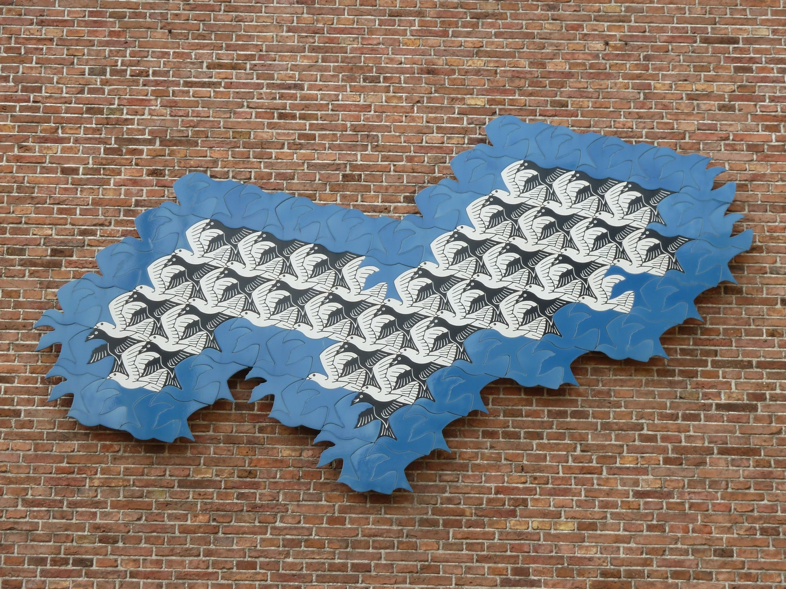
M.C. Escher

Slide 2
Aggregation
–
What’s it to The HDF Group?
ESIP Summer Meeting 2015
Mike Folk
The HDF Group

Slide 3
Why do we aggregate?
Aggregation and HDF
An aggregation reference model?

Slide 4
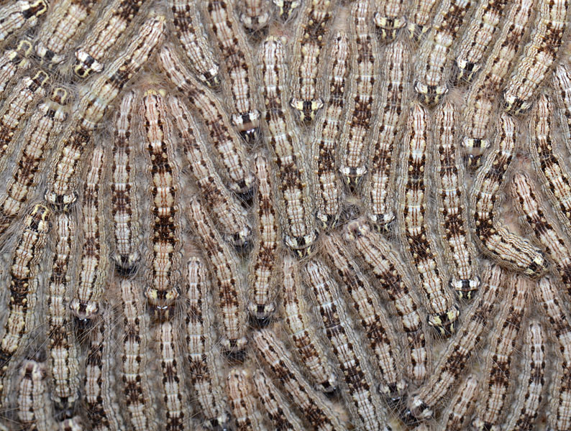
Why do we aggregate?

Slide 5
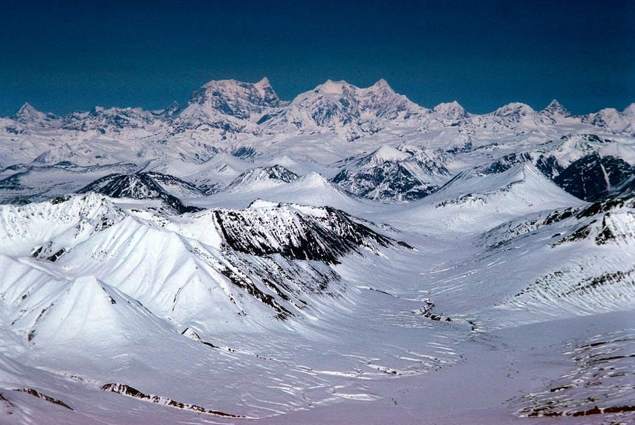
1. To see a bigger picture

Slide 7
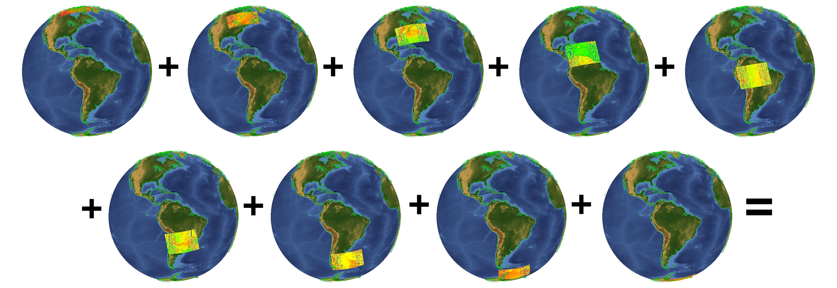
If a tool can only work with a single object, aggregation can combine together into a single object all the information we want the tool to use.

Slide 8
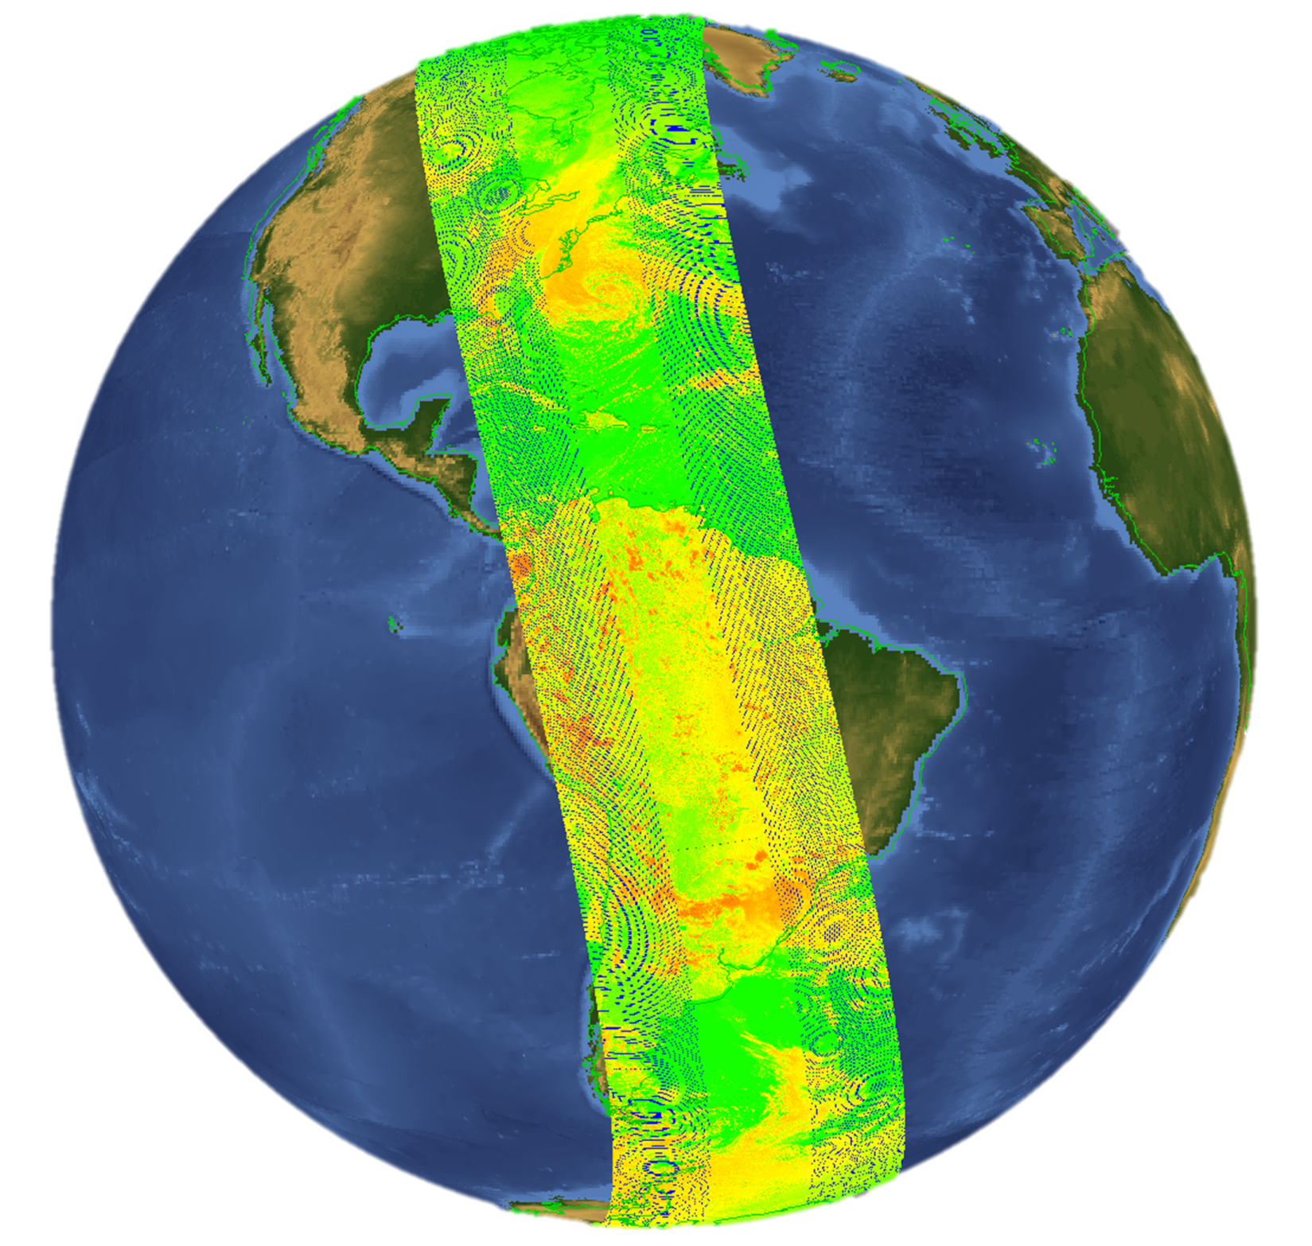

Slide 9
2. “The whole is more than the sum of its parts.”

Slide 10
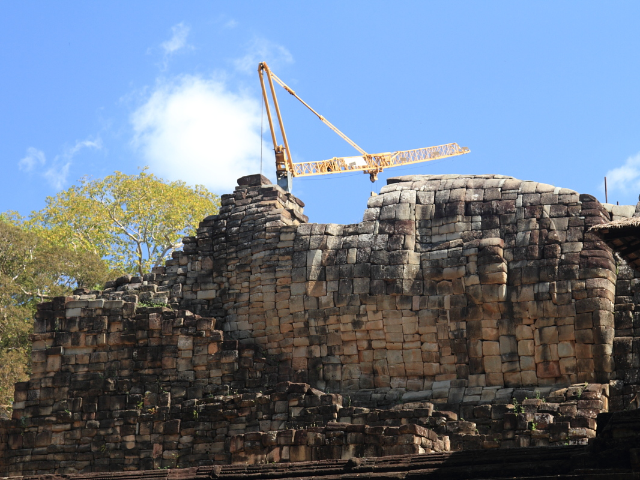
“The whole is more than the sum of its parts.”
Notes:
Baphuon Temple, Angkor Thom, Cambodia

Slide 11
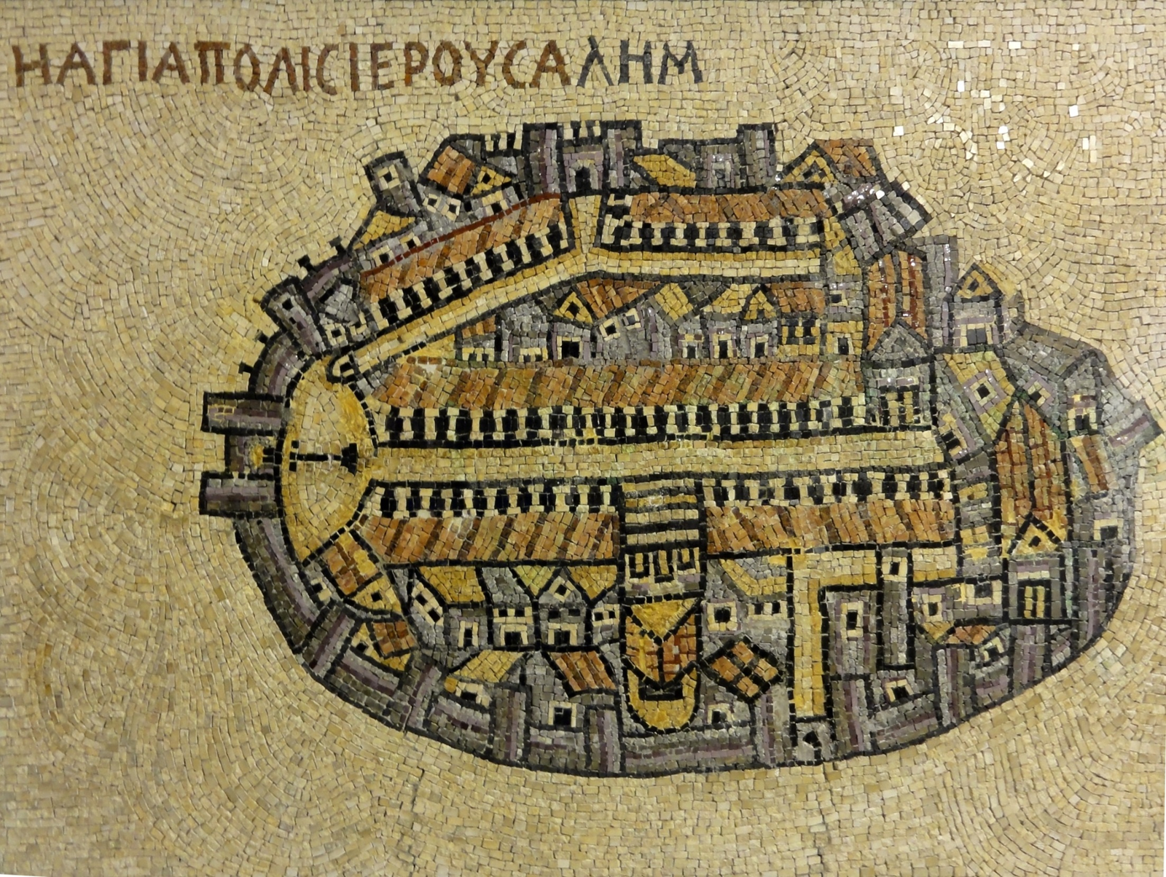
Jerusalem

Slide 12
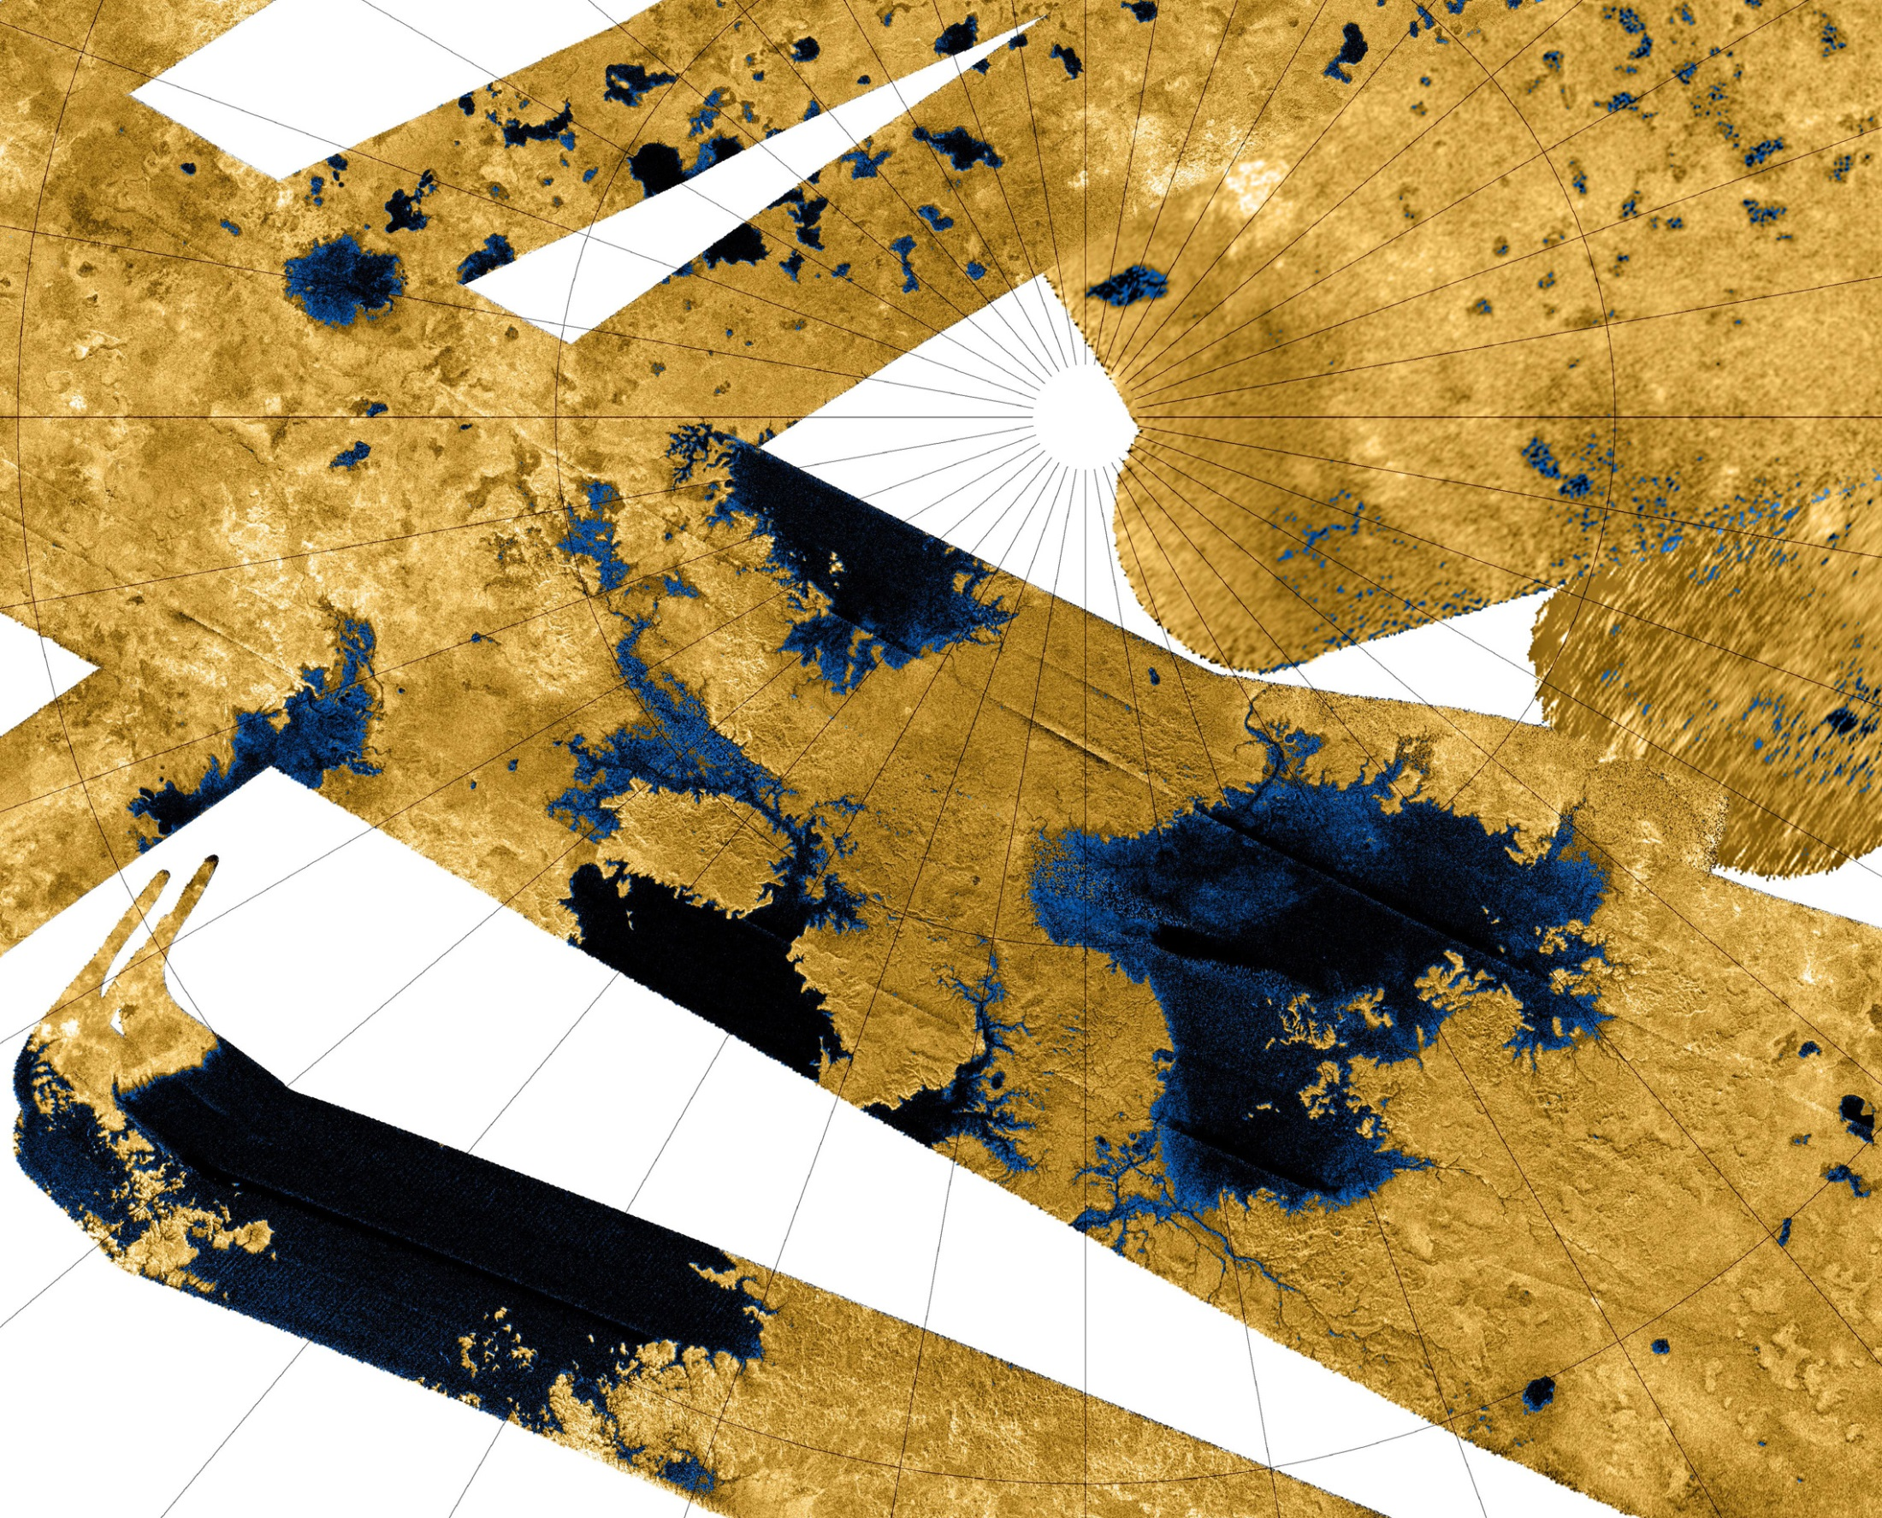
Seas and lakes of Titan, from Cassini mosaic

Slide 13
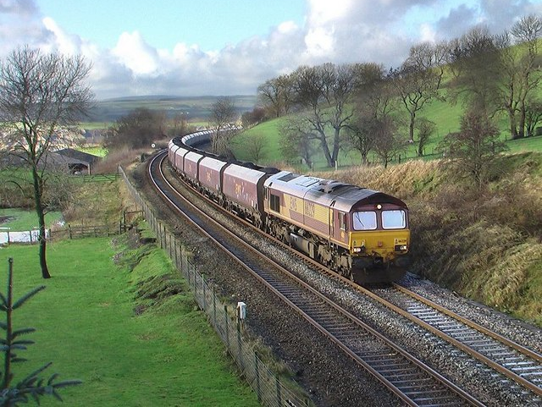
3. Greater efficiency in storage and transport.

Slide 14
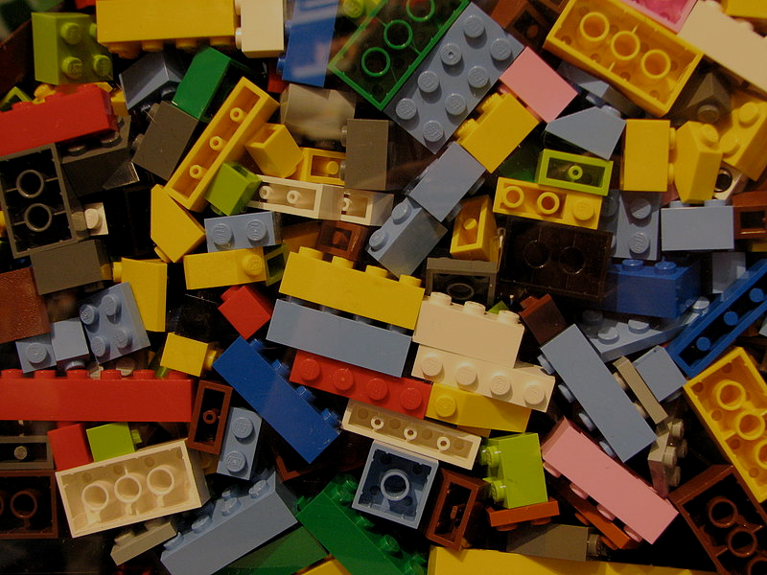
4. The LEGO Effect
(disaggregating in order to facilitate aggregating)

Slide 15
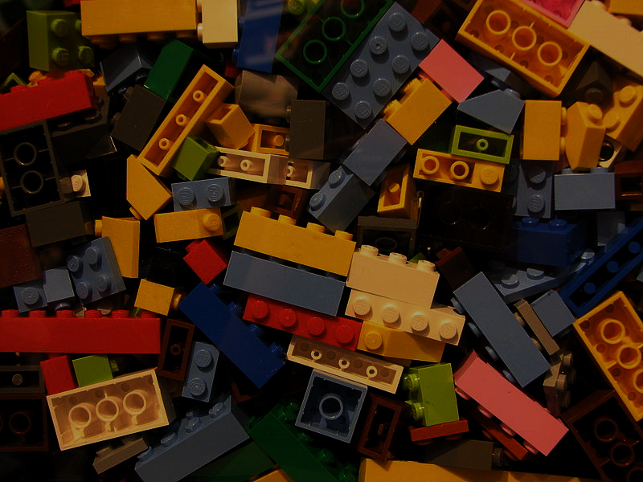
The LEGO effect
If we store items in smaller and simpler packages, this can enable use to aggregate objects in a greater variety of ways.

Slide 16
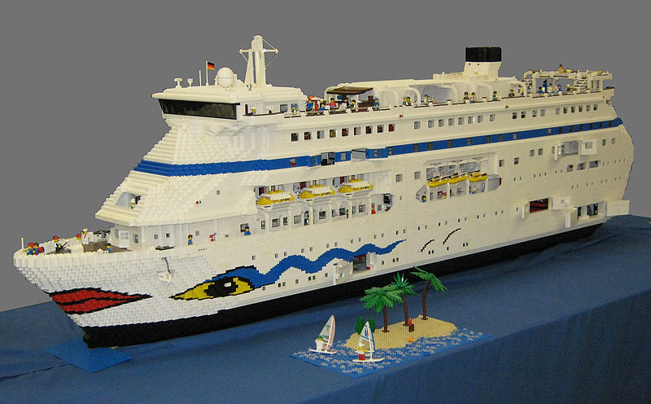

Slide 17
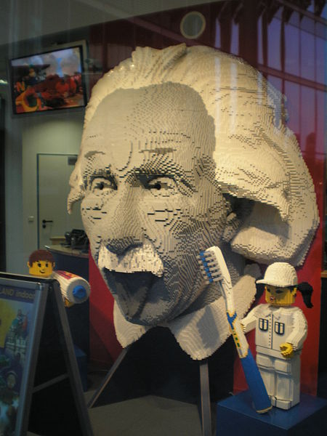

Slide 18
Summary
To see the bigger picture
The whole is more than the sum of its parts
Greater efficiency in storage and transport
LEGO Effect: Package small and simple to enable a greater variety of aggregations
(Add your own reason here.)

Slide 19
2. Aggregation in HDF

Slide 20
Aggregations in HDF itself
The H in HDF means hierarchy, which in practice is an aggregation.
An HDF array is an aggregation of aggregations
Certain datatypes – compound, array, string
Groups
Chunks

Slide 21
Virtual Datasets

Slide 22
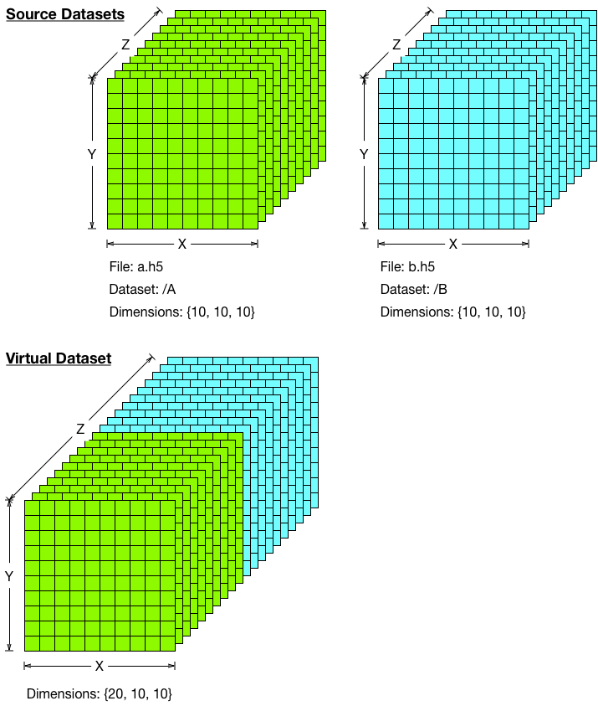
Virtual Datasets, Example 1
Notes:
Mechanism for creating a composition of multiple source datasets, while accessing through single virtual dataset
Modifications to source datasets are visible to virtual dataset
And writing to virtual dataset modifies source datasets
Can have subset within source dataset mapped to subsets within virtual dataset
Source and virtual datasets can have unlimited dimensions
Source datasets can be virtual datasets themselves

Slide 23
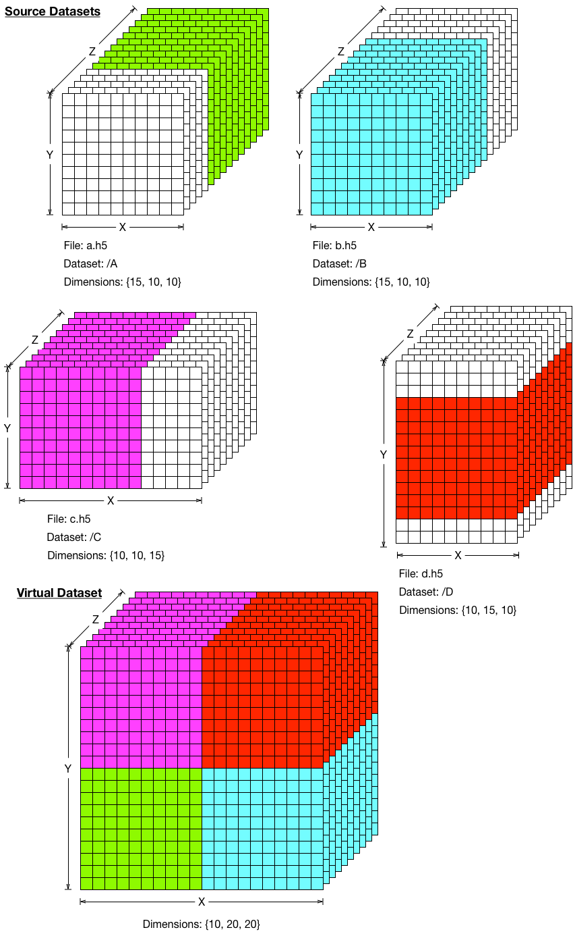
Virtual Datasets, Example 2

Slide 24
Using HDF for aggregation
It's everywhere
Perhaps the most common reason for using HDF is its ability to support aggregation in a very flexible way.

Slide 25

Swath Structure
SWATHS
SwathName:
<name>
Swath_1
…
Swath_2
DataFields:
<name>
Data
fields
Profile
fields
Geolocation
fields
FieldName:
<name>
Longitude
Latitude
Data
field.1
…
Data
field.n
Profile
field.1
…
Profile
field.n
Time
Notes:
Profile: Another type of data that the Swath is equally well suited to arises from a sensor that measures a vertical profile, instead of scanning across the ground track. The resulting data resembles a standard Swath tipped up on its edge.

Slide 26
nagg

Slide 27
nagg?
Nagg is a tool for rearranging Suomi-NPP data granules from existing files to create new files with a different aggregation number or a different packaging arrangement.

Slide 28
Definitions
Granule
  A grouping of measurements or derived data spanning a defined period (e.g., 28.6 seconds) and integer number of sensor scans.
Geolocation products
  Geolocation information is stored in the same manner as other data.
  Geolocation products may be packaged with data files, or they may be in separate files.
Aggregation¹
  A collection of temporally ordered granules within a JPSS HDF5 file.
  Compatible NPP data products together or with corresponding geolocation product in common files.
  ¹ JPSS Common Data Format Control Book – External Volume I, p 76

Slide 29
Nagg operations
Aggregation
Packaging
Aggregate data granules
disaggregate data granules
Re-aggregate data granules
Package granules of multiple compatible products in common files
Un-package products into separate files for each product
Notes:
Two independent operations which can be combined

Slide 30
Aggregation
Increase number of granules per file from 1 to 4
Input files (16)
0:31:12
0:31:44
0:32:16
0:32:48
0:33:20
0:33:52
0:34:24
0:34:56
Output files (2)
0:31:12
0:31:44
0:32:16
0:32:48
0:33:20
0:33:52
0:34:24
0:34:56
0
0
1
2
3
0
0
0
0
0
1
2
3
0
0
0
SATMS

Slide 31
Packaging
Input files (22)
0:31:12
0:31:44
0:32:16
0:32:48
0:33:20
0:33:52
0:34:24
0:34:56
Output files (8)
0:31:12
0:31:44
0:32:16
0:32:48
0:33:20
0:33:52
0:34:24
0:34:56
0
0
0
0
0
0
0
0
0
0
0
0
0
0
0
0
0
0
0
0
0
0
0
0
0
0
0
0
0
0
0
0
0
0
0
0
0
0
0
0
0
0
0
0
0
0
SATMS TATMS GATMO

Slide 32
“Putting some Spark into HDF-EOS” - Gerd Heber

Slide 33
“Putting some Spark into HDF-EOS”
Setup
  7,850 HDF-EOS5 files from MEaSURES
  GSSTF_NCEP.3 collection from 1987 to 2008.
Examples
  calculate daily summary statistics
  determine daily top 10 hottest and coldest locations
https://hdfgroup.org/wp/2015/04/putting-some-spark-into-hdf-eos/

Slide 34
disaggregating to improve aggregating (Lego effect)
An HDF server project

Slide 35
Scaling HDF Server
Uses “Object Store” to store HDF5 objects
  No Files (which are aggregations)
  Instead, each chunk is a separate object
  AWS S3, OpenStack/Swift, etc.

Slide 36
Scalable HDF Server Design
SN
DN
SN
DN
Clients
LB
SN
DN
SN
DN
Object Store
Legend
Clients: applications using REST API
LB: Load Balancer
SN: Service Nodes (Elastic Scaling Group)
DN: Data Nodes (Elastic Scaling Group)
Object Store: Partitioned HDF5 objects
Notes:
Read/writes are consistent per client
DN are sole read/writers to object in their partition
DN can serve as cache for objects
SN talk to one DN for group/attribute/dataset meta-data requests
SN talk to multiple DN’s for large data value requests (see next slide)

Slide 37
An aggregation/disaggregation reference model?

Slide 38
Could there be common vocabulary and model that spans the wide variety of products and types of aggregation?

Slide 39
E.g. types of aggregation for remote sensing
Temporal: Arranging according to time.
Spatial: Arranging according to space.
Packaging: Grouping a variety of related objects.
An aggregation may consist of all instances of an object over the dimensional extent.
Or it may be a sampling of instances of an object over the dimensional extent.

Slide 40
What else?

Slide 41
M.C. Escher

Slide 42

This work was supported by NASA/GSFC under Raytheon Co. contract number NNG10HP02C

