Slide 1
Global Change Information System
Curt Tilmes
NASA GSFC
USGCRP
ctilmes@usgcrp.gov
ESIP Federation Winter Meeting 2013
www.globalchange.gov

Slide 2
NCA 2009
http://nca2009.globalchange.gov

Slide 3
The “New” National Climate Assessment
Goal
Enhance the ability of the United States to anticipate, mitigate, and adapt to changes in the global environment.
Vision
Advance an inclusive, broad-based, and sustained process for assessing and communicating scientific knowledge of the impacts, risks, and vulnerabilities associated with a changing global climate in support of decision-making across the United States.

Slide 4
Global Change Information System (GCIS)
Vision:
A unified web based source of authoritative, accessible, usable, and timely information about climate and global change for use by scientists, decision makers, and the public.

Slide 5
GCIS

Slide 6
Linked Data Principles
1. Use URIs as names for things.
2. Use HTTP URIs so that people can look up those names.
3. When someone looks up a URI, provide useful information, using the standards.
4. Include links to other URIs, so that they can discover more things.
http://www.w3.org/DesignIssues/LinkedData.html

Slide 7
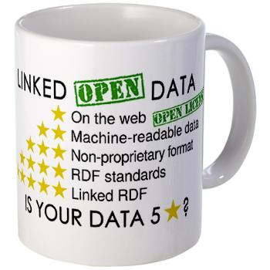
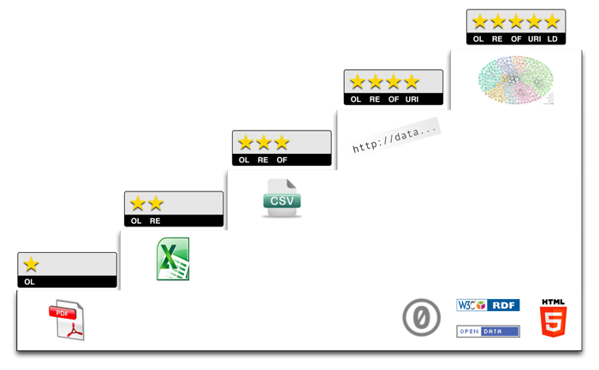
Linked Open Data
http://5stardata.info

Slide 8
Data Identifiers
NASA Earth Science Data Systems Working Group and ESIP Federation study resulted in dataset identifiers recommendations, [1] Duerr, et. al.
DOI – Digital Object Identifiers provide a well-defined mechanism to attach an identifier to a digital object.
Recommendation adopted by NASA for EOSDIS:
http://earthdata.nasa.gov/wiki/main/index.php/Digital_Object_Identifiers_(DOIs)_for_EOSDIS
doi:10.5067/MEASURES/GSSTF/DATA308
http://dx.doi.org/10.5067/MEASURES/GSSTF/DATA308

Slide 9
Identifier Resolution
doi:10.5067/MEASURES/GSSTF/DATA308
A common, persistent, citable reference to that dataset.
We build GCIS specific identifiers from those:
http://data.globalchange.gov/doi/10.5067/MEASURES/GSSTF/DATA308
Then we can resolve it (with content negotiation) on our site, and link it with identifiers for our other resources, including asserting equivalence and linking with the data center responsible for stewardship and distribution of the actual data. We can also refer and link to other repositories of information about those resources.

Slide 10
Content Negotiation
http://data.globalchange.gov/doi/10.5067/MEASURES/GSSTF/DATA308
The server response from the URI depends on what you ask for:
A traditional browser will ask for HTML, and receive and render a human readable description of the resource.
Web services can request formal, structured XML or RDF metadata about the resource.
Our goal is to provide a curated collection of authoritative global change information, but always link back to the data center or publisher responsible for the long term stewardship of the resource.

Slide 11
GCIS
Create an entity from the structured metadata about each thing – tag with related concepts.
Identify it with a persistent, controlled identifier.
Present with a human readable web page and a machine interface.
Represent all relationships between items.

Slide 12
NCA links to GCIS entities

Slide 13
URI Schema
URI for NCA instances consists of 3 parts: domain name, type of instance, identifier
Domain name: data.globalchange.gov
Types: Person, Project, Organization, Publication, etc.
Identifiers: depend on the instance type, we assign a unique id number or construct an identifier based on the instance’s unique property value.

Slide 14
More Examples
Person | http://data.globalchange.gov/person/<unique name>
Publication | http://data.globalchange.gov/publication/doi/<doi>
Project | http://data.globalchange.gov/project/ACMAP
Topic | http://data.globalchange.gov/topic/Human-health
Image | http://data.globalchange.gov/image/<uuid>
Figure | http://data.globalchange.gov/report/<reportid>/figure/<figureid>
Chapter | http://data.globalchange.gov/report/<reportid>/chapter/<chapterid>
Organization | http://data.globalchange.gov/organization/NASA
Model | http://data.globalchange.gov/model/<model_name>
Dataset | http://data.globalchange.gov/dataset/doi/<doi>
Platform | http://data.globalchange.gov/platform/<platform_name>
Instrument | http://data.globalchange.gov/instrument/<instrument_name>

Slide 15
W3C PROV (starting points..)
wasDerivedFrom
wasInformedBy
used
ENTITY
ACTIVITY
wasGeneratedBy
wasAttributedTo
wasAssociatedWith
AGENT
See http://www.w3.org/2011/prov
actedOnBehalfOf
Diagram from W3C PROV group and Ivan Herman
actedOnBehalf

Slide 16
GCIS and W3C Prov
For GCIS, we have agents (people, projects, agencies, data centers, publishers, etc.) who are associated with activities (measuring, deriving, modeling, analyzing, authoring, publishing, archiving, distributing, visualizing, etc. ) the entities (software, data, images, figures, papers, reports, etc.) related to global change.
We assign local identifiers to each (so we can persistently resolve them) and capture and represent their relationships.
Where possible, we link with external authorities:
agency data centers, journal publishers,
Researcher ID (researcherid.com) or ORCID (orcid.org).

Slide 17
Interagency Information Integration
GCIS can use relationships between all relevant information about global change across the agencies:
From observations to datasets to research papers to models to analyses to organizations to people to synthesized reports to human impacts...
Determine agency interdependencies -- An EPA analysis uses a NOAA model dependent on observations from a NASA satellite.
Can present unique interagency metrics "How many papers referenced datasets from a specific satellite?"
Direct users back to agency data centers for more detailed information and the actual content and data.

Slide 18
GCIS Data Mining
Structured information with relationships allows integrated data mining, searching, metrics.
What projects provided data used to produce figures that were referenced in the 2013 NCA section about coastal sea level rise impacts?
Which data centers hold data referenced by papers related to forests in the midwest?
Which agencies have people working on projects related to societal impacts of extreme weather events?
Show me the latest papers about health impacts of air quality in California. Which datasets were used in the analysis of air quality in California?

Slide 19
GCIS Benefits
NCA web portal, GCIS prototype
NCA content available online
Searchable, linkable
Complete provenance, traceability
Links back to source information including agency sources, scenarios, technical input
Link to associated and applicable information and tools
Ensure authoritative and appealing design and accessibility
Incorporates initial indicators of change, impact and response
Access to information about NCA process (transparency)
Facilitates collaboration across segments of the climate science and applications community
Construct, prototype and test the initial framework
Use constrained scope and dedicated staff to accomplish a lot in a short time
Ensure the system design is extensible and able to grow to meet long term GCIS needs
GCIS
A single web site can lead back to agency global change information across the program
A friendly, accessible entry into global change information for non-scientists
Global, persistent, reusable identifiers for each item
Integrated data catalog provides interagency metrics, data mining, searching, etc.
Interagency relationships allow discovery of interdependencies and increase collaboration opportunities
Agency information mapped into a common, consistent model with a standard vocabulary
Concept tagging and linking improves search results for agency products

Slide 20
Questions and Comments
For more information, visit http://www.globalchange.gov

