Slide 1
Parameter Visualizations as Metadata to Facilitate Discovery
ESIP Winter 2014

Slide 2
GIBS Overview (Global Imagery Browse Services)

Slide 3
EOSDIS as a Seamless, Efficient User Driven System
Present NASA’s EOSDIS as an interoperable system of systems where users can select, view, interact and download the data they need transparently from all subsystems in support of interdisciplinary Earth Science research.
Supplement current data system capabilities with new interoperable technologies to create a foundation for future evolution.
Metadata as a Service
(CMR)
Imagery as a Service
(GIBS)
Data as a Service
(???)
Data
Today
Tomorrow
Future
Notes:
From global EOSDIS perspective to the need for GIBS.

Slide 4
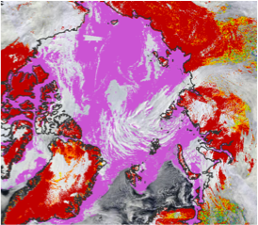
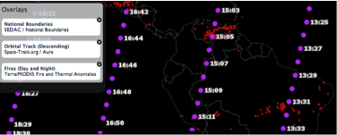
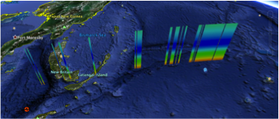
Imagery Graphic Types
2D Georeferenced Raster
Digital Elevation Models
Vector-based Data

Slide 5
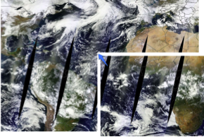
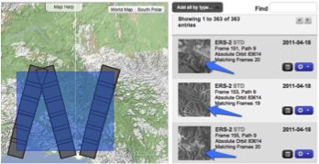
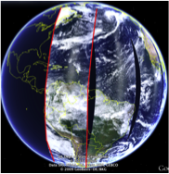
Imagery Coverage Types
Tiled (Composite/Mosaic)
Orbit/Path-Based
Granule-Based

Slide 6
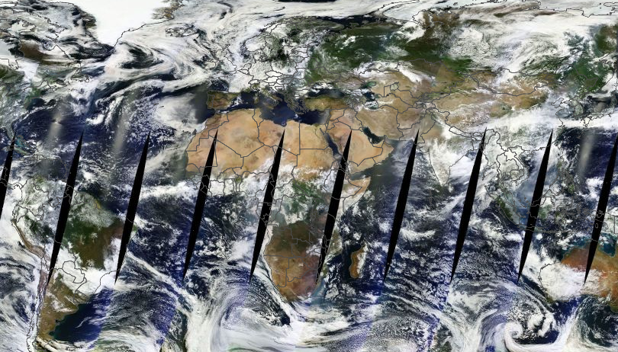
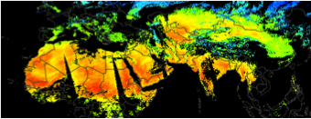
Imagery Layer Types
Base Layer
Static
Dynamic
Overlay Layer
Scaled & Colored

Slide 7
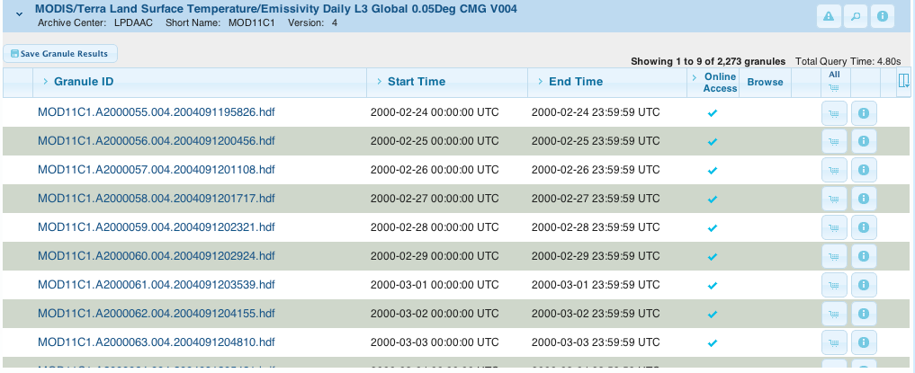
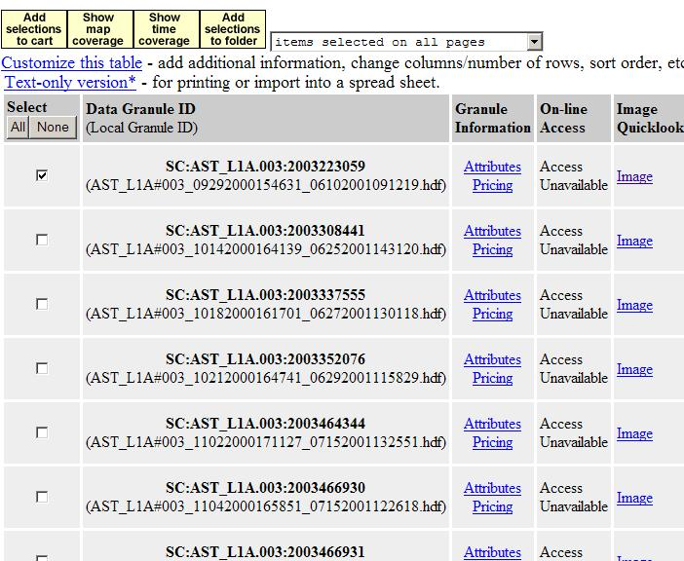
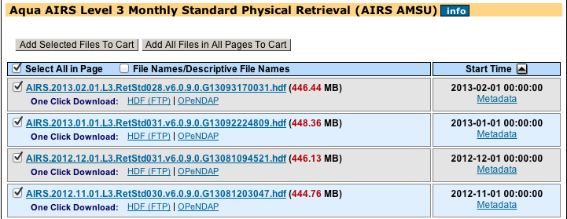
Metadata, Metadata, Metadata
1%
Notes:
Primarily Tabular Interface
Metadata Driven
Low-res imagery thumbnails
Focus on post-download filtering
High barrier of entry
Limited reach

Slide 8
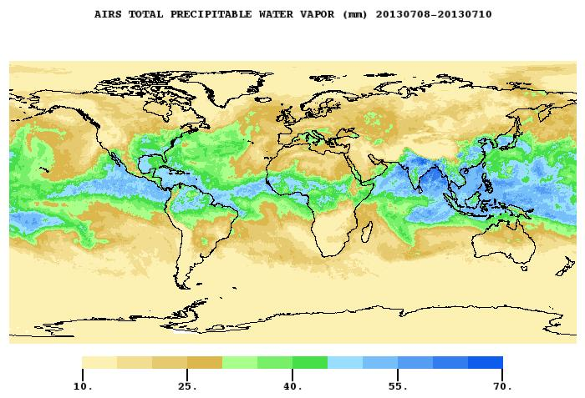
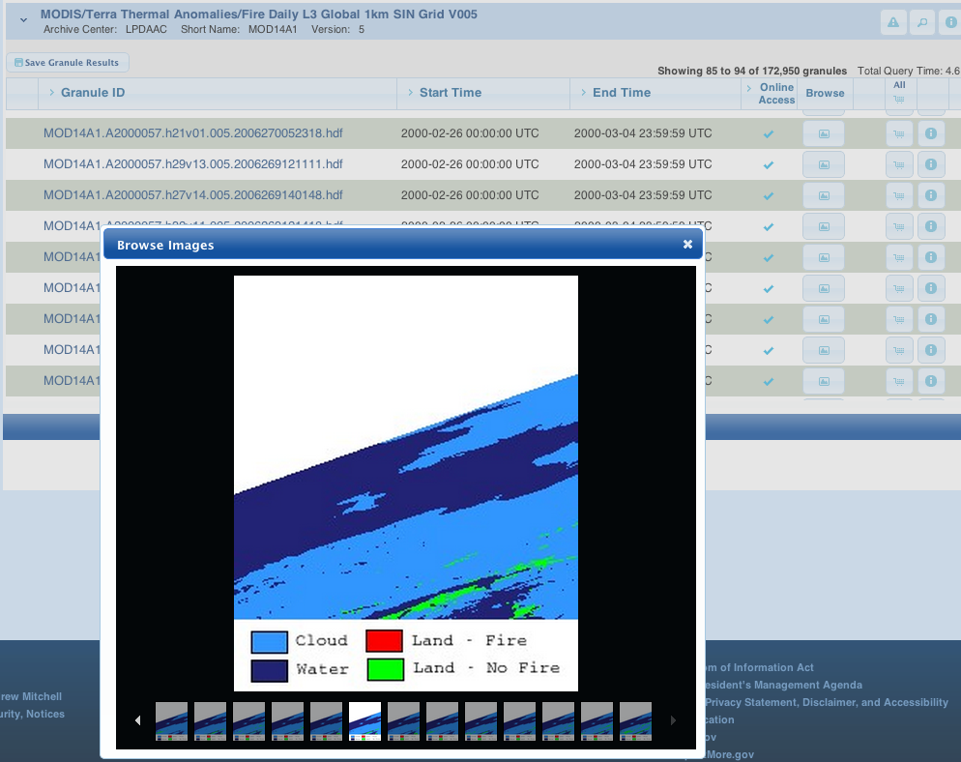
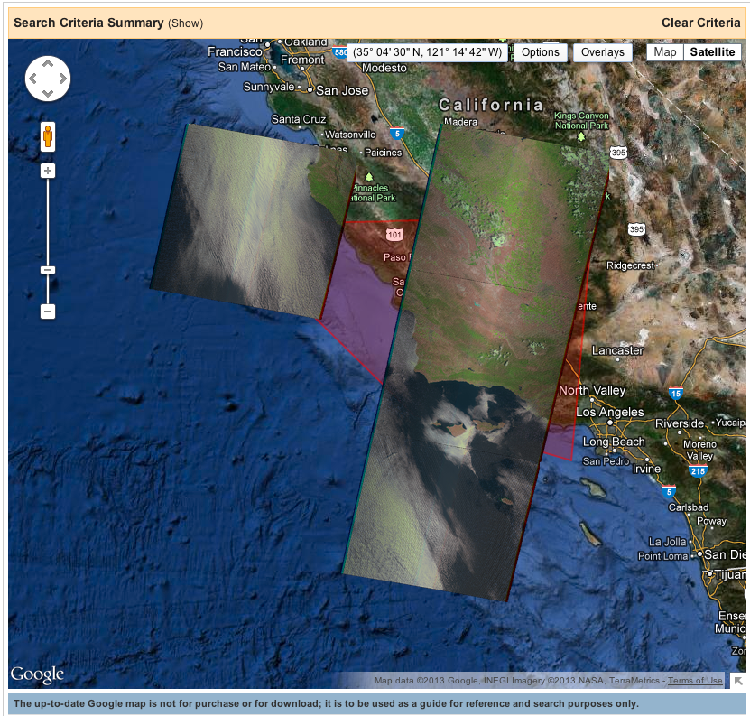
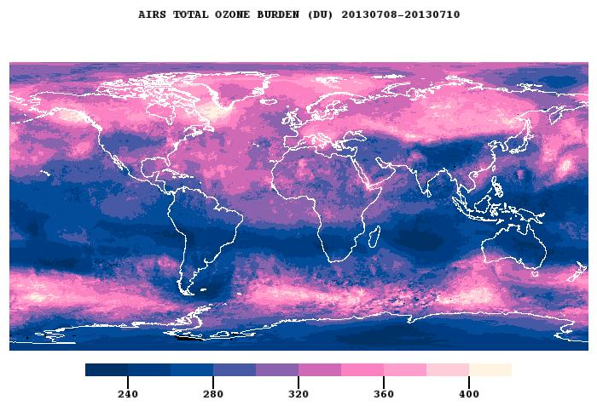
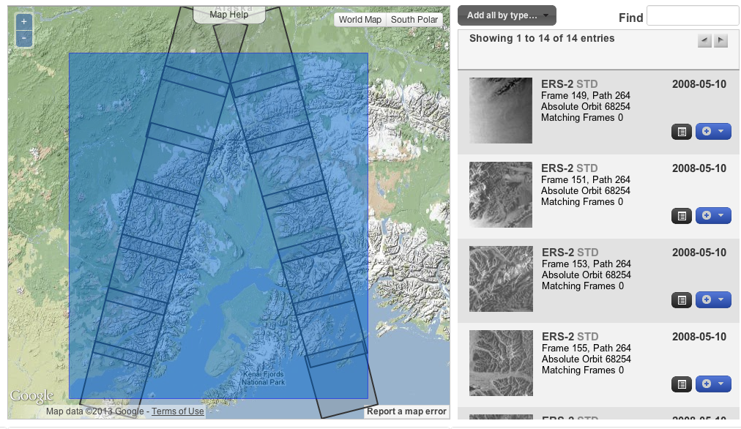
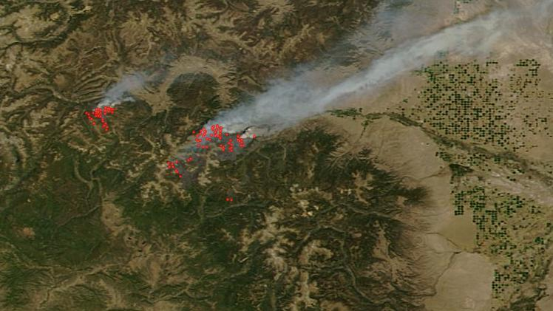
Broadening Usage

Slide 9
GIBS – Status
Now GIBS is an Operating Prototype
Providing access to ~100 LANCE/NPP/SEDAC imagery products
May 2012 -> Present
Standardized (OGC WMTS/TWMS/KML) service endpoints
Image download capability for Worldview (protected WMS)
Supports multiple clients: Worldview, EPA Airnow, iPhone App, PO.DAAC’s SOTO, Science on a Sphere
Supports multiple mapping libraries: OpenLayers, Leaflet, GDAL, WorldWind…

Slide 10
DESCRIBING GRANULES VISUALLY

Slide 11
What We Have
Overview
Millions of Granule Data Files
Dozens of Parameters w/i a Granule
Permanent Capability/Problem
Discovery Aides
Data Metadata Standards (e.g. ISO)
Discovery Interface Standards (e.g. OpenSearch)
Low-Res Browse Thumbnails
Higher/Full-Res Composites

Slide 12
What We Don’t Have
Consistency
Amalgamation of Projections & Representations
Incomplete Granule Imagery Coverage
Mostly low res, usually annotated, images
Requirements
Do users need full resolution granule imagery?
Do users need visualizations of every parameter?
Should images include annotations (graticules, legend)?
Should quality layers be visualized (quality mask)?
Standards
How do you request granule imagery?
How do you represent metadata for a granule image and its service?

