Slide 1














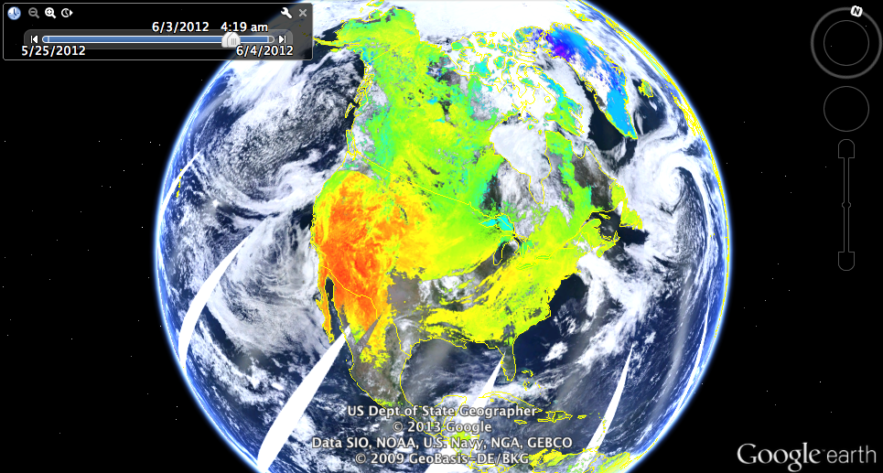

NASA Worldview & Global Imagery Browse Services (GIBS)
Demonstrating Changing Paradigms for Using Satellite Imagery
Kevin Murphy (kevin.j.murphy@nasa.gov), Ryan Boller (ryan.a.boller@nasa.gov), Matt Cechini (matthew.f.cechini@nasa.gov), Mike McGann (mike.mcgann@nasa.gov)
Global Imagery Browse Services (GIBS)
NASA Worldview
earthdata.nasa.gov/gibs
earthdata.nasa.gov/worldview
  Daily global imagery (May 2012 -> Present)
  Near Real-Time (< 3 hours from acquisition)
  100+ Imagery Products
  Full resolution, no boundaries access
  Open source, standards-based
  Core EOSDIS component
  GIBS Reference Client
  Cross-Device/Mobile Friendly
  Image/Data Download
  Web Map Tiled Service (WMTS)
  Keyhole Markup Language (KML)
  Web Map Service (WMS)
iPad Mini
GIBS Imagery Usage
OnEarth Open Source Project
Storage Format: Meta Raster Format (MRF) Specification
Storage Writer: MRF GDAL Driver Plugin.
Tile Service: mod_onearth Apache Module
Available late-2013

