Slide 1
Example Data Products for integration into the
Collaborative Common Operating Picture (C-COP):
E-DECIDER and GeoGateway
National Aeronautics and Space Administration
  Margaret Glasscoe, Andrea Donnellan, Jay Parker NASA Jet Propulsion Laboratory, California Institute of Technology
  Marlon Pierce, Jun Wang Indiana University
  Ronald Eguchi, Charles Huyck, ZhengHui Hu ImageCat, Inc.
  ZhiQiang Chen University of Missouri, Kansas City
  Mark Yoder, John Rundle University of California, Davis
  Anne Rosinski California Geological Survey, California Earthquake Clearinghouse
  Margaret.T.Glasscoe@jpl.nasa.gov
8 January 2015
2015 ESIP Winter Meeting – Disaster Life Cycle I
www.nasa.gov Jet Propulsion Laboratory
California Institute of Technology
Pasadena, CA
Copyright 2014 California Institute of Technology.
U.S. Government sponsorship acknowledged.

Slide 2

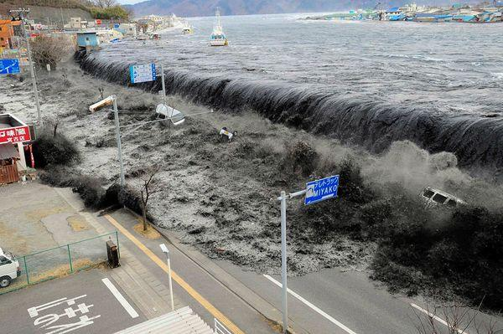

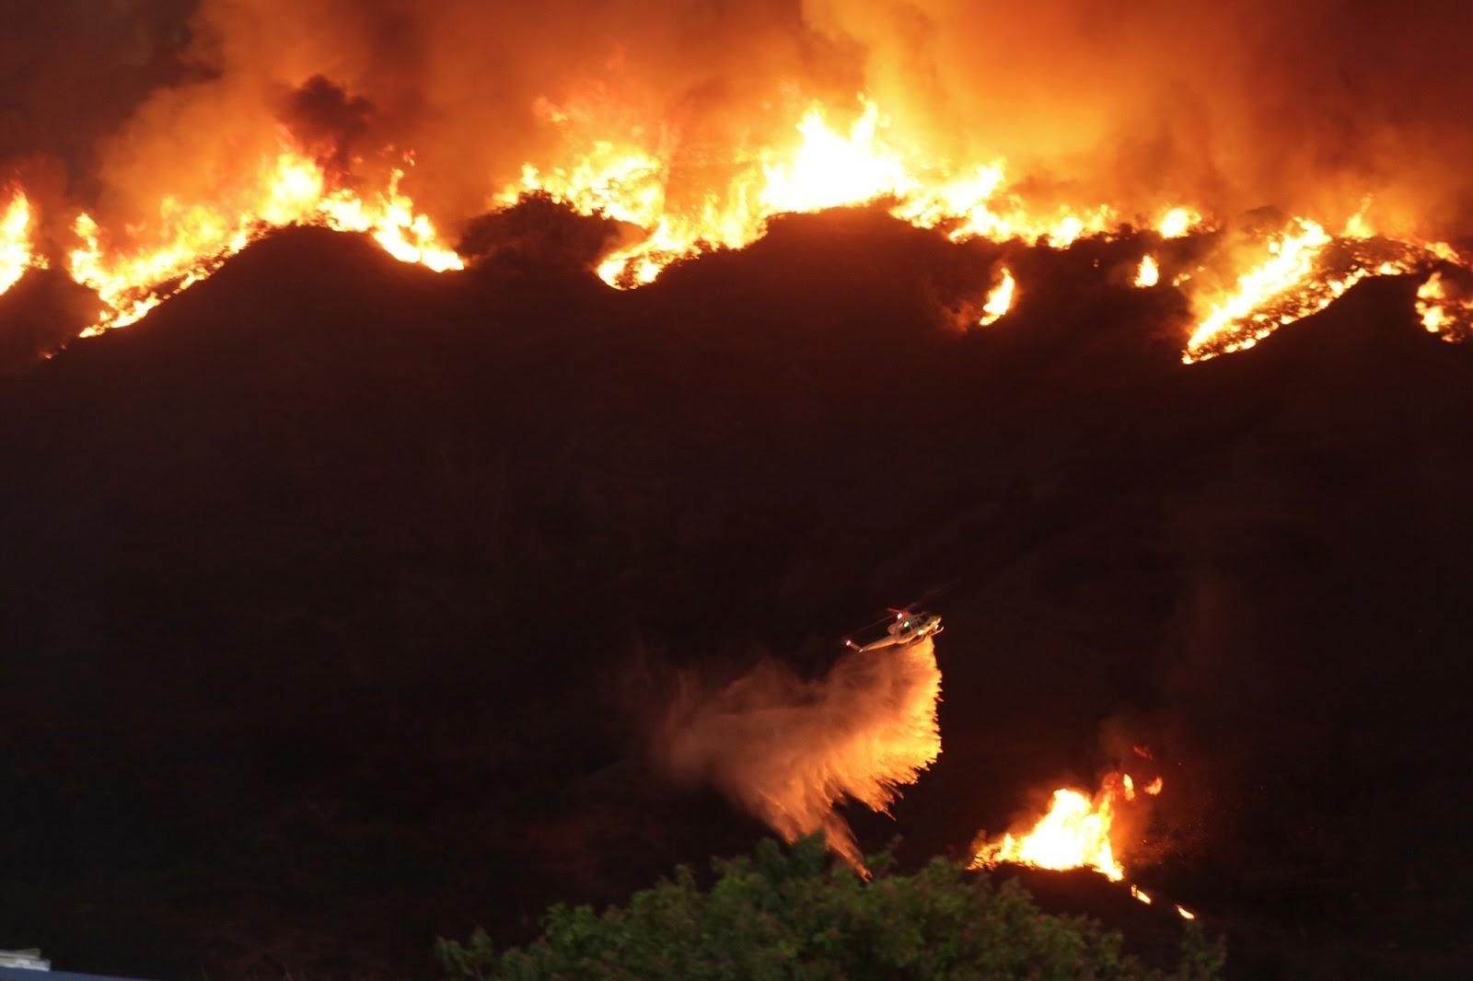

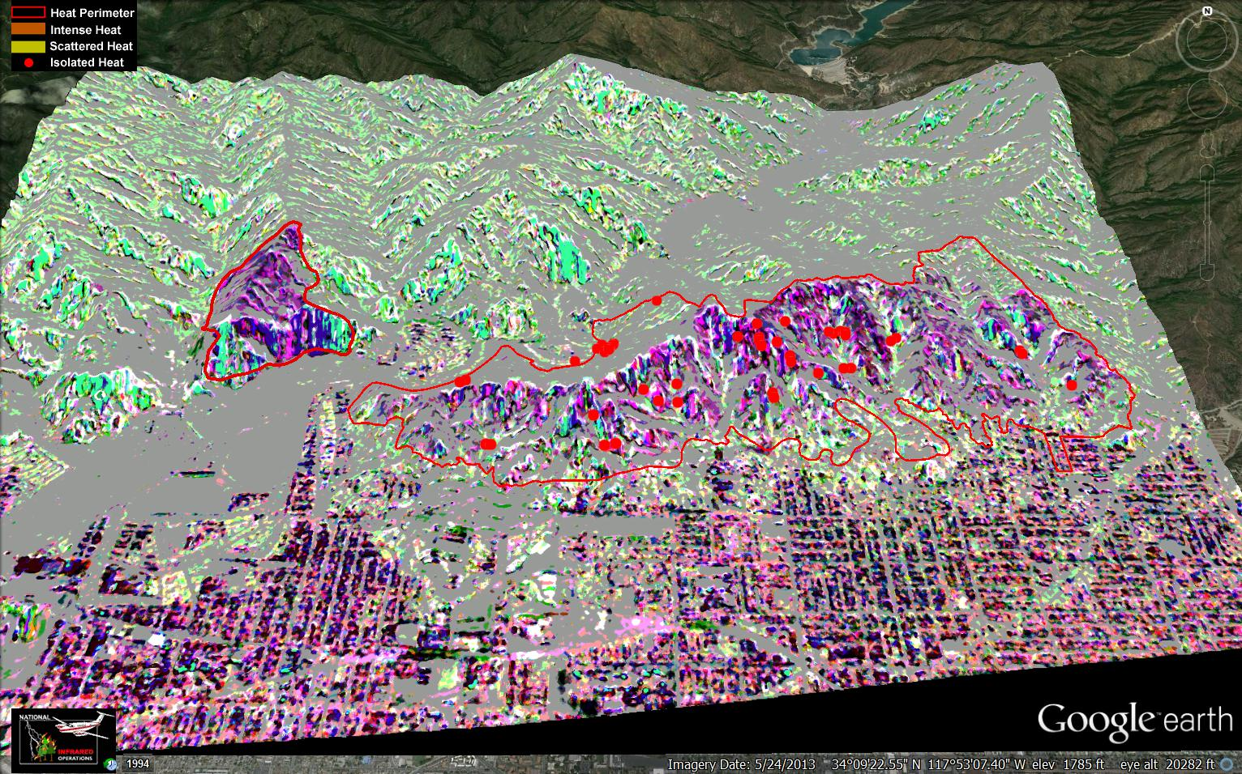
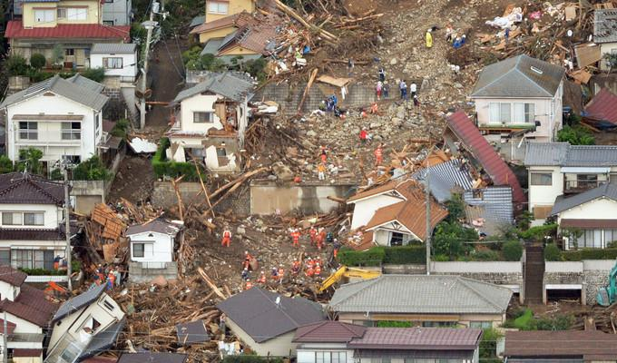
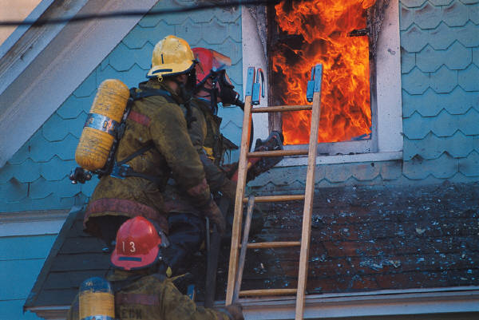
E-DECIDER Disaster Decision Support Platform
Generate Products
Emergency Event
Deliver to
Decision Makers
2013 Madre fire
2014 Colby fire
8 January 2015
2015 ESIP Winter Meeting – Disaster Life Cycle I

Slide 3
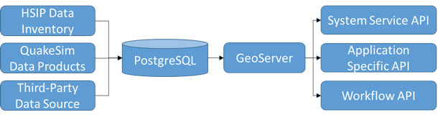
E-DECIDER Architecture
Uses Apache Airavata (http://airavata.apache.org/), an opensource software framework for executing and managing computational jobs and workflows on distributed computing resources including local clusters, supercomputers, national grids, academic and commercial clouds
Employs service-oriented architecture (SOA) based geospatial web service APIs, and totally committed OGC standards
8 January 2015
2015 ESIP Winter Meeting – Disaster Life Cycle I

Slide 4
E-DECIDER Architecture (2)
Workflow APIs control E-DECIDER services
8 January 2015
2015 ESIP Winter Meeting – Disaster Life Cycle I

Slide 5
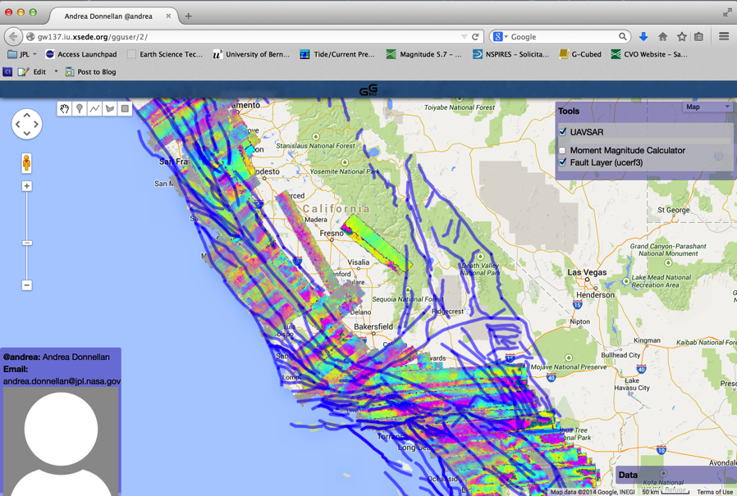
GeoGateway
Data product search and analysis gateway
  For scientific discovery, field use, and disaster response
  Web-enabled and map-based
Users require
  Data overlay
  Visualization
  Interactive analysis features
  Data product download
  Sharing and collaboration
Focus on NASA’s UAVSAR and GPS
  Integrate with faults, seismicity, and models
Faults overlaid on UAVSAR RPI Products
8 January 2015
2015 ESIP Winter Meeting – Disaster Life Cycle I

Slide 6
GeoGateway Inputs and Outputs
Data Products
Application
Interface
Faults
Scientific publications
Official data sets
Inferred from models
Data Exploration
Availability
Characteristics
Features
Map-based
Visualization
Modeling
Analysis
Datamining
GIS Compliant
Science
Crust and earthquake fault behavior
InSAR/UAVSAR
JPL, ASF, UNAVCO
GPS
JPL, SOPAC, UNAVCO, UNR
Forecasting
Earthquake probabilities
Seismicity
USGS, SCSN, NCSN, ANSS
Response
Tilt maps
Aftershock likelihood
Raw data
8 January 2015
2015 ESIP Winter Meeting – Disaster Life Cycle I

Slide 7



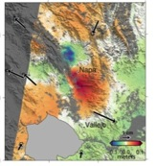
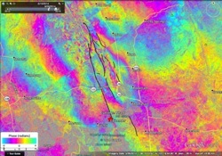


Napa Response Timeline
GPS Surface Deformation
Model Products
NASA UAVSAR Surface Deformation
Fault Model
First Radar Surface Deformation
M6.0 Earthquake
NASA UAVSAR images Napa area
Clearinghouse Activated
COSMO-SkyMed images Napa area
Aug 24
Day 1
Aug 26
Day 3
Aug 28
Day 5
Aug 30
Day 7
8 January 2015
2015 ESIP Winter Meeting – Disaster Life Cycle I

Slide 8
Model Products:
Napa Earthquake Response Day 1
Map data products, including a rapid damage and loss estimate, were provided to California Earthquake Clearinghouse within 24 hours of the event
Information can aid in prompt allocation of resources
Predicted Surface Strain with Critical Infrastructure
Strain Magnitude Map with Critical Infrastructure Overlay Highlights areas where greatest ground deformation (motion) has occurred based on a fault model. Once GPS observations are available, the model can be refined and deformation better constrained. These maps provide an early estimate of where the deformation has occurred, and where damage may be localized. Using the critical infrastructure overlays with damage estimates, decision makers can direct response efforts. The map shows an airport in the affected area that was predicted to have sustained minor damage. The infrastructure information contains both a damage estimate and location to help direct response efforts. With later satellite observations and field reconnaissance, this information can be verified.
Earthquake Aftershock Forecast Map with Critical Infrastructure Overlay
Highlights areas where aftershocks are likely to occur. These maps show estimated aftershock risk in a color scale -- warmer colors represent higher risk and cooler colors lower risk. Using the critical infrastructure overlays with damage estimates, decision makers can better direct response efforts. For example, the map shows an emergency care facility within the affected area that was predicted to sustain slight damage, which can later be verified in the field.
8 January 2015
2015 ESIP Winter Meeting – Disaster Life Cycle I

Slide 9
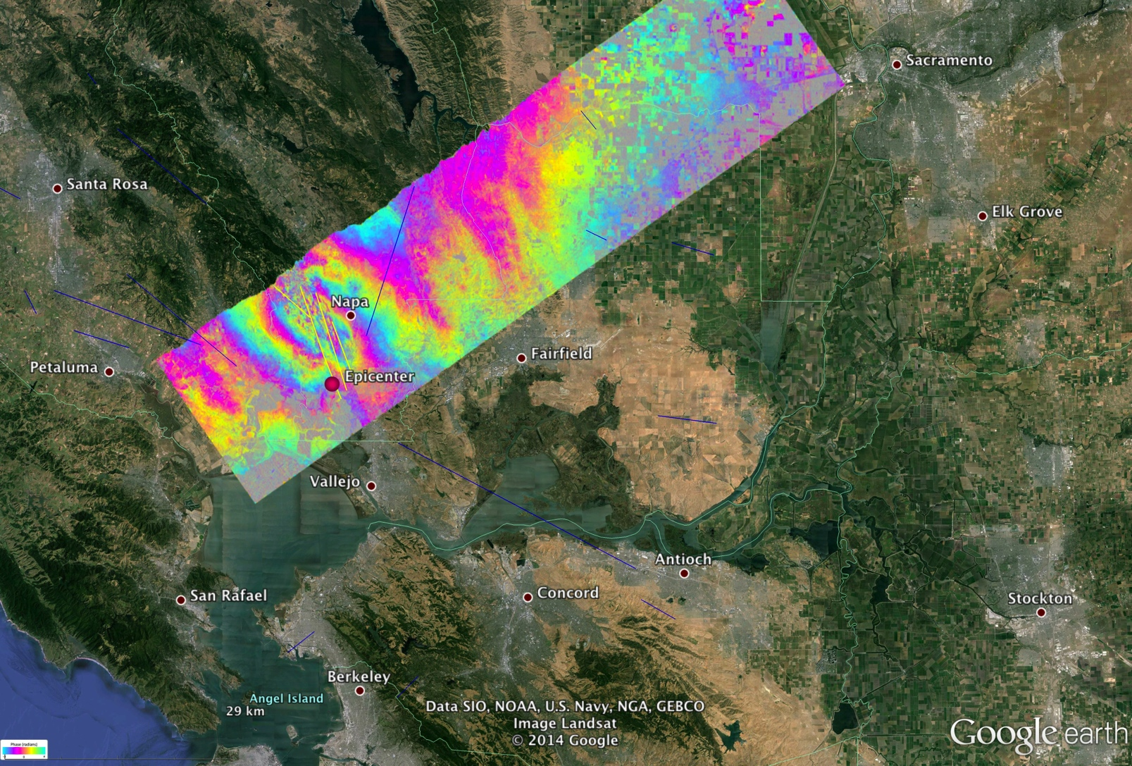
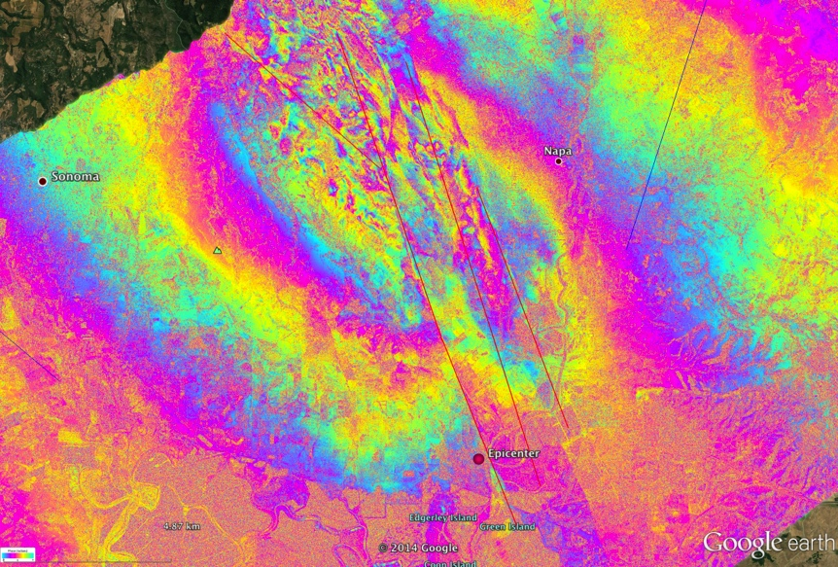

Mapping Faults with NASA UAVSAR – Day 7
M 6.0 South Napa Earthquake
August 24, 2014
NASA Jet Propulsion Laboratory
California Institute of Technology
Aircraft heading
Look
5 cm
29 cm 6.2–7.2 km
29 cm 3.1–4.9 km
30 cm 0–5.6 km
31 cm 0.2–8.5 km
JPL/Caltech ARIA Rapid GPS
9 cm
2 cm displacement
29 cm 2.1–6.3 km
Epicenter
10 km
Epicenter
10 km
1 km
NASA/JPL UAVSAR results showing multiple fault offsets from the earthquake. Each color band fringe is 12 cm displacement toward the instrument
NASA UAVSAR data was acquired to aid rapid response activities in determining faulting and levee/aqueduct status.
8 January 2015
2015 ESIP Winter Meeting – Disaster Life Cycle I
Notes:
----- Meeting Notes (9/26/14 13:42) -----
Andrea is going to update with Zoomed in version.

Slide 10







Data Exchange to End Users
Working in partnership with CA Earthquake Clearinghouse, CalOES, CA National Guard, FEMA, local governments, and other agencies
Pass on to Decision Makers (local, state, federal)
Products Generated
Authoritative data securely shared
Users query products
(Spot On Response, NICS, etc)
8 January 2015
2015 ESIP Winter Meeting – Disaster Life Cycle I
Notes:
Participated in 2011 NLE, working with CA Earthquake Clearinghouse since 2012, have produced various products for response exercises, including for 2014 NLE, and 2012-2014 Golden Guardian and ShakeOut exercises with Clearinghouse.

Slide 11
Thank you for your kind attention!
Questions?
National Aeronautics and Space Administration
Maggi Glasscoe
Margaret.T.Glasscoe@jpl.nasa.gov
http://e-decider.org
http://geo-gateway.org
http://www.californiaeqclearinghouse.org
www.nasa.gov Jet Propulsion Laboratory
California Institute of Technology
Pasadena, CA
Copyright 2014 California Institute of Technology.
U.S. Government sponsorship acknowledged.
8 January 2015
2015 ESIP Winter Meeting – Disaster Life Cycle I

