Slide 1
Documentation from NcML to ISO
Ted Habermann, NOAA NESDIS NGDC

Slide 2
Layers of Access
HDF/netCDF
GIS
MatLab, IDL,
IDV, Ferret, GMT
ArcMap, ArcIMS,
WMS, WFS, WCS
OPeNDAP
GML, KML,
SimpleFeatures
Climate Forecast,
Attribute Conventions
for Data Discovery
Community Data Models,
Open GIS Specifications
HDF & NetCDF Library
SQL
HDF5 Data
Geospatial Database

Slide 3
Conventions
Unidata Attribute Convention for Data Discovery
Discovery
ISO Conventions
Climate-Forecast (CF) Conventions
Standard variable names and data organizations
Use / Mashup
Understanding
ISO Conventions

Slide 4
Containers
THREDDS Catalog
NcML In the file or the catalog
netCDF in the file

Slide 5
Documentation Completeness
19139
C
O
M
P
L
E
T
N
E
S
S
ncISO
ncISO?
NcML
Climate
Forecast
ACDD
ISO
Use
Discovery
Understanding
Purpose
Notes:
NetCDF is a set of software libraries and self-describing, machine-independent data formats that support the creation, access, and sharing of array-oriented scientific data (http://www.unidata.ucar.edu/software/netcdf/). The original implementation of netCDF was done at Unidata during 1988. As the idea of using a standard format gained traction, members of the atmospheric and oceanographic communities found that differences in the details of how netCDF was implemented by different groups were inhibiting data sharing even among groups that were using netCDF.
In response, the Cooperative Ocean/Atmosphere Research Data Service developed the COARDS Conventions for netCDF (http://ferret.wrc.noaa.gov/noaa_coop/coop_cdf_profile.html) in order to promote the interchange and sharing of netCDF files. These conventions were later extended by an international group to form the NetCDF Climate and Forecast (CF) Metadata Conventions (http://cf-pcmdi.llnl.gov/).
The CF Conventions have achieved nearly universal acceptance in the atmospheric, oceanographic, and climate communities. All commonly used tools assume these conventions in order to make it possible to display, compare, and analyze data from different netCDF files.

Slide 6
Documentation in Multiple Dialects
KML
DIF, FGDC,
Data.Gov
Documentation
Repository
ISO 19115, 19115-2, 19119 and extensions
HDF, netCDF, ACDD, CF
SensorML
THREDDS
WCS, WMS, WFS, SOS
Open Provenance
Model, PROV
Although CF is specifically a netCDF standard, we feel that most of the ideas are
of wider application. The metadata objects could be contained in file formats other than netCDF. Conversion of the metadata between files of different formats will be facilitated if conventions for all formats are based on similar ideas.

Slide 7
Spiral Development / Training
Check Back
With Data Collectors/
Providers
Check Back
With Users
Standard
Guidance / Implementation
Spiral 2-N:
Scientific Questions
New Requirements
New Use Cases
Metadata Content
Independent of standard
Spiral 1:
Initial Content

Slide 8
Spiral Development / Training: Potential Spirals
Discovery
Understanding
Identification
Id
Title
Abstract
Resource Date
Topic Category
Theme Keyword
Metadata Contact
Science Contact
Extent
Geospatial Bounding Box
Temporal Start/End
Vertical Min/Max
Place Keywords
Text Searches
Purpose
Extent Description
Lineage Statement
Project Keywords
Content Information
Attribute Type
Attribute Names
Attribute Definitions
Attribute Units
Connection
OnlineResource:
Linkage (URL)
Name
Description
Function
Distribution
Distributor Contact
Online Resource
Distribution Format
Data Center Keywords
Browse Graphic
Acquisition Information
Instrument
Platform
Instrument Keywords
Platform Keywords
Quality/Lineage
Sources
Process Steps
Quality Reports / Coverages

Slide 9
Identification and Discovery
As metadata are shared between national and international repositories it is becoming important to unambiguously identify specific records. This required an identifier in the metadata. Some mechanism must exist for ensuring that these identifiers are unique. This is accomplished by specifying the naming authority or namespace for the identifier.
Climate-Forecast
title
Data Discovery
naming_authority:id
title
creator_name
creator_email
creator_url
date_created
institution
summary
keywords
keywords_vocabulary
THREDDS
dataset@id
keyword
keyword/@vocabulary
creator/name
creator/contact@email
creator/name
date/@type="created, issued, modified"]
ISO
fileIdentifier
title
abstract
resource date(s)
topicCategory
theme keyword
metadata contact
science contact

Slide 10
Connection
Climate-Forecast
Data Discovery
THREDDS
ISO
OnlineResource:
Linkage (URL)
Name
Description
Function

Slide 11
Extent
This basic extent information supports spatial/temporal searches that are increasingly important as the number of map based search interfaces increases. Many of the attributes included in this spiral can be calculated from the data if the file is compliant with the NetCDF Climate and Forecast (CF) Metadata Convention.
Climate-Forecast
geospatial_lat_min
geospatial_lat_max
geospatial_lon_min
geospatial_lon_max
geospatial_vertical_min
geospatial_vertical_max
time_coverage_start
time_coverage_end
Data Discovery
geospatial_lat_min
geospatial_lat_max
geospatial_lon_min
geospatial_lon_max
geospatial_vertical_min
geospatial_vertical_max
time_coverage_start
time_coverage_end
THREDDS
geospatialCoverage/northsouth/start
geospatialCoverage/northsouth/size
geospatialCoverage/eastwest/start
geospatialCoverage/eastwest/size
timeCoverage/start
timeCoverage/end
geospatialCoverage/updown/start
geospatialCoverage/updown/size
ISO
Geospatial Bounding Box
Temporal Start/End
Vertical Min/Max
Place Keywords / Geographic Identifiers

Slide 12
Other Extent
Climate-Forecast
geospatial_lat_units &res
geospatial_lon_units & res
geospatial_vertical_units & res
time_coverage_units & res
THREDDS
geospatialCoverage/northsouth/units &res
geospatialCoverage/eastwest/units &res
geospatialCoverage/updown/units &res
Data Discovery
geospatial_lat_units &res
geospatial_lon_units &res
geospatial_vertical_units &res
time_coverage_duration
time_coverage_resolution
ISO

Slide 13
Distribution
Climate-Forecast
Data Discovery
publisher_name
publisher_email
publisher_url
THREDDS
/metadata/publisher/name
/metadata/publisher/contact/@email
/metadata/publisher/contact/@url
Service URLs
ISO
Distributor Contact
Online Resource
Distribution Format
Data Center Keywords
Browse Graphic

Slide 14
Text Searches
Text searches are a very important mechanism for data discovery. This group includes attributes that contain descriptive text that could be the target of these searches. Some of these attributes, for example title and summary, might also be displayed in the results of text searches.
Climate-Forecast
comment
references
Data Discovery
contributor
contributor_role
acknowledgement
project
THREDDS
metadata/documentation
metadata/project
metadata/documentation[@type="funding"]
ISO
Purpose
Extent Description
Lineage Statement
Project Keywords

Slide 15
Acquisition Information
Climate-Forecast
source
Data Discovery
THREDDS
ISO
Instrument
Platform
Instrument Keywords
Platform Keywords

Slide 16
Quality Information
Climate-Forecast
source
history
flag_masks
flag_values
flag_meanings
ancillary_variables
Data Discovery
THREDDS
ISO
Sources
Process Steps
Quality Reports / Coverages
Quality Flags

Slide 17
Content Information
Climate-Forecast
long_name
standard_name
standard_name_vocabulary
scale_factor
add_offset
valid_min, max, range
units
Data Discovery
cdm_data_type
THREDDS
metadata/variables@vocabulary
ISO
Attribute Type
Attribute Names
Attribute Definitions
Attribute Units

Slide 18
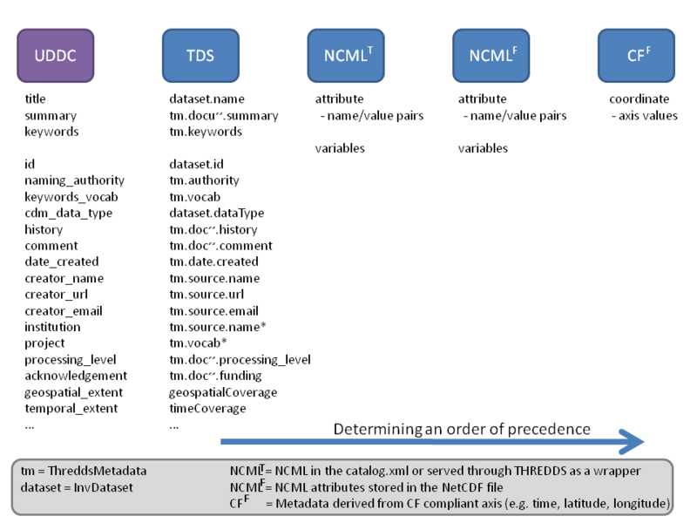

Slide 19
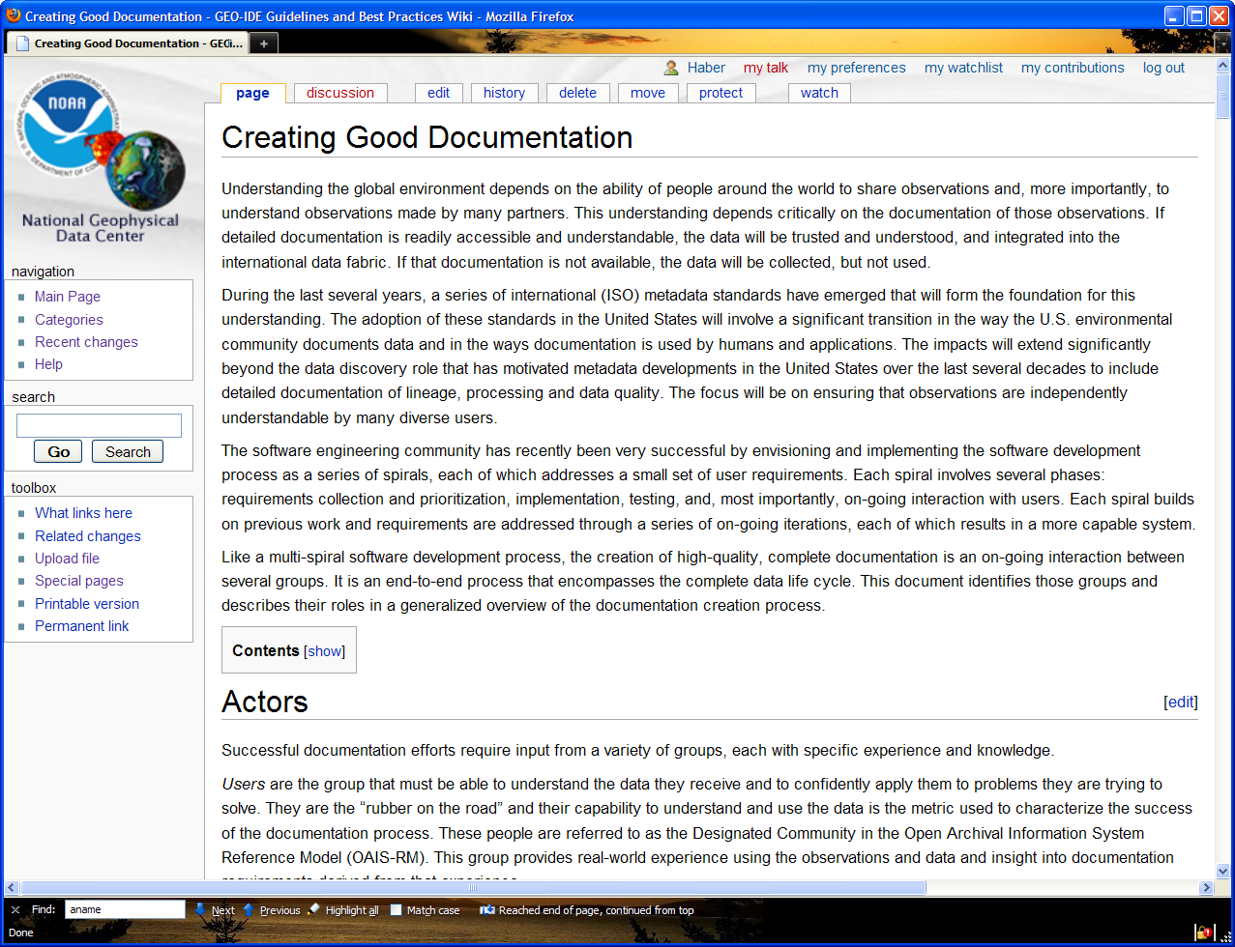
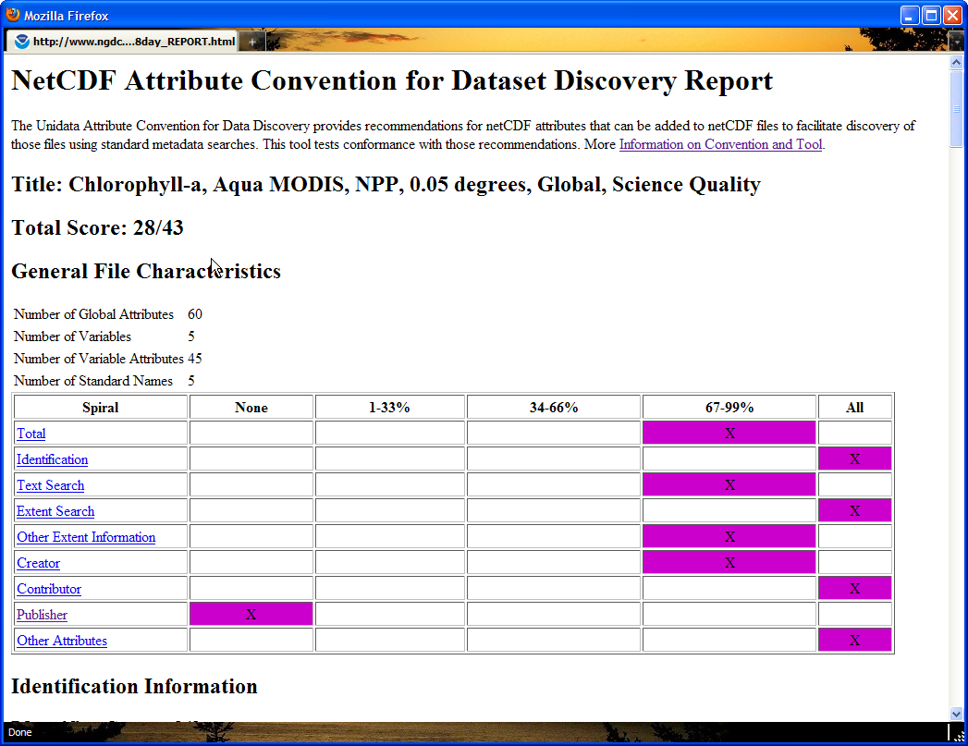
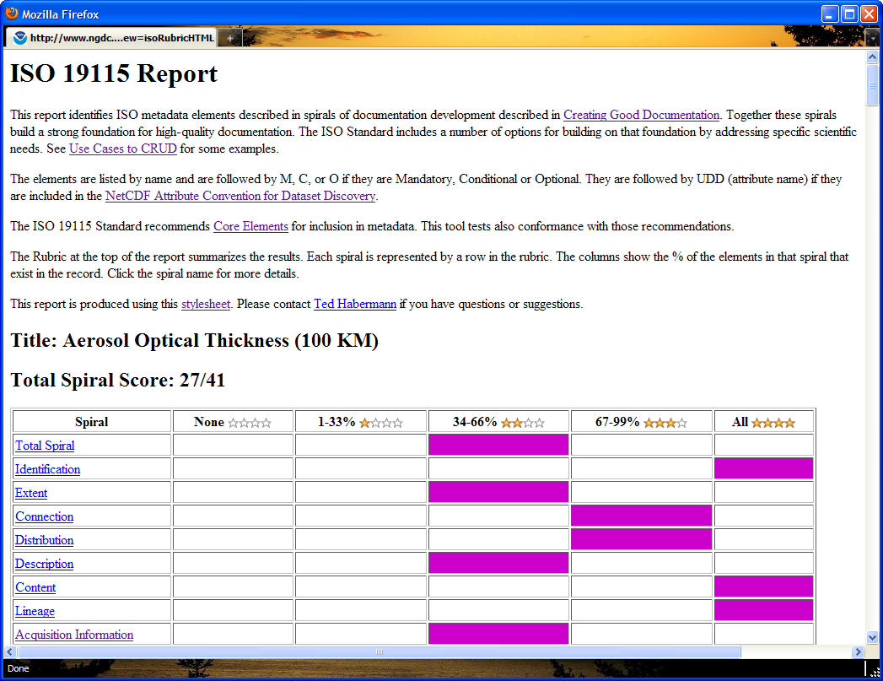
Spiral Development / Training: Rubrics

Slide 20
Multiple Dialects:
THREDDS Metadata Server
THREDDS Data Server
OPeNDAP
WMS
WCS
NcML
ISO
Rubric
Extract Data
Extract Metadata (NcISO)
THREDDS
Catalog
THREDDS
Catalog
THREDDS
Catalog
file1.nc
file2.nc
file3.nc
file4.nc
file1.nc
file2.nc
file.nc
file.nc
file.nc
file.nc

Slide 21
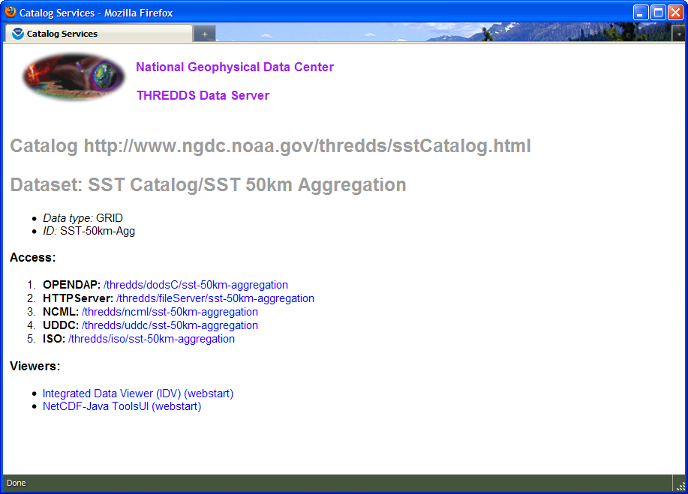
THREDDS Metadata Server

Slide 22
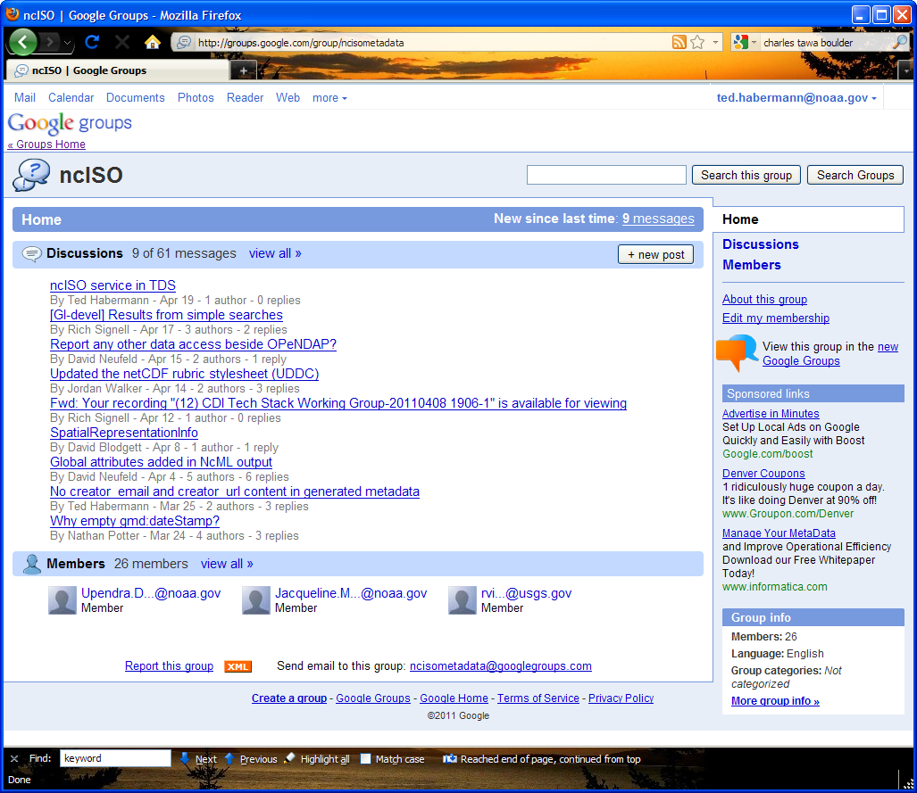
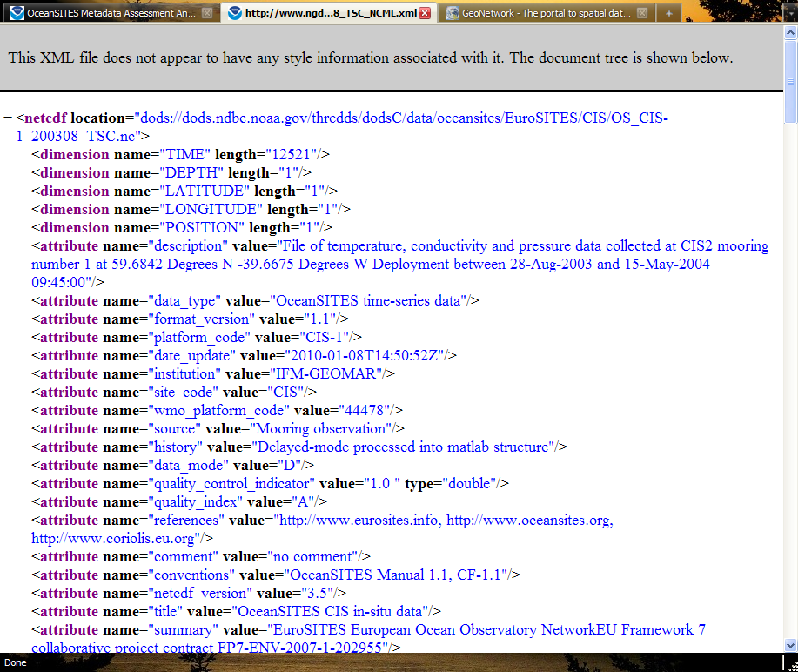
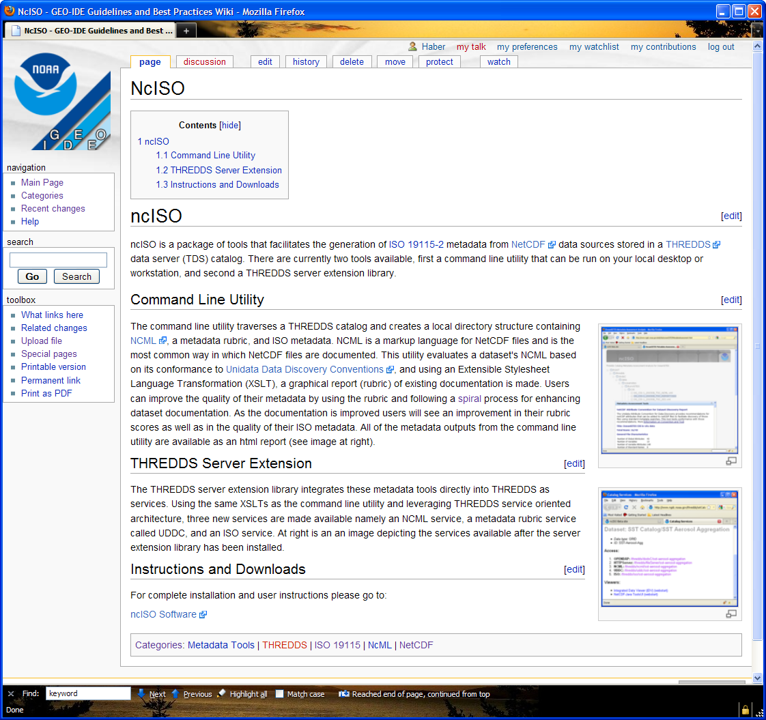
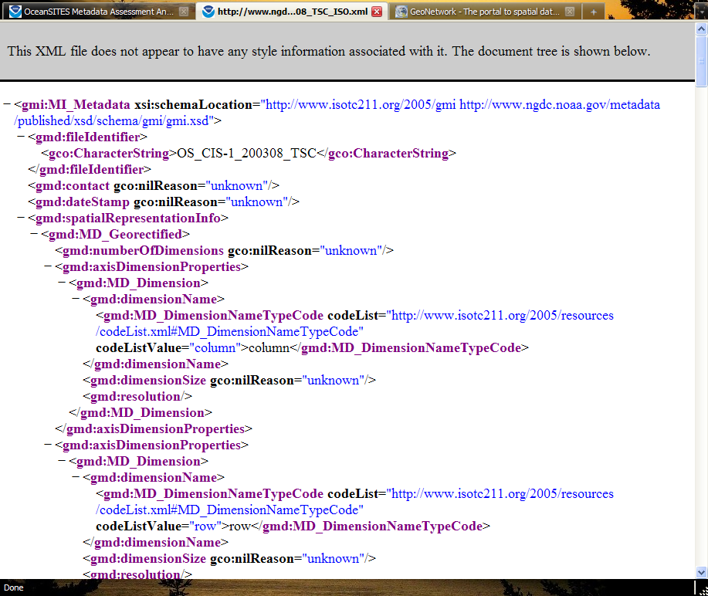
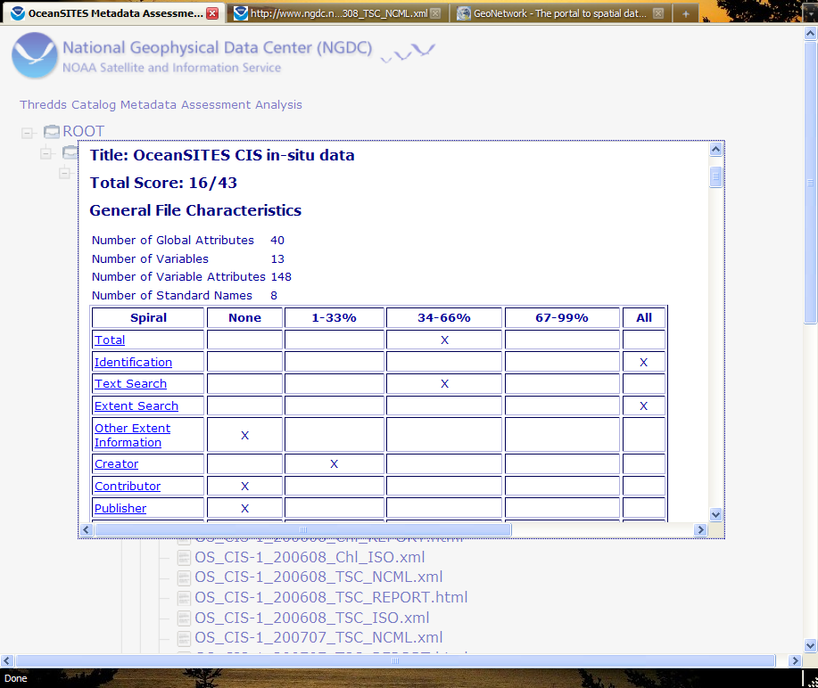
Documentation in Three Dialects
https://geo-ide.noaa.gov/
wiki/index.php?title=NcISO
http://groups.google.com/
group/ncisometadata
NcML
ISO
ACDD

Slide 23

Documentation in Multiple Dialects
KML
DIF, FGDC,
Data.Gov
1010101010101010101111100100101101001001001001000100100010010101001001010010010101000100100010100100100101010101010101010101010100010010101000010100
Documentation
Repository
ISO 19115, 19115-2, 19119 and extensions
HDF, netCDF, ACDD, CF
SensorML
THREDDS
WCS, WMS, WFS, SOS
Open Provenance
Model, PROV

Slide 24

Where Are Citations?
Documentation
dataset /
resource
source
application
schema
keyword
thesaurus
& ontology
algorithm
feature
catalog
Metadata
standard
specification
XML
evaluation
procedure
format
specification
feature
catalog
constraints
reference
additional
documentation
metadata
& service
standard
source
metadata
process
reference &
documentation
software
reference
alternate
metadata
associated
resource
name/metadata

Slide 25
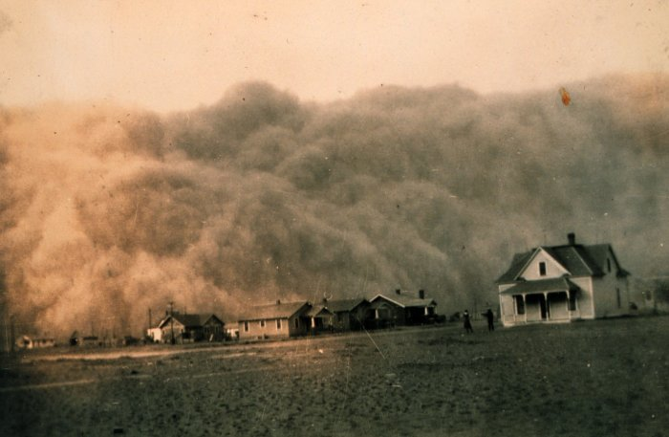
Questions?
ted.habermann@noaa.gov

