Slide 1
Harness
A Development and State Testing Framework
for
Big Data
Algorithms
(and anything else)
Ryan Berkheimer
Global Science & Technology, Inc
NCEI NOAA

Slide 2
Outline
Motivation
Domain
‘Big Data’
Ideals
Example
Improving the Ideal
Project
Concept
Design Tenets
System Architecture
Application Example
Technology
Progress

Slide 3
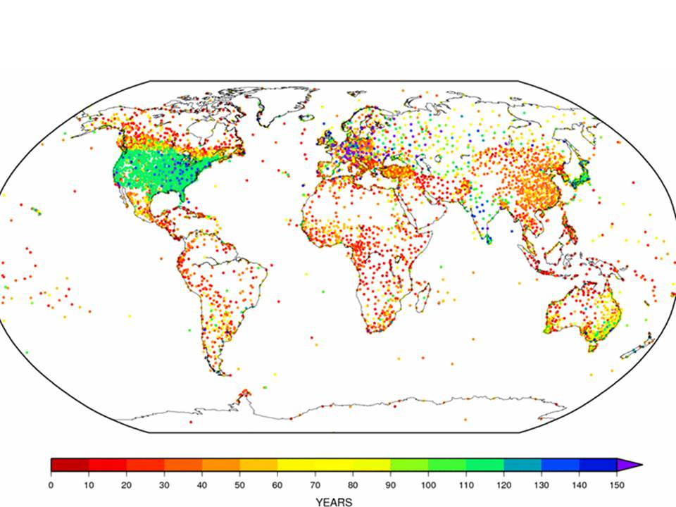
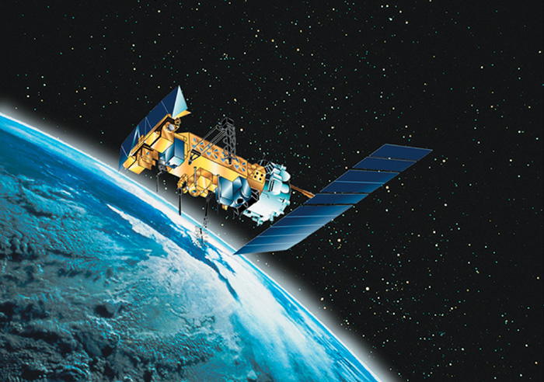
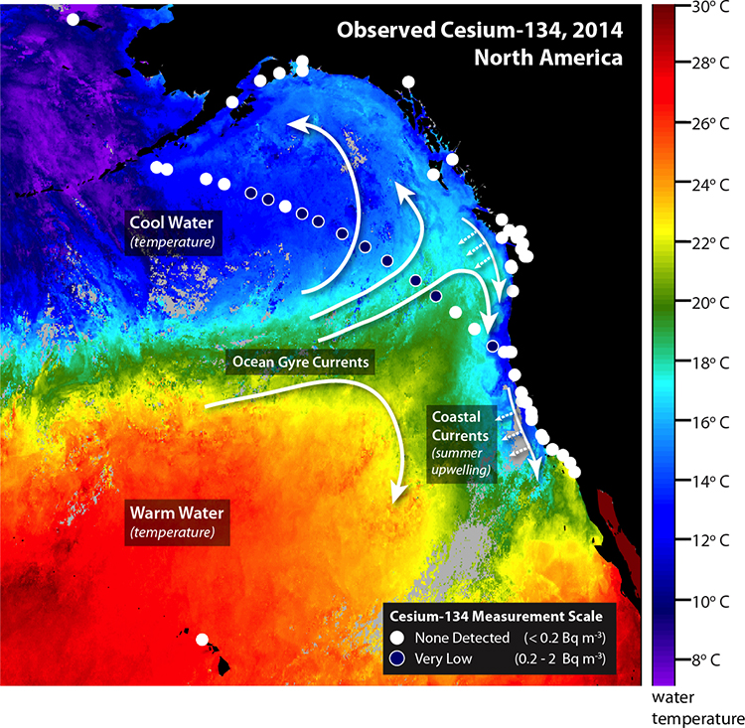
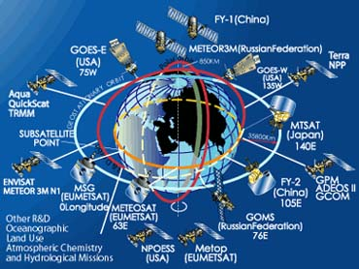
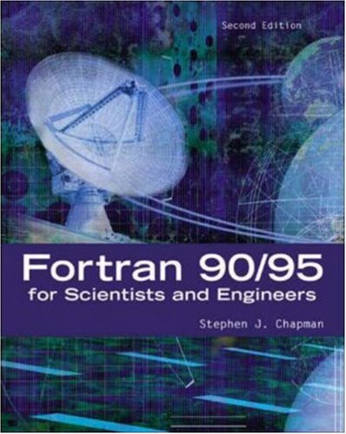
Big Data in the Earth Science Domain
Data, technologies, people
Notes:
The data science domain of climate data is one of the most enormous and complex imaginable.
The breadth, depth, diversity, and scope of data types, data sources, involved agencies, result utility, producers, and technologies is staggering.
And it’s only going to get larger as technology and interest grows.
NCEI alone currently holds petabytes of storage of just raw data from satellite and ground measurement programs.
And that’s just input, not counting work product of algorithmic and modeling analyses.
The analytical work of these projects stretches over decades, with a single project being an essential time capsule in programming technology.
A single project might contain six different languages. And every project might be responsible for producing output that serves as input to any number of other projects.
Because projects are so large, and they deal with dynamic conditions at every level, one of the primary concerns is making sure the output behaves as expected.
When you have a software project that takes in gigabytes of data a day from several sources, processes that data based on some peer reviewed algorithm that has been in existence since 1975 in a project that uses Fortran, python, R, and awk, and has to provide that data accurately with very little chance of failure, and it must be updated as research is updated, you have a large problem of quality assurance to deal with. The number of possible states is incredible.
This realm is the very definition of big data, and it motivates a strong framework environment that grows with your project, keeps a record of change, and allows for easy and fast paced development of state tests.
And it needs to do so while itself having a large number of unknowns.
Some sort of harness.

Slide 4
Domain Characteristics
Highly involved projects and development environments
Projects containing multiple languages and project dependencies
Project duplication across teams, languages, time
Large Project evolution over time, technology change
Diverse array of tools (tech) to choose from
Large amount of documentation coverage required
Large scale, varied input datasets and dataset products
Full stack production (design, collection, analysis, production, maintenance)
Enormous resource (computational) demands in product development
Enormous resource demands in live products
Legal obligations with results (conformity to published results)
The scope, breadth and depth of data issues in this domain makes it the very definition of ‘big data’
Notes:
This is an enormous list of things that belong to our domain, and there are so many others. One particular characteristic of the domain is the gr

Slide 5
Domain Trends
Technology -> Increasing options
Stakeholders -> More demanding
Algorithms -> More Complex
Funding -> Relatively Stagnant
People -> Increasing specialization
Obligations -> Increasing

Slide 6
Domain Our Focus
Pros
Data diversity
Expertise diversity
Cons
Data diversity
Expertise diversity
Technology diversity
Technology diversity
Better breadth and depth
Deeper understanding
More options to pick the best tools
More noise, processing requirements, deeper specializations
More hands in the pot, increased impedance mismatch, competing strategies
Too many options, increased chance of picking the wrong tool, increased learning curve

Slide 7
Domain Diversity Implies Complexity
Complexity in the Environmental Data Domain as a Sum of Partial Diversity over Time
Disclaimer: Illustrative Only

Slide 8
Domain Increased Complexity Implications
Larger effort to produce confident results
A larger effort implies more time required
More time implies either
More $$ needed
Limited budgets
Higher work/time output
Increased pressure on personnel
Mistakes
Increased Dissatisfaction
Decreased confidence in product

Slide 9
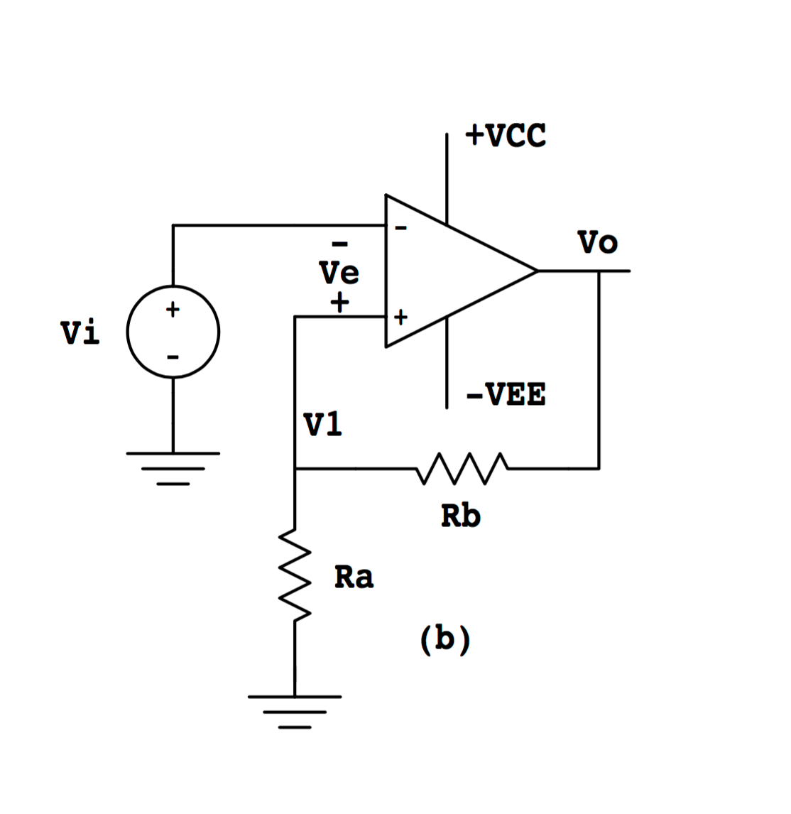
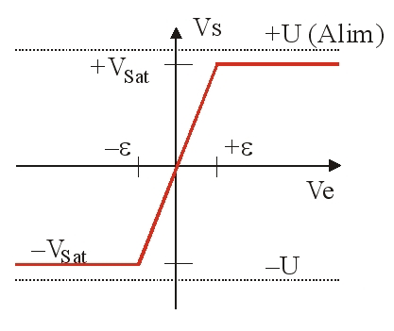
Domain Unmanaged Complexity
Positive Feedback
No complexity controls
Saturation
Domain is too complex to be efficient
Notes:
If the complexity keeps increasing without some regulation

Slide 10
Domain Product Management
Version Control
Git
Continuous Integration
Jenkins
Project Management
Strategy
Mercurial
Manual Efforts
Subversion
Gitlab CI
Shippable
Travis CI
Bamboo
Agile
Communication
Slack
Code
Development
JIRA
FogBugz
Trac
Skype
WebEx
SCRUM
Waterfall
CMMI
Deployment
Development
Virtual Machines
Docker
Profiles
Server separation
Documentation
Manual efforts
Doxygen
README
Notes:
Lots of bleed through between ideas here.

Slide 11
Domain Product Development Ideal
A blank slate development environment for
a single small cohesive team of world class experts
starting at the same time
with unlimited computing resources
and no security restrictions in place
This leads to the team choosing
a single project development strategy, conscientiously documented
using a consistent method that is never ignored in a technology that always stays the same and that everyone understands
And then developing the project software
in a set of languages which are universally accessible
and use libraries universally available
that can be deployed anywhere and anytime required
to produce results that are always reproducible exactly

Slide 12
Domain Assume the Development Ideal
Team A follows the ideal development path
In 2010, they use some established research to develop a brand new algorithm
Makes accurate, long term predictions on CO2 levels
Based on NOAA/NASA rainfall and temperature datasets
DOC economic models
USGS land cover datasets
They use a terrific plan
CMMI stages
Scrumy boards
Slack webhooks to have the team monitor all the development
Subversion for code control
They use the best tools
Modern Fortran for data processing
Python for data access and visualization
They document everything
Use automated document generation (doxygen)
Write dataset access guides
Write unit tests for everything
Have an entire warehouse full of jenkins data logs

Slide 13
Domain Assume the Development Ideal
Team B follows the ideal development path
In 2011, they use some established research to develop a brand new algorithm
Makes accurate, long term predictions on dominant flora patterns for the US at a county scale
Based on Team A’s CO2 Algorithm
Based on NASA/NOAA rainfall and temperature datasets
DOC economic models
USGS land cover datasets
They use a terrific plan
Agile development
JIRA for issue tracking
Development/Validation/Staging/Production server separation
Regular team meetings on Skype
Git for code control
They use the best tools
Java for data processing
R for visualization
They document everything
Authors are meticulous about writing code comments
The team has a dedicated tester for QA and documentation
The team always saves logs of builds

Slide 14
Domain Development Ideal Over Time
People begin to rely on Team B’s software
Logging companies
Forestry service
Real estate development
Climate companies
Things are changing
2013
New version of Python is released with new code standards
Major security issue found in Jenkins, developers move to new CI platform
Slack changes web hook REST pattern
2014
The software producing the NOAA temperature dataset gets a major overhaul
Two members of team A retire – the systems engineer and a meteorologist
Team B has to use Gitlab now (entire company migrated from Github)
2015
Team A’s data breaks because of data structure change in NASA dataset
Team A changes how they are reading dataset
Team B’s code breaks because Team A’s data starts being produced in a new format
2016
Team B’s code is repaired
Team A found a very small issue in their algorithm and made a correction.
Team A raises the resolution of their output dataset by two spatial orders of magnitude due to an algorithm change
Team B’s algorithm starts producing incorrect results for very specific location patterns
Team B doesn’t discover this issue due to incomplete input dataset testing domain coverage – Point of Failure

Slide 15
Domain Why Ideal Isn’t
Even with teams doing ideal development:
No team develops in a bubble
All products rely on other products.
All products may rely on specific instances of other products.
The ‘best’ tools are arbitrary
Every best has a plan, uses code, grabs input data, and produces documentation. There are many iterations of each of these things, and objective best is different from project to project.
Nothing escapes change
Personnel change. Products are people. People retire, learn, and have complex relationships.
Products change. Input products change. Assumptions change.
Technologies change. Storage, security concerns, patterns, schema.
Documentation is hard
Planning, development, code, results all require documentation. These things are all constantly changing.
Producing meaningful documentation that is searchable is even harder. Projects all rely on different input and output structures. Coming up with something more meaningful than a wall of text is a relatively unsolved problem in the domain.
Datasets are large and complex
Sub-setting data is a must when projects share resources and take hours or days to run.
Ensuring total coverage takes dedicated talent and skill.
Ensuring tests on data subsets means additional resources, meaning this is often overlooked.
Explaining datasets to people that use your data is difficult

Slide 16
Domain Potential for Improvement
Similar things should be
interchangeable
loose orthogonality of groups
technology agnostic
Product changes should be
documented
plug and play
Documentation should be
automated
useful
searchable
shareable

Slide 17
Domain Improvement Without Complexity
How do we provide all of this without introducing too much added complexity?

Slide 18
Harness Concept
Lightweight, flexible, unobtrusive framework
Notes:
Harnesses are found in many systems.
They tend to be small, lightweight, and generic parts of simple or complex actions and routines.
Good harnesses are unobtrusive and unrestrictive to what they contain, while being quickly adjustable as needed.
Here we have an exercise harness, two parachutists and their gear jumping in the same harness, and an astronaut, his space suit, and gear on a space walk.

Slide 19
Harness Purpose
Helping
complex
components
which are
unpredictable
and
uncontrolled
become
predictable
and
controlled
Notes:
The most interesting part of any harness is often its contents.
A harness without anything is just a bunch of straps.
Before anything is added, it makes no assumptions about what it will contain.
What they eventually contain are often complex systems, such as a living organism.
Living organisms have a huge amount of parts, states, and actions.
When we put them in a harness, we are generally hoping to expose some of those states, but in a controlled way.
Here we have a set of Belgian Shepherd Dogs (Malinois).

Slide 20
Harness Clarifying Meaning
Emphasizing functionality through constraint
Notes:
A harness should not care about what is inside of it.
All of these biological systems fit in a harness.
The harness exposes lots of their behaviors similarly.
When we see dogs in a harness, as opposed to without, we are more likely to focus on specific capabilities of that dog (walking the dog).
Further reasoning implies a dog wearing a muzzle would place emphasis on the functions of the mouth.
Constraint promotes emphasis on certain system functions.

Slide 21
Defining Scope
+
=
Harnessing systems makes a new system
Notes:
Multiple complex and diverse systems held together in a harness.
Here we have a space suit with many complex internal and external functions.
And here we also have an astronaut (Sally Ride).
Both of these are essentially complex systems that work together.
The equipment monitors and protects the astronaut, the astronaut manipulates the suit.
All of the equipment is harnessed to the astronaut in the suit. Everything becomes one system, functioning inside the harness, exposed to another system.

Slide 22
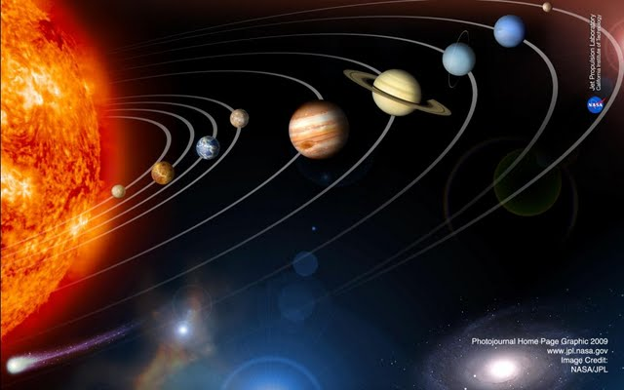
Framework Expansion
Imagine the solar system as a harness
Notes:
If we apply the converse to our harness logic, then a system of systems implies the systems are harnessed.
And if we follow along with our logic that we’ve outlined – a harness emphasizes what it constrains, is generic, and allows functional interaction between its contained systems,
Then our solar system is a harness, with straps replaced by the fundamental forces.
This new way of thinking gives us more freedom in our definition of a harness.
We don’t need to say harnesses are physical straps anymore.
We can define a harness as something that
Has a set of constraining rules
Contains an arbitrary set of components (the sun, planets, etc.)
Provides the contained components a way to interact with themselves, in ways enhanced by a particular constraint
Planetary gasses interacting with the planetary solids via gravity
Planetary gasses interacting with other planetary gasses via the electromagnetic force
Provides the contained components a way to interact with each other
Planets interacting with other planets and the sun via gravity
Exposes the systems as a whole to be useful to other systems
The solar system’s gravity as a whole can be observed from outside the solar system.

Slide 23
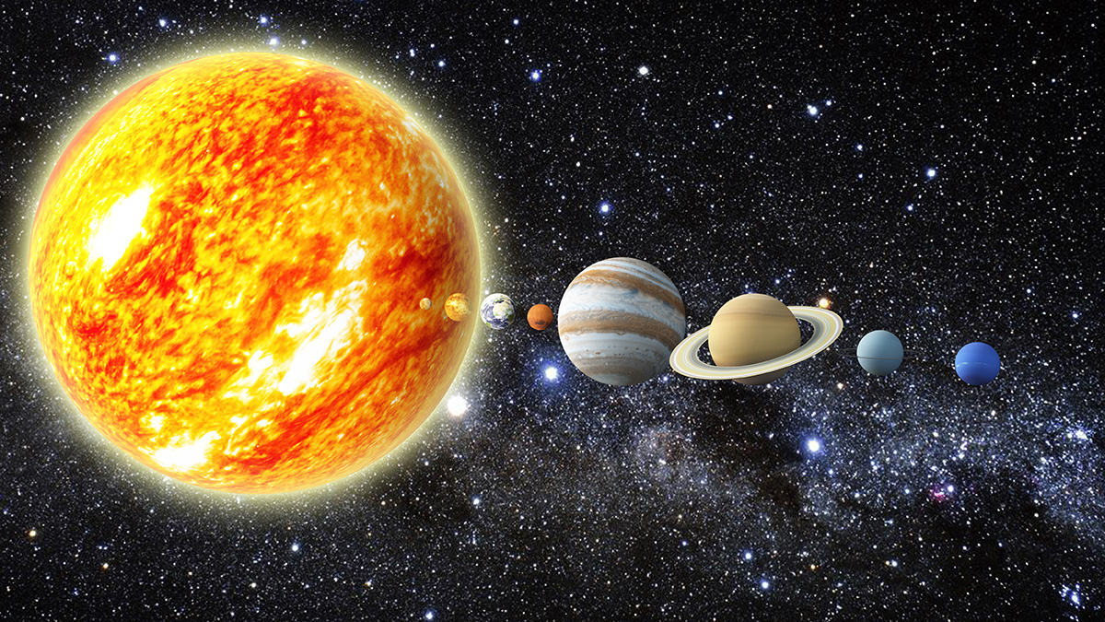
Harness as Software
Solar system as a Harness
The sun is the principal algorithm package
Each planet is a related software package
Sun and planets are all components
Notes:
Lets take our new conceptual definition of a harness and think of how it could apply to software development.
We might be working on a huge climate model project that models climate temperature data over the past 250 years.
This project has a central algorithm written in Fortran 77. It’s huge (massive) and very complex.
This project also has various associated software projects that handle preparing input data and analyzing results.
These are written in python and R. They are represented by the planets.
Some of the data preparation projects contain additional helper scripts and makefiles. They are represented by planet moons.
In our software, the sun and the moon are all added as components. The moons are picked up with the planets automatically.
The software doesn’t care what language the planets are. All are loaded as equal components.

Slide 24
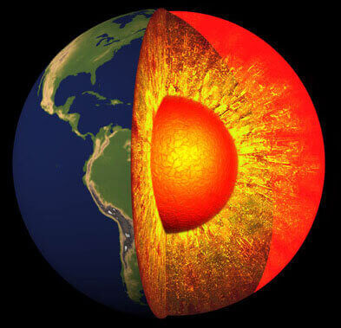
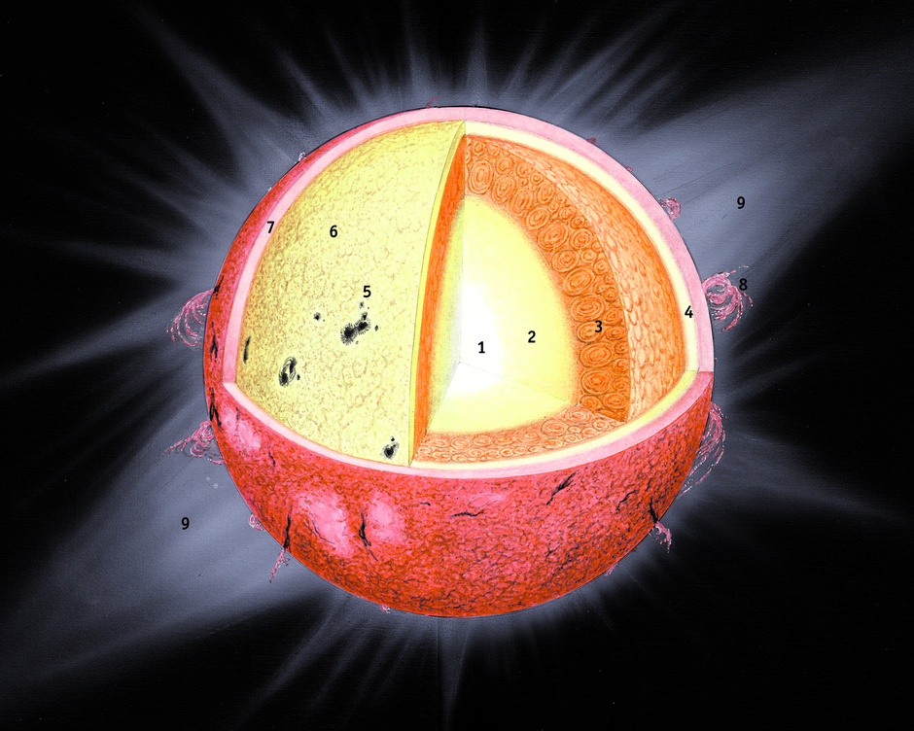
Component Functions - Internal
Notes:
Software programs are added to the Harness as components. Every component has internal methods, functions, subroutines, and modules.
All of these has input parameters and an output parameter.
Within a Harness, all of these or some of these functions can be exposed to the Harness overall, to be directly called or used with other functions.

Slide 25
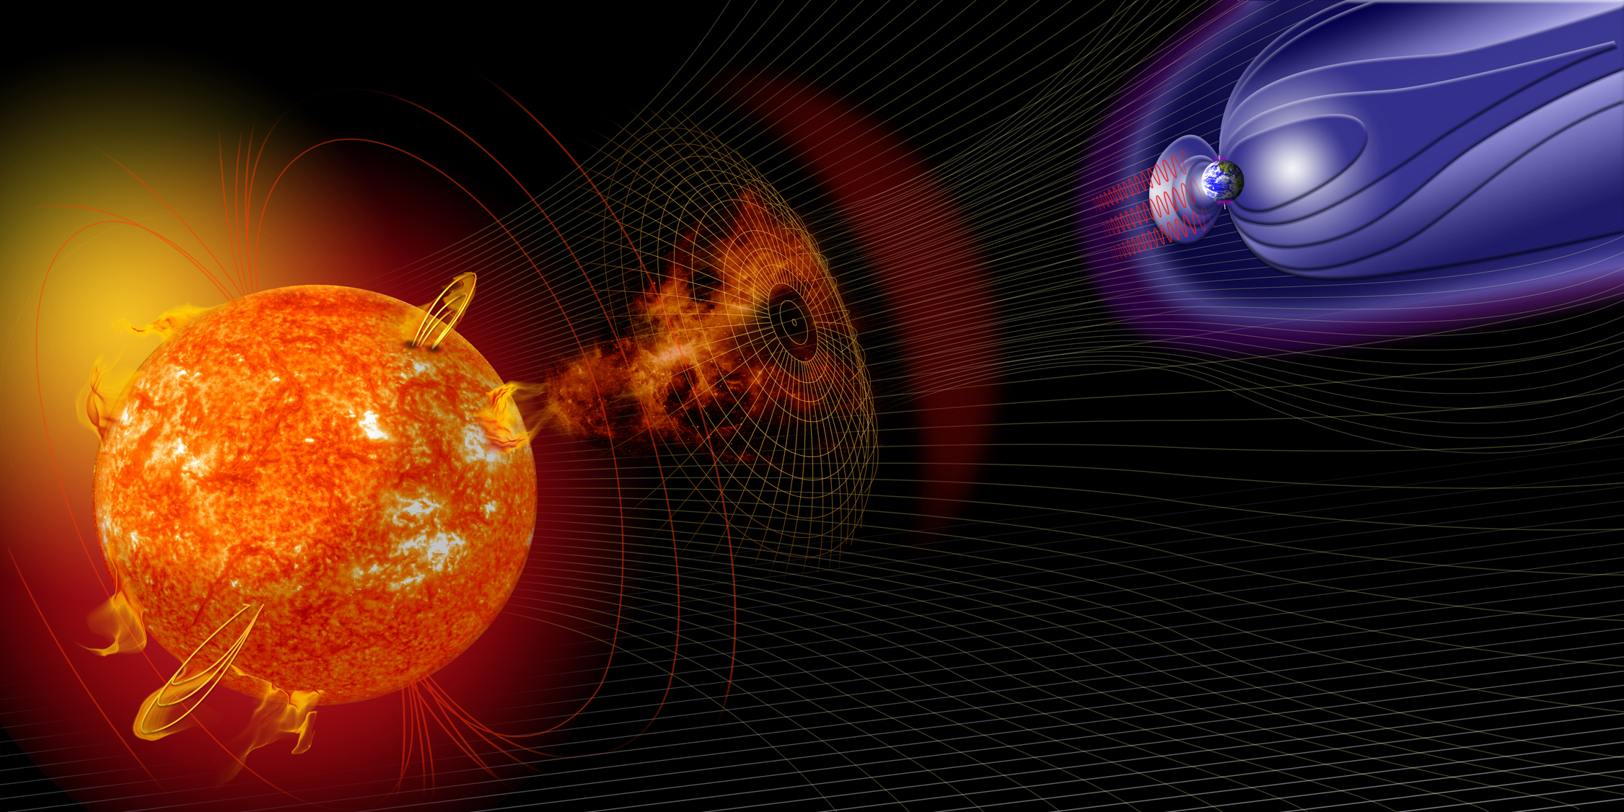
Component Functions - External
Notes:
Components that are in a Harness also have external functions – like a makefile command that might call a program as a whole to run the entire algorithm.
Like internal functions, these external functions are also able to be defined within a Harness, either for evaluation or use by the other Harness functions.
Here we see the main algorithm with an external function represented by its output of the solar wind, interacting with the magnetosphere of the earth.
The output of the solar wind function of the sun, charged particles, is accepted as an input to the magnetosphere function of the earth. This image is
Representative of the interaction, or chaining between two external component functions.

Slide 26
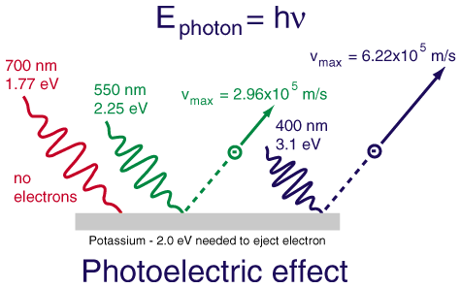
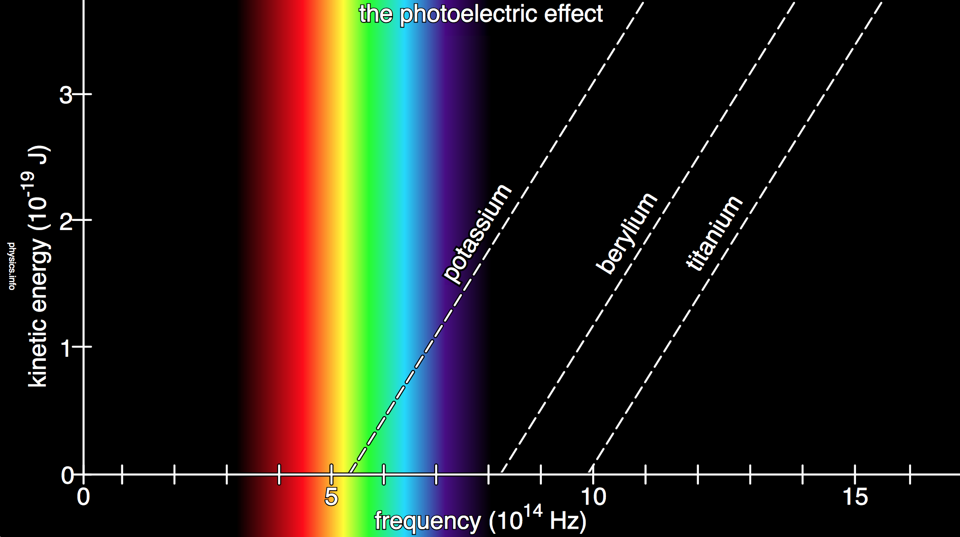
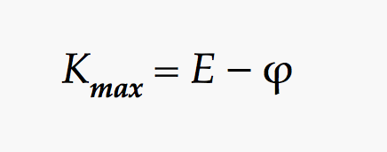
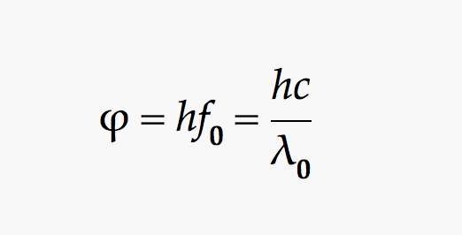
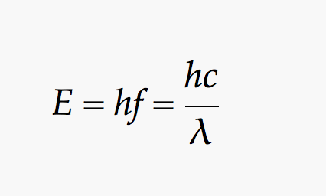
Functional Workflows
get_random_frequency()
return frequency
get_random_metal()
return metal
get_metal_threshold(metal)
return threshold
Function 2
Function 1
Function 3
Saved Workflow
Needs no inputs
Fortran program
needs 2 inputs
+
Python module
chain to need no input
=
Notes:
As we previously saw, we can define functions from components that exist for use within the entire Harness project.
These functions can be chained together, provided their output is a match to a subsequent function’s input.
This ability is central to the idea of Harness as a state testing machine, as functions from helper components can serve to provide
varied or large coverage test cases to the important model or algorithm routines that may have very large number of testable states.
Note that if a functional routine can be created that begins with a function that takes no input, no input must be provided to run the test.
This makes it ideal for writing clever and complex testing suites, that can be created and altered quickly to explore new testing cases.
As an example of this concept of chaining functions, let’s take the example of a simple program that contains a routine to calculate something we all know – the photoelectric effect.
(Explain example)

Slide 27
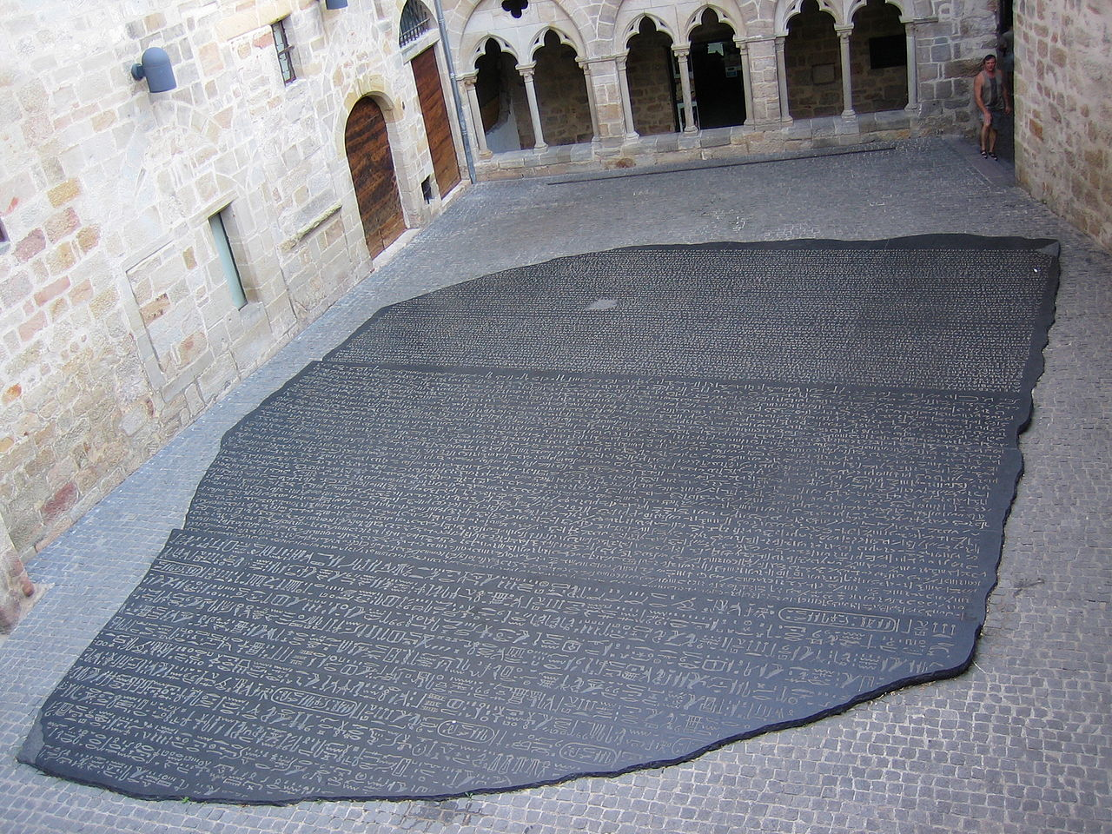
Language Translation
Notes:
Parameter maps are essential to translation between mapping and matching functions to create workflows.
A parameter map describes how one thing can be the same as another, and if necessary, describes the method of translation between parameters.
Every input and output of a Harness function is matched to a Harness parameter definition. This definition is stored in the database, and allows two parameters to be considered as equivalent.
For example, there could be a photon frequency parameter definition. A Fortran program might use that frequency, and the helper python script also uses that definition. The fortran might need it as a float 64 and the python doesn’t care.
So in the parameter itself, there are translation rules that help them translate so the python script can be used directly with the fortran code.

Slide 28
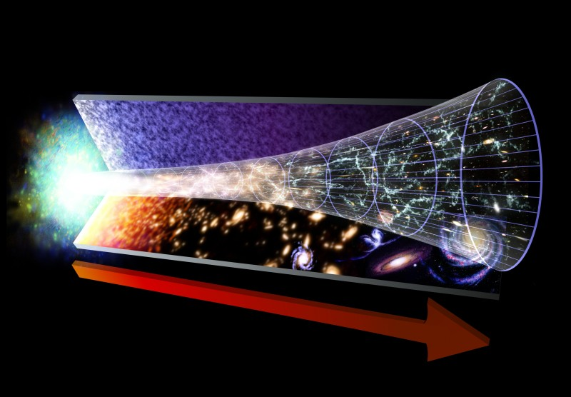
Accessible States
A retrievable record of all states through time
Notes:
A desirable feature of a software Harness that wasn’t in our general definition is the idea of recalling any state that’s ever existed.
If we looked at the Universe as a Harness, we would note that since the big bang, the universe is undergoing a continuous change in states.
Because we experience the passage of time, we are able to actively take measurements and compare them to previous results that we have taken.
It would be even more incredible to be able to instantly recall exactly a previous situation and return to it and compare to another.
Harness accomplishes this in software by using a storage engine to record all system state changes. Any state that has ever existed in a Harness can be recovered and re-evaluated.

Slide 29
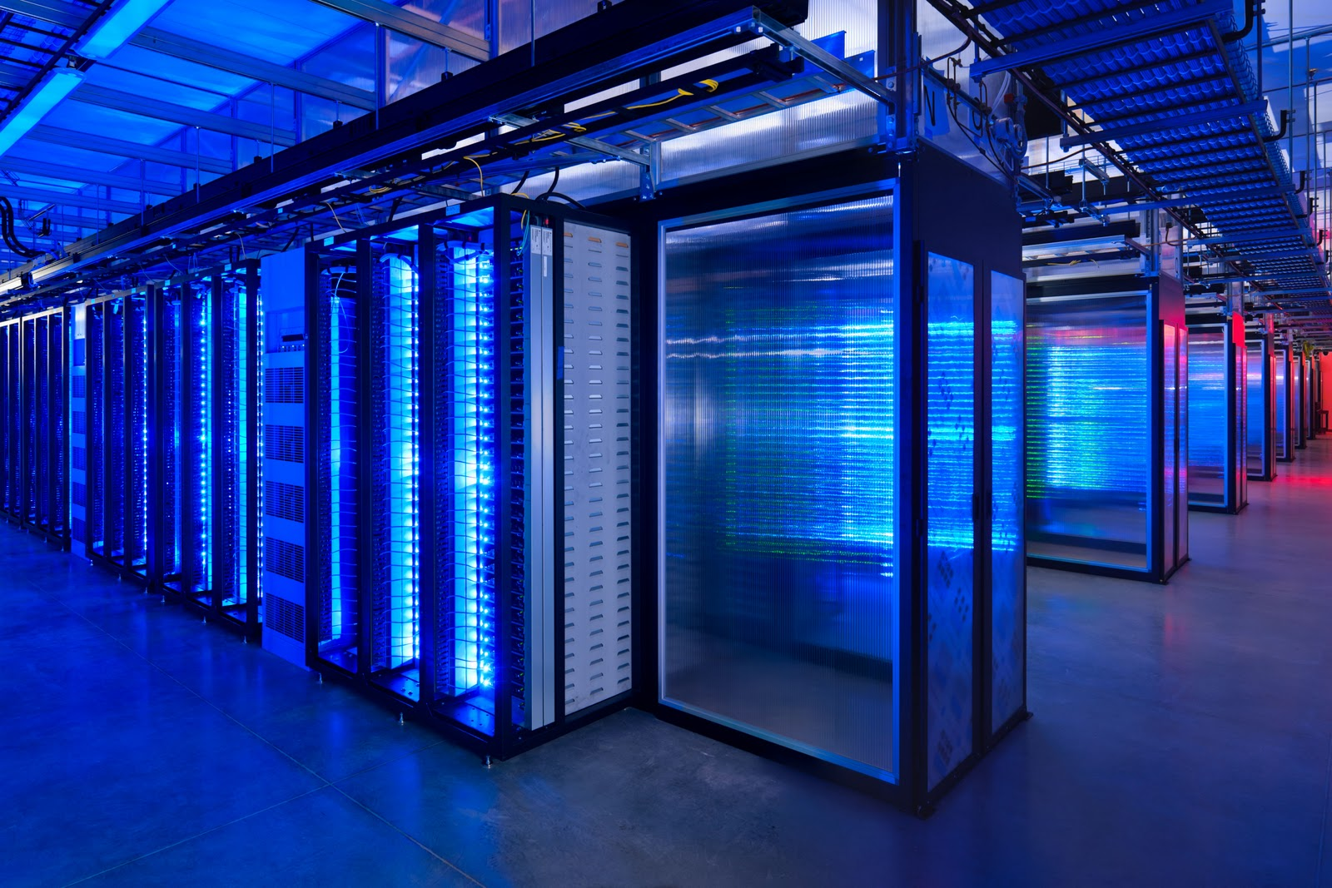
Concept to Design
Concept
Design
Notes:
Now that we’ve told a story about what we mean when we are discussing harness, let’s talk about the tenets of the Harness system itself.

Slide 30
Design Tenets
Abstract and generic framework
Try not to make assumptions about the project
Author assumptions
Number (Started with two, now there are five, …)
Diversity (data scientist, physical scientist, technologist, …)
Organizational Assumptions
Version control (git, subversion, mercurial, filesystem (none), ...)
Security (avoid scaring IT – no strange dependencies)
Code assumptions
Language (Fortran and/or Python and/or …)
Structure (module vs. function vs. compiled code)
Product assumptions
Workflows (how code is combined)
Outputs (what are the structures, i.e. things produced by project)
Storage (which ones/how are structures going to be stored)

Slide 31
Design Tenets
Seamless and comprehensive utility
Automatically add DRY functionality without obfuscation
Provide state access
Components (every file addition/removal/change via version control)
Functions (run the current code or a specific historical version)
Structures (functions may require specific copies of structures)
Workflows (as functions change how we combine them also changes)
Evaluations (store inputs, outputs, metadata for every evaluation)
Provide uniformity
Components (automate the guts of version control updating)
Functions (fortran, python, makefile commands, all the same)
Structures (user defined, nestable, reusable, and easily changeable)
Workflows (function combinations, glued together by structures)
Evaluations (View matching or translatable structure records together)
Provide project access
Functions, Workflows, Evaluations (Once defined, available as REST services)
Multi user potential (sharing components, functions, workflows, and evaluations)
Multi deployment potential (single user or shared deployment)

Slide 32
Design Tenets
Accommodation for Development
Promote flexible development strategies
For the Project Authors
Components (add, remove, update, enable, lock)
Structures (Add/remove/update, groups, templates, translators)
Functions (User based code by design)
Workflows (Input sources specified on evaluation)
Evaluations (Immutability, save by default, remove on request)
For Harness Developers
Modular development pattern (model/processor/controller separation)
Plug and play drivers (what runs the code)
No explicit classes and objects (dictionaries and named tuples)
Functional patterns (closures, maps, filters)
Easy to add features (new language drivers, machine learning modules)
Easy to swap features (e.g. flask for twisted klein service controller)

Slide 33
Deployment Architecture
Deployment
Harness (project)
Harness (project)
Harness (project)
Harness (project)
Metadata
Users
Metadata
Users
Metadata
Users
Metadata
Users

Slide 34
Project Architecture
Harness (project)
Users
Components
Functions
Structures
Templates
Fields
Translators
Workflows
Functions
Structures
Evaluations
Evaluations

Slide 35
Harness Architecture
Component
Component
Component
Harness

Slide 36
Harness Architecture Adding a Component
Metadata
Version Control
Location
Name
Description (optional)
Where to get it from
How is it versioned
Status
Enabled (default)
Unlocked (default)

Slide 37
Component Architecture Local copy
Directory
Directory
Directory
Component (disk)
File
File
File
File
Directory
File
File
File
File

Slide 38
Component Architecture Updating a Component
Version 1
Version 2
Database Record 1
Database Record 2
Function Set 1
Function Set 1 (copied)
Change associated function -> Function Set 2
Function Set 2 (copied)
Database Record 3
Version 3

Slide 39
Component Architecture Function Structure
Component
file
function
function
file
function
function
file
function
function
file(function)

Slide 40
Function Architecture Adding a Function
Metadata
Outputs
Type
Inputs
Language
Name
Description (optional)
Component (auto)
Scope
Possible Automation
Module
Method
Statement
Possible Automation
Name
Description (optional)
Position
Name
Position (optional)
Description (optional)
Location
Component
File

Slide 41
Function Architecture Functions in Harness
Harness
Functions
Function 1
Function 2
Function 1 (Reference)
Function 3
Function 3 (Reference)
Component 1
Components

Slide 42
Workflow Architecture Adding A Workflow
Metadata
Name
Description (optional)

Slide 43
Workflow Architecture A Workflow In Harness
Workflow
Function
Function
Inputs
Outputs
Input
Source
Target (Optional)
Input
Metadata
Order
Metadata
Order
Source
Target (optional)
Output
Metadata
Order
Target (optional)
Required
Required

Slide 44
Evaluation Architecture Adding an Evaluation
Choose workflow
Define input sources, and optionally targets
Optionally define output targets

Slide 45
Evaluation Architecture Input Source Options
Input Sources
Outputs of other functions in the workflow
Link output of another function to the input
Direct entry by value
Directly pass a value to the input
Some saved structure of a previous evaluation
Specify a record from another evaluation
A named structure of a named evaluation
A named structure of the most recent evaluation

Slide 46
Evaluation Architecture Unspecified Input Sources
Workflow
Function 1
Function 3
Function 2
Function 4
Function 5
Nebulous function order

Slide 47
Evaluation Architecture Specified Input Sources
Function 1
Function 5
Input A = Function 1, Output A
Function 3
Input A = Function 1, Output A
Function 4
Function 2
Input A = Function 3, Output A
Input B = Function 5, Output A
Input A = Function 4, Output A
As input sources are specified, order updates and checks against recursion

Slide 48
Evaluation Architecture Performing an Evaluation
Each function is evaluated in turn
Functions use the appropriate driver specified by function metadata in the workflow
Each function records metadata after evaluation
Execution time
System resources
The output of a function is temporarily stored if it is to be used later
Function inputs/product are then passed back to the evaluation processor
The evaluation processor creates storage structures for specified storage
The evaluation processor then compiles metadata

Slide 49
Evaluation Architecture Storing an Evaluation
Harness
Function 1 Input A
Function 2 Output B
Function 1 Input B
Function 1 Output A
Function 5 Output A
Evaluations
Evaluation A
Structures
Workflow A
Metadata
Statistics
Evaluation A

Slide 50
Structure Architecture Overview
Structures are parameters of the system
Language agnostic
Class of classes, can be topologies
Structures can be optionally grouped
Groups are additional metadata labels for projects with large numbers of structures
Topologies
Every structure contains templates
Templates are groups of fields
Models/Classes
A template field has a name and a type
The name is unique to the template
The type can be
basic type (string, number)
User type (any other structure template)
Recursion is automatically prevented
A collection type (collection of any user type or basic type)
Fields can specify order and requirement
Structure templates can provide translators between each other
If a specific structure template is desired but data is loaded via another template, a translator can be added between the two templates for automatic loading of the desired type

Slide 51
Structure Architecture Structure Storage
Harness
Structure
Structure
Group
Structure
Structure
Structure
Template
Field
Field
Field
Field
Template
Template
Field
Field
Field
Template
Field
Field
Field
Template
Template
Template
Field
Field
Field
Field
Field
Structures
Translator

Slide 52
Structure Architecture Adding a Structure
Metadata
Group (optional)
Name
Description

Slide 53
Structure Architecture Adding a Template
Structure
Metadata
Automatic
Name
Description (optional)

Slide 54
Structure Architecture Adding a Field
Template
Metadata
Order (optional)
Automatic
Name
Description (optional)
Required (optional)
Type
Index (optional)
Spatial Index

Slide 55
Structure Architecture Translators
Template A (Field A)
Template B (Field A)
Template C (Field B)
Template D (Field A)
Translator 2
Translator 1
Translator 3

Slide 56
Evaluations and Structures The Key to It All
User defined structures are the Rosetta stone of the framework.
They add self documentation to the system
Allow searchable results
Are stored as BSON and retrieved as JSON
‘Find me all the evaluations of workflow A that produced anomalous stations within 50 miles of Ohio’
‘Find me all the workflows that produced an evaluation with a mean temperature greater than 56’
Immutable by default, can be named and reused in future evaluations
Load this huge dataset that only changes once a year
Reuse this dataset for other things
Query this dataset
Share it with other projects directly
Translators allow similar things produced by different code to be stored in the same way
Station set A, B and C – all stations

Slide 57
Architecture Summary Takeaways
A Harness deployment is a code and database deployment of a collection of harness projects
Harness projects contain components, that can be entire projects themselves
Components self manage their own version control but can be locked
Functions are defined from components but contain their own information
Functions run on the component code but functions from different components can be combined into workflows
Adding a function to a harness also exposes a way to run that function using a REST API call – hence, micro-framework potential
Similarly, defining workflows and specifying all input sources exposes these to the REST API
All the parts of a Harness include their own metadata and every change is recorded by default. Immutability of all of this data results in self documentation. Everything is stored similarly, and can be recalled as JSON using a patterned REST API.
Extreme malleability and simple user defined structures allow fast changes
A REST API implies that development, tests, and results can all be shared with other Harness instances

Slide 58
Case Study PHA Practical Application
The Pairwise Homogeneity Algorithm
Project
The algorithm is in active service for several years. Two years ago, due to increased public interest, version 3 was scheduled for code level refactor. The code itself is based on published results and as such the refactor was required to maintain these results exactly. While the code was being refactored, the production code was simultaneously being updated, with these changes required to be integrated into the refactored code as they occurred. The refactor was being performed by a team of software engineers, independent of the science team responsible for the production code.
Background
NCEI NOAA Algorithm
Part of the Global Historical Climatology Network-Monthly pipeline
Used for automated correction of faulty instrument response functions
Operationally involved in two data programs (USHCN and GHCNM) and three datasets for each (minimum, maximum, and average temperature)
Uses additional historical record files when available

Slide 59
Case Study Technical Details
The Pairwise Homogeneity Algorithm
Technical Details
Original Production code
Fortran 77
Some subversion code control
Different builds for different datasets
Builds based on external MAKE commands
Text based logs
No test coverage
Sparse documentation
Extraneous files remaining in project
Each run repeated data loading
Largest full dataset requires full day

Slide 60
Case Study Refactoring Beginnings
The project began by mocking code in Java before Fortran 95 was accepted as a suitable replacement language.
The lead engineer responsible for the refactor began by writing logging and unit testing modules for Fortran 95.
The project was then given a modern pipeline.
Server separation was implemented (development, validation, staging, production)
Jenkins was implemented for automated builds
The project was updated to Git version control
Gitlab was implemented for linking code pushes to managing Jenkins
Issue tracking was implemented (Trac)
Everything was tied together using Slack

Slide 61
Case Study Refactoring Issues
Three things became clear priority issues
The time to run input data (day per set)
The number of input permutations (6 input sets)
The divergent quality of production code and refactored code (both codes being updated)
Solution?
Data sub-setting
Faster to run small datasets
Run several small datasets simultaneously on different input
Automation

Slide 62
Case Study Sub-setting Issues
The data sub setting package was written in Python
Many methods to subset the variety of data inputs in different ways
Initially plugged into Jenkins pipeline
Clearly became not ideal
Jenkins text logs not ideal
When code would run and fail, which subsets made it fail?
Hard to remember or look at logs to figure out failures
One off solutions for analysis of failure, time loss
Can we choose from these subsets, recombine and pinpoint particular stations?
Can we pass these failures between testers/engineers/scientists for discussion, or at least have them available for team meetings for search?
I.e., can I pass you a failing test and we can see exactly why this dataset made it fail, or correlate between failing datasets

Slide 63
Case Study PHA Harness Components
A PHA Harness created
Component 1: the production level PHA code
Fortran 77, make, awk
Component 2: the refactored PHA code
Fortran 95, make
Component 3: the data subset package
Python 2.7
Component 4: the Fortran commons library
Fortran 95
Component 5: the Python commons library
Python 2.7

Slide 64
Case Study PHA Harness Functions
Functions were loaded from the components. The most important functions were
Building and running each main PHA file using make
Testing certain PHA internals, things like choosing neighbors for deeper testing
Data sub setting – choosing specific subsets of stations, station neighbor pairs, correlation pairs, and temperatures
Data loading – loading stations and history files from a filesystem

Slide 65
Case Study PHA Harness Structures
For everything produced or consumed by a function needed, a structure was created.
A station structure was created with templates for
GHCNM
USHCN
A program structure
A coordinate structure
Used by the location
A location structure
Used by the station structure
The station structure was given a spatial index on location for spatial search

Slide 66
Case Study PHA Harness Workflows
Various workflows were set up
Workflows to load files into stations
These large station datasets were then able to be used in other workflows without reloading
Because they were spatially indexed, the input data was then automatically available for spatial search
These workflows could be run less often, whenever the input dataset changed. They were then named after the day the input data was created.
Workflows to do sub setting and use those subsets in the PHA functions
Using existing station evaluation structures, workflows to randomly select those stations, run them through the PHA algorithms, and produce output datasets
Because outputs were logged and contain searchable structures with translators between station types, this data is available for easy comparison

Slide 67
Case Study Aside A Note on Advanced Workflows
Because operations in Harness are user defined, meta workflows can be defined where code can automate harness results as it evaluates
For example, because we know how harness operates, we could write a workflow with a function that waits for harness to complete an evaluation, looks at part of the results of the evaluation, and re-runs the evaluation if a certain result exists.
This opens the potential for self modifying code. It has a huge upside for automated, parameter based testing.

Slide 68
Case Study Project Results
PHA Results
Finished on schedule
Results for all datasets match exactly on full datasets without running full dataset more than a handful of times during development
Refactor effort and team commended by NCEI/CWC management and leadership, nominated for employees of the year

Slide 69
Harness Technology
Front End
JavaScript
Angular
D3.js
Open Layers 3
Angular Strap
Angular Material
HTML
Back End
Language
Python 2.7
Database
MongoDB

Slide 70
Technology User Interface

Slide 71
Technology
User Interface (Front End)
Progress
Node-tree library complete
Used for all setup menus
Drag and drop
Dropdown Menus
Asides
REST API hooked in – 75%
Open Layers 3 controller written
Spatial data viewer operational
Evaluation record display
Planned

Slide 72
Technology
Back End
Web Controller
Flask
Plans for migration to Twisted Klein
Current Code Drivers
Python methods
Python modules
Shell commands
Fortran modules
Fortran methods (in progress)
Databases
MongoDB
MARS structure package
Complete

Slide 73
Technology - Goals
Language Drivers
Java
R
UI
Evaluation view
Compare evaluations
Asynchronous web controller
Allow UI to function with long running processes
Shared deployments
Allow sharing of components/functions/workflows directly
Profiles
Add profiles to evaluations (specified compiler, file paths, etc.)
Add machine learning to Harness – meta workflows

Slide 74
Contact Information
Always looking for interested parties and collaborators
Ryan Berkheimer, GST
Global Science & Technology
ryan.berkheimer@noaa.gov

Slide 75
Project Information
Notes:
Developed at NOAA NCEI Asheville NC
On Contract with Global Science and Technology, Inc.
On a python stack
Using MongoDB and git.

Slide 76
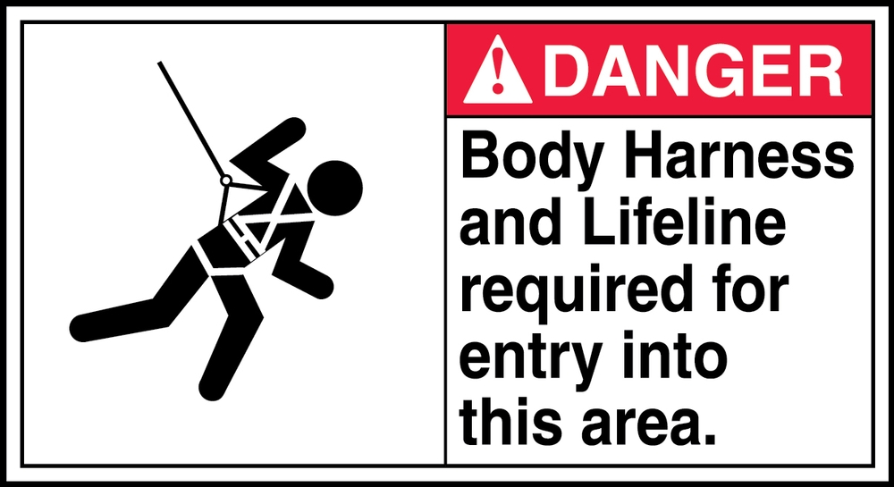
Wrap Up
Questions?
Notes:
Ask for questions

