Slide 1
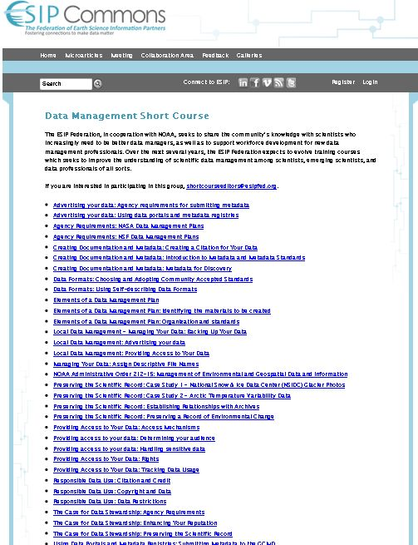
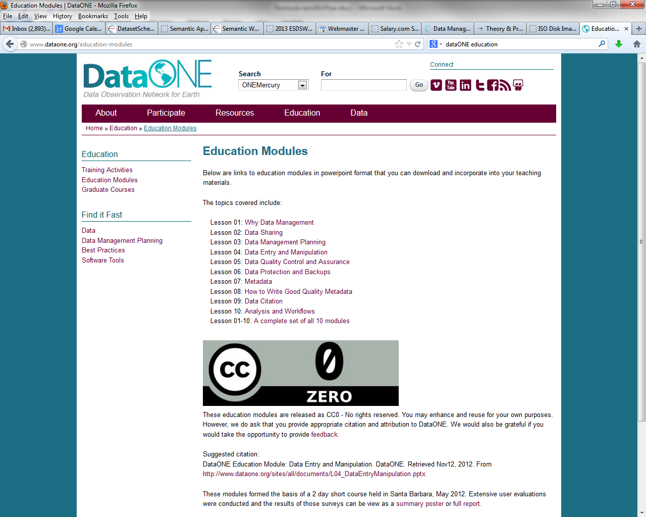
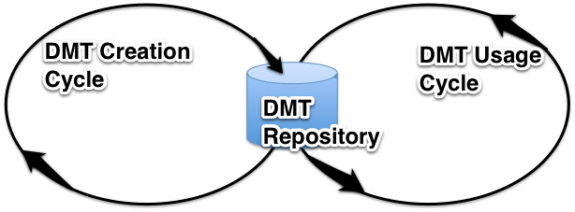
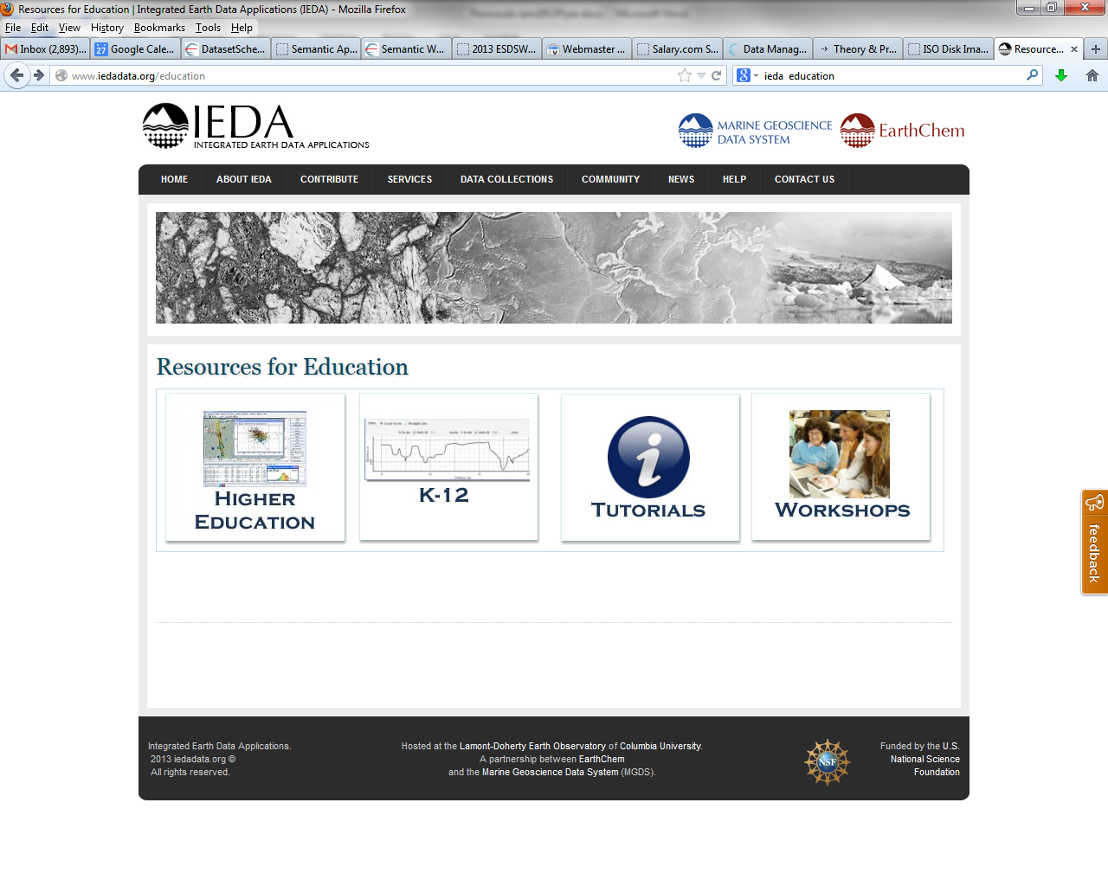
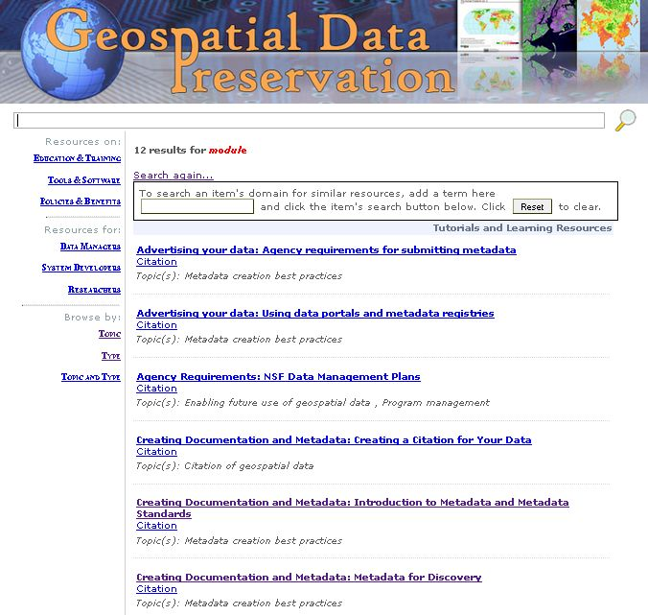
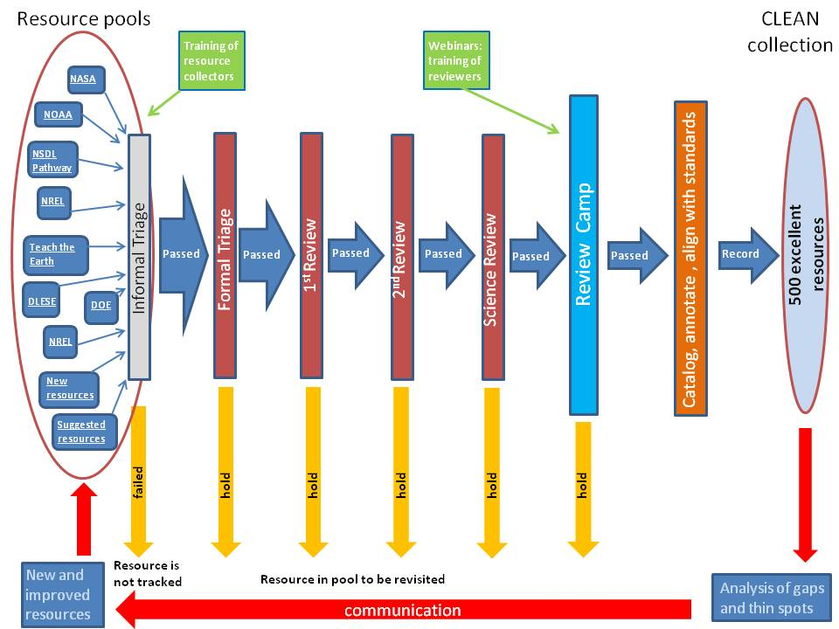
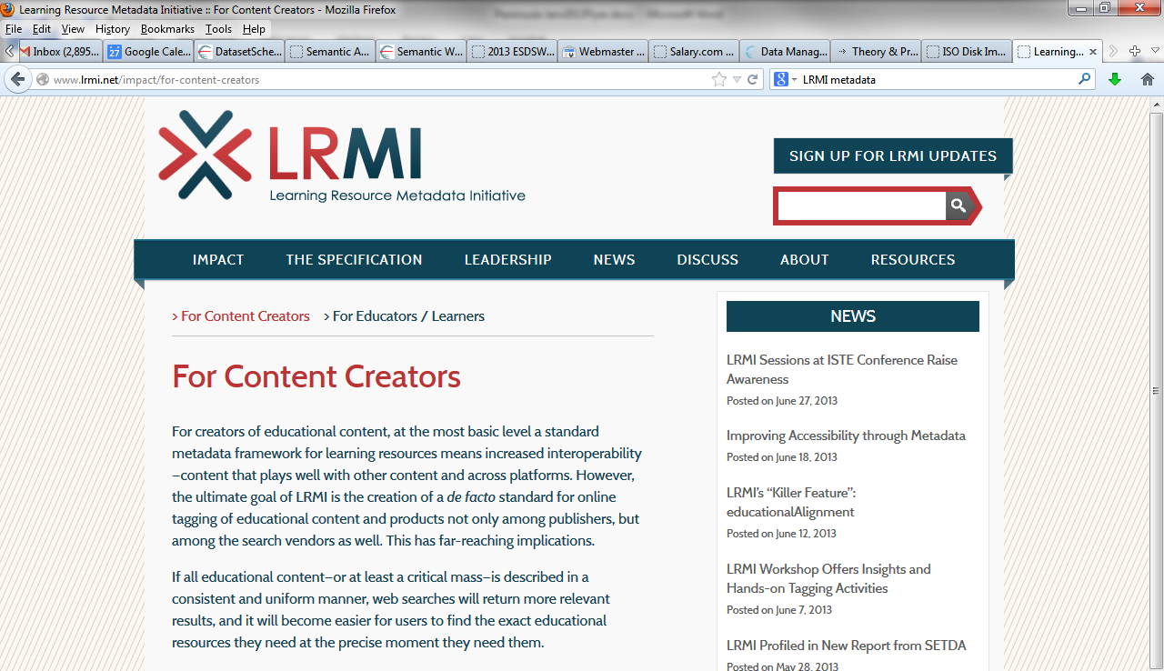
Nancy J. Hoebelheinrich Knowledge Motifs LLC nhoebel@kmotifs.com ESIP Federation Meeting July 9-12, 2013, Chapel Hill, NC
Data Management Training – Next Steps ESIP Federation / NOAA
DataONE / NSF
IEDA
?
Who?
WhAT?
Why?
Data Management Training Life Cycle
Research Questions:
What DMT resources are available for Earth Science currently?
Who is using? For what purposes? How often?
What community-generated criteria should be used to review DMT resources?
Are the DMT resources effectively meeting research scientists’ training needs?
How best to receive user feedback? What can resource creators learn from user feedback?
How are DMT resources being marketed? Are there other mechanisms that would increase usage?
Research Plan:
Survey & Categorize / Catalog Existing DMT Resources
Identify targeted groups of users to assess DMT resources
Develop & conduct survey to assess usability & review educational effectiveness of inventoried DMT resources
Conduct usage assessment and compile results
ID existing marketing tactics
Evaluate effectiveness of marketing
Perform gap analysis & ID alternative marketing / promotion techniques
Promote existing DMT resources using new channels
How?
-- CIESIN added descriptors
-- Adapt CLEAN Review Process?
Improve Search Engine retrieval using Schema.org-incorporated LRMI metadata
-- Schema.org-incorporated LRMI metadata
Usage Surveys by targeted users
Ideas
Time
$$
Other?
Gap Analysis of Marketing Methods
Can You Help?
Copyright 2013. Nancy J. Hoebelheinrich
This work is licensed under a Creative Commons Attribution 3.0 Unported License.

