Slide 1

ICESat-2 Metadata
ESIP Summer Session
July 2014
SGT/Jeffrey Lee
NASA GSFC/Wallops Flight Facility
Jeffrey.E.Lee@nasa.gov

Slide 2
Introduction : ICESat-2
Research-Class NASA Decadal Survey Mission.
ICESat follow-on; but uses a low-power multi-beam photon counting altimeter (ATLAS).
Launches In 2017.
Science Objectives :
  Quantifying polar ice-sheet contributions to current and recent sea-level change, as well as ice-sheet linkages to climate conditions.
  Quantifying regional patterns of ice-sheet changes to assess what drives those changes, and to improve predictive ice-sheet models.
  Estimating sea-ice thickness to examine exchanges of energy, mass and moisture between the ice, oceans and atmosphere.
  Measuring vegetation canopy height to help researchers estimate biomass amounts over large areas, and how the biomass is changing.
  Enhancing the utility of other Earth-observation systems through supporting measurements.
MABEL:
  Aircraft-based demonstration photon-counting instrument.
  Great platform to prototype and test ICESat-2 processing software.

Slide 3
My Role : ASAS
ASAS is the ATLAS Science Algorithm Software
  Transforms L0 satellite measurements into calibrated science parameters.
  Several independent processing engines (PGEs) used within SIPS to create standard data products. (PGE=product generation executable)
  Class C (non-safety) compliant software effort.
  Responsible for implementation of the ATLAS ATBDs.
  Responsible for delivering software to produce 20 Standard Data Products.
The ASAS Team writes the software that creates the science data products.

Slide 4
Data Product Goals
To deliver science data to end users.
To document the data delivered.
To provide bidirectional traceability:
  Between the products themselves;
  Between the products and the ATBDs.
To be compliant with ESDIS standards.
To be interoperable with other earth science data products.

Slide 5
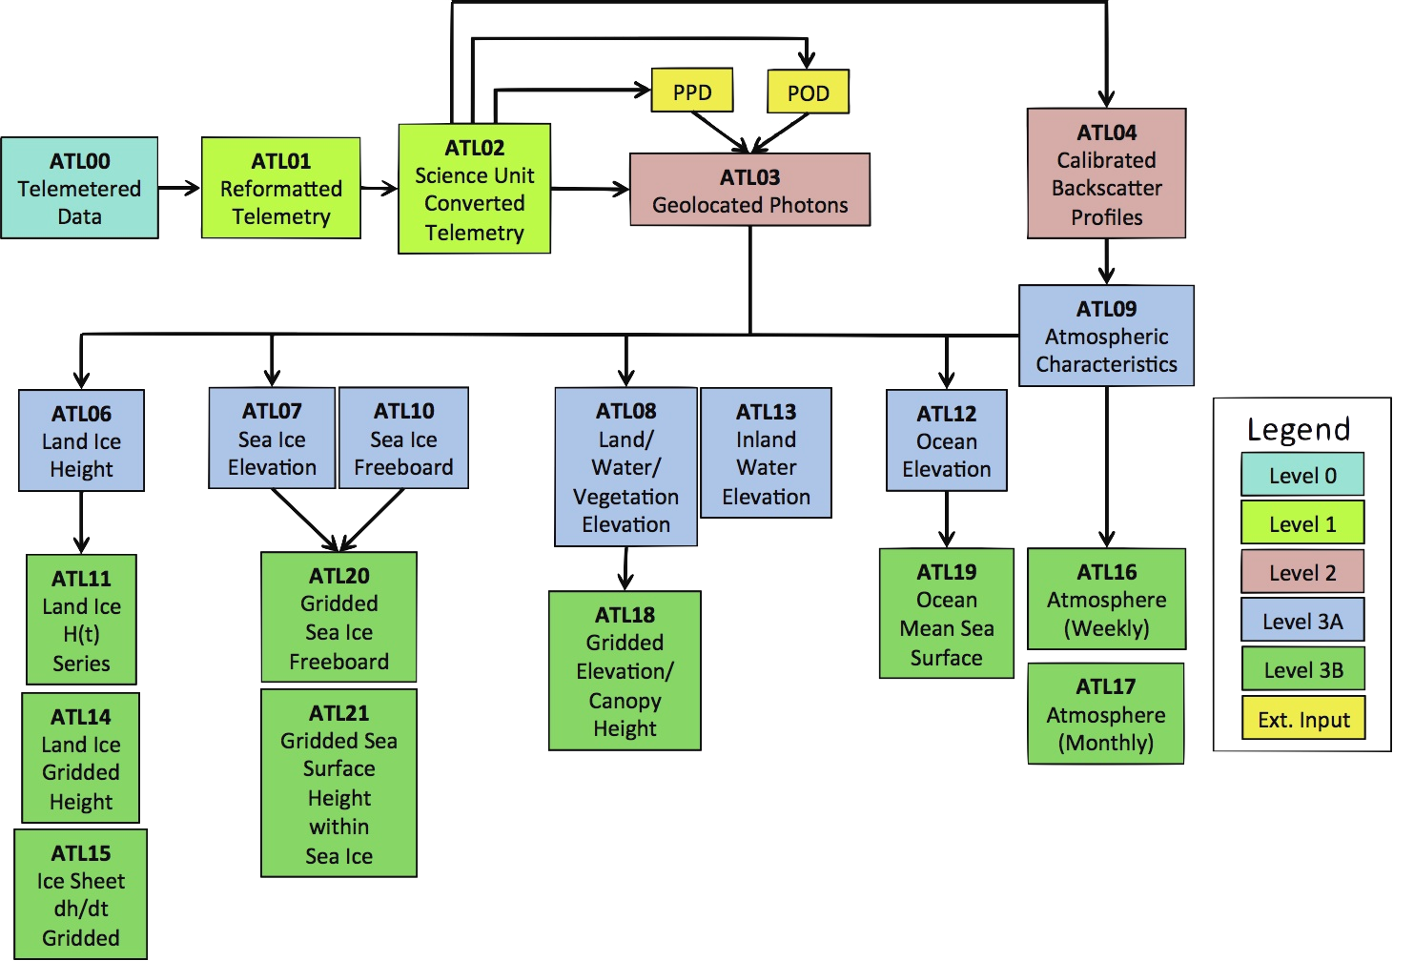
Standard Data Products
Engineering
Along-Track
Gridded
Science
(ATL=ATLAS; POD/PPD=Precision Orbit Determination/Precision Pointing Determination)

Slide 6
ICESat-2 Data Characteristics
  80 GB L0 data daily.
  1 TB of L1A-L3B data daily.
  3.5 PB over 3 years.
  Every photon geolocated to a precise lat/lon/hgt.
  Discipline-specific products.
    Land Ice, Sea Ice, Ocean, Land, Atmosphere.
  Sparse, multi-rate along-track products (L1A-L3A).
  Gridded products (L3B).
  Over 3,200 science parameters (and counting…)
Only the L3B data fit within the predominant imagery/gridded model.

Slide 7
ICESat-2 HDF5 Data Model
Science data stored as simple HDF5 datasets.
HDF5 chunking and internal gzip compression.
HDF5 grouping.
Ancillary data stored as ‘compact’ HDF5 datasets.
Embedded structured metadata.
Extracted ISO19115 metadata.
CF/ACDD global metadata.
CF/ACDD variable metadata.
Best-effort NetCDF4-Extended compatibility.

Slide 8
ISO What?
I am an ISO 19115 novice (at best).
I do, however, write software.
And metadata is just lightweight data.
So all I have to do is collect all the data I need, store it somewhere and transform it into an XML representation.
That can’t be too hard (can it?)

Slide 9
Metadata
Goals
  Provide search information for the Data Center.
  Make the products self-documenting.
  Provide provenance information and traceability to the ATBDs.
Customers
  Data Center
  Data Users
Requirements
  ISO19115 delivery to the Data Center via ISO19139 XML.

Slide 10
A Working Assumption
“Granules are forever” and should stand alone.
To be completely self-documenting, a product should contain both collection and inventory level metadata within the product itself (see bullet 1).

Slide 11
Pieces of the Puzzle
ACDD global attributes
ACDD/CF variable attributes
Grouped Organization
/ancillary_data
/METADATA (OCDD ?)
ISO19139 XML
Workflow/Tools

Slide 12
ACDD/CF Global Attributes
Attribute Conventions for Data Discovery
Climate/Forecast Conventions
Implementation | HDF5 attributes with standard labeling.
Scope | The entire data granule.
Prime Audience | Data Users (ncdump –h | h5dump –H)
Rationale | Standards compliance; Light-weight information with standard labeling not requiring additional description.
http://wiki.esipfed.org/index.php/Attribute_Convention_for_Data_Discovery

Slide 13
ACDD/CF Variable Attributes
Attribute Conventions for Data Discovery
Climate/Forecast Conventions
Implementation | HDF5 attributes with standard labeling.
Scope | The parent dataset
Prime Audience | Data Users
Rationale | Standards compliance; Light-weight information with standard labeling describing each data variable.
http://cf-pcmdi.llnl.gov/documents/cf-conventions/1.6/cf-conventions.html.

Slide 14
Groups
Huh? Groups are metadata?
  Well, grouping allows organization of the variables into logical divisions.
  Attributes can be attached to groups that describe the data contained within.
Implementation | HDF5 groups.
Scope | The group content.
Prime Audience | Data users.
Rationale | Organization; grouping of like variables.

Slide 15
/ancillary_data
Some metadata, itself, needs to be well-described.
Very thin line between data and metadata here.
Very close to “additional_attributes”.
Implementation | HDF5 compact datasets with CF standard labeling.
Scope | The entire data granule.
Prime Audience | Data users.
Rationale | Provenance & ATBD traceability.

Slide 16
/ancillary_data Content
Examples:
  Algorithm constants.
  Data settings used during processing.
  Control information.
  Other global data where a simple attribute label is not sufficient for precise description.

Slide 17
/METADATA
Object Conventions for Dataset Discovery ?
Sufficient information & labeling to generate an ISO19115 translation.
Implementation | HDF5 groups and attached attributes.
Scope | The entire data granule, including collection-level information.
Prime Audience | Data Centers - source of ISO 19115 information.
Rationale | Useful to data users; needed for ISO19115 generation.
http://wiki.esipfed.org/index.php/Attribute_Convention_for_Data_Discovery_(ACDD)_Object_Conventions

Slide 18
/METADATA
Translation of the ISO 19115 namespace into HDF groups/attributes.
Flat attributes are insufficient to fully represent ISO19115 without grossly large attribute labels.
Translation into ISO19139 XML is a simple text transformation.
Primarily geared towards generation of metadata for data centers – however, this approach makes the metadata useful to users lacking ISO or XML knowledge/tools.

Slide 19
/METADATA
Issues
  No standard labeling convention exists.
  No standard tool support exists.
  Adds lots of groups/attributes to the product.
  Can cause a duplication of information.
A new approach?
  No. Very similar to SMAP implementation.
  I did something similar with GLAS in 2002.

Slide 20
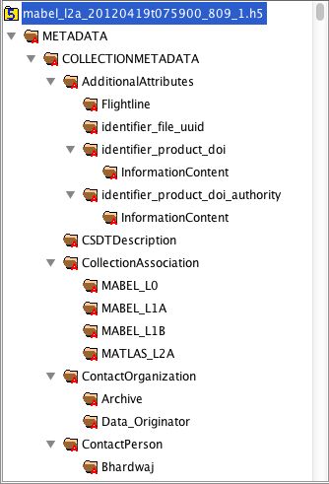
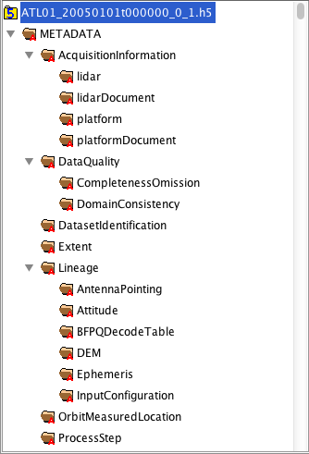
/METADATA – 2 Examples

Slide 21
ISO 19139 XML
XML Representation of ISO 19115.
Generated from data stored on the product.
Stored back on the product in XML format.
Implementation | Attached & Detached XML.
Scope | The entire data granule, including collection-level information.
Prime Audience | Data Centers.
Rationale | Required deliverable to Data Center.

Slide 22
Product Generation Workflow
  Metadata, QA and Browse embedded in standard data product.
  Utility software extracts metadata and reformats to ISO19139 & embeds.
  Utility software extracts browse and reformats to PNG .
  Utility software extracts QA and feeds into a trend database.
  Utility software creates a data dictionary from product content

Slide 23
The Challenge
20 Standard Data Products.
Over 3,200 science parameters.
At least 6 different flavors of metadata with some duplication.
Need to translate metadata into XML for Data Center ingest.
Need to translate metadata in HTML for data dictionary.

Slide 24
Programming Steps Required
For each ACDD global attribute, create and fill the attribute; close the attribute.
For each /METADATA group, create the group; create and fill the attributes; close the attributes; close the group.
For each /ancillary_data dataset, create the dataset; open the memoryspace, open the dataspace, write the dataset; attach dimension scales; create and fill each of the 12 variable attributes; close each attribute; close the memoryspace, close the dataspace, close the dataset.
For each of the 3200 datasets, create the dataset; open the memoryspace, open the dataspace, write the dataset; attach dimension scales; create and fill each of the 12 variable attributes; close each attribute; close the memoryspace, close the dataspace, close the dataset.…

Slide 25
Programming Steps Required
For each ACDD global attribute, create and fill the attribute; close the attribute.
For each /METADATA group, create the group; create and fill the attributes; close the attributes; close the group.
For each /ancillary_data dataset, create the dataset; open the memoryspace, open the dataspace, write the dataset; attach dimension scales; create and fill each of the 12 variable attributes; close each attribute; close the memoryspace, close the dataspace, close the dataset.
For each of the 3200 datasets, create the dataset; open the memoryspace, open the dataspace, write the dataset; attach dimension scales; create and fill each of the 12 variable attributes; close each attribute; close the memoryspace, close the dataspace, close the dataset.…
Yikes!

Slide 26
A Solution
A web-based product database to store and maintain relationships between files/groups/attributes/parameters (mySQL/PHP : h5es_builder).
Software to read output from the product database and create HDF5 template files (Fortran : h5es_creator).
A strategy to integrate this toolset into the ASAS product-development workflow.
H5-ES (HDF5-Earth Science or HDF5-EaSy)

Slide 27
The Key: Template Files
Valid HDF5 file with all groups, attributes and datasets created, but no (or little) data values filled-in.
Basically, a ‘skeleton’.
What makes this possible:
  Chunked datasets can be created with a dimensions of “0” and then filled later.
  Attributes can be created with initial values, but later overwritten.
  H5_copy allows the developer to copy content between one or more HDF5 files.

Slide 28
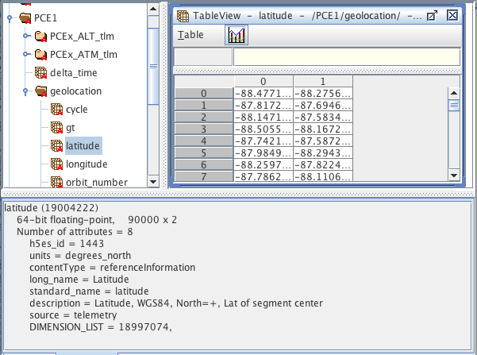
Example PGE Code
!
! Write DOUBLE:latitude(6 x unlimited)
!
err_sum=0
do i = 1, 6
d_arr2(i,:) = out_data(1:n_values)%latitude(i)
enddo
p=h5_open_param_n(out_fs%h5file_id, &
"/lrs/geolocation/latitude",H5T_NATIVE_DOUBLE)
call h5_write_param_n(p, C_LOC(d_arr2), (/6_HSIZE_T, n_values/))
err_sum=err_sum+p%err_sum
!
! Set dimension scales
!
call H5DSattach_scale_f(p%did, ds%did, 1, i_res)
if (i_res .ne. 0) err_sum=err_sum+1
call H5DSattach_scale_f(p%did, ds2%did, 2, i_res)
if (i_res .ne. 0) err_sum=err_sum+1
!
! Check results
!
if (err_sum/=0) then
i_res=GE_H5_D_WRITE
call check_error(i_res, THIS_MOD, THIS_SUB, &
trim(p%last_err)//" latitude",.FALSE.)
return
endif
call h5_close_param_n(p)
This small fragment effectively creates a grouped 2-dim, 90k element HDF5 dataset with CF/ACDD attributes & DS.
Error checking is almost half the code.
Temporary arrays are used to guarantee contiguous memory when using structures.

Slide 29
Example PGE Code
!
! Write DOUBLE:latitude(6 x unlimited)
!
err_sum=0
do i = 1, 6
d_arr2(i,:) = out_data(1:n_values)%latitude(i)
enddo
p=h5_open_param_n(out_fs%h5file_id, &
"/lrs/geolocation/latitude",H5T_NATIVE_DOUBLE)
call h5_write_param_n(p, C_LOC(d_arr2), (/6_HSIZE_T, n_values/))
err_sum=err_sum+p%err_sum
!
! Set dimension scales
!
call H5DSattach_scale_f(p%did, ds%did, 1, i_res)
if (i_res .ne. 0) err_sum=err_sum+1
call H5DSattach_scale_f(p%did, ds2%did, 2, i_res)
if (i_res .ne. 0) err_sum=err_sum+1
!
! Check results
!
if (err_sum/=0) then
i_res=GE_H5_D_WRITE
call check_error(i_res, THIS_MOD, THIS_SUB, &
trim(p%last_err)//" latitude",.FALSE.)
return
endif
call h5_close_param_n(p)
This small fragment effectively creates a grouped 2-dim, 90k element HDF5 dataset with CF/ACDD attributes & DS.
Error checking is almost half the code.
Temporary arrays are used to guarantee contiguous memory when using structures.
Huh?
But… How did the parameter get created?
How did the groups get created?
How did the attributes get created?

Slide 30
Example PGE Code
!
! Write DOUBLE:latitude(6 x unlimited)
!
err_sum=0
do i = 1, 6
d_arr2(i,:) = out_data(1:n_values)%latitude(i)
enddo
p=h5_open_param_n(out_fs%h5file_id, &
"/lrs/geolocation/latitude",H5T_NATIVE_DOUBLE)
call h5_write_param_n(p, C_LOC(d_arr2), (/6_HSIZE_T, n_values/))
err_sum=err_sum+p%err_sum
!
! Set dimension scales
!
call H5DSattach_scale_f(p%did, ds%did, 1, i_res)
if (i_res .ne. 0) err_sum=err_sum+1
call H5DSattach_scale_f(p%did, ds2%did, 2, i_res)
if (i_res .ne. 0) err_sum=err_sum+1
!
! Check results
!
if (err_sum/=0) then
i_res=GE_H5_D_WRITE
call check_error(i_res, THIS_MOD, THIS_SUB, &
trim(p%last_err)//" latitude",.FALSE.)
return
endif
call h5_close_param_n(p)
This small fragment effectively creates a grouped 2-dim, 90k element HDF5 dataset with CF/ACDD attributes & DS.
Error checking is almost half the code.
Temporary arrays are used to guarantee contiguous memory when using structures.
That stuff is already defined in the template!

Slide 31
Product Development Strategy
Product designer works with database interface and/or H5-ES Description File.
Once satisfied, they generate H5-ES Templates.
A programmer generates the example code, rewrites it into production-quality code and merges the result with science algorithms to create a PGE.
The PGE “fills-in” the template with science data values to create an HDF5 Standard Data Product.
The PGE adds metadata from a metadata template.
This process eliminates the need to write the code that defines the product structure and a significant amount of the metadata.
By manually editing the H5-ES template, you can fix a description or misspelling without recompiling code.

Slide 32
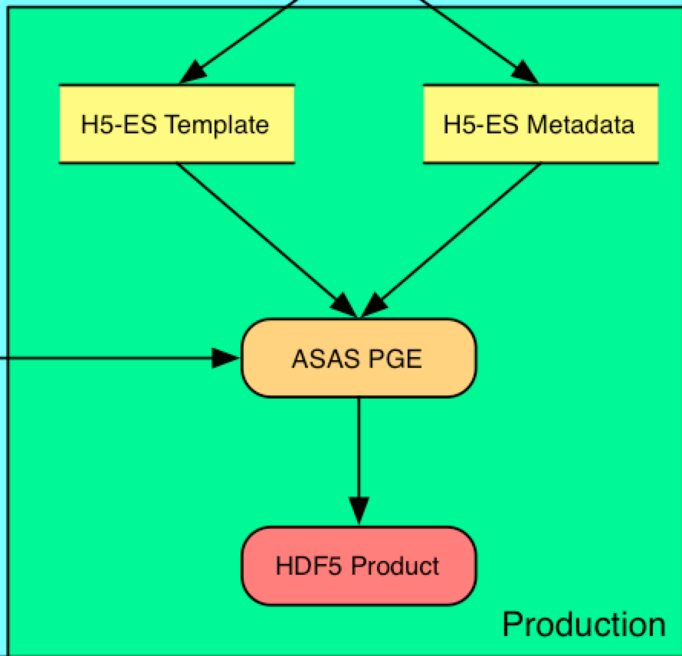
Did You Catch It?
This strategy separates a significant amount of the /METADATA generation from the product generation.

Slide 33
ICESat-2 Metadata Strategy
/METADATA is stored in a separate H5-ES database.
Create/maintain separate H5-ES templates for metadata.
Static values are filled within database using default values.
PGE fills dynamic values when merging into data product.
Can change static metadata without changing PGE code.

Slide 34
ICESat-2 Metadata Delivery
All metadata is stored within the data products.
A utility parses product metadata and transforms it into an ISO19139 XML representation.
Another utility creates a distribution-quality data dictionary by parsing the product content.

Slide 35
Status
ASAS V0 & MABEL 2.0 products generated using H5-ES strategy.
MABEL uses ECHO-style /METADATA
ASAS V0 uses ISO19115-style /METADATA.
  Shamelessly stolen from SMAP and slightly modified.
ASAS V1 targets full ISO19115 implementation.
  We have to pick the target ISO19115 ‘flavor’.
  Will have to gather the values to we need to fill.
  We have to develop (or borrow) the extraction tool.
Future development of H5-ES tool promising.

Slide 36
Questions/Comments
?
What have we missed?
What surprises await?

Slide 37
Backup Slides
Example Types of Metadata

Slide 38
ACDD/CF Global Attributes
Attribute | Description
title | A short description of the dataset.
summary | A paragraph describing the dataset.
keywords | A comma separated list of key words and phrases.
keywords_vocabulary | If you are following a guideline for the words/phrases in your "keywords" attribute, put the name of that guideline here.
history | Provides an audit trail for modifications to the original data.
comment | Miscellaneous information about the data.
date_created | The date on which the data was created.
project | The scientific project that produced the data.
processing_level | A textual description of the processing (or quality control) level of the data.
… | …

Slide 39
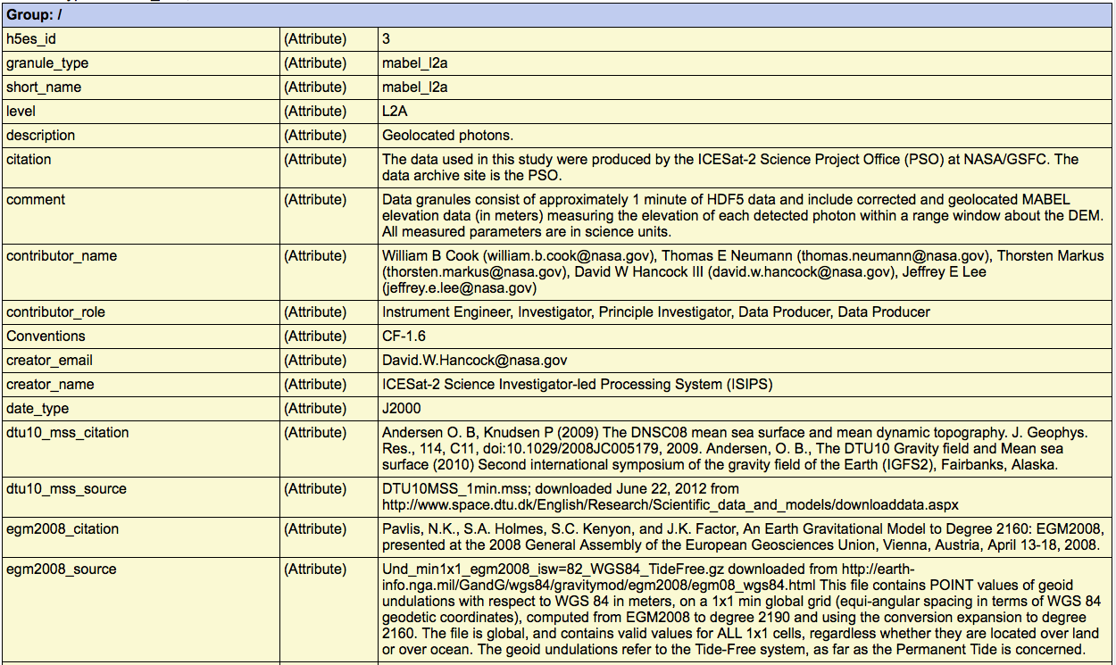
ACDD Global Example

Slide 40
ACDD/CF Variable Attributes
Attribute | Description
long_name | Descriptive name of the parameter
standard_name | A standard name that references a description of a variable’s content in the standard name table.
units | Units of a variable’s content. (compliant with NetCDF UDUNITS)
content_type | ISO19115 classification of the parameter.
description | Description of the parameter.
source | Method of production or source of the original data.
coordinates | Identifies auxiliary coordinate variables, label variables, and alternate coordinate variables.
valid_min | Smallest valid value of a variable.
valid_max | Largest valid value of a variable.
flag_values | Provides a list of the flag values. Use in conjunction with flag_meanings.
flag_meanings | Use in conjunction with flag_values to provide descriptive words or phrases for each flag value. If multi-word phrases are used to describe the flag values, then the words within a phrase should be connected with underscores.
_Fillvalue | A value used to represent missing or undefined data. Not allowed for coordinate data except in the case of auxiliary coordinate variables in discrete sampling geometries.

Slide 41
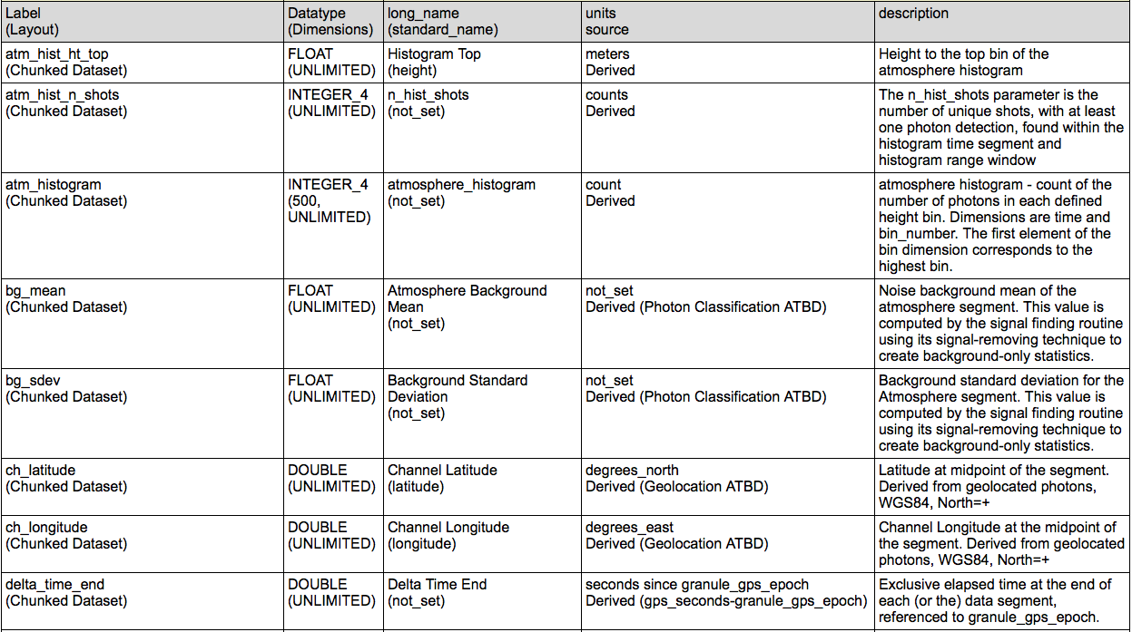
Variable Attribute Examples
(Not all CF attributes used are presented in the screenshot)

Slide 42
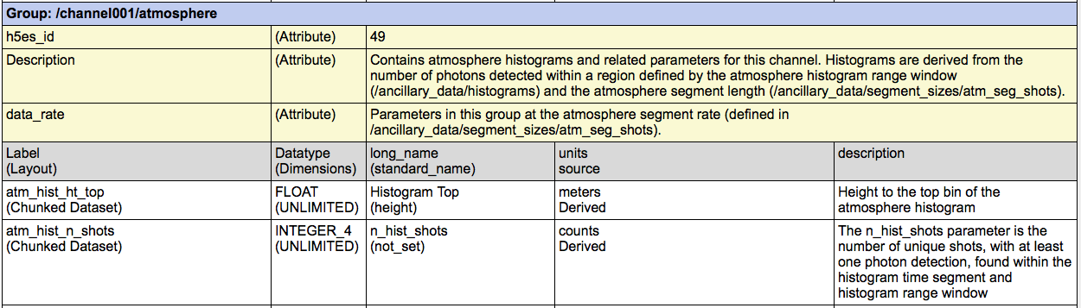
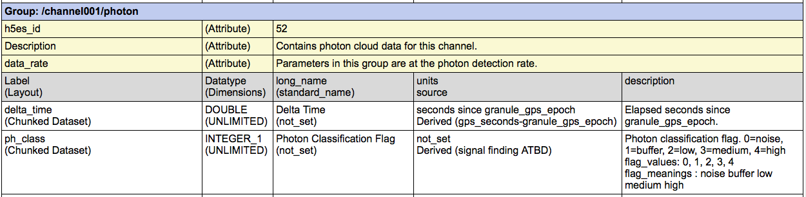
Group Examples

Slide 43
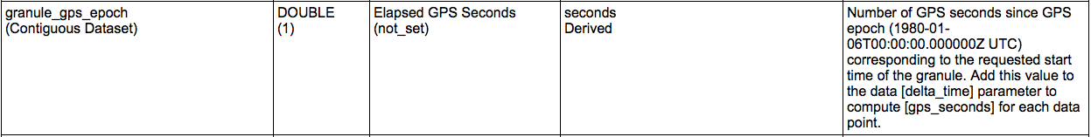
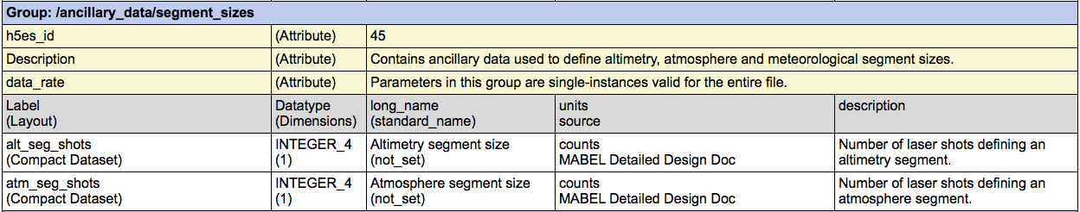
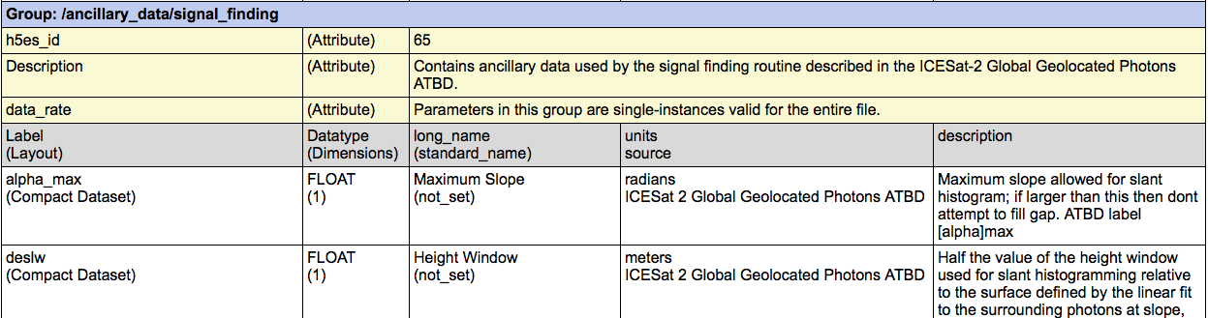
/ancillary_data Examples

Slide 44
Backup Slides
H5-ES

Slide 45
H5-ES : Database
Web-based interface written in PHP.
MySQL backend.
Stores Information about :
  Files (A science product implemented in HDF5)
  Groups (HDF5 groups)
  Attributes (HDF5 attributes)
  Parameters (all with CF parameter attributes)
    Datasets (chunked/zipped HDF5 datasets)
    Dimension_Scales: (HDF5 dimension scales)
    Ancillary_Data: (HDF5 compact datasets)
Maintains relationships between components.

Slide 46
H5-ES Functions
Supports multiple “projects” using multiple databases.
Imports/Exports H5-ES Description Files
  Tab-delimited text | Excel
Generates Template Files
  HDF5 “skeleton” files
Generates comprehensive HTML-based Data Dictionary.
Generates IDL & Fortran example code to fill H5-ES Templates with “data”.

Slide 47
Overall Benefits of H5-ES
Traceability of parameters from one product to another.
Improved consistency between data products.
Can directly prototype/evaluate products before coding.
Significant reduction in amount of code to write.
  Creates an unfilled H5-ES template file with NO coding.
  Provides code fragments from the generated example programs that can be incorporated within science algorithms (or a data conversion program).

Slide 48
Can This Help Me Now ?
  Template files and workflow are biggest logical leap.
  You can create template files now with H5View.
  The HDFGroup has something “in the works”.

Slide 49
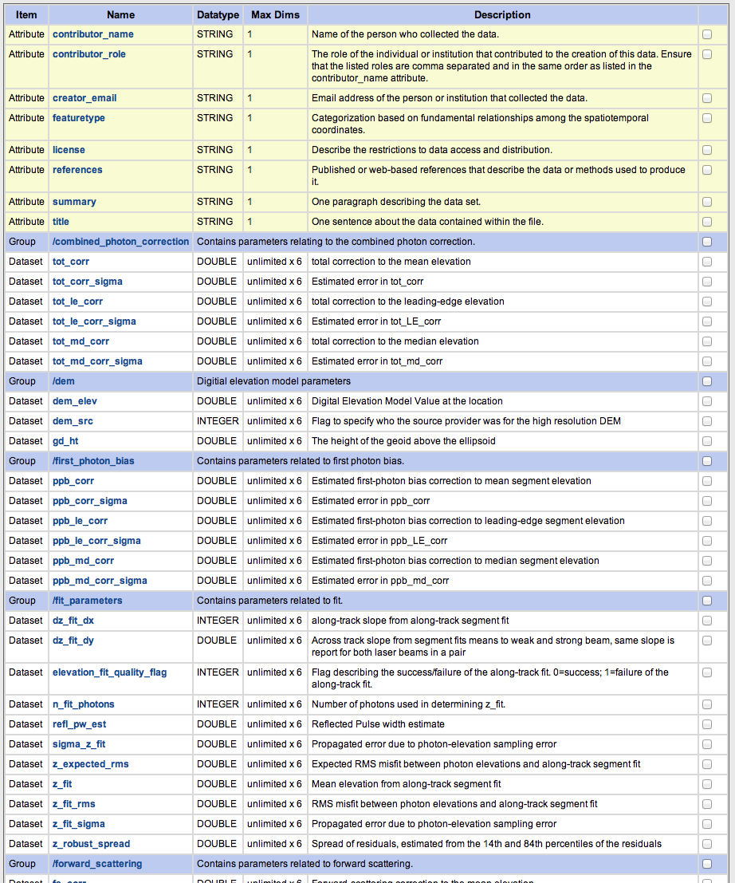
H5-ES Database Content
➔

Slide 50
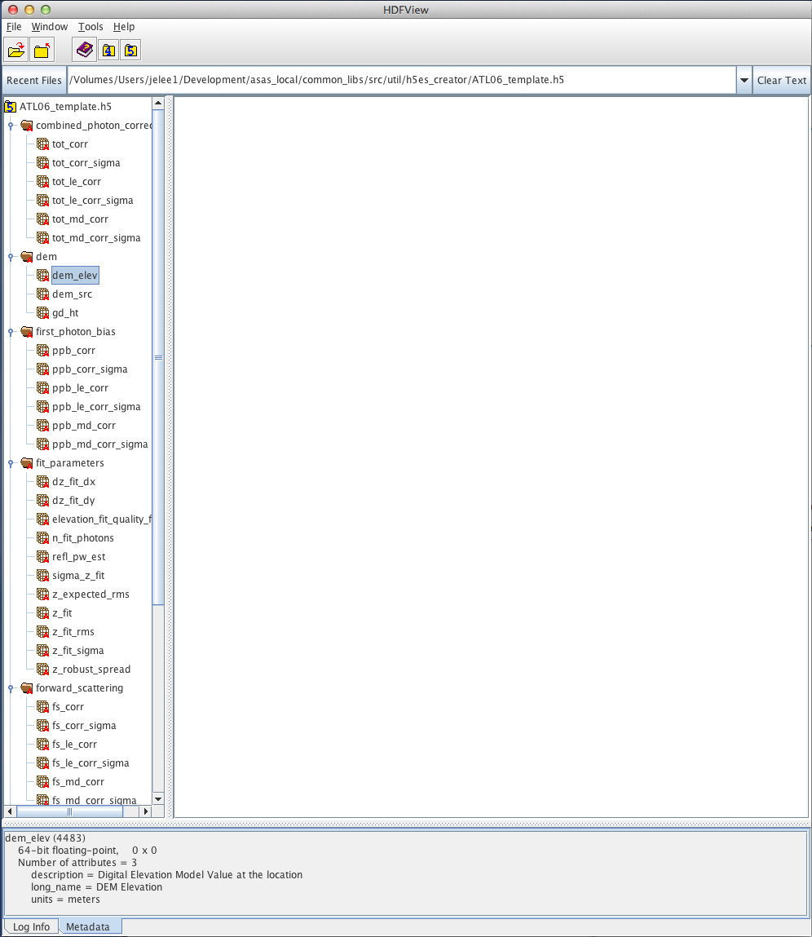
Template Generated & Displayed in H5View
Lines of Code Written=0

Slide 51
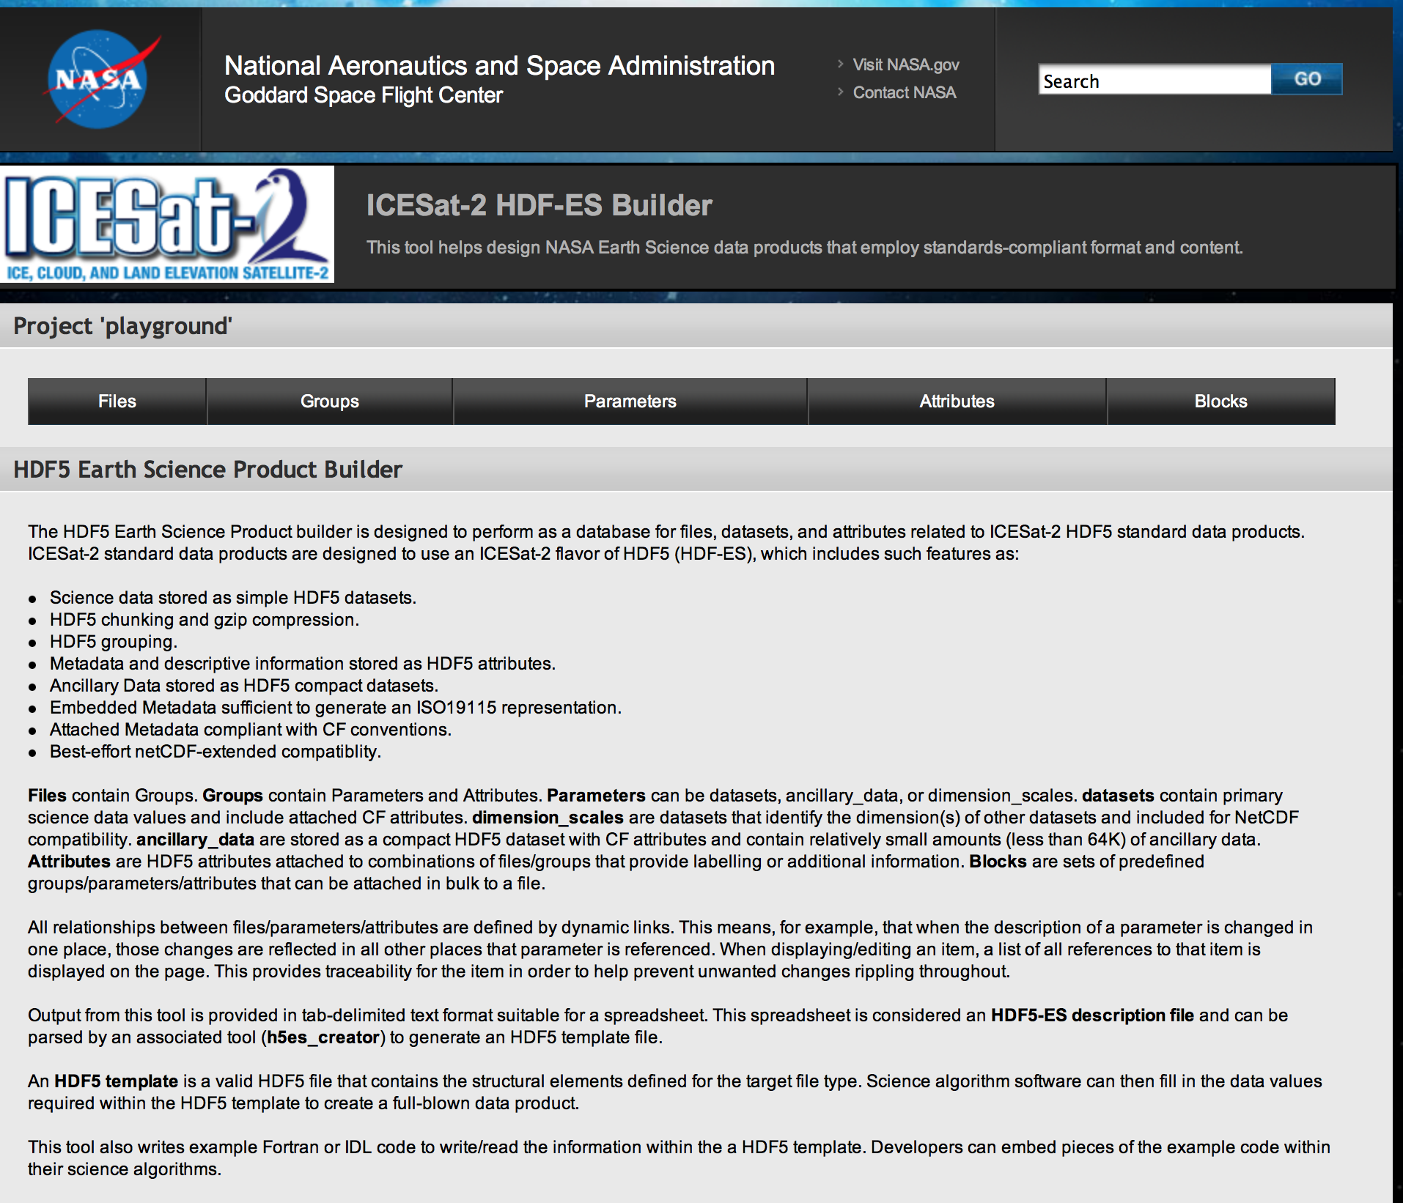
Main Page (top)
The Main Menu

Slide 52
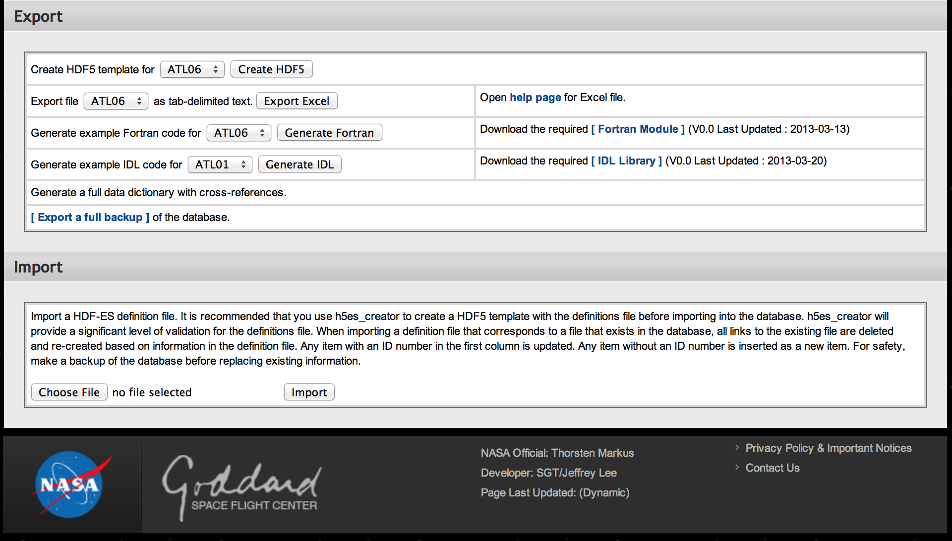
Main Page (bottom)
Main Menu:
Export Options
Import
Options

Slide 53
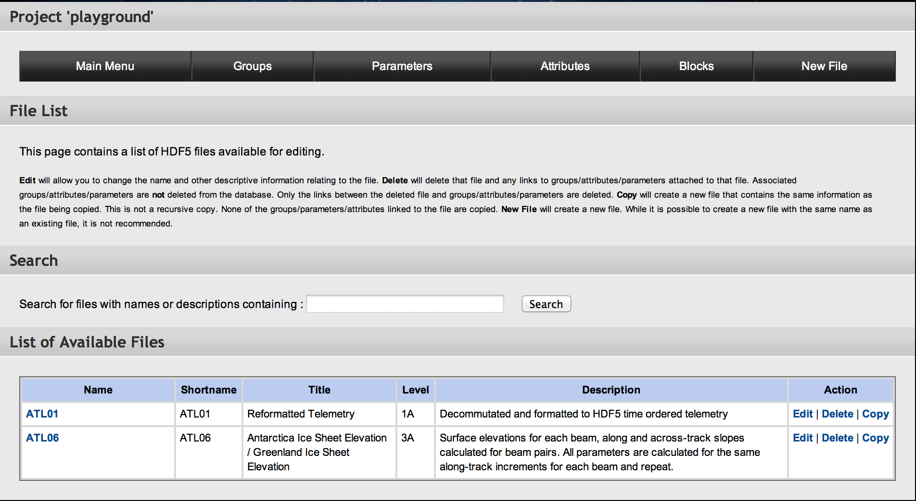
List of Files
Files: Listing

Slide 54
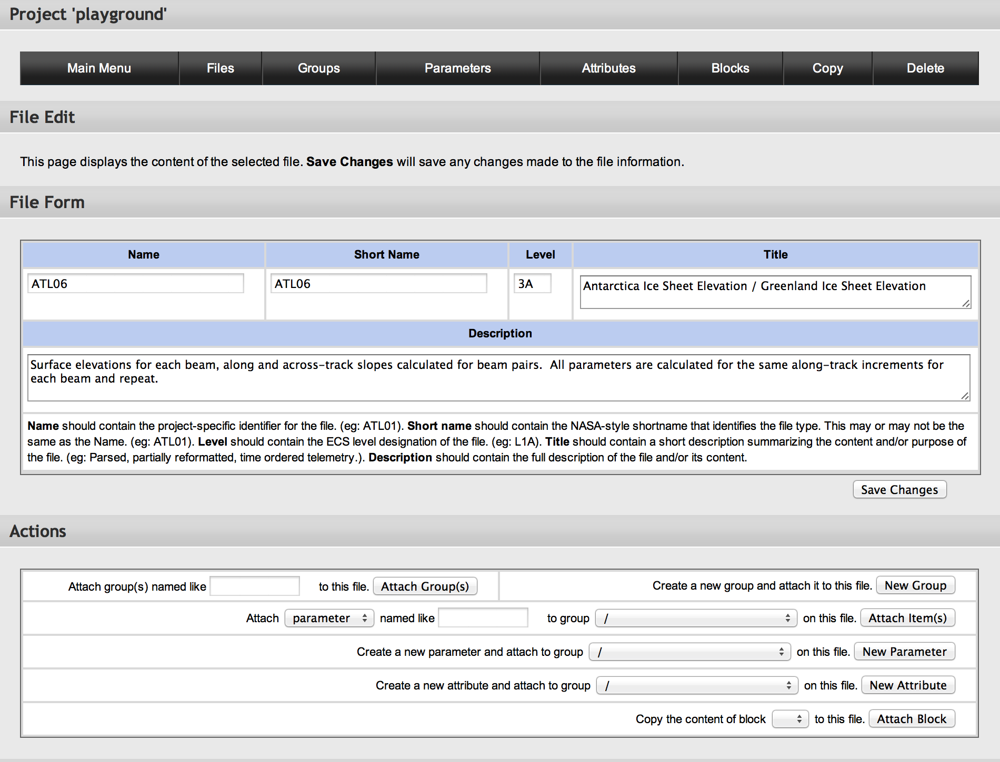
File Form
Files:
Fields
Files:
Attachment Options

Slide 55
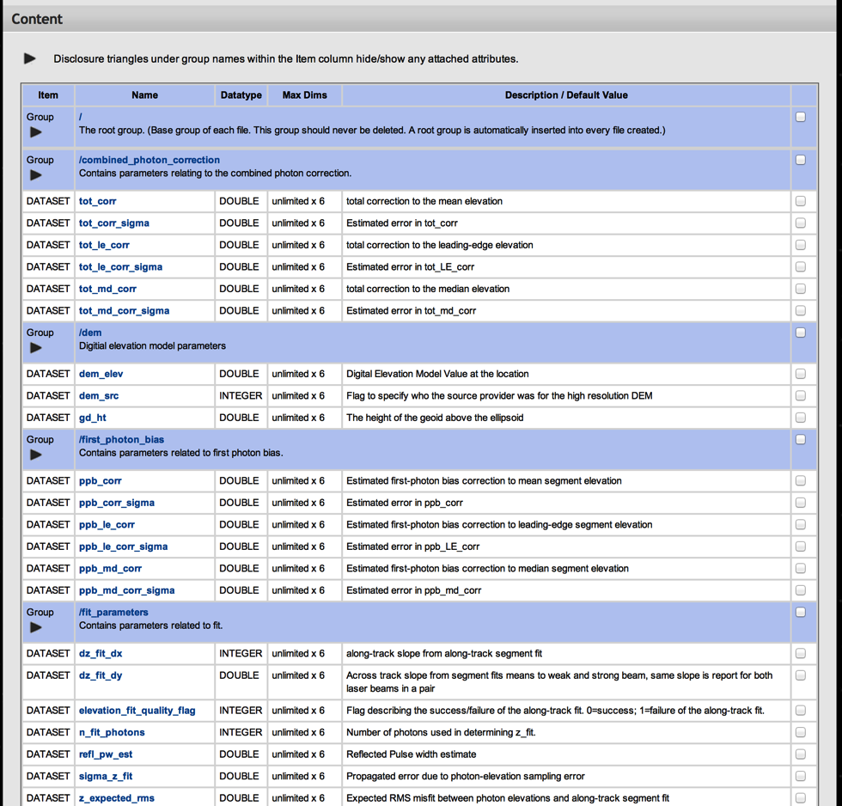
File Content
Files:
Content Listing

Slide 56
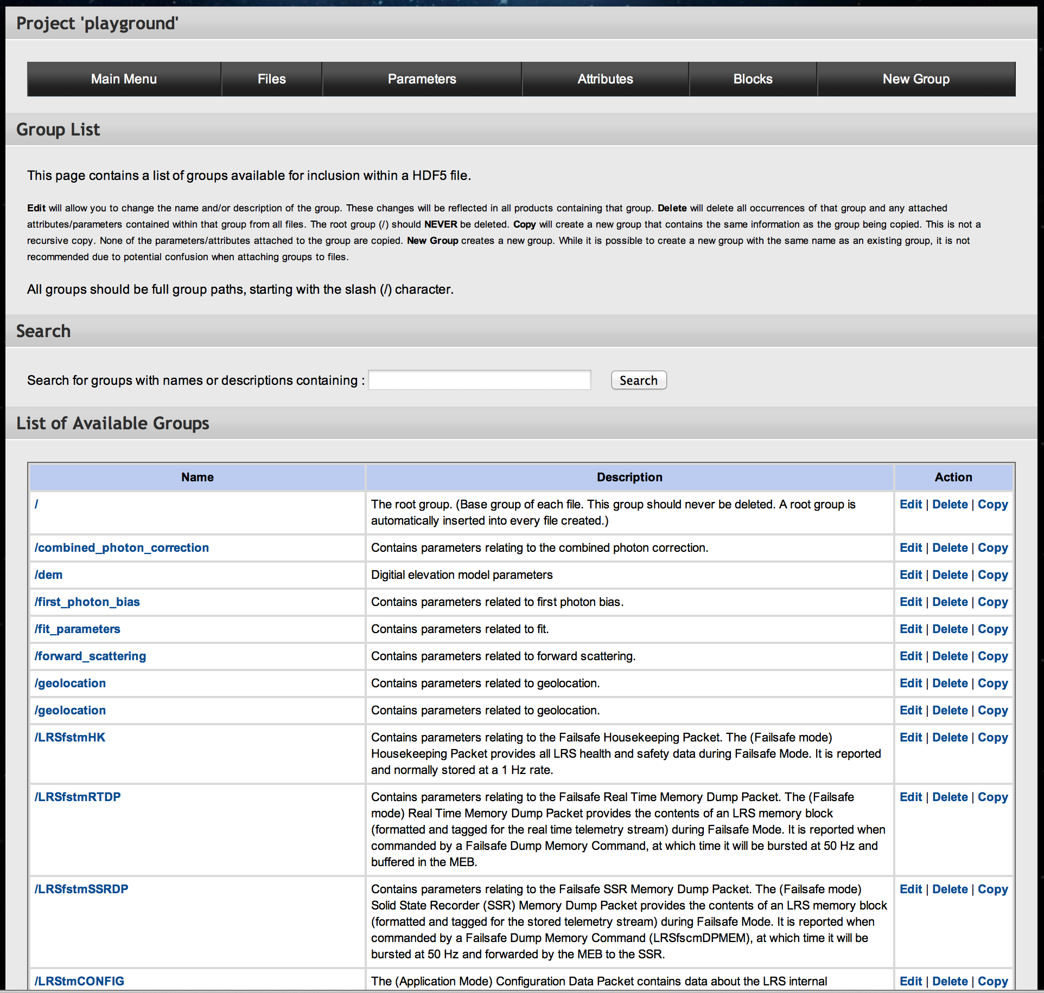
List of Groups
Groups :
List

Slide 57
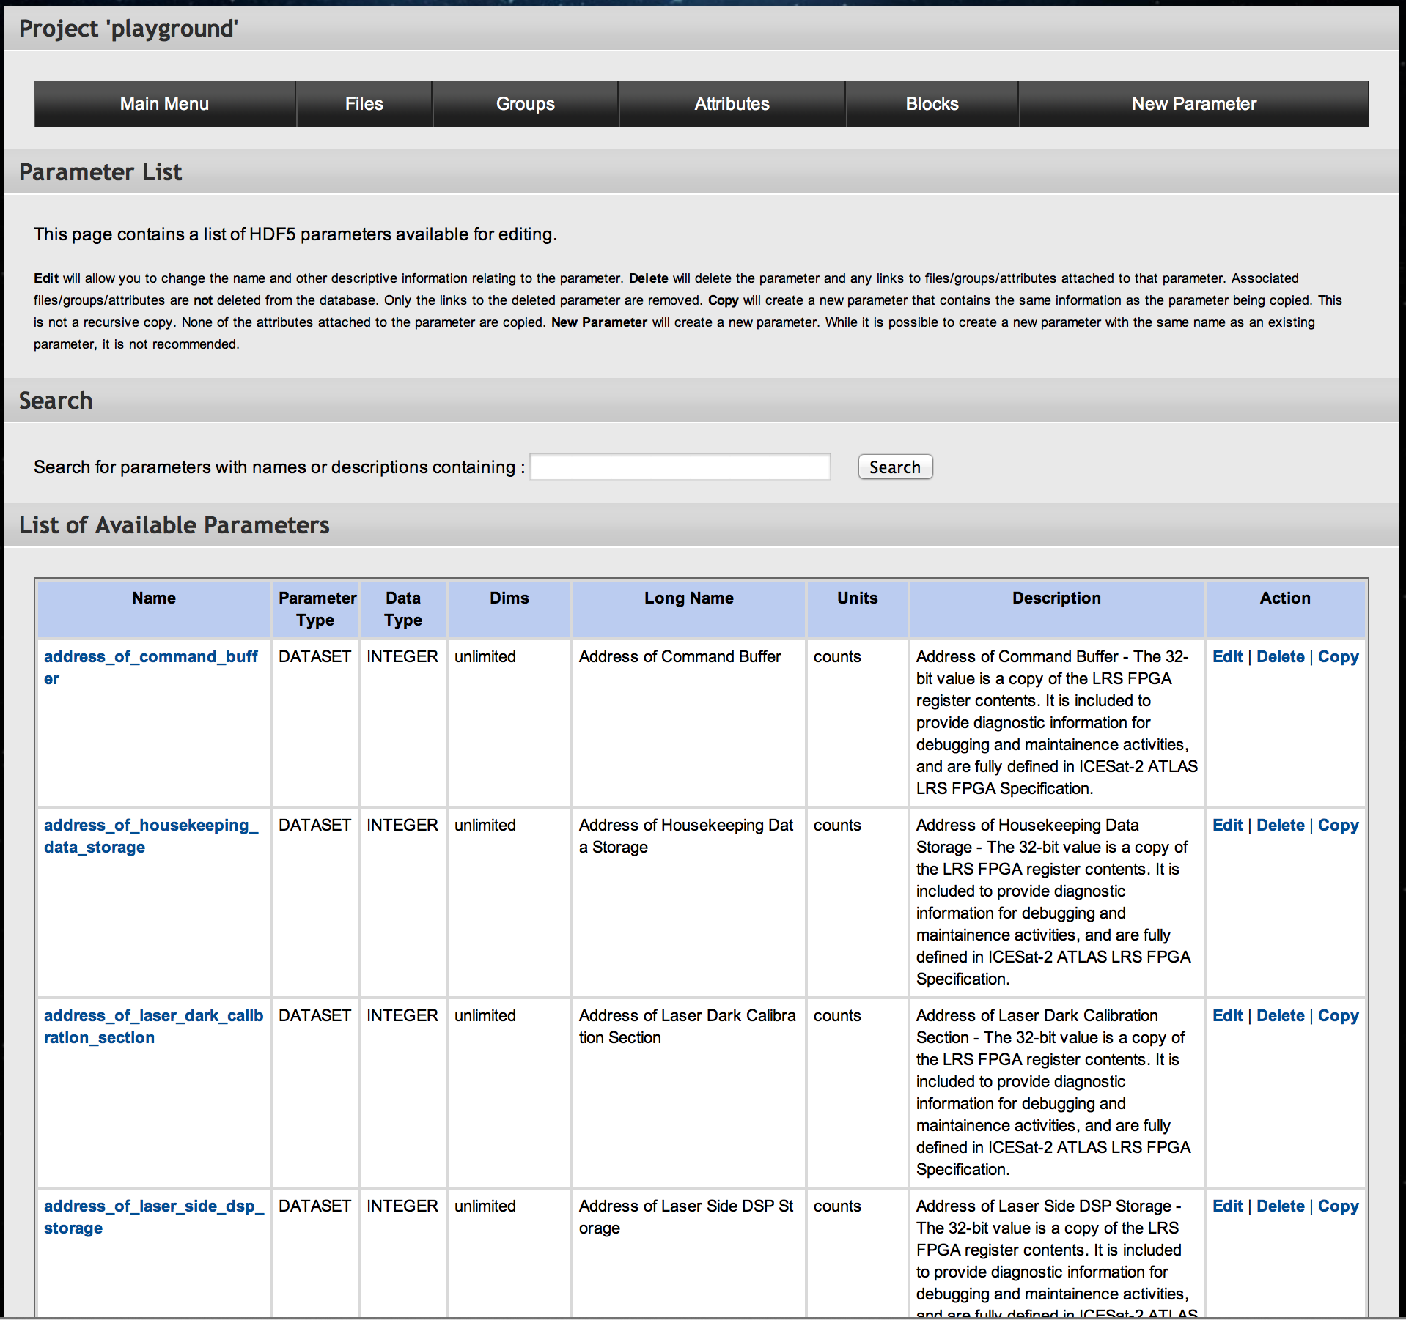
List of Parameters
Parameters:
List

Slide 58
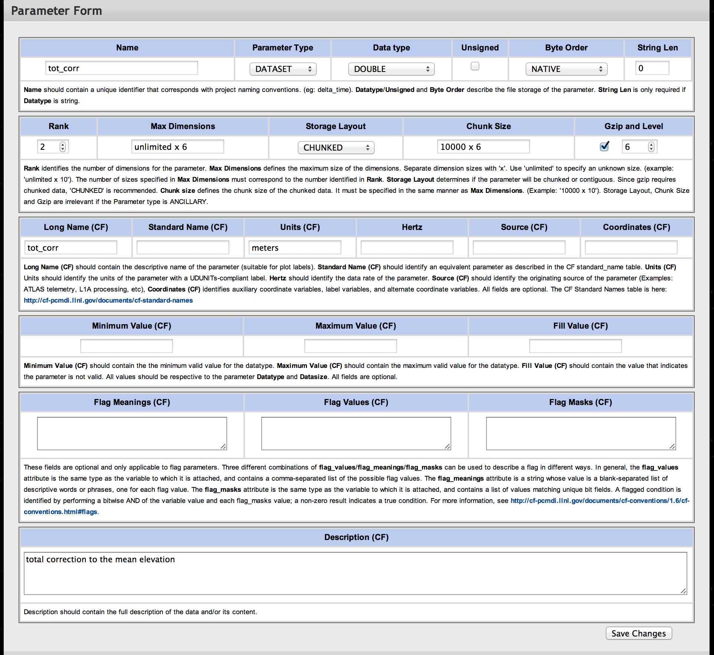
Parameter Contents
Parameters:
Fields

Slide 59
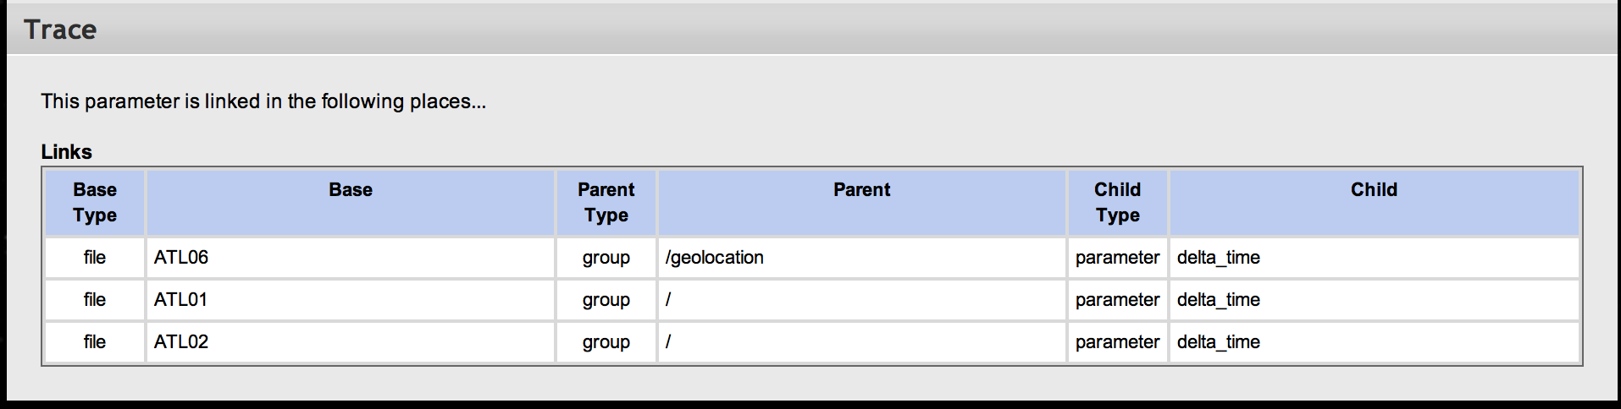
Parameter Trace
Parameters:
Trace

Slide 60
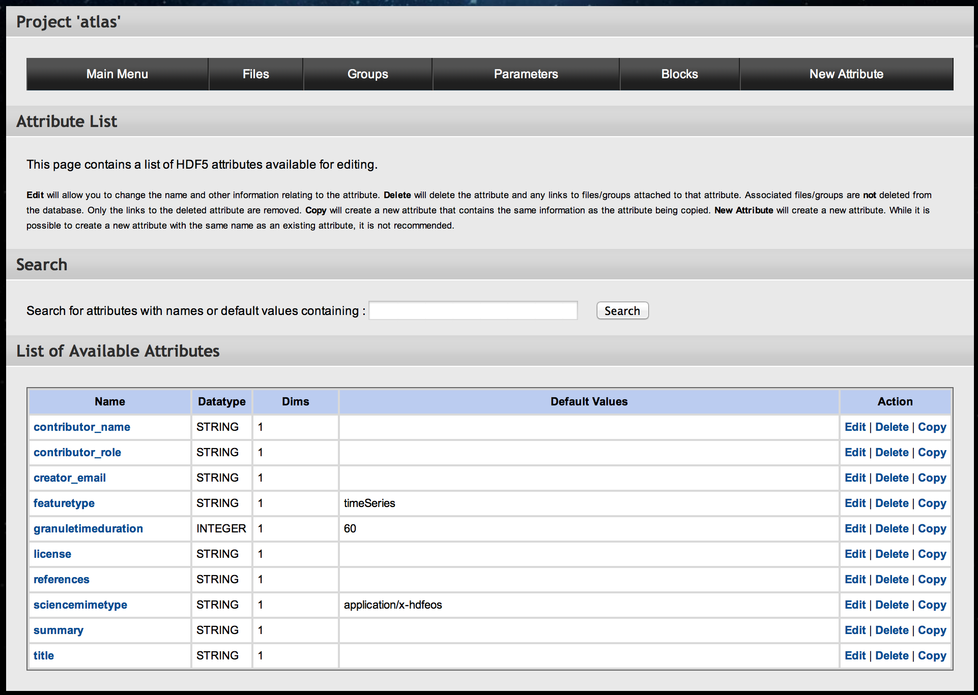
List of Attributes
Attributes:
List

Slide 61
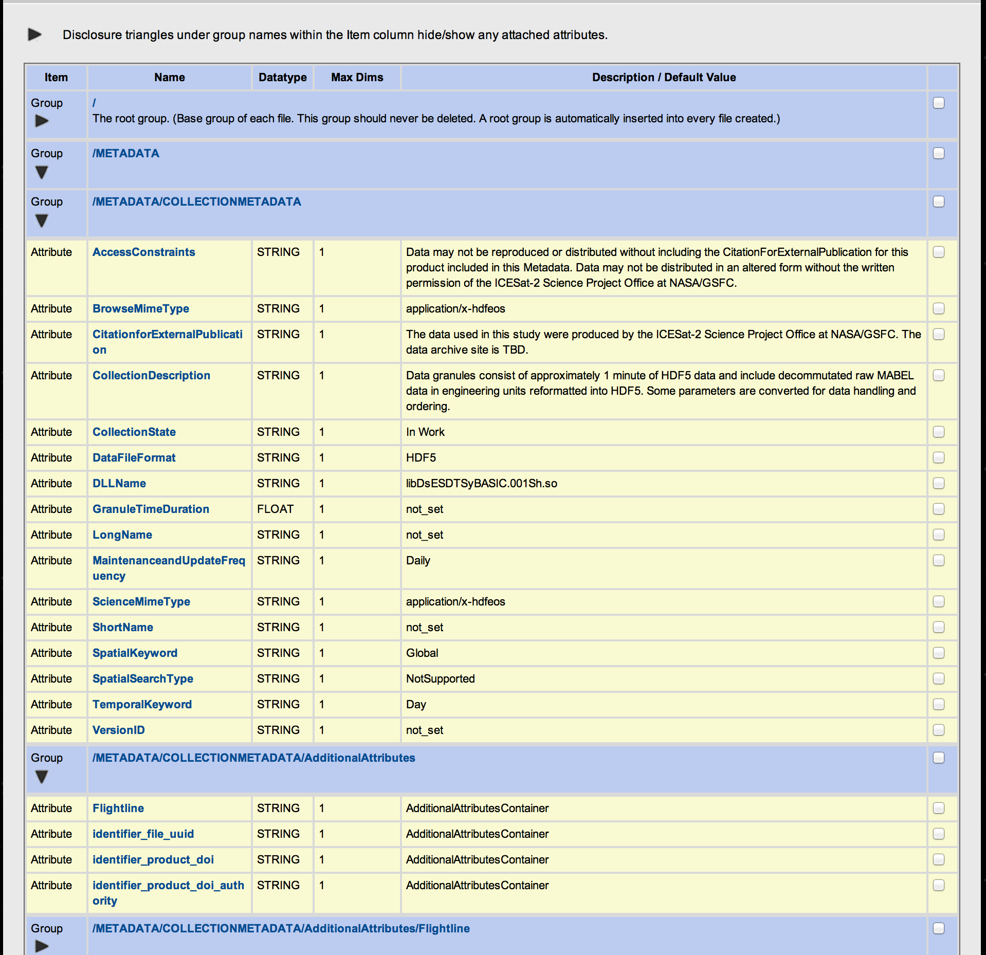
Attributes Attached to Group/File
Attributes:
Attached to a Group

