Slide 1
Interoperable data federation
Matthew B. Jones
NCEAS, UC Santa Barbara
0000-0003-0077-4738
@metamattj
ESIP Sustainable Data Management Cluster July 20, 2016
Notes:
List Leadership Team members and BOLD those that will be present at RSV

Slide 2
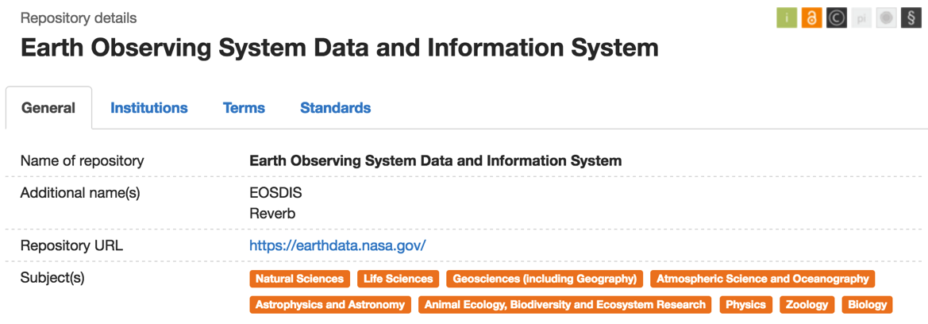
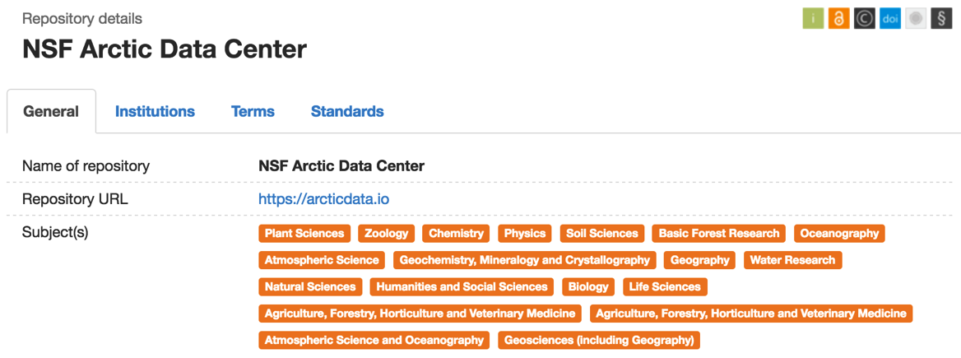
Multitudes of repositories
Biology (555)
GeoSciences (536)

Slide 3
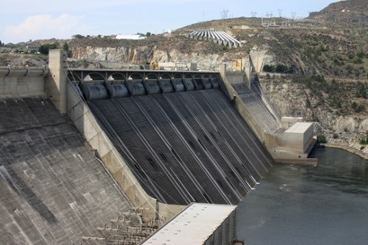
Barriers to interoperability
Momentum of built infrastructure
Allure of shiny new technology
Institutionalized funding models
By David Brodbeck
Notes:
Communities of practice define the bounds of our decision-making about interoperability.
Coulee Dam image by David Brodbeck from Seattle, WA, USA – under Creative Commons Attribution 2.0, https://commons.wikimedia.org/w/index.php?curid=7716964

Slide 4
is creating an
Interoperable
Federation

Slide 5
Key principles:
API-centric
Loose Coupling
Diverse components
Tiered deployment

Slide 6
DataONE Member Nodes Current and Upcoming
2012
2
3
4
2013
2
3
4
2014
2
3
4
2015
2
3
4
2016
2
3
4
Upcoming Member Nodes

Slide 7
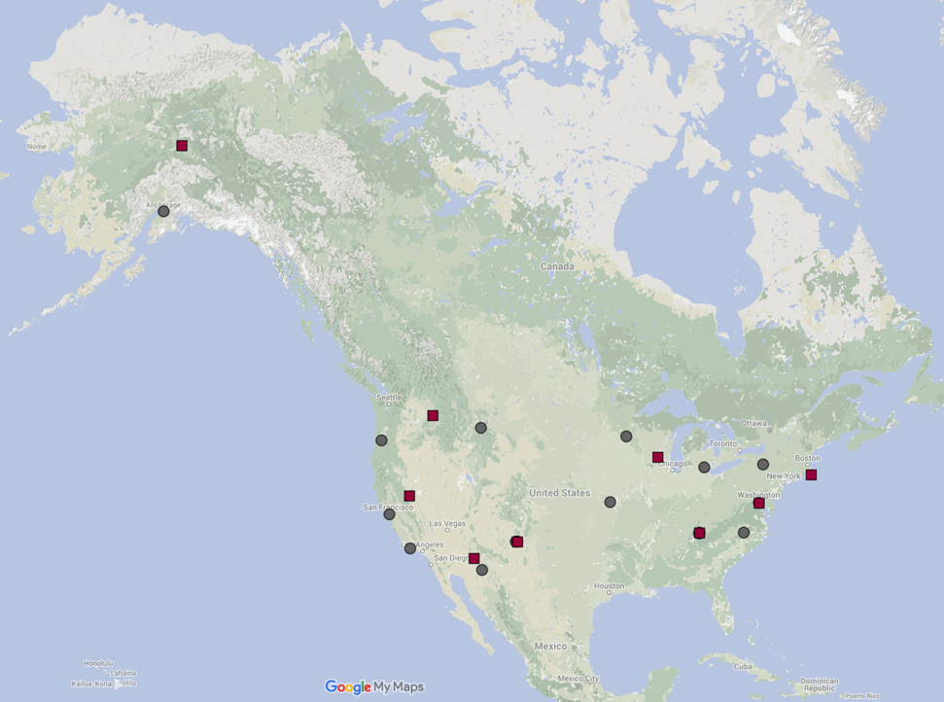
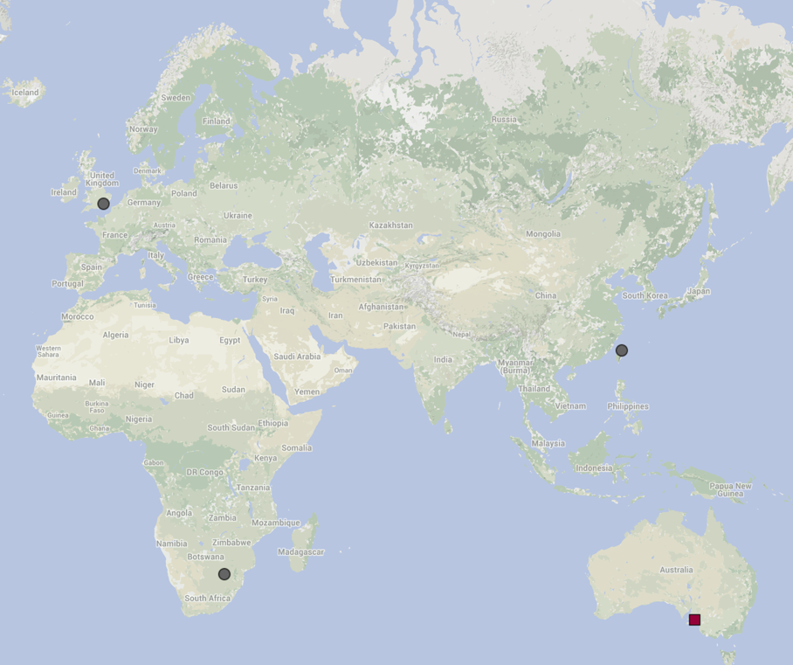
DataONE
Member
Nodes
Notes:
TO BE UPDATED

Slide 8
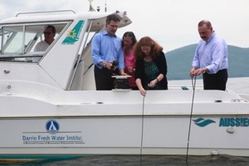
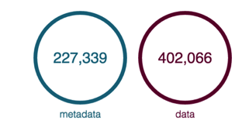
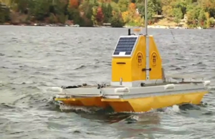
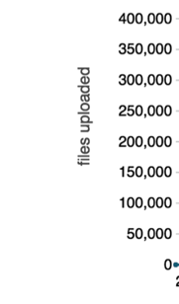
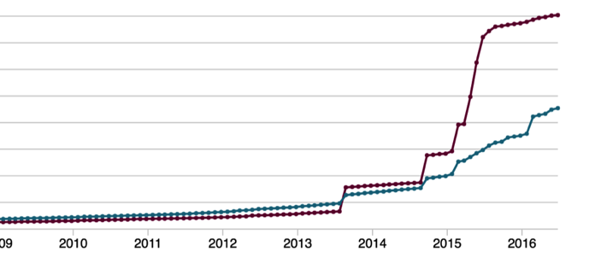
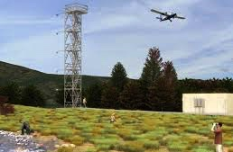
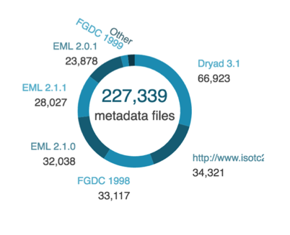
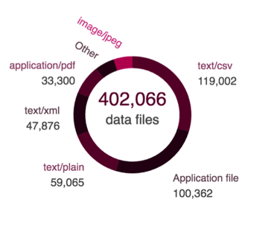
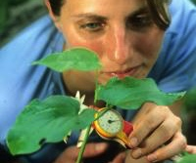
Data Holdings
www.search.dataone.org/#profile

Slide 9
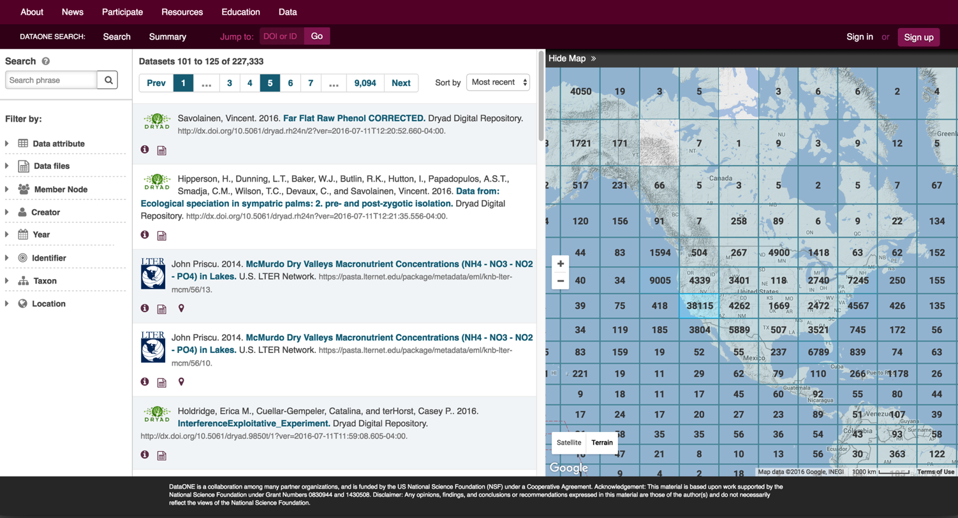
DataONE Search
Notes:
Amber Notes:
Add screencast

Slide 10
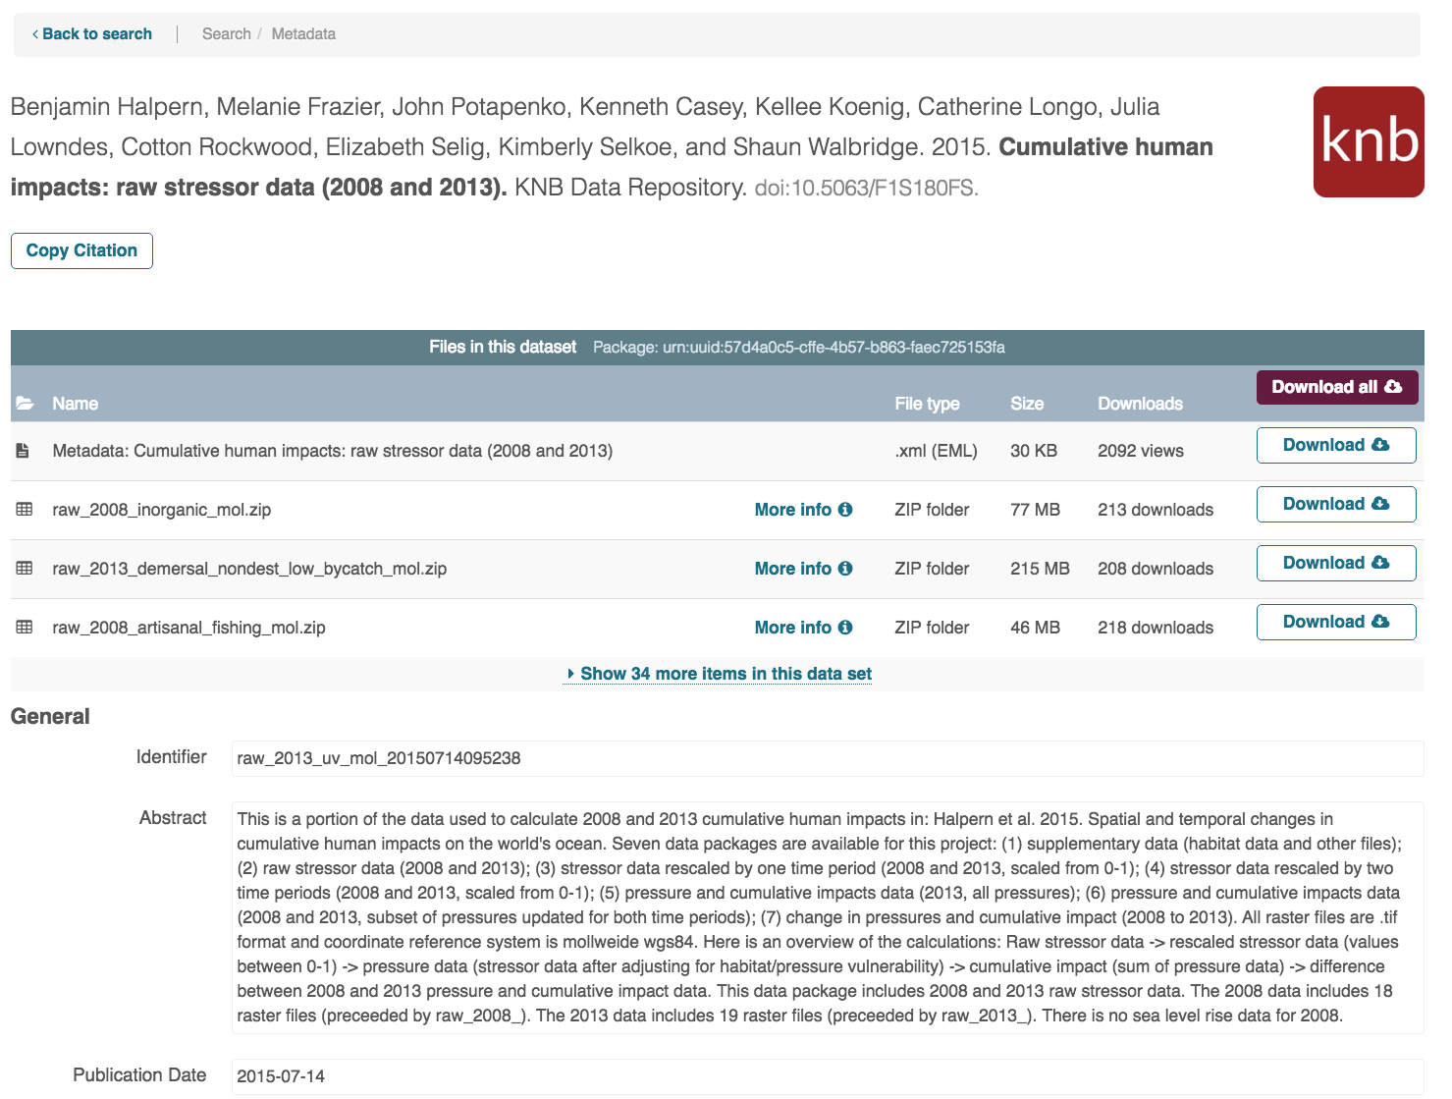
Download Stats Dataset Views

Slide 11
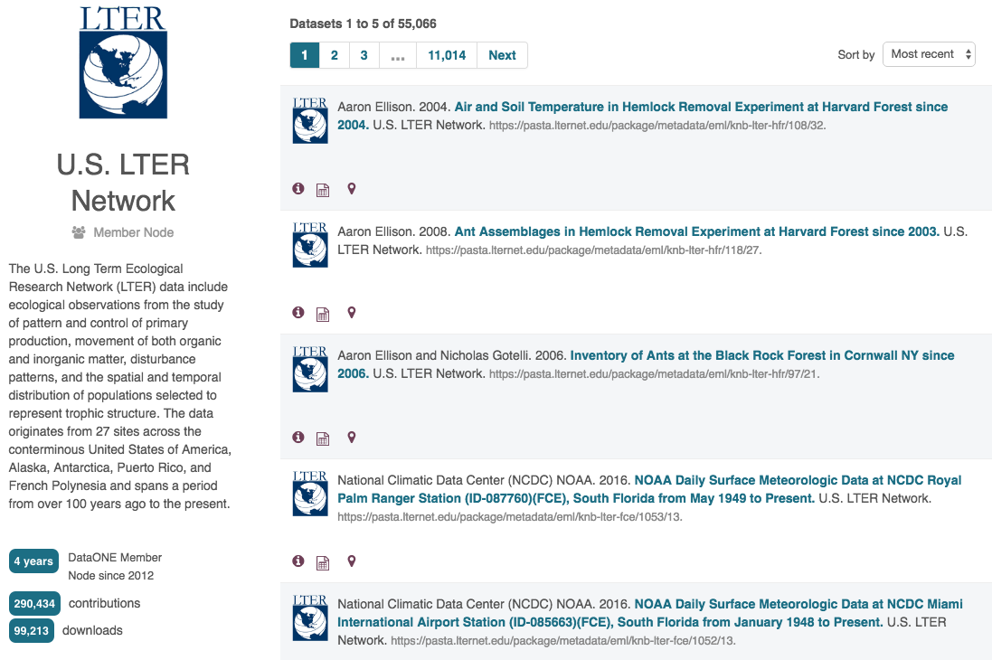
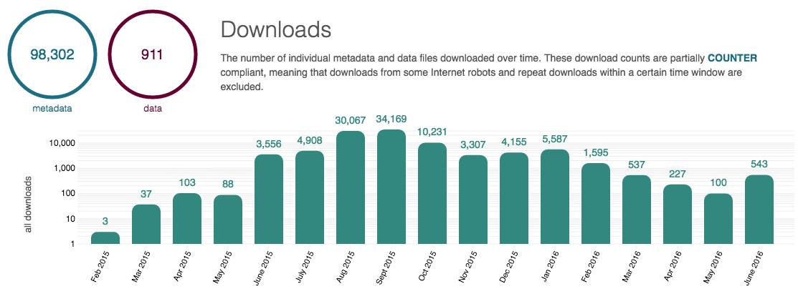
Member Profiles

Slide 12
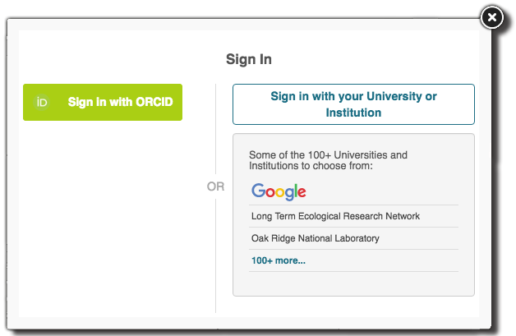
ORCID support
Universal ID for researchers

Slide 13
Its all about building community
Sustainable
Data Management
Cluster

Slide 14
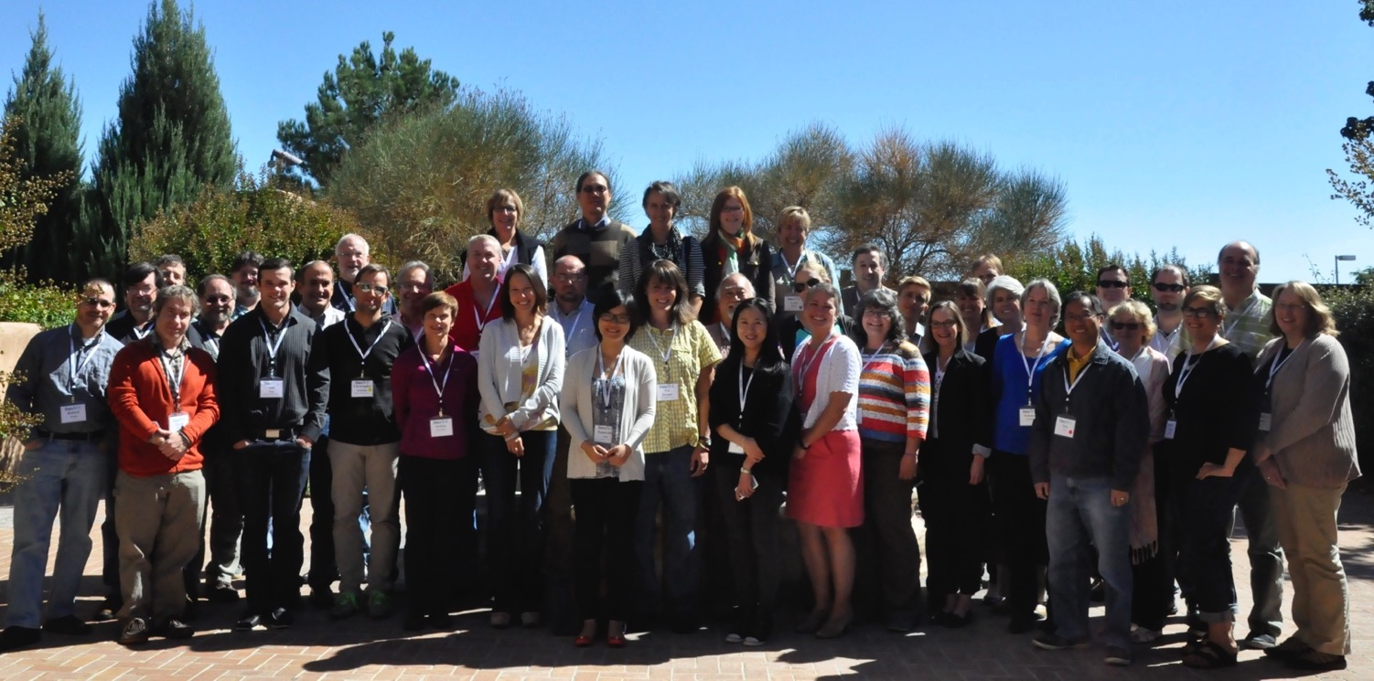
dataone.org
Notes:
Rebecca: the large blue/green box uses up a lot of the slide – could it be smaller?

