Slide 1


Using Data Portals and Metadata Registries:
Submitting Metadata to the GCMD
Section:
Local Data Management - Advertising Your Data
Lola Olsen¹ , Tyler Stevens²,
1 National Aeronautics and Space Administration (NASA)
2 Wyle Information Systems (NASA Contractor)
Version 1.0
October 2012
Copyright 2012 Lola Olsen & Tyler Stevens.
Notes:
Introduction:
This is the Federation of Earth Science Information Partners Data Management for Scientists Short Course, Section: Local Data Management – Advertising Your Data: Using Data Portals and Metadata Registries; Module: Submitting Metadata to the GCMD.
Slide 1: Title: Local Data Management – Advertising Your Data: Using Data Portals and Metadata Registries; Submitting Metadata to the GCMD.
This training module is part of the Federation of Earth Science Information Partners (or ESIP Federation's) Data Management for Scientists Short Course. The subject of this module is "Submitting Metadata to the GCMD." This module was authored by Lola Olsen from the National Aeronautics & Space Administration, NASA, and Tyler Stevens, NASA Contractor for Wyle Information Systems at the Global Change Master Directory, and the Goddard Space Flight Center. Besides the ESIP Federation, sponsors of this Data Management for Scientists Short Course are the Data Conservancy and the United States National Oceanic and Atmospheric Administration (NOAA).

Slide 2
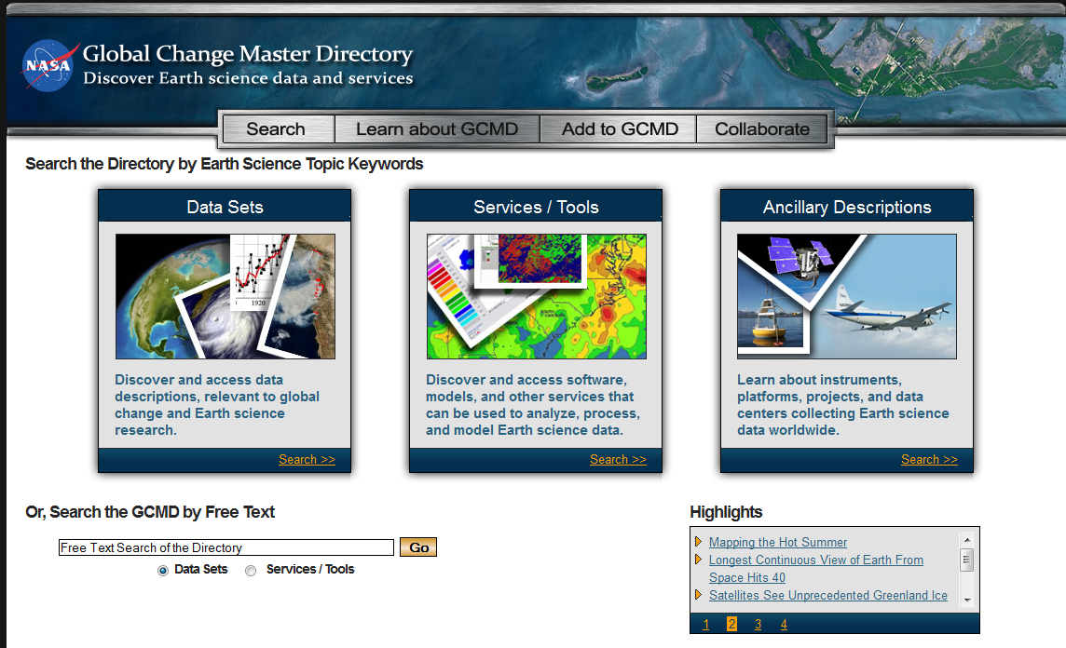
Overview
Introduction to the Global Change Master Directory (GCMD)
Submitting Metadata using docBUILDER
Overview of docBUILDER Functionality
GCMD Homepage
Notes:
Slide 2: Overview
In this module, we will provide an introduction to the Global Change Master Directory, known as the GCMD; describe how to submit a metadata record for your data to the GCMD using the docBUILDER metadata authoring tool; and provide an overview of docBUILDER functionality.

Slide 3
Global Change Master Directory
The GCMD enables the scientific community to discover and access over 25,000 Earth science data sets and services.
The GCMD uses the Directory Interchange Format (DIF), a discovery metadata standard used by NASA and the Committee on Earth Observation Satellites (CEOS).
The DIF contains specific information that allows users to more easily find a data set and/or service, and determine its appropriateness for their needs.
Submitting metadata will allow it to be searchable in the GCMD and Google.
Notes:
Slide 3: Global Change Master Directory
The National Aeronautics & Space Administration (NASA’s) Global Change Master Directory is a comprehensive online directory of information that enables the scientific community to discover and access earth science data sets and services. The GCMD uses the Directory Interchange Format (DIF), an internationally recognized metadata standard that is used by NASA and the Committee on Earth Observation Satellites, CEOS. CEOS is an international organization that coordinates civil space-borne observations of the Earth.
DIF contains detailed information that allows users to more easily find a data set and/or service and determine its appropriateness for their needs. Submitting metadata to the GCMD will allow the information about your data to be searchable in the GCMD, but also indexed and searchable more broadly by Google and other online search engines.

Slide 4
Submitting Metadata
docBUILDER is a free, online tool for creating, updating, and submitting DIF metadata entries to the GCMD.
  Provides a check-list of required, highly recommended, and recommended fields to populate.
  Checks for valid and complete values in metadata fields.
  Allows for templates when creating entries with duplicate information.
Users can register for an account at https://urs.eosdis.nasa.gov/
Users can access docBUILDER at http://gcmd.nasa.gov/User/authoring
Notes:
Slide 4: Submitting Metadata
docBUILDER is a free metadata authoring tool provided by the GCMD for creating, updating, and contributing DIF metadata entries. The tool is easy to use. It gives you a visual checklist of required, highly recommended, and recommended fields to populate. In the process of submitting your metadata, the tool will check for valid and complete values in metadata fields. For your convenience, the tool allows you to use templates when you want to create multiple entries that have duplicate information.
On this slide, we have provided the links for you to register for an account on docBUILDER, and to access and use docBUILDER.

Slide 5
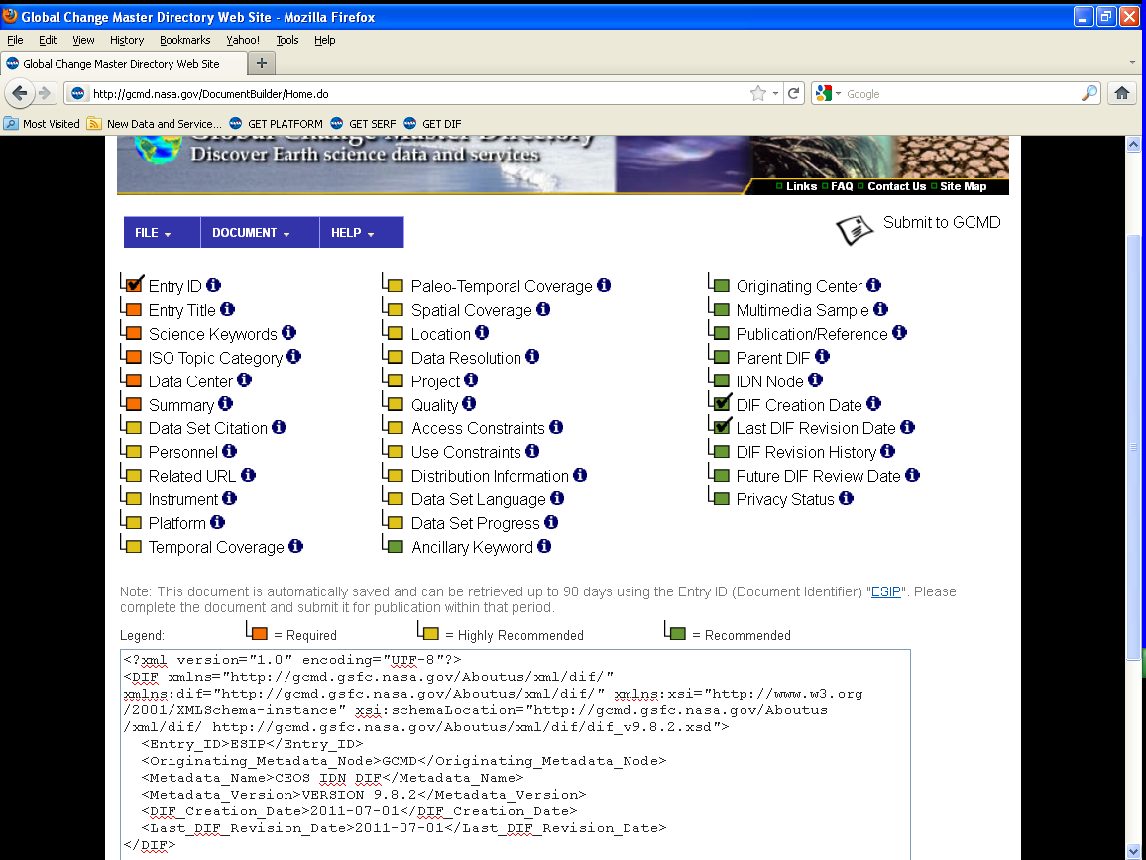
Using docBUILDER
Validate Your Document
and/or Get Help
Submit Your Document
to the GCMD
Checked When Completed
Populate Metadata Fields
Notes:
Slide 5: Using docBUILDER
On this slide, we’ve provided a glimpse of the docBUILDER interface that highlights the features mentioned in the previous slide. The menu in blue at the top of the tool gives you many options. The File dropdown menu allows you to Save, Enter, or Add a metadata record. The Document dropdown menu allows you to Validate, Preview and Submit your metadata document. The Help dropdown menu allows you to access the docBUILDER and metadata authoring tutorials. You can also contact the GCMD staff if you have additional questions.
In this view of the docBUILDER interface, you can see that when you create a metadata record by populating the fields, the tool automatically adds a check to the field as it is completed. When users are finished editing their metadata record they can click the Submit to GCMD button in the top right hand corner to send their metadata. After review, the record will be approved by the science coordinators, and loaded into the GCMD database.
You can also use docBUILDER to generate templates when you want to submit multiple records that have repeatable information in separate required fields. The online tutorials give you step by step directions for creating and editing templates.

Slide 6
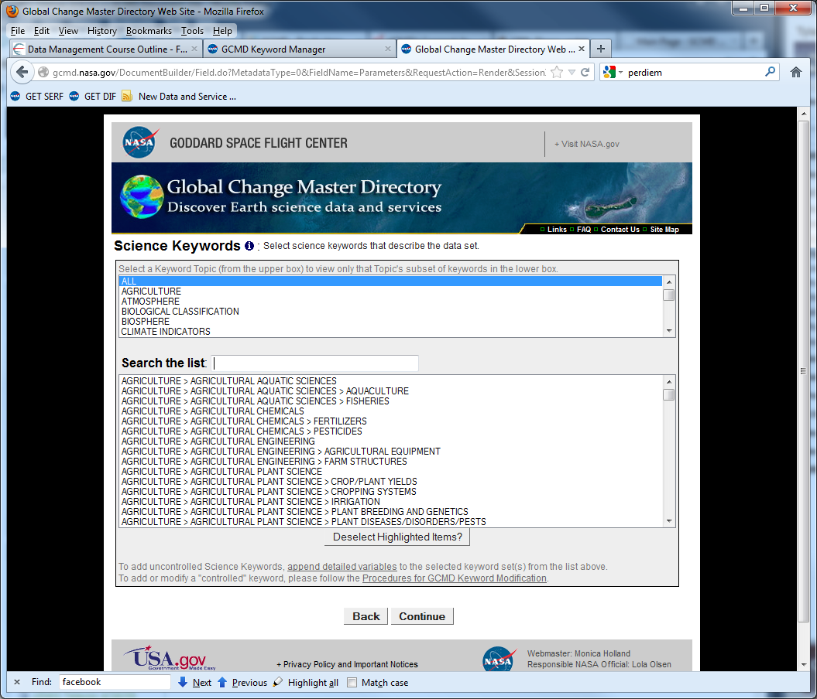
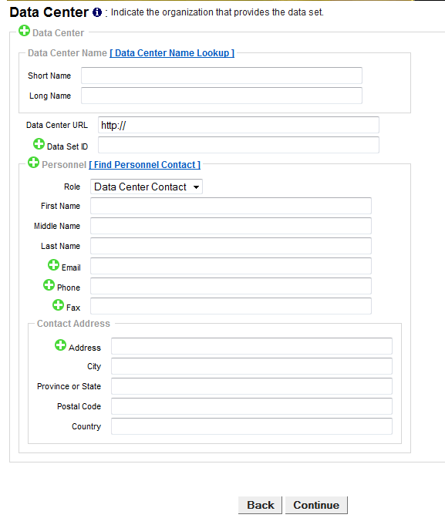
Using docBUILDER – Example of
Fields and Entering Information
Science Keywords
Data Center
Notes:
Slide 6: Using docBUILDER - Example of Fields and Entering information
On this slide, we show you several key fields in the docBUILDER metadata authoring tool. On the left, you can see that the tool allows you to select the Earth Science keywords that describe the topics covered by your data set from a searchable and scrollable list. On the right, you can see how you would enter the name of the data center that will provide the data, and contact information for a person at the data center. As you fill out the field and click continue, the information you enter is automatically saved.

Slide 7
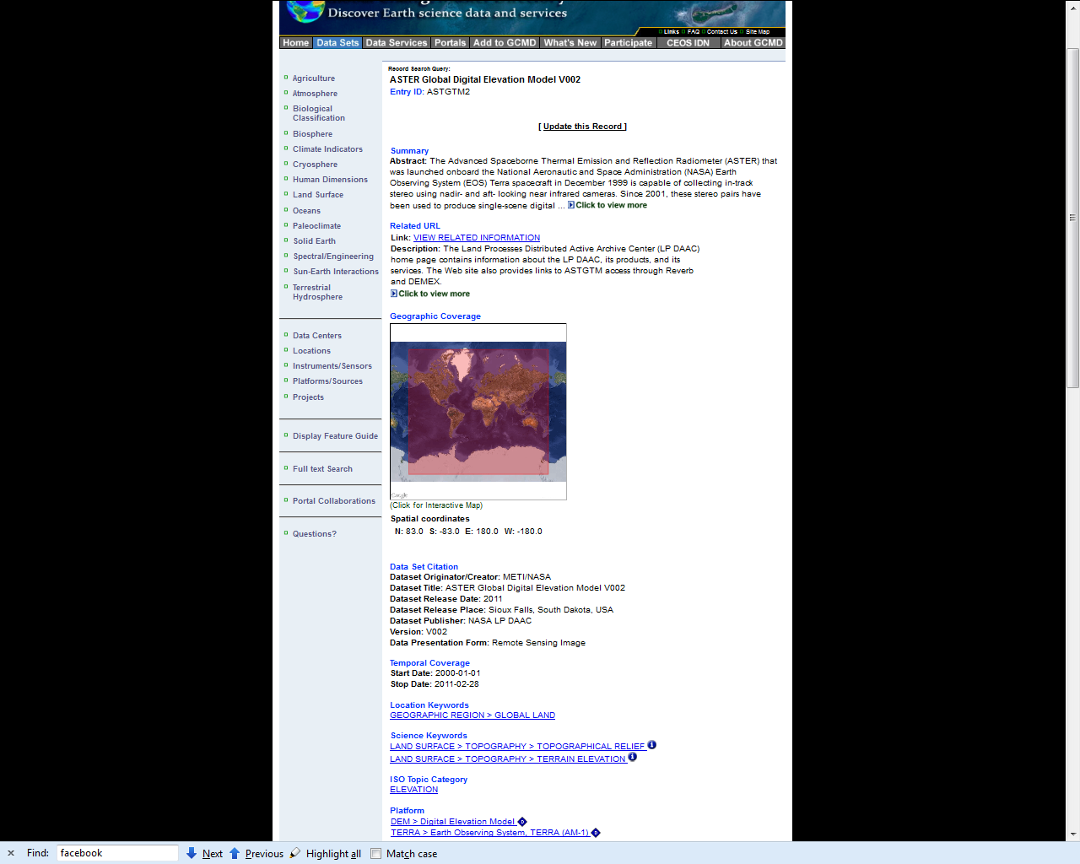
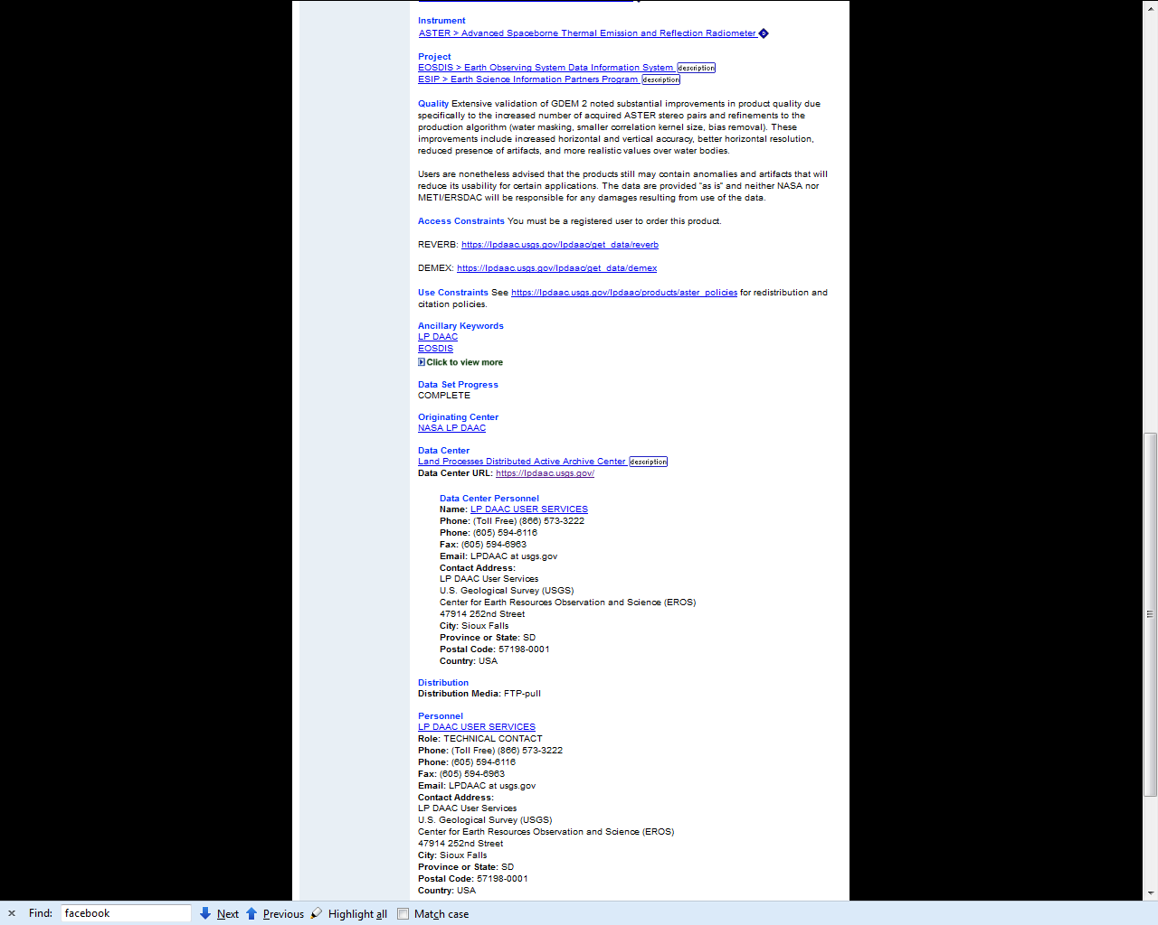
Submitted Metadata Document
Example of a completed metadata document in the GCMD
Notes:
Slide 7: Submitted Metadata Document
In this slide is an example of a submitted metadata record with many of the fields populated. The metadata will help users better understand the data set and how to access the data.

Slide 8
Relevance to Data Management
Creating and maintaining metadata is part of the data management lifecycle.
docBUILDER makes it easy for users to update/maintain their metadata entries.
DIF entries provide a direct link (i.e. http://gcmd.nasa.gov/getdif.htm?GES_DISC_AIRI2CCF_NRT_V005) to metadata that can be added to data management reports.
Notes:
Slide 8: Relevance to Data Management
Now that you have seen what this module has covered, you may be wondering why these topics are important for data management. To answer that question, please consider the following:
Creating and maintaining metadata is an important part of the data management life cycle of your data set. The docBUILDER tool can be a big part of the process of creating, updating and maintaining your metadata because it is easy to use and free.
When you contribute metadata for your Earth Science data sets using docBUILDER, you and your institution still have control of your data, and the processes and methods that you use to keep the public information about your data maintained and updated.
Once you submit your metadata record and it is added to the GCMD database, you can link directly to your metadata record. You can easily insert this link into the data management reports and other documentation that is required by your funding agency.

Slide 9
References
Ritz, S. “GCMD/IDN: Advances in Keyword and Metadata Interoperability”. Documenting Data in Multiple Dialects. Federation of Earth Science Information Partners (ESIP) Summer Meeting, Madison, WI, USA, 16-19 July 2012. (Presentation). http://commons.esipfed.org/node/450
Aleman, A., L. Olsen, S. Ritz, M. Morahan, L. Cepero, T. Stevens. "NASA's Global Change Master Directory: Discover and Access Earth Science Data Sets, Related Data Services, and Climate Diagnostics". Federation of Earth Science Information Partners (ESIP) Winter Meeting, Washington D.C., 4-6 January 2012. (Poster) . http://wiki.esipfed.org/index.php/2012_Winter_Meeting_Poster_Session
Aleman, A., L. Olsen, T. Stevens, S. Ritz, M. Morahan, L. Cepero. "NASA's Global Change Master Directory: Discover and Access Earth Science Data Sets, Related Data Services, and Climate Diagnostics." American Geophysical Union Fall Meeting 2011, San Francisco, CA, 5-9 December 2011 (Poster). http://fallmeeting.agu.org/2011/fall-meeting-2011-program-book/
Notes:
Slide 9: References
Within this module, we've made reference to a number of published information sources that we think you may want to review when you want more in-depth information. The most relevant references are listed here.

Slide 10
Resources
National Aeronautics and Space Administration (NASA). 2010. “Directory Interchange Format (DIF) Writer's Guide”.
Global Change Master Directory. http://gcmd.nasa.gov/User/difguide/
National Aeronautics and Space Administration (NASA). Global Change Master Directory (GCMD). http://gcmd.nasa.gov/
National Aeronautics and Space Administration (NASA) GCMD docBUILDER: http://gcmd.nasa.gov/User/authoring
Notes:
Slide 10: Resources
On this slide, you will find a linked listing of some additional resources you might find helpful should you need more information about some of the areas we’ve covered briefly in this module.

Slide 11
Other Relevant Modules
For more information about discovery metadata, see
  Local Data Management – Creating Documentation and Metadata: Metadata for Discovery
To find out additional ways to advertise your data, see
  Local Data Management – Advertising Your Data: Using Data Portals and Metadata Registries
Notes:
Slide 11: Other Relevant Modules
The modules of ESIP Data Management Course have been designed to complete and supplement each other. In light of this plan, we think you might find the following related modules relevant to you as you gain a better understanding of data management.
For more information about discovery metadata, see Local Data Management – Creating Documentation and Metadata: Metadata for Discovery.
To find out additional ways to advertise your data, see Local Data Management – Advertising Your Data: Using Data Portals and Metadata Registries.

Slide 12
Recommended Citation
Olsen, L. and T. Stevens, 2012. “Local Data Management – Advertising Your Data: Using Data Portals and Metadata Registries; Submitting Metadata to the GCMD.” In Data Management for Scientists Short Course, edited by Ruth Duerr and Nancy J. Hoebelheinrich, Federation of Earth Science Information Partners: ESIP Commons. doi:10.7269/P35H7D63
Copyright 2012 Lola Olsen and Tyler Stevens.
Notes:
Slide 9: Recommended Citation
This module is available under a Creative Commons Attribution 3.0 license that allows you to share and adapt the work as long as you cite the work according to the citation provided.
Thank you very much for your interest in the ESIP Federation’s Data Management for Scientists Short Course.

