Slide 1
Managing Your Data: Backing Up Your Data
Section:
Local Data Management
Robert Cook
Oak Ridge National Laboratory
Version 1.0
October 2012
Notes:
Introduction:
This is the Federation of Earth Science Information Partners Data Management for Scientists Short Course, Section: Local Data Management - Managing Your Data; Module: Backing Up Your Data.
Slide 1: Title: Local Data Management - Managing Your Data: Backing Up Your Data.
This training module is part of the Federation of Earth Science Information Partners (or ESIP Federation's) Data Management for Scientists Short Course. The subject of this module is "Backing Up Your Data." This module was authored by Robert Cook from the Oak Ridge National Laboratory. Besides the ESIP Federation, sponsors of this Data Management for Scientists Short Course are the Data Conservancy and the United States National Oceanic and Atmospheric Administration (NOAA).

Slide 2
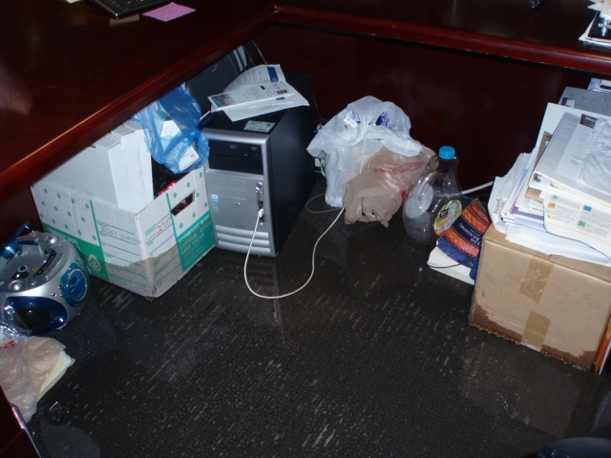
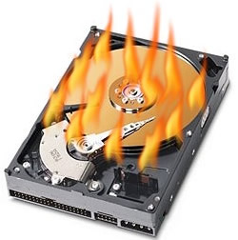
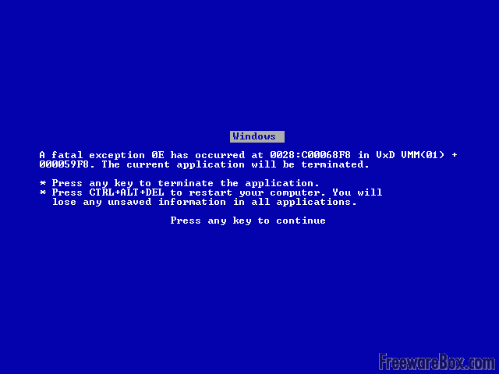
Overview
Provides guidance for individual researchers in backing up data and other digital files (email, documents, etc.)
To protect against data loss, create multiple copies of files located in several sites
These files can be used to replace lost files
http://i1.kym-cdn.com/photos/images/masonry/000/028/825/bsod20110724-22047-t51ovf.png
http://activerain.com/image_store/uploads/2/4/0/4/4/ar134664183344042.JPG
http://www.coredatarecovery.com/wp-content/uploads/2011/08/hard-drive-burning1.jpg
2
Notes:
Slide 2: Overview:
Probably everyone has had the horrible feeling of coming into their office and seeing that the hard drive crashed or seeing the “blue screen of death”. If you, or others you know have had this experience, you know the difficulties you can have in recovering information from a broken system.
In this module, we will provide some guidance to you as an individual researcher on backing up your data and other digital files, such as email and documents that are really important to you. The practices we’ll suggest will help you protect against data loss by creating multiple copies of files which can then be used to replace lost files.

Slide 3
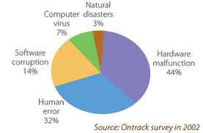
Relevance to Data Management
Valuable data and information can be lost
Limit loss of data, some of which may not be reproducible
Save time, money, productivity
http://www.netpipe.com/NBS/web/page_1.html
3
Notes:
Slide 3: Relevance to Data Management
There are many different ways that valuable data and information can be lost. We’ve already mentioned hardware malfunctions, but human error can also occur when someone forgets to save a file or overwrites another file. The practices we will discuss will help you limit the loss of data from such events, especially important for the research scientist with field data that may not be reproducible. If you’ve been collecting data out in the field, it may be impossible to get back out to the field and recreate the conditions surrounding your observations. So protecting against data loss will be important so you don’t lose those non-reproducible results. Getting into the habit of data protection will save you time, money and productivity.

Slide 4
Back up your data files (1 of 2)
Create back-up copies often
Ideally three copies
original, one on-site (external), and one off-site
Frequency based on need / risk
Higher value data should be backed up more often
Sensor data collected at high frequency should be backed up more often
4
Notes:
Slide 4: Back up your data files (1 of 2)
One of the best practices that we recommend is that you create backup copies and that you do so often. We recommend that you make three copies of your data: the original copy that’s on the hard drive of your desktop computer or your laptop; one onsite but external to your computer and to your office or your lab; and the third copy offsite that could be at your home, another location at your university or laboratory or out of your geographical area.
These three copies will help ensure that if a disaster struck your office building, for example, you’d be able to retrieve the data from your offsite location.
The frequency with which you make these backups really depends upon the type of data and the risk. If you are collecting very unique data every day, then you would want to make three copies every day. If you are running a sensor network that’s collecting a lot of information every day, you’d probably want to back up that data every day as well. On the other hand, if you’re doing field work for a month once a year, once you finish the field work and have multiple copies existing in various places, you probably don’t need to back up those copies more frequently if there is nothing added to the data files.

Slide 5
Back up your data files (2 of 2)
Ensure that, when created, all backup copies are identical to the original files
Checksums
calculations based on the contents of a file. If the checksum values of a backup and the original are the same, it is highly likely the files are the same.
File comparison
Use software to compare two files line by line and identify any differences.
5
Notes:
Slide 5: Back up your data files (2 of 2)
One important task to work into the process of making your backup data files is to ensure that when you create the backup copies they are identical to the original files. There are a couple ways of doing this: one is to use checksums, that is, calculations based on the contents of the file. If the checksum for your backup is identical to the checksum for your original file it’s quite likely the files are identical. This task is really important, for you don’t want to be saving a file that is not the same as the original. Another method is to use file comparison software to compare two files line by line and identify any differences.

Slide 6
Use reliable devices for backups
Managed network drive
Raid, tape system
Managed cloud file-server
DropBox, Amazon Simple Storage Service (S3), Carbonite
6
Notes:
Slide 6: Use reliable devices for backups
Regardless of the timing and method for creating backups for your files, you definitely want to use reliable devices for backups. At your institution, you may have a managed network drive system such as a RAID or tape system. If so, talk to your network administrator about getting backup copies made from your machine onto this network drive. Another option that has developed recently is the use of managed cloud file servers. There are a number of cloud services available at present including Carbonite, Amazon Simple Storage Service (S3) from Amazon Web Services, and Dropbox. Cloud storage is developing into a good way to create offsite backups for you as an individual researcher.

Slide 7
Test your backups
Automatically test backup copies of files frequently to ensure they are viable
Media degrade over time
Annually test copies using checksums or file compare
Know that you can recover from a data loss
Periodically test your ability to restore information (at least once a year)
Each year simulate an actual loss, by trying to recover solely from the backed up copies
7
Notes:
Slide 7: Test your backups
For added insurance once you have backup copies of your data files created, we recommend that you periodically test your backups to make sure that they remain viable. Since the physical media degrade over time, we recommend that you test your backup copies on an annual basis at least. Using similar processes or tools that you used initially for adding and comparing checksums or for file comparison, you can be more sure that, over time, the contents remain as originally written.
An important corollary to backing up your files and testing their integrity over time is testing that you will be able to recover from a data loss. For this reason, we recommend that once a year, you test your ability to restore information by taking your backup disc and trying to recreate your main disc from that backup.
This kind of reality check came home when a colleague who had assumed that he was backing up to a network drive using a commercial backup system had his hard drive fail. When he wanted to bring his backup copies to a new hard drive, he found out that he had to manually copy over each of the individual files he created. This colleague was a computer programmer who had millions of files! He found out that he had to face the very difficult task of copying all those files back over to his hard drive. If he had simulated the loss and recovery of his files by recreating his main drive from the backups, he would not only have realized how difficult it was, but also whether or not the backups would actually work.

Slide 8
References
Brunt, J. 2010. “Protecting Your Digital Research Data and Documents”, LTER Forum.
http://intranet2.lternet.edu/content/protecting-your-digital-research-data-and-documents
DataOne Best Practices, see Data Preservation and Backup:
http://www.dataone.org/best-practices
8
Notes:
Slide 8: References
Within this module, we've made reference to published information sources that we think you may want to review when you want more in-depth information about backing up your data.

Slide 9
Resources
Tools to generate checksums
http://www.pc-tools.net/win32/md5sums/
http://corz.org/windows/software/checksum/
File Comparison Software
http://en.wikipedia.org/wiki/Comparison_of_file_comparison_tools
For more information about backing up your data:
http://en.wikipedia.org/wiki/Backup
http://en.wikipedia.org/wiki/Incremental_backup
http://www.data-archive.ac.uk/create-manage/storage/back-up
For more information about cloud storage services:
www.dropbox.com/
http://www.carbonite.com/
http://aws.amazon.com/s3/
9
Notes:
Slide 9: Resources
On this slide, you will find a linked listing of some additional resources you might find helpful should you need more information about some of the areas we’ve covered briefly in this module.

Slide 10
Other Relevant Modules
For information about how you might document the backup strategies for your data, see
Data Management Plans:
Elements of a Plan
Backups, Archives, and Preservation Strategy
10
Notes:
Slide 10: Other Relevant Modules The modules of the ESIP Data Management for Scientists Short Course have been designed to complement and supplement each other. In light of this plan we think you may find the following modules relevant to you as you gain a better understanding of data management:
For information about how you might document the backup strategies for your data, see
Data Management Plans: Elements of a Plan, and
Data Management Plans: Backups, Archives, and Preservation Strategy.

Slide 11
Recommended Citation
Cook, R. 2012. “Local Data Management – Managing Your Data: Backing Up Your Data.” In Data Management for Scientists Short Course, edited by Ruth Duerr and Nancy J. Hoebelheinrich, Federation of Earth Science Information Partners: ESIP Commons. doi:10.7269/P3NK3BZN
Notes:
Slide 10: Recommended Citation
This module is available under a Creative Commons Attribution 3.0 license that allows you to share and adapt the work as long as you cite the work according to the citation provided.
Thank you very much for your interest in the ESIP Federation’s Data Management for Scientists Short Course.

