Slide 1
COPDESS (Coalition for Publishing Data in the Earth & Space Sciences)
Kerstin Lehnert
Interdisciplinary Earth Data Alliance
Lamont-Doherty Earth Observatory
Columbia University, USA
Credits:
Brooks Hanson
American Geophysical Union, USA
Andrew Sallans
Center for Open Science, USA
“Connecting Earth Science publishers and Data Facilities to help translate the aspirations of open, available, and useful data from policy into practice.”

Slide 2
Data Repositories & Publishers
Scholarly publication is a key high-value entry point in making data available.
Majority of data submitted along with publications are in formats and forms of storage that make discovery and reuse difficult or impossible.
Domain repositories provide quality and standards, enriching and organizing data from multiple sources to facilitate new discoveries.
Connection between publishers and domain repositories is essential to promulgate best practices.

Slide 3
COPDESS: Goals
foster consensus and consistency among publishers, editors, funders, and data repositories
on how data that are part of scholarly publications should be curated and published
help data repositories collect the data that are within their scope more easily and comprehensively, raise their visibility
help authors properly submit their data to repositories up front
Simplify data submission process
Provide sufficient information about it
help journals, funding agencies, and the research community by doing all of the above
Approach: Continued dialog & practical resources

Slide 4
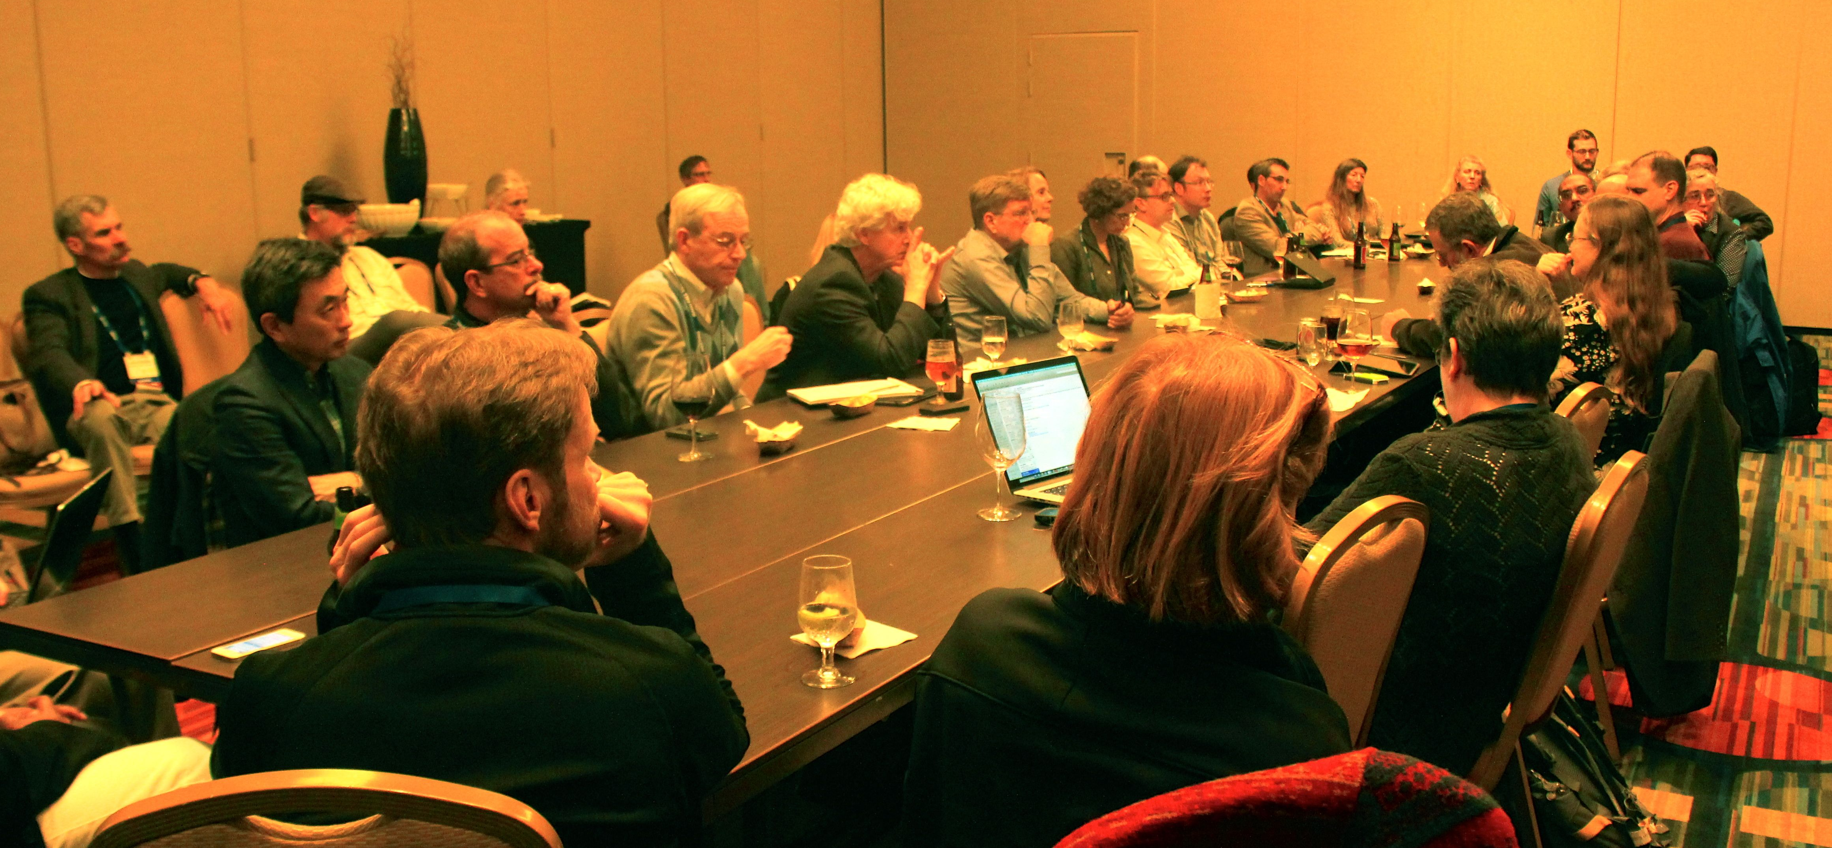
COPDESS Achievements
2 major workshops (2014, 2015) and ongoing Town Halls at major Earth & Space Science conferences (AGU, GSA, EGU)
Statement of Commitment signed by >40 publishers and data facilities
Guidelines for journal data policies released
COPDESS directory of data repositories online
COPDESS Town Hall AGU 2014

Slide 5
“Earth and space science data should, to the greatest extent possible, be stored in appropriate domain repositories that ... follow leading practices, and can provide additional data services.”
COPDESS Statement of Commitment

Slide 6
Specific Commitments
Provide an online community directory of appropriate Earth and space science community repositories.
Promulgate metadata information and domain standards.
Promote education of researchers in data management; organize and develop training and educational tools and resources
Promote referencing of data sets using the Joint Declaration of Data Citation Principles.
Include in research papers concise statements about data location and availability.
Develop workflows within the repositories that support the peer review process (for example, embargo periods with secure access) and within the editorial management systems that will ease transfer of data to repositories.
Use of Persistent Identifiers (ORCID, IGSN, FundRef)

Slide 7
COPDESS Directory
“This directory will help you, as an Earth and Space science researcher, author, or journal (and DATA CURATOR!), find the right repository for your data, based on data type, discipline, and other relevant repository factors.”
https://copdessdirectory.osf.io/

Slide 8
COPDESS Directory
Use of re3data.org metadata schema to describe data repositories
Detailed taxonomy of disciplines (from EarthCube survey) to help authors identify appropriate repositories
Metadata about repository scope and best practices:
Certification?
Endorsed by which journals/publishers?
Assigns DOIs?
Arrangements for long-term archiving?
Links to publications?

Slide 9
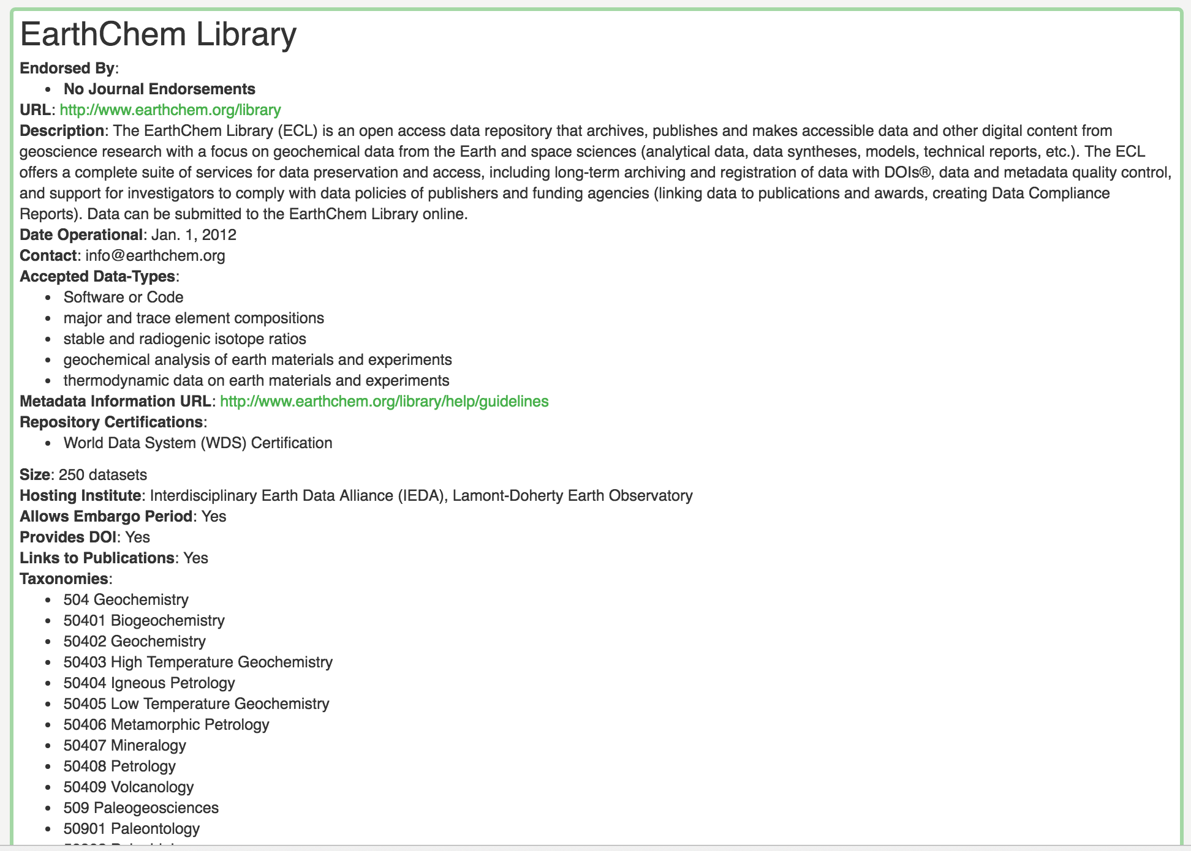
Example: IEDA’s EarthChem Library

Slide 10
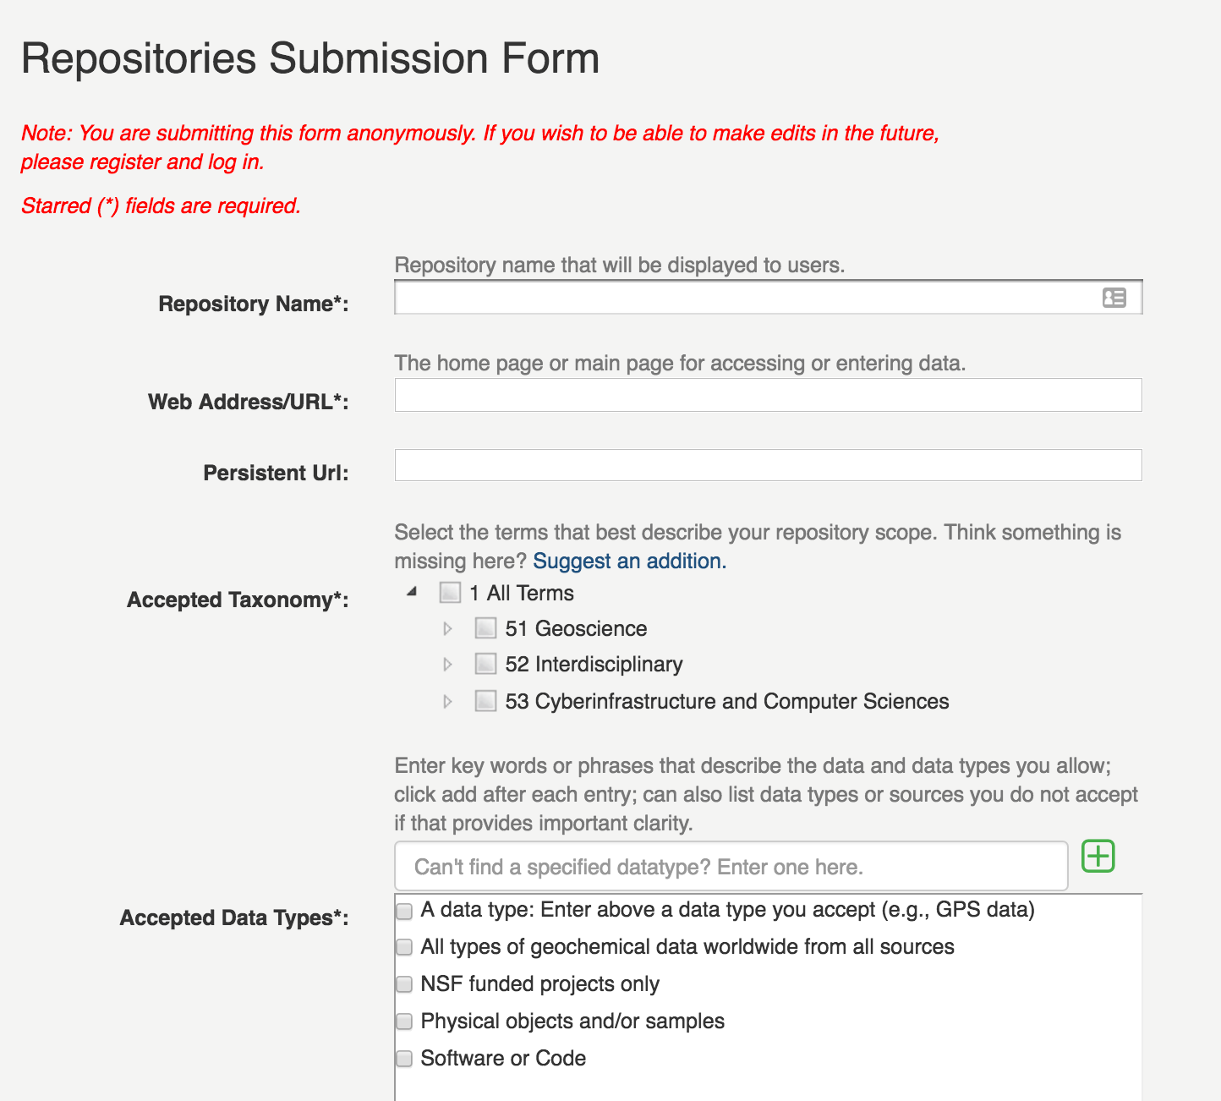
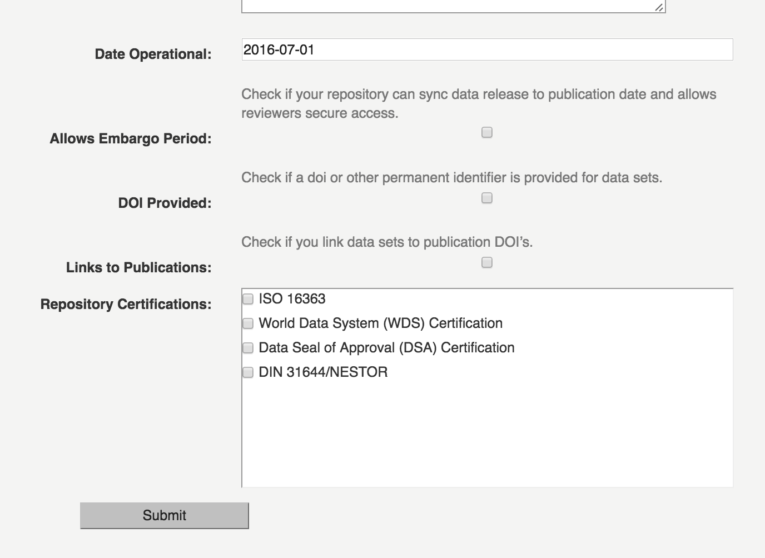
Repository information can be submitted and edited online.
AGU currently helps with metadata QA/QC and making the directory more comprehensive (see Shelley Stall here at ESIP)

Slide 11
Collaboration: re3data.org & COPDESS
Goal: Avoid multiple repository directories!
Concept: COPDESS provides an Earth & space science specific portal for author, journals, and repositories.
Action: Enable COPDESS to dynamically query and embed a subset of selected records into its website (currently being developed by COS) and add/extend selected vocabularies.
Memorandum of Understanding between re3data.org and Center for Open Science.

Slide 12
Next Focus: Educate Editors & Authors
Joint initiative with political/social science data repositories (ICPSR/G.Alter & Qualitative Data Repository/C.Elman)
Domain specific editors workshops.
Program for collective pan-disciplinary organizations (CSE, SSP, etc);
Programs aimed at young researchers.
Planning to establish RDA Working Group
Power is working within domain-specific publishing culture
Get trusted leaders in the domains to advocate & educate

