Slide 1
Migrating the Earth Observing System Data and Information System into the Cloud
Chris Lynnes
with contributions from Katie Baynes
NASA/GSFC
Earth Observing System Data and Information System

Slide 2
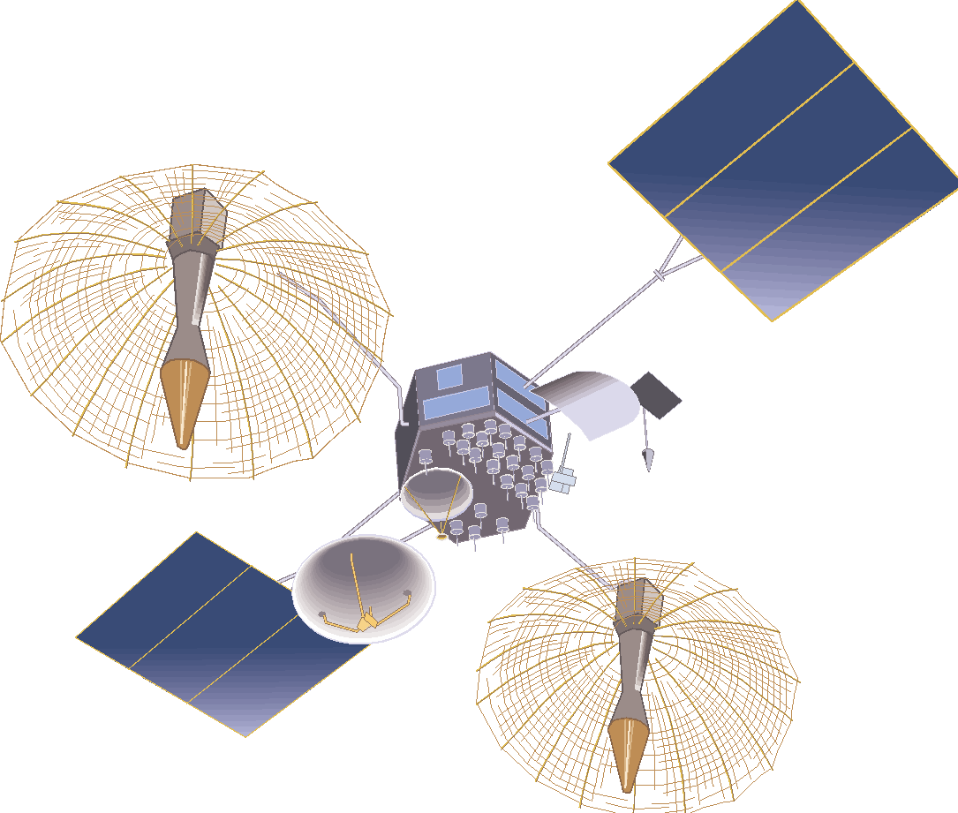
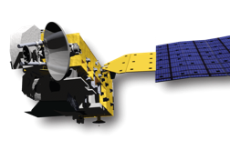
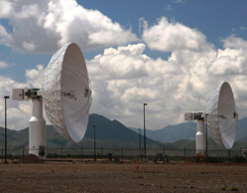
EOSDIS Functions
EOSDIS
Research
distribute
Applications
Education
data downlink
subset
Users
archive
capture and clean
process

Slide 3
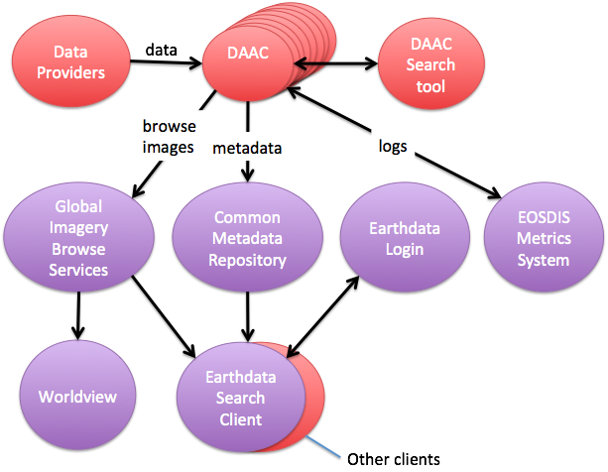
DAACs and users are supported by EOSDIS Common Services

Slide 4
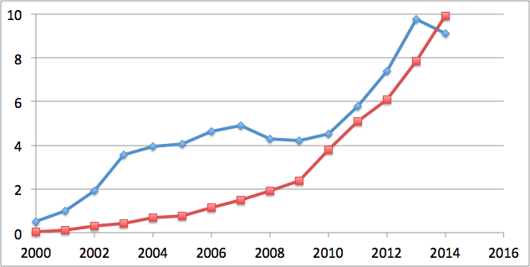
EOSDIS Works with (pretty) Big Data
Archive Volume
Petabytes
Distribution Volume

Slide 5
EOSDIS Cloud Plans

Slide 6
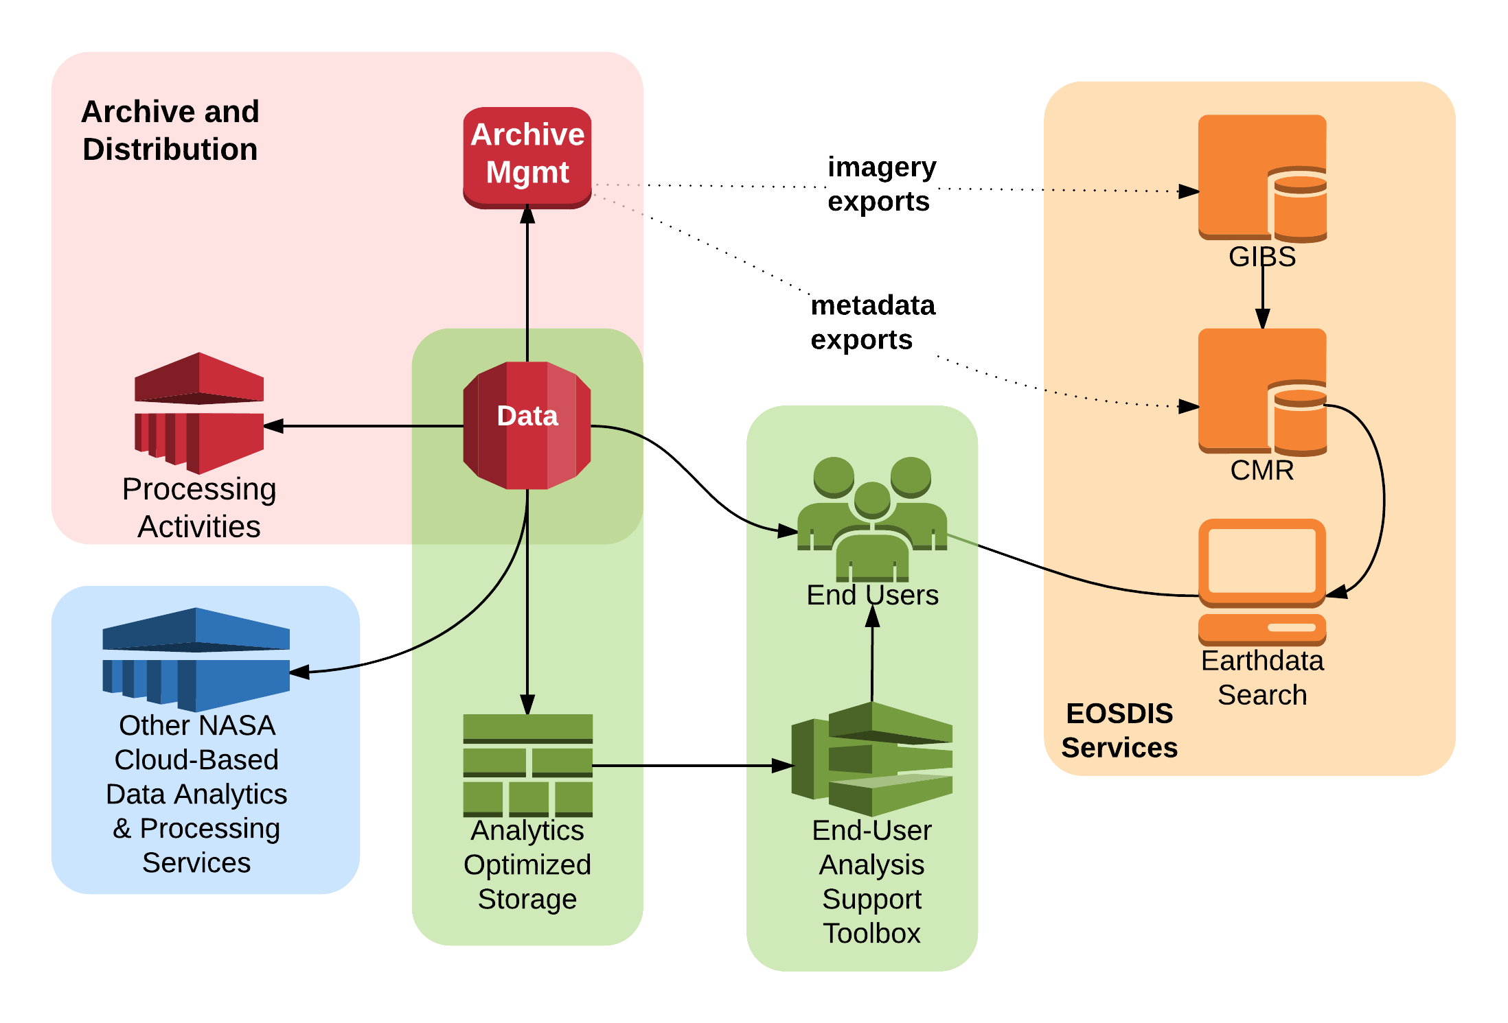
Planned Cloud Prototypes
3
1
2
Key
Archive Mgmt
Analytics Support
Application Hosting

Slide 7
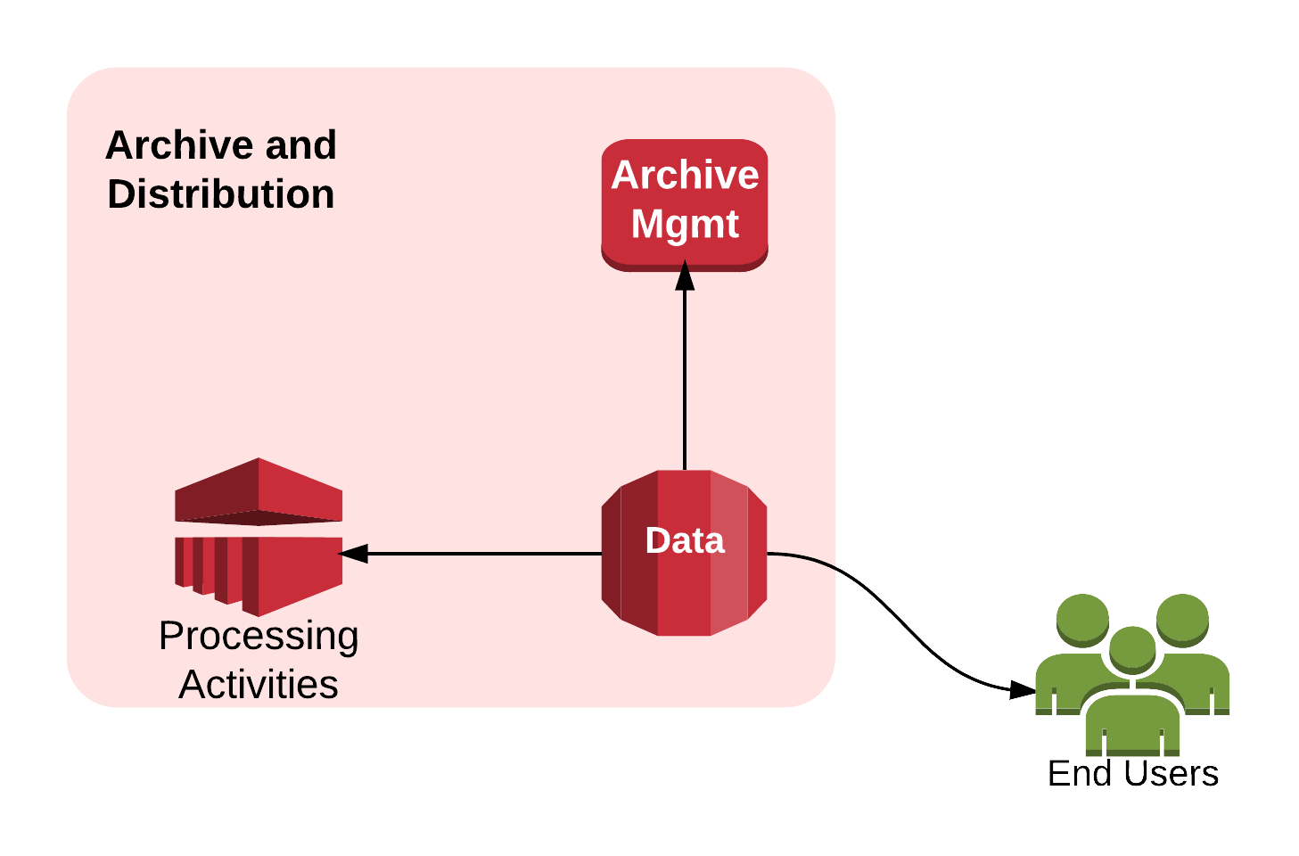
Archive and Distribution Prototype(s)
1
Cloud-based data distribution of Sentinel radar data by the Alaska Satellite Facility DAAC

Slide 8
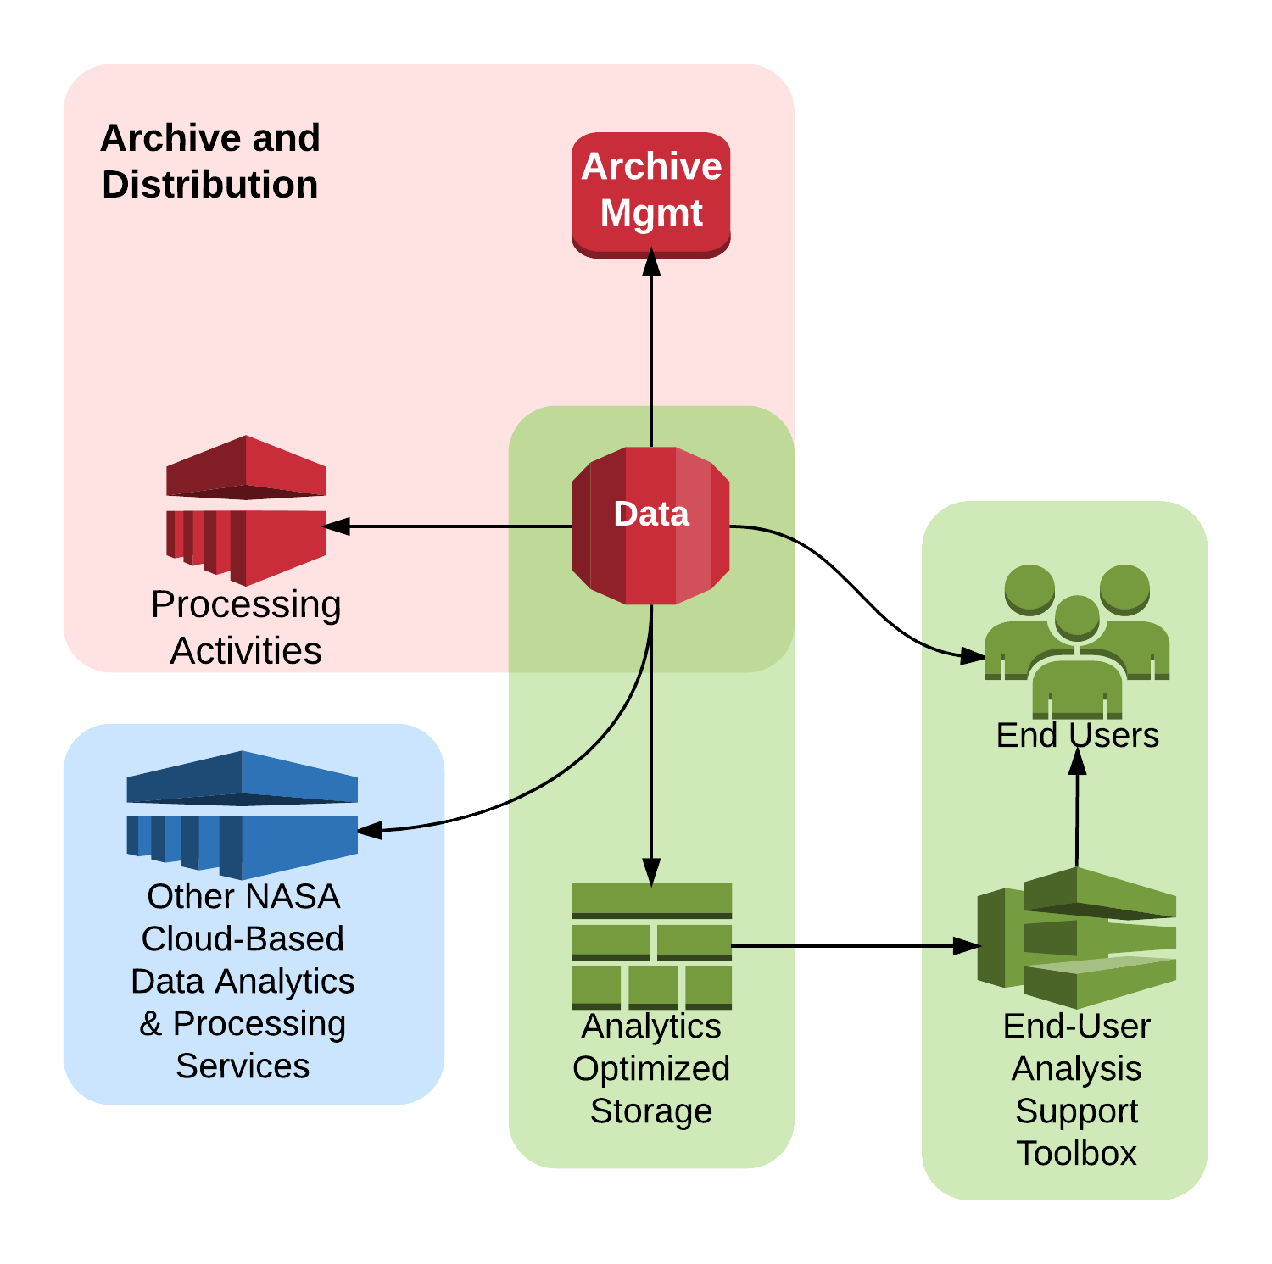
Cloud Analytics Prototypes
2
Containerized tools:
EOSDIS-specific:
Search / access
Analyze
Open source
R, SciPy, nco, IDV, …
Analytics-optimized storage examples
Hadoop, MapReduce, Cassandra, SciDB, Rasdaman, Google Earth Engine, ...

Slide 9
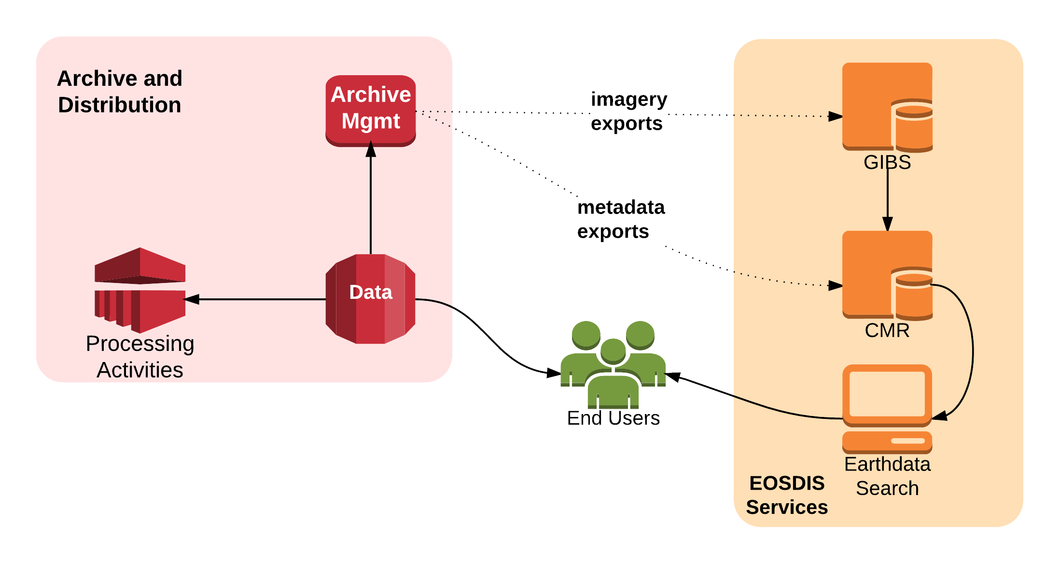
Application-Hosting Prototypes
3
Port existing services to cloud
Common Metadata Repository
Global Imagery Browse System
Earthdata Search client
Leveraging a reusable EOSDIS framework NGAP...

Slide 10
Yay, Cloud!
...but, just 1 or 2, or maybe 8, big questions to answer along the way...

Slide 11
Yay, Cloud!
But, just 1 or 2, or maybe 8, BIG questions to answer along the way...

Slide 12
Big Questions
How can we supply data to all users on a non-discriminatory basis?

Slide 13
Big Questions
2. How can we avoid storage lock-in?

Slide 14
Big Questions
3. How can we attract end users to the cloud, and how will that alter usage patterns?

Slide 15
Big Questions
4. How can we predict pricing 2-5 years out...
...especially as usage patterns change

Slide 16
Big Questions
5. How can we migrate near-archive data services to Web Object Storage?
Web Object Storage
OPeNDAP
w10n
OGC W*S

Slide 17
Big Questions
6. What functionality or data should NOT go into the cloud?

Slide 18
Big Questions
7. How do we handle provisioning and accounting of cycles and storage across the DAACs*?
* 4 NASA Centers, 2 Other federal agencies, 4 Universities

Slide 19
Big Questions
8. Do we need new operations policies or procedures?

