Slide 1
NASA Perspectives on Data Quality
July 2014

Slide 2
Overall Goal
To answer the common user question, “Which product is better for me?”
Notes:
http://www.whitehouse.gov/sites/default/files/microsites/ostp/nstc_2013_earthobsstrategy.pdf

Slide 3
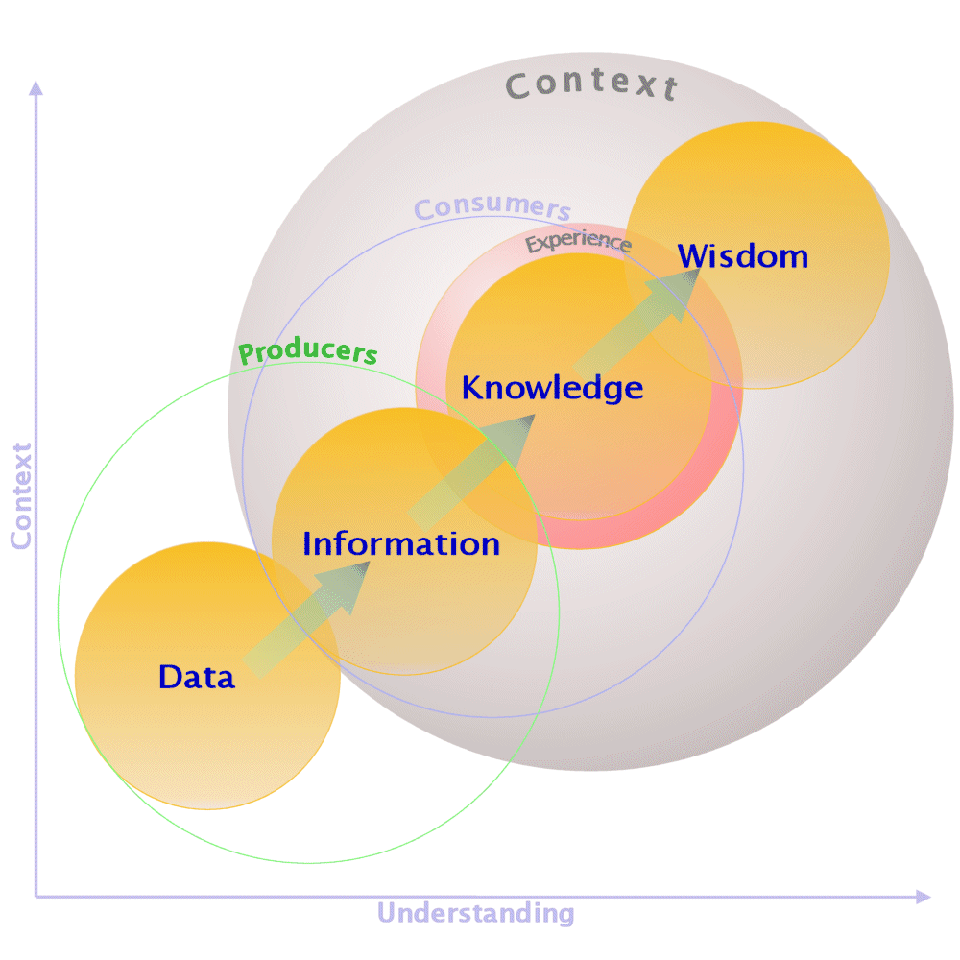

Slide 4
Aspects of Quality

Slide 5
Aspects of Quality
Intrinsic Aspects:
Uncertainties
Resolution
Completeness
Validation Status
Extrinsic Aspects:
Format
Access method
Documentation
User support

Slide 6
Structured Information On Quality
Aspects of Quality
Intrinsic Aspects:
Uncertainties
Resolution
Completeness
Validation Status
Extrinsic Aspects:
Format
Access method
Documentation
User support

Slide 7
Structured Information On Quality
Aspects of quality that have structured (e.g. ISO 19115/19138) largely for machines (i.e. tools & services)
Aspects of Quality
Intrinsic Aspects:
Uncertainties
Resolution
Completeness
Validation Status
Extrinsic Aspects:
Format
Access method
Documentation
User support

Slide 8
Knowledge Of Quality
Structured Information On Quality
Aspects of quality that have structured (e.g. ISO 19115/19138) largely for machines (i.e. tools & services)
Aspects of Quality
Intrinsic Aspects:
Uncertainties
Resolution
Completeness
Validation Status
Extrinsic Aspects:
Format
Access method
Documentation
User support

Slide 9
Knowledge Of Quality
Tools that can make inferences on the “right” product, i.e. the most “fit for purpose”
???????
Structured Information On Quality
Aspects of quality that have structured (e.g. ISO 19115/19138) largely for machines (i.e. tools & services)
Aspects of Quality
Intrinsic Aspects:
Uncertainties
Resolution
Completeness
Validation Status
Extrinsic Aspects:
Format
Access method
Documentation
User support

Slide 10
Knowledge Of Quality
Tools that can make inferences on the “right” product, i.e. the most “fit for purpose”
???????
Structured Information On Quality
Aspects of quality that have structured (e.g. ISO 19115/19138) largely for machines (i.e. tools & services)
Aspects of Quality
Intrinsic Aspects:
Uncertainties
Resolution
Completeness
Validation Status
Extrinsic Aspects:
Format
Access method
Documentation
User support

Slide 11
Knowledge Of Quality
Tools that can make inferences on the “right” product, i.e. the most “fit for purpose”
???????
Structured Information On Quality
Aspects of quality that have structured (e.g. ISO 19115/19138) largely for machines (i.e. tools & services)
Aspects of Quality
Intrinsic Aspects:
Uncertainties
Resolution
Completeness
Validation Status
Extrinsic Aspects:
Format
Access method
Documentation
User support

Slide 12
Consumer Data Quality “Sticker”
Knowledge Of Quality
Tools that can make inferences on the “right” product, i.e. the most “fit for purpose”
???????
Structured Information On Quality
Aspects of quality that have structured (e.g. ISO 19115/19138) largely for machines (i.e. tools & services)
Aspects of Quality
Intrinsic Aspects:
Uncertainties
Resolution
Completeness
Validation Status
Extrinsic Aspects:
Format
Access method
Documentation
User support

Slide 13
Backup

Slide 14
Common Metadata Repository (CMR)
Provides a single source of unified, high-quality, and reliable Earth Science metadata to that meets evolving needs of the EOSDIS community and external users
e.g. DAACs, application developers and national/international agencies
Provides a single ingest and search architecture for submission and discovery of all metadata
Supports collections, granules and new metadata concepts (e.g. parameters, visualization, documentation)
Preforms QA on new and existing metadata records (i.e. collection level)
Introduces the concept of adapters to transform metadata upon ingest.
Introduces the concept of a metadata lifecycle that helps evolve metadata standards to ensure ‘richness’ and new concepts proposed by stakeholders (i.e. EOSDIS and national/international agencies)

Slide 15
Drivers
National Strategy For Civil Earth Observations, April 2013
“Earth observations should be of known quality and fully documented.”
“Earth-observation data and ancillary information should be of known quality, meaning that they are fit for their intended use in operational missions and for planning.”
Notes:
http://www.whitehouse.gov/sites/default/files/microsites/ostp/nstc_2013_earthobsstrategy.pdf

