Slide 1
POV: Data contributor
Margaret O’Brien
Long Term Ecological Research (LTER) Network
Environmental Data Initiative (EDI)

Slide 2
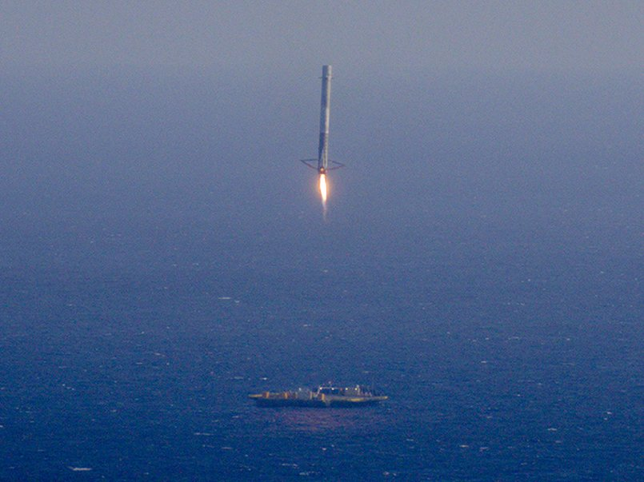
Falcon 9 attempts a landing on the barge named “Just Follow the Instructions”
Source: http://www.techinsider.io/spacex-rocket-landing-failure-2016-3

Slide 3
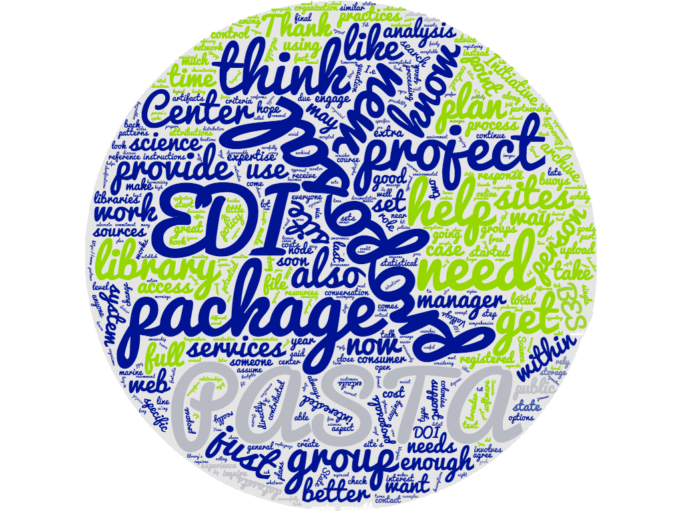
Landscape - a Scientist’s Point of View
DMPs should include archiving plans.
I think there are options.
It’s complicated.
Can I get help?
Notes:
A lot of researchers’ interest in repositories stems now from requirement to include DMPs with proposals, and that these include archiving plans.
But that landscape is also changing. There are many repos now, plus some are capable of either pushing data up to national archives (like BCODMO), or there federators (like Dataone) that are make datasets from multiple repositories appear together. So the researchers have options for where they put their data, that they may not have had a few years ago. And while blurring the lines between repositories (in the long run) is great, it can make the initial steps blurry, too....
Some are aware that LTER sites (like mine) have data managers, who understand at least part of the repository landscape - so we try to help.
Word cloud is the text from a recent batch of emails, in the last month or 2 - from people asking for help with proposal data management plans (hence the word ‘proposal appearing so large).

Slide 4
Scientists need to know...
Where is the best place for “my data”?
How do I get it there?
Can those who want it find it?

Slide 5
Who needs to find it?
Funder
Journal
Another researcher
Some other community
Programmers writing web apps
Decision/policy maker
Educator
Public

Slide 6
Knowledge Spectrum
Liaison access
Contributor’s computing expertise

Slide 7
Does the Repository Provide...
Community BPs Vetting systems Communication | Technical specs API Bug tracking
Templates Definitions Web forms | Code libraries Documentation API
Liaison access
Contributor’s computing expertise

Slide 8
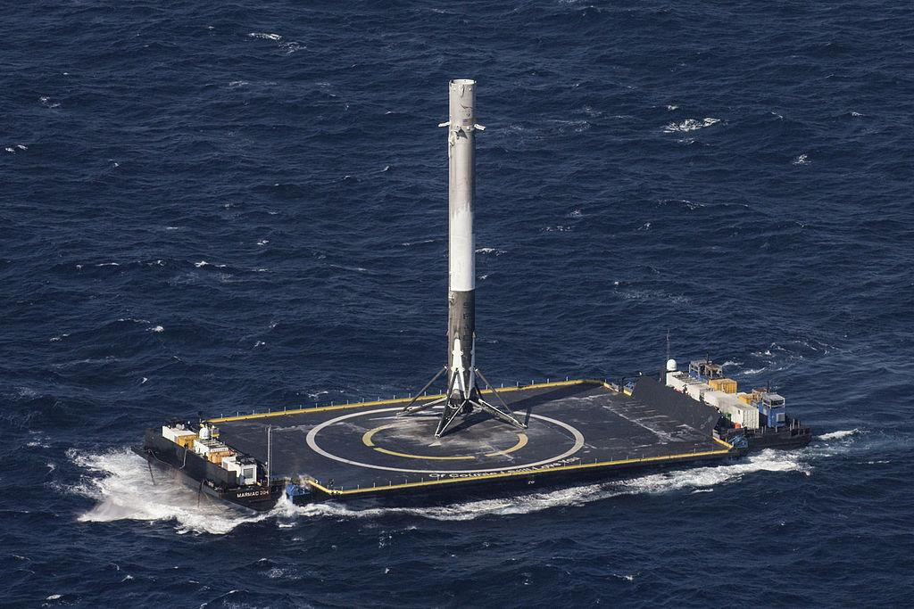
By SpaceX Photos (CRS-8) [CC0 or CC0], via Wikimedia Commons

