Slide 1
OneStop: Project Overview
Improving NOAA’s Data Discovery and Access Framework
Kenneth S. Casey OneStop Project Manager
NOAA’s National Centers for Environmental Information
January 7, 2016
NOAA Satellite and Information Service | National Centers for Environmental Information

Slide 2
OneStop Feedback Form
http://goo.gl/forms/6c54aH7S1e
Three thumbs up/thumbs down questions, add a user story, become a beta tester, and a free text comment field (email address optional)
Open it now!! I’ll wait for you….
http://goo.gl/forms/6c54aH7S1e

Slide 3
Recalling Yesterday’s Plenary
“What’s the use of having developed a science well enough to make predictions if, in the end, all we’re willing to do is stand around and wait for them to come true?” – Dr. F. Sherwood Rowland
“Is it enough for a scientist simply to publish a paper? Isn’t it a responsibility of scientists, if you believe that you have found something that can affect the environment, isn’t it your responsibility to actually do something about it,
enough so that action actually takes place?
- See more at: https://www.climatecommunication.org/news/in-memory-of-f-sherwood-rowland-1996-interview/#sthash.2bO3mDQk.dpuf
http://goo.gl/forms/6c54aH7S1e

Slide 4
Background and Motivation
Administration directs agencies to provide open access to their data and information -- sets policy/practices environment
US Open Data Policy, Executive Order and OMB Memorandum M-13-13 (2013)
OSTP Memo, Increasing Access to the Results of Federally Funded Scientific Research, OSTP Memo (2013)
USGEO Common Framework for Earth Observing Data (CFEOD)
DOC/NOAA respond with new initiatives to expand data access
NOAA funding (~$0.9M in FY15) for Big Earth Data Initiative (BEDI)
Big Data Project -- Cooperative R&D Agreements (CRADA)
NOAA Public Access to Research Results (PARR) Plan, 2/13/15
NOAA Procedural Directives (Access, Documentation, Data Management Planning, Data Citation, Archive, Data Sharing)
http://goo.gl/forms/6c54aH7S1e

Slide 5
OneStop Purpose
NESDIS* contributing a pathfinder effort through
NCEI to improve discovery, access, and
usability of its data: OneStop
OneStop supports NOAA's efforts by leveraging existing catalog and access technologies to develop an improved data access framework that will provide improved discovery, access, and visualization services for the highest quality data that NOAA has to offer
* With contributions from multiple NESDIS Programs
http://goo.gl/forms/6c54aH7S1e

Slide 6
OneStop Scope
OneStop is a NESDIS pathfinder effort with an initial focus on JPSS, GOES-R, and other high-priority NCEI-stewarded data but eventually scalable across NOAA’s data
OneStop will also leverage, when possible, datasets improved by the Big Earth Data Initiative (BEDI) and both leverage and support data cloud-enabled by the NOAA Big Data Project (BDP), but is not reliant on those separate efforts for success
OneStop supports implementation of Open Data, NOAA PARR, and EDMC Procedural Directive requirements by improving data documentation, access, and machine-readability
http://goo.gl/forms/6c54aH7S1e

Slide 7
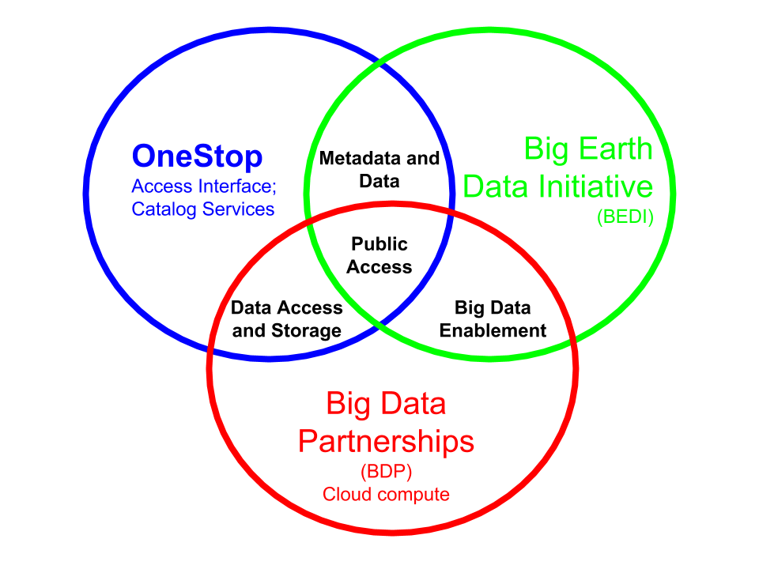
OneStop Relation to Other Data Initiatives
OneStop will leverage datasets improved under BEDI
OneStop will leverage and support BDP by simplifying access to data currently on tape and enabling discovery of cloud-hosted data
Goal: To enable public access to NOAA data
http://goo.gl/forms/6c54aH7S1e

Slide 8
OneStop Value Proposition
For NOAA programs who need to ensure their data are publicly accessible and machine readable to meet US Open Data mandates, OneStop is a data discovery and access framework that will meet those requirements and satisfy evolving user expectations. Those expectations include modern web services and an exemplar user interface that is simple, smart, and provides next-level discovery and access to support a wide range of new research and commercial innovation.
http://goo.gl/forms/6c54aH7S1e
Notes:
What value we are adding.

Slide 9
OneStop Approach
Modernize high-priority* data
Update data and metadata to meet standards and best practices
Copy data from tape to disk or cloud to support access
Improve data infrastructure in a secure, user-centered way
Improve rankings so most relevant data listed first (think Google)
Improve “facets” to allow filtering of results (think Amazon)
Support data visualization to enhance search experience (think Netflix)
Improve performance and stability of interface to meet user expectations
Enable user registration to support ratings, save searches, etc.
Release software incrementally for internal stakeholder review and external testing
* Initial prioritization has been by/in by the NOAA Big Data Partnerships, National Climate Assessment/Global Change Information System, Climate Data Initiative, 2012 Earth Observations Assessment, and the NOAA-owned Observing Systems of Record/NOAA Observing System Integrated Assessment
http://goo.gl/forms/6c54aH7S1e
Notes:
How we will do it. Five slides are visuals to help see what OneStop will look like.

Slide 10
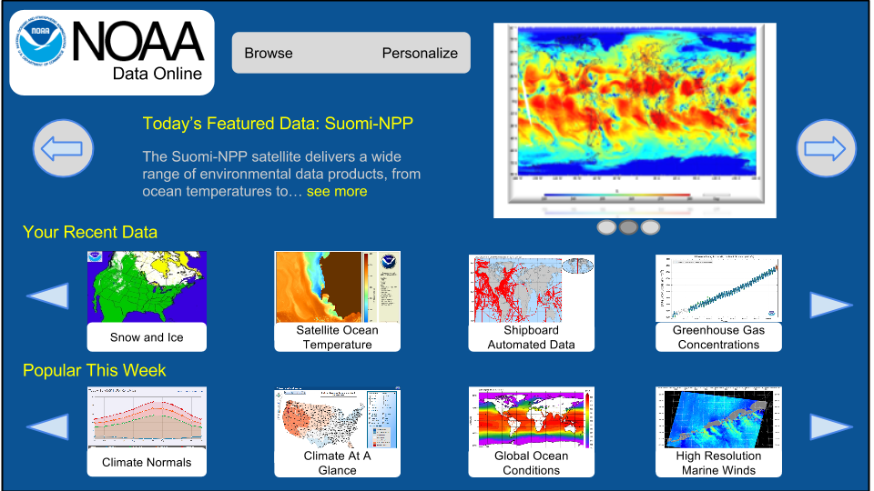
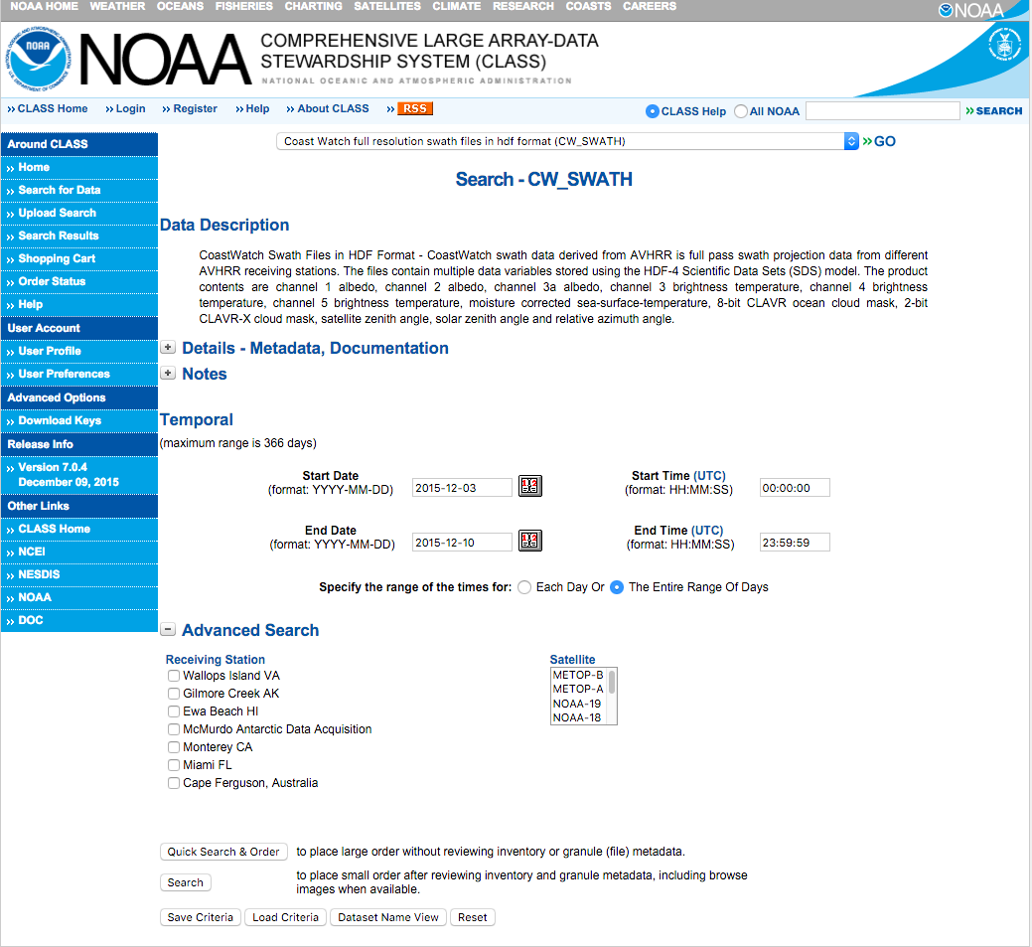
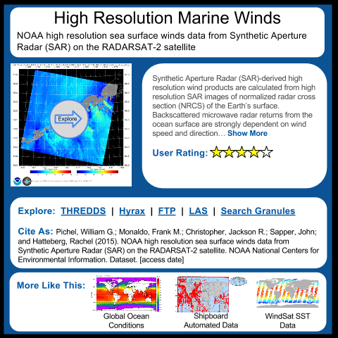
OneStop Value Proposition - Case Study
Current User Workflow for Many NOAA Big Data Datasets |  | Workflow with OneStop
Response Time: Minutes to Days Download Only, via FTP |  | Response Time: Immediate Range of Download, Subset, and Visualization services (e.g., WMS, OPeNDAP, THREDDS) plus cloud access when available
Supports traditional order, bulk download, and application of known data on user’s system |  | Supports server-wide subset, visualization, and mobile apps; effective discovery of previously unknown data; innovative commercial applications; and cloud-based access (when available)
http://goo.gl/forms/6c54aH7S1e
Notes:
User Story: Shipping company wants to find optimal times for delivering fragile cargo to Alaska. Looking for patterns in low wind speed events, when seas are calm. Today, with existing tape-based access, user makes a manual selection of a dataset they already know about, then select many granlues over a long period of time since they don’t know when the low wind events take place. Then, they wait for the granules to be retrieved from the tape robotics.. minutes to days. Then they download them in bulk via FTP (if they can store that much data locally) and process them on their local hardware (if they have the right software and enough CPU cycles).
Under OneStop, the process is transformed… highly visual interface enables discovery of available wind speed datasets. Detailed landing pages can be viewed, and the right product identified. Available services are summarized and options available to the user to dig deeper. OneStop enables the modern way of interacting with Big Data… server side visualization and subset, cloud integration, support of mobile applications, etc. THe next slides illustrate the benefits in more detail by walking through the rest of the user story...

Slide 11
OneStop Value Proposition - Case Study
Workflow with OneStop
Notional Mockup for illustrative purposes | Netflix analogy... User-centric Highly visual Proactive ...
http://goo.gl/forms/6c54aH7S1e
Notes:
Note first the highly visual, user-centric, and proactive nature of the “smart” interface. Recent searches, account management, and “trending” items can be highlighted.

Slide 12
OneStop Value Proposition - Case Study
Workflow with OneStop
Notional Mockup for illustrative purposes | Netflix analogy... User-centric Highly visual Proactive Summary descriptions Ratings Related items “OneStop ready…” Standardized data/metadata Robust underlying infrastructure and services
http://goo.gl/forms/6c54aH7S1e
Notes:
Supporting the initial collection level discovery are features like summaries, user ratings, and related similar datasets (all supported by OneStops robust underlying standardized data, metadata, and infrastructure), all helping the user find a product they want to dig deeper into...

Slide 13
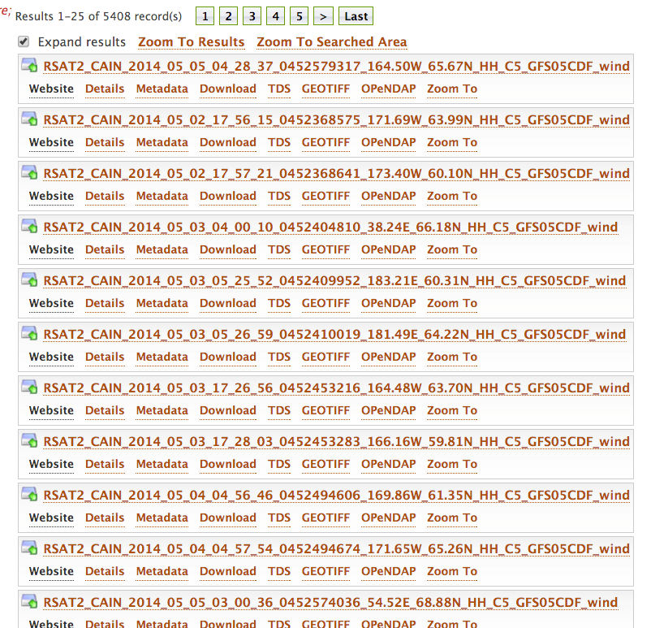
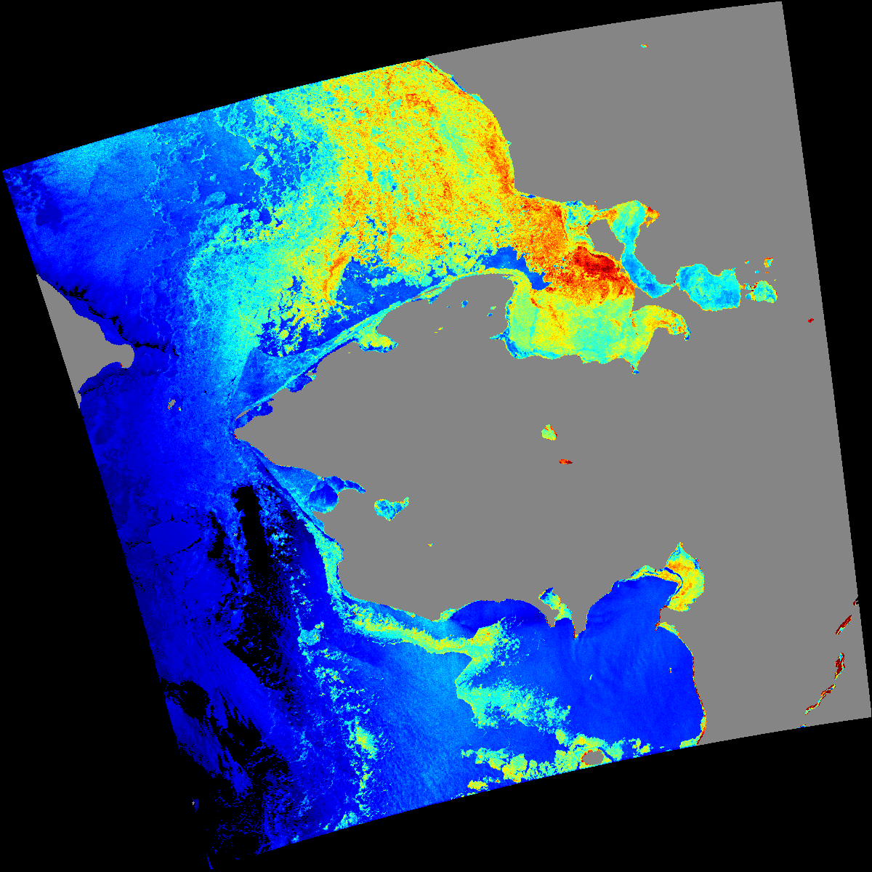
OneStop Value Proposition - Case Study
Workflow with OneStop
Notional Mockup for illustrative purposes | See available data granules Direct link to access mechanisms Examine browse imagery
http://goo.gl/forms/6c54aH7S1e
Notes:
Query for granules and examine browser imagery… see detailed and direct links to immediately available services...

Slide 14
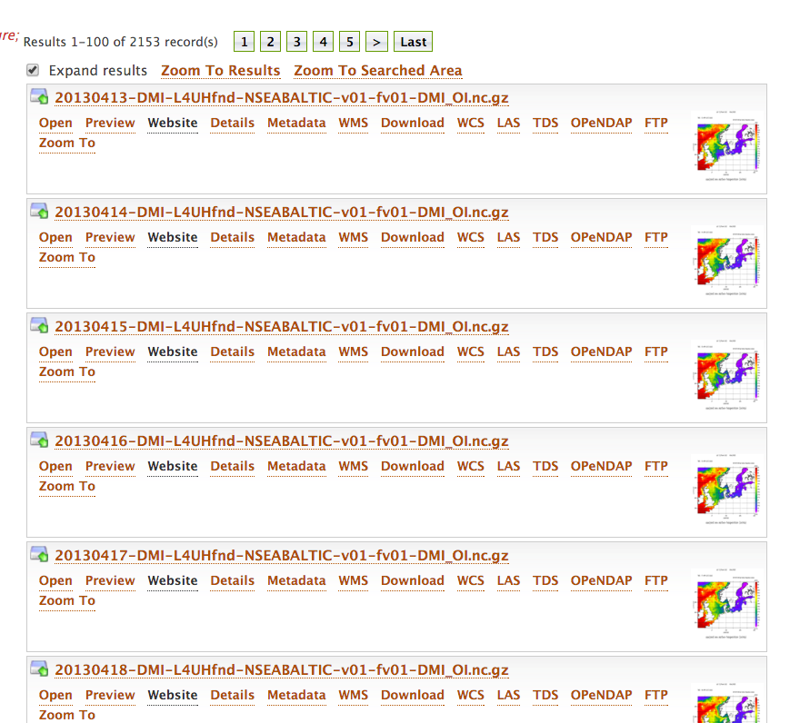
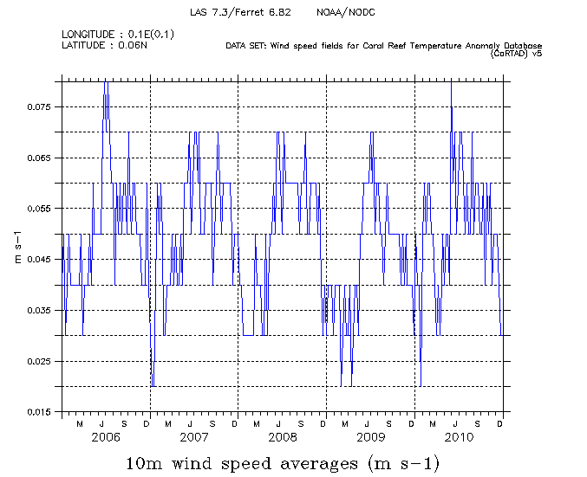
OneStop Value Proposition - Case Study
Workflow with OneStop
Notional Mockup for illustrative purposes | Generate simple time series Find low wind speed events And only download those data, or better yet, connect directly to the web services!
http://goo.gl/forms/6c54aH7S1e
Notes:
Generate a simple time series for applicable datasets, and get closer to the useful data needed to find those optimal shipping times and routes.

Slide 15
OneStop Project Organization
NCEI and NESDIS Management
Cross-NOAA Engagement
Kenneth Casey, Project Manager
User Engagement
OneStop Integrated Project Team (IPT)
NCEI, ACIO-S, OSGS
OneStop Project Teams
Architecture Team
IT Team
Metadata Team
Relevance Ranking Team
Data Improvement Team
Data Services Team
http://goo.gl/forms/6c54aH7S1e

Slide 16
OneStop Progress to Date
Feasibility Assessment: May
Project Scoping, Charter, and Approval: June-July
FY15 Procurement: August-September
Formation of Teams: September-October
November-December:
FY16 Procurements
OneStop Design and Architecture Document
GEARS Enterprise Architecture Team concurrence
OneStop Storage Concept of Operations
IRMAC Procurement Request and Approval
Data Format Best Practice: NCEI netCDF Templates v2
Metadata Best Practice: Draft
Throughout, ongoing community engagement (NOSC, CIOC, DAARWG, EDMC, AGU, EDM Workshop, ESIP, etc.)
http://goo.gl/forms/6c54aH7S1e

Slide 17
OneStop Data Framework^{30,000 ft}
User Interface
Other User Interfaces
Catalog Services
Other Metadata Systems
Metadata
Other Data Access Systems
Data access, subset, visualization, and granule services
Data - Local Disk and/or Cloud Deployment
http://goo.gl/forms/6c54aH7S1e

Slide 18
OneStop Architectural Components
Build on foundation of existing, mature data standards and web services
Emphasize not just interface, but the supporting data infrastructure
User-centered, design focused
Design Principles
Use existing enterprise capabilities when possible
Rely on loose coupling of reusable system components
Use standards at interfaces
Use Open Source
http://goo.gl/forms/6c54aH7S1e

Slide 19
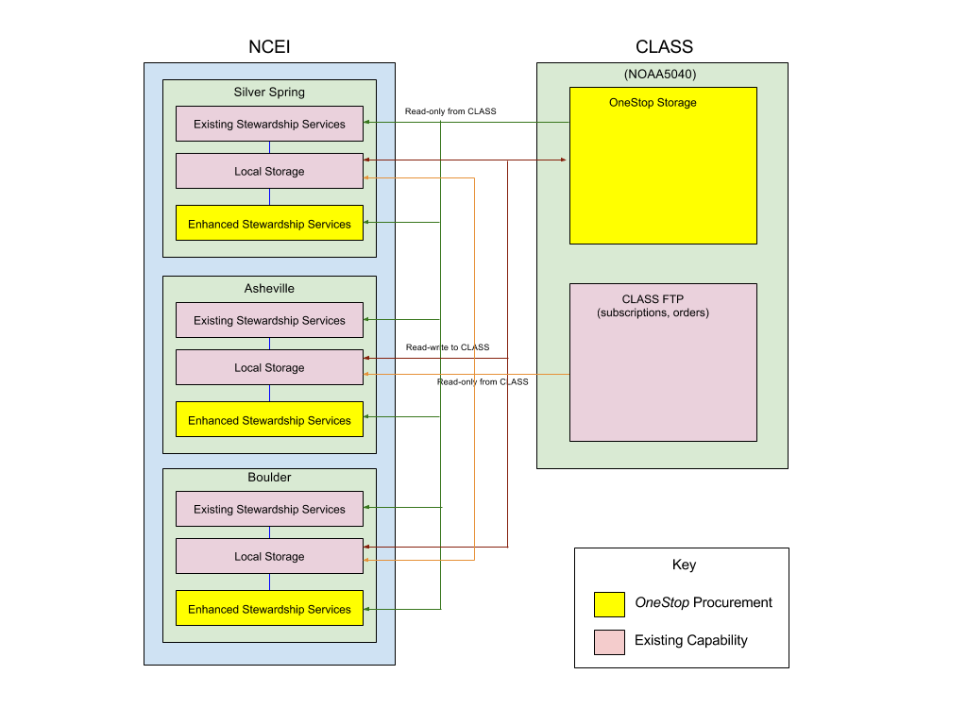
Advancing Enterprise Capabilities
http://goo.gl/forms/6c54aH7S1e

Slide 20
Schedule
Event | Date
Project Initiation | Q4 FY15
Architecture Design Review | Q1 FY16
Operational Readiness testing | Q3 FY16
Software Release -- Beta Version | Q4 FY16
Internal Evaluation Report | Q1 FY17
Software Release -- Version 1.0 | Q1 FY17
Independent Evaluation Report | Q1 FY17
Software Release -- Version 1.1 | Q2 FY17
Pathfinder Completion - Shift to Sustainment | Q2 FY17
http://goo.gl/forms/6c54aH7S1e

Slide 21
Remaining Session Agenda (Loosely)
2:30: Review of the OneStop Architecture, Dave Fischman, NOAA/NESDIS
2:45: OneStop: Progress Toward Implementation of Enterprise Storage Services, John Relph, NOAA/NESDIS
3:00: Status and Progress of OneStop’s Implementation of the NOAA Procedural Directive for Data Documentation and Citation, Nancy Ritchey, NOAA/NESDIS
3:15: Open Discussion
http://goo.gl/forms/6c54aH7S1e

Slide 22
We are hiring!
Agile Team in Boulder: (up to five positions) https://cires.colorado.edu/contact/jobs/job-openings/ciresncei-pra-software-engineer-ncei-9/
Metadata Content Specialists (1 in each of three locations)
Silver Spring - http://chk.tbe.taleo.net/chk04/ats/careers/requisition.jsp?org=ERT&cws=1&rid=1394
Asheville - http://chk.tbe.taleo.net/chk04/ats/careers/requisition.jsp?org=ERT&cws=1&rid=1392
Boulder - http://chk.tbe.taleo.net/chk04/ats/careers/requisition.jsp?org=ERT&cws=1&rid=1393
Data Modernization, Granule Metadata, Metadata Rubrics - Junior Developers
(1 in Silver Spring, 1 in Asheville, 2 in Boulder)
Silver Spring - http://chk.tbe.taleo.net/chk04/ats/careers/requisition.jsp?org=ERT&cws=1&rid=1395
Asheville - http://chk.tbe.taleo.net/chk04/ats/careers/requisition.jsp?org=ERT&cws=1&rid=1397
Boulder - http://chk.tbe.taleo.net/chk04/ats/careers/requisition.jsp?org=ERT&cws=1&rid=1396
Metadata Tool Developers - Senior Developers
(1 in each of Silver Spring and Asheville locations)
Silver Spring - http://chk.tbe.taleo.net/chk04/ats/careers/requisition.jsp?org=ERT&cws=1&rid=1398
Asheville - http://chk.tbe.taleo.net/chk04/ats/careers/requisition.jsp?org=ERT&cws=1&rid=1399
http://goo.gl/forms/6c54aH7S1e

Slide 23
OneStop Feedback Form
http://goo.gl/forms/6c54aH7S1e
Three thumbs up/thumbs down questions, add a user story, become a beta tester, and a free text comment field (email address optional)
Questions?
http://goo.gl/forms/6c54aH7S1e

Slide 24
www.ncei.noaa.gov
NCEI Climate Facebook: http://www.facebook.com/NOAANCEIclimate NCEI Ocean & Geophysics Facebook: http://www.facebook.com/NOAANCEIoceangeo NCEI Climate Twitter (@NOAANCEIclimate): http://www.twitter.com/NOAANCEIclimate
NCEI Ocean & Geophysics Twitter (@NOAANCEIocngeo): http://www.twitter.com/NOAANCEIocngeo

