Slide 1
ESIP Resource and Services
ESIP Products and Services Committee
2013 ESIP Winter Meeting

Slide 2
Agenda
Introduction
Cloud Management – JPL’s Douglas Hughes
Update on Testbed Portal
Life Cycle of Testbed Projects

Slide 3
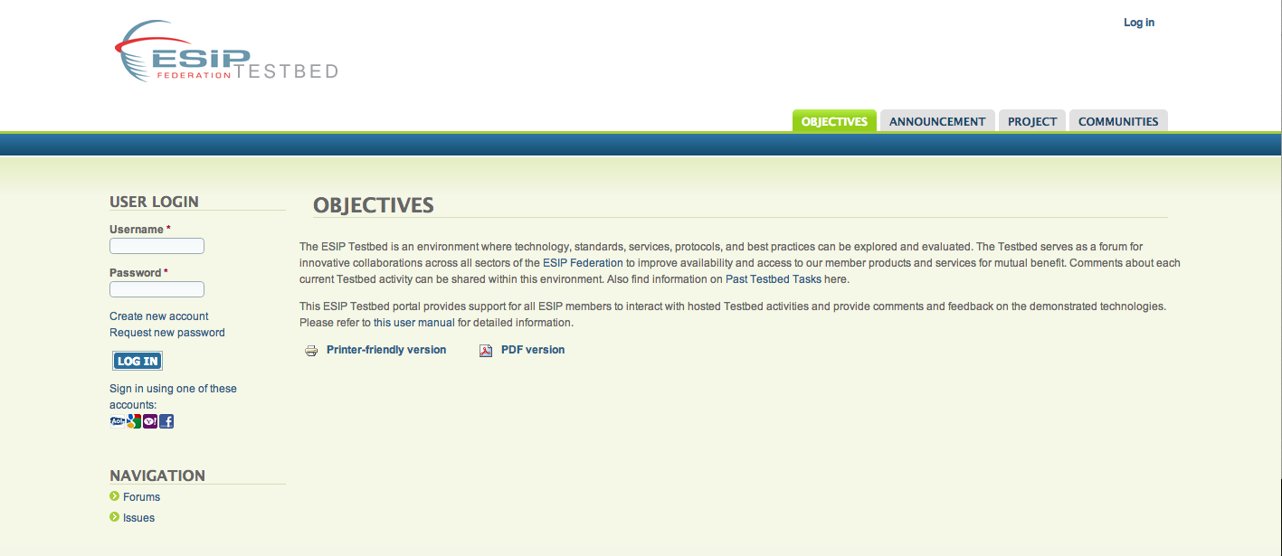
Introduction
Originated from the Products and Services Committee
To encourage the development, use and improvement of best science practices to ensure the quality, usability, and breadth of data and resultant information, products, and services
To provide a Federation-wide forum for defining, developing and evaluating requirements for Federation Earth science products
To provide a Federation-wide forum for defining, developing and evaluating requirements for product services and user services
Testbed Purpose
Provide an environment to prototype…
Standards (ISO)
Services (e.g. expert skills database)
Protocols (e.g. casting)
Technologies (e.g. drupal)
Explore best practices (E.g. data identifiers)
Provide a forum for innovative collaboration across ESIP
Improve visibility and access to products and services
http://testbed.esipfed.org

Slide 4
Cloud Resource Management
Douglas Hughes – JPL office of the CIO
With Tom Soderstrom and Jonathan Chiang
Remote from JPL

Slide 5
Integrated Testbed Portal Phil Yang and Chen Xu
http://testbed.esipfed.org/

Slide 6
Deploy a Testbed Portal – Goals
Make ESIP Testbed activities more visible to the public
Support ESIP members to interact with hosted Testbed activities
Support interactivities between ESIP members and Testbed task developers

Slide 7
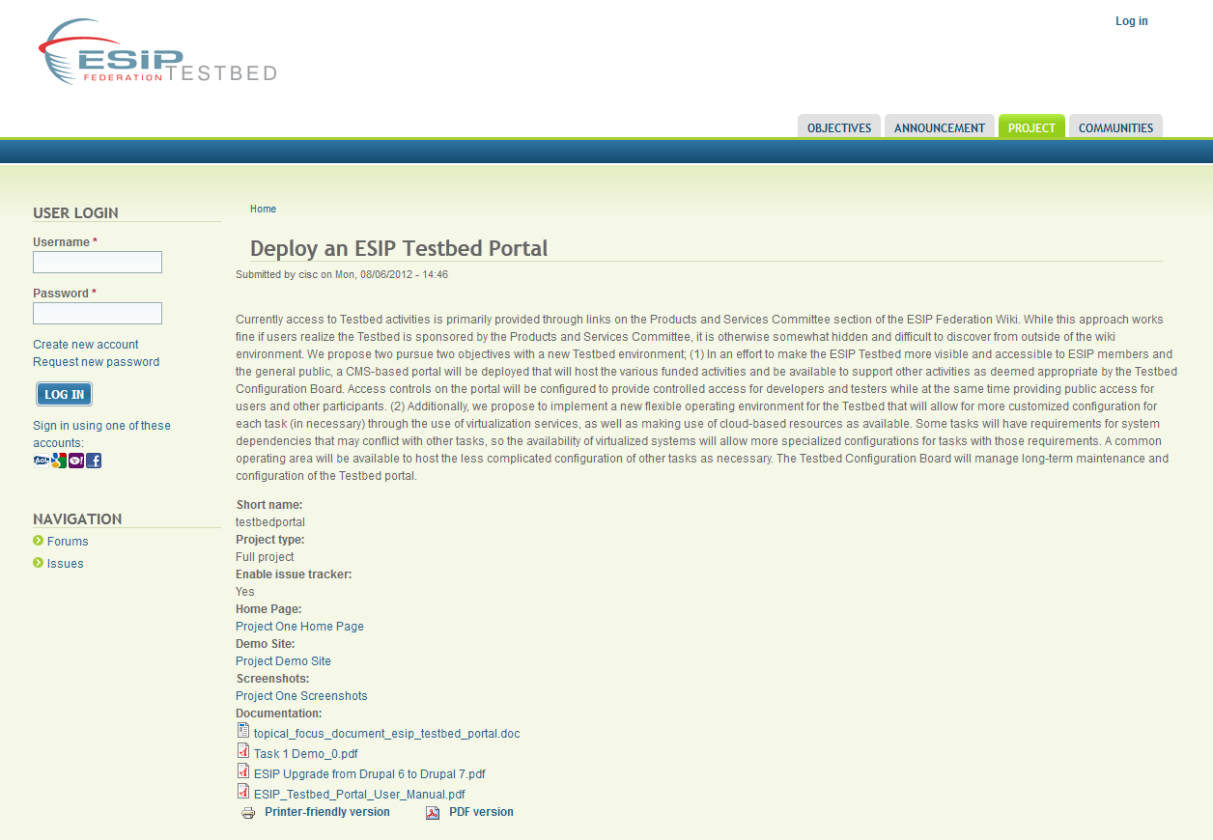
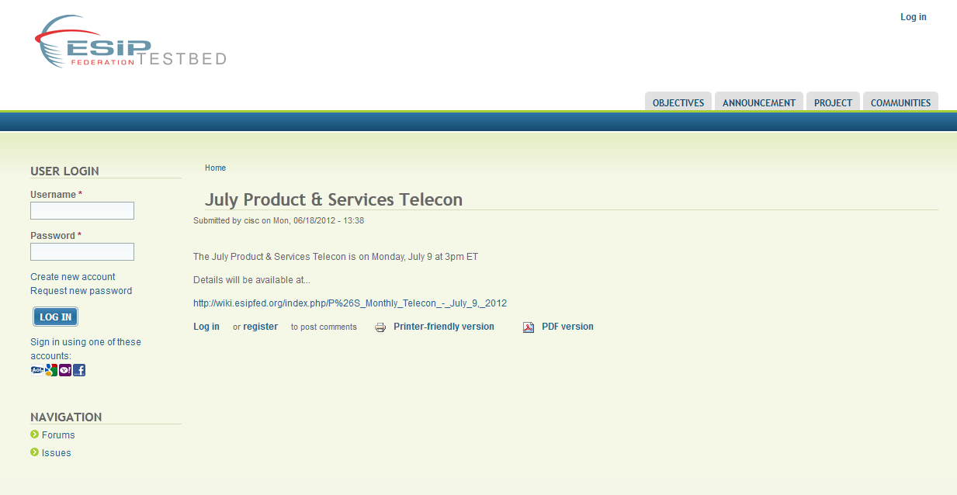
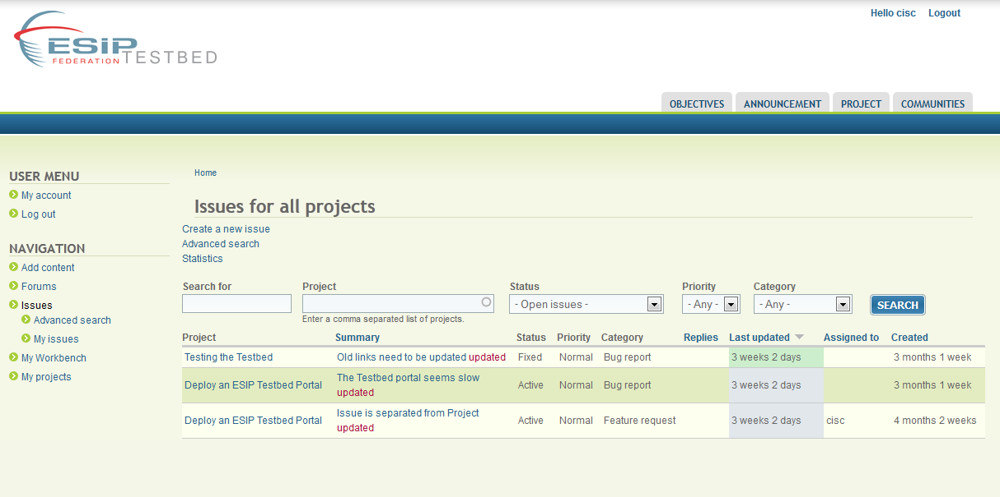
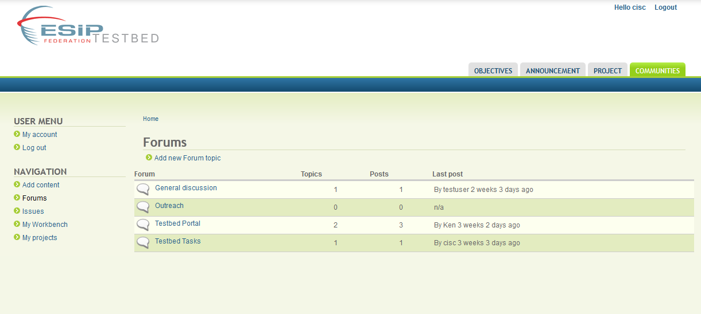
Portal Functions
Testbed Announcement
Project Information Management
Project Issues Management
Testbed User Forums

Slide 8
Lifecycle of Testbed Projects
How to submit new proposals
Information in Testbed Portal and Commons
Using git repository to support Testbed projects - David Bassendine
Testbed relationship to other clusters/committees
http://testbed.esipfed.org/

Slide 9
Proposal Submission
Call for Proposals
2011 RFP
Resulted in 5 funded projects
Topics of Interest
Outreach to committees, clusters, working groups
Review process
Testbed Configuration Board for content and feasibility
Finance Committee for funding – if requested
http://testbed.esipfed.org/

Slide 10
Testbed Portal and Commons
Documentation
Testing Results
User Feedback
http://testbed.esipfed.org/

Slide 11
Git
David Bassendine
http://testbed.esipfed.org/

Slide 12
Testbed: an ESIP-wide Service 2011-12 Projects
ESIP Ontologies in the Cloud (Line Pouchard – Semantic Web Cluster)
Linked Data for Collaboration Discovery (Eric Rozell and Tom Narock – Semantic Web Cluster)
Testbed Portal Development (Chen Xu and Jing Li – Products & Services Committee)
Discovery Services and Clients (Christine White – Discovery Cluster)
Best Practices for Using Cloud Resources (Phil Yang – Cloud Computing Cluster)
Data Stewardship (Nancy Hoebelheinrich and Greg Janee - Preservation and Stewardship Cluster)
Re-usable Metadata Authoring Tool (Jerry Pan – Information Technology and Interoperability Committee)

Slide 13
Innovation and Successes
Engaging numerous ESIP groups
Using variety of resources
Demonstrating new capabilities and ideas
Providing ESIP Community Resources
Utilizing a Testbed Configuration Board to oversee directions

Slide 14
New Testbed Portal
Provide a more prominent home and environment for the Testbed
Engage ESIP members in the testing and review of projects
Capture information about projects
Preserve project software and resources for future ESIP use

Slide 15
Testbed Portal
http://testbed.esipfed.org/

Slide 16
Project Access
http://swp.gmu.edu/esiptestbed/

