Slide 1
Relevancy 101
ESIP Summer Meeting 2016
July 19-22 2016
Chris Lynnes (NASA ESDIS)
Doug Newman (NASA Earthdata – Raytheon)
The material is based upon work supported by the National Aeronautics and Space Administration under Contract Number NNG15HZ39C

Slide 2
WHAT IS RELEVANCY?

Slide 3
A la Wikipedia
“how well a retrieved document or set of documents meets the information need of the user”

Slide 4
Say I’m looking for ozone data from the Ozone Monitoring Instrument...

Slide 5
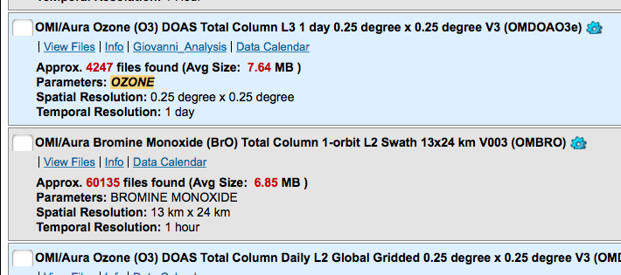
Say I’m looking for ozone data from the Ozone Monitoring Instrument...
Wait, what?

Slide 6
WHY IT IS IMPORTANT?

Slide 7
Back to our ozone search...

Slide 8
Back to our ozone search...
Good thing I’m not busy for the next two weeks :-/

Slide 9
HOW?

Slide 10
The Content Heuristic
Well, it would be nice if the dataset actually had the content I am looking for...

Slide 11
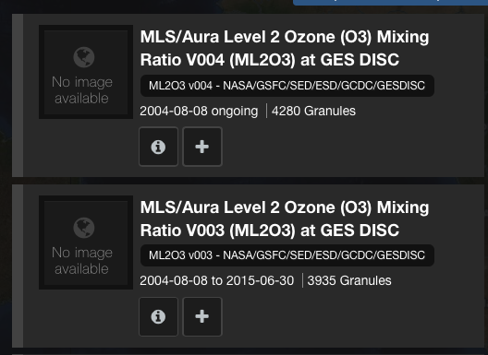
New and Improved Heuristic - Processing Version
Newer version is better than older version

Slide 12
New and Improved Heuristic - Processing Version
New version is more likely to be up to date

Slide 13
New and Improved Heuristic - Instrument
Newer instrument is supposed to be “better” than previous instruments

Slide 14
Usability Heuristic
Level 3 Gridded datasets are easier for most users to use than Level 2 Swaths

Slide 15
Community Usage Heuristic
The dataset most often used by the community is more likely to be useful

Slide 16
Time Range Heuristic
Datasets covering the user’s full time range are better than those covering just part of it

Slide 17
Spatial Heuristic
Datasets covering the user’s full area are better than those covering just part of it

Slide 18
User-centric Heuristics
User type or intent | The most relevant datasets are...
Applications users | High spatial resolution, near-real-time
Students | Easier to use data (L3 grids in netCDF)
Climate Modeler | Datasets on Climate Model Grid (CMG)

Slide 19
This material is based upon work supported by the National Aeronautics and Space Administration under Contract Number NNG15HZ39C.

