Slide 1

US National Geothermal Data System
NGDS Design and Development Team
Stephen Richard (presenting)
2013 ESIP Summer Meeting
Chapel Hill, North Carolina, July 12,, 2013

Slide 2
Outline
How is it put together
  Approach to Data Management
  The Domain Steering Committee
  Recommended data types
How does it work
  Content Models
  Interchange formats
  Catalog

Slide 3
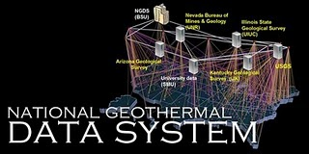
Overview
NGDS is a data system, not a database
  Discover and access geothermal data from many different sources
System is unified by:
  Catalog and standardized metadata
  Data access protocols and
  interchange formats (it’s the
  Web for data)

Slide 4
A distributed data system
Users
Data space
Web services: the connections
Catalogs: listings of available resources
Data: the World Wide Web as the data store

Slide 5
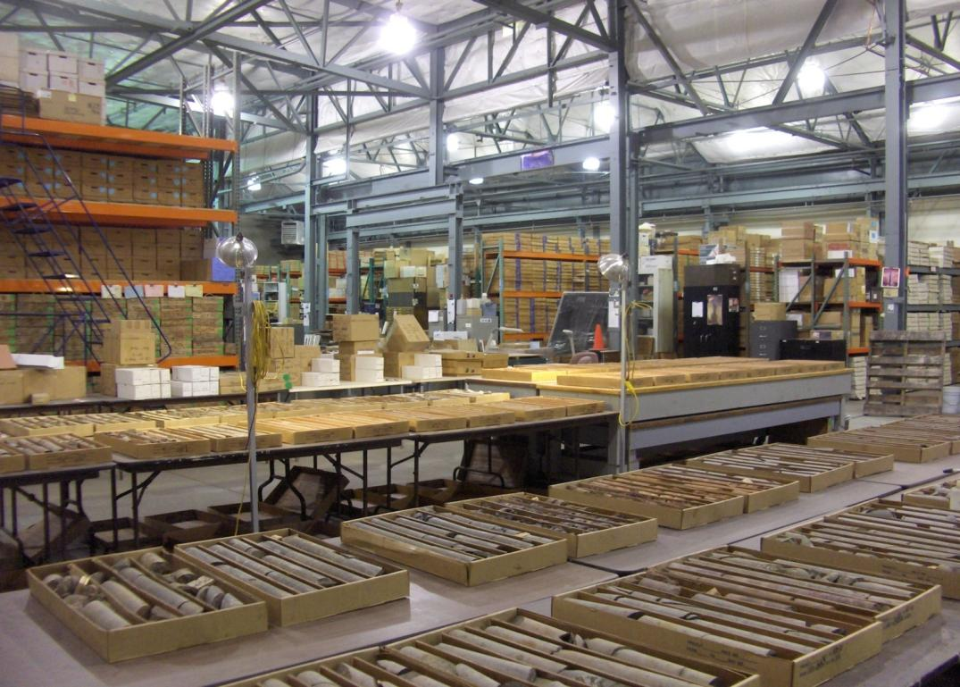
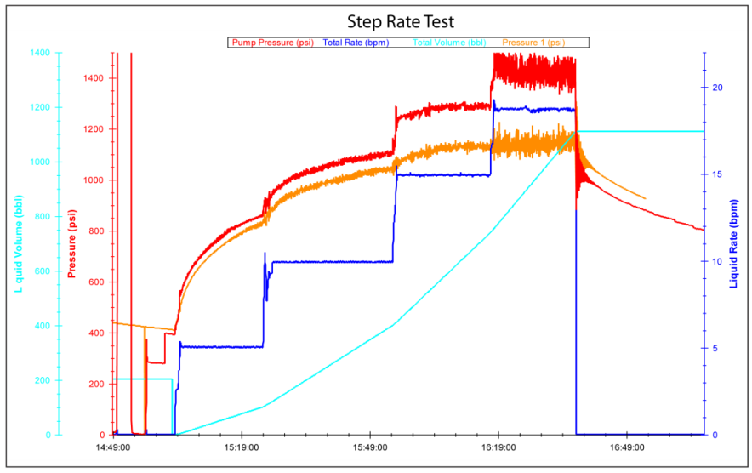
Data Types
EGI Geothermal Sample Library
Three sorts of information:
  Data – information about the Earth and geothermal energy systems
  Metadata – Information about resources (for discovery, evaluation, access)
  Annotation – notes added to by the community (ratings, comments, reviews, usage…)

Slide 6
Outline
How is it put together
  Approach to Data Management
  The Domain Steering Committee
  Recommended data types
How Does it work: information exchanges
  Content Models
  Interchange formats
  Catalog

Slide 7
Domain Steering Committee
Formed to determine data priorities
Represent user community
Toni Boyd: Geo-Heat Center Oregon Institute Technology: direct use data - national
Roland Horne: Stanford University-Stanford Reservoir Engineering Conference papers and research results
Joseph Moore: Energy & Geoscience Institute-legacy resource and research data (Chair)
Lisa Shevenell: University Nevada, Reno – legacy to recent resource and research data

Slide 8
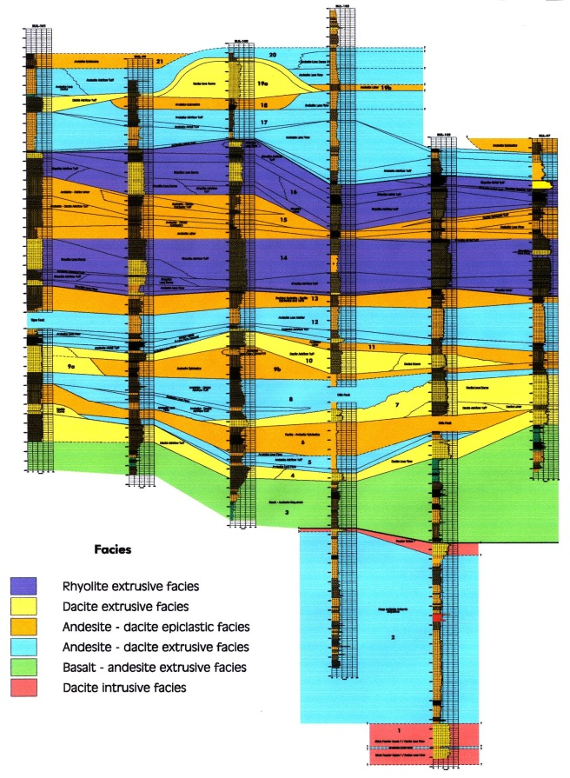
Domain Steering Committee
Solicit input from experts
  Content models
  User stories – functionality and data output
  Sustainability – future user input
Prioritize data types needed by the geothermal community
Review content models and user stories with DOE invited experts
Provide recommendations to Project Management

Slide 9
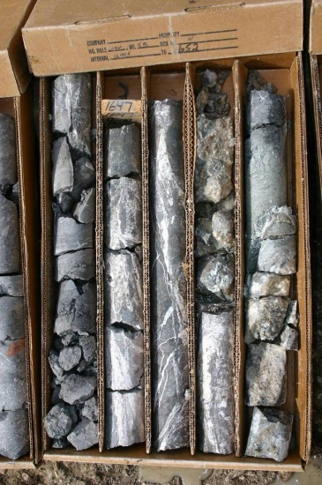
Data type recommendations
  Well Logging
  Geochemistry
  Geophysics
  Land Status and Ownership
  Power Plant History
  Well field Development Costs
  Geothermal system resource
  models

Slide 10
Outline
How is it put together
  Approach to Data Management
  The Domain Steering Committee
  Recommended data types
How does it work
  Content Models
  Interchange formats
  Catalog

Slide 11
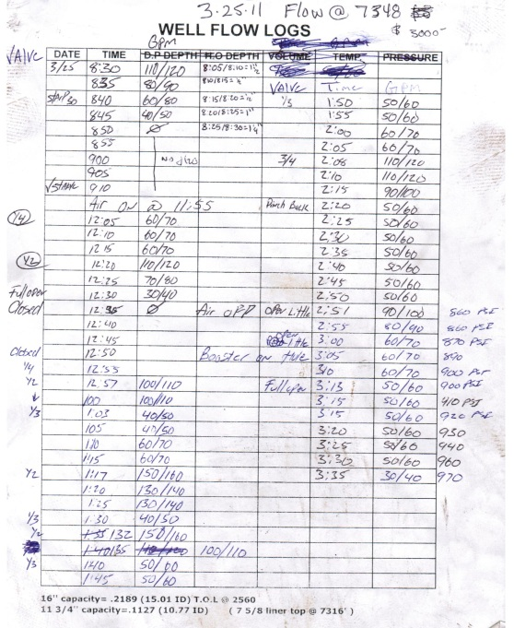
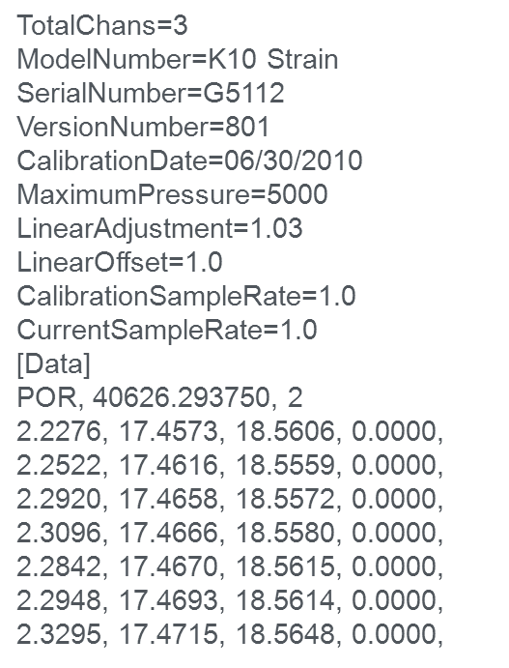
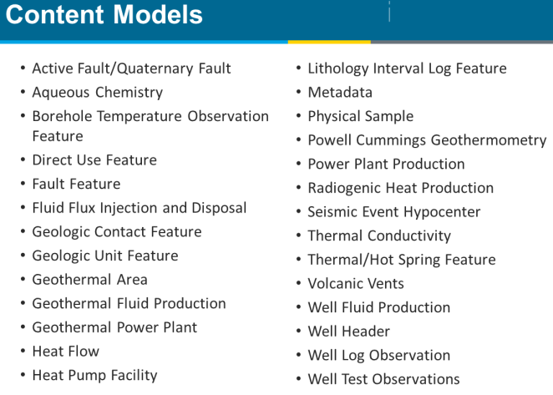
Data Interoperability Tiers
Tier 1: unstructured content in files
  Text, images, graphics files
  MS Word, Adobe Acrobat, Illustrator, TIFF….
Tier 2: Structured data, custom formats
  May be accessed in files or via services
  Excel, Microsoft Access, dbf, xml…
Tier 3: Information Exchange:
  Structured data in standard schema and encoding
  Deliver via web service, or in file.
Tier 1
Tier 2

Slide 12
Being part of the system
Any Tier: Resource is described by metadata in the system catalog
Tier 1– File accessible on the Web
Tier 2– Structured, user does data integration
  need to document data format
Tier 3 – Structured, provider does data integration
  mapped to community interchange scheme
  provider has to validate format

Slide 13
The Catalog
Data space
Services: structured data discovery and access
Catalog: registry of available resources
Data: the World Wide Web as a file system

Slide 14
Metadata Content Model
Title
Extent
  Geographic
  Vertical
  Temporal
Access instructions
Description
Keywords
Originator(s)
Date
Resource ID
Access constraints
Language
Quality
Lineage
Citation
Distribution contact
Metadata
  Date
  Contact
  Specification
  Identifier
Online document: http://lab.usgin.org/profiles/doc/metadata-content-recommendations

Slide 15
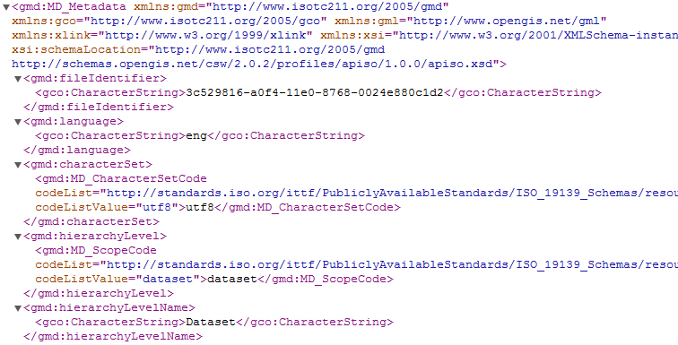
Metadata Interchange
Standard interchange format: USGIN Profile for ISO 19139 metadata (XML)
…

Slide 16
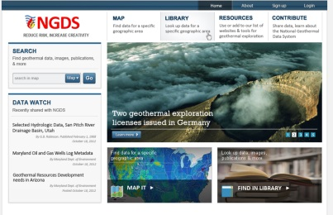




Metadata cloud
NGDS portal – access point for geothermal community
NGDS aggregator: collect metadata for all NGDS resources
NGDS portal
Metadata contributors
Other portals

Slide 17
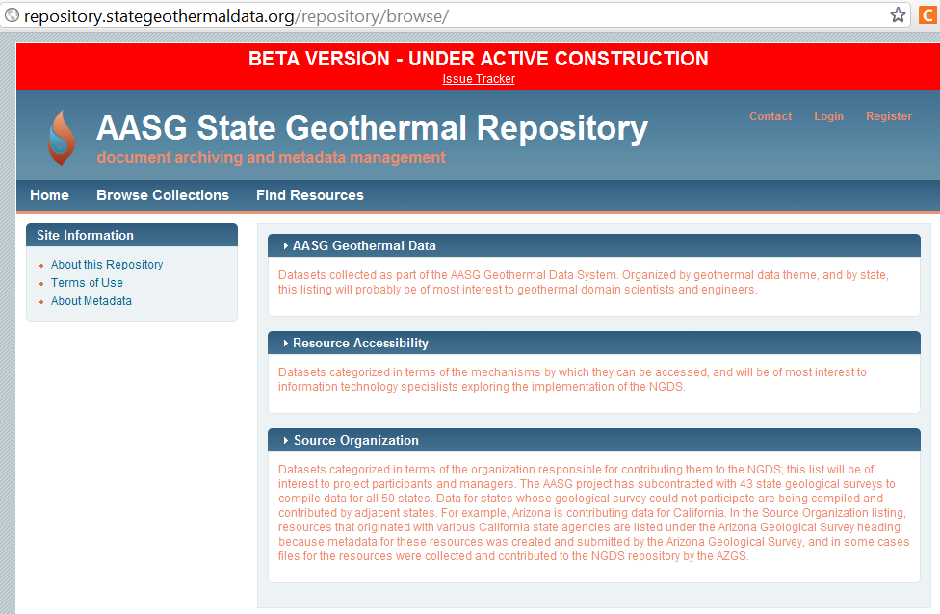
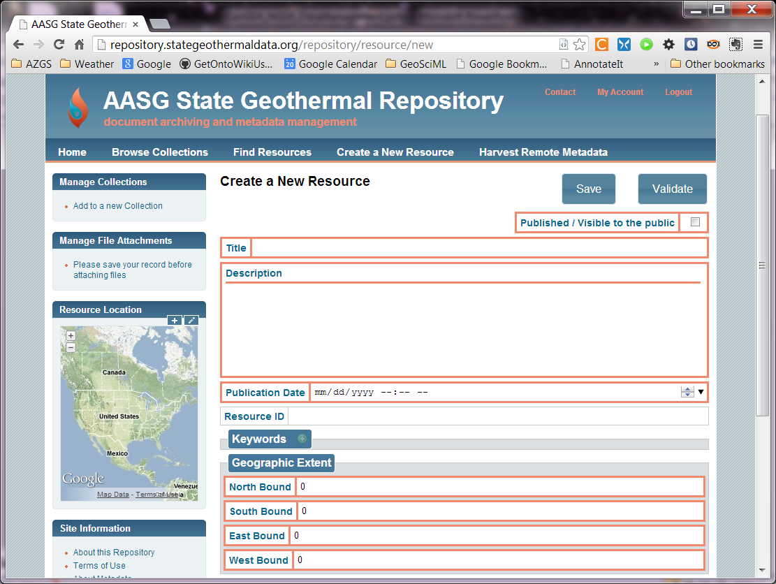
Metadata Repository Tool
Generate and manage metadata
Registry of resources
Upload capability
Django/NodeJS implementation

Slide 18
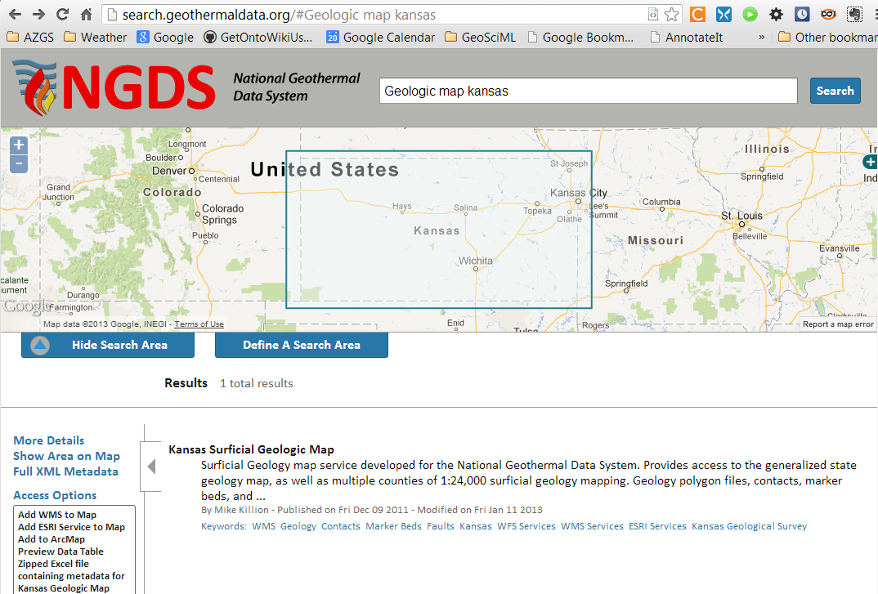

Search Client
Uses CSW interface

Slide 19
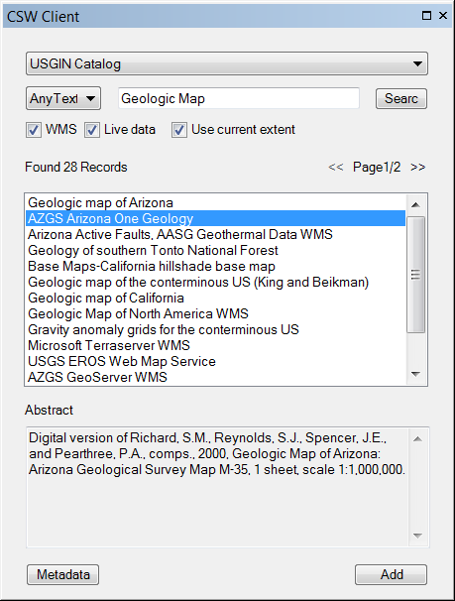
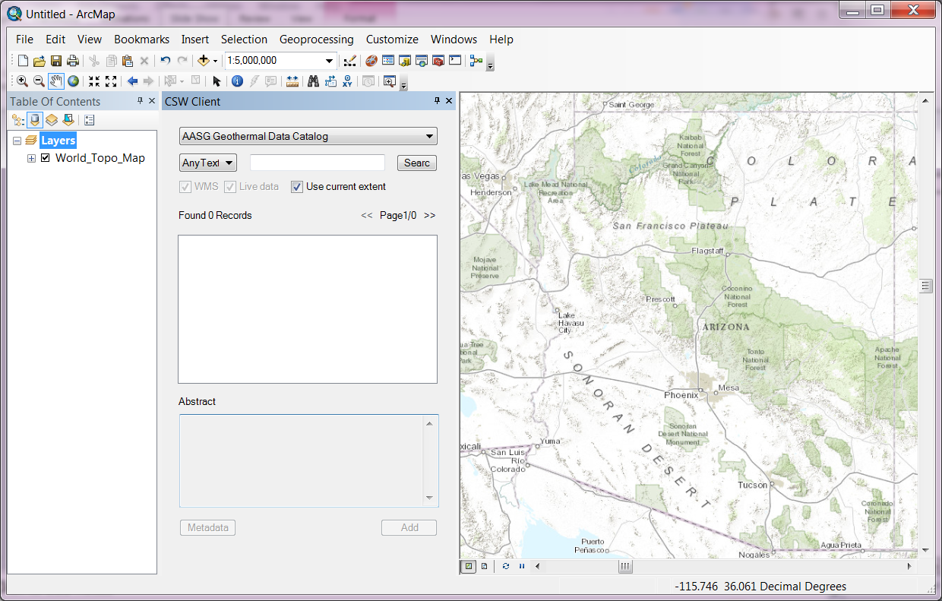
ArcGIS CSW Client

Slide 20
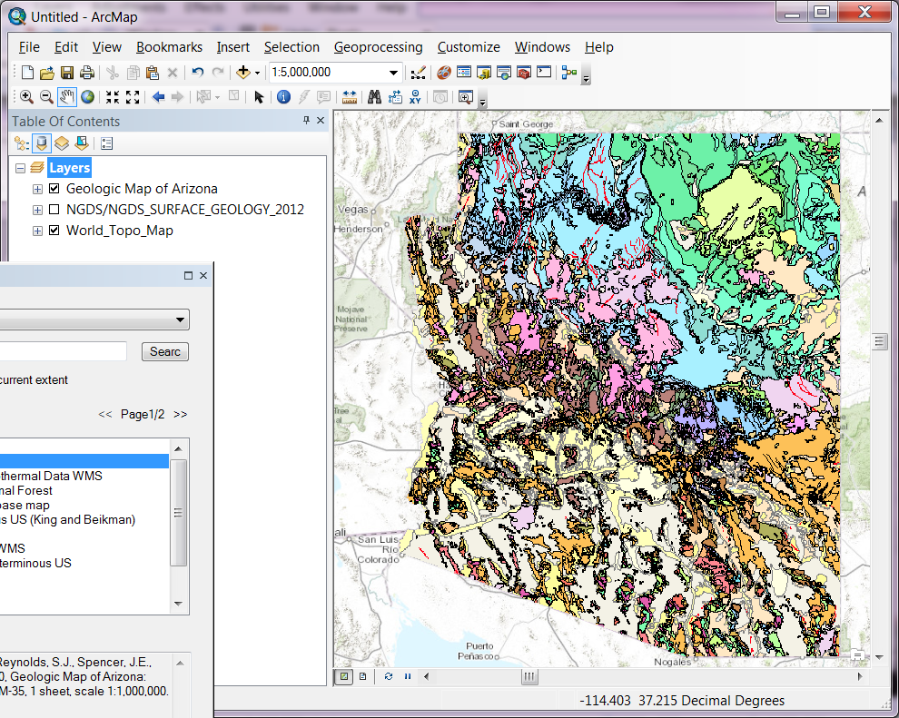
Display map in ArcMap

Slide 21
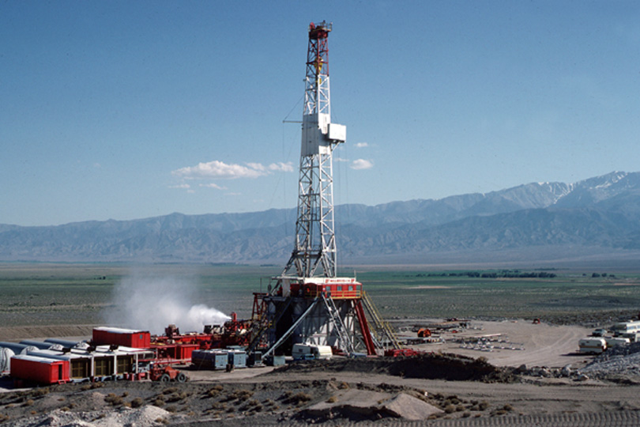
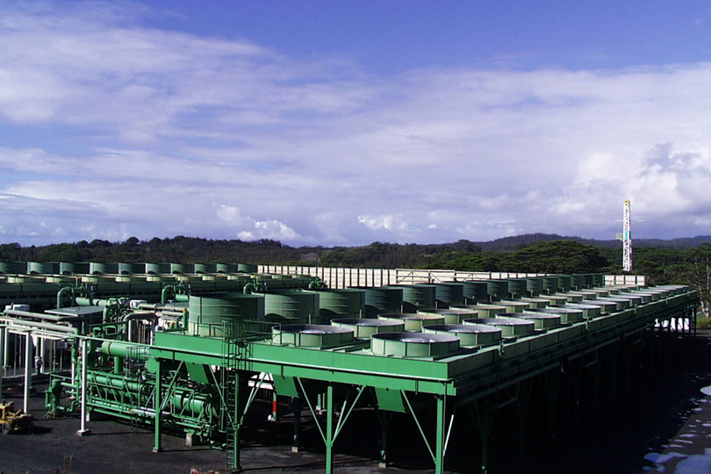
Tier 3: Information Exchanges
Conventions for how information will be sent between computers
  Designed for consumption by computer software
Content Model:
  Defines the information content
  Data schema
  May be implemented with various encoding formats
Encoding formats
  HTML, XML, JSON, NetCDF, TIFF, JPG…
<whm:facilityType>Well</whm:facilityType>
facilityType: “Air-cooled binary plant”

Slide 22
Content Models (Tier 3)
Active Fault/Quaternary Fault
Aqueous Chemistry
Borehole Temperature Observation Feature
Direct Use Feature
Fault Feature
Fluid Flux Injection and Disposal
Geologic Contact Feature
Geologic Unit Feature
Geothermal Area
Geothermal Fluid Production
Geothermal Power Plant
Heat Flow
Heat Pump Facility
Lithology Interval Log Feature
Metadata
Physical Sample
Powell Cummings Geothermometry
Power Plant Production
Radiogenic Heat Production
Seismic Event Hypocenter
Thermal Conductivity
Thermal/Hot Spring Feature
Volcanic Vents
Well Fluid Production
Well Header
Well Log Observation
Well Test Observations
Notes:
22

Slide 23
Delivery Platform
File download
  simple Web link that results in a file download
  no support for understanding content
  little or no automation is possible
Web application
  User-driven computer program, run in client browser
  form-based querying, browser-based visualization
  may offer file downloading (clip and ship, query results…)
Web Service
  computer program executes requests sent via the World Wide Web
  Interface for machine to machine interaction
  Execute filtering or processing of data on server side

Slide 24
Tiers and delivery platforms
 | Tier 1 | Tier 2 | Tier 3
File download | X | X | X
Web application |  | X | X
Web service |  | X | X

Slide 25
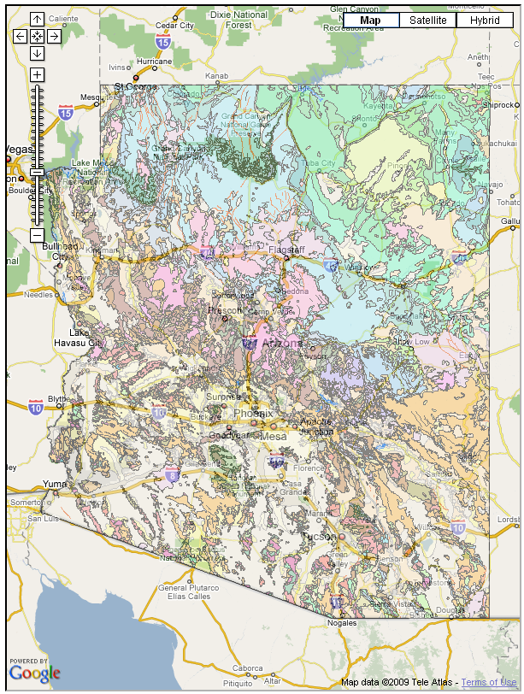
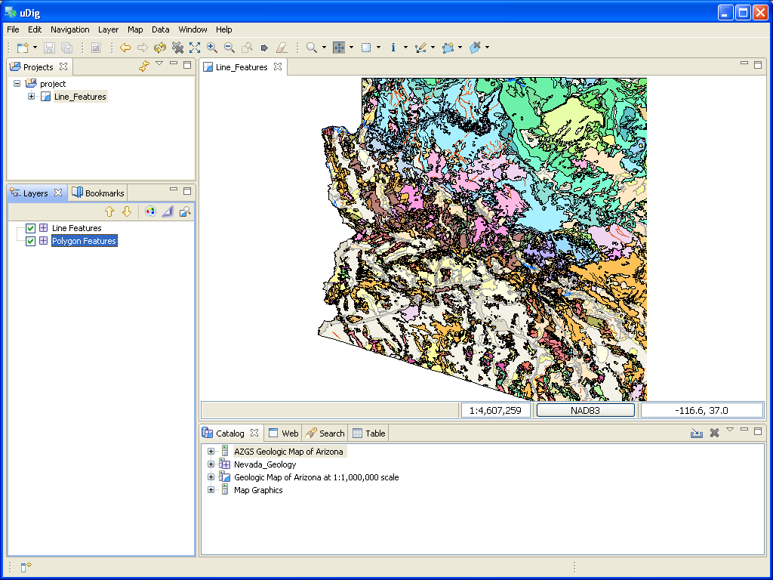
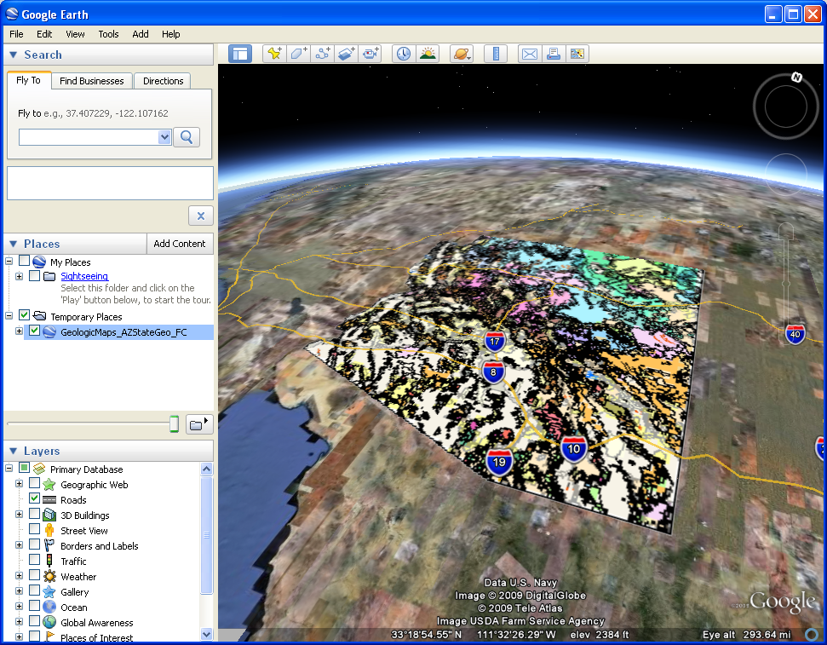
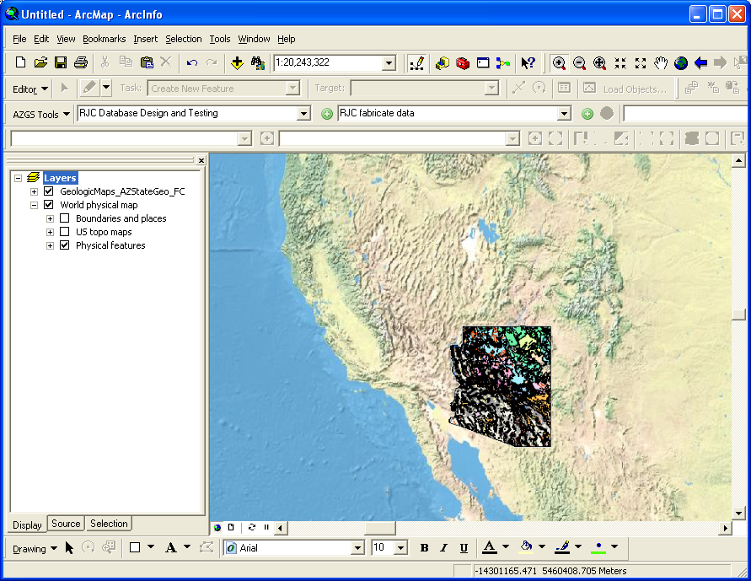
Data Delivery Platform: web services
OGC Services
-- Useful in Existing Applications
WMS for providing a symbolized portrayal of vector data
WFS for full access to attributes and to download vector data
WCS for access to continuous raster data

Slide 26
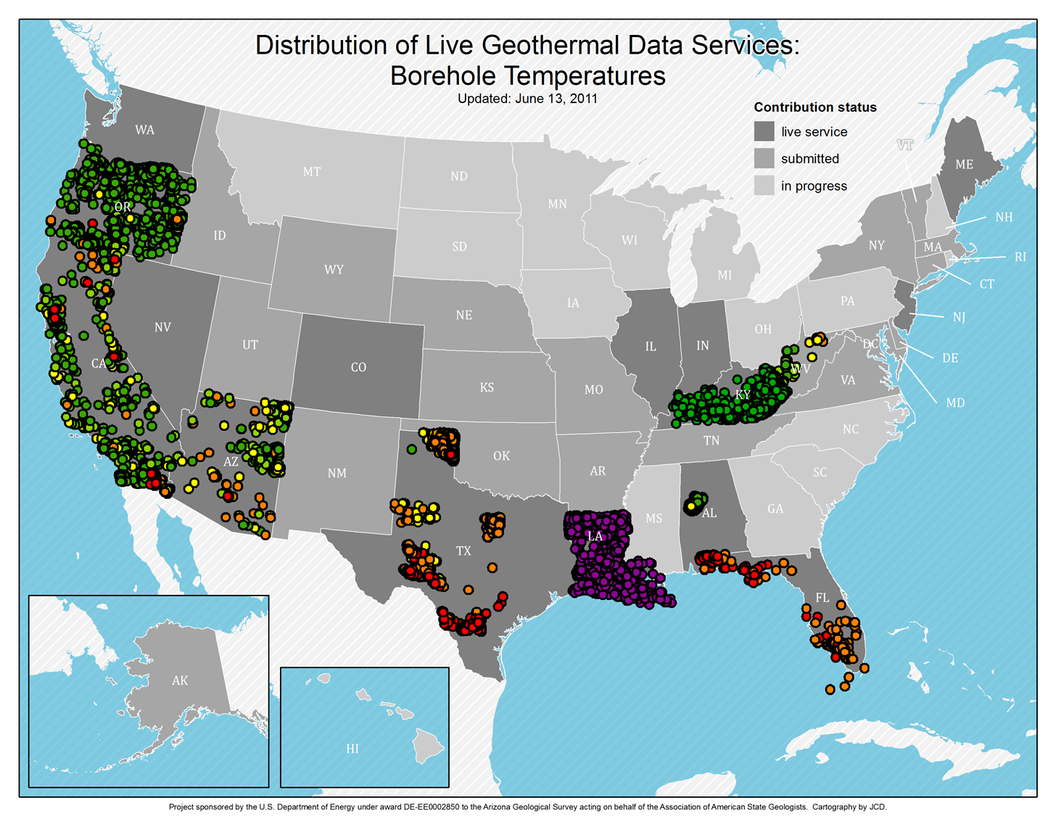
Consistent map legends
OOOPS!

Slide 27
Protocol – Web Feature Service (WFS)
Open Geospatial Consortium Web Feature Service
  Standard, structured encoding of content
  Each feature defines content model (xml schema)
Feature service –
  designed for data access based on features (representation of geolocated entity with attributes)

Slide 28
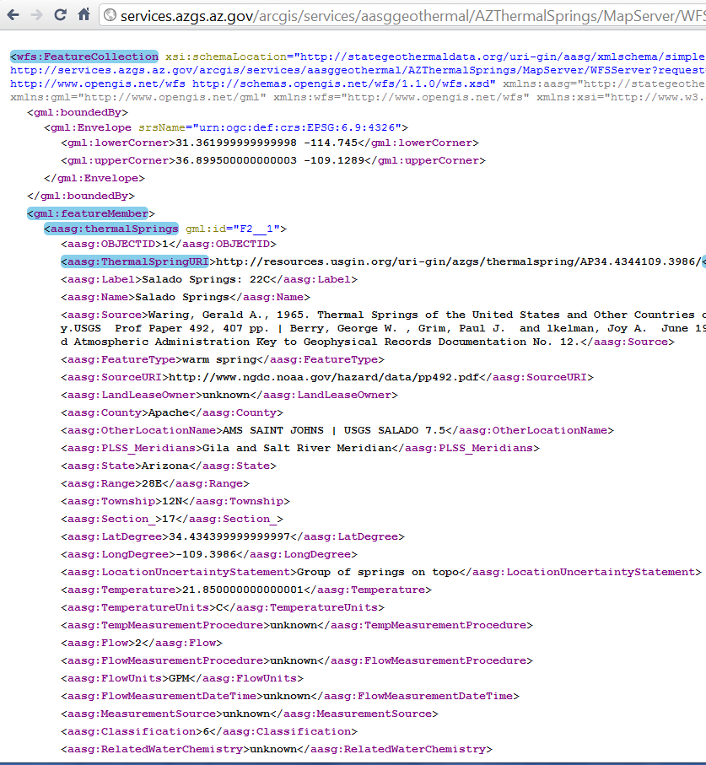
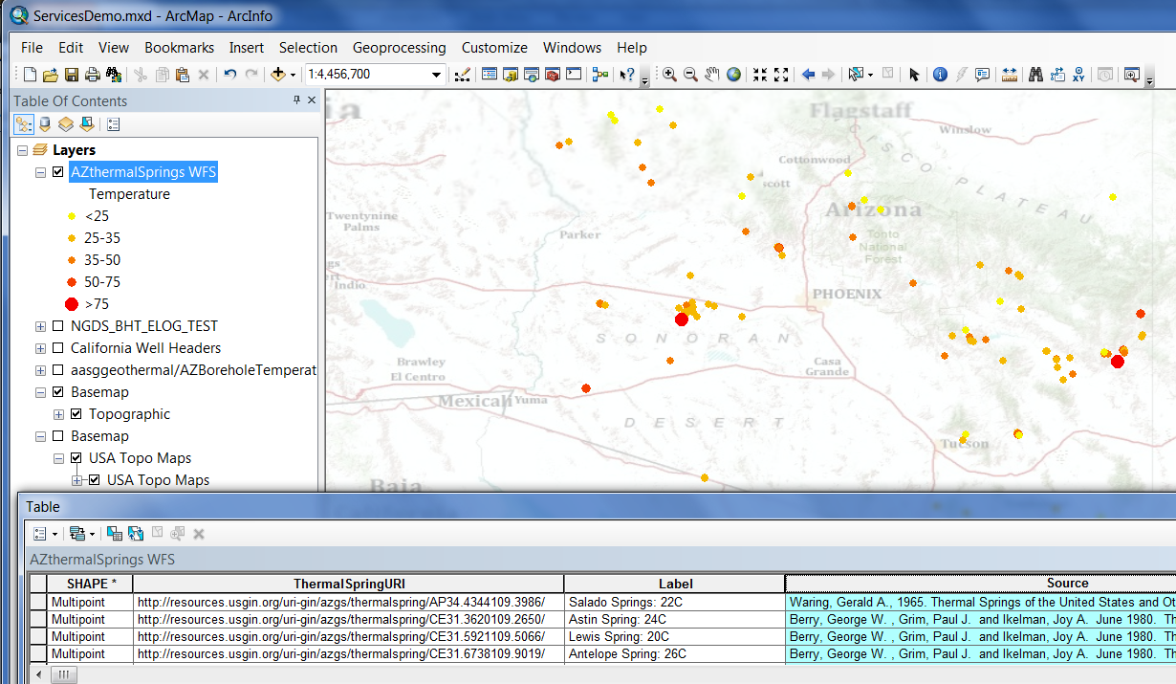
WFS example-Interchange format

Slide 29
USGIN URI redirect
URIs dereference to one or more online representation of each resource. Examples:
  http://resources.usgin.org/uri-gin/isgs/well/API:120010005200/
  http://resources.usgin.org/uri-gin/isgs/welllog_tif/120010010800_ies/
Create URI:
Concatenate:
  the redirect host path: ‘http://resources.usgin.org/uri-gin/’
  naming authority for the data provider (i.e., azgs, cadoggr, nhgs)
  token, specific to the dataset (i.e., bhtemp, welllog, drillstemtest)
  unique identifier for each record

Slide 30
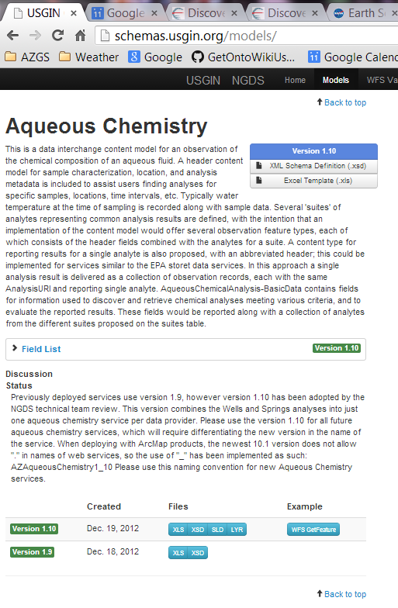
Tools Schema Repository
Registry/repository
Field descriptions from schema
annotation
Links to Excel workbook view
Links to XSD
Versions
Link to example instances

Slide 31
Conclusions
The World Wide Web is the file system and data repository
Resources include:
  Structured and unstructured data in files (most of the content)
  Standardized structured data accessible through web services (metadata and some data)
Information exchange specifications:
  Conventions for content model and encoding enable applications to work with multiple data sources

Slide 32
Discussion
USGIN:
  Community for developing Geoscience Information Exchanges
  Metadata exchange is most important
Majority of content is unstructured documents
Challenge: what is value proposition for ‘long tail’ information exchanges

Slide 33
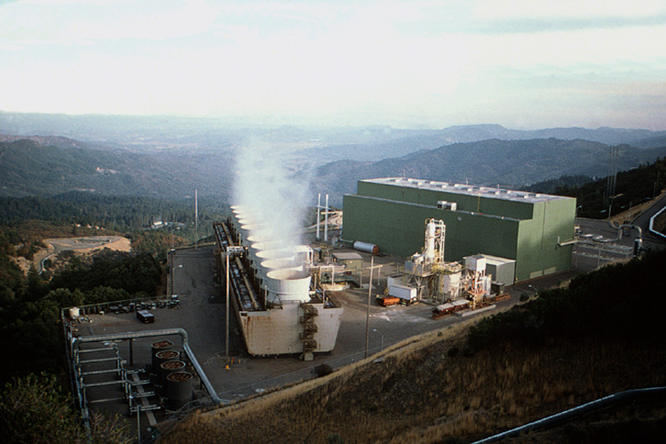
Thank You
The Geysers

Slide 34
Intentionally blank
Begin extra slides

Slide 35

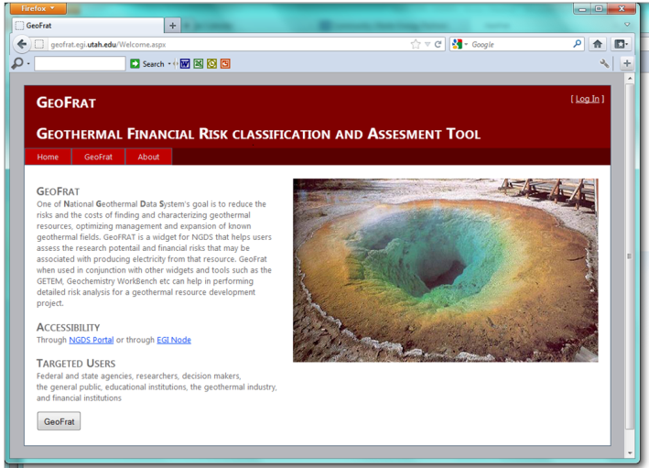
Approach to Data Management
Use WWW infrastructure, Open Geospatial Consortium (OGC) services, ISO standards
Simple interchange formats
Tiers of interoperability

Slide 36
NGDS_Resource
+
itemURI :anyURI
+subject
+
itemType :term
+
source :longText
1
+
relatedItem :link [0..*]
+documentation
+annotation
0..*
NGDS_DataResource
Metadata
Annotation
+
itemName :text
+
itemDescription :text [0..1]
1..*

Slide 37
NGDS_DataResource
+
itemName :text
+
itemDescription :text [0..1]
Tier 2,3
Tier 1
NGDSdataItem
+member
Dataset
UnstructuredResource
+
otherID :text [0..*]
1..*
Location
+position
Feature
Observation
1
+
featureOfInterestName :text
+
shape :geometry
1
+
label :shortText
+
featureOfInterestURI :anyURI
+
symbol :text
FeatureOfInterest
+
procedure :longText
+
observationDate :dateTime
GeologicFeature
Facility
SamplingFeature

Slide 38
Catalog system issues
How to manage metadata
  Various streams for importing
  Management system based on conceptual model
Metadata for machines– connect user to services inside of their user environment
  Requires machine-actionable links
Document and file searching should be done with standard search engines

Slide 39
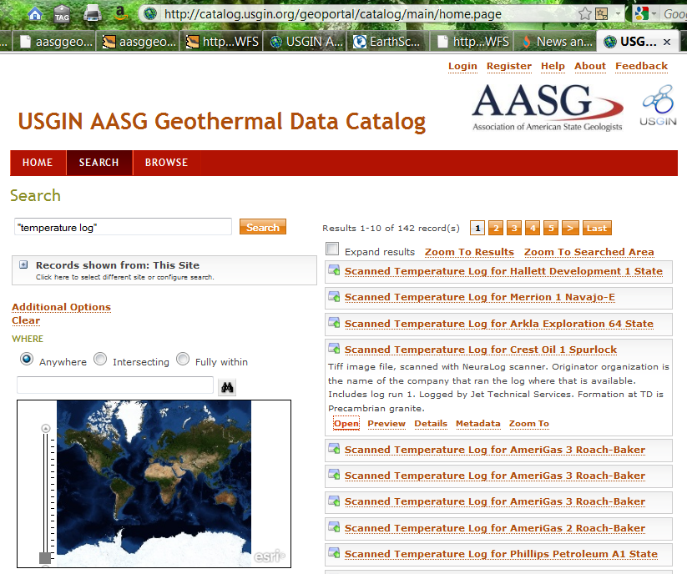
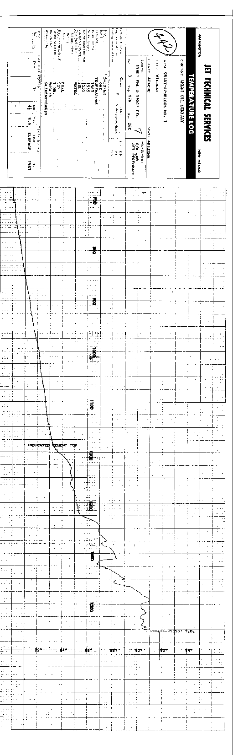

Slide 40
Domain Steering Committee Members
  Toni Boyd: Geo-Heat Center Oregon Institute Technology: direct use data - national
  Roland Horne: Stanford University-Stanford Reservoir Engineering Conference papers and research results
  Joseph Moore: Energy & Geoscience Institute-legacy resource and research data (Chair)
  Lisa Shevenell: University Nevada, Reno – legacy to recent resource and research data

Slide 41
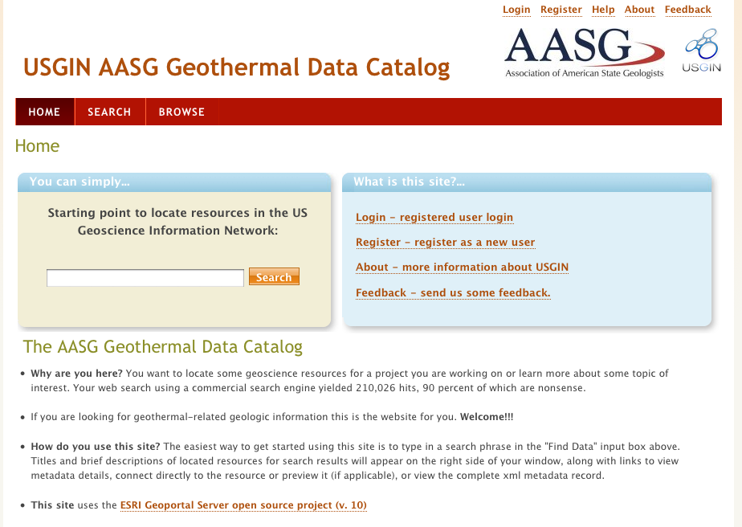
Search interfaces
Catalog -- for data discovery
Collection of consistent metadata describing network resources
Tested various catalog service implementations;
Current interface is ESRI Geoportal
(http://catalog.geothermaldata.org/geoportal)

Slide 42
AASG Geothermal data
Catalog file-based resources in repositories
Simple feature (flat file) schema
  27 content models
More on the way –
http://geothermaldata.org
The goal is simple, really….

Slide 43

turn this….
Winona State U.

Slide 44
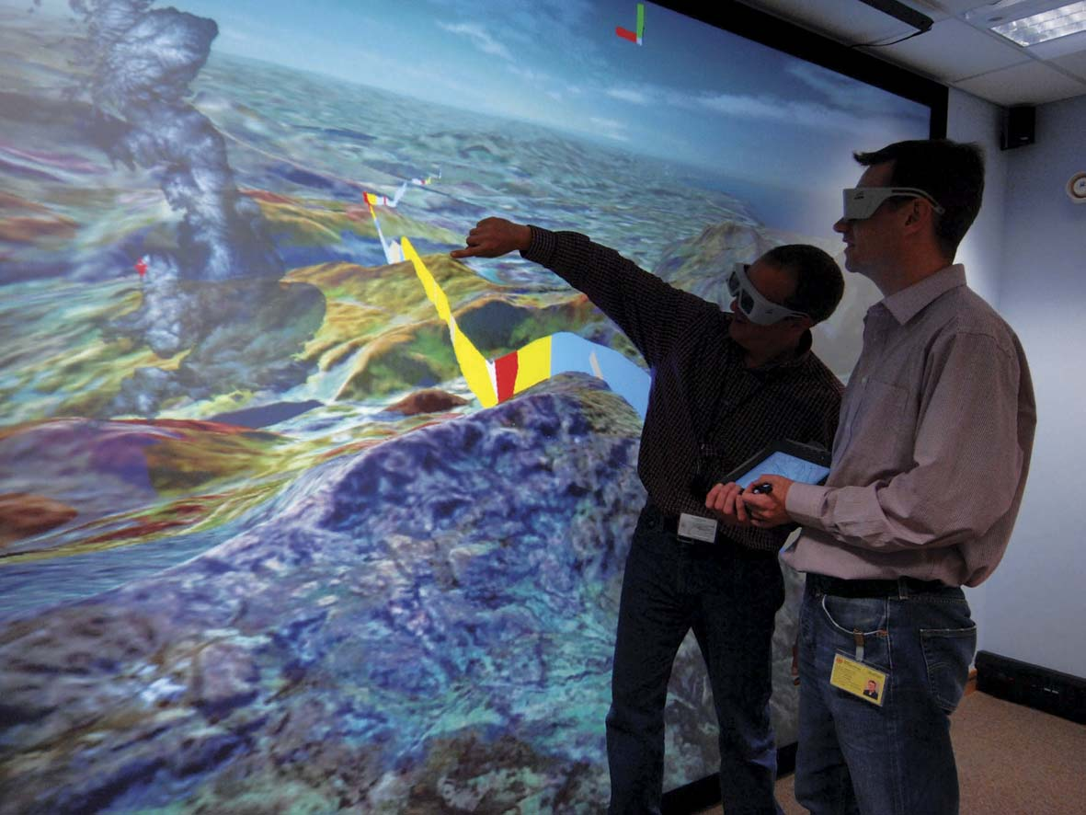
….into this
NERC 2008
Notes:
44
44

Slide 45



USGIN Catalog Implementation
Why a Geoportal Catalog?
Allow a variety of metadata creation methods to be aggregated
Allow distributed metadata records to be aggregated: harvesting between catalogs
Provide a consistent interface for searching and retrieving metadata records: CSW
Why ESRI’s Geoportal Server?
  Geonetwork was too hard
  They made it open source!
Metadata Wizard
Document Repository
Excel Template
XML in Web-Accessible Folder
Another Catalog
Another Catalog
Geoportal Catalog

Slide 46
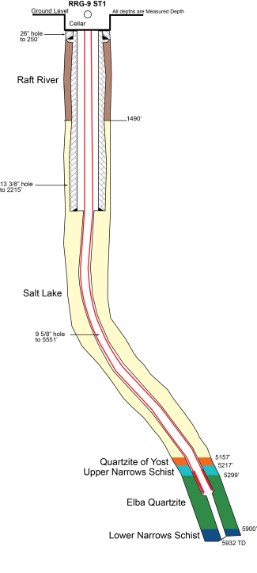
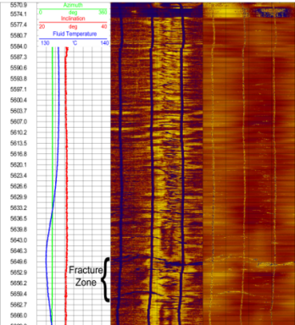
Wells: data requirements
Links to related information:
  Log and well data to geographic location
  From well to all related data: drilling records, daily reports, well maintenance, costs, sundry notices, regulatory filings, all logs, time lines….
  Technical papers to well locations
3-D geometry of well bore
History of well (drilling, completion, production, rework, repurpose, abandonment…)
Solution: Interchange formats for well, borehole temperature obs, well log obs, lithology interval obs, fluid production/ injection/disposal, tests…; related resource links

Slide 47
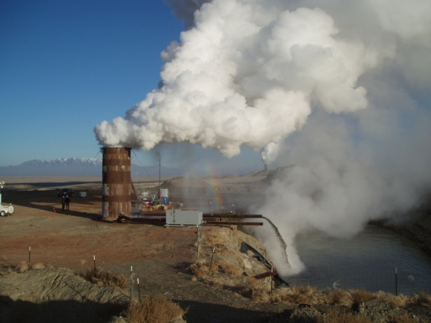
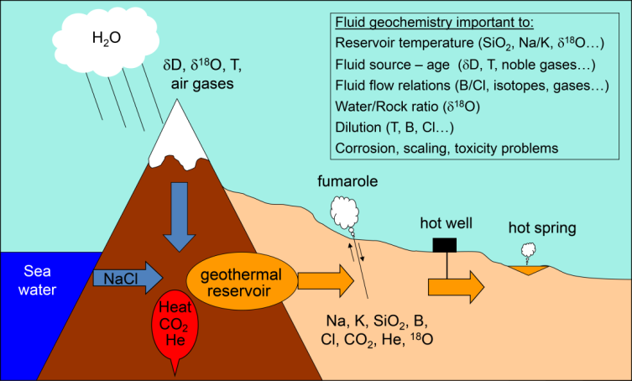
Geothermal fluid characterization
Property: | Approach
Reservoir temperature | Temperature logs
Fluid composition | Aqueous geochemistry obs
Fluid production | Fluid production obs
Fluid origin, age, mixing | No data yet
Direction of fluid movement | No data yet
Steam fraction | Aqueous geochemistry obs
Well Testing
B. Evans 2011
J. Lovekin, GeothermEx, Inc. 2010

Slide 48
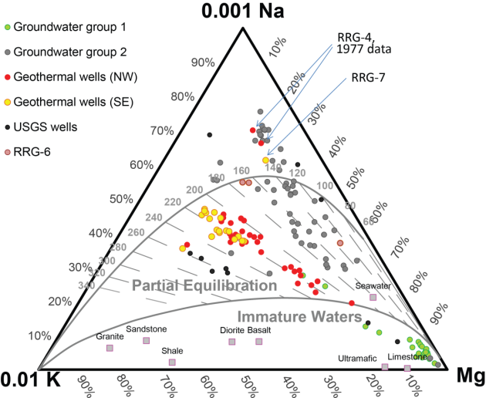
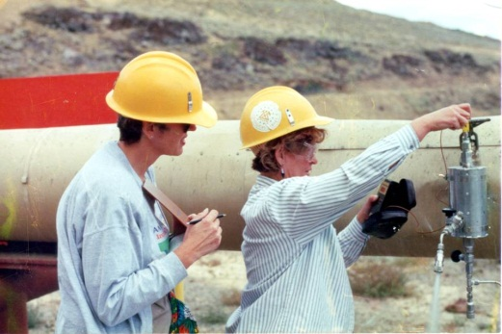
Aqueous Geochemistry
Analytical data for geothermometry, Piper and triangular diagrams:
  Need time of sampling information
  Content model based on Powell and Cummings (rev 2010) spreadsheet
Solution: Geochemistry interchange formats
Access to relational database with exhaustive data compilation: Tier 2 files
Raft River Chemistry
Cathy Janik with a miniseparator

Slide 49
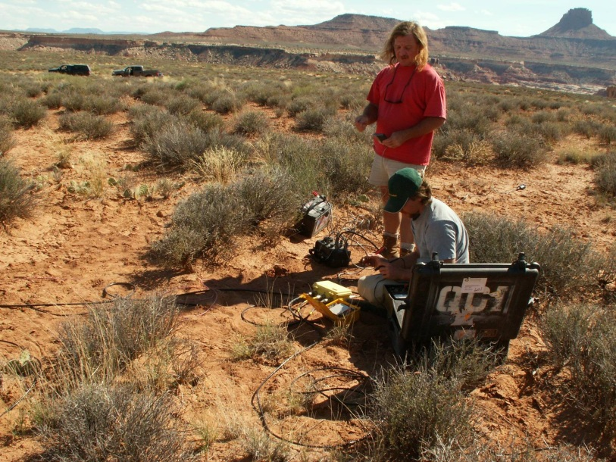
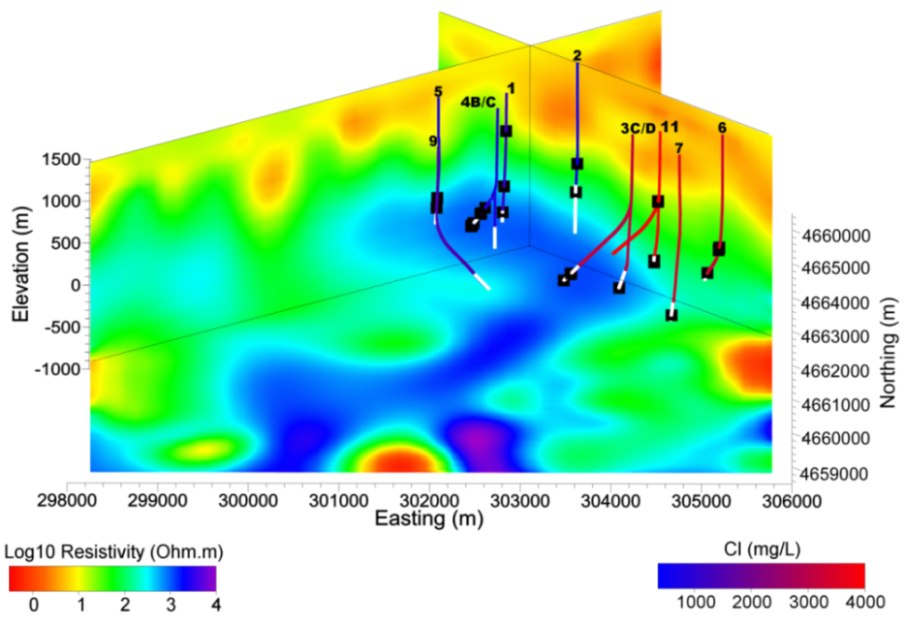
Geophysical data types
Gravity, magnetic, resistivity… Continuously varying coverage
Data model is simple: X,Y,Z,value
Data represented using numeric arrays (grids).
Solution: Web Coverage Service, OpenDAP/NetCDF
Commonly only accessible as an image of a data visualization
Need to georeference these data
visualizations to put in context:
Solution: Web Map Services
Photo by P. Wannamaker
Magnetotelluric model of Raft River (Maris and others, 2012)
Magnetotelluric (MT) Surveys

Slide 50
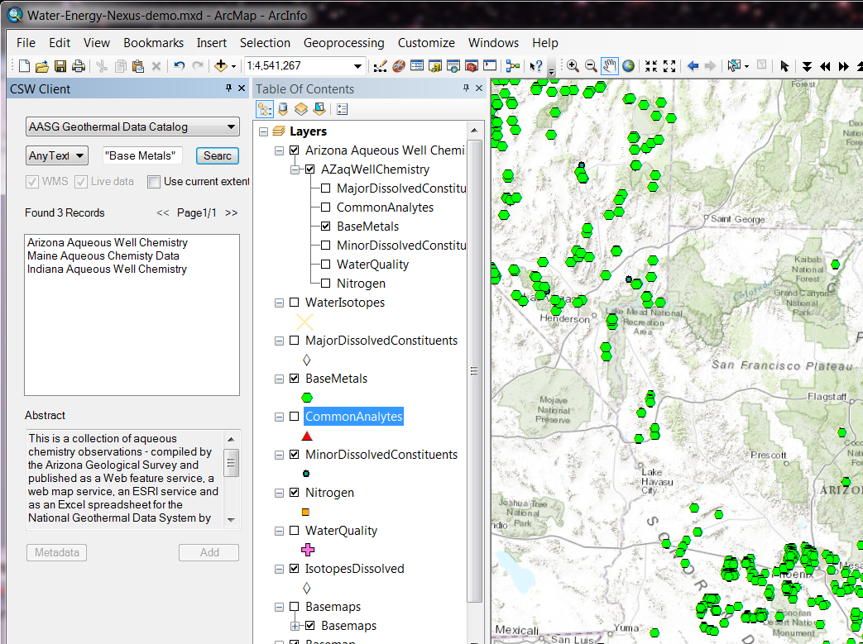
Other Data
Geologic Maps
  Rock unit distribution
  Location, orientation of contacts and faults
  Solution: GeoSciML feature services and map services
Infrastructure
  Land ownership: Parcel maps; under stewardship of various land agencies
  Power lines, transportation, water…
  Solution: services from other agencies (Western Regional partnership, USGS and others)

Slide 51
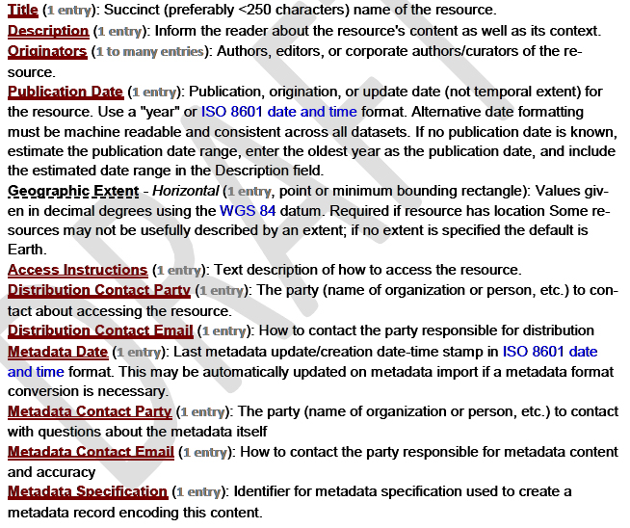
Metadata: Strong Conventions
Minimum metadata content recommendations

Slide 52

Other Portals
CanGEA portal

Slide 53
Protocol: Web Map Service (WMS)
Simple, widely used, many clients
Access to georeferenced map image
Servers
  MapServer, GeoServer, Deegree, ArcGIS
Data integration = agreeing on standard portrayal schemes (legends)

Slide 54
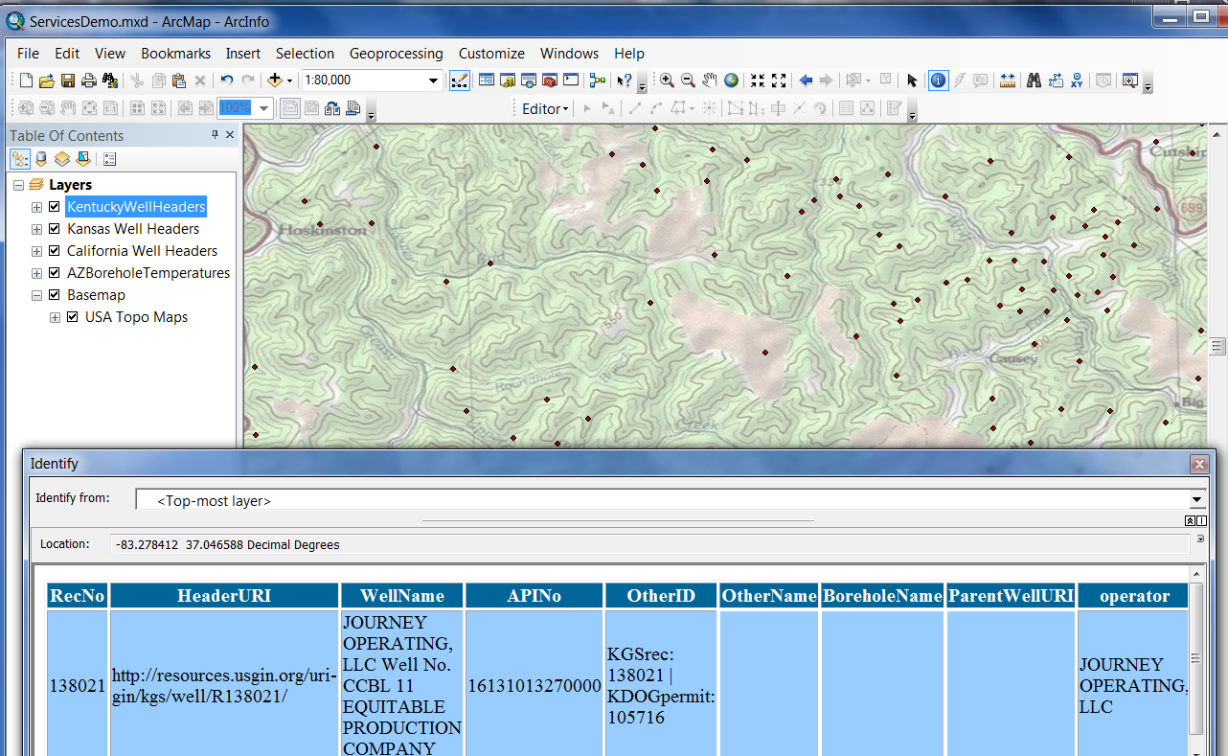
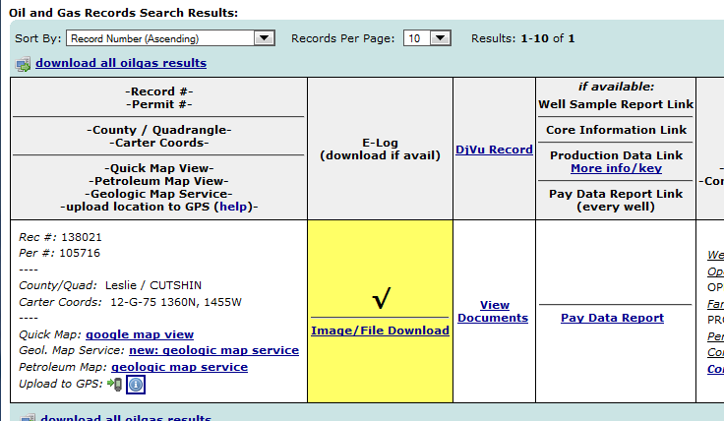
WMS for well headers

Slide 55
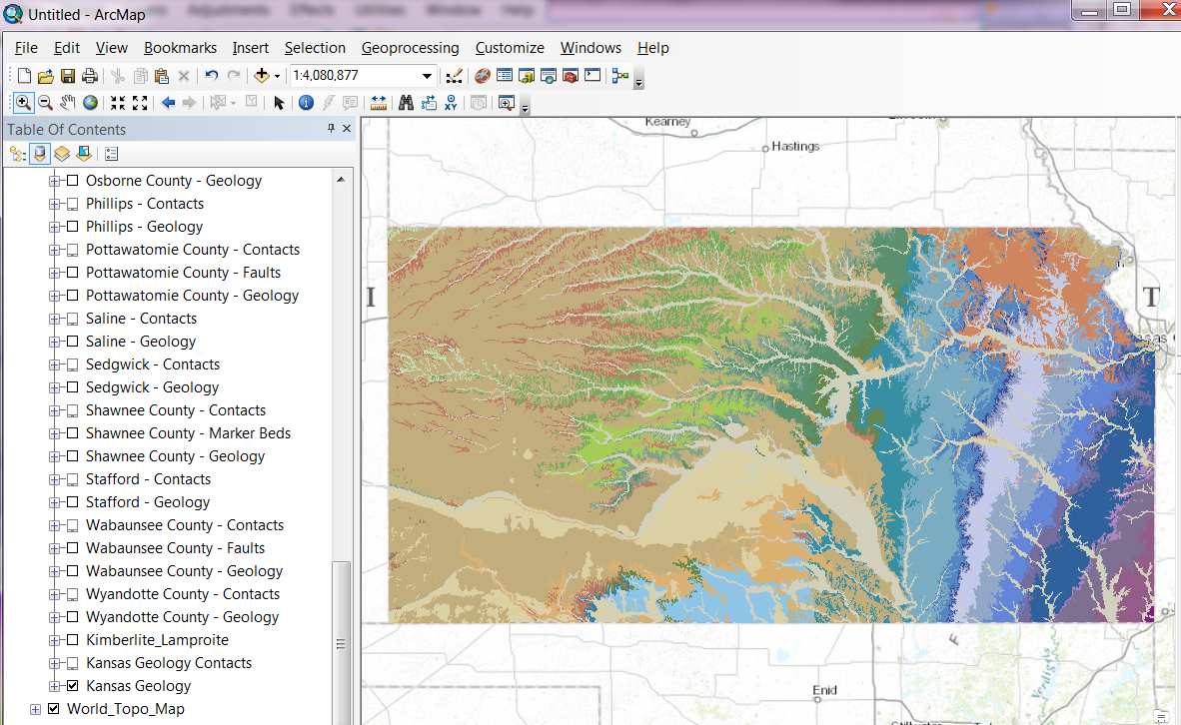
Geologic Map

Slide 56
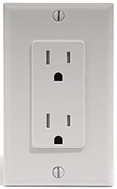
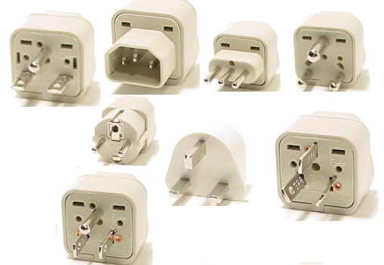
What does Interoperability mean?
… the ability of diverse systems and organizations to exchange information and use the information that has been exchanged…
To me this means that when I want data:
I always know how to ask for it
I always know the format in which I’ll receive it
I always know what it means
Notes:
Amalgamation of multiple definitions on Wikipedia
Know what it means because terminology is defined
56

