Slide 1
Aggregation of Tabular (Sequence) Datasets in DAP / ERDDAP
OBIS SOS Custom DAP ERDDAP ...
Database ERDDAP Files
Your Favorite Client Software
Try it: http://coastwatch.pfeg.noaa.gov/erddap Bob Simons <bob.simons@noaa.gov> NOAA NMFS SWFSC ERD

Slide 2
Defining Terms:
OPeN(DAP) vs ERDDAP

Slide 3
Defining Terms: Gridded vs. Tabular (Sequence) Datasets
Gridded Datasets (DAP projection constraints) DAP: ?wtemp[437] [46:1:162][122:282] ERDDAP: ?wtemp[(2014-07-01)][(22):(51)][(-145):(-105)]
Tabular Datasets (DAP selection constraints) DAP: ?s.id,s.owner,s.time,s.latitude,s.longitude,s.wtemp&s.id="SANF1"&s.time>=1435708800 ERDDAP: ?id,owner,time,latitude,longitude,wtemp&id="SANF1"&time>=2015-07-01
id | owner | type | time | latitude | longitude | wtemp | atmp
46088 | NDBC | 3m Discus | 1993-06-01T14:20:00Z | 48.336 | -123.159 | 16.4 | 18.0
46088 | NDBC | 3m Discus | 1993-06-01T14:50:00Z | 48.336 | -123.159 | 16.5 | 18.2
... | ... | ... | ... | ... | ... | ... | ...
SANF1 | SFSU | C-MAN | 1968-10-14T16:00:00Z | 24.456 | -81.877 | 15.8 | 14.9
SANF1 | SFSU | C-MAN | 1968-10-14T17:00:00Z | 24.456 | -81.877 | 15.8 | 14.8
... | ... | ... | ... | ... | ... | ... | ...

Slide 4
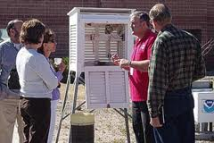
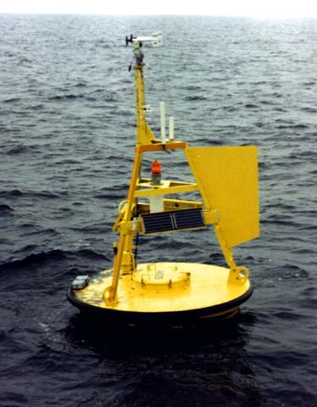
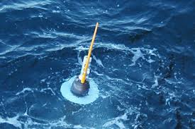
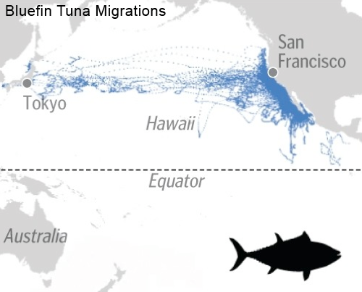
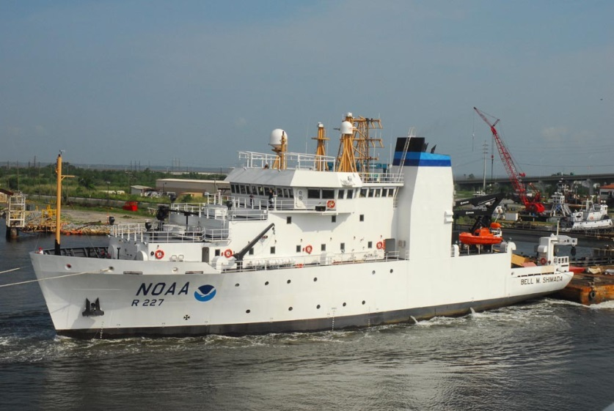
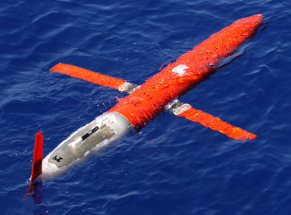
Defining Terms: Tabular: Good for In situ Data
Aggregation: many in one dataset
Notes:
Tables are a good way to store IN-SITU data:
from WEATHER stations, moored buoys, drifting buoys,
ships, gliders, even tagged ANIMALS.
In short, much of the data that NOAA deals with.

Slide 5
Sources of Tabular Data
Diverse: databases, Cassandra, OBIS, SOS, CSV files, flat .nc files, CF DSG .nc files, ...
Geospatial CF 1.6 Discrete Sampling Geometry (DSG) feature types: Point: whale sightings Profile: disposable CTD TimeSeries: moored buoy TimeSeriesProfile: CTD Trajectory: ship TrajectoryProfile: profiling glider
Non-Geospatial laboratory data, references, fish disease lists, ecosystem: what eats what, ... Larry Ellison is rich because databases are reusable for numerous types of data.

Slide 6
Aggregation: What is a Granule?
Obvious for gridded datasets
Not appropriate for tabular datasets Data is stored/organized in different ways in different datasets. A file?

Slide 7
ERDDAP Presents a Dataset as One Table (Sequence)
A column for each type of information
A row for each observation
Aggregation of multiple features (points, stations, profiles, trajectories, ...) by concatenating the rows
"Presents" - Actual implementation details are hidden
id | owner | type | time | latitude | longitude | wtemp | atmp
46088 | NDBC | 3m Discus | 1993-06-01T14:20:00Z | 48.336 | -123.159 | 16.4 | 18.0
46088 | NDBC | 3m Discus | 1993-06-01T14:50:00Z | 48.336 | -123.159 | 16.5 | 18.2
... | ... | ... | ... | ... | ... | ... | ...
SANF1 | SFSU | C-MAN | 1968-10-14T16:00:00Z | 24.456 | -81.877 | 15.8 | 14.9
SANF1 | SFSU | C-MAN | 1968-10-14T17:00:00Z | 24.456 | -81.877 | 15.8 | 14.8
... | ... | ... | ... | ... | ... | ... | ...

Slide 8
(ERD)DAP Requests for Tabular (Sequence) Data
DAP sequence requests use the terminology of the dataset. (It's easy.)
?id,owner,type,latitude,longitude&distinct()
?id,type,latitude,longitude&owner="NDBC"&distinct()
?id&latitude>=22&latitude<=55&longitude>=-145&longitude<=-105&distinct()
?id&latitude>=22&latitude<=55&longitude>=-145&longitude<=-105&time>=2015-07-01&distinct()
?&latitude>=22&latitude<=55&longitude>=-145&longitude<=-105&time>=2015-07-01
index | id | owner | type | latitude | longitude | time | wtemp | atmp
1 | 46088 | NDBC | 3m Discus | 48.336 | -123.159 | 1993-06-01T14:20:00Z | 16.4 | 18.0
2 | 46088 | NDBC | 3m Discus | 48.336 | -123.159 | 1993-06-01T14:50:00Z | 16.5 | 18.2
137522 | BP114 | BP | 3m Discus | 36.905 | -75.713 | 2003-02-09T02:00:00Z | 16.7 | 12.2
137523 | BP114 | BP | 3m discus | 36.905 | -75.713 | 2003-02-09T04:00:00Z | 16.6 | 12.0
1732156 | NC312 | NCSU | C-MAN | 24.456 | -81.877 | 1968-10-14T16:00:00Z | 15.8 | 14.9
1732157 | NC312 | NCSU | C-MAN | 24.456 | -81.877 | 1968-10-14T17:00:00Z | 15.8 | 14.8
3282459 | 41005 | NDBC | 6m Discus | 32.501 | -79.090 | 1984-08-22T14:20:00Z | 14.6 | 26.8
3282460 | 41005 | NDBC | 6m Discus | 32.501 | -79.090 | 1984-08-22T14:50:00Z | 14.7 | 26.2
There are no row index numbers. Even if there were, making these requests with index numbers would be a very difficult, inefficient, multi-step, programming task.

Slide 9
(ERD)DAP Sequence Requests vs. Database SQL Requests
(ERD)DAP: ?id,owner,type,time,latitude,longitude,wtemp&id="46088"&time>=2014-07-01
SQL: SELECT id,owner,type,time,latitude,longitude,wtemp FROM s WHERE id="46088" AND time>=2014-07-01
Easy for ERDDAP to get data from a database.
Pablo Picasso: "Good artists copy, great artists steal."

Slide 10
Response: a Table
DAP Sequence
ERDDAP
Simple Tabular File Different representations, on-the-fly E.g., .html table, .csv, .tsv, .nc, .odv, .kml
.nc: CF 1.6 Discrete Sampling Geometry Aggregations of feature types:
Points: whale sightings
Profiles: disposable CTDs
TimeSeries: moored buoys
TimeSeriesProfiles: CTDs
Trajectories: ships
TrajectoryProfiles: profiling gliders

Slide 11
Internally: Finding Relevant Data Efficiently
Obvious for gridded datasets
Not obvious for tabular datasets Depends on how data is organized. ERDDAP maintains an internal database with min/max of each variable in each file. ?id,owner,time,latitude,longitude,wtemp&id="SANF1"&time>=2015-07-01

Slide 12
The Power of Aggregation
Aggregation makes life vastly easier for users:
Just one dataset to find, not 10,000.
Just one dataset to query, not 10,000. E.g., find all the data in a lat/lon/time bounding box.
Entire response in one file, not 10,000.

Slide 13
Why?
Why use tables/sequences, not grids? Not a grid. Appropriate query system.
Why use one table, not nested tables/sequences? Simplicity. Left outer join?
Why use DAP? Standard. Great, RESTful query system.
Why use ERDDAP? OPeNDAP + response in other file types.
How does this promote data-driven community resilience? How is this needs-driven? Nobody can foresee. (Resilience? See Nassim Taleb's book: Antifragile)

Slide 14
Summary
DAP Sequences
Tabular data: in-situ/CF DSG and other (non-geospatial)
DAP sequence requests: ~SQL, uses dataset's terminology
DAP sequence response: a table (sequence)
ERDDAP
Works with gridded and tabular (sequence) data
DAP-compatible (with additional features)
Get data from many sources
Aggregation: vastly easier for user
Catalog services
Simple, DAP-style data requests + server-side functions
Return data in many formats (with structure), on-the-fly
Makes graphs and maps
FOSS. Reusable. Up and running in a few hours.

Slide 15
Thank you!
More info / try ERDDAP: http://coastwatch.pfeg.noaa.gov/erddap Email: bob.simons@noaa.gov

