Slide 1

State of the Federation
Peter Fox, President (RPI), @ESIPPres
http://commons.esipfed.org/node/2607
July 10, 2014

Slide 2

ESIP Community
Multiple Science Domains
Data Providers
Cross-Agency
Users
Data Archives
Application
Developers
Tool & System
Developers
Academia
Corporate
Notes:
Benefits of Engaging with Community:
Enhance staff knowledge through peer knowledge exchange
Take away new technologies
Identify new collaborations
Leverage scarce resources through reuse, repurpose
Help define community best practices

Slide 3
Membership count
Type I: data centers (23)
  NASA DAACs
  NOAA (NGDC, NODC, NCDC)
Type II: researchers and tool developers (72)
  Academia
  Government labs
Type III: application developers (61)
  Commercial
  Nonprofit
  Educational
Type IV: strategic partners (2)
  NASA
  NOAA

Slide 4
Collaboration http://esipfed.org/collaboration-areas
ESIP Working Groups
Data Study
Drupal
Climate Education
Visioneers
ESIP Clusters
Agriculture & Climate
Cloud
Decisions
Disasters
Discovery
Documentation
Earth Science Data Analytics
Energy & Climate
Info Quality
Science Software
Semantic Web
Standing Committees
  Data Stewardship
  Education
  Information Technology and Interoperability
  Products and Services
Administrative Committees
  Constitution and Bylaws
  Finance and Appropriations
  Partnership

Slide 5

Two Organizations: ESIP Federation & Foundation for Earth Science
ESIP Federation is the community.
Foundation for Earth Science provides management, operational and logistical services to the ESIP Federation.
In reality (up to 2013):
ESIP
Federation
Foundation for
Earth Science

Slide 6

Two Organizations: ESIP Federation & Foundation for Earth Science separated…
ESIP Federation as a community remains unchanged.
Foundation for Earth Science provides management, operational and logistical services to the ESIP Federation, unchanged.
Some administrative aspects are changing
ESIP
Federation
Foundation for
Earth Science
MOU

Slide 7
Foundation for Earth Science Executive Director
Is Open.
Job description was created.
Ad here: ….
In the interim: Chuck Hutchinson

Slide 8
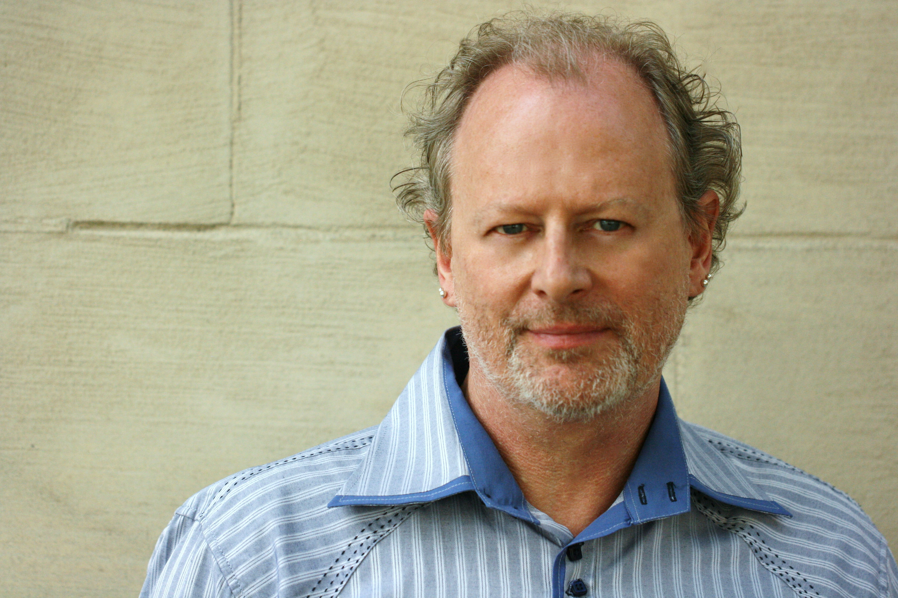
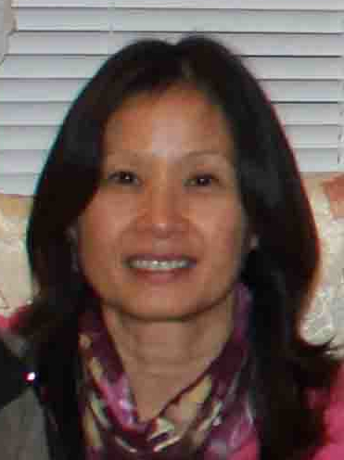
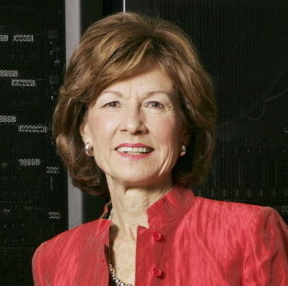

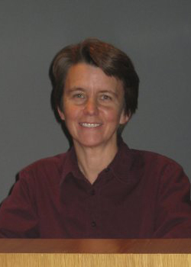
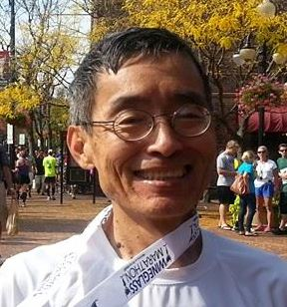
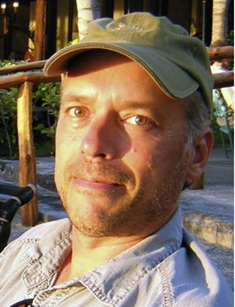
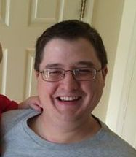
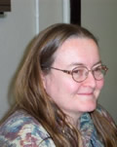
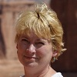
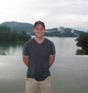
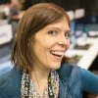
ESIP Executive Leadership
President & Vice President
ESIP Type Reps
Peter Fox
Emily Law
Sara Graves
Ken Keiser
Margaret Mooney
Administrative Committee Chairs
Bill Teng
Bruce Caron
Tyler Stevens
Standing Committee Chairs
Ruth Duerr
Roberta Johnson
Matt Austin
Christine White
Notes:
ESIP works cross agencies, cross sectors, and cross science domains.

Slide 9
ESIP Federation committee work
Strategic plan – see http://wiki.esipfed.org/index.php/2009-2013_Strategic_Accomplishments
Nomination Committee – see
http://wiki.esipfed.org/index.php/Nomination_Committee_Discussion
Quorum and Membership – see http://wiki.esipfed.org/index.php/Quorum_and_Membership_lapsing
See also http://wiki.esipfed.org/index.php/Constitution_and_Bylaws

Slide 10
ESIP Federation committee work
Project Funding – coming (Finance)
Partnership packet and draft criteria for membership: see http://wiki.esipfed.org/index.php/Partnership
Testbed evolution – see http://wiki.esipfed.org/index.php/Products_and_Services
Visioneers – see http://wiki.esipfed.org/index.php/Visioneers

Slide 11
Committee – Products and Services (White)
Success: Issuing Spring 2014 Testbed RFP which resulted in funding of $6,500 for two Testbed Projects. Planning, organizing, and staffing the FUNding Friday competition to be held at the ESIP Summer Meeting. Developing slides and updating Testbed Logo to bring awareness and understanding of the ESIP Testbed. Erin overhauled the ESIP Testbed site at http://testbed.esipfed.org and it looks great!
What we’re working on now: Getting geared up for FUNding Friday at Summer Meeting, preparing for second 2014 Testbed Project call due October 30, and helping existing Testbed projects through development, reporting, and other aspects of the project lifecycle.

Slide 12
Committee – Products and Services (White)
How to get involved: Attend ESIP 101 session to learn more about the Testbed and FUNding Friday. Join in on our calls – the third Tuesday of each month at 2 PM Eastern. Submit an innovative and collaborative earth science idea in response to the Testbed RFP’s, or present it for FUNding Friday.

Slide 13
Committee – Stewardship (Duerr)
First draft of a paper geared to the library world about the ESIP Data Stewardship cluster and its activities, particularly around Provenance and Context content is complete. Needs editorial pass prior to submission (assigned and in work).
A paper geared to the science community on the importance of provenance and context, the work ESIP has done in defining content in the Earth Sciences, and the success of having NASA adopt that for their Earth science missions.

Slide 14
Committee - Stewardship (Duerr)
Email List: esip-preserve (Archive)
Meetings
Telecons:
  Second Fridays of each month at 3:00pm EST
Telecon: 1-877-668-4493 Access Code 23138372
Webex: Password: 23138372
Contact Committee Chair: Ruth Duerr
Student Fellow: Sarah Ramdeen

Slide 15
Committee – IT&Interoperability (Austin)
Increased collaboration within Earth Science Community through well attended monthly Rant and Rave Series telecons focused on interesting topics relevant to data interoperability. Many participants from outside the ESIP community were introduced to ESIP for the first time.
  February: IPython and Wakari for Earth Science Richard Signell USGS
  April: Mesonets, CubeSats, and Drones, Oh My! Emerging Earth Science Technologies in Disaster Management John Evans from Global Science Technologies, INC.
  May: Experiences with Structured Data for the Discovery and Publishing of Ocean Drilling Data Doug Fils Consortium for Ocean Leadership
  June: Data Management Maturity Model June- Harry Furukawa AGU

Slide 16
Committee – IT&Interoperability (Austin)
IT & I is hosting the Agile programing workshop at the summer meeting.
We are constantly on the lookout for presenters that would like to share their challenges and solutions for solving data interoperability challenges in a upcoming Rant and Rave.
To participate join the email list: esip-interoperability@rtpnet.org

Slide 17
Committee – Education (Johnson)
Coming
Contact leads, go to our wiki page.

Slide 18
Cluster related to this meeting – science software (Lenhardt)
Formed and has had sessions at three most recent ESIP meetings
Helped to provide inputs for summer meeting focus on sustainable software
Cluster has had interactions w/AGU through participating in ESSI sessions
Multiple (?) sessions accepted for AGU Fall 2014 meeting coming from ESIP-ers on this topic
Cluster has monthly telecons; activities documented on ESIP wiki
Goal to have more concrete work plan coming out of the summer meeting

Slide 19
Cluster related to this meeting – data science analytics (Kempler)
Exploring a relatively new facet of Information Science, the Earth Science Data Analytics (ESDA) spent the better part of 5 telecons, in it's first 5 months, deciphering what Data Analytics, and the role of the Data Scientist, means, through the expertise of 7 guest presenters (and counting), the creation and population of the Data Analytics Use Case matrix (10 use cases and counting), and the gathering of available/promising data analytics tools/techniques (11 and counting)

Slide 20
Cluster related to this meeting – data science analytics (Kempler)
The group is continuing to gather and analyze use cases in order to glean out the specific data user needs that can benefit from data analytics; Is analyzing tools/techniques that have been collected; and will begin mapping 'types' of users (from the ESIP User Needs Cluster User Model) to 'types' of data analytics that serve them.
If you are an Earth science data user, faced with analyzing large amounts of heterogeneous data, your use scenaio and/or analyisis solutions are just what is needed. If you are a data scientist or data analytics tool developer, your techniques/expertise would greatly benefit the ESDA cluster. Visit the ESDA Discussion Forum; Attend the ESDA telecons, 3rd Thursday of the month. The more participants we have, the better we can get our arms around this nebulous topic…

Slide 21
Working group related to this meeting – Drupal (Shepherd)
ESIP Drupal WG community had two sessions accepted at Drupalcon Austin from members
  DEIMS, A Drupal Profile for Managing Ecological Data https://www.youtube.com/watch?v=5hJQ4_rxDAQ 50+ attendees, 81 views on Youtube
  Linked Data + Drupal for Oceanographic Data Management https://www.youtube.com/watch?v=wEllMpcNQFg 70+ attendees, 84 views on YouTube
  Follow-up BoF on Linked Data had 30+ attendees; led to new relationships formed between ESIP Drupal WG and NOAA Fisheries, Hawaii & NASA Langley Research Center (Atmospheric Science Data Center)

Slide 22
Working group related to this meeting – Drupal (Shepherd)
Had 15 attendees at Drupalcon Austin "Science on Drupal BoF" led to doubling membership in the ESIP Drupal.org group
Attracted 2 experts in the Web development community to come present at ESIP Summer Meeting
  Greg Knaddison from CARD.com presenting on Web Security for your applications + Drupal
  Brandon Morrison from Phase II Technology (runs Visual Dimensions VODcast on data visualization: https://plus.google.com/114815123144726996608/posts) presenting on effective data visualizations for the Web including Maps
2. Something your group is working on now
1) Trying to broaden the traditional audience of ESIP and build bridges with the software development community.
examples:
- hosted Agile & Scrum guru Sadie Honey at Drupal WG Telecon in April (https://www.youtube.com/watch?v=dgLSWGcbYrA&index=11&list=PLMX9RG75MgALpwWkQTUehLPbK1miNOiny)
- re-scoping the Drupal.org ESIP group to be "Science on Drupal" with blessing of ESIP and Drupal.org admins
--- https://groups.drupal.org/science-on-drupal - https://groups.drupal.org/esip redirects to science-on-drupal).
2) discovering projects that we can collectively work on in support of geosciences
examples:
- exploring the possibility to share information between RDA, ESIP, and EarthCube websites since all run on Drupal. Bruce Caron has begun discussions with Mark Parsons who was interested in the idea.
- exploring how to discover, gather, and highlight science-related issues that need to be fixed or improved on the Drupal.org platform (Thematic Meta Issue Tracker project)
3. How to get involved in the group
Drupal.org Group: https://groups.drupal.org/science-on-drupal
Email List: http://www.lists.esipfed.org/mailman/listinfo/esip-drupal (esip-drupal@lists.esipfed.org)
Twitter: https://twitter.com/ScienceOnDrupal
Google+: https://plus.google.com/communities/105355344055119765640
YouTube: http://www.youtube.com/playlist?list=PLMX9RG75MgALpwWkQTUehLPbK1miNOiny

Slide 23
Working group related to this meeting – Drupal (Shepherd)
Trying to broaden the traditional audience of ESIP and build bridges with the software development community. Examples:
  hosted Agile & Scrum guru Sadie Honey at Drupal WG Telecon in April (https://www.youtube.com/watch?v=dgLSWGcbYrA&index=11&list=PLMX9RG75MgALpwWkQTUehLPbK1miNOiny)
  re-scoping the Drupal.org ESIP group to be "Science on Drupal" with blessing of ESIP and Drupal.org admins - https://groups.drupal.org/science-on-drupal - https://groups.drupal.org/esip redirects to science-on-drupal).

Slide 24
Cluster related to this meeting – Drupal (Shepherd)
New: discovering projects that we can collectively work on in support of geosciences. Examples:
  exploring the possibility to share information between RDA, ESIP, and EarthCube websites since all run on Drupal. Bruce Caron has begun discussions with Mark Parsons who was interested in the idea.
  exploring how to discover, gather, and highlight science-related issues that need to be fixed or improved on the Drupal.org platform (Thematic Meta Issue Tracker project)

Slide 25
Working group related to this meeting – Drupal (Shepherd)
Drupal.org Group: https://groups.drupal.org/science-on-drupal
Email List: http://www.lists.esipfed.org/mailman/listinfo/esip-drupal (esip-drupal@lists.esipfed.org)
Twitter: https://twitter.com/ScienceOnDrupal
Google+: https://plus.google.com/communities/105355344055119765640
YouTube: http://www.youtube.com/playlist?list=PLMX9RG75MgALpwWkQTUehLPbK1miNOiny

Slide 26
Cluster related to this meeting – Energy & Climate (Eckman/Prados)
Working with multiple agencies (DOE, USGS), academia, and stakeholders (e.g., the American Wind and Wildlife Institute), and leveraging ESIP expertise and graduate student participation, we developed a prototype Dynamic Decision Tools catalog addressing wildlife vulnerability to wind energy infrastructure development. This catalog used ESIP community expertise to provide east data access and exploitation, is interoperable, and is based on open standards.

Slide 27
Cluster related to this meeting – Energy & Climate (Eckman/Prados)
The Energy & Climate WG is currently engaged on identifying US-based activities that use Earth observations to address energy (initially, renewable) decision needs. This activity will support the forthcoming USGEO 2nd Earth Observation Assessment. We are also working with the GEO Secretariat’s energy SBA coordinator to better link these U.S. based activities with those occurring internationally and which are currently known to GEO. An outcome of this effort is to better understand Earth observation data needs and identify gaps relevant to the energy sector. In the near future, we plan to engage stakeholders and end-users to better understand their needs.
Contact the co-chairs, Richard or Ana.

Slide 28
Cluster related to this meeting – Disasters (Law)
Strong interest. Good discussions, presentations, and excellent synergy with GEOSS.
Start conversations on use cases, information architecture, collaboration with other activities.
Contact cluster leads, go to our wiki page. http://wiki.esipfed.org/index.php/Disasters, join our mailing lsit http://rtpnet.org/mailman/listinfo/esip-disasters

Slide 29
Cluster related to this meeting – Semantic Web (Narock/ Huffer)
Coming – session on Friday AM.
Contact leads, go to our wiki page. http://wiki.esipfed.org/index.php/Semantic_Web

Slide 30
Cluster related activity – Climate Education (Mooney)
Coming – webinar on Thursday.

Slide 31
Cluster - Envirosensing (Gries)
The 'Sensor and Sensor data management best practices' collection of wiki documents was released http://wiki.esipfed.org/index.php/EnviroSensing_Cluster. it was announced in several place where summaries can be found:
LTER DataBits article: http://databits.lternet.edu/2014-spring/sensor-and-sensor-data-management-best-practices-released
ESIP blog: http://esipfed.org/node/2434

Slide 32
Cluster – Envirosensing (Gries)
We are preparing for the first Envirosensing concentration workshop during the upcoming ESIP meeting. The plan is to introduce the best practices document, brainstorm and gauge further interest in this concentration, and attracting more contributors to the best practices document.
Wiki page editing http://wiki.esipfed.org/index.php/EnviroSensing_Cluster is open to all and a mailing list http://lists.esipfed.org/mailman/listinfo/esip-envirosensing exists regular WebX meetings are scheduled through ESIP http://www.esipfed.org/

Slide 33
Cluster – Agriculture and Climate (Teng)
Engaged (1) USDA LTAR (Long-Term Agroecosystem Research) Network and (2) National Agricultural Library (NAL), which will handle the data system part of LTAR, in exploring areas of collaboration, with current focus on linking NASA and other satellite data with LTAR sites.
Active participation in ESIP Summer Meeting by LTAR and USDA Northern Plains Regional Climate Hub.
Review of past and ongoing work on climate effects on agriculture, in the science literature, by USDA agencies (as coordinated by the Climate Change Program Office), and by other sources.
Exploring ways to integrate satellite data, including the 2014 mission data from GPM, OCO-2, and SMAP, into the LTAR program.

Slide 34
Cluster – Agriculture and Climate (Teng)
How to get involved in the group
Subscribe to email list, http://rtpnet.org/mailman/listinfo/esip-agclimate
Contact Bill Teng (william.l.teng@nasa.gov)

Slide 35
You get the idea!
How to get involved in activities:
  http://esipfed.org/collaboration-areas

Slide 36
ESIP Online
Home page
  http://esipfed.org
Wiki
  http://wiki.esipfed.org
Commons
  http://commons.esipfed.org
Facebook
  http://tinyurl.com/esip-facebook
Twitter
  #esipfed, @ESIPFed, @ESIPPres

Slide 37
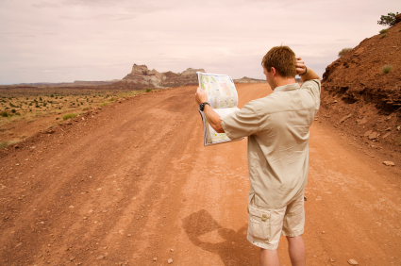
Questions
Peter Fox, president@esipfed.org
Emily Law, emily.law@jpl.nasa.gov

