Slide 1
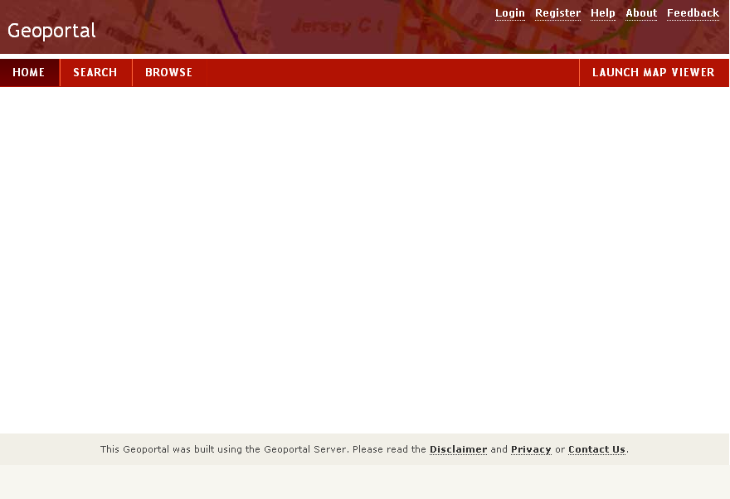
Geoportal XML Indexing
Christine White, Esri
cwhite@esri.com

Slide 2
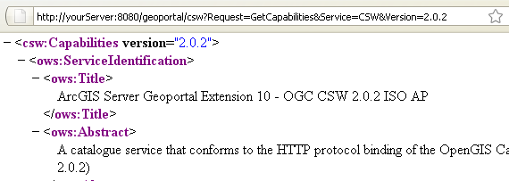
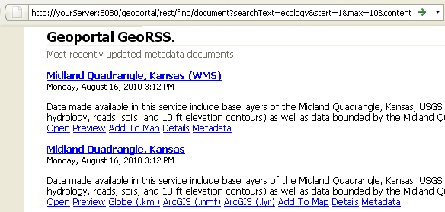
Geoportal provides services for discovery
OGC CS-W
REST
OpenSearch

Slide 3
Read: Details of Lucene Indexing in the Geoportal
Lucene: open source search engine by Apache
Content submitted for indexing will be assigned a meaning.
Meaning determines how Lucene will index the content and how it may be searched
Lucene references property-meanings.xml to index the metadata value for search and retrieval
When a user searches by ‘title’, Lucene is searching all its title indexes for the search term
You can add meanings if existing ones do not suit your organization’s needs

Slide 4
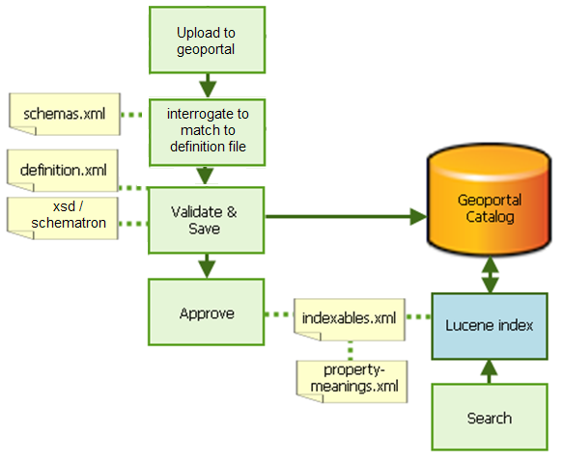
Publishing process
For GXE, the definition.xml file
calls the GXE files, which
Generate the UI and
Resulting metadata XML
GXE files

Slide 5
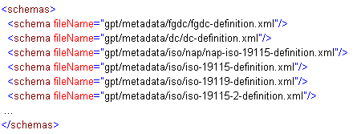
Schemas.xml—List of Schemas
Lists supported profiles
Determines order of interrogating an uploaded document

Slide 6
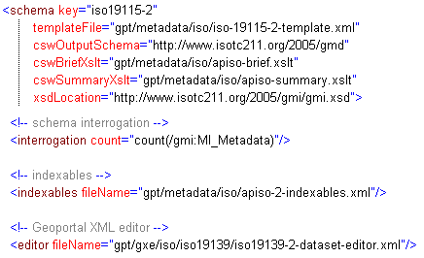
Definition file includes interrogation and validation

Slide 7
Validation Order
Geoportal will use one validation mechanism at a time; if you have enabled all three, here is what happens:
Validate based on the validation rules in the definition.xml <parameter> elements, displaying any errors found.
If you fix those problem elements and attempt to publish again, it would pass validation on the <parameter> elements, but would then show any errors that result from the xsd validation.
If you fix the problem elements and attempt to publish again, it would pass the first two mechanisms of validation and finally apply the Schematron validation, displaying errors associated with that.

Slide 8
Details page can use an XSLT - http://sourceforge.net/apps/mediawiki/geoportal/index.php?title=Use_an_XSLT_to_Render_the_Details_Page
Without an xslt, will use definition.xml file to render Details page
Only defined <parameter> elements will be displayed
Map the details XSLT parameters to a file accessible to your geoportal
Useful for more metadata to user in human-readable form

Slide 9
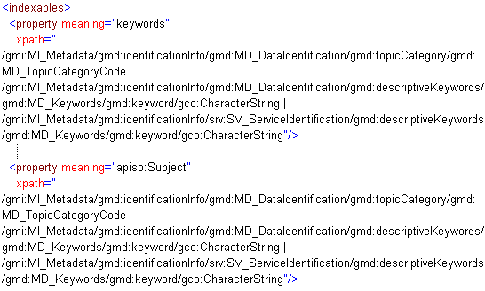
indexables.xml
Notes:
Determines what properties are queriable and how search results are returned when a user submits search criteria to the geoportal
Approved metadata document is indexed, assigning a particular meaning to certain metadata elements
'meanings’ are defined in property-meanings.xml
indexables.xml makes a connection between an element's XML xpath and its associated meaning in the property-meanings.xml file

Slide 10
Property-meanings.xml
Maps to the meanings assigned in the indexables.xml

Slide 11
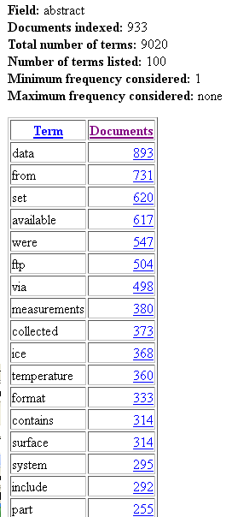
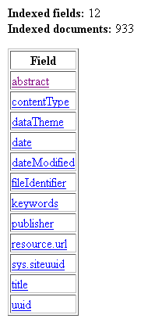
View geoportal’s lucene index
//server/geoportal/rest/index/stats/fields

Slide 12
Resources
Details of Lucene Indexing in the Geoportal
on geoportal doc wiki - http://sourceforge.net/apps/mediawiki/geoportal/index.php?title=Details_of_Lucene_Indexing_in_the_Geoportal
Geoportal Server: http://esriurl.com/geoportal
Me: cwhite@esri.com

