Slide 1
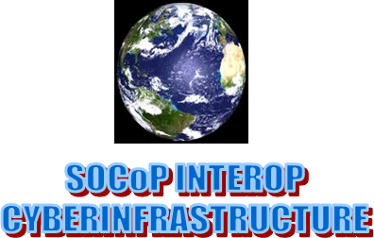
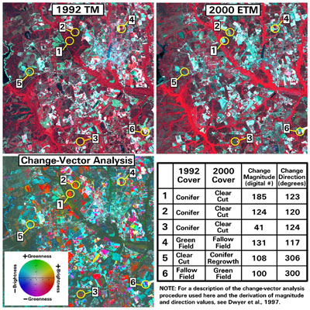
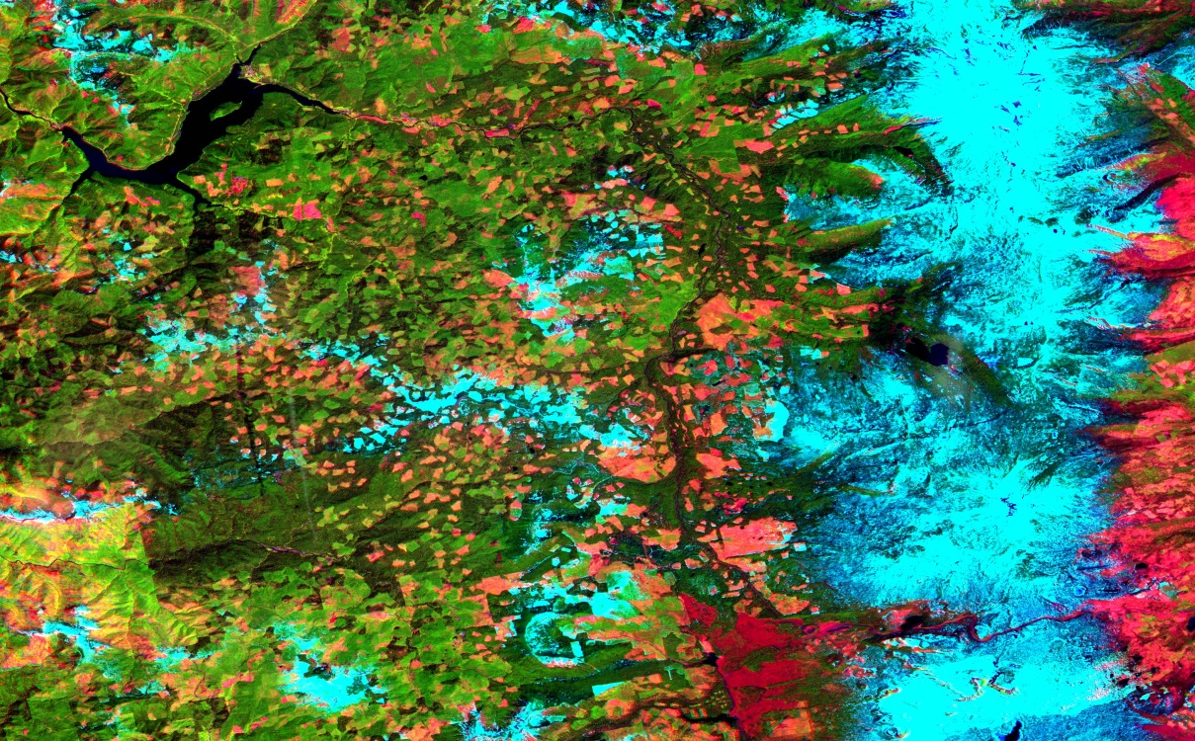
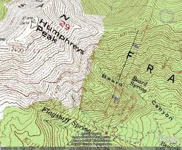
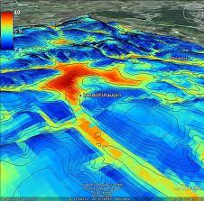
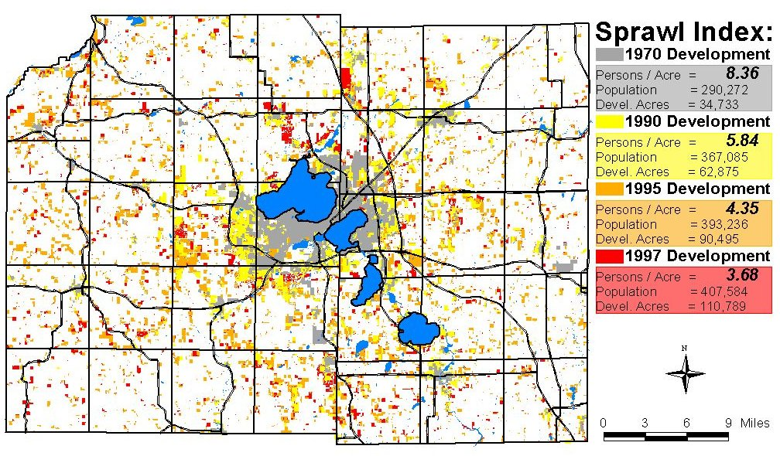
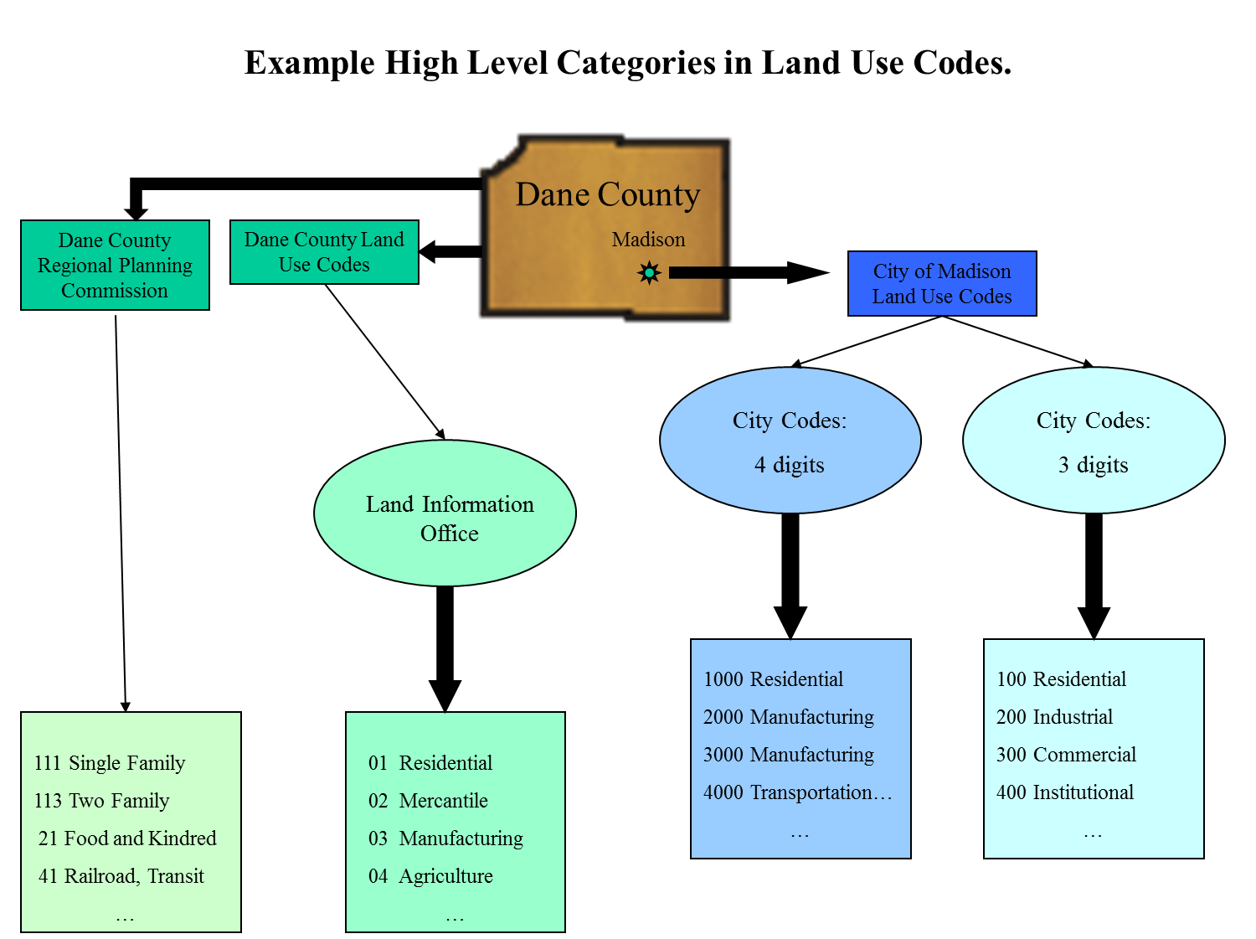
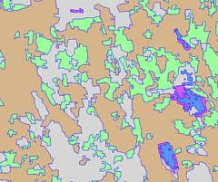
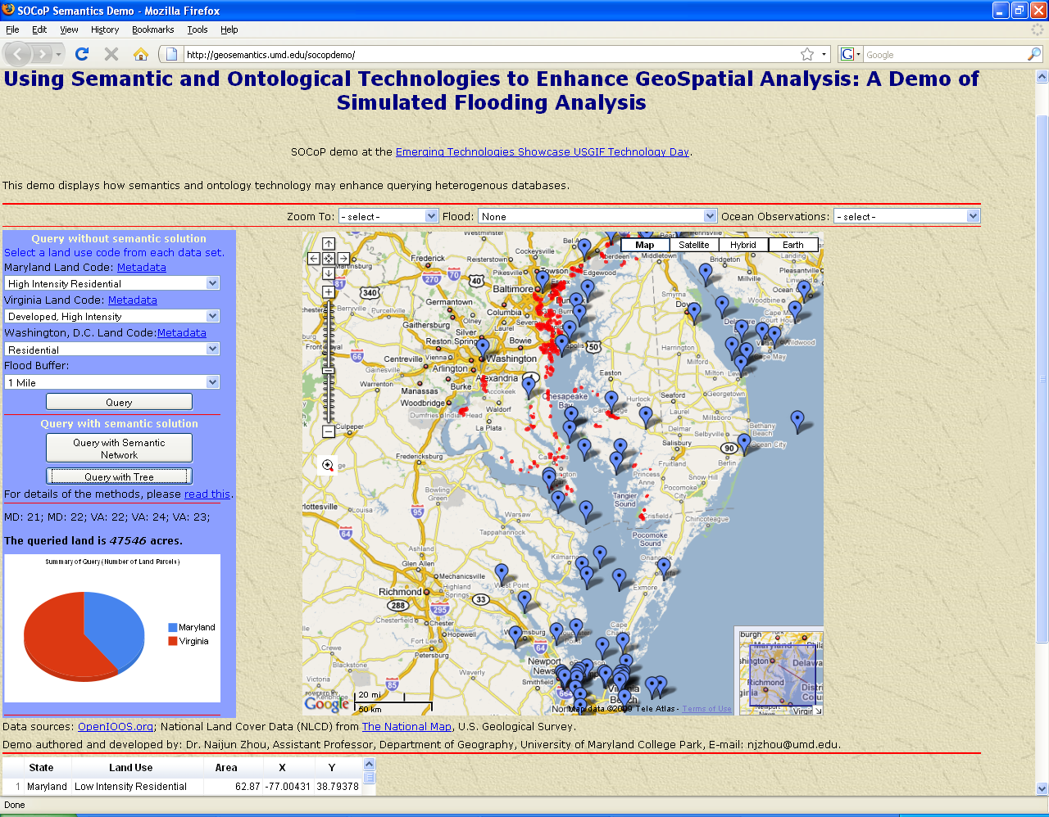
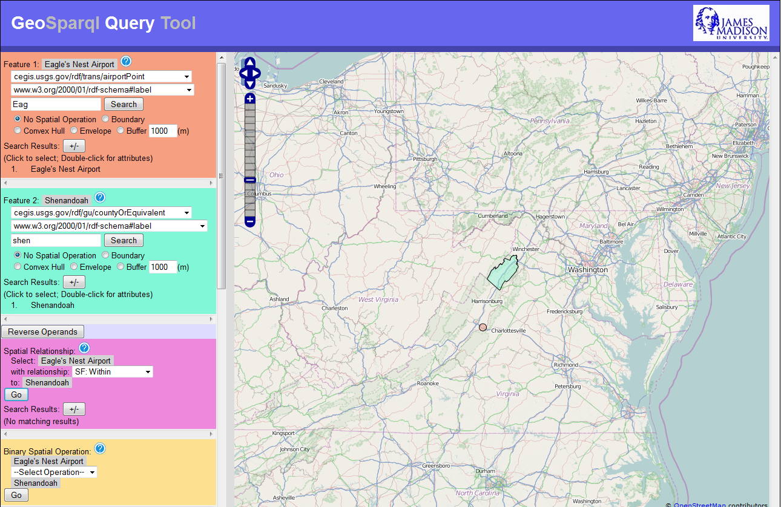
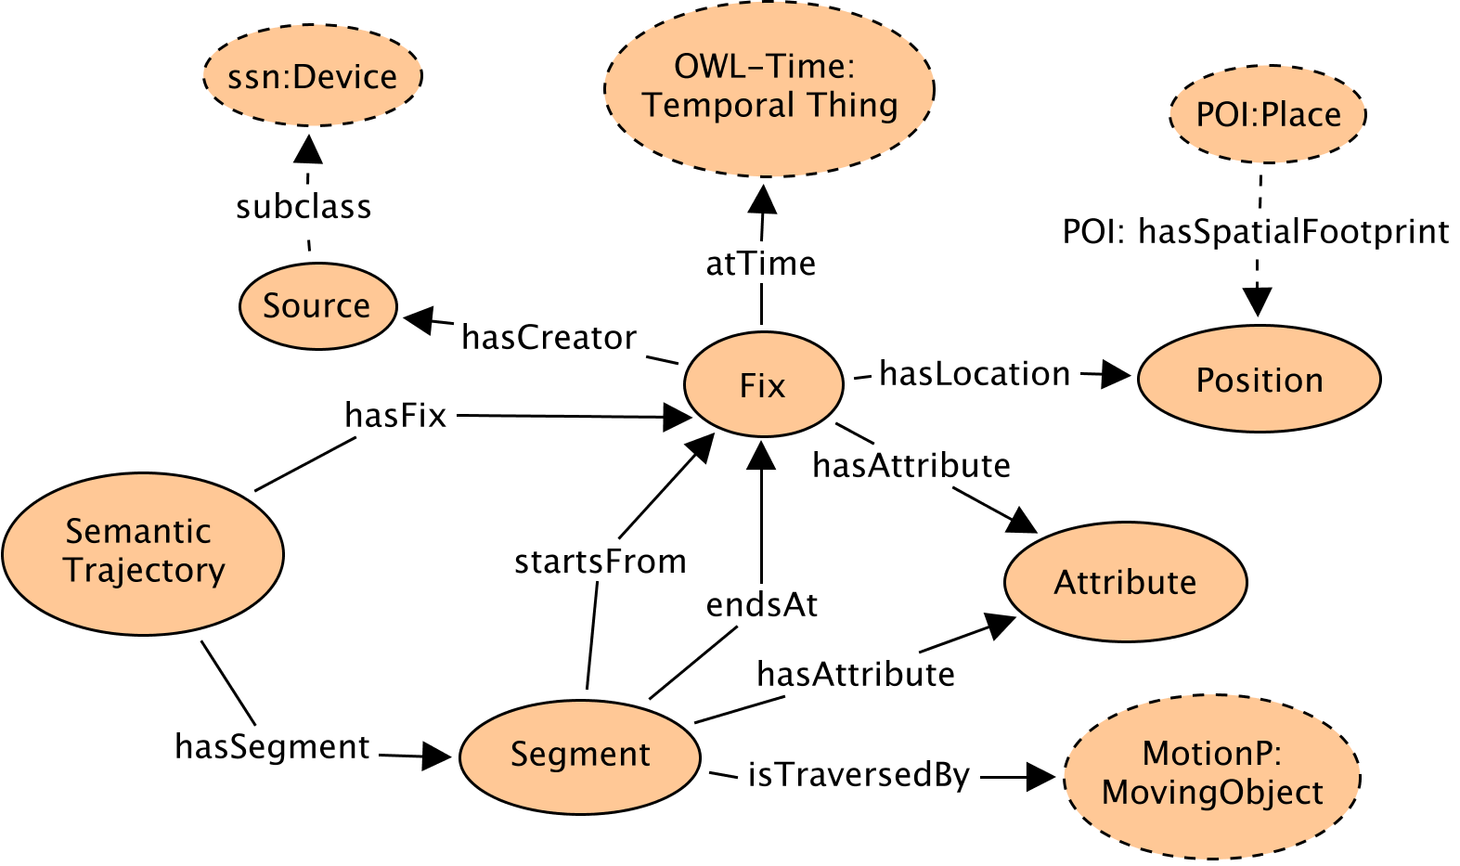
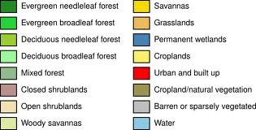
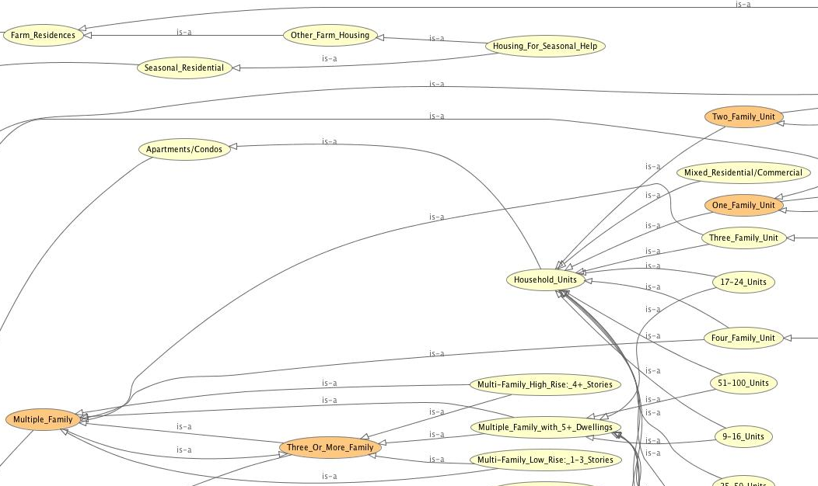
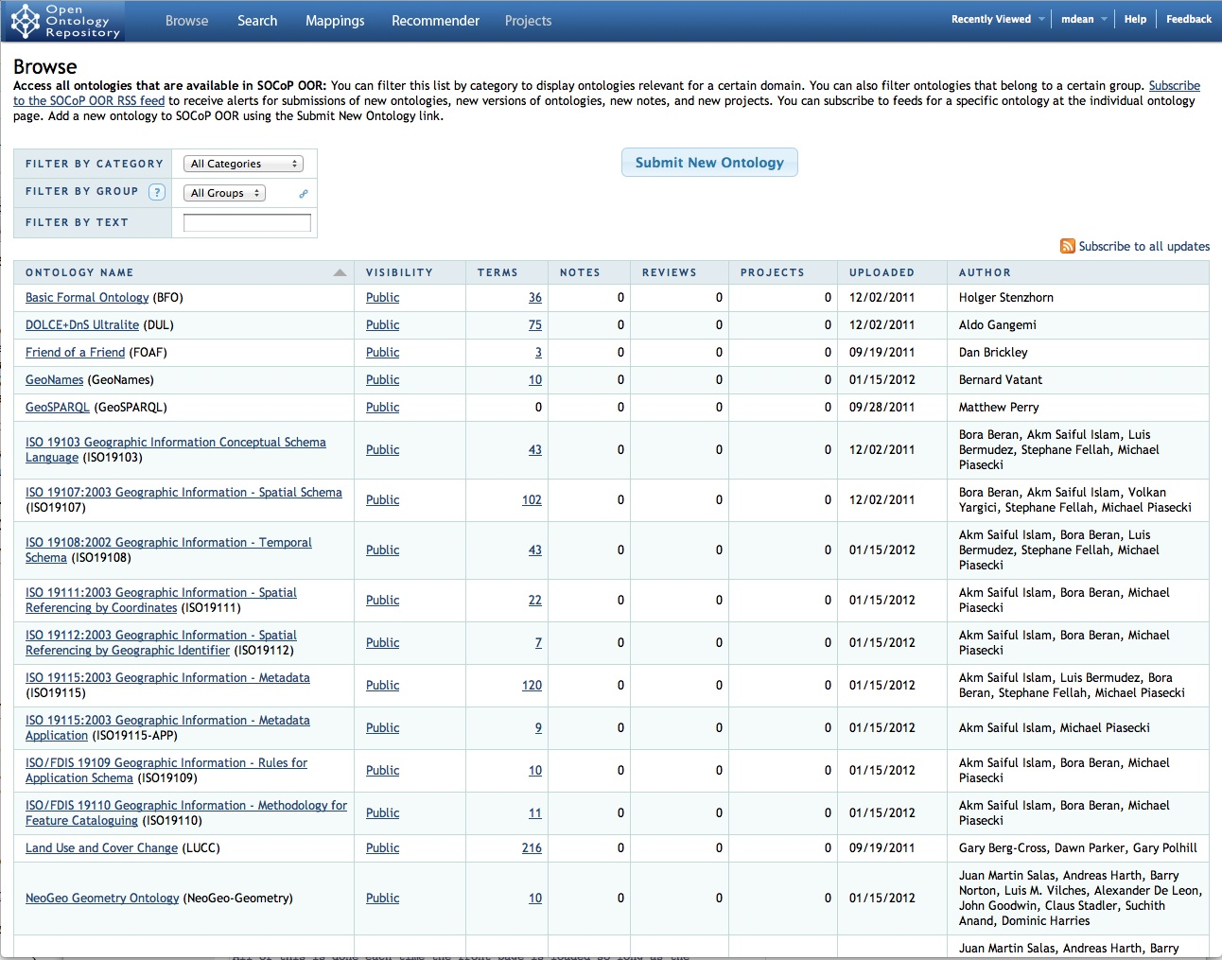
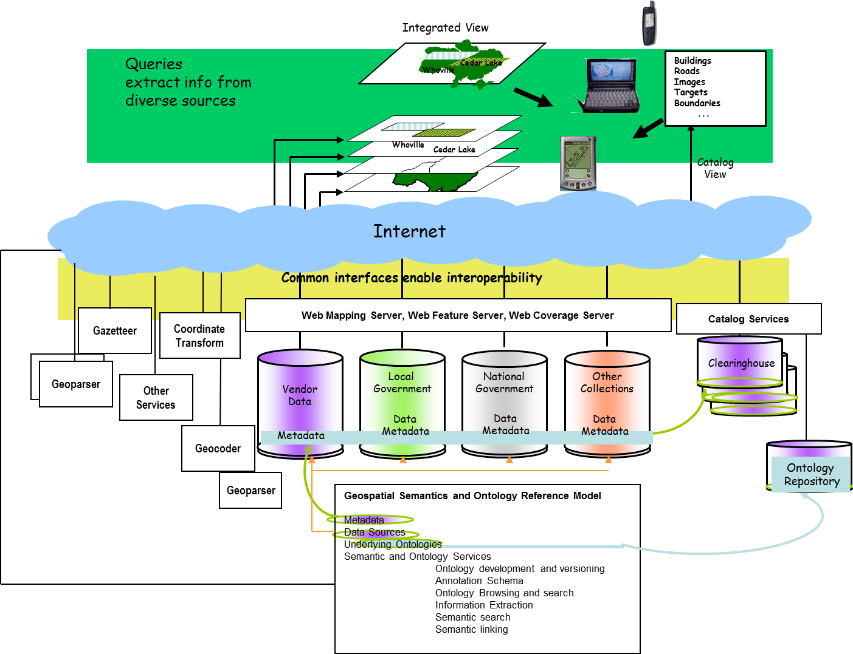
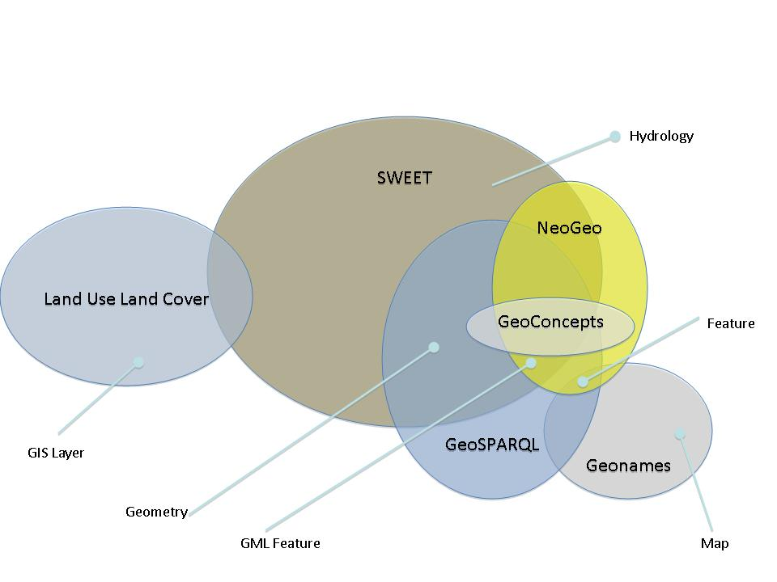
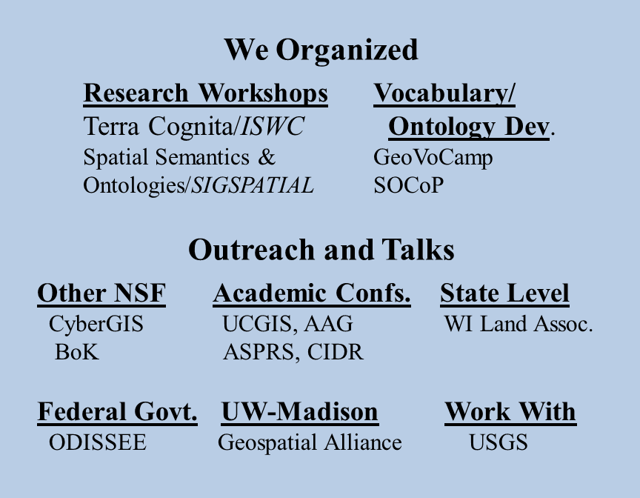
INTEROP – Spatial Ontology Community of Practice: an Interdisciplinary Network to Support Geospatial Data Sharing, Integration, and Interoperability
PIs are from SOCoP (Spatial Ontology Community of Practice, www.socop.org, interop.socop.org):
Gary Berg-Cross - Knowledge Strategies, Mike Dean and Dave Kolas – Raytheon BBN Technologies, John Moeller - JJMoeller and Associates,
Nancy Wiegand - University of Wisconsin-Madison, James Wilson - James Madison University, Peter Yim - CIM3 Engineering, Inc., Naijun Zhou - University of Maryland College Park
Goals
Apply and develop semantic technologies for the Geospatial domain
Share ontologies to promote data interoperability
Geospatial Data
Need for Ontologies
Ontology Design Patterns (ODP)
A Geo-Ontology Design Pattern for Semantic Trajectories. Yingjie Hu, Krzysztof Janowicz, David Carral, Simon Scheider, Werner Kuhn, Gary Berg-Cross, Pascal Hitzler, Mike Dean, Dave Kolas,
In: Thora Tenbrink, John G. Stell, Antony Galton, Zena Wood (Eds.): Spatial Information Theory - 11th International Conference, COSIT 2013, Scarborough, UK, September 2-6, 2013. Proceedings. Lecture Notes in Computer Science Vol. 8116, Springer, 2013, pp. 438-456.
Demonstrations using Ontologies
GeoQuery Tool
For GeoSPARQL Queries
Residential Land Use Ontology
Education
Identify Linkages with the UCGIS GIS&T BoK
Conceptual Foundations (CF1-1)
Metadata, standards, and infrastructures (GD12-2)
Critical GIS (GS7-1)
Undergraduate Curriculum Development
Geog465: Topics in GIS: Geospatial Ontologies & Semantics,
James Madison University
GeoSPARQL tutorial on the Wiki page
Open Ontology Repository (OOR)
http://socop.oor.net
SDI Architecture
Some Ontologies in our Repository &
Notional Ideas of Overlap
Broaden the Network - Outreach
NSF Program: Community-based Data Interoperability Networks (INTEROP)
Note: The material on this poster is based upon work supported by the National Science Foundation under Grant No. 0955816. Disclaimer: Any opinions, findings, and conclusions or recommendations expressed in this material are those of the authors and do not necessarily reflect the views of the National Science Foundation.

