Slide 1
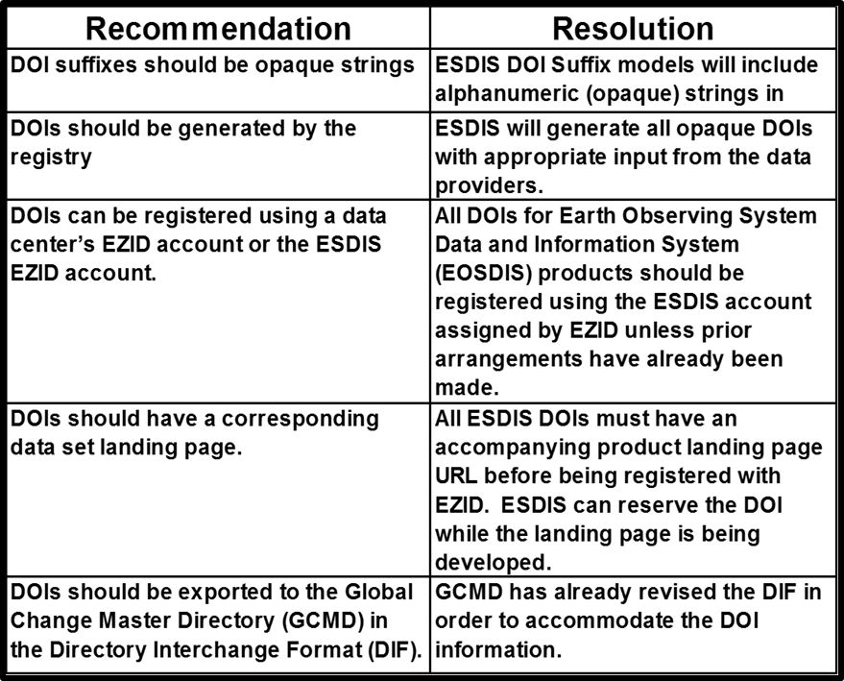
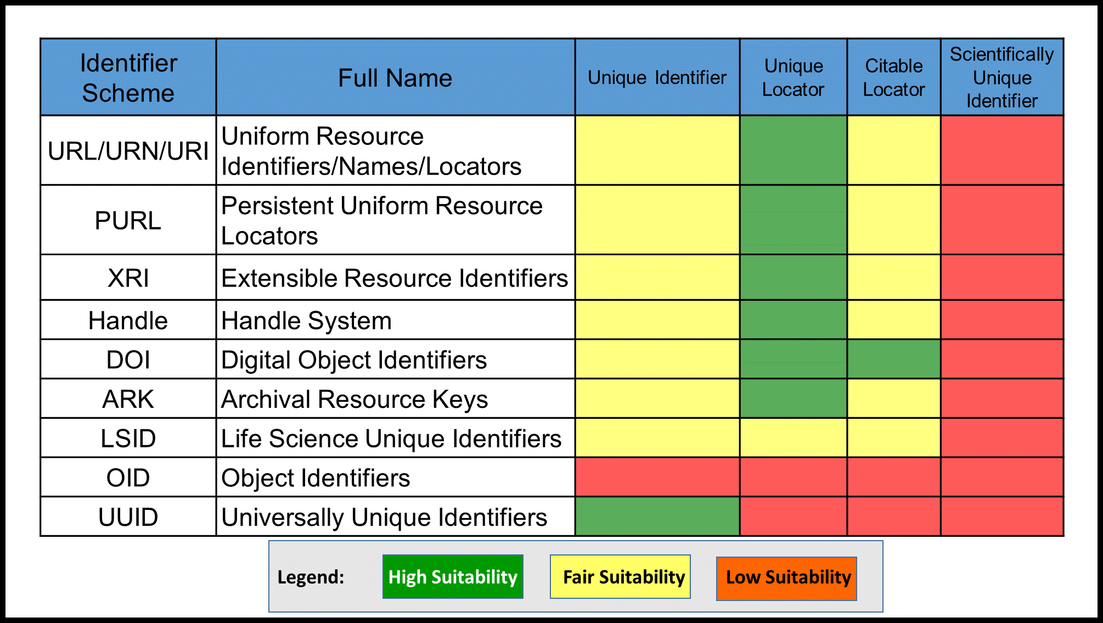
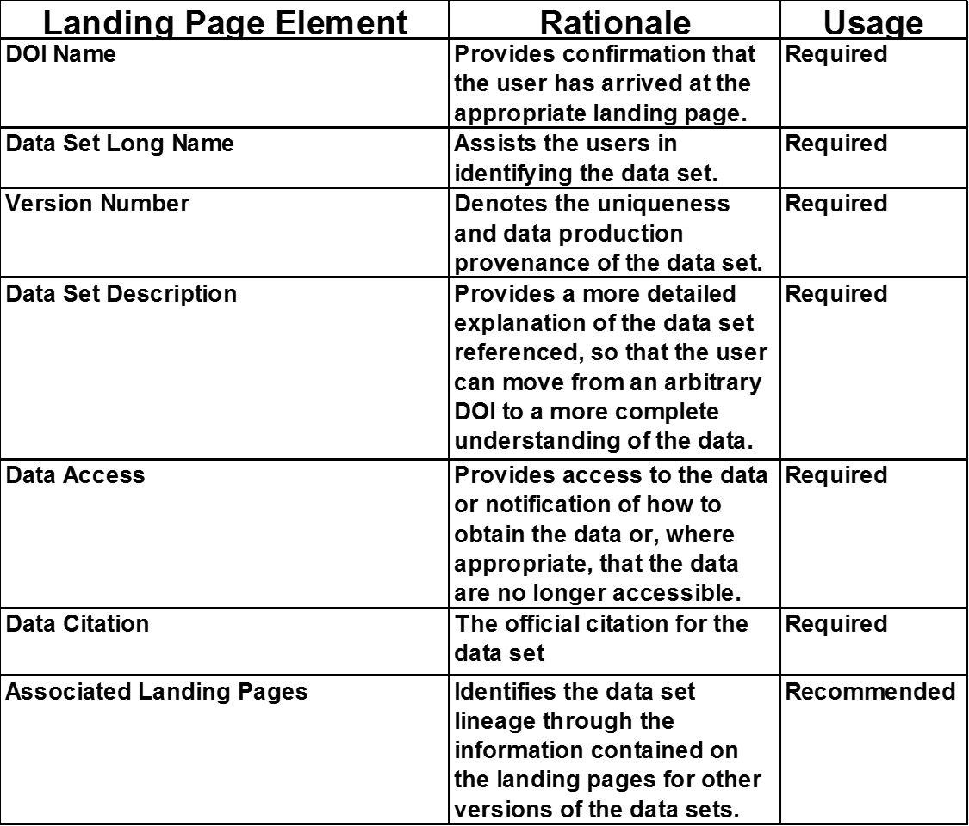
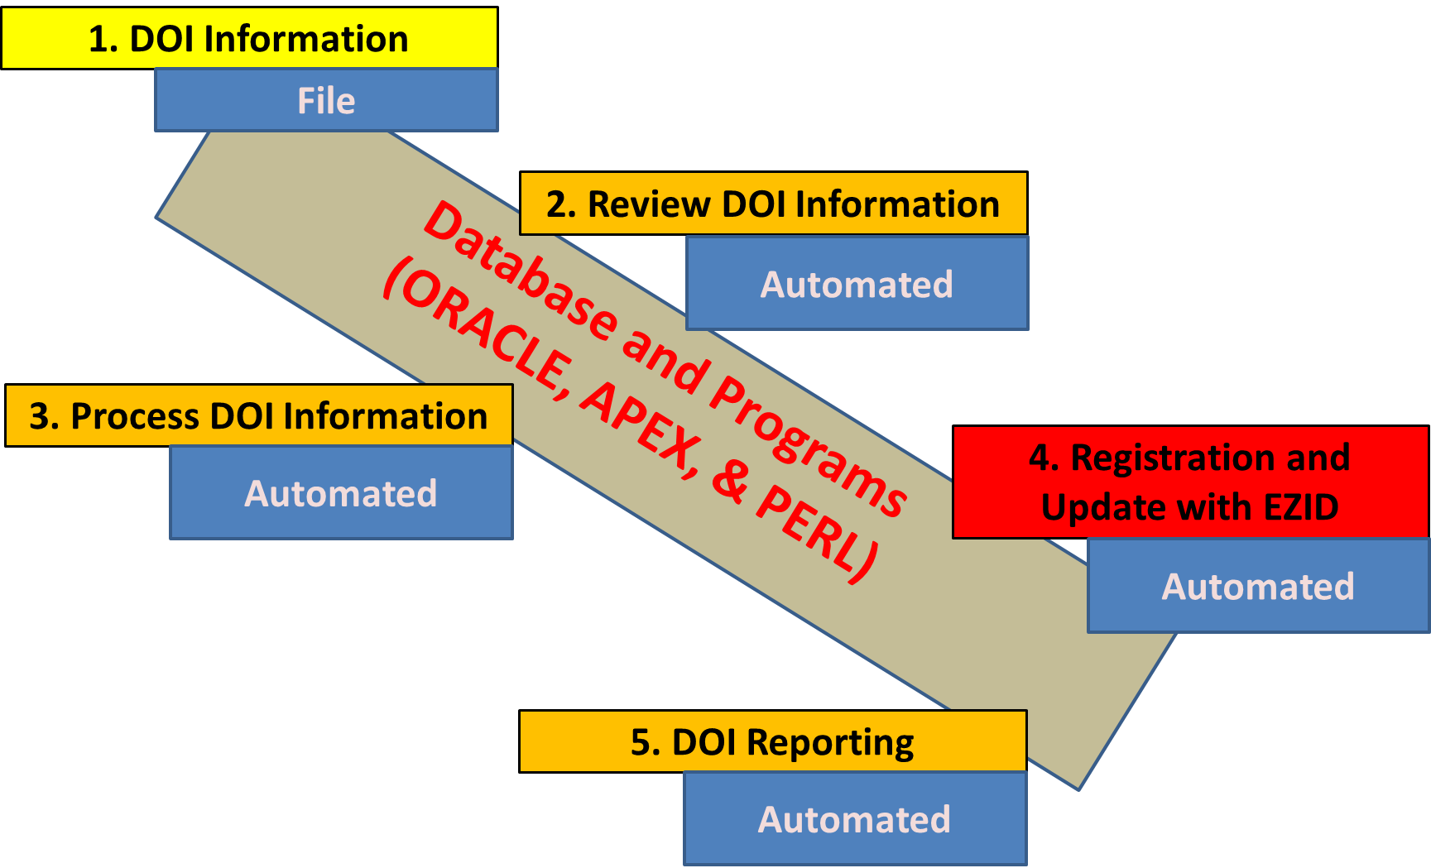
AGU Paper Number: IN43B-1697
Evolving a NASA Digital Object Identifiers System with Community Engagement
Lalit Wanchoo¹ (lalit.wanchoo@nasa.gov) and Nathan James² (nathan.l.james@nasa.gov),
¹ ADNET Systems, Inc., 7515 Mission Drive, Suite A100, Lanham, MD 20706 , ² Earth Science Data and Information System Project (Code 423), NASA Goddard Space Flight Center, Greenbelt, MD 20771
Introduction
In 2010, NASA’s Earth Science Data and Information System (ESDIS) Project began investigating the assignment of unique identifiers to its suite of data products being stewarded at different data centers across the country. This led to the use of Digital Object Identifiers (DOIs) and the development of an automated system for the registration of the DOIs.
A key factor in the successful evolution of the DOI registration system has been the incorporation of community input. Over the last three years, ESDIS solicited community input for making the DOI registration process more efficient from three focus groups under NASA’s Earth Science Data System Working Group (ESDSWG). These groups were largely composed of DOI submitters and data curators from the 12 data centers serving user communities of various science disciplines. The suggestions from these groups were formulated into recommendations for ESDIS consideration and implementation.
The ESDIS DOI registration system has evolved to be fully functional with over 3,500 publicly accessible DOIs and over 200 DOIs being held in reserve status until the information required for registration is obtained. The goal is to assign DOIs to the entire 7000+ data collections under ESDIS management via its network of discipline-oriented data centers.
ESDIS established user working sub-groups through Earth Sciences Data Systems Working Group (ESDSWG) to gather input and evaluate the DOI System and Services. These groups addressed each of the identified components of the community engagement approach and approaches as implemented by ESDIS are described in the following sections:
In addition, the group evaluated the information that is made available to the people who are assigning DOIs to the products. Recommendations for the current practices made by this working group and the action taken by the ESDIS are shown in Table 2. These recommendations were accepted and implemented.
Table 2: Current Practices Recommendations
Selection of Identifier Scheme
ESDIS gave responsibility to a group that included experts from various Distributed Active Archive Centers (DAACs) to evaluate the various available schemes for assigning permanent identifiers to data products distributed by various DAACs. This group evaluated nine applicable schemes as shown in Table 1.
Recommendations:
Assign Universally Unique Identifiers (UUIDs) for each data ﬁle or granule in datasets.
Assign a DOI for each dataset so that they may be cited.
ESDIS accepted the recommendations and selected the use of DOIs as the identifier scheme for all the ESODIS products..
Usage and Feedback
To promote consistency, discoverability, and usefulness across NASA, the ESDSWG established three working groups to analyze the implementation and the DOI usage. These groups recommended the landing page and data citations requirements for the data products that are distributed by EOSDIS. Such recommendations, listed in Tables 3 and 4, were accepted and implemented. The Data Citation group used the Mandatory and Suggested content for citations given in the Data Citation Guidelines for Data Providers and Archives document developed and approved by the Federation of Earth Science Information Partners (ESIP) Federation. Theses guidelines shall be followed to the greatest extent possible in developing suggested citations.
Table 1: Suitability Assessment of Selected Identifier Scheme
Objective
To demonstrate how the ESDIS DOI processes and system evolved over these years based on the recommendations provided by the user community (whether the community members create and manage DOI information or use DOIs in the data citations)
The user community is a group of people who have common interest and needs for the identifiers and are actively involved in the creation and usage process. Engagement is the set of interactions through which the community provides information, evaluates the proposed processes, and provides guidance in the area of identifiers.
Adapted from Duerr, R. E., et al.. 2011. On the utility of identification schemes for digital Earth science data: An assessment and recommendations. Earth Science Informatics. DOI 10.1007/s12145-011-0083-6
Table 3: Landing Page Recommendations
Table 4: Data Citation Recommendations
System Development
ESDIS developed a system that addressed the needs of the community and provided a process that allowed identifiers to be reserved and registered. The operational system is fairly automated and uses a Perl script with an Oracle database for the data. The system functionality provides reports using Oracle Apex.
Benefit of the Community Engagement
Development and implementation of processes, services, and systems that best serves the user community.
Conclusion
The ESDIS DOI System and the process for the registration have been primarily developed based on the input from the EOSDIS community and have been successfully operating for last four years. The system has processed over 5,000 DOI requests from 11 data providers (see Figure 2). Currently, the System has registered over 4,000 DOIs.
Figure 2: Monthly DOI Requests Received by ESDIS for Registration
Community Engagement Approach
Selection
(Identifier Scheme)
System
(Design, Development, &
Testing)
Figure 1: Components of ESDIS DOI Registration and Managing System
Feedback
DOI System
and Service
System Evaluation
The ESDSWG established a DOI Working Group to analyze the approaches and practices for DOI usage across the Earth Observing System Data and Information System (EOSDIS) data centers and DAACs. This group analyzed the process undertaken by the ESDIS in reserving and registering the DOIs..
System Usage
System
(Operations and Evaluation)
Acknowledgments
Lalit Wanchoo’s contributions to this study were funded through the Science and Exploration Data Analysis (SESDA III) GSFC NASA Contract No: NNG12PL17C and Nathan James’s contributions to this study were made as a part of his employment by NASA.
ESDIS DOI WIKI URL: https://wiki.earthdata.nasa.gov/display/DOIsforEOSDIS

