Slide 1

ARIA-MH: Advanced Rapid Imaging & Analysis for monitoring Hazards—
A Hybrid-Cloud Computing Approach
ESIP 2013 Summer Meeting
Chapel Hill, NC
Friday, July 12, 2013
Hook Hua¹, Susan Owen¹, Sang-Ho Yun¹, Paul Lundgren¹, Angelyn Moore¹, Eric Fielding¹, Gian Franco Sacco¹, Piyush Agram¹, Gerald Manipon^{1,} Costin Radulescu¹, Mark Simons², Paul Rosen¹, Timothy Stough¹, Brian Wilson¹, Peter F. Cervelli⁴, Michael Poland³, Jennifer Cruz¹
¹ Jet Propulsion Laboratory, California Institute of Technology
² California Institute of Technology
³ USGS Hawaiian Volcano Observatory
⁴ USGS Menlo Park Science Center
Copyright 2013 California Institute of Technology.
Government sponsorship acknowledged.

Slide 2
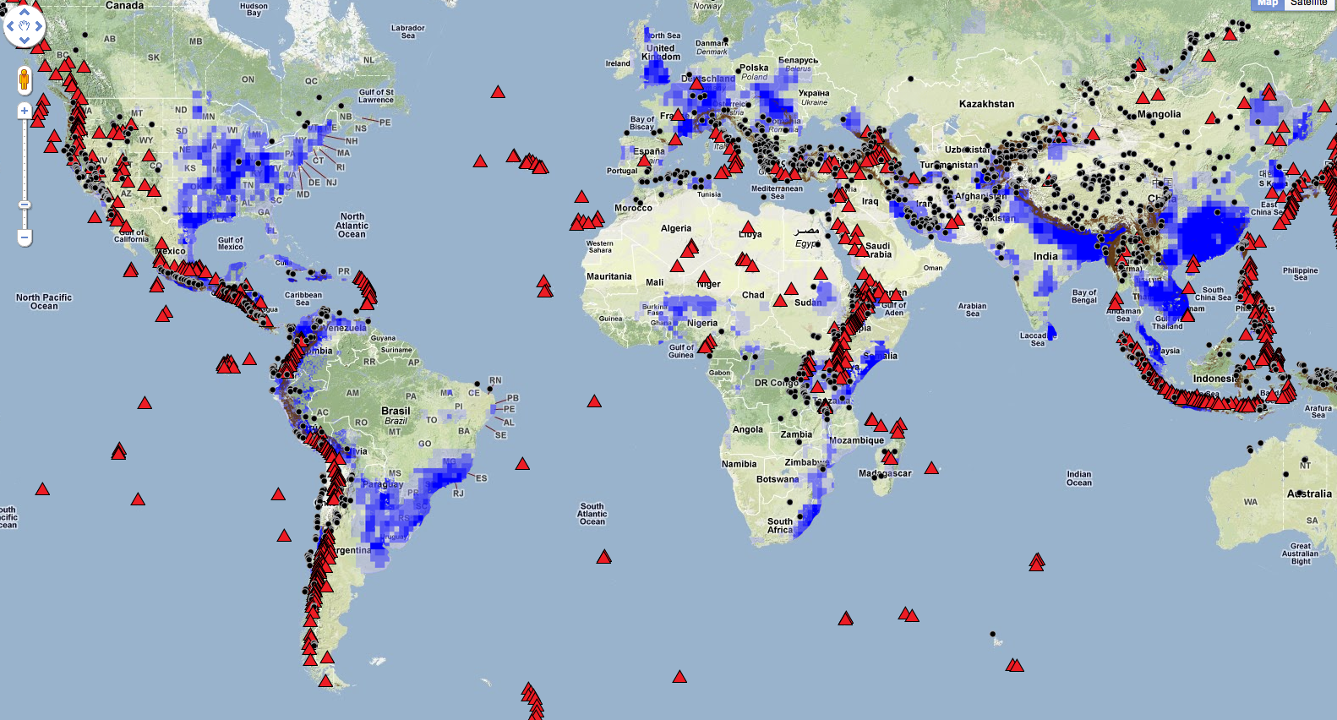
Natural Hazards
known or inferred Holocene volcanoes (Smithsonian Global Volcanism Program)
shallow earthquake epicenters (>50 km depth) on land with a magnitude of 6.5 or higher since 1976
extreme flood events (Dartmouth Flood Observatory , from 1985-2003)
subject to landslides (Norwegian Geotechnical Institute and UNEP-Grid Geneva).
Source: Sang-Ho Yun (JPL)

Slide 3
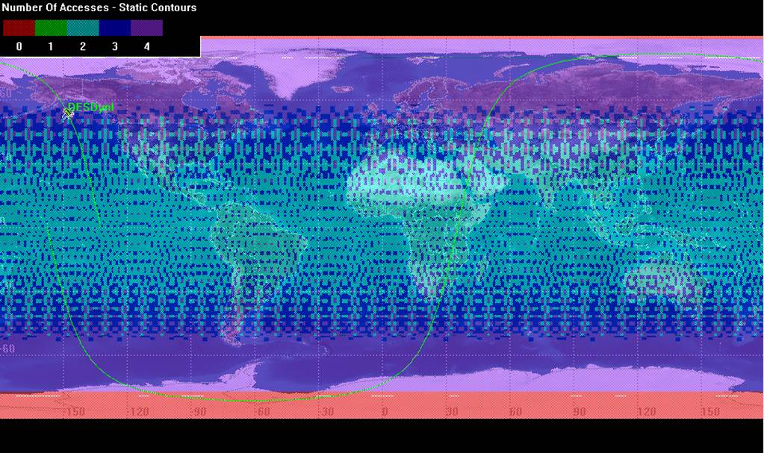
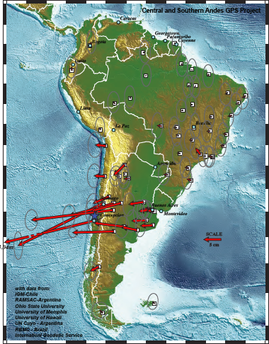
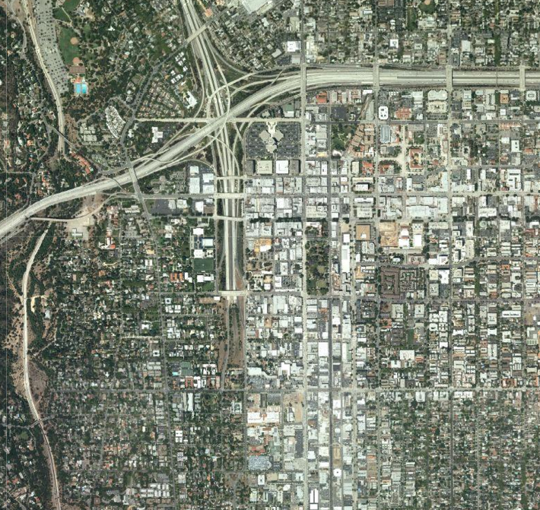
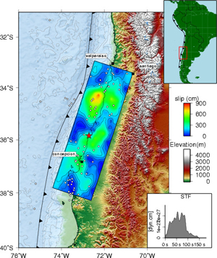
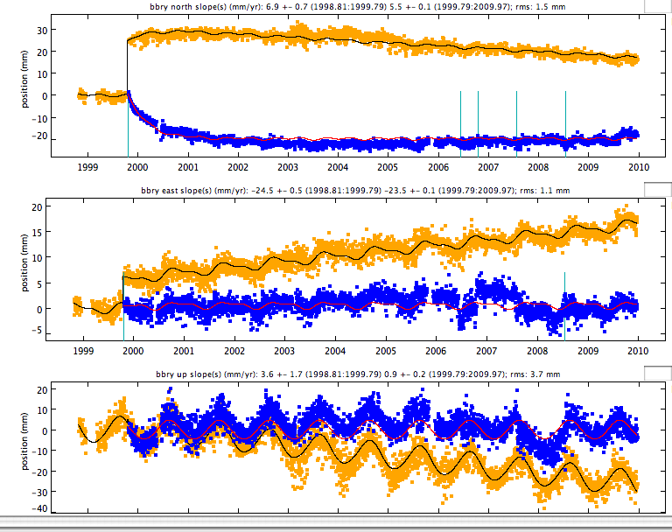
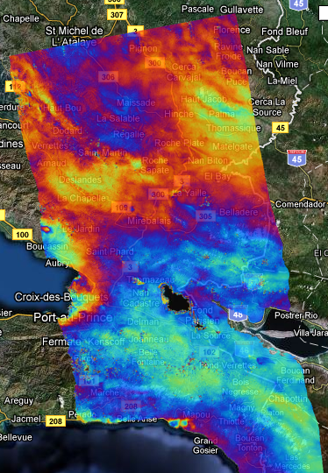
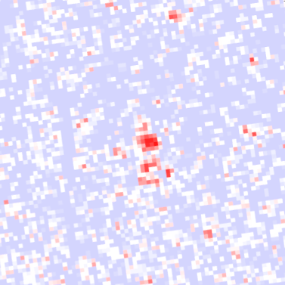
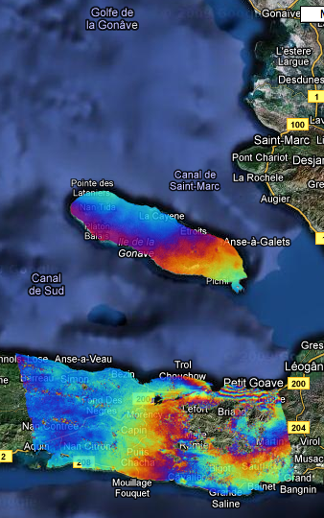
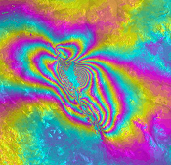
The Challenge of Leveraging
Remote Sensing for Disaster Response
Mean Access Time (Day)
∞ 4 2 1.3 1
Automated data system are required to analyze large quantities of data from LSM (formerly the DESDynI mission concept*), other satellite missions, and rapidly expanding GPS networks.
Going from Artisan to Automation: Use system engineering approach to translate specialized data analysis into operational capability.
Demonstrate response to hazards with standardized set of data products for decision & policy makers.
Temporal Records
of Ground Deformation
Spatial Maps of Ground Deformation
Coseismic Ground Deformation
Coseismic Damage
Earthquake
Models

Slide 4
Data Acquisition Latency of InSAR Missions
Expected wait time until the first SAR satellite to visit after an event
Ascending + descending orbit
Right-looking mode
Latitude of 38° N/S
Present: 15 hours
2020: 8 hours
Source: Sang-Ho Yun (JPL)

Slide 5
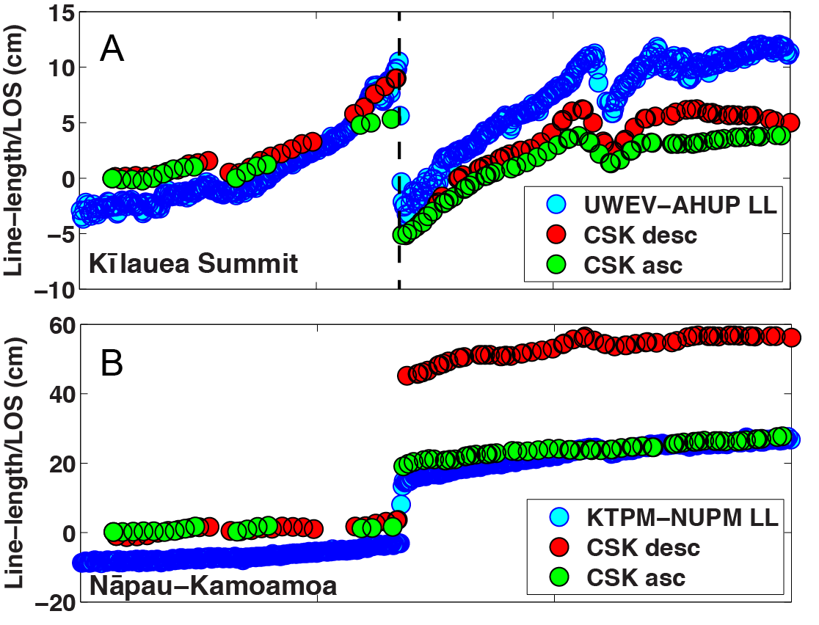
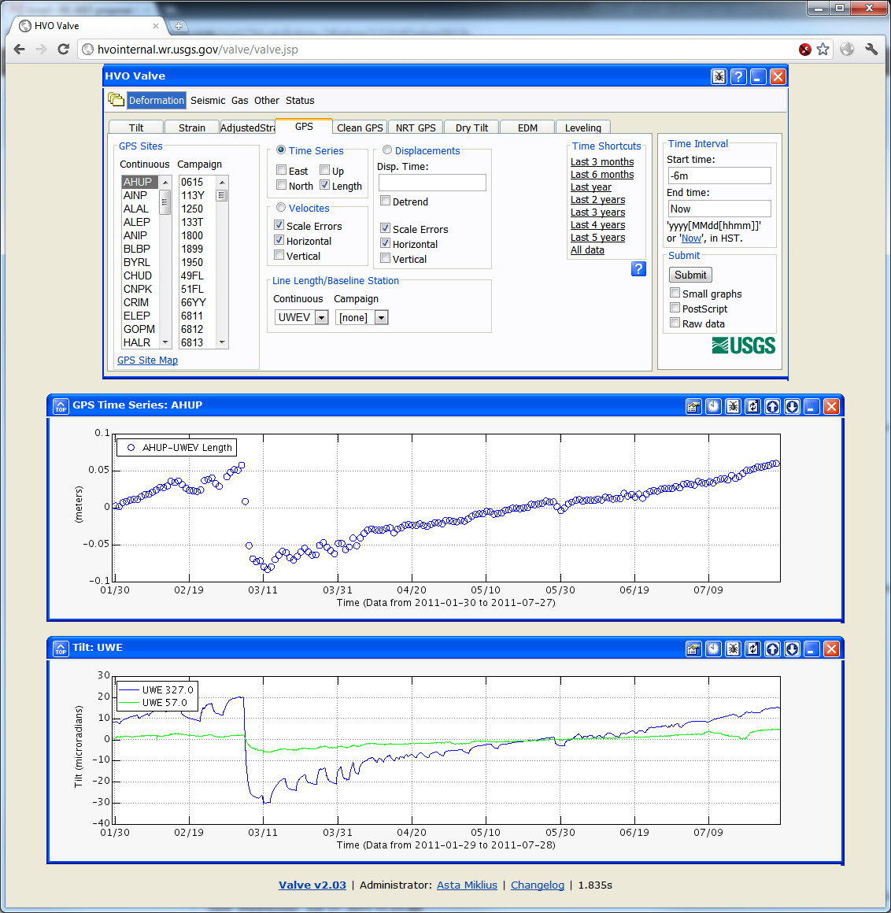
Example Use Case: Volcanology
System collects SAR and GPS data as soon as it is available from data sources.
System processes data and generates ARIA-MH data products (GPS position solutions, tropo-corrected interferograms, coherence and amplitude change maps) and pushes to USGS Hawaiian Volcano Observatory (HVO).
HVO puts products in VALVE database and accesses updated results for monitoring volcanic deformation as needed/for weekly status update meetings.
A: Kilauea summit GPS line-length (LL) and COSMO-SkyMed (CSK) InSAR time series. B: East rift zone (ERZ) near Kamoamoa dike intrusion.
The Volcano Analysis and Visualization Environment (VALVE) application that is used at multiple USGS Volcano Observatories.

Slide 6
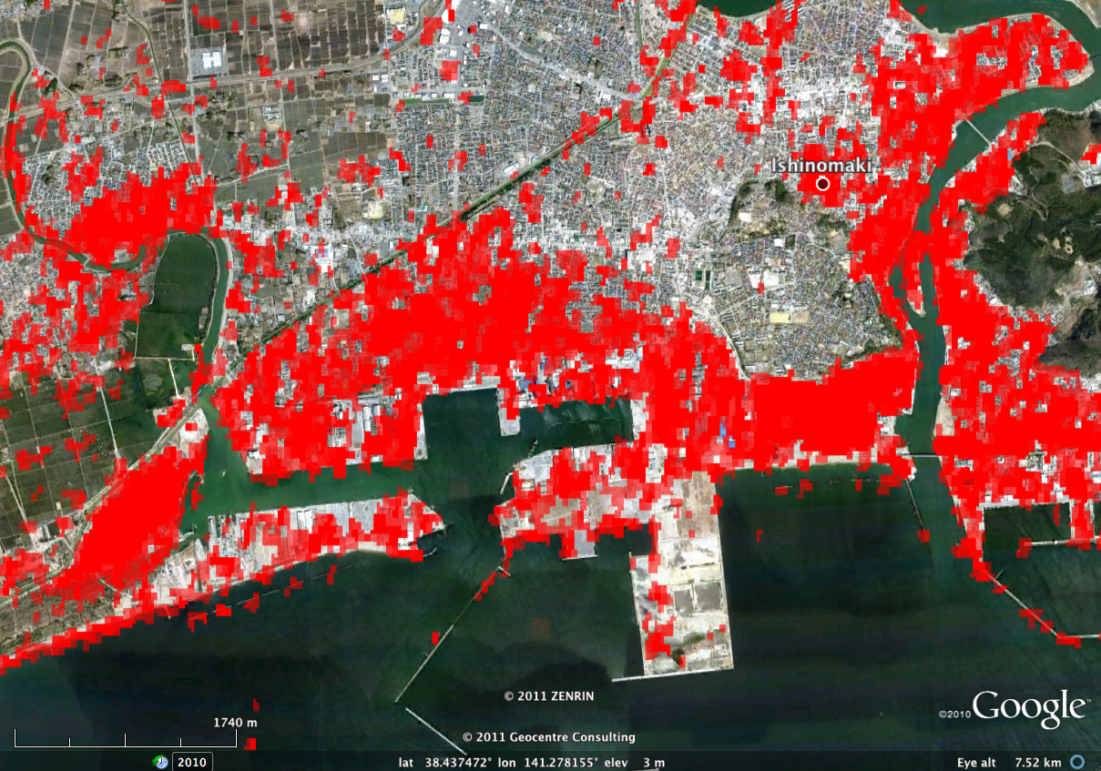
Example Use Case:
Event Data Product Request
Following an event (e.g., eruption, flood, fire, landslide), user requests data products before and following event.
User specifies region, time range, and data products. User specifies if would like updated data products as more data becomes available.
If system has not already collected and processed data from this region, system downloads and processes data, generates requested data products, and either pushes to user or notifies user that products are available for download (email, atom/RSS feeds, or notifications to USGS PDL system).
User may use portal to visualize data products . Similar data pushes/alerts are sent as new data from region becomes available.
Damage Proxy Map of flooding in Ishinomaki, Japan caused by Tohoku Tsunami. Envisat (ESA, C-band) ASAR 2011.01.31-2011.03.02-2011.04.01 (courtesy of S-H Yun)

Slide 7
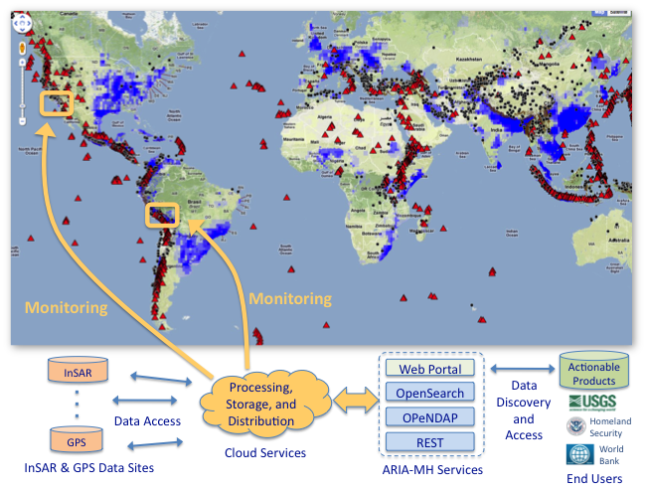
Approach

Slide 8
Data Products
Product | Needs/Applications
GPS time series and displacements | Forms the basis for higher level products. Provides high temporal resolution for monitoring surface deformation, transient detection.
InSAR displacements | Forms the basis for higher level products. Provides high spatial resolution maps of surface deformation for assessing hazards.
Coherence Change maps and time series | Detects damage from lava flow, ash fall, earthquakes, landslides, levee failure, floods, etc. Very useful with all-weather day/night capability and comprehensive coverage. U.S. patent for algorithm (Yun et al., 2011b).
InSAR Time Series | Provides history of surface deformation with high spatial resolution, input for data fusion and transient detection.
Reflectivity Change maps | Detects damage from flood and tsunami. Can provide volcano monitoring capability. Very useful with all-weather day/night capability and comprehensive coverage.
Troposphere-corrected interferograms | Higher fidelity surface deformation measurements.
Combined GPS and InSAR 3D surface motion maps | High spatial and temporal resolution products for monitoring. Provides basis for transient detection.
Advisory Alerts of anomalous ground motion | Identifies regions that need further investigation. Useful for regions where data set is too large to evaluate manually

Slide 9
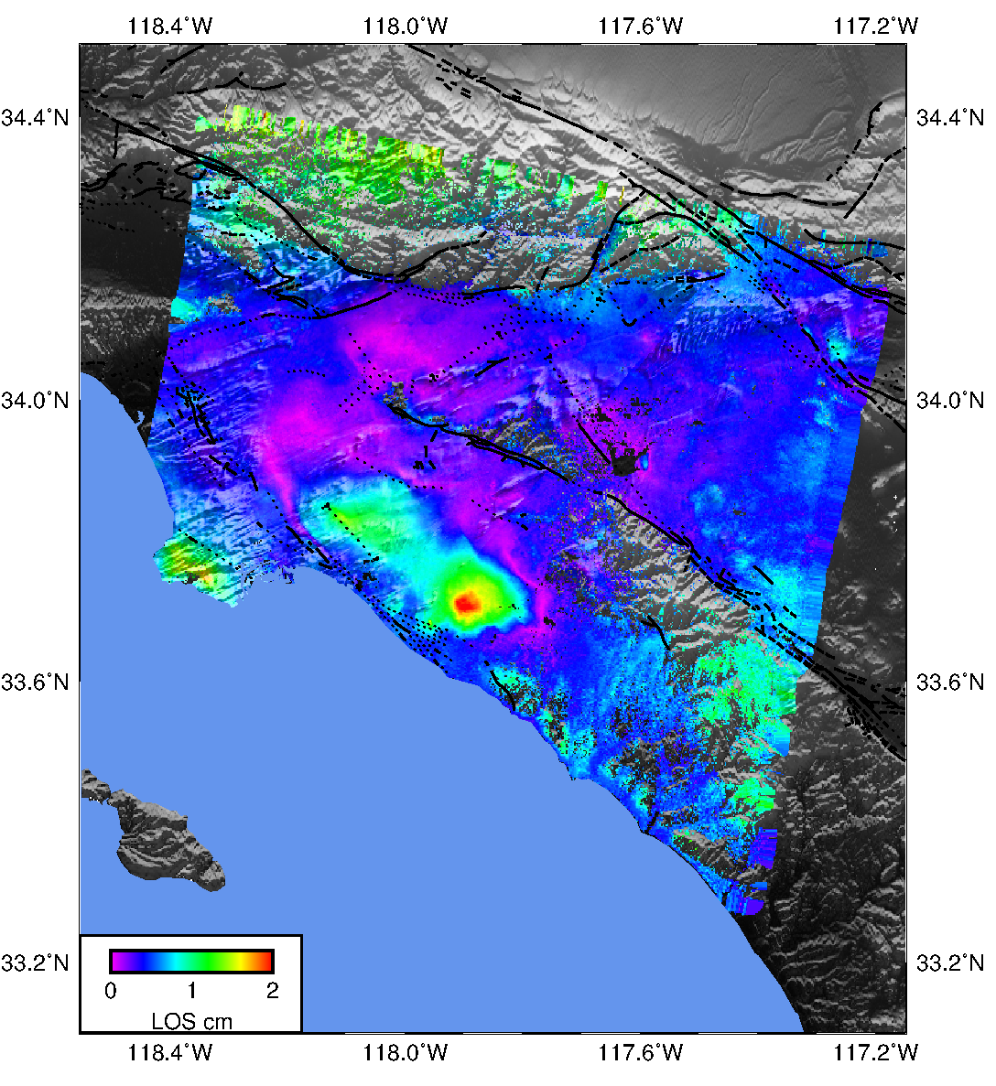
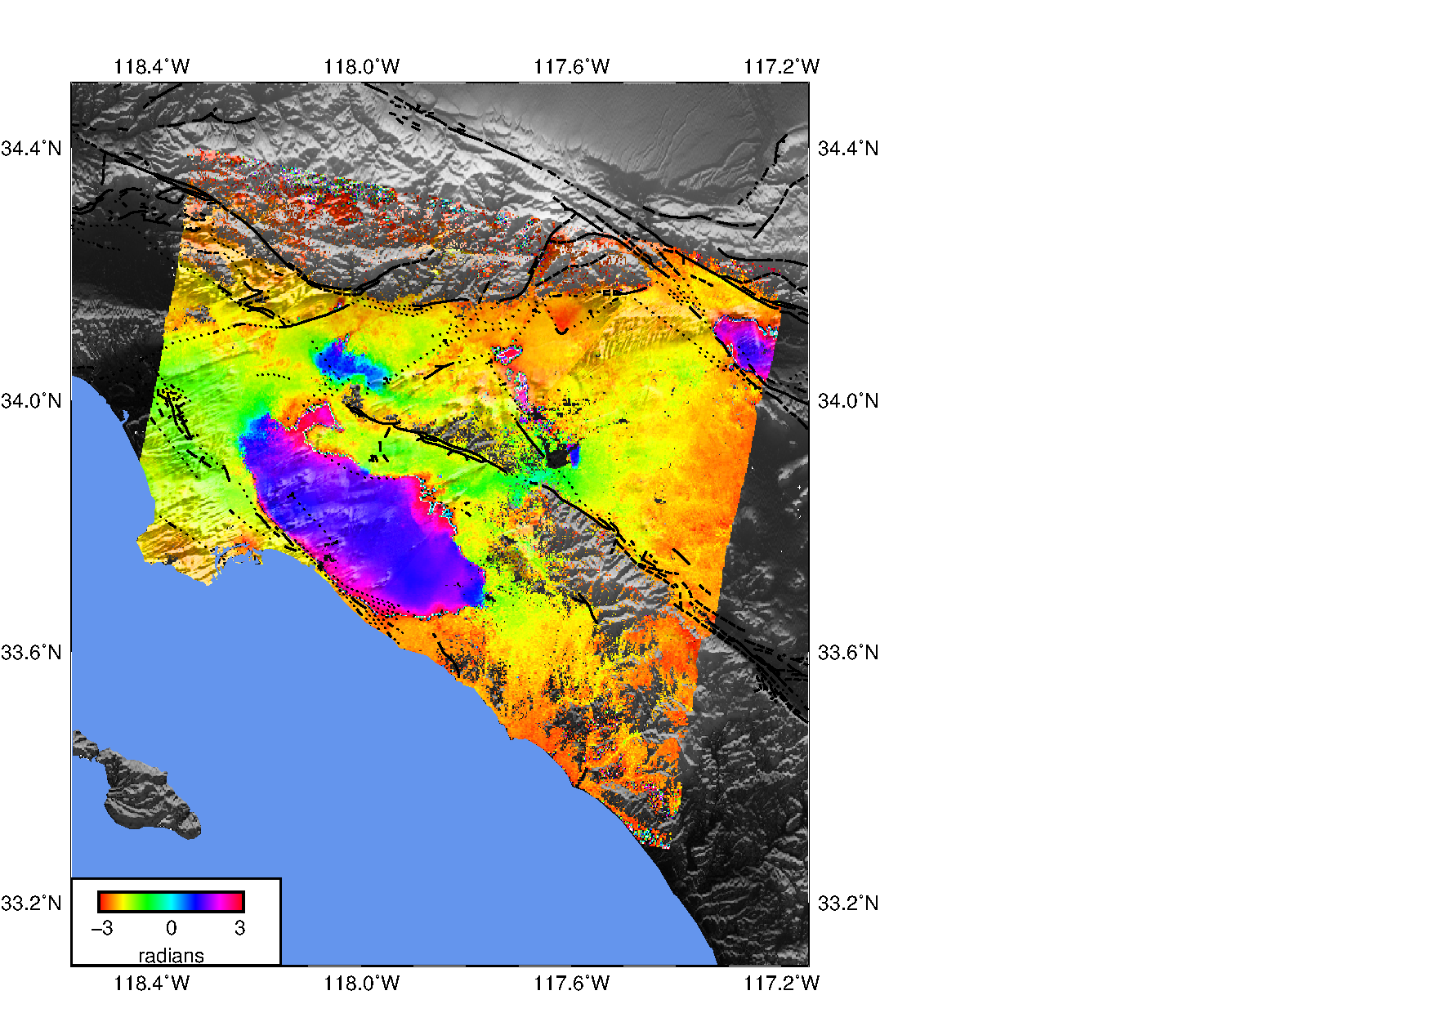
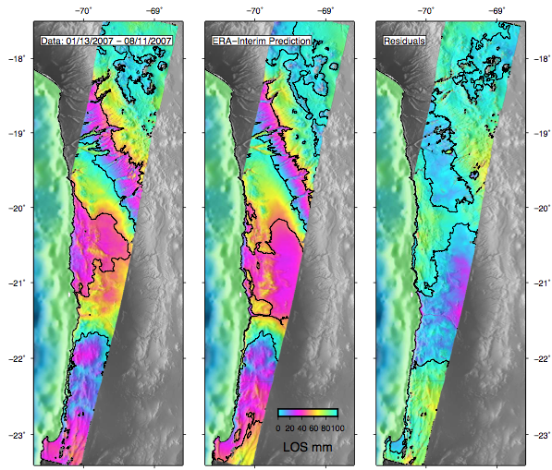
InSAR Time-Series Analysis
Common framework for time-series analysis
Multiple algorithms
State-of-the-art InSAR corrections
Interface for handling GPS and weather model data
Time-series and uncertainty products
Amplitude
Phase
Example analysis
Seasonal signal over LA
Example correction
Atmosphere over South America
Agram et al (2013), New Radar Interferometric Time Series Analysis Toolbox Released, EOS Trans. AGU, 94(7), 69.
Website: http://earthdef.caltech.edu
Data
ECMWF

Slide 10
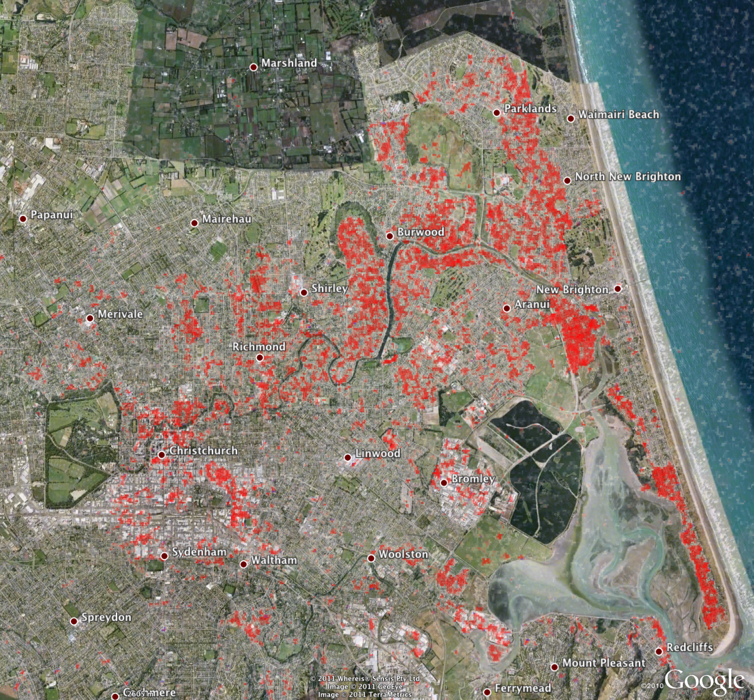
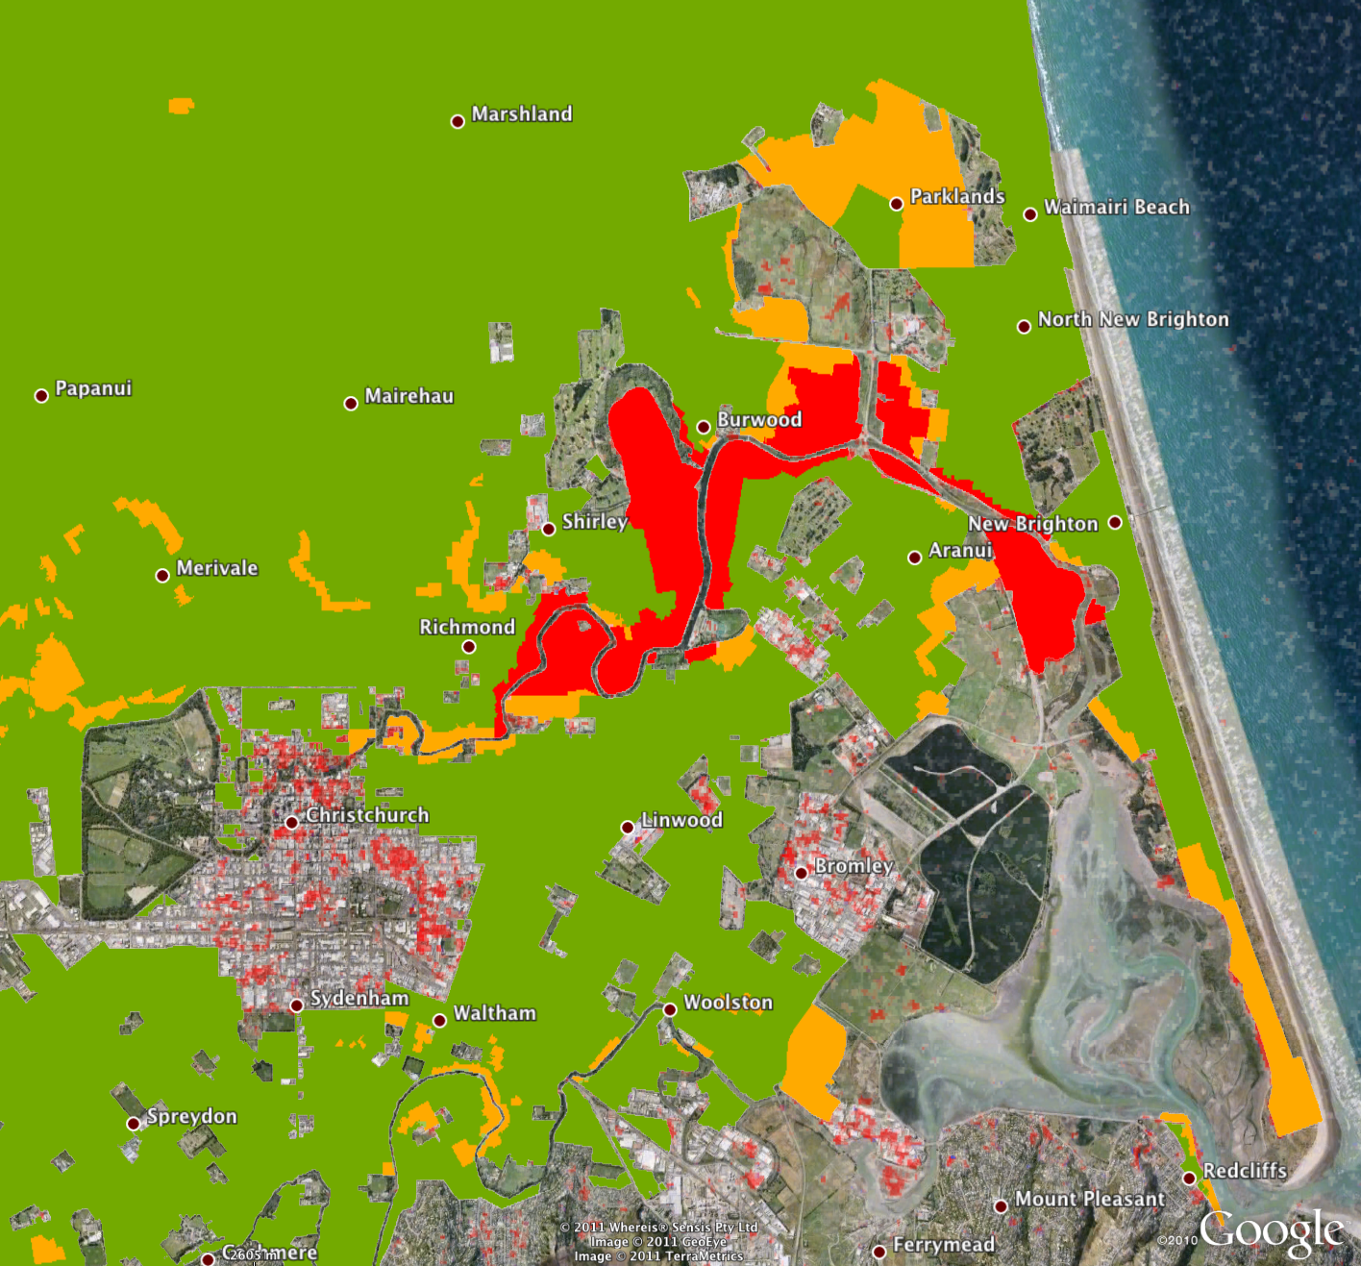
Damage Proxy Map vs Ground Truth
Damage Proxy Map (ALOS PALSAR A335):
2010.10.10 – 2011.01.10 – 2011.02.25
Google Earth (GeoEye) Image: 2011.02.26
2011.06.22 version
Sourced from geospatial.govt.nz, Created by Tonkin & Taylor NZ for CERA (Christhurch Earthquake Recovery Authority)

Slide 11
Damage Proxy Map (DPM)

Slide 12

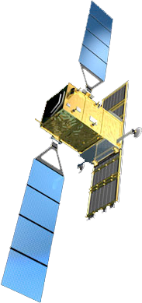
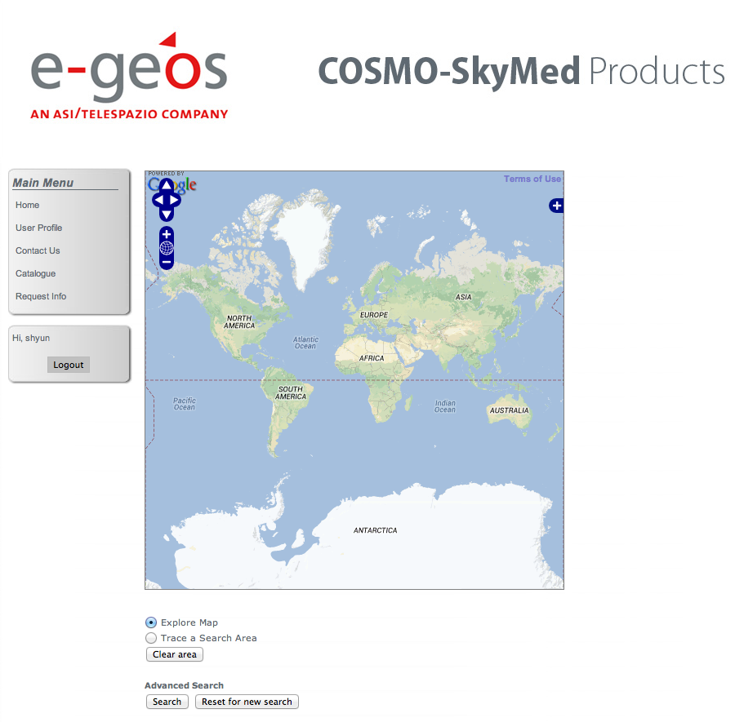
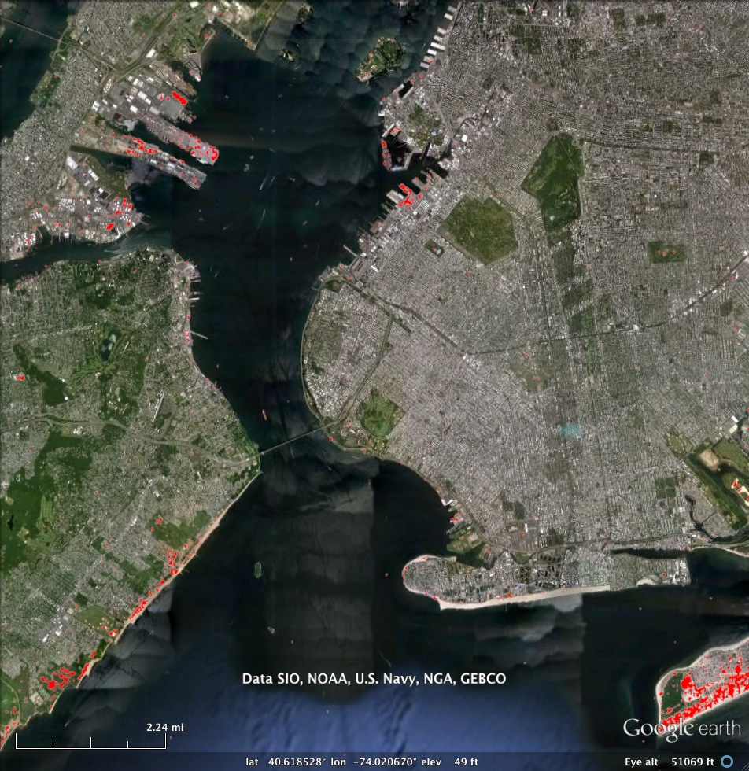
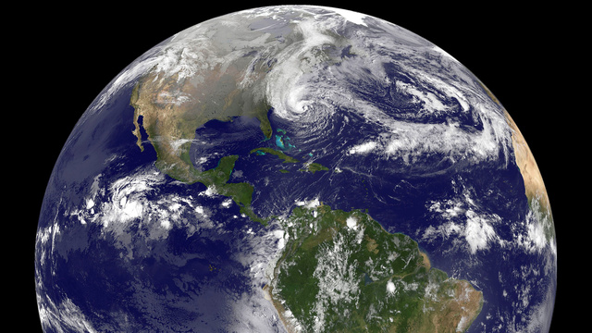
ARIA’s Sandy Response Timeline Analysis
Data Acquisition
5 days
Discovery, Transfer, Processing
6 days
Validation
4 days
Sandy landfall
2012/10/29 8PM
Day 5
Day 8
Day 9
Day 11
Day 15
COSMO-SkyMed
acquires data 11/3
Data appear
in web catalog
ARIA
downloads
the data
ARIA produces
DPM
DPM validation
completed
ftp://
Source: Sang-Ho Yun (JPL)

Slide 13
ARIA’s Sandy Response Timeline Analysis
Data Acquisition
5 days
Discovery, Transfer, Processing
6 days
Validation
4 days
COSMO-SkyMed (4)
TerraSAR-X (2)
Radarsat2
Sentinel-1A/B (2)
ALOS-2
SAOCOM-1A/B (2)
Radarsat Constellation (6)
US L-band SAR
ARIA system +
Collaboration between
ARIA/JPL/Caltech/NASA
and space agencies (ASI, ESA, CSA, DLR, JAXA)
GISCorps, ESRI
< 1day
~ Hours
~ Hours
Source: Sang-Ho Yun (JPL)

Slide 14
Processing Pipeline
ARIA-MH
raw data ingestion scheme
T=Track
FS=Frame-stitch (3-4 frames along track based on defined peg regions)
D=Date
int
corr
int
unw
T₁FS_{n}D₁
Interferable Pair Selection
Form all pairs that meet
Spatial
Temporal
Doppler
Baselines
Execute after each acquisition
tc
tc,u
Peg₁₂ Dop₁₂
Int-gen
I₁₂,A₁₂
tropoMap
I₁₂,A₁₂
unwrap
I₁₂,A₁₂
T₂FS_{n}D₂
C₁₃,
I₂₄,A₂₄
tc
tc,u
Cont’d
Next
Page
T₃FS_{n}D₃
Peg₂₄ Dop₂₄
int-gen
tropoMap
I₂₄,A₂₄
unwrap
I₂₄,A₂₄
Peg₃₄ Dop₃₄
I₃₄,A₃₄
tc
tc,u
T₄FS_{n}D₄
int-gen
tropoMap
I₃₄,A₃₄
unwrap
I₃₄,A₃₄
Peg₃₅ Dop₃₅
I₃₅,A₃₅
tc
tc,u
int-gen
tropoMap
I₃₅,A₃₅
unwrap
I₃₅,A₃₅
T₅FS_{n}D₅
I₄₆,A₄₆
tc
tc,u
Peg₄₆ Dop₄₆
int-gen
tropoMap
I₄₆,A₄₆
unwrap
I₄₆,A₄₆
T₆FS_{n}D₆
Peg_{tu} Dop_{tu}
int-gen
I_{tu,}A_{tu}
tc
tc,u
tropoMap
I_{tu,}A_{tu}
unwrap
I_{tu,}A_{tu}
T₇FS_{n}
D_{m}
tc
tc,u
Peg_{t’u’} Dop_{t’u’}
int-gen
I_{t’u’},A_{t’u’}
tropoMap
I_{t’u’},A_{t’u’}
unwrap
I_{t’u’},A_{t’u’}
Cont’d
Next
Page
T₈FS_{n}
D_{m+1}
Peg_{t’’u’’} Dop_{t’’u’’}
int-gen
I’’,A’’
tc
tc,u
tropoMap
I’’,A’’
unwrap
I’’,A’’
Peg_{t’’’u’’’} Dop_{t’’’u’’’}
int-gen
I’’’,A’’’
tc
tc,u
T₉FS_{n}
D_{m+2}
tropoMap
I’’’,A’’’
unwrap
I’’’,A’’’
Peg_{t’’’’u’’’’} Dop_{t’’’’u’’’’}
I’’’’,A’’’’
tc
tc,u
T₁₀FS_{n}
D_{m+3}
int-gen
tropoMap
I’’’’,A’’’’
unwrap
I’’’’,A’’’’

Slide 15
Processing Pipeline
T=Track
FS=Frame-stitch (3-4 frames along track based on defined peg regions)
D=Date
Repeated from previous page
unw
unw
tc,u
tc,uw
ARIA Archive
I₁₂,A₁₂
Geo-code
I₁₂,A₁₂
tc,u
tc,uw
I₁₃,A₁₃
Geo-code
I₁₃,A₁₃
tc,u
tc,uw
I₂₄,A₂₄
geo-code
I₂₄,A₂₄
tc,u
tc,uw
I₃₄,A₃₄
geo-code
I₃₄,A₃₄
tc,u
tc,uw
I₃₅,A₃₅
geo-code
I₃₅,A₃₅
tc,u
tc,uw
I₄₆,A₄₆
geo-code
I₄₆,A₄₆
ARIA Archive
corr
dpm
dpm
C₁₃
C₁₃,C₂₃
geo
DPM
geo-code
C₁₃,C₂₃
C₂₃

Slide 16
Processing Pipeline
Repeated from previous page
T₁FS₁
Time-series
T₁
Time-series
unw
unw
tc,u
tc,uw
GIAnT Time Series Processing
SBAS or
NSBAS or
MInTS
I₁₂,A₁₂
Geo-code
I₁₂,A₁₂
tc,u
tc,uw
I₁₃,A₁₃
Geo-code
I₁₃,A₁₃
T₁FS₂
Time-series
tc,u
tc,uw
I₂₄,A₂₄
geo-code
I₂₄,A₂₄
mosaic
tc,u
tc,uw
Large-area
Mosaicking of time-series accounting for disparate incidence angles
I₃₄,A₃₄
geo-code
I₃₄,A₃₄
tc,u
tc,uw
T₁FS₃
Time-series
I₃₅,A₃₅
geo-code
I₃₅,A₃₅
tc,u
tc,uw
I₄₆,A₄₆
geo-code
I₄₆,A₄₆
T_{n}FS_{m}
Time-series
T₂FS₁
Time-series
T₂
Time-series
T₂FS₂
Time-series
tc,uw
mosaic
tc,u
geo-code
I_{tu,}A_{tu}
I_{tu,}A_{tu}
tc,u
tc,uw
T₃FS₃
Time-series
I_{t’u’},A_{t’u’}
geo-code
I_{t’u’},A_{t’u’}
tc,u
tc,uw
I’’,A’’
geo-code
I’’,A’’
tc,u
tc,uw
I’’’,A’’’
geo-code
I’’’,A’’’
tc,u
tc,uw
I’’’’,A’’’’
geo-code
I’’’’,A’’’’
… etc. for all tracks

Slide 17
Production Rules
Defines conditions that must be met before dispatching a processing step
Codified in Python
  Enables complex conditions
Scalable asynchronous production rules checking
  System state checks are queued
  Multiple workers evaluate conditions
Example: interferogram formation
  Checks for existence PEG region
  Checks for contiguousness of two neighboring orbits of along-track frames
  Common coordinate systems

Slide 18

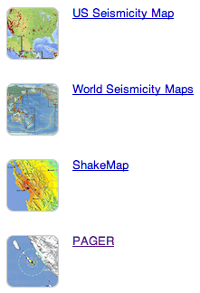

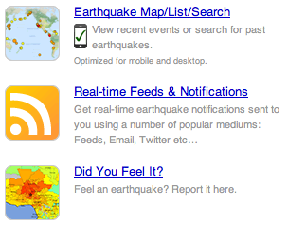

Event Notifications
Leverage USGS National Earthquake Information Center (NEIC)’s Product Distribution Layer (PDL)
  Pub-sub notification of events and data products
  Publish events/data to PDL Hub
  Receive notifications from PDL Hub
Different intent from
PDL Hub
Messaging
Constraints Filter
Event Listener
Notes:
http://earthquake.usgs.gov/regional/neic/

Slide 19
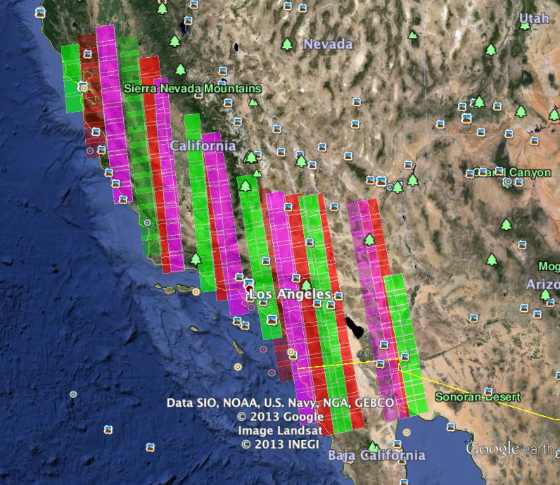
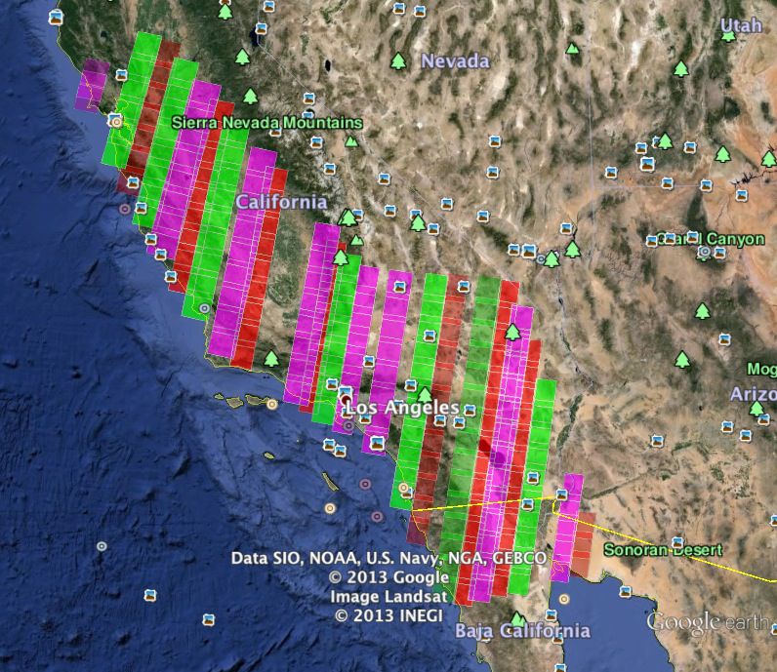
Example Data Coverage and Volumes
Coverage of California by Cosmo-SkyMED InSAR constellation
1 frame = 40 x 40 Kms swath, 3 m. res., 1.2 Gb
Total = 580 Gb every 16 days of raw data
234 frames - ascending
246 frames - desending

Slide 20
Data Volume and Cost Estimates
Raw data
  1 frame = 40 x 40 Kms swath, 3 m. res., 1.2 Gb
  Total = 580 Gb every 16 days of raw data
Data Volume
  Minimum 2 frames for each interferogram
  Up to 8X of baseline pairs from each frame
  3X data volume increase in derived data products from each frame
  PB-scale for 36-months of observations, for California area
Storage options
  NASA HPC Pleiades: 10TB limit per project
  JPL OCIO: 10TB limit per project
  continued on next page…

Slide 21
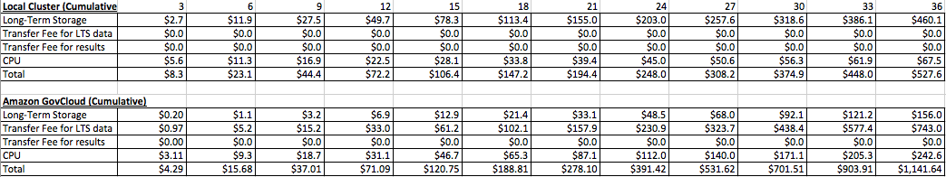
Compute, Data, & Cost Estimates
Notional analysis comparing local hardware purchase versus AWS GovCloud usage
  12,960 compute hours on 8-core nodes (1.5 years wall-clock processing)
  Process 16-days of data in at most 8-days
  EC2 instances with
    Persistent EBS for cached data
    Ephemeral local VM disk for scratch disk
  Use AWS Glacier for cheaper long term storage (with lower data access latency)
  Break-even point at 9-months
  AWS market prices frequently changes (estimate already outdated)
  Costs based on today’s dollars. Does not account for inflation. Does not account for future AWS price drops.
Cumulative months

Slide 22
Motivation for Cloud Computing
Large data volumes to come
  COSMO-SkyMed (CSK) and CSK second generation data from ASI
  Sentinel 1A/1B
  ALOS-2
  NASA Decadal Survey: US L-band Mission Science (LSM) concept
Monitoring and event-triggered processing
  User definable bounding box regions of interest for nominal background monitoring & processing.
Geographically disperse data centers
  ESDIS DAACs (e.g. ASF)
  UNAVCO SAR Archive
  ASI for CSK
  DLR for TerraSAR-X
  JAXA
  Various GEO Supersites

Slide 23
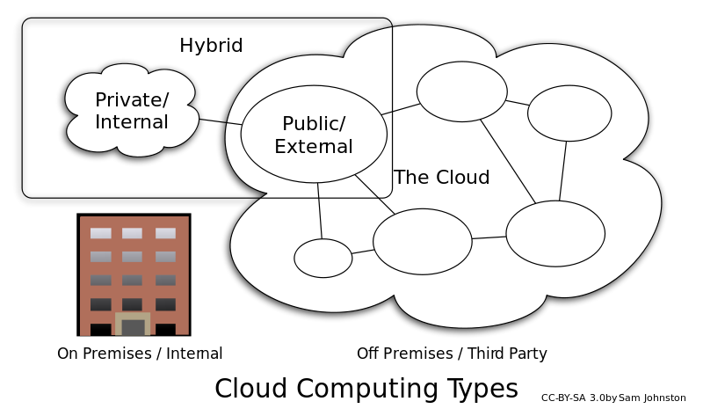
Motivation for Hybrid Cloud
Utilizes both on-premise and off-site infrastructure
Leverage existing infrastructure investment
  “Sunken cost” investment
PB-scale processing and storage in public cloud currently too expensive
Hybrid data system architecture
  Burst out to public cloud when demand exceeds on-premise resources
  AWS-compatible Eucalyptus cloud stack
Decrease dependency on commercial vendors
  “Vendor lock-in”
Recognize that not all resources need to be in the public cloud
Degree of fault tolerance

Slide 24
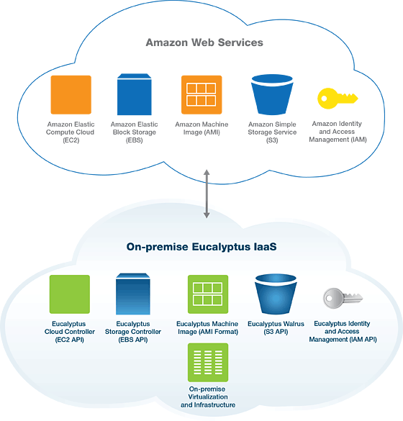
AWS and Eucalyptus Compatibility

Slide 25







High-Level Architecture
Discover/Access NASA-processed InSAR and GPS Actionable Data Products
World
Bank
Homeland
Security
USGS Hawaiian Volcano Observatory (HVO)
End Users
(Infusion)
InSAR and GPS
Data from Data Centers
System Interfaces
Interoperability
Drupal
Collaboration Web Portal
OpenSearch Service
OPeNDAP
Service
OGC & REST
Services
WebDAV
Command Line
TerraSAR-X
COSMO-SkyMed
Data System Components
REST Services
ALOS
Data Discovery
and Access
Data Management
Resource Management
Workflow Management
Provenance
ENVISAT
boto, elasticwolf, euca2ools
Cloud Services
Amazon AWS Services
EBS File System
S3 Storage
EC2 Computing
SQS Message
Data Buckets
Bootstrap
Bucket
Process Request
InSAR/GPS
Processing
Request
Queue
Response
Queue
GNSS
Storage Controller
Walrus
Cloud Controller
RabbitMQ Messaging
CloudWatch
Data Buckets
Bootstrap
Bucket
Process Request
InSAR/GPS
Processing
Request
Queue
Response
Queue

Slide 26
Hybrid Cloud Topology
Leverage heterogeneity of compute resources
  Amazon Cloud (AWS)
  Eucalyptus
  VMware
  Bare machines
Run compute node, storage service, discovery service, provenance serivce, etc. as VM in different environments
Off-site (e.g. Amazon)
On-premise (e.g. JPL)
Public Cloud
(AWS)
VM
VM
Private Cloud
(Eucalyptus)
VM
VM
Virtual Machines
Bare Machines

Slide 27
Hybrid Cloud Topology
Run localized storage repositories
  Fast data access
  Minimize data movement outside of local facilities
  Local repository at JPL for compute nodes at JPL
  Remote repository at AWS for compute nodes at AWS
Resource management and data discovery can run anywhere since metadata movement
Off-site (e.g. Amazon)
On-premise (e.g. JPL)
ISCE
ISCE
ISCE
Repo
ISCE
ISCE
ISCE
Virtual Machines
ISCE
Mozart
ISCE
Repo
GYPSY
Bare Machines

Slide 28
Automated Package for Deployment
Hybrid approach to processing on-premise or off-site
Migrate processing code into VM compute nodes
  Software with all dependencies
VM migration across Cloud stacks not easy
Processing VM in Eucalyptus
Non-interoperable
Processing VM
in AWS EC2
Processing VM in Eucalyptus
Processing VM
in AWS EC2
Processing VM in Eucalyptus
Processing VM
in AWS EC2
Processing VM in Eucalyptus
Processing VM
in AWS EC2

Slide 29
Automated Package for Deployment
Leveraged Puppet to automate VM setup.
Also solves cross-Cloud replication in hybrid topology
Setup packages, dependencies, and system config
Puppet Modules
Package
Automation
Processing VM in Eucalyptus
Package Automation
Processing VM
in AWS EC2
Processing VM in Eucalyptus
Processing VM
in AWS EC2
Processing VM in Eucalyptus
Processing VM
in AWS EC2
Processing VM in Eucalyptus
Processing VM
in AWS EC2

Slide 30
Some Lessons Learned from Hybrid
Heterogeneity of platforms supported
  Amazon AWS
  Eucalyptus
  Lighter weight Vmware
  Native on bare metal OS
Eucalyptus setup considerations
  Upfront effort to setup on-premise cloud stack
  Potential institutional constraints on IP address pools
  Service topography
Incompatibilities across on-premise and off-site virtualization environments
  Hypervisors and formats (e.g. Open Virtualization Format)
  Setup of VMs
Lowest common denominator of services
  Compute, Block storage, Bucket Storage, VM, and Identity
Package management (e.g. Puppet/Chef) key to ease of deployment across cloud stacks

Slide 31
Spatial Locality of Data
Leverage data locality on each compute node
Run entire workflow pipeline on same compute node
  Minimizes data movement for job staging in each processing step
Can map and cache data on compute nodes
Run storage repository close to compute nodes
Run pipeline on same machine
Generate Raw
Metadata Extraction
PEG Region Check
Generate Raw
Metadata Extraction
PEG Region Check
Generate Interferogram
and Corrections
Staging
Frames
Generate Raw
Metadata Extraction
PEG Region Check
Ingest and Cataloging
Product Staging
Repository

Slide 32
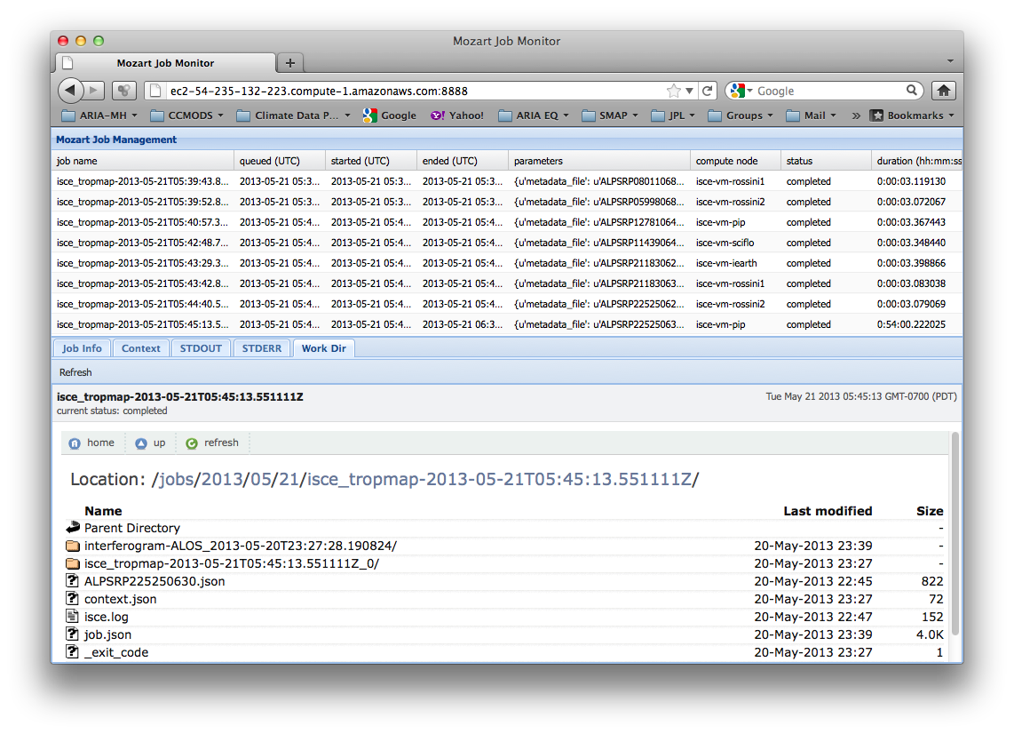
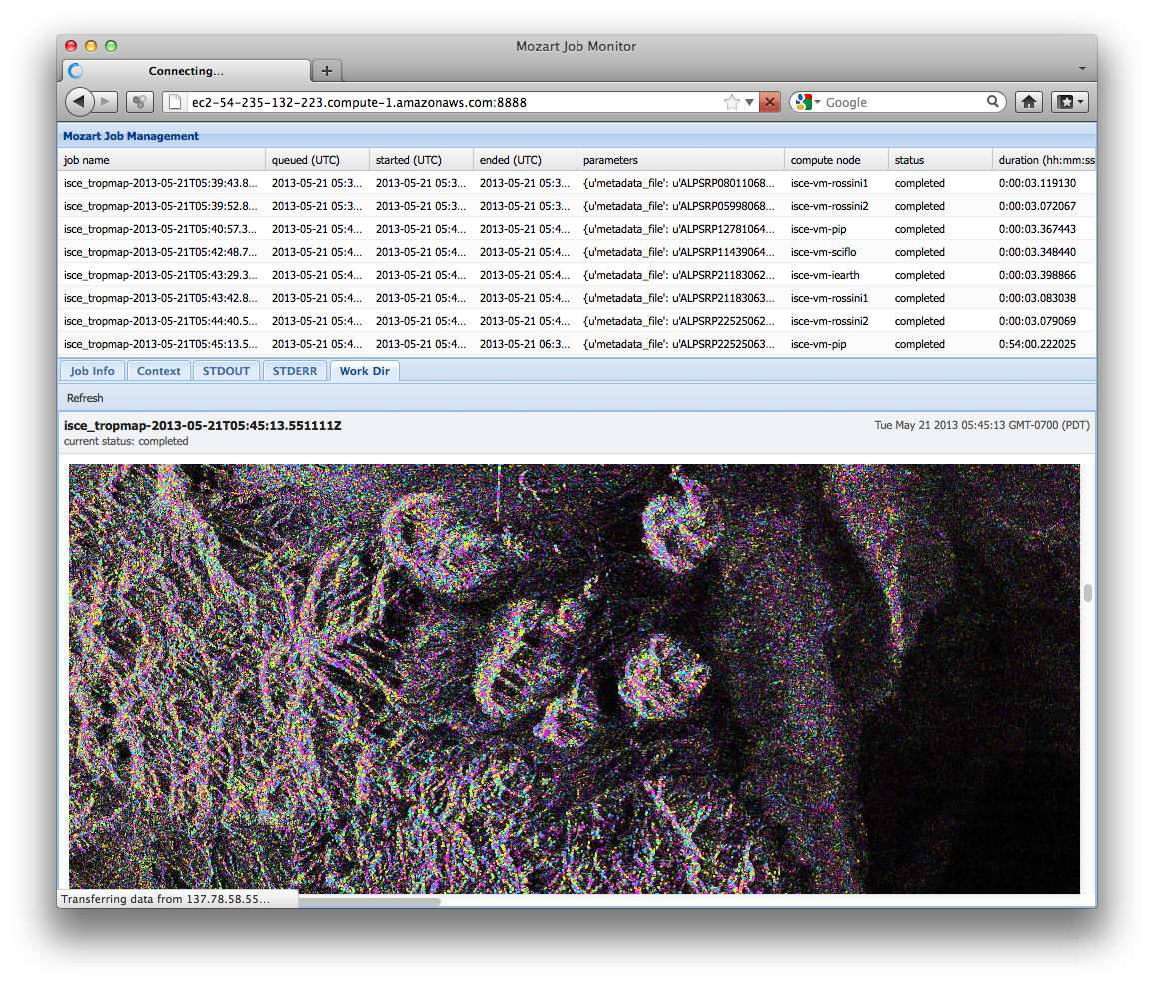
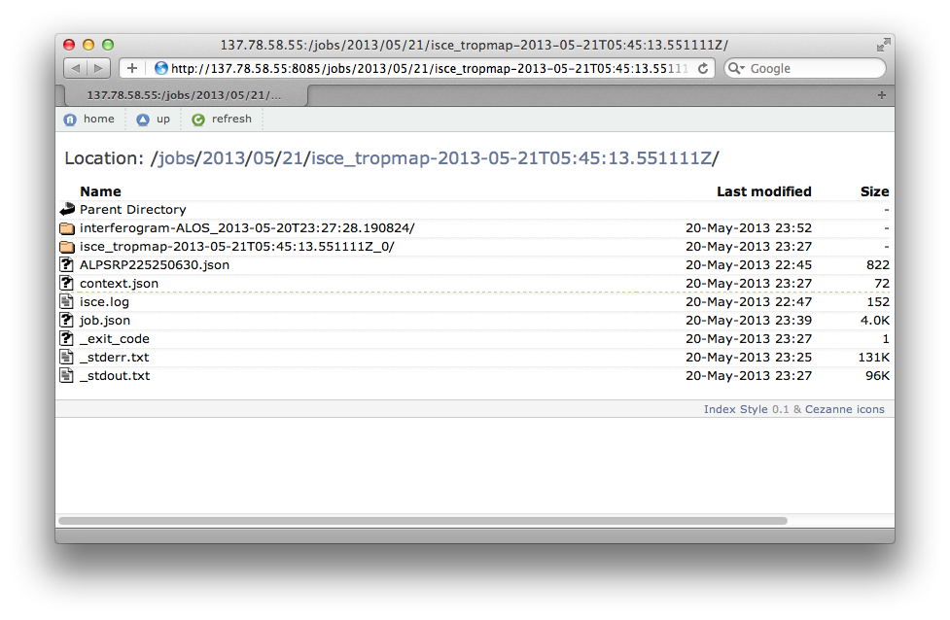
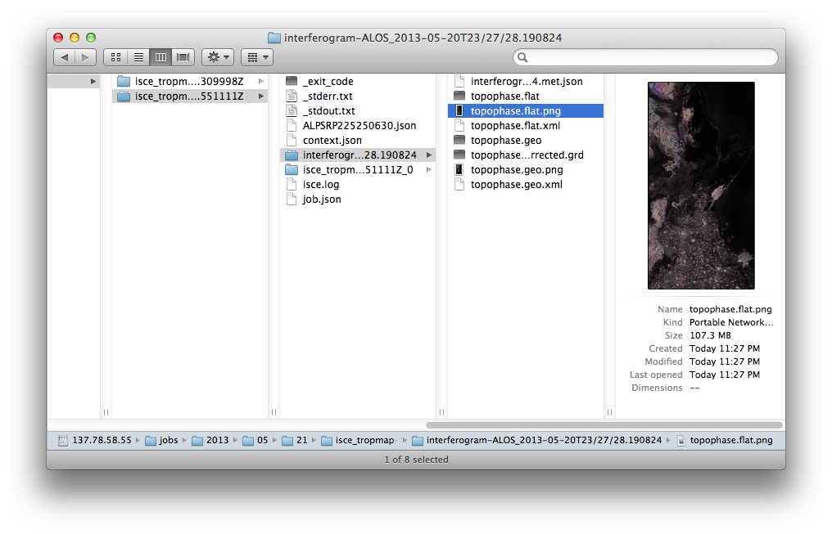
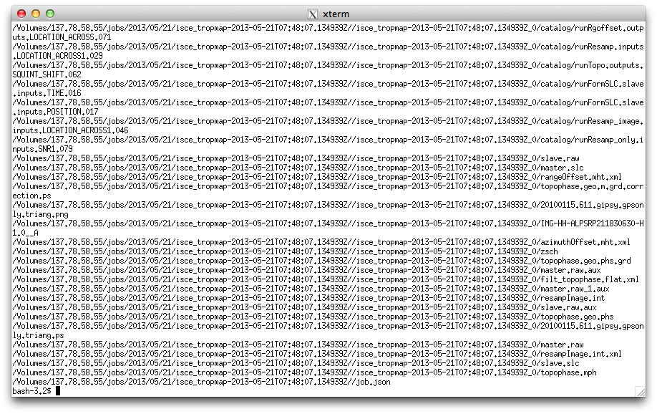
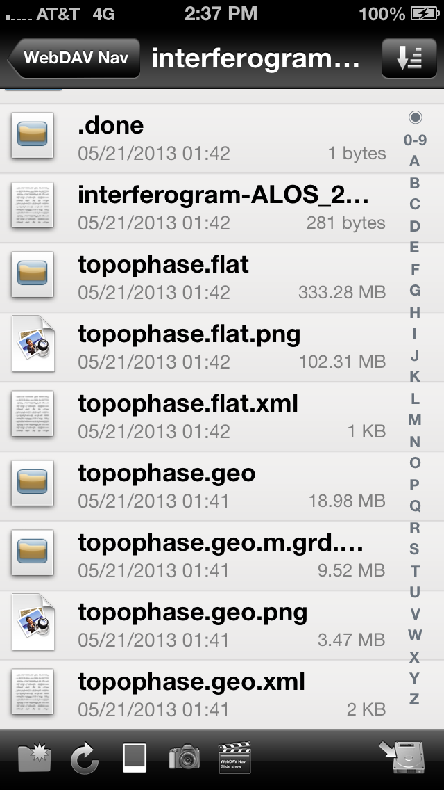
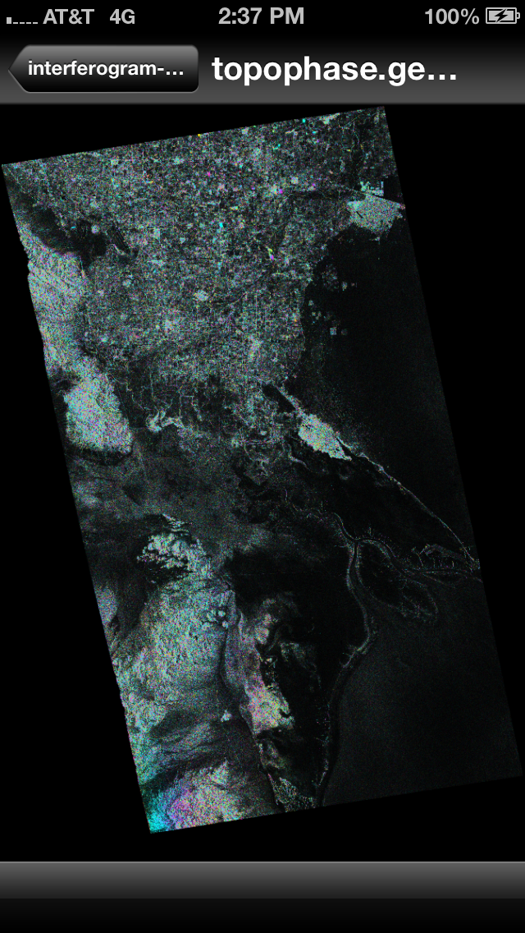
Data Access
Leverages interoperable WebDAV specification
Extended from prior ACCESS-2011 work
Enable access to data products via various interfaces
Job Management: browse remote jobs
Job Management: browse “first looks”
Web Interface to Repository of Data Products
MACOSX Finder: drag-and-drop to local file system mount
Command-line interface
Mobile phone interface

Slide 33
Findings on Geodetic Processing on Hybrid Cloud Science Data System
Licenses of software in elastic cloud environment
  Legacy code in Matlab/IDL.
    Costs of multiple concurrent Matlab and/or IDL licenses.
    Including Matlab Toolboxes licenses.
Cloud computing policies (NASA)
  Restrictions with export controlled software
  OCIO is close to allowing EAR99 software to run on regular AWS cloud
  Use of Amazon GovCloud US
Data movement a big issue (data access and staging)
  Want to minimize data staging for distributed compute jobs
  Leverage spatial and temporal locality of compute jobs
  Cache data products near compute jobs
  Dispatch geodetic processing compute jobs closer to data centers
PB-scale data volumes in cloud computing and storage significant enough to affect architectural design of data system

Slide 34
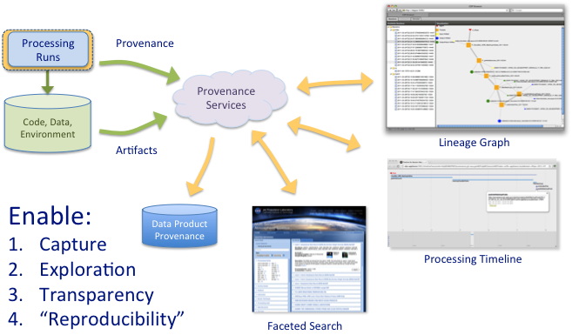
Provenance as a Service
Want to enable more transparency and trust—especially for actionable/decision-making data products.
Provenance capture of metadata and artifacts
Semantic rules
  Infer facets for discovery
  Summarize for presentation
Lineage graph
  levels of detail
  session chaining
Faceted Browsing
  Drill down into multidimensional provenance
  Constrain by time, user, session, data type, version, etc…
NASA ACCESS
Advancing Collaborative Connections for Earth System Science

Slide 35
Enabling Situational Awareness
Capability Needed | Technology Available
Near real-time information access | Remote sensing data streams (e.g. Digital Globe, Digital Eye, Cosmo-SkyMED, Sentinel 1a/1b, LSM, etc.) In-situ sensor webs Local city/government data streams Crowd-sourced social media (e.g. Twitter)
Low latency processing | Cloud computing HPC supercomputing Near Real-Time (NRT) products
Coherent data fusion for integrative analysis | OGC KML overlays Combining geospatial data with other information (e.g. SEDAC) “Location analytics”
Two-way information notifications | Esri’s “Disaster Response in a Box” - dashboard for situational awareness Mobile apps for “boots on the ground” USGS PDL
Interoperable data and services specifications | e.g. HDF5, OGC KML, Common Alerting Protocol (CAP), …

