Slide 1
Santa Barbara Channel Marine Biodiversity Observation Network
SBC MBON
Margaret O’Brien
ESIP, Winter 2017

Slide 2
Overview
Data Streams
Indicators supported by those data
Barriers to making those data interoperable
Progress

Slide 3
SBC MBON Data Stream
Google spreadsheet showing individual SBC MBON data sources (approx 50 datasets):
http://bit.ly/2jE0YjT
Notes:
TOP IMAGE: This is the basic pathway that all data takes. Pathway developed by 3 MBONs together.
SECOND IMAGE: SBC MBON plan for how datasets flow from our group to other systems, namely
SBC MBON research activities
SBC IMBON data mgt system, which takes care of building data packages and putting them into a repository
REPOSITORY = permanent archive
And ACCESS SYSTeM makes the data easier to use. Ideally, data .goes into a repository FIRST.
An end user (3rd party) coult use data directly from the repository, but we think it will be asier for them to access it from an access system.
Most likely, the access system we will use will be ERDDAP.. Where it will be housed is still to be determined.
The google spreadsheet is link to view a list of initial SBC MBON data sources, by originator, with some categories. This is an early version; canonical content is now in a management DB, (postgres), so that it can be queried more easily.

Slide 4
Notes:
Shows four examples of datasets, inn the pipeline, and their products.
Sorry there is so much here!
The firest one, with four projects supplying primary data, and 3 datasets coming out, is done. Yay.
At the end of the chain, we’ve put one “expected use” that could be answered by data in this dataset; that is a Channel Is National Marine Snctuary condition report question
The first is complete. We have integrates primary data from 4 surveys in the region, and produced datasets of abundance for 200 kelp forest species at appropriate scales. These are ready for other uses (last column)

Slide 5
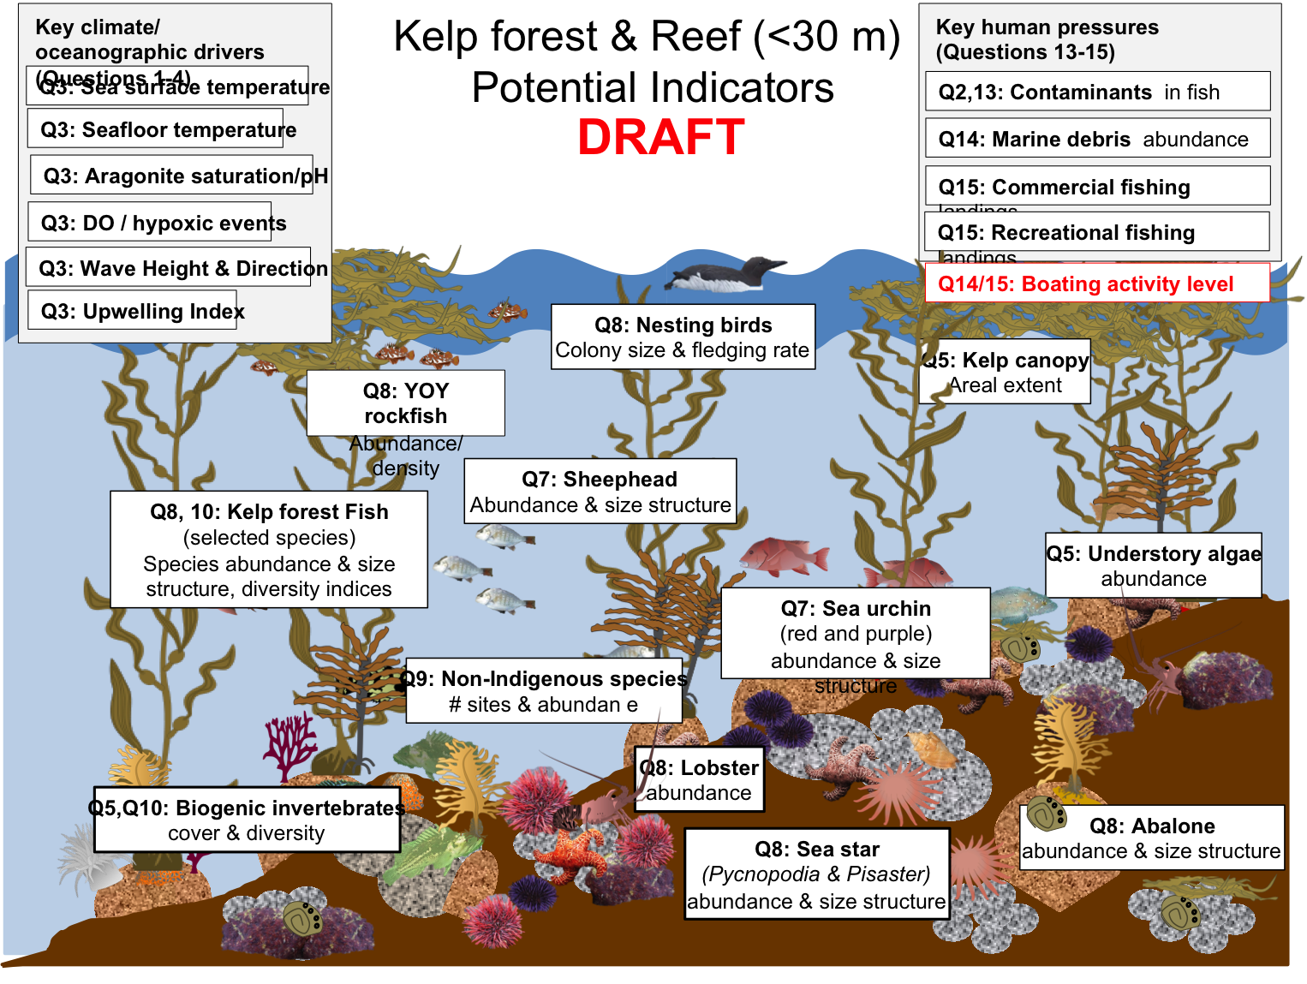
Potential Uses - DRAFT
Channel Island National Marine Sanctuary Condition Reports
Notes:
Where that data could appear – PLEASE REMEMBER THIS IS A DRAFT!

Slide 6
Barriers, by stage
Data need extensive cleaning
1. Insufficient metadata
2. custom reformatting (FTE)
Inexact terms in vocabularies
Notes:
The stages in COLOR at the left are ALL ACCOMPLISHED BY THE BON. Stages in black are handled by others.

Slide 7
Progress – Local
Dictionary of measurements ready for mapping to external vocabularies
Four abundance datasets in public repositories, ready for an access system or future use

Slide 8
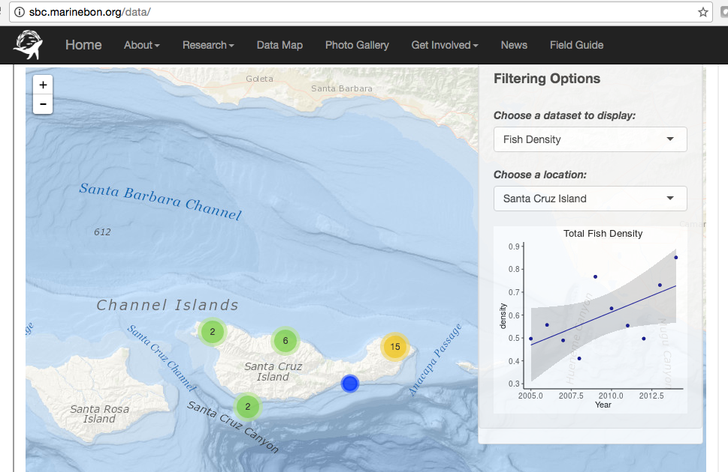
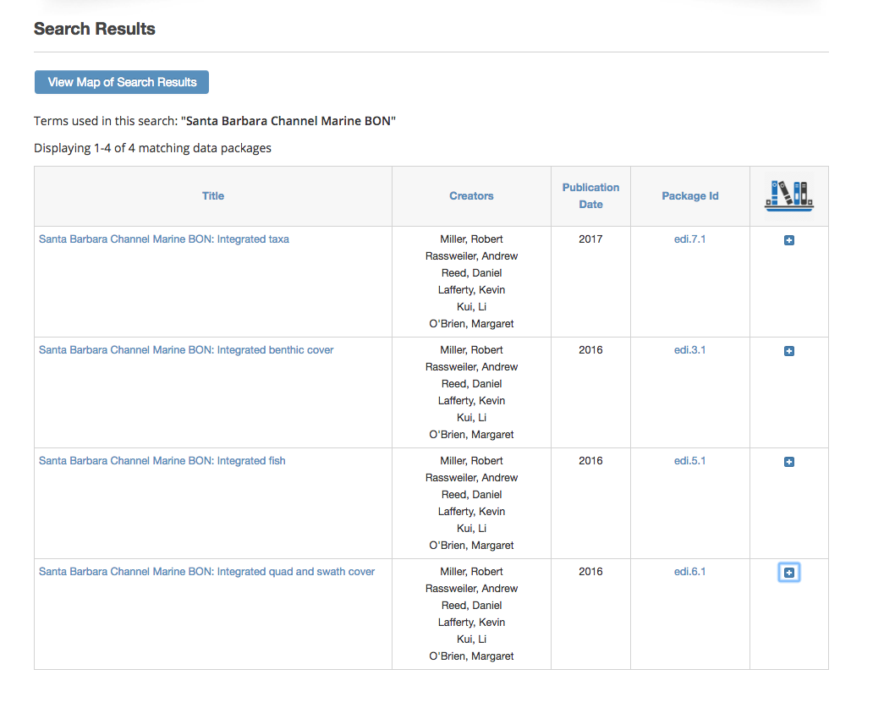
Progress – Public Data
Results from one data stream:

